Slide 1


Measuring Service Quality at Palestinian Telecommunication Company (Jawwal) using SERVQUAL model of service quality
An-najah National University
Faculty of Engineering
Industrial And System Engineering Department
Prepared by:
Arqam Bani-Shamsah
Abd-Alqader Moqadi
Sanad-aldeen Abed
Sama Bani-Mattar
Directed By:
Dr. Ayham Jaron

Slide 2
Introduction
In the last century the world tend to a new concept this concept which achieve their requirement by the best way they call this” the quality”
Quality term : Only the customer can really determine the requirement by their expectation and acceptance of the product or service provided
Quality dimension : can’t measure by quantitative scale but by qualitative which is the harder we have more dimension of quality like responsiveness ,competence ,access ,courtesy ,communications ,credibility ,security .

Slide 3
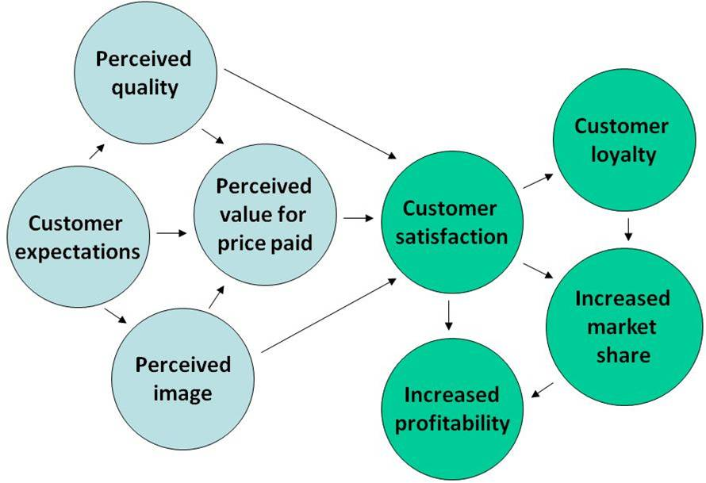
Why service quality : dream of all organization to reach service quality , customer more satisfied , employee more satisfied ,more profit sale and shareholder , consistently for future .
Customer Satisfaction: Customer satisfaction is influenced by a complex interplay of factors. Customer expectations can pose a major challenge , The diagram below demonstrates the links between the various elements that drive customer satisfaction.

Slide 4
Jawwal company
Communications is the most important thing in the word that all people most to communicate each other people speed and right of case study we choose JAWWAL which is the first Palestinian Provider for communication services, it helps all people to communicate through the latest technology regardless of the hard political, economical and social obstacles facing it.

Slide 5
JAWWAL Company Overview
JAWWAL is the first Palestinian Provider for communication services; it helps all people to communicate through the latest technology regardless of the hard political, economical and social obstacles facing it. With our committed team, we had been able to overcome all the various challenges.

Slide 6
Jawwal Mission
In the first place, there is the vision - the dream. It's where you want to go, what you want to be
Services :
    Massaging services include : Google SMS ,Voice SMS ,MMS, SMS.
    Bill related service include : Banking services ,Sms bill ,Direct debit ,Email bill .
    Call related services include : Mcb , Collect call ,Twin SIM, Hat wa khod .

Slide 7
Customer Care :
  Call center
  Maintenance center
  Outgoing calls' unit
  Dealers' Service Centre
  Company's Authorized Personnel
  Customer Care numbers

Slide 8
Special offer jawwal gives to its customer
Special offer make customer more satisfaction and give company more profit with decreasing cost for customer and with make more talking .
  Wazarat
  Jawwal Thawani
Dardesh Plan Package
Military Plan
Kartak Plan
Handicaps' Plan

Slide 9
SERVQUAL MODEL
SERVQUAL model was developed by Parasuraman, berry and zeithamel. And we develop it to close each gap within service quality then we apply it in telecommunication services especially on JAWWAL Company of mobile telecommunication.

Slide 10
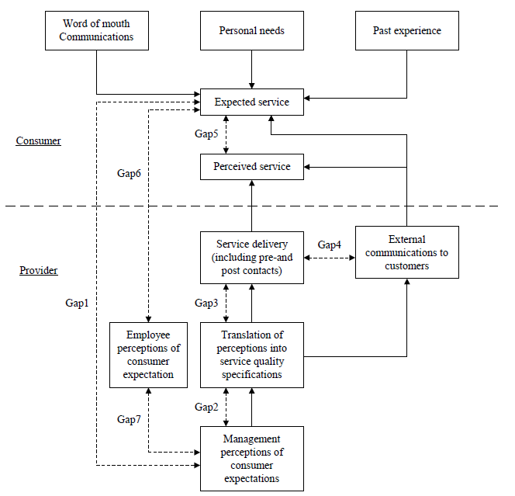
Methodology to measure service quality as mention by Parasuraman (1985; 1988) contains seven gap as shown in the figure (1) below:

Slide 11
Service Quality
Service quality can thus be defined as the difference between customer expectations of service and perceived service. If expectations are greater than performance, then perceived quality is less than satisfactory and hence customer dissatisfaction occurs.

Slide 12
Model of Service Quality Gaps
There are seven major gaps in the service quality concept, which are shown in Figure 1. The model is an extension of Parasuraman, Gap1, Gap5 and Gap6; they have a direct relationship with customers so it the most important gaps.
Gap1: Customers expectations versus management perceptions
Gap2: Management perceptions versus service specifications

Slide 13
Gap3: Service specifications versus service delivery.
Gap4: Service delivery versus external communication
Gap5: The discrepancy between customer expectations and their perceptions of the service delivered
Gap6: The discrepancy between customer expectations and employees perceptions
Gap7 : The discrepancy between employee s perceptions and management perceptions

Slide 14
Gap1
For each services customers expect the service to be as they believe or as an imaginary picture in their mind, but it’s impossible or to be hard that the provider to provide a service to customer as they think completely for many reason.
To close gap (1)
Research and planning are vital to ensure that your business idea is viable and that you’re pricing is both competitive in your Marketplace and provides an adequate return .

Slide 15
seven tactics for service recovery
1. Measure the Costs
2. Break the Silence
3. Anticipate Needs for Recovery
4. Act Fast
5. Train Employees
6. empowers the Front Line
7. Close the Loop

Slide 16
Gap (2)
For service, intelligent managers understand customer service easily with low level of limitation and independent on customer's requirement type which must be go parallel with service specification in balance line.

Slide 17
Gap (3)
Each services provider must boss main point related to its specification and other point that related to how to deliver this specification. Due to this fact and depending on SERVQUAL instrument of determining headline of each gap ,services must boss specification that help the service to avoid many problem that lead to gap

Slide 18
Gap (4)
External communication is an important issue on gap four so this gap is due to lack of integrated services marketing communications so, a tendency to view each external communication as independent or not including interactive marketing in communication plan or absence of strong internal marketing program all these cause a problem with integrated services marketing communication.

Slide 19
Gap (5)
Understanding customer expectation is an important and essential issue in the field of service science. For instance, what factor would particularly affect the desired service level and adequate service level of customer expectation? And how can producers fulfill the variable need for customer satisfaction. Hence, this gap based on domain knowledge of expectation is to propose frame work which aids in producing the service tactics of providers to a better course of customer expectation management.

Slide 20
Gap (6)
Each service provider employee have their perception about the customer need which is differ from customer expectation in many point gap six now must contain the reason for the gap and the solution to close this gap.
UNDERSTANDING CUSTOMER expectations is a prerequisite for delivering superior service; customers compare perceptions with expectations when judging a firm’s service.1 However, the nature of customer service expectations and how they are formed has remained ambiguous.

Slide 21
Gap(7)
The discrepancy between employee s perceptions and management perceptions: as a result of the differences in the understanding of customer expectations between managers and service providers.
People didn't leave organization , they leave their manager
Retention of talent remains one of the greatest challenges to organizations today. Likewise, one of the most salient variables influencing retention is the employee /manager relationship

Slide 22
Data collection

Slide 23
DATA COLLECTION:
Data collection is a way of gathering information for use in various studies or decision making situations. Depending on the required outcome or information needed methods of data collection can vary and even be combined to achieve needed results.
(oppapers.2011).

Slide 24
DATA collection methods:
Questionnaires
Registration
Interviews
Direct Observations
Reporting

Slide 25
Questionnaires:
It defined as a group of questions that people respond to verbally or in writing. Questionnaires refer to forms filled in by respondents alone. Questionnaires can be handed out or sent by mail and later collected or returned by stamped addressed envelope. This method can be adopted for the entire population or sampled sectors.

Slide 26
Why do we need to collect data
Every process improvement effort relies on data to provide a factual basis for making decisions throughout the Plan-Do-Check-Act cycle. Data Collection enables a team to formulate and test working assumptions about a process and develop information that will lead to the improvement of the key quality characteristics of the product or service. Data Collection improves decision-making by helping focus on objective information about what is happening in the process, rather than subjective opinions
purpose of data collection is to obtain information to keep on record, to make decisions about important issues, to pass information on to others. Primarily, data is collected to provide information regarding a specific topic.

Slide 27
Data collection required here to take the opinion of each one membership in this cycle, customer, employee and manager. A different opinion between them depending gap type will lead to A GAP which will cause different problem related to the supplier

Slide 28
How did we set the questionnaires?
Setting questionnaires require focusing the topic of gap, since different topic yield different axes for the statement of questionnaires, so after defining each gaps axes, this allowed us to easily write the most effective questions.

Slide 29
Gap 1: Customer's expectations versus management perceptions:which is as a result of the lack of a marketing research orientation, inadequate upward communication and too many layers of management?
Dimension of gap:
Accessibility: which mean there is no barriers should be between Management and customers.
Market segmentation: dividing the market to many type and the requirement of each type (male, female..business , or other)
Feedback: the opinion of the customer about the company and acceptance of its services.
Empathy: the ethics of the employee when communicate to customers in service center or by call.
Responsibility: of managers and employee to perform their job as best as they possible to help and understand customer and to company successful.

Slide 30
Gap 2: Management perception versus service specification: as a result to inadequate commitment to service quality, apperception of unfeasibility inadequate tasks standardization and an absence of goal setting.
Dimensions of gap:
Continuous learning: training and MSc. degree for the employee also the development of the services due to science development.
Needs: the need of customers that are increasing and changing at a constant base.
Satisfaction Measurement: Measurement of the customer satisfaction about the services by survey and other tool for determining customer requirement.

Slide 31
New Project t Development plan: planning to develop the service to go parallel with both customer needs.
Customer Expectation System: the expectation of customer about the service to survive them as they require.
System Support Policy
System Monitoring Measurement
Progress Report:

Slide 32
GAP 3: service specification versus service Delivery: as a result of role ambiguity and conflict, poor employee job fit and poor technology-job fit, inappropriate supervisory control system, lack of perceived control and lack of team work.
Dimensions of gap:
Selection Criteria: recruitment procedure of new employees and upgrading the existing employees.
Voice Of Internal Customer: meeting and discussion between managers and employee and the effect internal customer on the company.
Implementing Suggestions: follow up meeting result on the company.

Slide 33
GAP4: service delivery versus external communication: as a result of inadequate horizontal communication and propensity to over promise.
Dimensions of gap:
Time: time to perform different services within the company to minimize waiting time.
Quality: capability of company to provide the best quality less unwanted effect on the general environment.
Fitting and customization: providing services as customers need without delay.
Way of communication: to reach to provider service and communication media

Slide 34
GAP5: the discrepancy between customer expectations and their perceptions of service delivered: as a result of the influences exerted from the customer side and the short falls (gap) on the part of the service provider, in this case, customer expectations are influenced by the extent of personal need, word of mouth recommendation and past service experiences.
Dimensions of gap:
Tangibles: physical facilities, equipment and personal appearance.
Reliability: ability to perform the promised service dependably and accurately.
Responsiveness: Willingness to help customers and provide prompt services.
Assurance: include competence and courtesy, credibility and security.
Empathy: include access, communication, understanding the customer” caring and individualization attention that the firm provide to its customers.

Slide 35
GAP6: the discrepancy between customer expectation and employee, perception: as a result of the difference in the understanding of customer expectations by front-line service providers.
Dimensions of gap:
Tangibility:
Reliability:
Responsiveness:
Confidence:
Empathy:
Process:

Slide 36
GAP7: the discrepancy between employee perceptions and management perception: as a result of the difference in the understanding of customer expectation between managers and service providers.
Dimensions of gap:
Directing:
Development:
Learning:
Needs:
Trust:

Slide 37
Data collection method:
we divide the project into two parts.
customer's side and the company side.
For customer side after translating the English questionnaires to Arabic
chose the sample size which was student on the university. Using their break to collect our questionnaires .
each respondent was asked if he or she had time to answer the questionnaires to give us the most appropriate answer about their opinion.
A sample size of 100 respondents was taken for each type of customers questionnaires which include four category gap 1,gap 5 of its tow side and gap 6

Slide 38
The company side
which was more difficult to collect its relevant data because of the company rule and limitation about number of questionnaires and the content of questionnaires.
This problem take the largest time on our project because they say that" the company only take 25 questionnaires of the all number " which mean the big problem for data collection process also mean poor data by the way finally we reach to Corporate sales manager\North Area who promise to help us as much as possible , after a week they told they will answer our needs, we send email to company contain all questionnaires that we need for our project , we wait about 45 day until finally they send answered questionnaires to their branch in Nablus- Rafeidia service center-JAWWAL collect the questionnaires as they say electronically then they print it and send them to us.

Slide 39
DATA ANALYSIS

Slide 40
Analysis of data is a process of inspecting, cleaning, transforming, and modeling data with the goal of highlighting useful information, suggesting conclusions, and supporting decision making. Data analysis has multiple facets and approaches, encompassing diverse techniques under a variety of names, in different business, science, and social science domains.
Data mining is a particular data analysis technique that focuses on modeling and knowledge discovery for predictive rather than purely descriptive purposes. Business intelligence covers data analysis that relies heavily on aggregation, focusing on business information. In statistical applications, some people divide data analysis into descriptive statistics, exploratory data analysis, and confirmatory data analysis.
( Wikipedia. May 2011)

Slide 41
Program used in analysis
SPSS
(originally, Statistical Package for the Social Sciences) was released in its first version in 1968 after being developed by Norman H. Nie and C. Hadlai Hull. SPSS is among the most widely used programs for statistical analysis in social science. It is used by market researchers, health researchers, survey companies, government, education researchers, marketing organizations and others. ( Wikipedia. April 2011)
Data collected analyze using SPSS program .We use this program to filling all raw data of each gap from questionnaires collected with each gap side in separated file, then a statistical analysis was done, especially the MEAN to fined the average answer of each question in the questionnaires or the expected answer to each dimension as will shown later.

Slide 42
Microsoft Excel:
is a commercial spreadsheet application written and distributed by Microsoft for Microsoft Windows and Mac OS X. It features calculation, graphing tools, pivot tables, and a macro programming language called Visual Basic for Applications. It has been a very widely applied spreadsheet for these platforms, especially since version 5 in 1993, and it has almost completely replaced Lotus 1-2-3 as the industry standard for spreadsheets. Excel forms part of Microsoft Office. The current versions are 2010 for Microsoft Windows and 2011 for Mac OS X. (Wikipedia. may 2011)
Data analyze using SPSS transfer for Microsoft excel 2007 for more calculation such as the overall weighted average score and the difference between the two side of each gap, also we use it to determining the RESULT of each dimension using logical operation. the following code use in Microsoft excel to determine the overall average opinion {=IF(C149>=4.2;"strongly agree";IF(C149>=3.4;"agree";IF(C149>=2.6;"undecided";IF(C149>=1.8;"disagree";IF(C149>=1;"strongly disagree";x))))} which use to simplify analysis operation. Another usage of excel program in this project is to represent the data analyze using PIE CHART, so the effect of dimension in each gap by percent was represented using a pie chart for one.

Slide 43
Likert Scale:
A Likert scale measures the extent to which a person agrees or disagrees with the question. The most common scale is 1 to 5. Often the scale will be 1=strongly disagree, 2=disagree, 3=not sure,4=agree, and 5=strongly agree for positive statement and 1=strongly agree, 2=agree, 3= undecided, 4=disagree, 5=strongly disagree for negative statement.( uni.2011)
By Likert scale we need to determine the length of each interval, since we have four interval,1to2, 2to3, 3to4, 4to5 and we have 5 answer 1,2,3,4,5 the length of each interval will be =4/5:
4: number of interval 5: number of possible answer
The length of interval will be =0.80, Table (5.1) show the relation between each answer and its value.

Slide 44
Likert table
RESULT | Average of dimension
strongly disagree | from 1 to 1.79
disagree | from 1.8 to 2.59
undecided | from 2.6 to 3.39
agree | from3.4 to 4.19
strongly agree | from 4.2 to 5

Slide 45
Results

Slide 46
Gap 1 :
gap 1 customer expectations versus management perceptions
Dimension | Customer Expectations | Management perceptions | Gap score | Weighting | Weighted average
Feedback | 3.4867 | 4.2361 | 0.7494 | 0.17 | 0.127398
Market segmentation | 3.43 | 4.25 | 0.82 | 0.12 | 0.0984
Accessibility | 3.37 | 3.2639 | -0.1061 | 0.3 | -0.03183
Empathy | 3.1 | 3.6569 | 0.5569 | 0.29 | 0.161501
Responsibility | 3.21 | 4.0417 | 0.8317 | 0.12 | 0.099804
overall average weighted SERVQUAL score = |  |  |  |  | 0.455273

Slide 47
Gap 1 :
Each dimension has its own effect on the overall gap

Slide 48
gap 1 customer expectations versus management perceptions
Dimension | Customer Expectations | Result
Feedback | 3.4867 | Agree
Market segmentation | 3.43 | Agree
Accessibility | 3.37 | undecided
Empathy | 3.1 | undecided
Responsibility | 3.21 | undecided
Dimension | Management perceptions | Result
Feedback | 4.2361 | strongly agree
Market segmentation | 4.25 | strongly agree
Accessibility | 3.2639 | Undecided
Empathy | 3.6569 | Agree
Responsibility | 4.0417 | Agree

Slide 49
Gap 2
gap 2 Management perception versus service specification
Dimension | Management perception | service specification | Gap score | Weighting | Weighted average
Continuous learning process | 4 | 4.1333 | -0.1333 | 0.08 | -0.010664
Needs | 4.2143 | 4.0667 | -0.1476 | 0.13 | -0.019188
Satisfaction Measurement | 4.3214 | 4.2 | -0.1214 | 0.13 | -0.015782
New project development plan | 4.2857 | 4.0667 | -0.219 | 0.15 | -0.03285
Customer expectation | 4.1071 | 4.7333 | -0.6262 | 0.11 | -0.068882
System support policy | 4.0893 | 4.15 | -0.0607 | 0.2 | -0.01214
System monitoring Measurements | 4.2857 | 3.9333 | -0.3524 | 0.09 | -0.031716
Progress report | 4.3214 | 4.2333 | -0.0881 | 0.11 | -0.009691
overall average weighted SERVQUAL score = |  |  |  |  | -0.200913

Slide 50
Gap 2

Slide 51
Gap 2
gap 2 Management perception versus service specification
Dimension | Management perception | RESULT
Continuous learning process | 4 | agree
Needs | 4.2143 | strongly agree
Satisfaction Measurement | 4.3214 | strongly agree
New project development plan | 4.2857 | strongly agree
Customer expectation | 4.1071 | agree
System support policy | 4.0893 | agree
System monitoring Measurement | 4.2857 | strongly agree
Progress report | 4.3214 | strongly agree
gap 2 Management perception versus service specification
Dimension | service specification | RESULT
Continuous learning process | 4.1333 | agree
Needs | 4.0667 | agree
Satisfaction Measurement | 4.2 | strongly agree
New project development plan | 4.0667 | agree
Customer expectation | 4.7333 | strongly agree
System support policy | 4.15 | agree
System monitoring Measurements | 3.9333 | agree
Progress report | 4.2333 | strongly agree

Slide 52
Gap 3
GAP 3 service specification versus service Delivery
Dimension | employee opinion | manager opinion | Gap score | Weighting | Weighted average
Selection criteria | 3.9545 | 4.08 | -0.1255 | 0.35 | -0.043925
Voice of internal customer | 3.9394 | 2.9889 | -0.9505 | 0.3 | -0.28515
Suggestion and implementation | 3.9545 | 4.0667 | -0.1122 | 0.35 | -0.03927
overall average weighted SERVQUAL score = |  |  |  |  | -0.368345

Slide 53
Gap 3

Slide 54
Gap 4
GAP4: service delivery versus external communication
Dimension | employee opinion | manager opinion | Gap score | Weighting | Weighted average
Time | 3.955 | 3.6167 | -0.3383 | 0.3 | -0.10149
Quality | 4.3636 | 4.0667 | -0.2969 | 0.2 | -0.05938
Fitting And Customization | 4.303 | 3.9111 | -0.3919 | 0.25 | -0.097975
Way Of Communication | 4.2273 | 4.2667 | -0.0394 | 0.25 | -0.00985
overall average weighted SERVQUAL score = |  |  |  |  | -0.268695

Slide 55
Gap 4

Slide 56
Gap 5
GAP5: the discrepancy between customer expectations and their perceptions of service delivered
Dimension | Customer Perceptions | customer Expectations | Gap score | Weighting | Weighted average
Tangibles | 3.4896 | 4.3112 | -0.8216 | 0.2 | -0.16432
Reliability | 3.1396 | 4.3551 | -1.2155 | 0.3 | -0.36465
Responsiveness | 3.6328 | 3.3959 | 0.2369 | 0.2 | 0.04738
Assurance | 3.1719 | 4.0765 | -0.9046 | 0.15 | -0.13569
Empathy | 2.9444 | 3.5986 | -0.6542 | 0.15 | -0.09813
overall average weighted SERVQUAL score = |  |  |  |  | -0.71541

Slide 57
Gap 5

Slide 58
Gap 5
GAP5: the discrepancy between customer expectations and their perceptions of service delivered
Dimension | Customer Perceptions | RESULT
Tangibles | 3.4896 | agree
Reliability | 3.1396 | undecided
Responsiveness | 3.6328 | agree
Assurance | 3.1719 | undecided
Empathy | 2.9444 | undecided
GAP5: the discrepancy between customer expectations and their perceptions of service delivered
Dimension | customer Expectations | RESULT
Tangibles | 4.3112 | strongly agree
Reliability | 4.3551 | strongly agree
Responsiveness | 3.3959 | undecided
Assurance | 4.0765 | agree
Empathy | 3.5986 | agree

Slide 59
Gap 6
GAP6: the discrepancy between customer expectation and employee, perceptions
Dimension | Customer Expectations | Employee Perceptions | Gap score | Weighting | Weighted average
Tangibility | 3.7381 | 4.22 | 0.4819 | 0.15 | 0.072285
Reliability | 3.4674 | 4.3333 | 0.8659 | 0.1 | 0.08659
Responsiveness | 3.2268 | 4.14 | 0.9132 | 0.14 | 0.127848
Confidence | 3.433 | 4.1667 | 0.7337 | 0.16 | 0.117392
Empathy | 3.433 | 4.25 | 0.817 | 0.11 | 0.08987
Process | 3.2351 | 4.44 | 1.2049 | 0.23 | 0.277127
Responsibility | 3.4948 | 4.3 | 0.8052 | 0.11 | 0.088572
overall average weighted SERVQUAL score = |  |  |  |  | 0.859684

Slide 60
Gap 6

Slide 61
Gap 7
GAP7: the discrepancy between employee perceptions and management perception
Dimension | Employee Perceptions | Management Perceptions | Gap score | Weighting | Weighted average
Directing | 3.7381 | 4.22 | -0.4819 | 0.2 | -0.09638
Development | 3.4674 | 4.3333 | -0.8659 | 0.22 | -0.190498
Learning | 3.2268 | 4.14 | -0.9132 | 0.14 | -0.127848
Needs | 3.433 | 4.1667 | -0.7337 | 0.15 | -0.110055
Communications | 3.433 | 4.25 | -0.817 | 0.16 | -0.13072
Trust | 3.2351 | 4.44 | -1.2049 | 0.13 | -0.156637
overall average weighted SERVQUAL score = |  |  |  |  | -0.812138

Slide 62
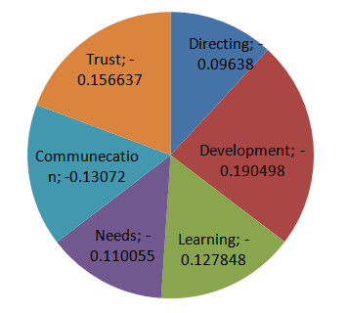
Gap 7

Slide 63
Summary
Negative Gaps
Gap 7 | -0.812
Gap 5 | -0.715
Gap 3 | -0.368
Gap 4 | -0.268
Gap 2 | -0.2
Positive Gaps
Gap 6 | 0.8569
Gap 1 | 0.455

Slide 64
RECOMMENDATION

Slide 65
From gap two:
Gap two talks about management perceptions versus service specifications that is due to inadequate commitment to service quality, apperception of unfeasibility inadequate tasks standardization and an absence of goal setting. The following point must be taken in consideration by JAWWAL:
This company must work on master degree for employee to improve employees’ efficiency.
Develop a clear and straight forward marketing strategy for gaining competitive advantages and they should work on benchmarking to satisfy needs.
They must use survey to measure customer satisfaction and opinion about the service.
Planning to develop the service to go parallel with both customer needs.

Slide 66
Should work on scorecard of customer-based metrics and develop operating system to meet customers’ requirements.
They should use clear procedure to improve the service , and use clear policy to improve the system.
They should have check points for new activities, task before they maintain it
They must held regular presentation to communicate vision, mission & company strategy.

Slide 67
From gap three:
Gap three discus the difference between service specification and service Delivery that is due to role ambiguity and conflict, poor employee job fit and poor technology-job fit, inappropriate supervisory control system, lack of perceived control and lack of team work. They should improve:
Role that is conflict on the company.
Employee’s job fit.
Technology job fit and efficiency
develop their supervisory control system
Team work.

Slide 68
We can add: JAWWAL must work and develop selection criteria to good job fit by looking to qualification of internal customers and interviewed them before recruitment process, and employees must trained enough before commitment to work. Furthermore the ranking of employees within the company depend on their effort and responsibility.

Slide 69
From gap four:
From gap four:
Service delivery versus external communication: as a result of inadequate horizontal communication and propensity to over promise. The existent of this gap could be eliminated by:
Minimize waiting time of customers, using further study of surviving time and trained employees to increase their efficiency.
JAWWAL must provide the best quality and the less unwanted effect on general environments.
Provide customers services as they need customize and without delay by providing services in professional way.
Simplify the communication way between customers and company.

Slide 70
From gap Five:
Gap five discuss what customers expect about the company and then what their mangers are perceives , we find that they expect from JAWWAL more they perceive. The following recommendation derives as a result of this gap.
  Customers expect that their tangible were better than what are exist especially about equipment and physical facility appealing.
  JAWWAL reliability must be restudy, customers expect that some of promise services not done, so they must done what they promise and on time, they must sympathize and reassure customers, farther more this company should be independent.

Slide 71
This company should work hard to make customers trust the employees and to make them feel safe in their transactions.
The company should work on employees to gets adequate support to do their jobs, in addition to provide some services at heart to the customers.

Slide 72
From gap Seven:
This gap discus the discrepancy between employees perceptions and management perceptions, the existence of this gap is due to the different in understanding of customers expectations between managers and service providers. When we analyze collected data of gap seven we reach to the following recommendations:
  Managers must be awareness of what employees do and give them a clear sense of direction.
  Employees should know what are the objective of the coming year.
  Managers should be fair in evaluation of employees.
  Managers should dealing with employees by micromanages, conduct productive meetings and manage their time properly.

Slide 73
  Inform employees about professional standards, should give them positive feedback, encourage them to give their best to the department, give them constructive criticism and identify their need for development in addition to give them challenging assignments.
  Managers should use effectively the resources available in their department , allow employees to take risk and make simple mistake to learn from these mistakes.
  Encourage team work and collaboration among colleagues and welcome suggestions.
  Managers should allow and welcome feedback about managers performance, acknowledge and discus conflicts with staff also to allow employees sufficient flexibility to meet their family and personal needs.
  Mangers should do what they promise to the employees, and assign the right people to the right position.
  Managers should supervise their staff always.

Slide 74
From positive Gap
There are two points in JAWWAL Company measured and have a good evolution. Analysis process show these point and we advise to save it.
Good point comes from analysis of:
  Gap one: Customer's expectations versus management perceptions: the total weighted average of customers expectations is less than management perceptions and this is mean that customers expectations is covered and more than customers expectations are delivered.
  Gap six: the discrepancy between customer expectation and employees: the excitant of difference on this gap is that customer expect less than employee perceive that mean the employees cover customers expectations and more services were delivered.

Slide 75
Conclusion:

Slide 76
Conclusion:
in our project we work on service of quality as defined by SERVQUAL and Model of Service Quality Gaps by Arash Shahin then we implement it on (JAWWAL COMPONY) from this project we learning many things ,initially learn the nature of the work of the company and the most important services provided by its customers, And also we know the importance of service quality and its impact on the company's performance in all aspects.
Service quality is of the hot topics that consider every step in deliver services to the customers, and as customers become satisfy more and more they will be loyal to their service provider. Hence, SERVQUAL model can be use by any services organization to measure the difference between different opinion using Gaps model, the last conclusion we reach to it is that; SERVQUAL model after we develop it is cover and measure almost every process within the company and every expected and percept services for the customers

Slide 77

THANK YOU
?
?
?
?
?
?
?
?
?
?
?
?
?
?
?
?
?
?
?
?
?
?
?
?
ANY QUESTIONS

