Slide 1

An-Najah National University
Faculty of Engineering and Information Technology
Industrial Engineering Department
English in the workplace
Dreams and Goals
Prepared by:
Ahmad Omar
Supervisor:
Dr. Asala Mayaleh

Slide 2
Differences between dreams and goals
Dreams | Goals
Dreams are something you are just thinking about | Goals are something you are acting on
Dreams are just well dreams | Goals have deadlines
Dreams are free | Goals have a cost
Dreams never have to end | Goals have a finish line
Dreams can inspire you | Goals can change your life

Slide 3

Creating the Life of Your Dreams
“Dreams are like stars you may never touch them, but if you follow them, they will lead you to your destiny.”

Slide 4
Why create a life plan?
“If you don’t design your own life plan, chances are you’ll fall into someone else’s plan. And guess what they have planned for you?
Jim Rohn

Slide 5

Did you know?
“People who wrote down their goals, shared this information with a friend, and sent weekly updates to that friend were on average 33% more successful in accomplishing their stated goals than those who merely formulated goals.”

Slide 6


A life plan helps turn your dreams into reality. Your plan should answer two main questions:
What is your destination?
How will you get there?
“A goal without a plan is just a wish.”

Slide 7
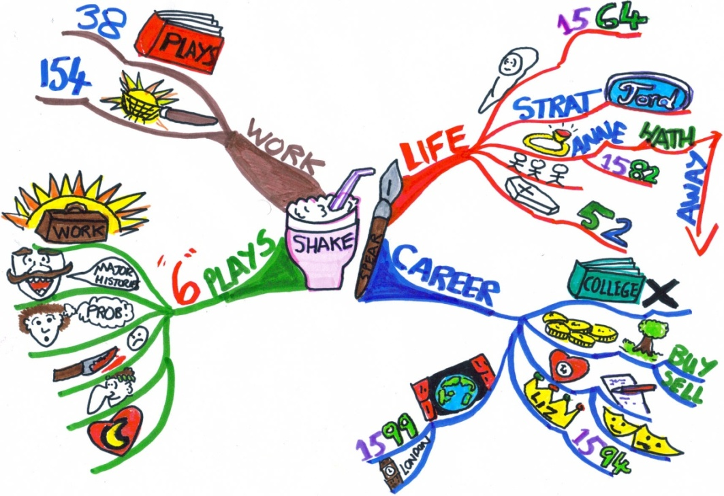
Mapping out your goals
A life map is your road map for your life plan it outlines the journey that will take you to your destination.

Slide 8
Components of your life map:
Dreams
Represent your destination
Goals
Are your itinerary the final decisions about how to travel
Activities
Are the different options you have to reach your destination

Slide 9
Creating your life map:
Order: Decide which dreams take priority and from there identify your ‘main goal’. Write it in center box using personal, positive, present tense.
Why: What are the emotional reasons why you simply must achieve your goals? Write them down in boxes marked ‘reasons why’.
Activities/How: On separate sheet of paper, brainstorm all the different activities or actions you can take to achieve your main and sub goals.
When: Define your timeline for achieving your main goal. Place at bottom of main goal & write today’s date.
Who: Choose the people or organizations that can support you in achieving your goals. Place in ‘who’ boxes. Align the names with the activities, or ‘how’ steps you wish them to help with.

Slide 10
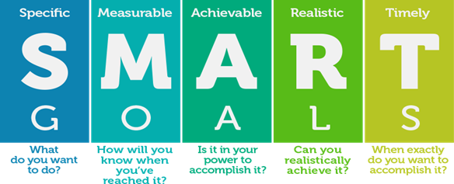

Slide 11

Thanks, you

