Slide 1
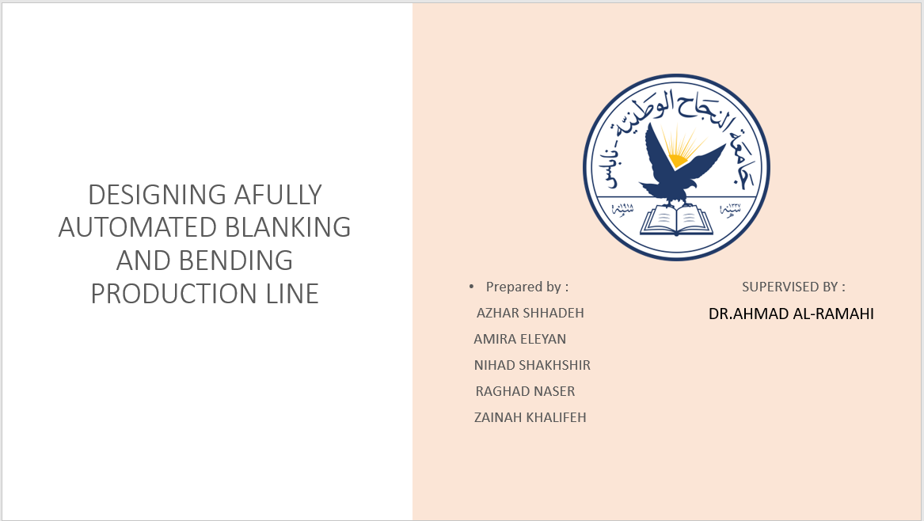

Slide 2
OUTLINE
•INTRODUCTION
•PROBLEM STATEMENT
•FLOW CHART
•DESIGN SYSTEM
•CONCLUSION
•FEASIBILITY STUDY
•CALCULATION

Slide 3
INTRODUCTION
•Automated production line is comprised of a series of workstations linked by a transfer system and an electrical control system.
• Door hinges are one of the most essential parts of home architecture. In Palestine the construction sector is growing and the need for door hinges has increased accordingly.
•Therefore, this project gives a detailed design of a manufacturing line of a specific type of door hinges. which contains various processes including blanking, piercing and bending.

Slide 4
PROBLEM STATEMENT
•The market dependency in Palestine has been on imported door hinges especially from China and Turkey
•There is a great opportunity to reinforce the local Palestinian industries Therefore, there seems potential for the feasibility of establishing an automatic production line to manufacture door hinges locally, which can lead to lowering prices and strengthening local industries

Slide 5
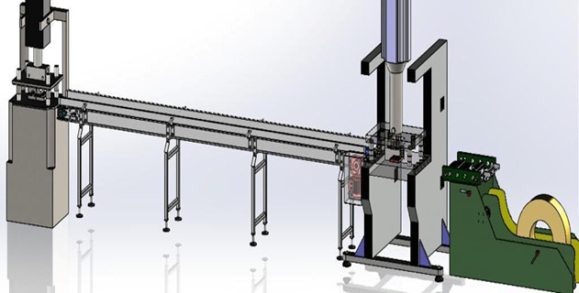
FLOW CHART
THE WHOLE LINE
sheet metal straightener
Feeder
Blanking & piercing
Conveyer
Bending & curling
Assembly

Slide 6
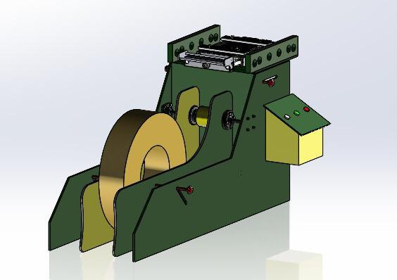
SHEET METAL STRAIGHTENER
The rolls of sheet metal are straightened as the first step using the sheet metal straightener

Slide 7
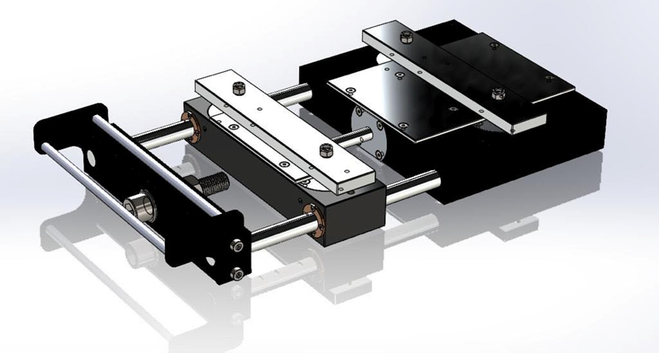
FEEDER
The sheet metal is pushed into the line using a pneumatic sheet metal feeder that feeds the strips in a speed suitable for the speed of the entire line and stations

Slide 8
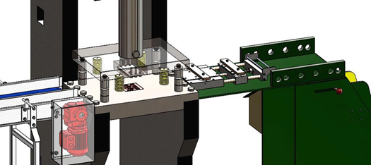
It consists of a compound blanking and piercing punch and die they are designed in order to be able to pierce small holes and blank the required hinge shape
BLANKING &PIERCING

Slide 9
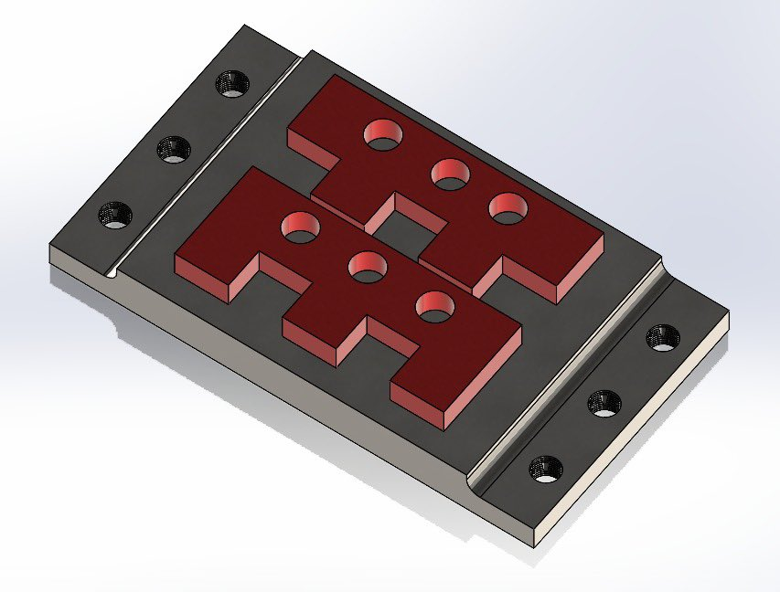
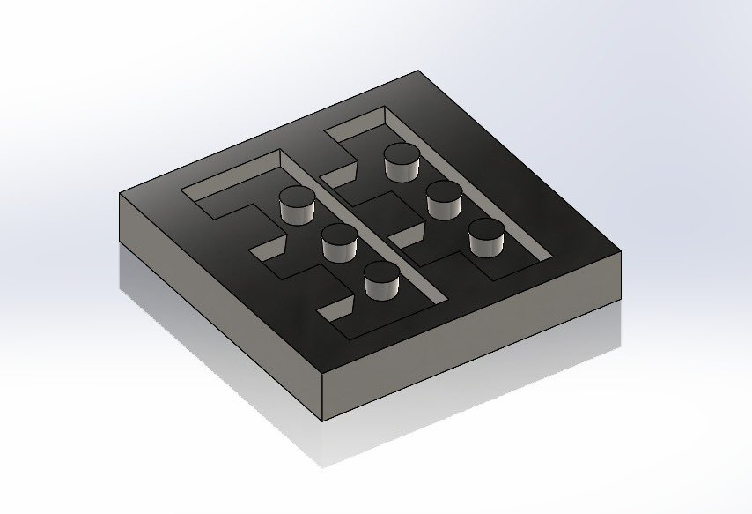
DIES
& PINCHES OF BLANKING

Slide 10
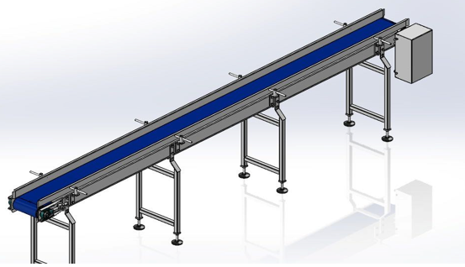
The conveyor is used to transfer the blanked pieces to the next bending station
CONVEYER

Slide 11
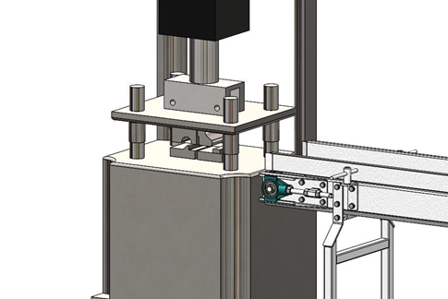
The bending process in this specific hinge type is done using two forming punches, the first one is used for v-bending and the second tool is used for curling
BENDING &CURLING

Slide 12
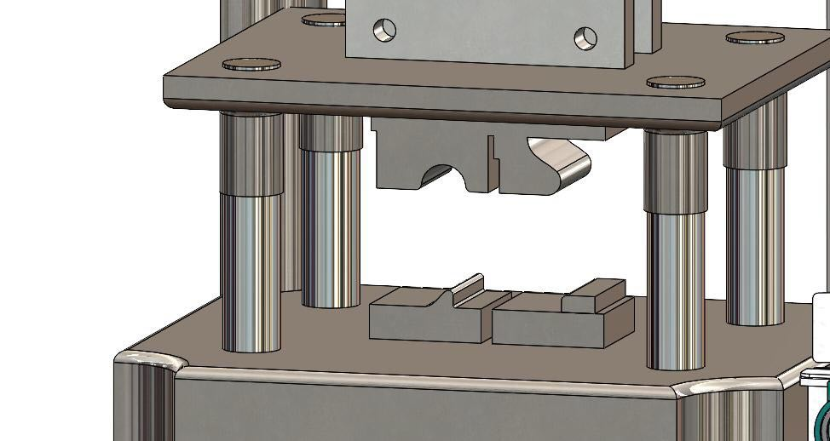
DIES OF BENDING

Slide 13


Slide 14
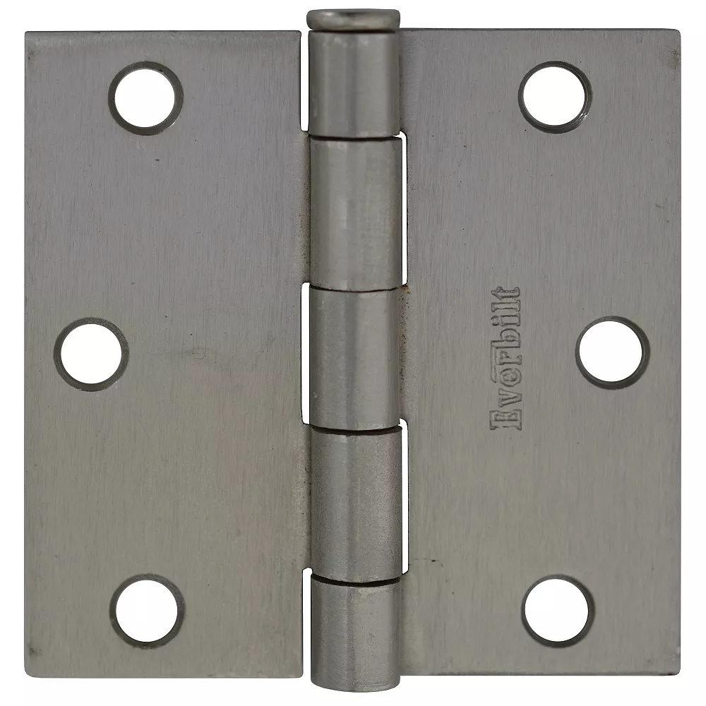
OUR HINGE

Slide 15
FEASIBILITY STUDY
•Feasibility study consist of three stages :-
1.Market study
2.Technical study
3.Financial study

Slide 16
Market study
•Our market study questionnaire parts:-
1.Reorder point
2.local market
3.availability of specific hinge
4.the cost of the specific hinge source country
5.the price of the hinge
6.the number of stores in city ,demand

Slide 17
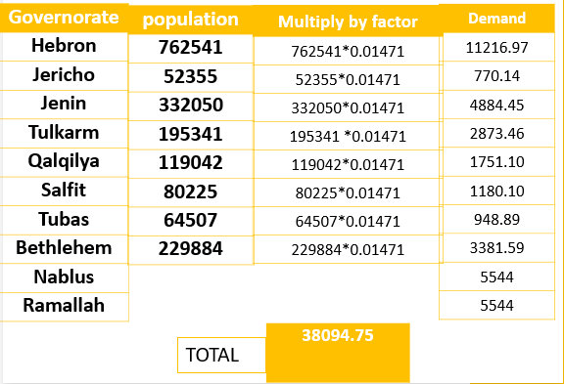
MARKET STUDY
•The estimated demand for other governorates is a follows depending on the population of each city
•In Bethlehem Taking into consideration the increased demand for carpenters' stores, the demand may arrive 40000 pieces per week

Slide 18
Technical study
$ Price ​ | Machine ​
35,000​ | Blanking machine (including motor)​
40,000​ | Bending machine (Hydraulic)​
700​ | Strip feeder​
300​ | Feed track​
1000​ | Conveyer​
2000​ | Straightening machine​
$79000​ | Total ​
Price​​ | Material ​​
12 ILS/KG​​ | Steel 4140 (for making dies)​​
3 ILS/3Meter​​ | Steel 1010 (sheet metal)​​

Slide 19

Technical study
•Labor requirements:
Salary$/month | Worker
550 | Supervision worker
450 | Packaging worker
$1000 | Total
•Production capacity:
The demand for west bank arrives 40000 pieces/week, by this project we can cover up to 30% of the market share.
$the production capacity$
=$40000∗30\%$
=$12000 piece/week$

Slide 20
Financial study
Start-up costs:
Price $ | Startup cost
$35,000 | Blanking machine (including motor)
$40,000 | Bending machine (Hydraulic)
$700 | Strip feeder
$300 | Feed track
$1000 | Conveyer
$2000 | Straightening machine
$1000 | Line installation engineer
$2000 | Furniture
$300 | Advertisement
$500 | Interior Design
$82800 | Total

Slide 21
Operating Cost
Cost $/month | Fixed Operating cost for line
$70 | breakdown for machine
$30 | Service contract
$1000 | Salary
$400 | Rent
$100 | Promotion
$100 | Telecommunication
$100 | Insurance
$1800/month | Total
1.Fixed Operating Cost
The maintenance of the line
= cost for breakdown for machine + cost of service contract
=(1 breakdown/month) =
$70 + 30$ = $100

Slide 22
Financial study
Cost $/month | Variable expense
$3400 | Sheet metal (steel 1010)
$780 | Electricity
$100 | Water
$220 | Screws (for assembly of the hinge)
$500 | Packaging
$5000 | Total
Operating Cost
2. Variable Cost
Raw material. For steel 1010
every 1 profiles of steel 1010 makes 12 hinges
12000/12 = 1000 Profiles.
So, we need 1000 Profiles to make 12000 hinges
The cost per week =
1000*3 = 3000
The cost per month = 3000*4=12000 ILS = $3400.

Slide 23
Financial study
•Salvage value
Salvage value = p(1-i)^n = 79000(1- 0.1)^8 = 34006
•Income and profit:
Income = Selling price per unit x number of units sold
= (12000 piece/week )*( 1 ILS) =12000 ILS/week
= 12000*4= 48000 ILS/month = $15000

Slide 24
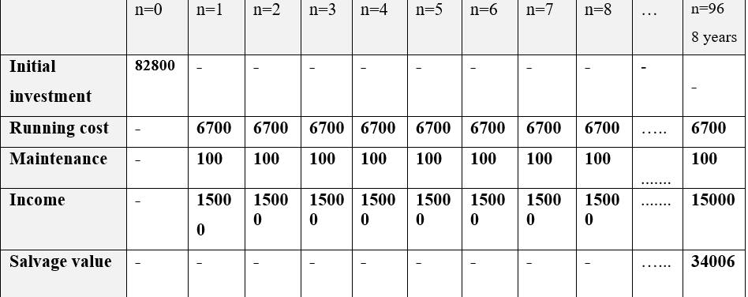
Financial study
Rate Of Return(RoR)
NPV_{n=0} = - 82800 +8200(P/A,i,96) + 34006(P/F,i,96)
I = 9.835 %

Slide 25
Financial study
Cumulative Net Cash Flow | Net Cash Flow | Month
__ | -82800 | 0
-74580 | +8220 | 1
-66360 | +8220 | 2
-58140 | +8220 | 3
-49920 | +8220 | 4
-41700 | +8220 | 5
-33480 | +8220 | 6
-25260 | +8220 | 7
-17040 | +8220 | 8
-8820 | +8220 | 9
-600 | +8220 | 10
PAYBACK PERIOD = 11 MONTHS
11 | +8220 | +7620

Slide 26
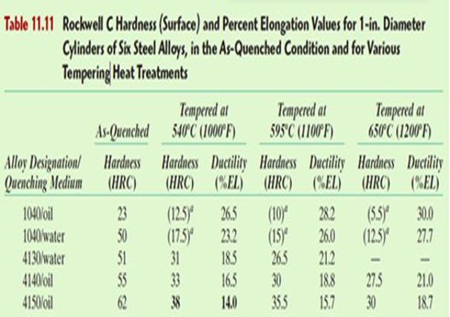
Heat treatment of dies
Material selection was based on Rockwell's hardness of different types as shown in Fig. In order to choose accordingly. The most suitable option is AISI 4140 steel.
For AISI 4140 steel, quenching typically:
1570°F (855°C) for 1 hour .
Then tempering to increase the ductility :
1000°F (540°C)

Slide 27
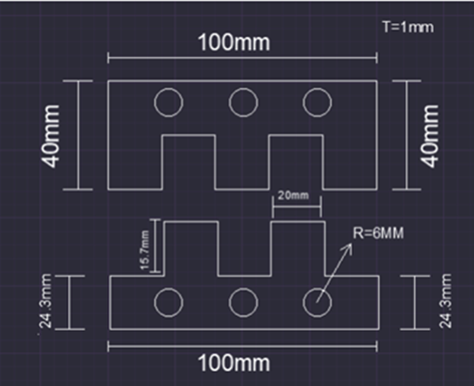
design
•The calculation was implemented based on the type of the sheet metal, AISI 1010 Carbon Steel UTS=356MPA,
• S = 241MPA .
• As for the dimensions of the piece, this shape was adopted

Slide 28
Calculation of the Blanking and piercing die
TYPE OF CUT | FOR RECTANGULAR CUT (BLANKING ) | FOR ROUND CUT (PIERCING)
Area | 342.8 𝒎𝒎𝟐 | 18.85𝒎𝒎𝟐
Shear strength (S) | 241 MPa | 241 MPa
Force | 82614.8 N | 4542.75 N
Force of blanking &piercing | 82614.8N
F = S × A
For rectangular cuts A = (2L + 2W) × T
For round cuts A=3.1416×D×T

Slide 29
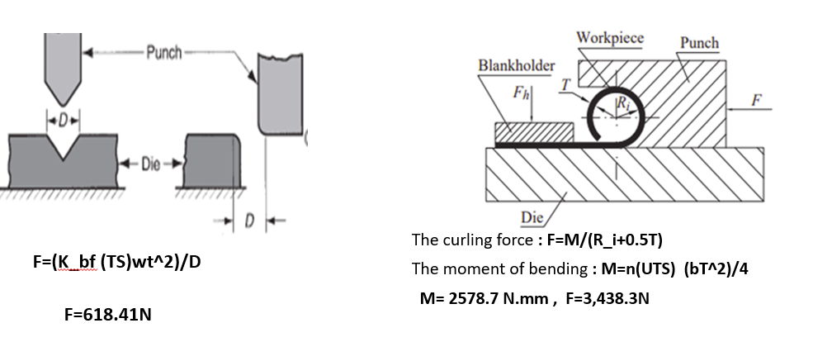
Calculation of Bending (Curling &v-bending )

Slide 30
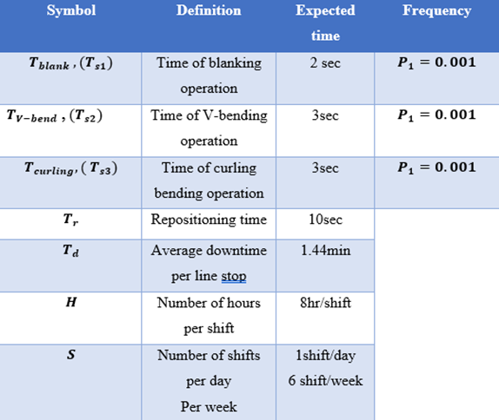
Calculation of the production line
•An automated production line is comprised of a series of workstations linked by a transfer and control system.
•This table has been adopted to find the needed calculations for the line.

Slide 31
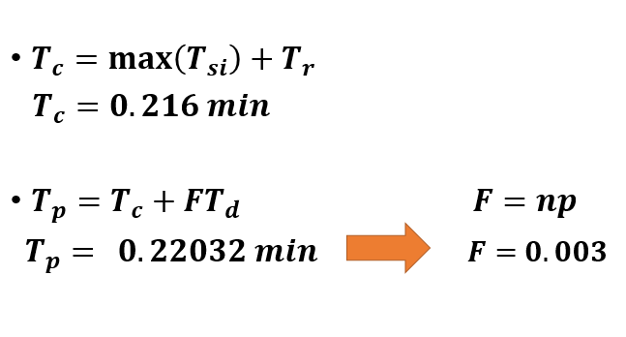
Cycle time & production time

Slide 32
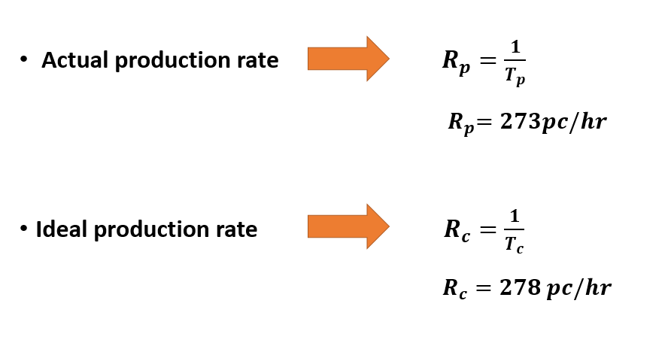
Production rate

Slide 33
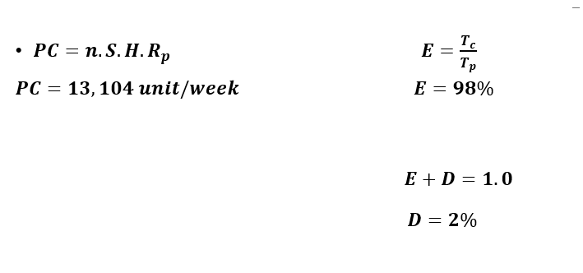
Production capacity & Efficiency

Slide 34
Conclusion
In this project a sufficient literature review on previously published work done .
A feasibility study was conducted which includes three stages: the first one is market study, technical study and final part is the financial study
It is shown by the calculations that the project is profitable and the payback period is after 11 months.
Then the line is illustrated with all of its components using SolidWorks with an explanation of the working mechanism

