Slide 1
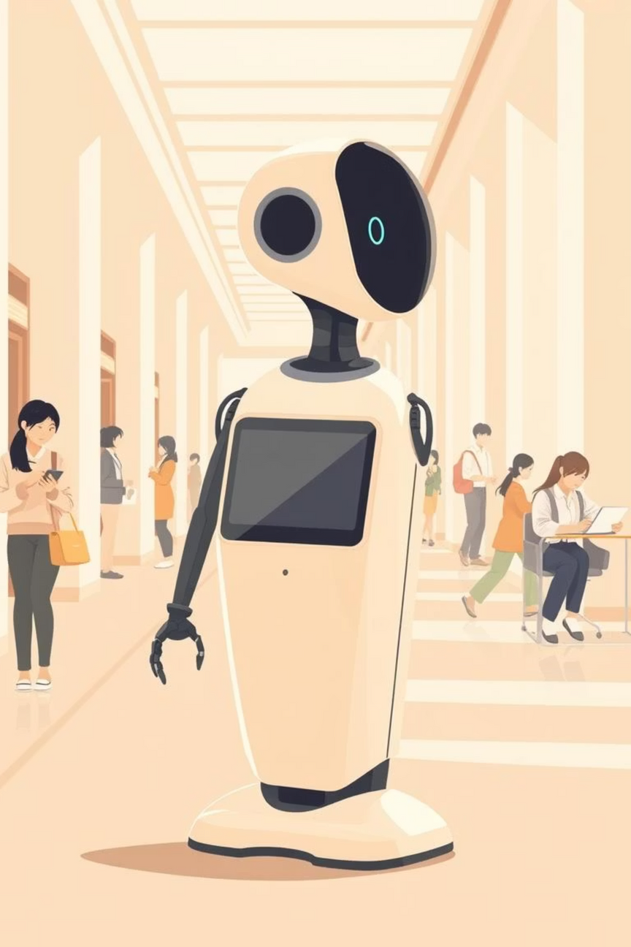
Hall Guide Robot - Igris
Presented by Omar Maher Khatib and Osaid Islam Raddad
Supervisor: Dr. Manar Qamhieh
Notes:
1

Slide 2
Content
1
Introduction & Problem Statement
2
How Our Robot Works
3
Key Hardware Components
4
Current Constraints & Challenges
5
Future Work & Enhancements
Notes:
2

Slide 3

Campus Navigation Challenge
Navigating large university campuses can be daunting, especially for new students, visitors, or those attending events in unfamiliar buildings. This often leads to:
  Wasted time: Endless searching for specific rooms or offices.
  Frustration: Getting lost in complex layouts.
  Inefficiency: Decreased productivity and a less welcoming environment.
Our solution aims to simplify this experience, making campus navigation intuitive and stress-free.
Notes:
3

Slide 4
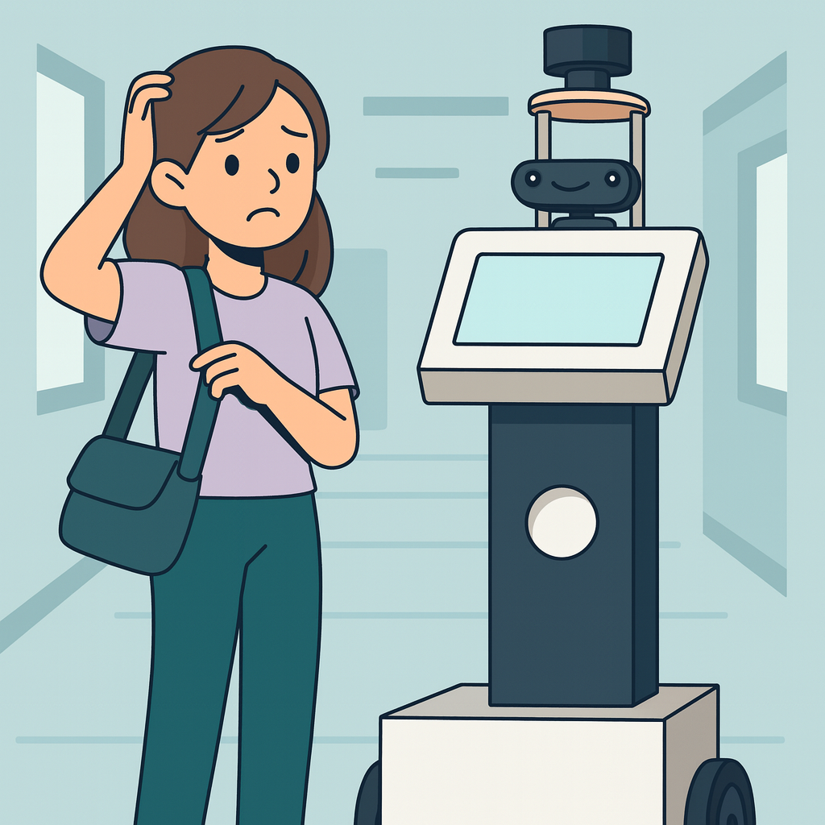
Introducing the Hall Guide Robot
Your Campus Navigator
We developed an autonomous Hall Guide Robot designed to assist students and visitors in finding their way around campus buildings with ease.
  Intuitive Interaction: User-friendly touchscreen interface for easy room selection.
  Accessible Assistance: Provides guidance to anyone needing help navigating.
  Efficient Exploration: Reduces time and effort spent searching for destinations.
Notes:
4

Slide 5
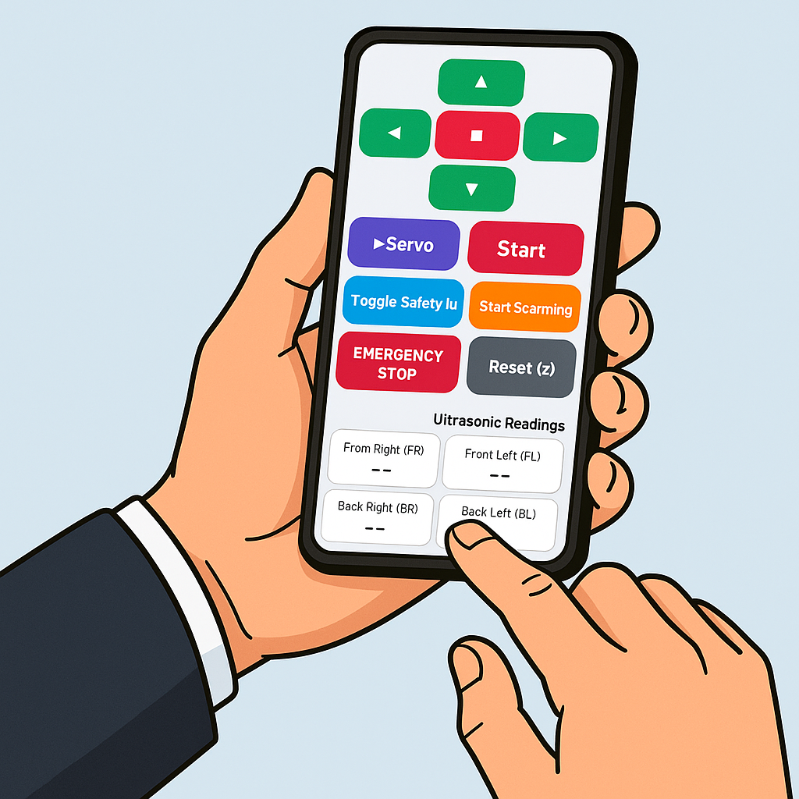

How Our Robot Guides You
1. Administrator Setup
An administrator uses a web remote control to initiate the scanning process. The robot autonomously maps the area until stopped, storing scanned room numbers on its touchscreen.
Notes:
5

Slide 6
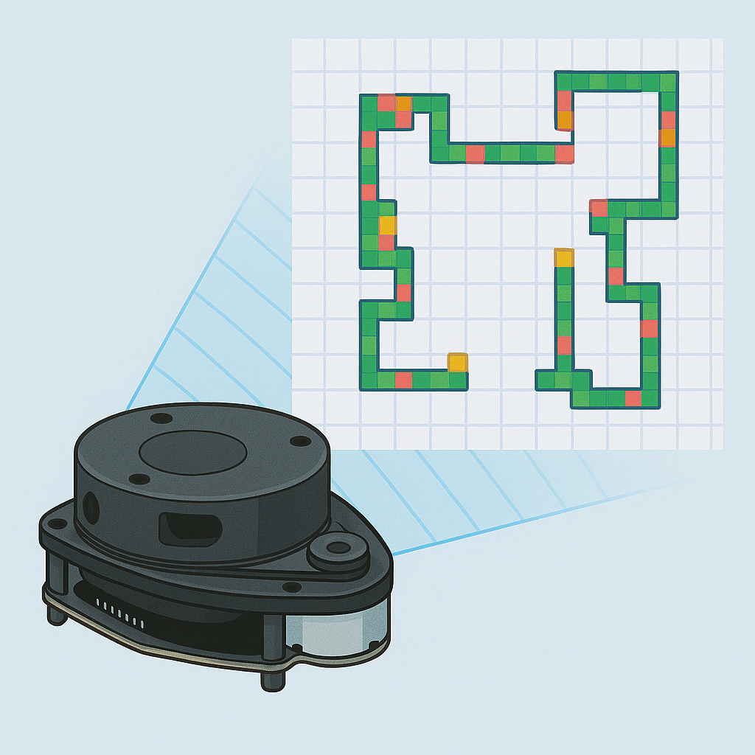

How Our Robot Guides You
2. Autonomous Mapping
Utilizing LIDAR technology, the robot creates a detailed map of the environment, identifying and logging accessible rooms for future navigation.
Notes:
5

Slide 7
How Our Robot Guides You
3. User Interaction
Students or visitors simply select their desired room number from the touchscreen. The robot is now ready to guide them directly.
4. Safe & Guided Navigation
The robot plots the most efficient route using its internal map and destination data, actively avoiding obstacles to ensure a smooth journey. Upon arrival, it provides clear voice and screen feedback.
Notes:
5

Slide 8
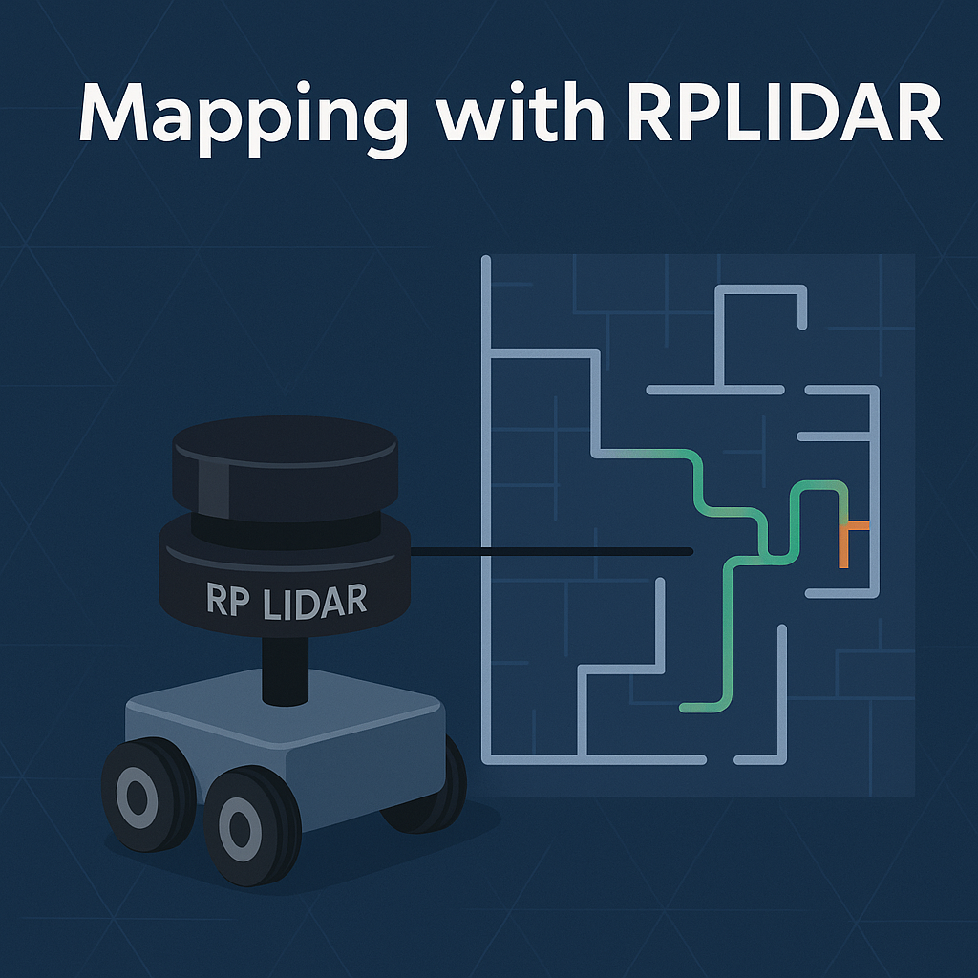
Robot Operating System & Mapping
The robot uses ROS to connect all components together.
With LIDAR, the robot creates a digital map of the hallway.
This map helps the robot know where it is and how to reach the destination.
The system also allows the robot to avoid obstacles in real time.
Notes:
2

Slide 9

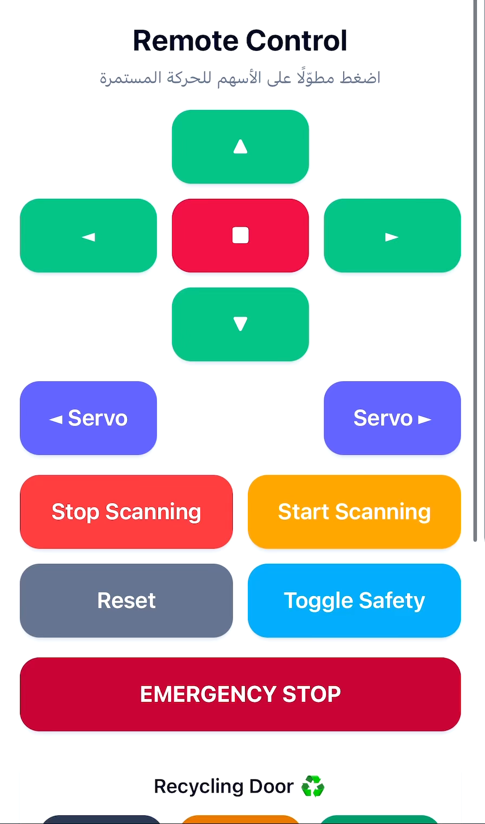
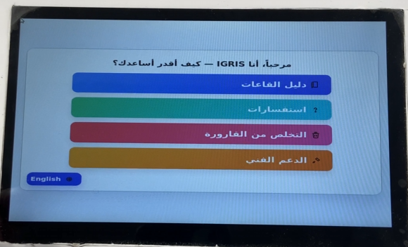
User Interface and Remote Control
Touch Screen Interface
Remote Control Interface
Notes:
5

Slide 10
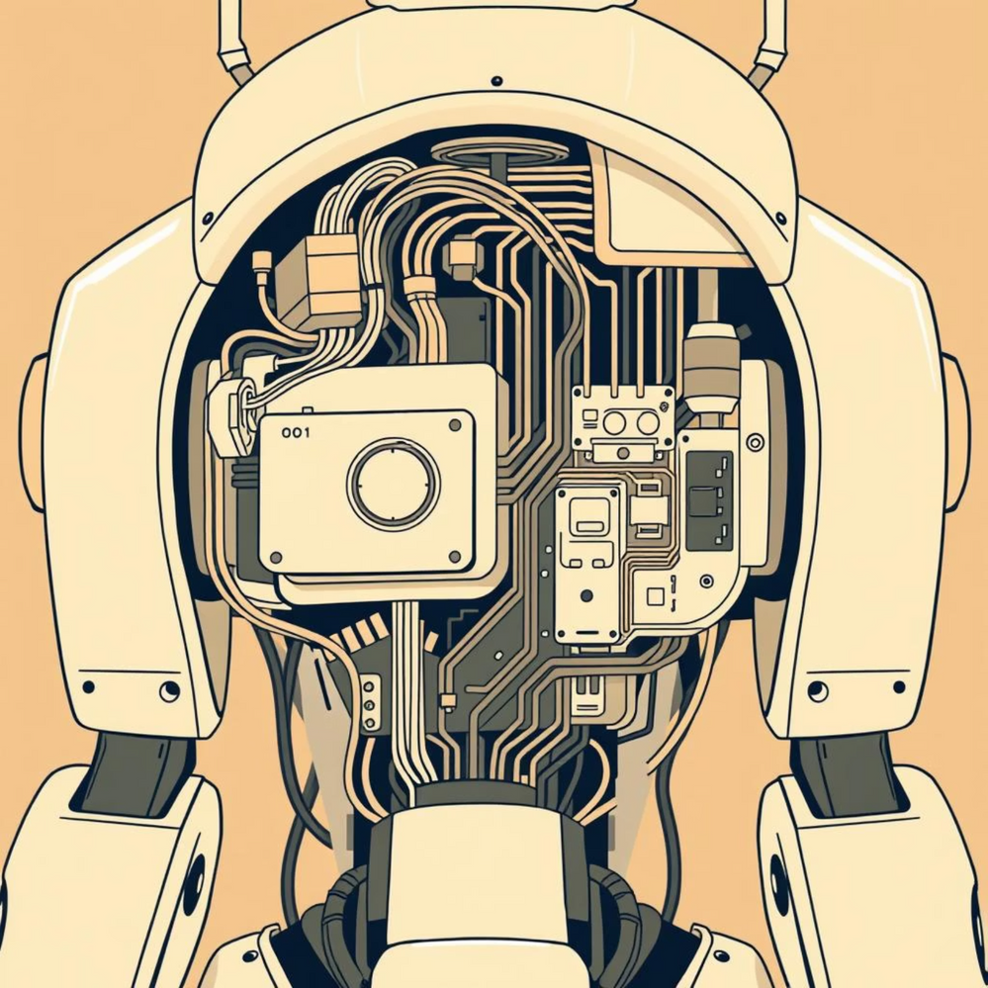
Under the Hood: Hardware Components
Our Hall Guide Robot is built with a robust combination of readily available and specialized components to ensure reliable performance
Notes:
6

Slide 11
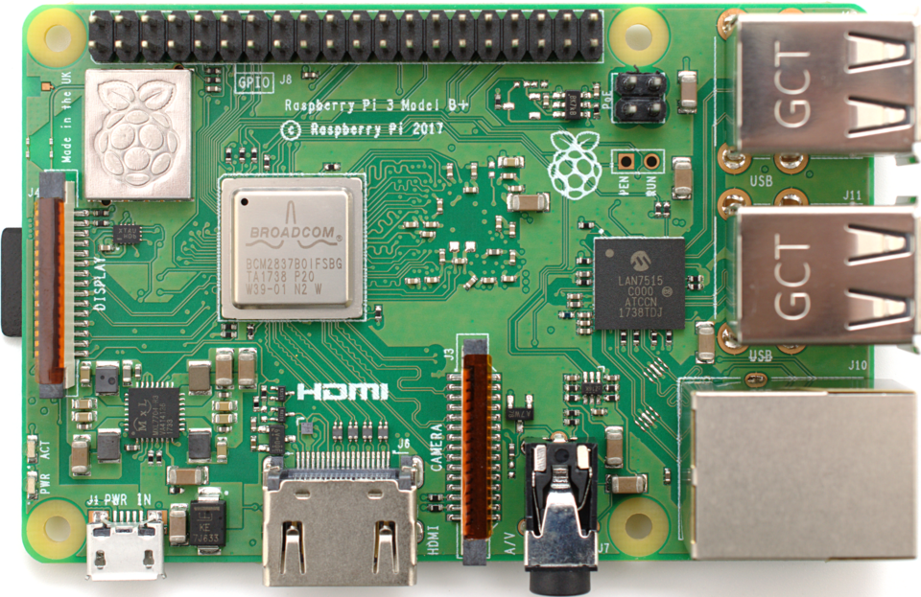
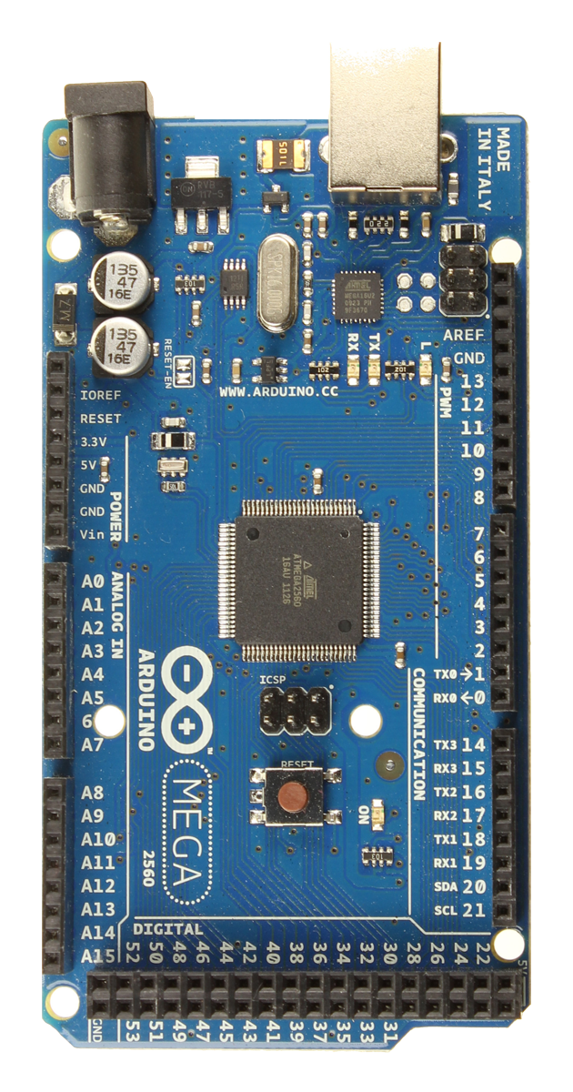
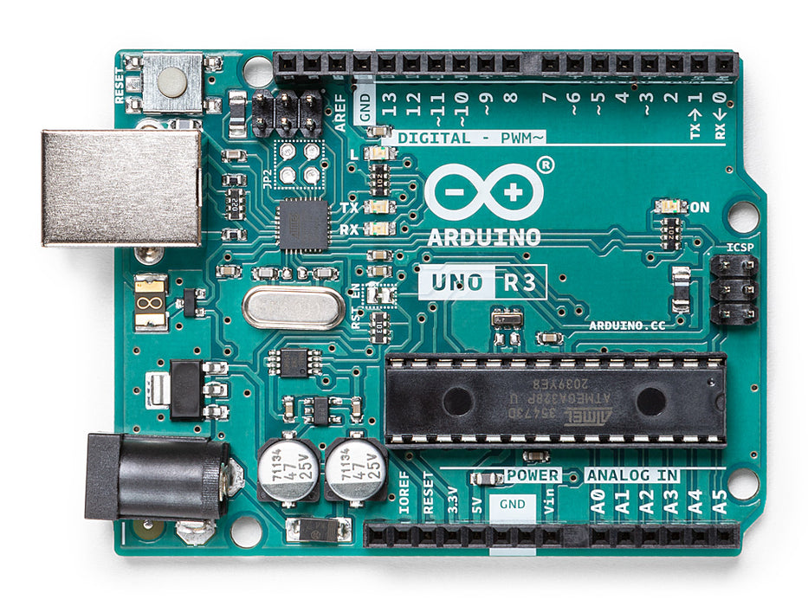
  Core Processors
Raspberry PI 4B
Arduino Mega
Arduino UNO

Slide 12
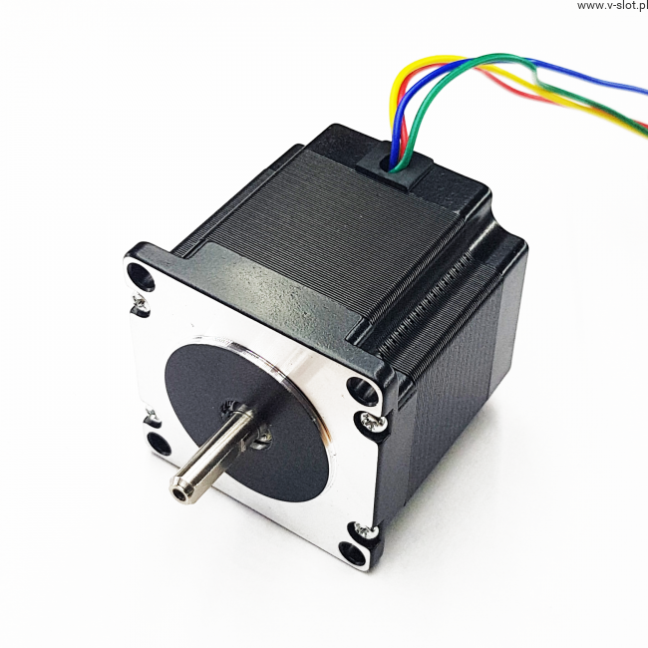
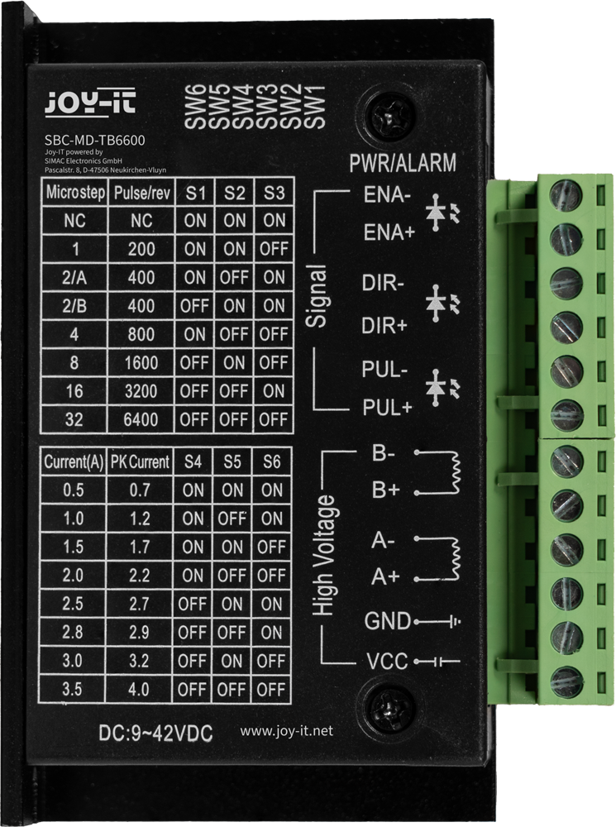
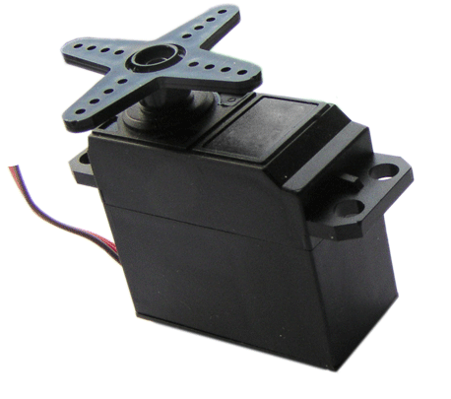
  Movement Systems: 4 NEMA 23 motors with 4 TB6600 drivers for powerful locomotion, 2 servo motors one for camera rotation and the other for bottles door.
Nema 23
TB6600 Driver
Servo Motor

Slide 13
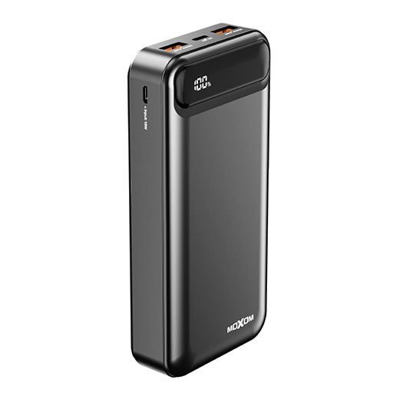

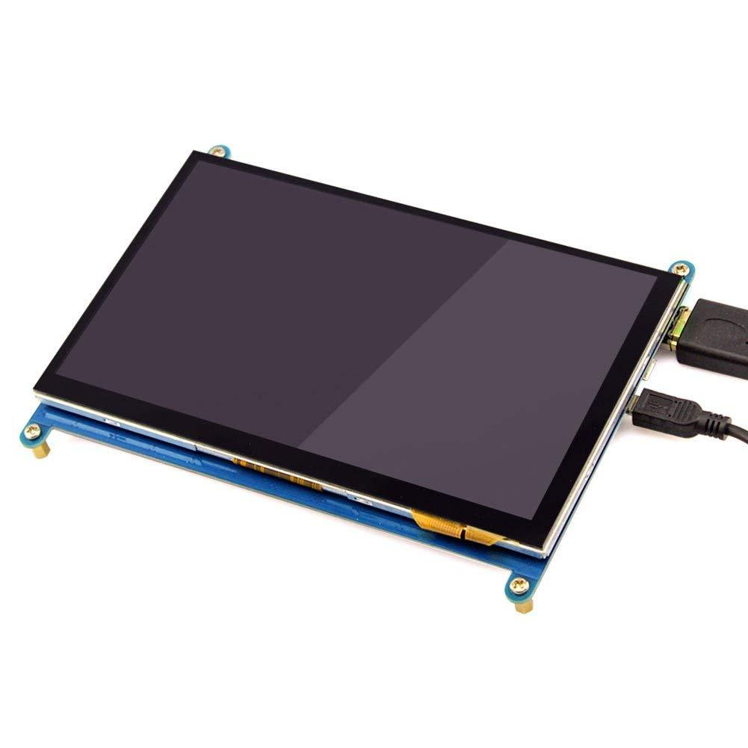
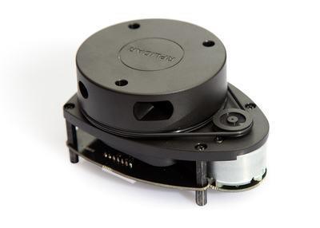
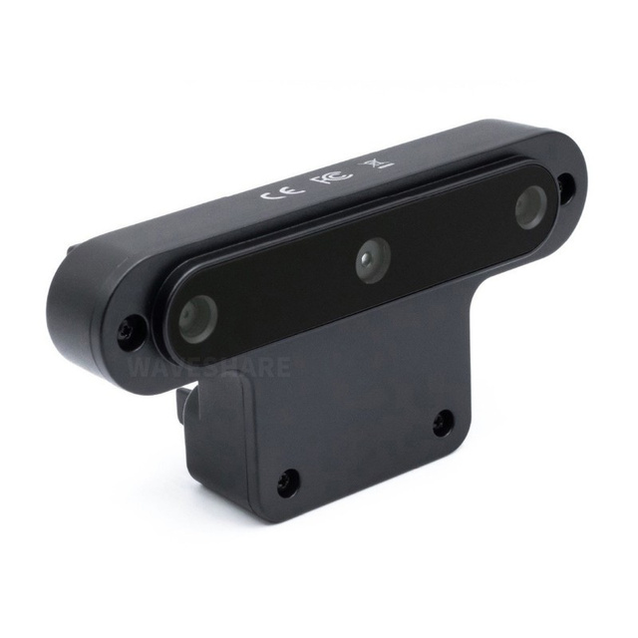
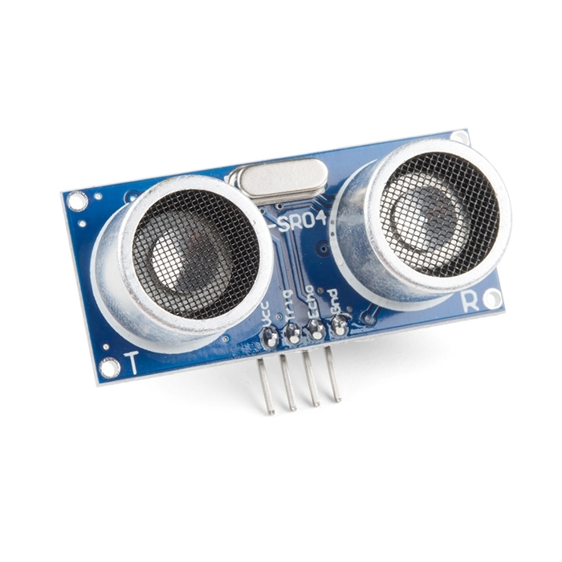
  Environmental Sensing: Ultrasonic Sensors for Stairs detection and safety, a RPLIDAR A1 for accurate obstacle detection, mapping and localization, Camera for Room numbers detection.
  User Interface: An intuitive Touchscreen for interaction and a Camera for visual processing and future enhancements.
  Power Source: A reliable 12V Battery to ensure extended operational periods with power bank for the raspbery.
Power Sources
7 inch
Touch Screen
Ultrasonic
RPLiDAR A1
Camera

Slide 14
Development Constraints
Limited Development Time
Workshop Access
The project faced tight deadlines, which impacted the scope and depth of certain features.
Restricted workshop hours significantly slowed down hardware assembly and testing phases.
Robot Weight
Indoor, Single-Floor Use
The necessary motors and battery added considerable weight, affecting maneuverability and design iterations.
Current functionality is limited to indoor environments and navigation on a single floor, presenting a scope for future expansion.
Notes:
7

Slide 15
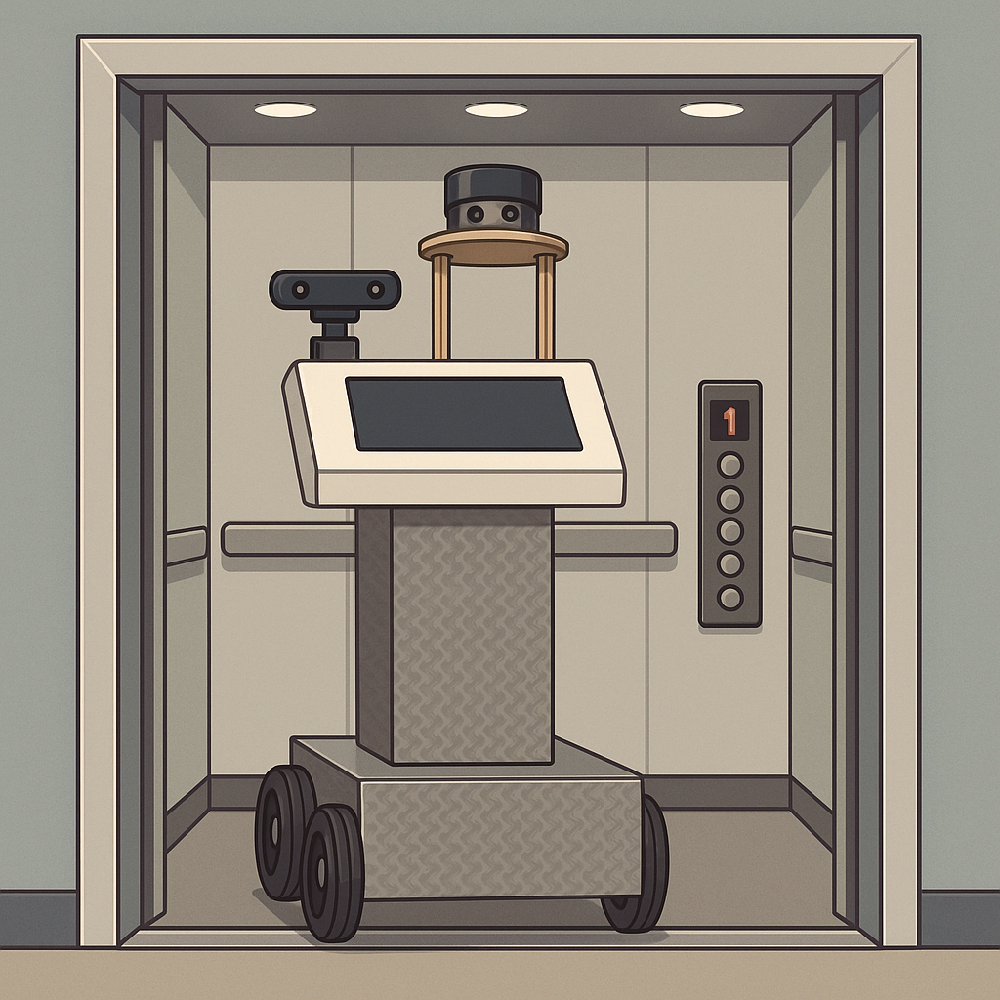
Future Work & Enhancements
To further enhance the Hall Guide Robot's capabilities and address current limitations, our future plans include:
  Multi-Floor Navigation: Integrating elevator control for seamless movement across different building levels.
  Automatic Charging: Developing an autonomous docking station for self-charging, minimizing human intervention.
  Improved Mobility: Designing and implementing better wheels for smoother motion and enhanced stability on various surfaces.
  Advanced Vision: Enhancing the camera system for more robust recognition of room numbers and improved interaction with people.
Notes:
8

Slide 16
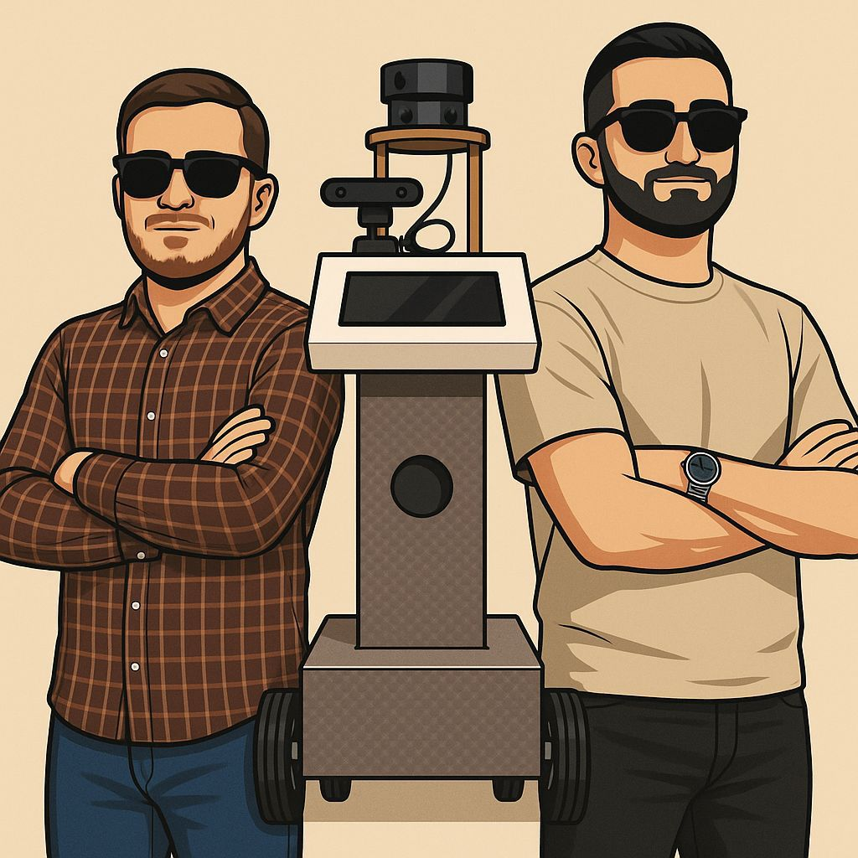
`
Thank you
Notes:
7

