Slide 1

An-Najah National University
Engineering & IT Faculty
Civil Engineering Department
The Structural Design and Analysis of a futuristic court house in Nablus
By:
Alaa Abd al-Ra’ouf Othman Al-mosa.
Mussab Abdulrahim Tafal.
Deya’ Ahmad Barhoush.
Murad Mufid ya’qoob.
Under supervision of : Dr. Mahmoud Dwaikat/ Dr.Imad Al-Qasem.

Slide 2
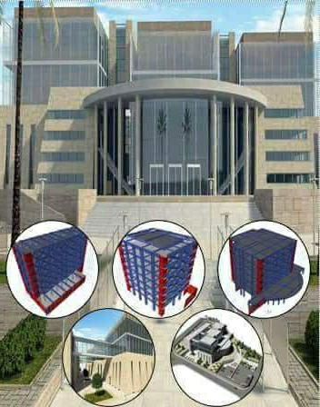
Outline:
Introduction.
Block 1.
Block 2.
Block 3.
Steel bridge.

Slide 3
INTRODUCTION

Slide 4
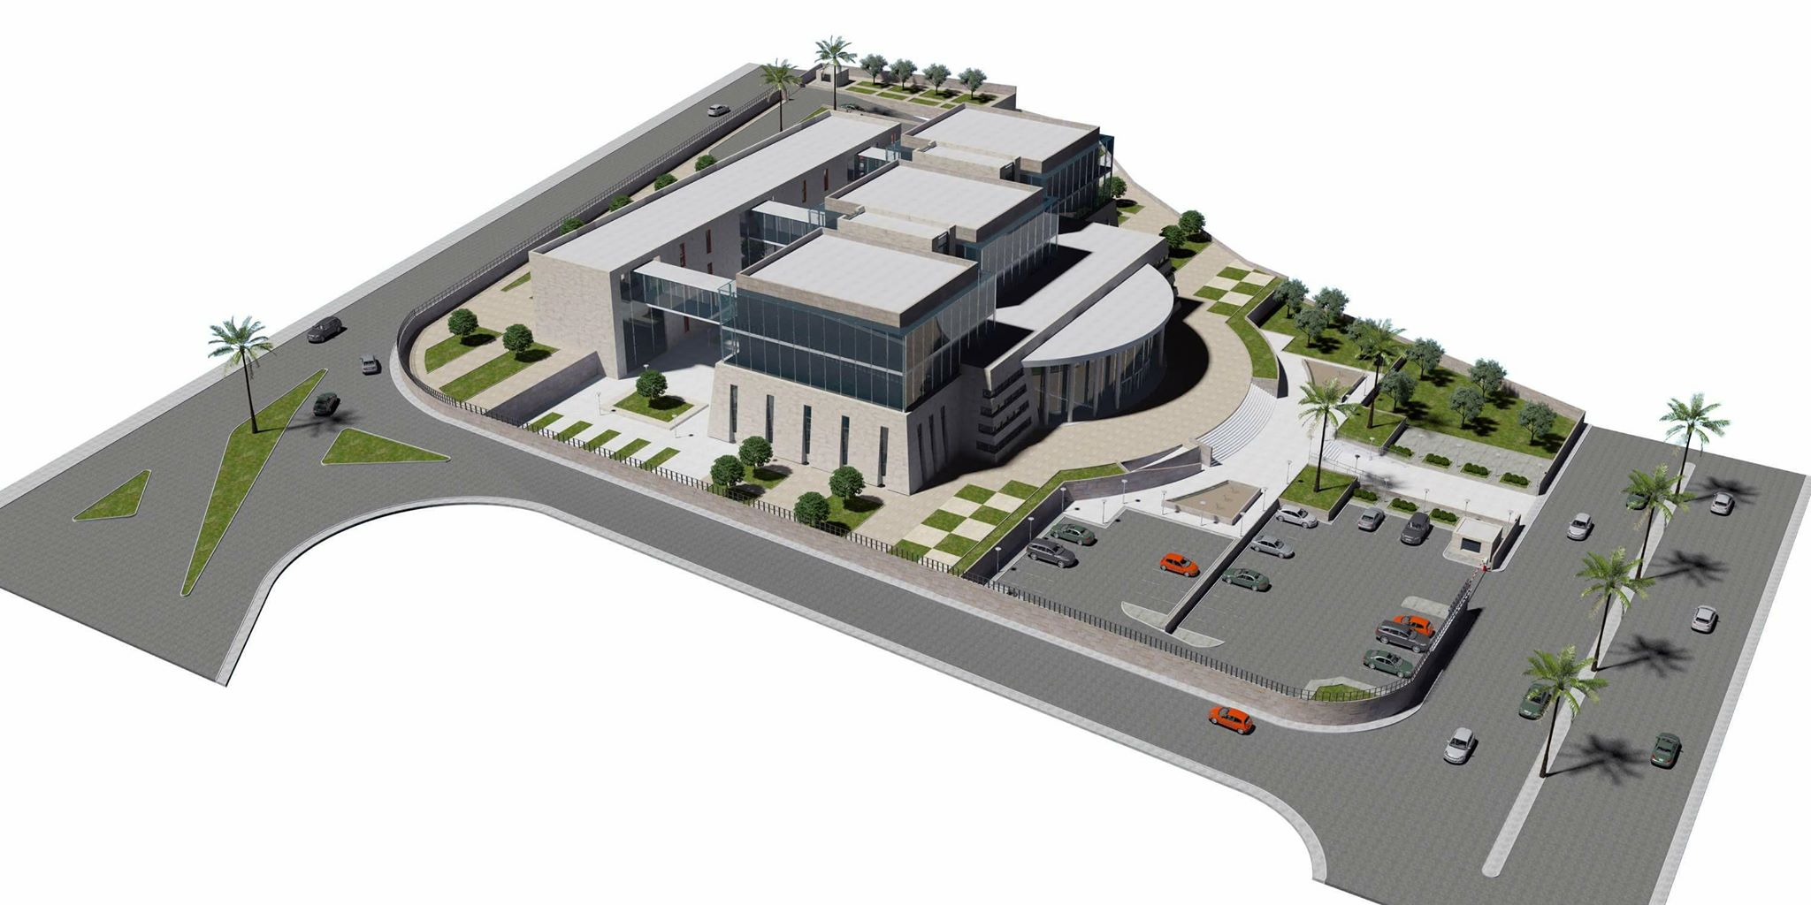
Project Overview
Location : Nablus.
7 floors: Basement and 6 floors for each building(main and secondary .
Floor area(main) : 2321 m².
Floor area (secondary):842 m².
Three steel bridges: the critical one is (19.2m) length.

Slide 5
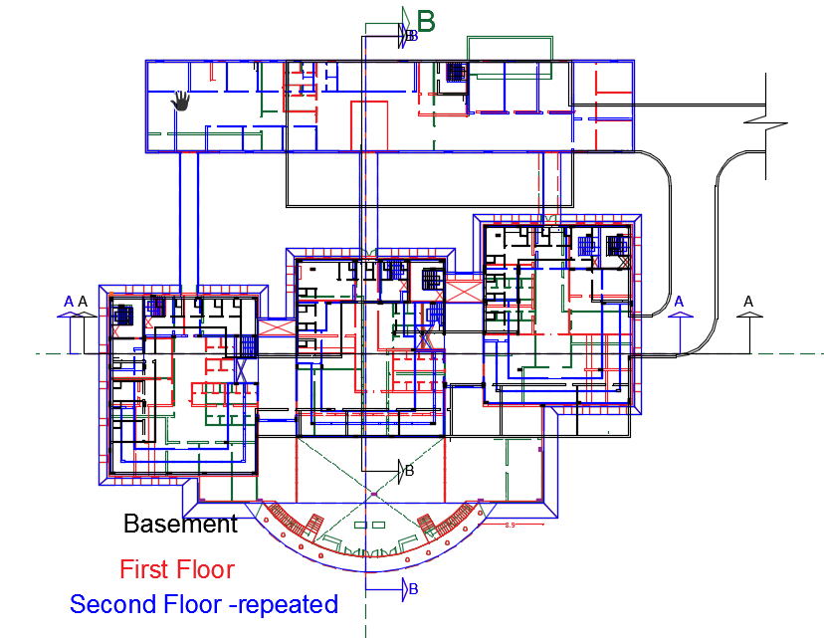
Architectural challenges

Slide 6
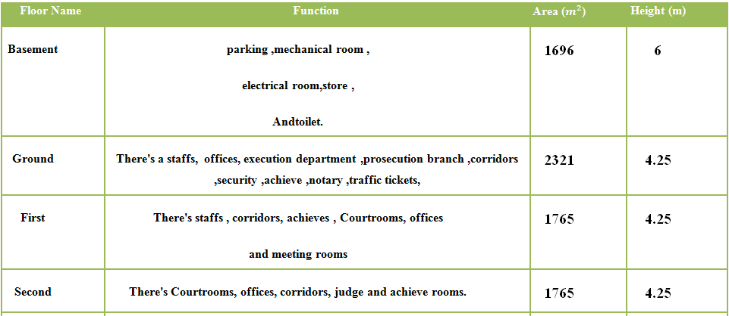
Floors Dimensions and Uses.
*Main

Slide 7
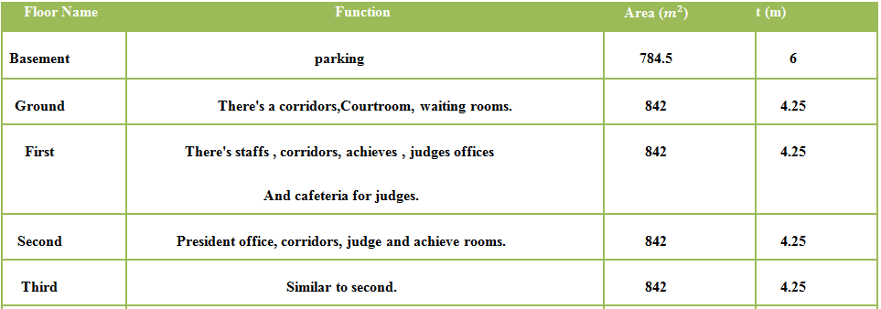
Floors Dimensions and Uses.
*Secondary

Slide 8
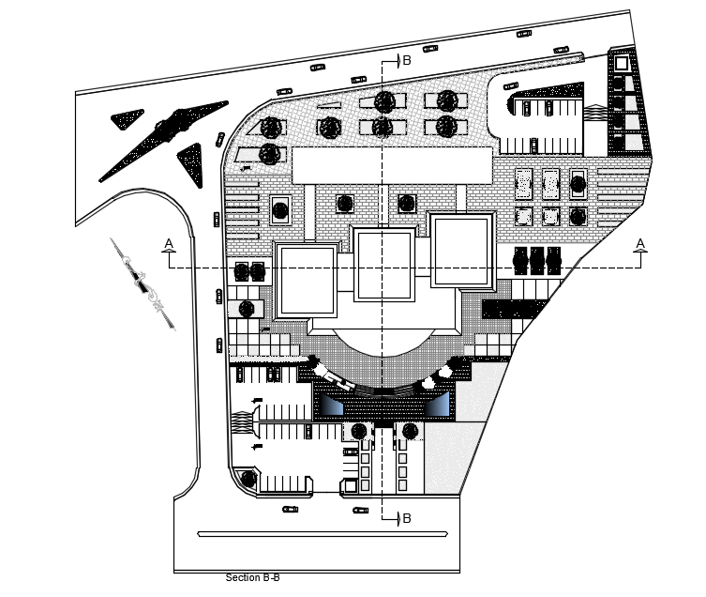
Blocks Distribution

Slide 9
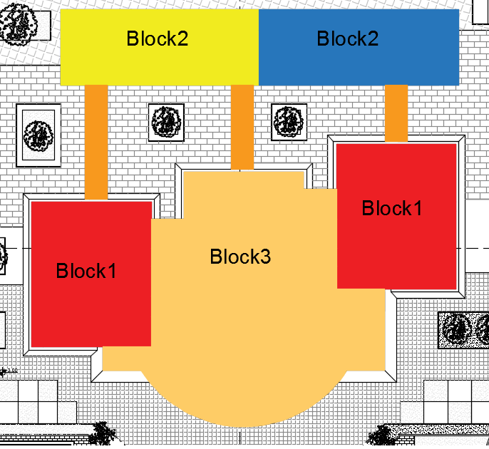

Slide 10
Codes
ACI 318-14 (American Concrete Institute)
IBC-2015 (International Building Code).
ASCE-2010 (American Society of Civil Engineers).
ASTM (American standards for testing materials).

Slide 11
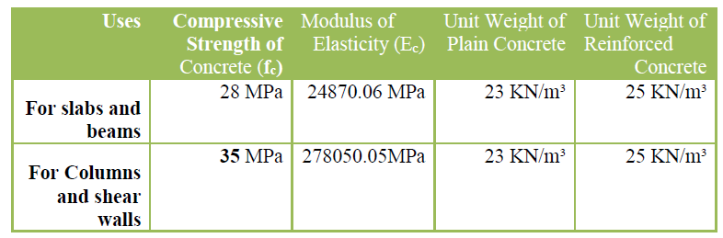
Materials

Slide 12
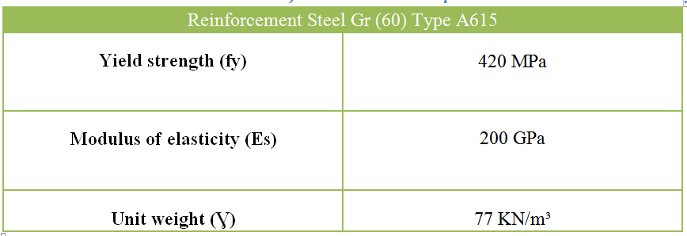
Reinforcement steel Gr (60) type A615 according to ASTM specifications is used

Slide 13
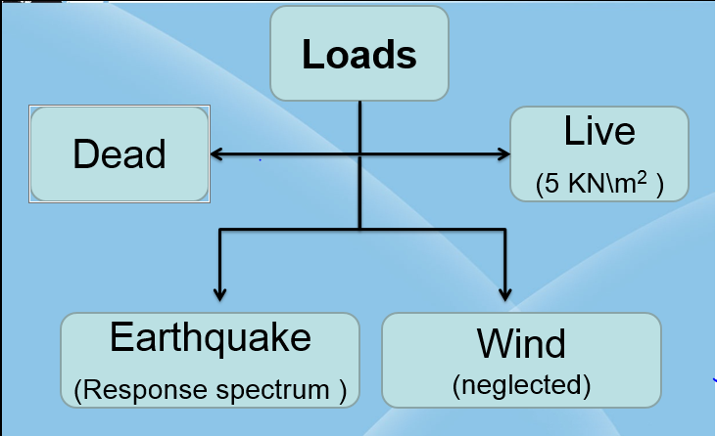
Loads

Slide 14
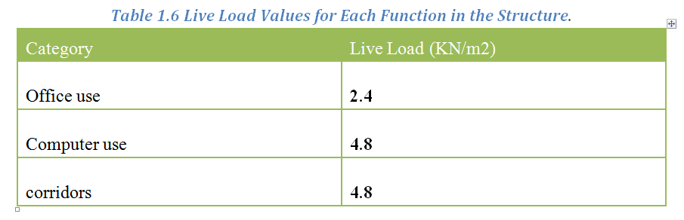
Live load

Slide 15
Super Imposed loads

Slide 16
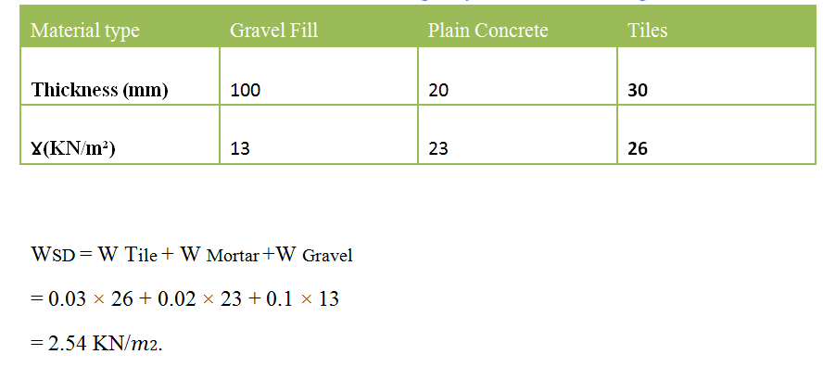

Slide 17
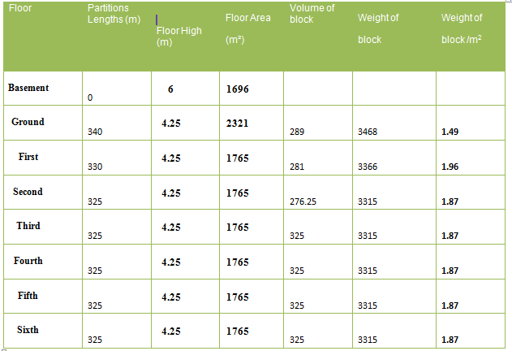

Partitions loads

Slide 18
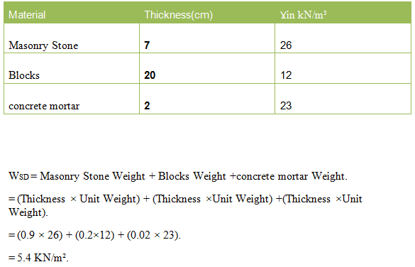
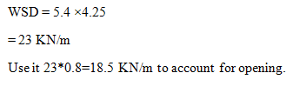
External walls

Slide 19

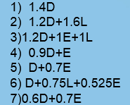
Load combinations

Slide 20
Modifiers for each element
Modifier | Element
0.7 | Column
0.35 | Beam
0.25 | Slab
0.7 | Shear wall

Slide 21
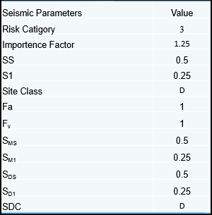
Seismic parameters for used in the Project.
Nablus City.
Rock.

Slide 22
BLOCK 1

Slide 23
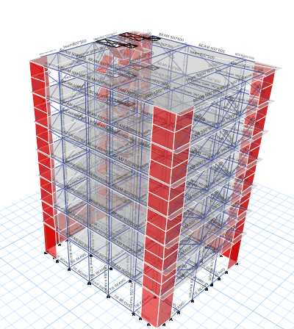
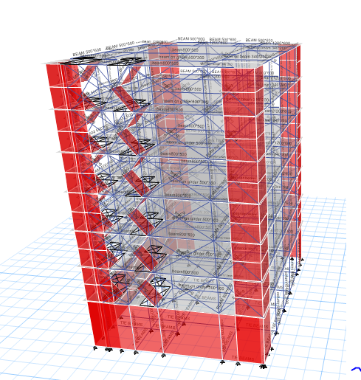

Slide 24
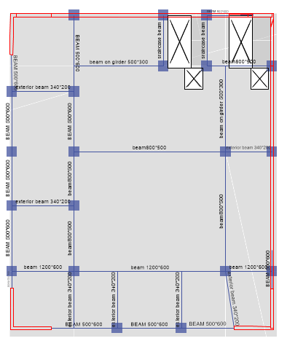
Basement slab

Slide 25
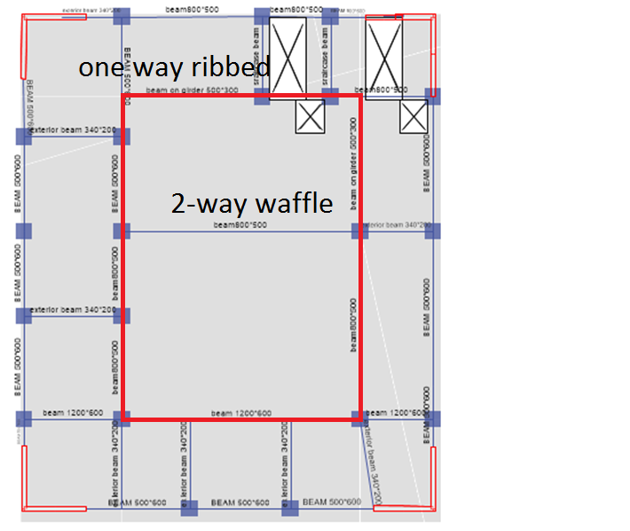
Structural system

Slide 26
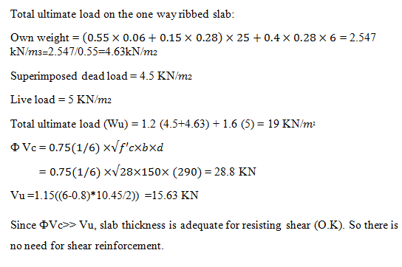
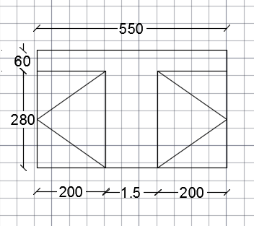
For one way ribbed slab
Max span=6 m .
Thickness=0.34 m.

Slide 27
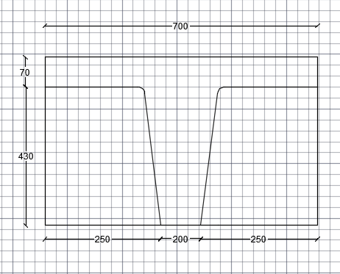
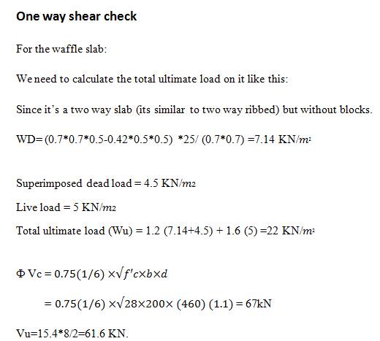
For Waffle slab
Max. span=10.7m
Thickness=500mm
Thickness of slab=(L/36)*(4/3)

Slide 28
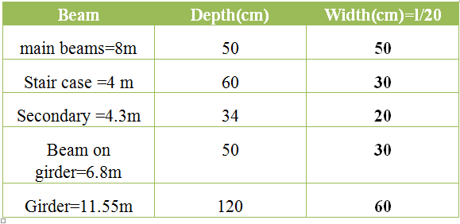
Beams Dimensions

Slide 29
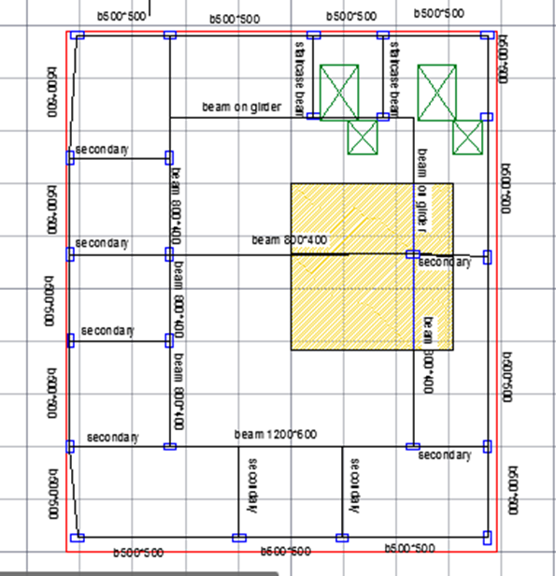
Preliminary design
We take the column that gives the longest panel = (7.8*7.5)
Pu=7.8*7.5*22*7=8599.5 KN.
Pu=ᶲʎ (0.85fc (Ag-0.01Ag) +0.01Ag*Fy)
ᶲ = 0.65
ʎ = 0.8
fc = 35MPa
fy = 420MPa
Ag=700*700 mm2.
800*800 mm2 was used

Slide 30
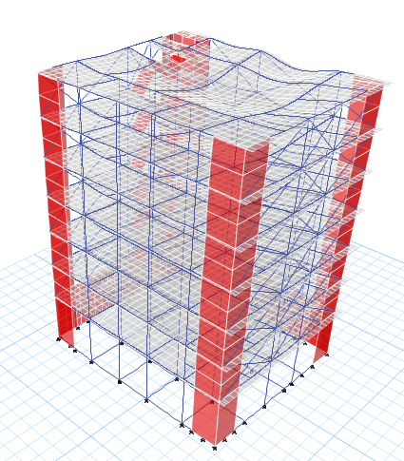
Compatibility check

Slide 31
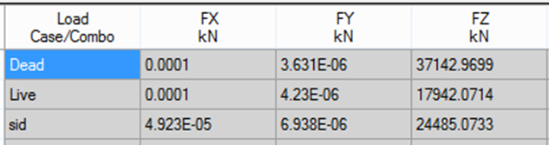
Equilibrium check

Slide 32
Equilibrium check
By hand calculation for dead load
Total = 38322 KN
Error=38322-37143/37143*100% = 3.1% <5% , Error is acceptable
Live load
LL=5KN/m2 & total area=3528 m2
Reaction = LL*total area
=3528*5=17640KN
Error=17942-17640/17942 *100% = 1.6% <5%
Error is acceptable

Slide 33
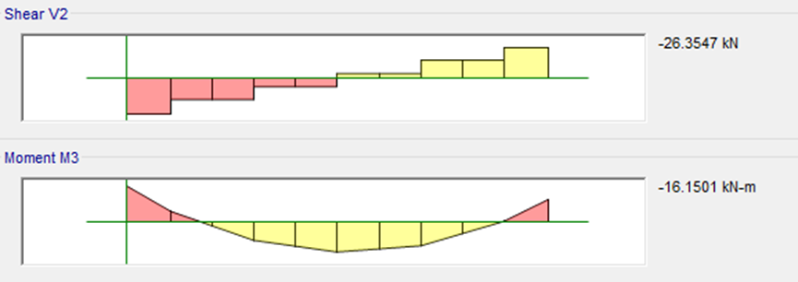
Internal Forces Check
For beam :
By hand calculation
W (live) = 5*4.5*(0.5) = 11.25KN/m
M=WL2/8=12*5^2/8=34.56 KN.m
By etabs :
M = ((16.2 +15.5) /2) +16= 32KN.m
Error=6.25% < 10% error is acceptable.

Slide 34
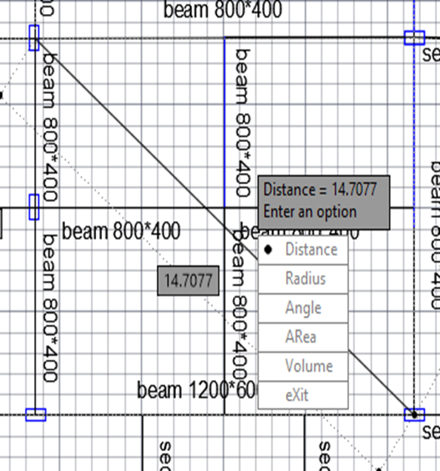
Deflection check
Deflection=30.3-0.25(9+9+11.5+13)
=20mm
Allowable deflection = L/240
L=14.7m
=14.7/240=0.061m=61mm>20.3mm its ok

Slide 35
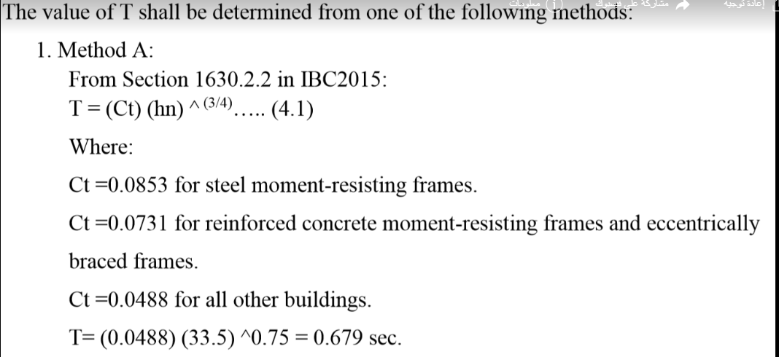
Dynamic Analysis

Slide 36
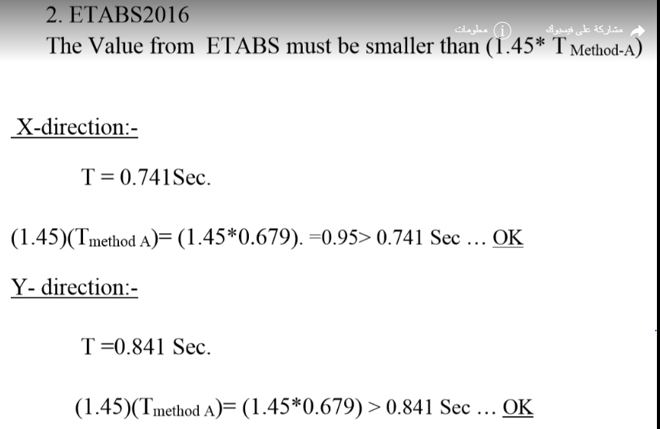

Slide 37
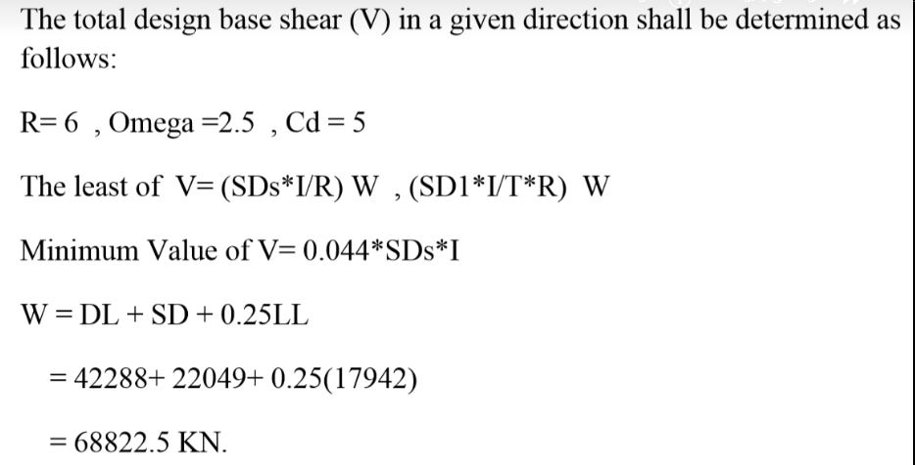

Slide 38
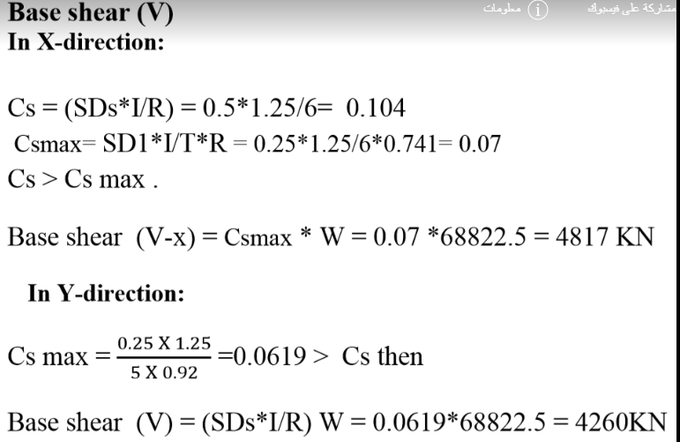

Slide 39
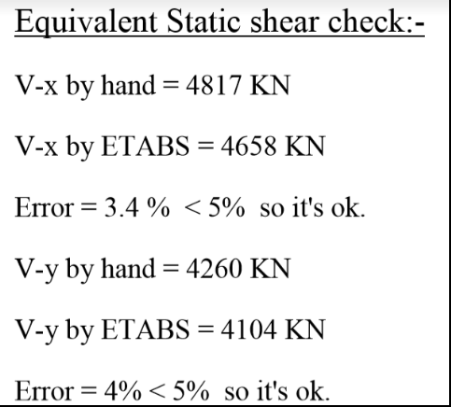
Result

Slide 40
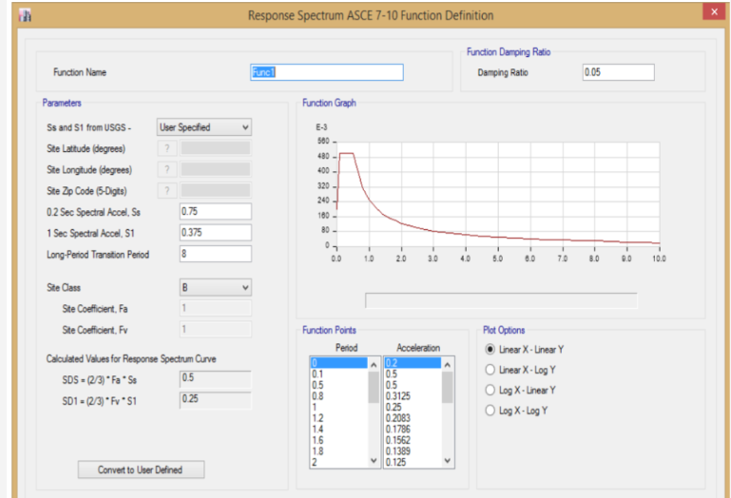
Definition of Response Spectrum function

Slide 41
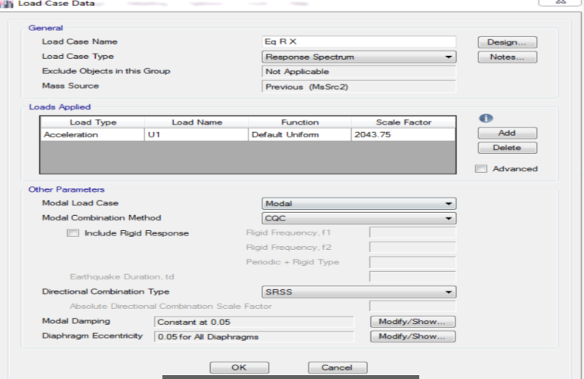

Slide 42
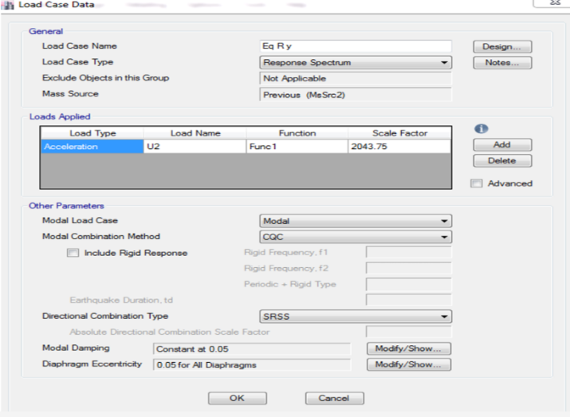

Slide 43
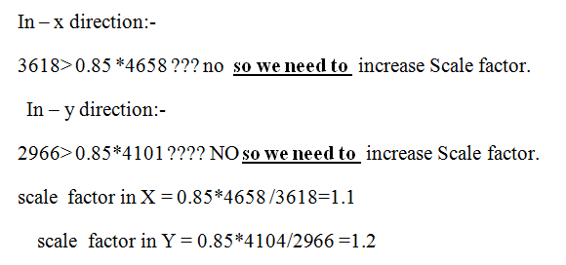

Slide 44
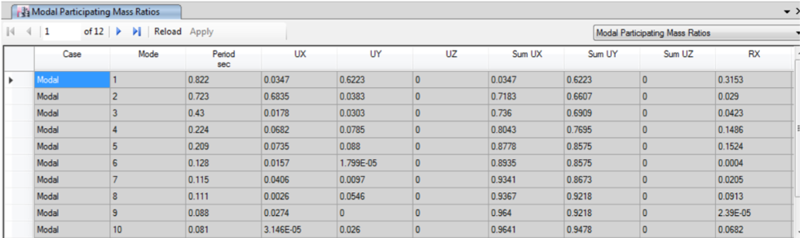
Modal Participation mass ratio:

Slide 45
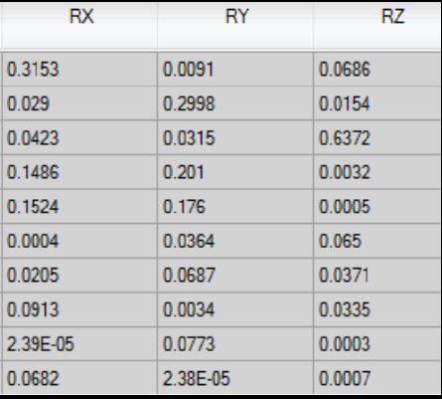
Torsion check:

Slide 46
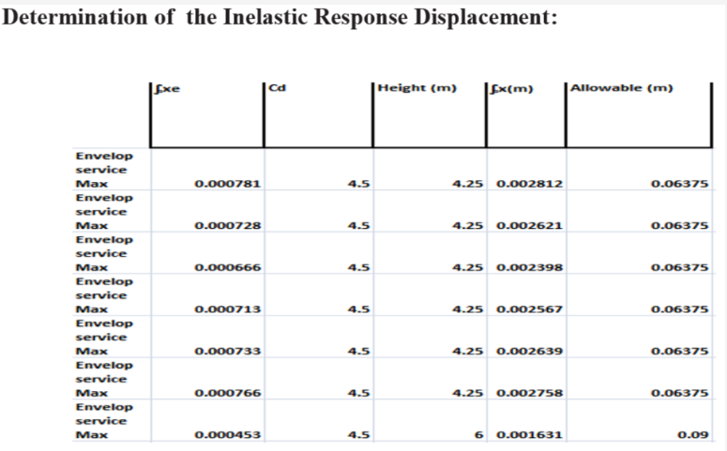
Drift Check:

Slide 47
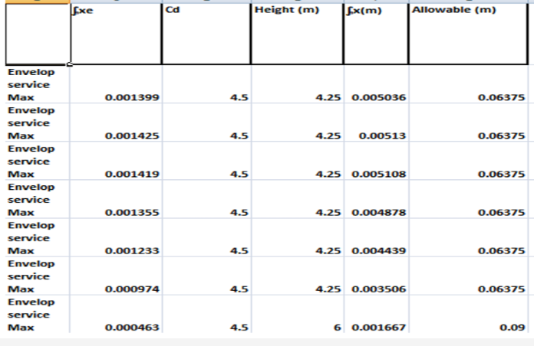

Slide 48
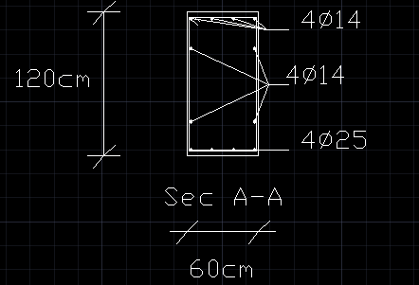
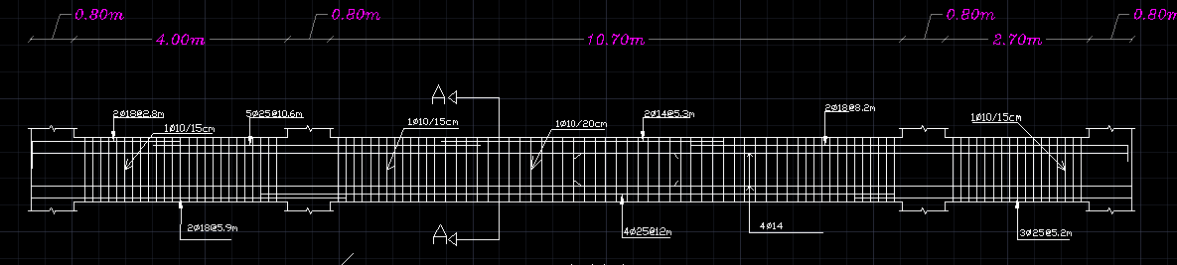
Detailing samples :

Slide 49
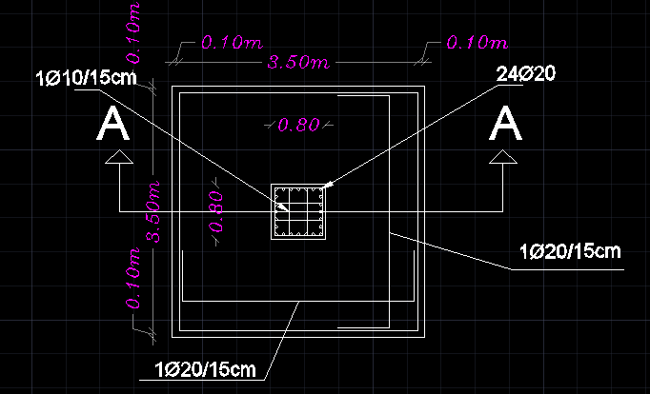
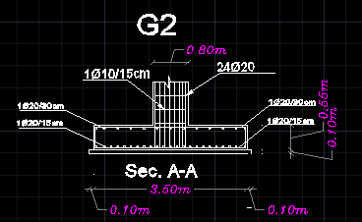

Slide 50
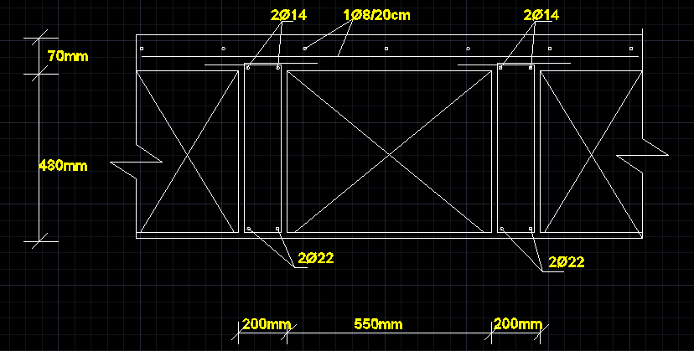
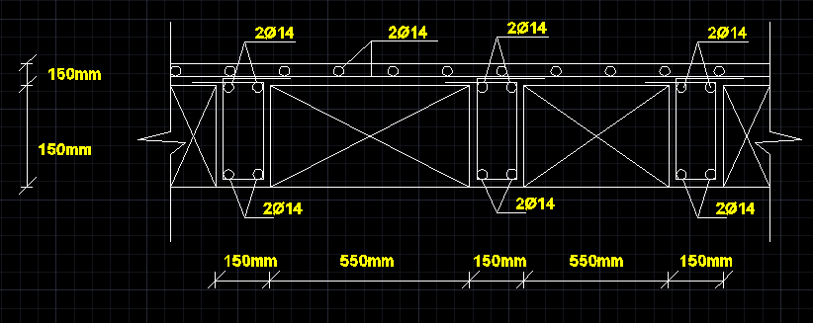

Slide 51
BLOCK 2

Slide 52



Slide 53

Structural system
Basement slab

Slide 54

Structural system
Remaining slabs

Slide 55

For one way solid slab
Max span= 7 m .
Thickness=0.35 m.

Slide 56


Beams Dimensions

Slide 57

Preliminary design
We take the column that gives the largest panel = (6.75*6.3)
Pu=6.75*6.3*25.4*7=7561KN.
Pu=ᶲʎ (0.85fc (Ag-0.01Ag) +0.01Ag*fy)
ᶲ=0.65
ʎ=0.8
Fc=35MPa
fy=420MPa
Ag=577600mm2.
1000*700mm2. Was used

Slide 58

Compatibility check

Slide 59

Equilibrium check

Slide 60
Equilibrium check
By hand calculation for dead load
Total = 63264
Error = 61362-63264/61362*100% = 3.1 % <5% Error acceptable
LL=5KN/m2 & total area=area1 +area2= 680 +3036 = 3716 m2
Reaction = LL*total area
=3716*5=18580KN
Error=18597-18580/18597 *100% = 0.09% <5% Error accepted.

Slide 61

Internal Force Check
For beam :
By hand calculation
W (live)=33.75KN/m
M=WL2/8=33.75*11.4^2/8=548 KN.m
By etabs :
M = 526 KN.m
Error=4.2 %< 10% Error aceptable

Slide 62

Deflection check
Deflection=33.157-0.25(5.3+4.55+5.7+7.2)
=27.5mm
Allowable deflection = L/240
L=13 m
=13/240=0.054m=54mm>27mm, Error is acceptable

Slide 63

Dynamic Analyses

Slide 64


Slide 65

Modal Participating mass ratio

Slide 66


Slide 67

Base shear check

Slide 68


Result

Slide 69
Definition Response spectrum

Slide 70


Slide 71


Slide 72


Slide 73


Slide 74

Torsion Check

Slide 75

Inelastic response displacement in x

Slide 76

Inelastic response displacement in y

Slide 77


Detailing of some structural elements:

Slide 78



Slide 79


Slide 80

Bracing

Slide 81


Slide 82


Slide 83

BLOCK 3

Slide 84



Slide 85

Structural system
Basement slab

Slide 86

Structural system
Ground Slab

Slide 87

Structural system
remaining slabs

Slide 88

Beams Dimensions
Max beam length =9.5 m

Slide 89
For waffle slab:
Max span=9.5 m .
Thickness=0.5 m.

Slide 90


For waffle slab:

Slide 91

Model checks:
Compatibility check

Slide 92


Equilibrium checks:
For Live Load:
By hand: 32605KN
By etabs: 32513KN
Error=32513-32605/32513 *100% = 0.3% <5%➔ Error is.acceptable
For dead loads:Error=68287-71042/68287*100% Error= 4<5% ➔ Error is acceptable.
For beam:
Moment by hand =7.26 Kn.
Moment by Etabs = 7 Kn.
Error= 3.7<5% ➔ Error is acceptable

Slide 93

Deflection check:
From long term combination load(2D+2SD+1.3L)
Deflection= 20.68 mm
=27.5mm
Allowable deflection = 20/240
L=20 m
=20/240=0.083m=83mm>27mm
It’s ok!

Slide 94

Dynamic Analysis

Slide 95


Slide 96


Slide 97


Slide 98


Slide 99
Definition of Response Spectrum function

Slide 100


Slide 101


Slide 102


Slide 103

Modal Participation mass ratio:

Slide 104

Torsion check:

Slide 105


Slide 106


Slide 107


Detailing samples :

Slide 108



Slide 109


Slide 110

Design of some structural elements:
Column element:

Slide 111



Slide 112


Slide 113


Slide 114
Steel bridge
The structure contains three identical in design bridges
The most critical bridge was designed
It has a total length of 19.2 m
The bridge consists of a 1 m height truss that is braced laterally every 3.2 m.
Braces where added in other directions to reduce warping effect.
Connection where designed on Ram connections and checked manually
Two sample critical connections where designed.
Gravity loads are transferred by purlins to the structure.

Slide 115

Steel Bridge
Note that trusses are covered by plates which are added as super-imposed load in the analysis.
bridge functions as a connection between the main and secondary buildings .

Slide 116
Methodology of analysis.
SAP model.
Defining material: (A36) steel.
Defining sections: (W-sections) LRFD, Square tube sections.
Section unification by iteration and check analysis vs design sections.
Check compatibility.
Check deflection.
Check period.

Slide 117

SAP Bridge Model.

Slide 118

Steel sections.

Slide 119

Section Dimensions.
W6*8.5:
Depth: 148 mm
Flange Width: 100 mm
Flange Thickness: 4.9 mm
Web Thickness: 4.3 mm

Slide 120

Section Dimensions.
HSS 2-1/2 x 1-1/2 x .125:
Outside depth: 0.0635 m.
Outside width: 0.0381 m.

Slide 121

Compatibility
Shows that the whole structure works as a unit.

Slide 122

Bridge Period
The period of the bridge = 0.12884 seconds which is reasonable.

Slide 123
Connections
Only two sample connections where designed
The first connection was designed on RAM connections.
The second connection was designed manually.
The methodology that will be followed in the steel bridge design is to choose the most critical connections design them manually and compare the calculations to the RAM connections check values.

Slide 124



Connection 1 (truss members connection)

Slide 125


**load vs capacity ratio = 0.21 which means the connections can withstand the subjected load. And the ratio is highlighted in green which means that the connection is designed according to the standard dimension from the AISC 2016 LRFD code.

Slide 126


RAM CHECKS cont.

Slide 127


Connection 2 (purlins and beams)
HSS sections were used with a line of weld = 10 cm

Slide 128


Checks
SHEAR:
Design shear = $∅ 0.6 FE70 AW$
=0.75$×0.6×70×7×0.707×0.006×0.1=9.35>2.1⇒ OK$
Check base metal yielding:
0.6$×0.9×248×002×0.1=26.8kn>2.1⇒ok$

Slide 129

**ANY QUESTIONS ?!
يا رب لاء !!

Slide 130
Thank You Very Much

