Slide 1

An-Najah National University
Faculty of Engineering & Information Technology.
Building Engineering Department.
Graduation project (2)
Integrated redesign of modern English school in Nablus city.
Prepared By:
1. Anwar Juma.
2. Sali Yahya.
3. Sineen Yahya.
Supervisor: Dr.Fady fatayer

Slide 2
01
TABLE OF CONTENTS
02
03
04
05
Introduction
Architectural Aspects
Environmental Aspects
Structural Aspects
Electro-Mechanical Aspects
06
Quantity Surveying and Cost Estimation
2

Slide 3
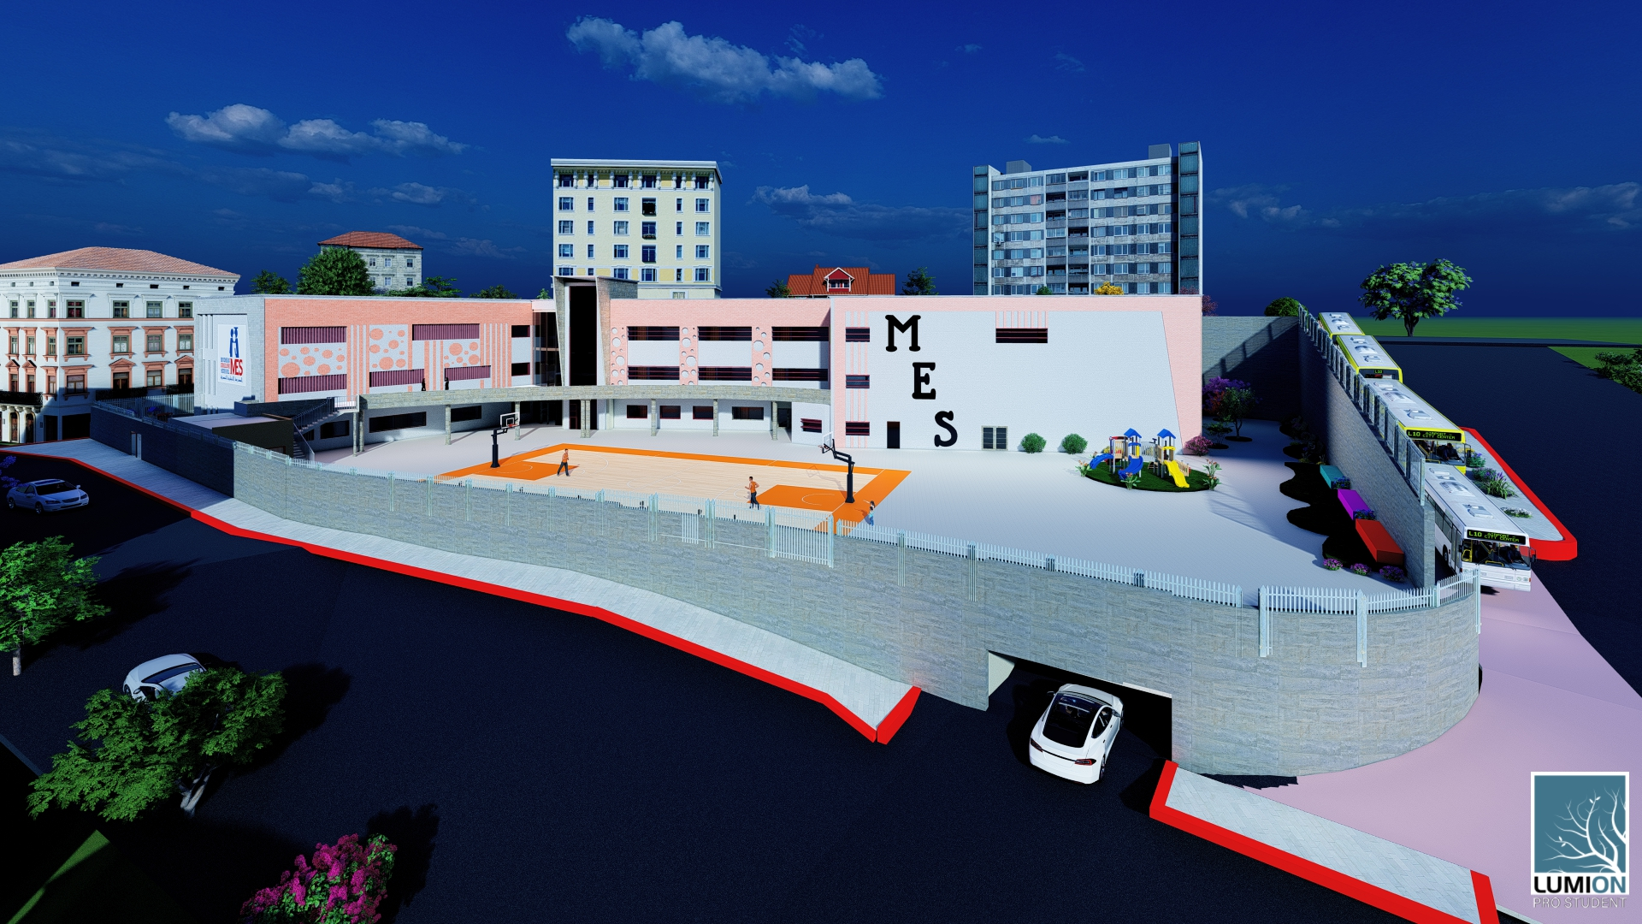
01
Introduction

Slide 4
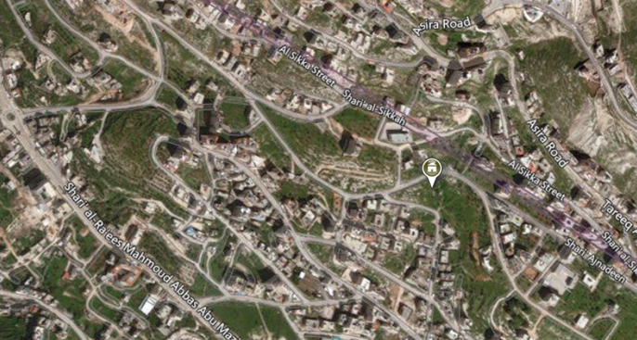
  Project Description
Location:
The site is located in Al-Ma’ajeen in Nablus, Palestine
Area = 4800m²
Three Streets surrounding school

Slide 5
02
Architectural Aspects
Site analysis
Adding a Parking floor
plans before and after modification
3D Picture

Slide 6

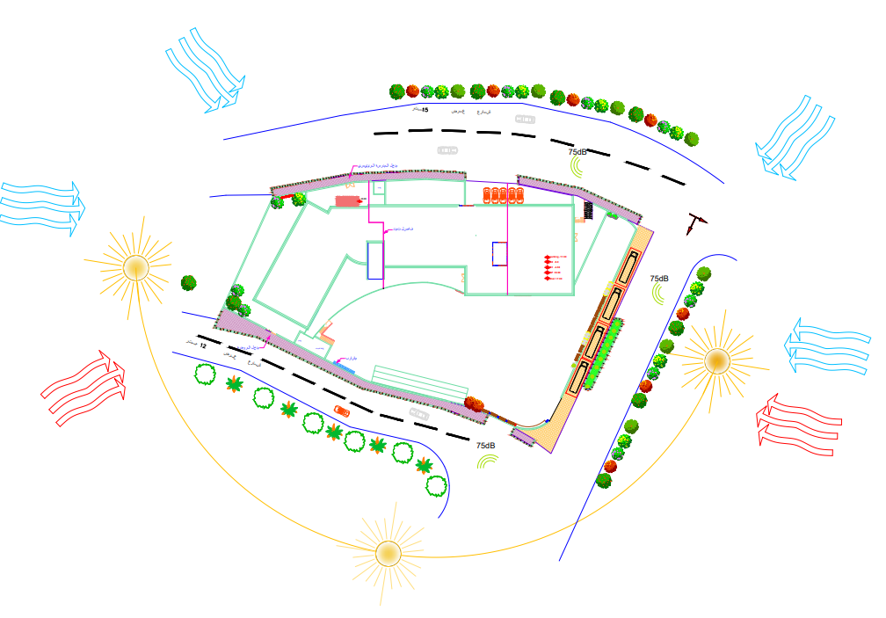
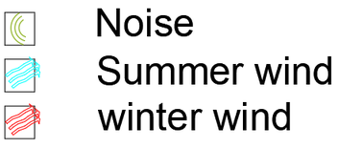
Site Analysis
6

Slide 7
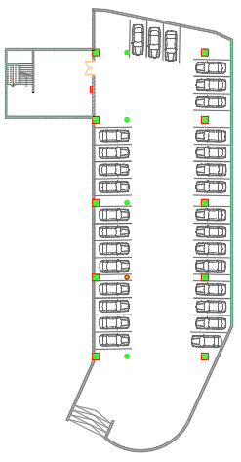
Adding a Parking floor

Slide 8
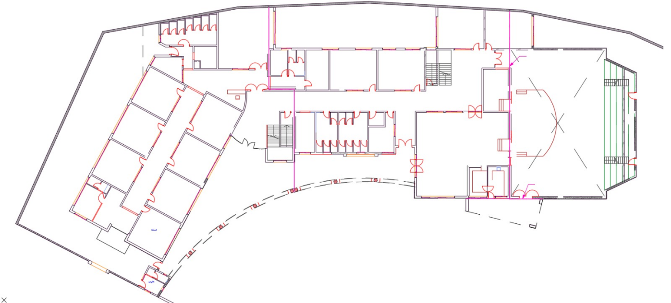
Basement two floor before modification
Plan before modification
8

Slide 9
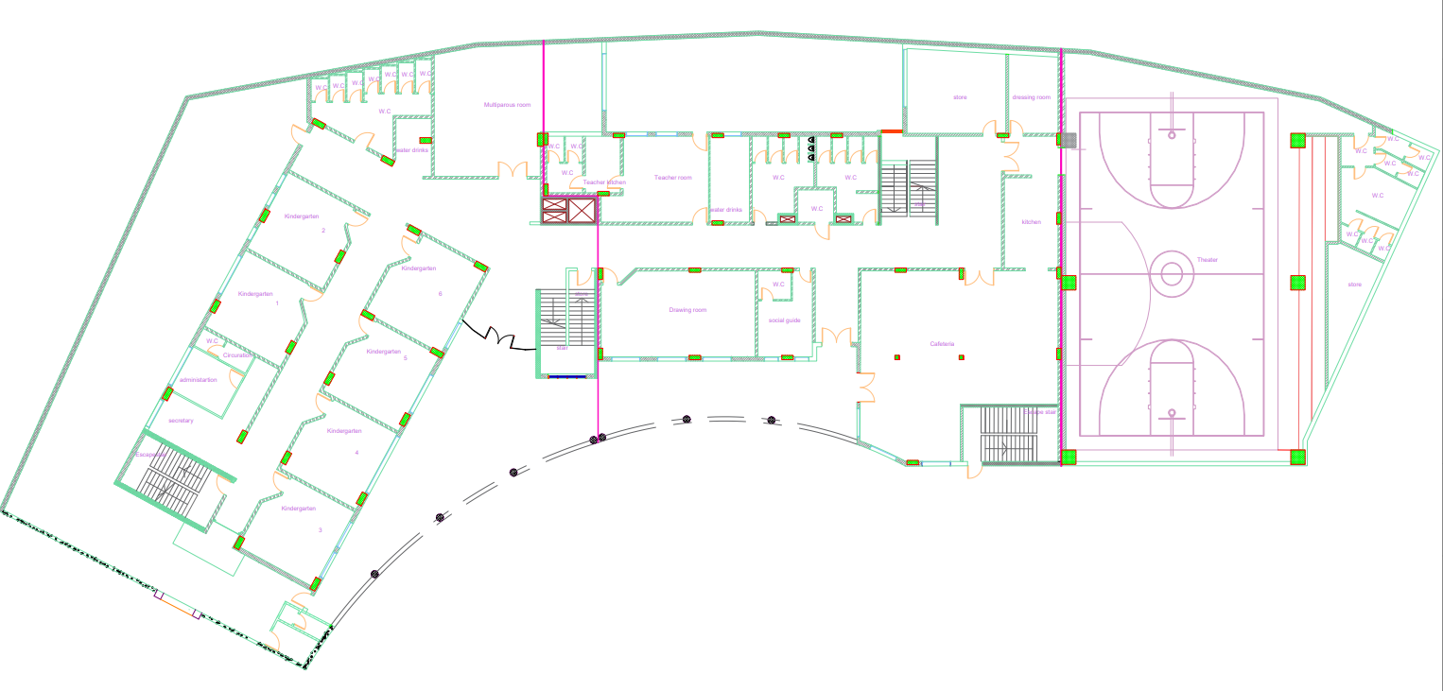
Basement two floor After modification
Plan After modification
9

Slide 10
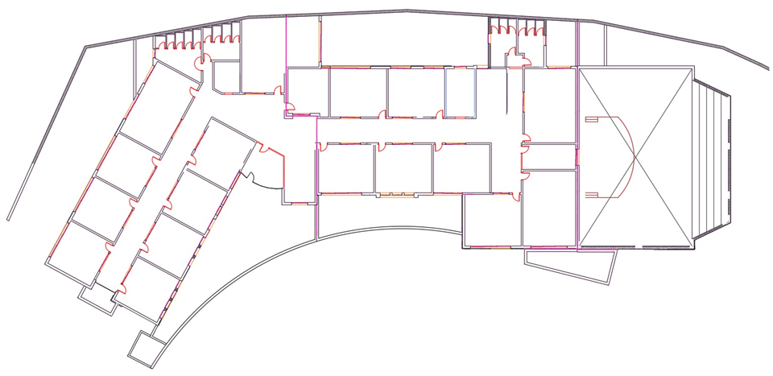
Basement one floor before modification
Plan before modification
10

Slide 11
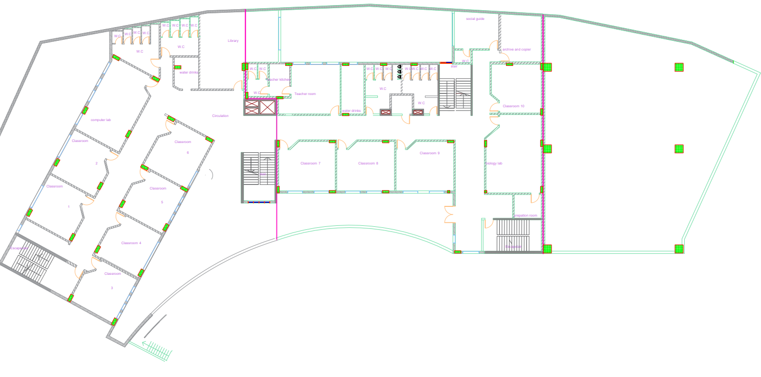
Basement one floor After modification
Plan After modification
11

Slide 12
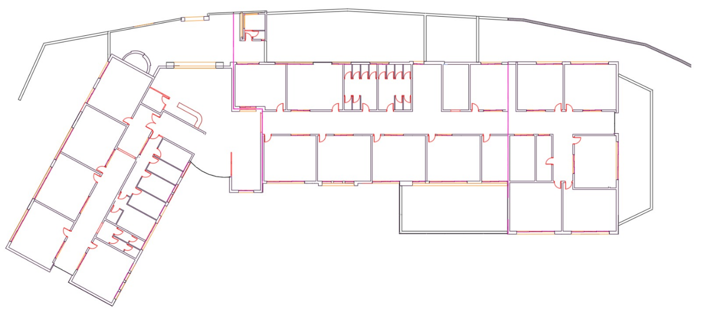
Ground floor before modification
Plan before modification
12

Slide 13
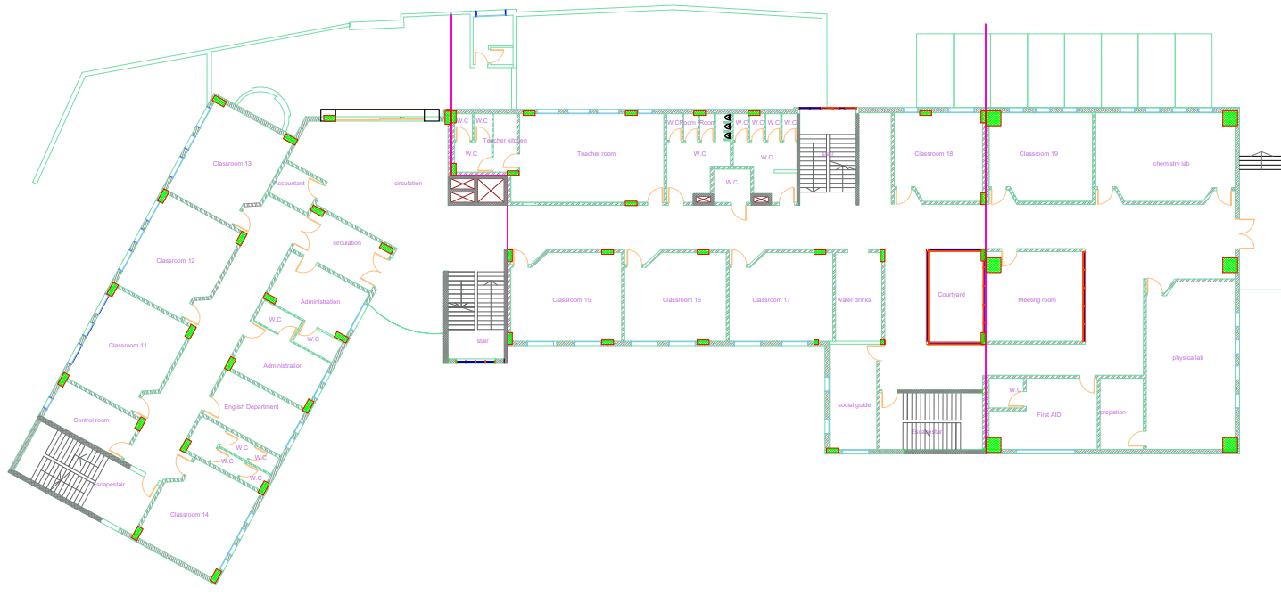
Ground floor After modification
Plan After modification
13

Slide 14
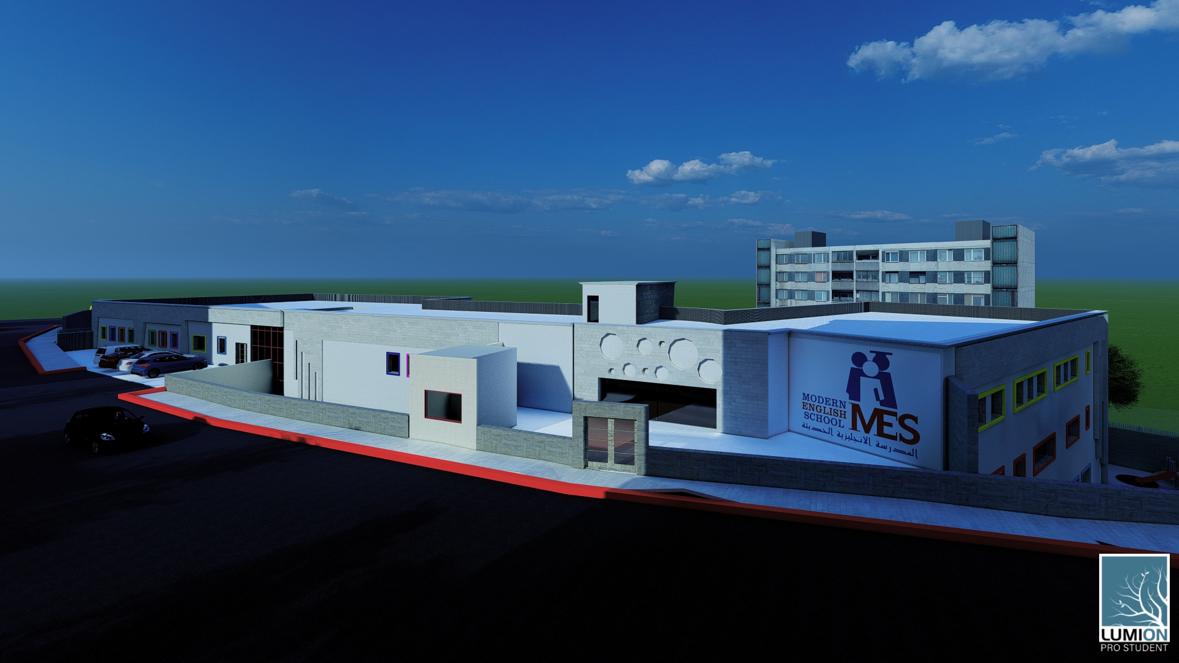

Slide 15
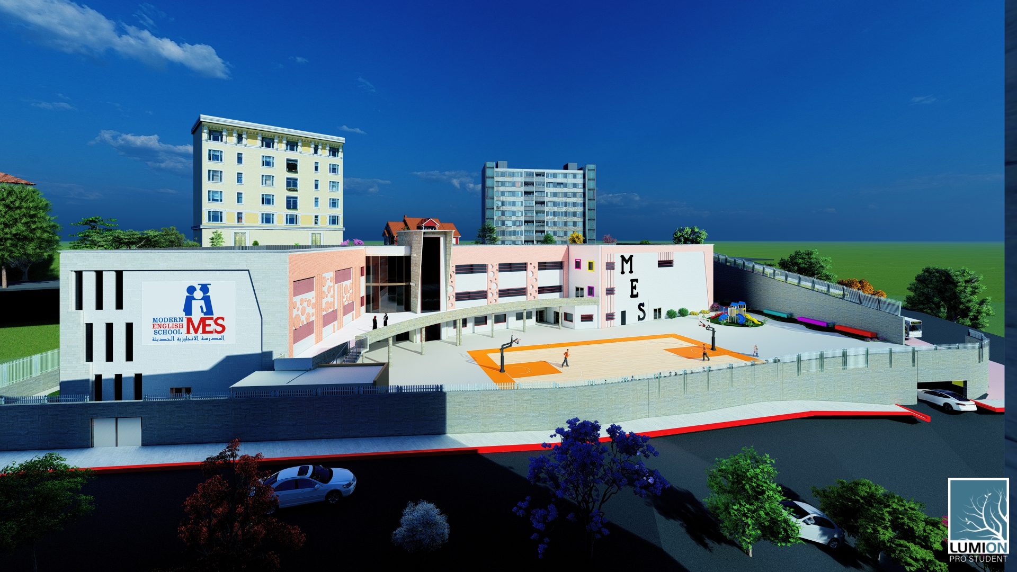

Slide 16
03
Enviromental Aspects
Design Builder simulation
Daylight Factor
Shading Analysis

Slide 17
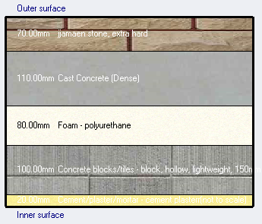
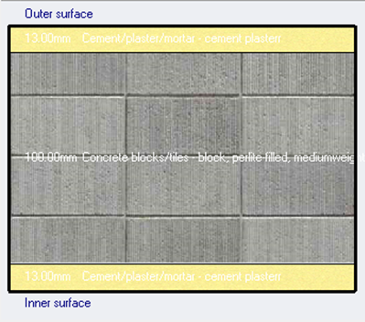
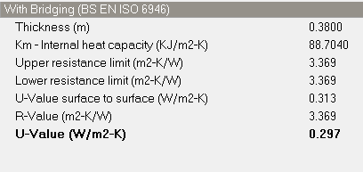
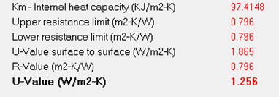
Design Builder Simulation Analysis
External wall
Internal wall
17

Slide 18
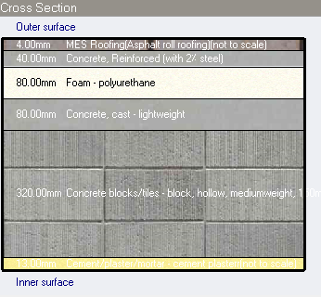
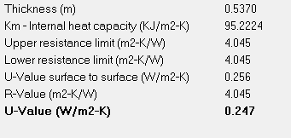
Design Builder Simulation Analysis
Roof slab
18

Slide 19
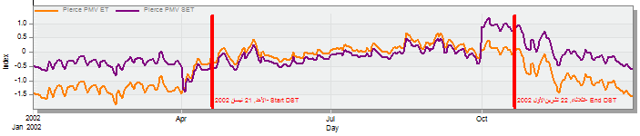
Design-Builder Simulation Analysis(Thermal comfort)
PMV (-0.5 to +0.5)
Total cooling load capacity= 271.93 kW
Total heating load capacity= 259.94 kw
19

Slide 20
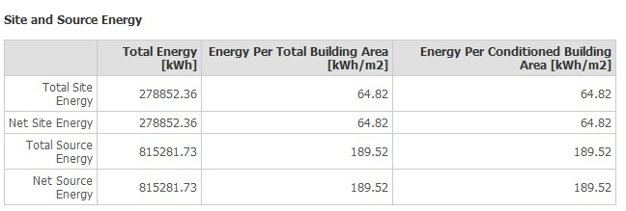
Design-Builder Simulation Result
20

Slide 21
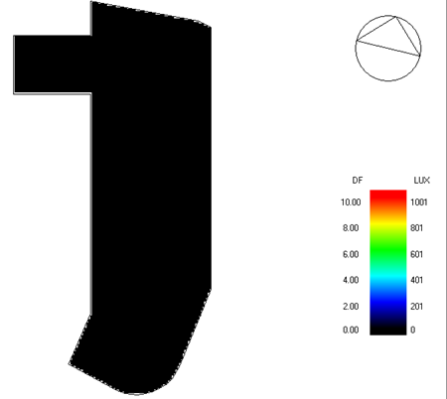


Daylight analysis for Basement 2
Before Modification
After Modification

Slide 22
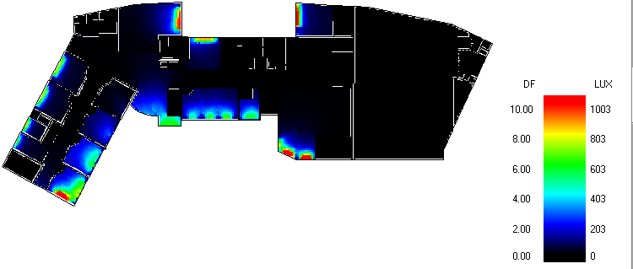
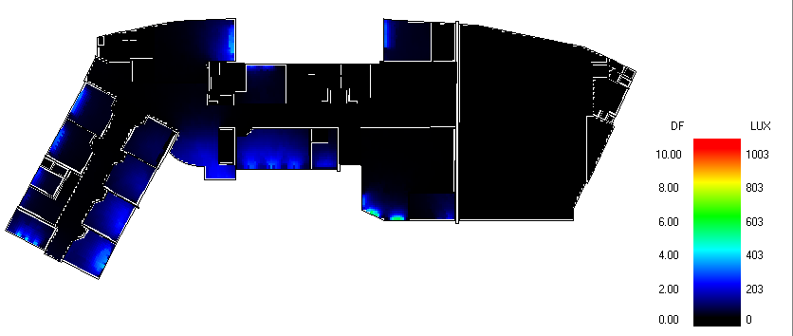
Daylight analysis for Basement 2
Before Modification
After Modification

Slide 23
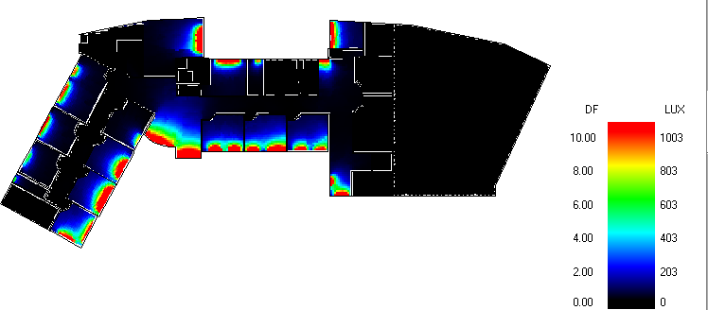
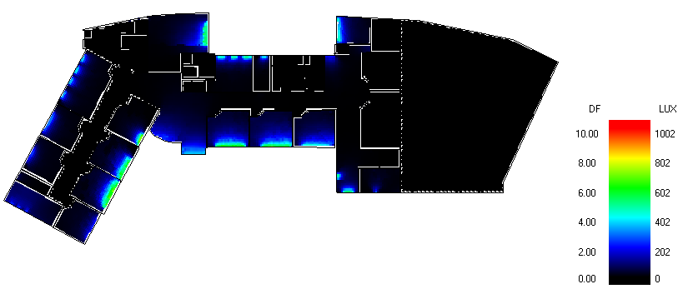
Daylight analysis for Ground floor
Before Modification
After Modification

Slide 24
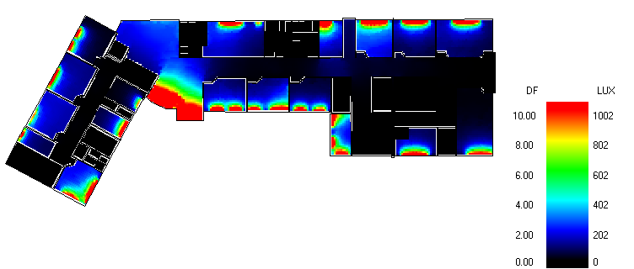
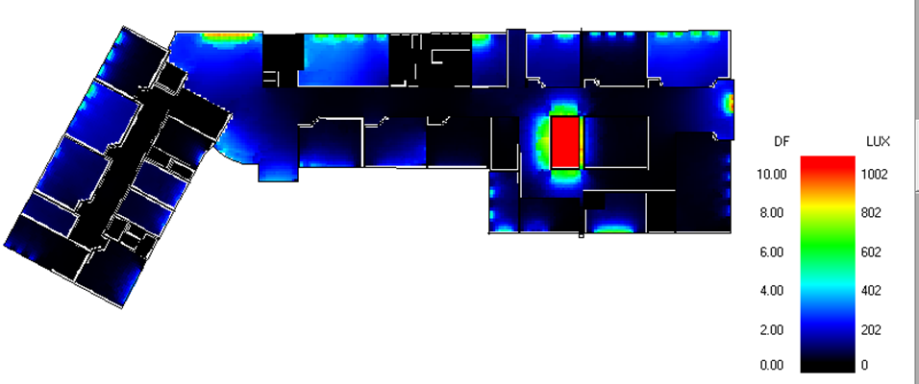
Daylight analysis for Ground floor
Before Modification
After Modification

Slide 25
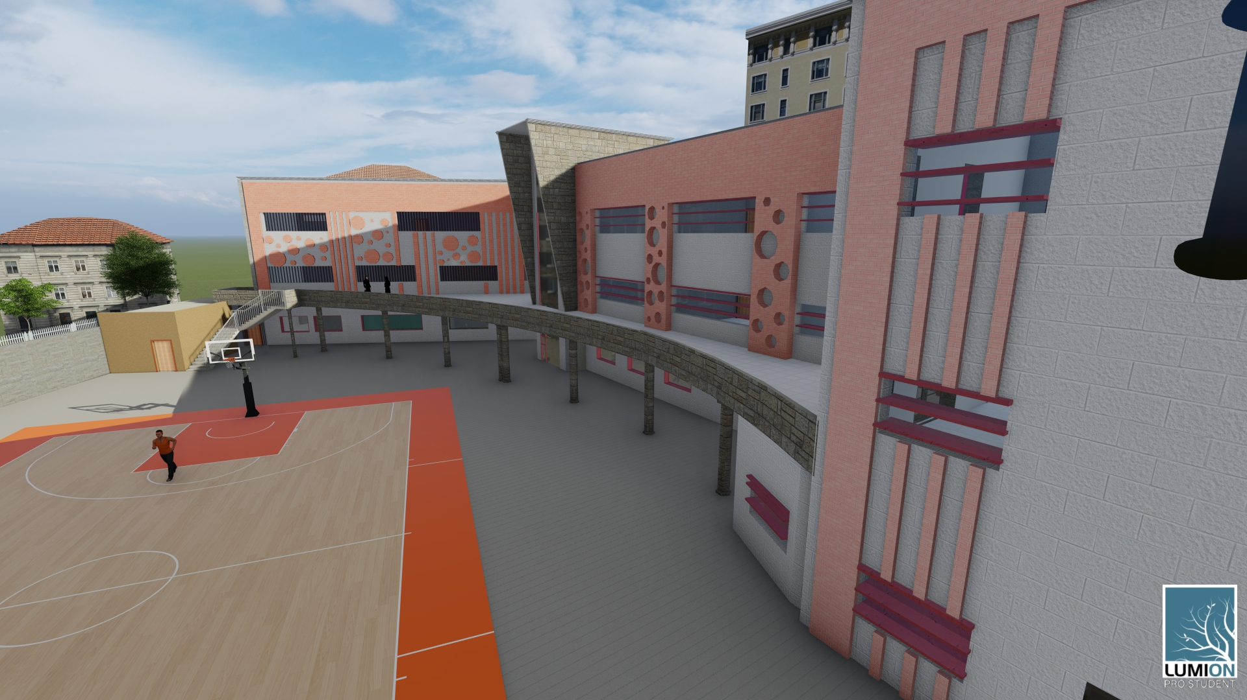
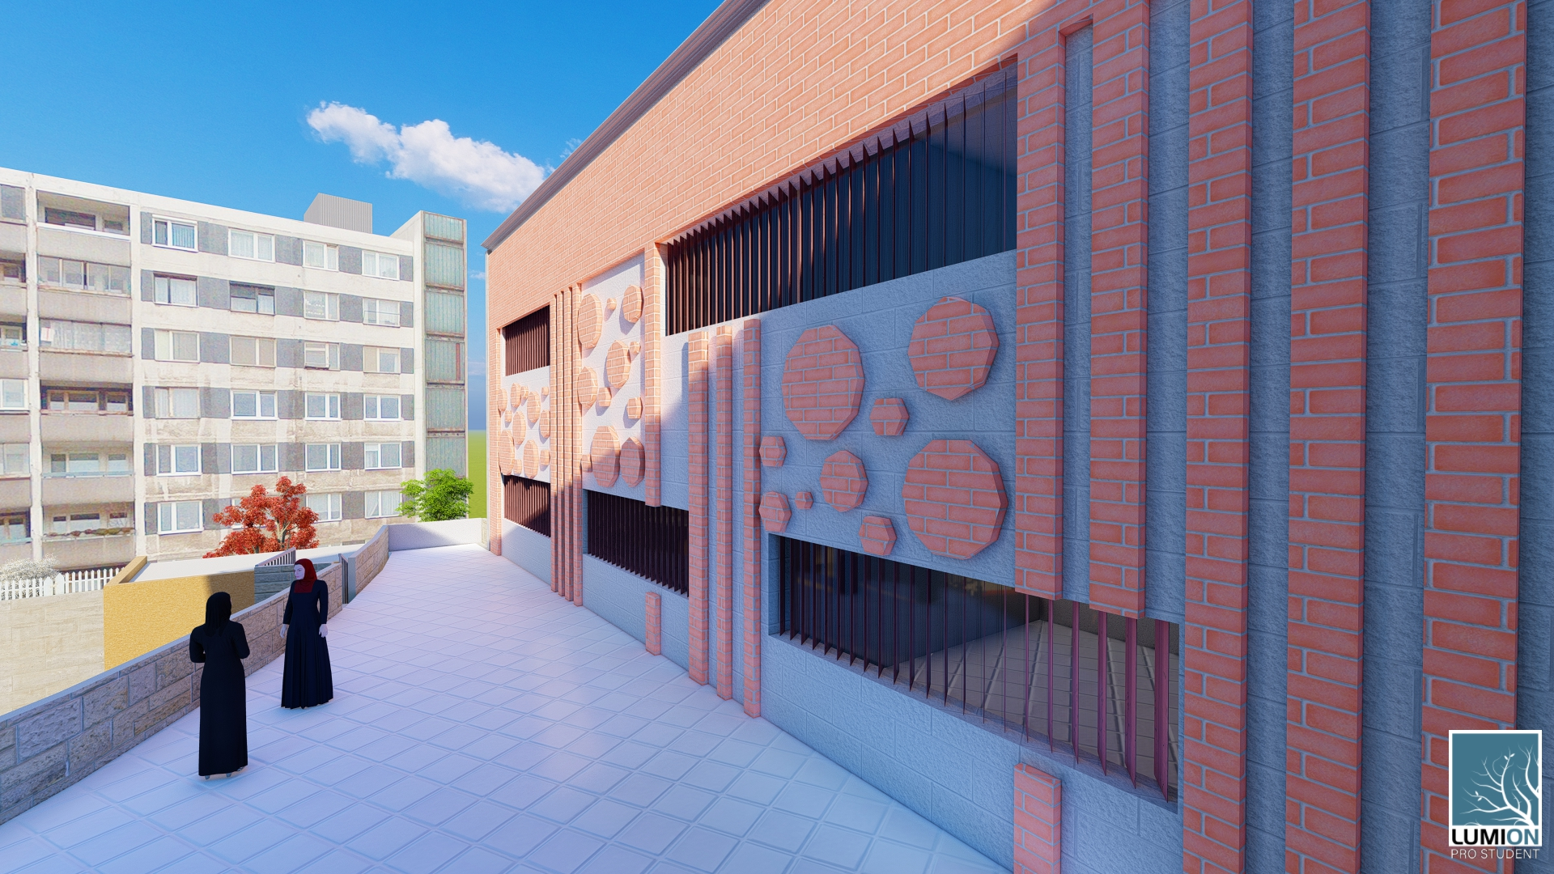
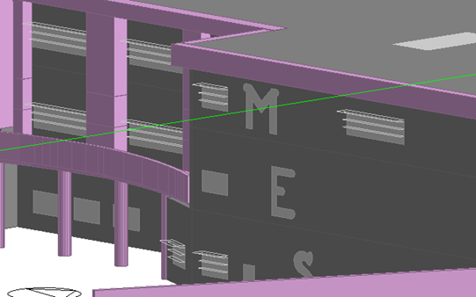
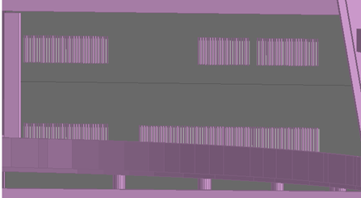
Shading
25

Slide 26
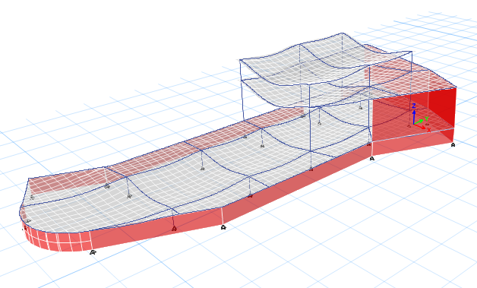
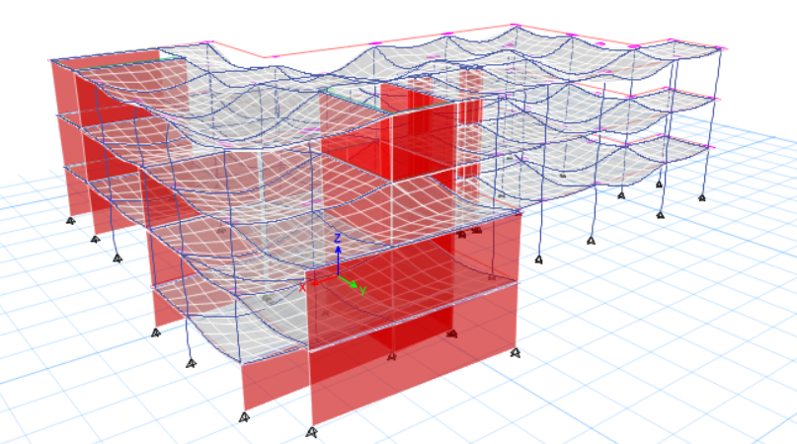
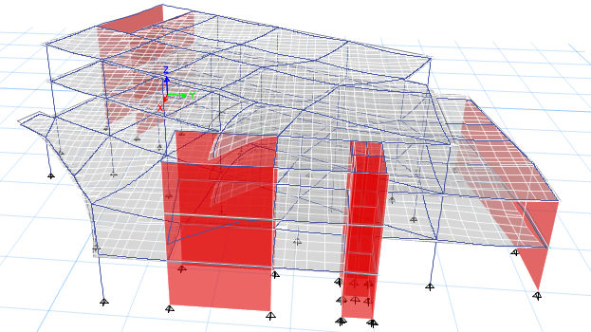
03
Structural Aspects
Structural System
Structural Checks
Seismic Design
Seismic Checks
Design & Details

Slide 27
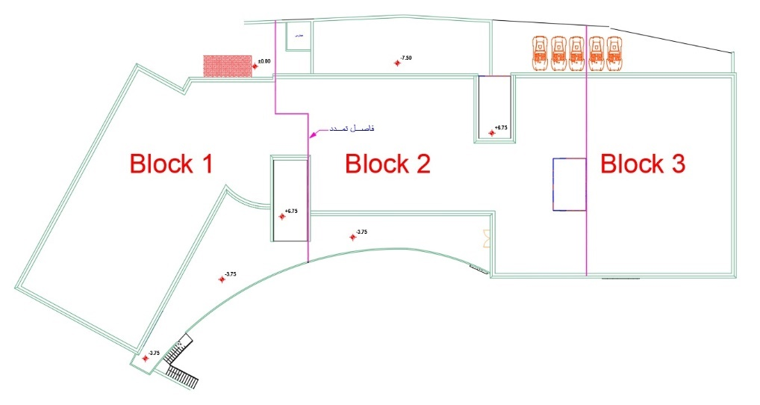
Structural Blocks

Slide 28
Structural System
The following codes were used in the structural design:
The American concrete institute code ACI 318 for reinforced concrete design
Uniform Building Code -UBC-97 for seismic design and load combinations.
Load effect :
Dead load (From ETABS)
SID= 4 KN/m²
Live Loads = 5 KN/m²
28

Slide 29
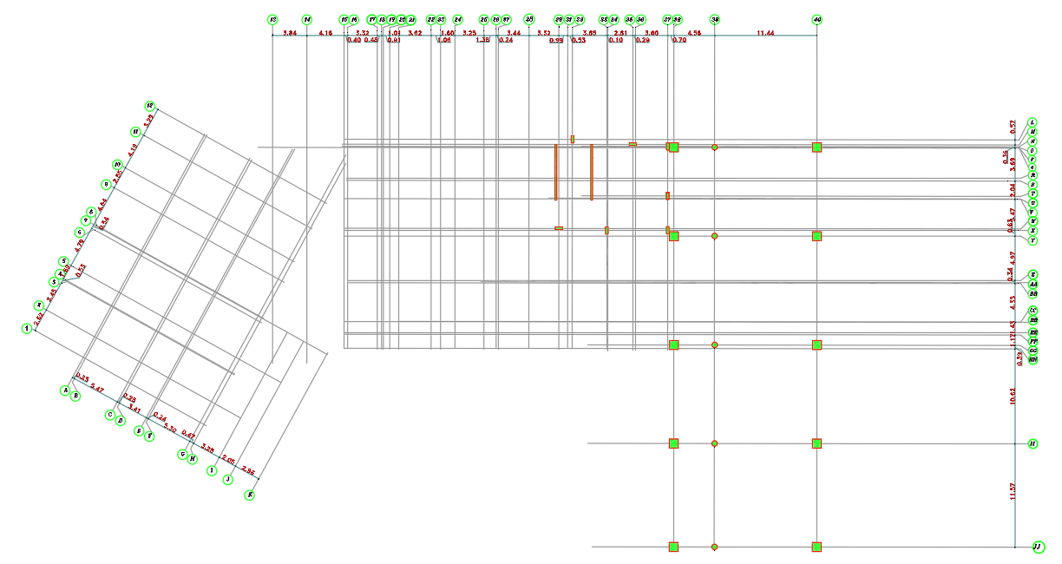
Structural System
Basement three floor
Column Distribution

Slide 30
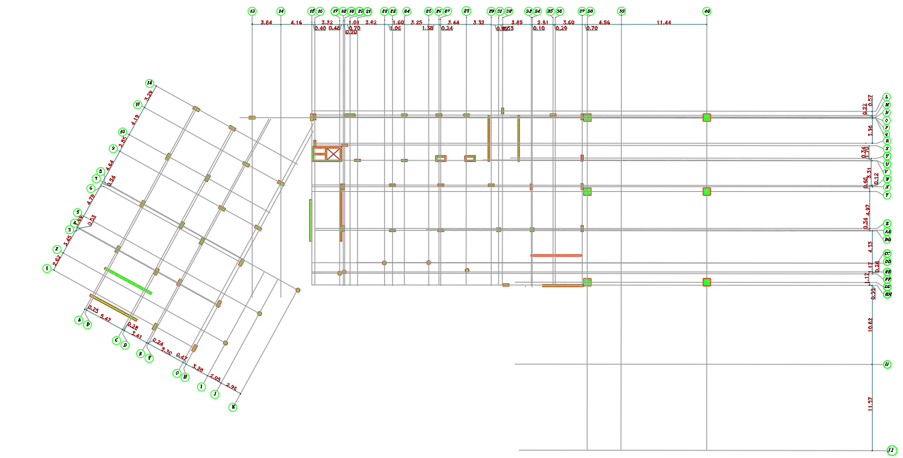
Structural System
Basement two floor Column Distribution

Slide 31
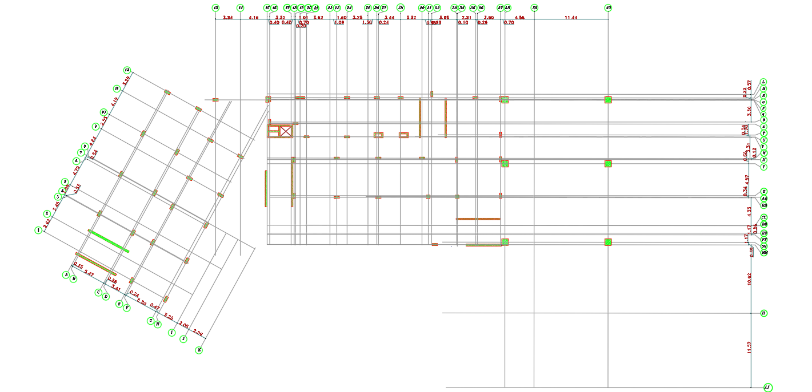
Structural System
Basement one floor
Column Distribution

Slide 32
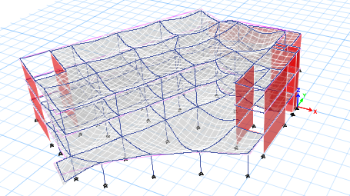
Structural System
Block 1
Compatibility Check

Slide 33
Structural System
Block 1
Equilibrium Check
Load | Manual calculation | ETABs | Error (%)
Dead | 18194.088 | 18425.338 | 1.2%
Live | 9850 | 9851.2581 | 0.005%
SID | 20222.51 | 20222.5112 | 0.0%

Slide 34
Structural System
Block 1
Internal forces checks
Stress-Strain Check – Columns
Column type | Calculated axial load | Axial load from ETABS | Difference (%)
Edge | 2589.39 | 2566.790 | 0.8%
Corner | 354.87 | 356.98 | 0.5%
Middle | 597.51 | 610.27 | 2.0%
Stress-Strain Check – beams
beams | Calculated moment | ETABs moment | Difference (%)
Main beam | 380.34 | 377.115 | 0.85%
Secondary beam | 270.81 | 267.7 | 1.16%

Slide 35
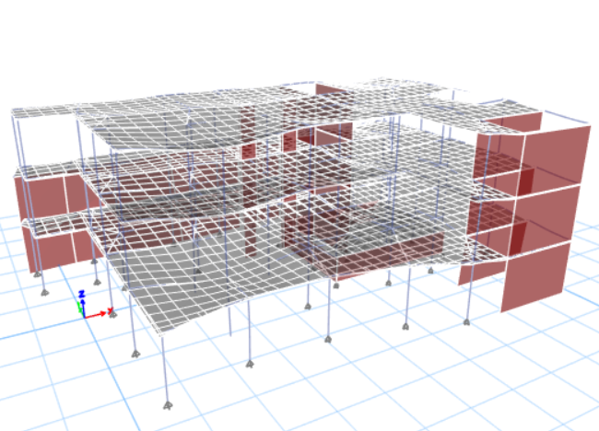
Structural System
Block 2
Compatibility Check

Slide 36
Structural System
Block 2
Equilibrium Check
Load | Manual calculation | ETABs | Error (%)
Dead | 24145.6 | 23775.59 | 1.5%
Live | 10326.85 | 10301.54 | 0.24%
SID | 22763 | 22763.71 | 0.0%

Slide 37
Structural System
Block 2
Internal forces checks
Stress-Strain Check – Columns
Column type | Calculated axial load | Axial load from ETABS | Difference (%)
Edge | 417.03 | 451.65 | 7.6%
Corner | 129.35 | 126.69 | 0.5%
Middle | 1645.42 | 1719.37 | 4.3%
Stress-Strain Check – beams
beams | Calculated moment | ETABs moment | Difference (%)
Main beam | 374.88 | 391.355 | 4.2%
Secondary beam | 346.725 | 337.68 | 2.6%

Slide 38
Structural System
Block 3
Compatibility Check

Slide 39
Structural System
Block 3
Equilibrium Check
Load | Manual calculation | ETABs | Error (%)
Dead | 37510.83 | 36737.5138 | 0.4%
Live | 11350 | 11360.8905 | 0.09%
SID | 14480 | 15036.38 | 1.05%

Slide 40
Structural System
Block 3
Internal forces checks
Stress-Strain Check – Columns
Column type | Calculated axial load | Axial load from ETABS | Difference (%)
Edge | 1527.3 | 1605.32 | 4.8%
Corner | 1095.89 | 1185.13 | 7.5%
Middle | 4924.85 | 5329.32 | 7.5%

Slide 41
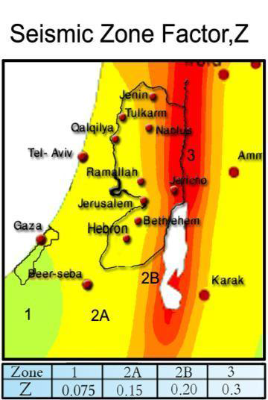
Seismic Design
City of structure: Nablus
zone 2B which has a seismic zone factor of 0.20.
Soil profile type of very dense soil and soft rock (Sc).
Seismic importance factor of 1.5.
Building frame concrete system R 5.5.
Ca of 0.24.
Cv of 0.32.

Slide 42
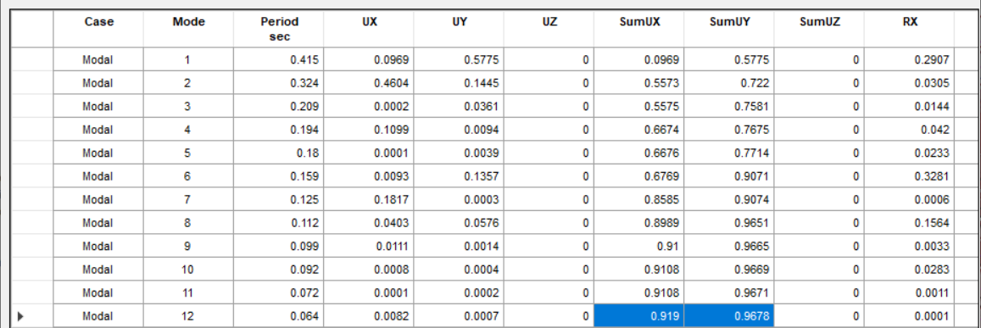
Structural System
Seismic checks
Block 1
1. Check modal participation mass ratio

Slide 43
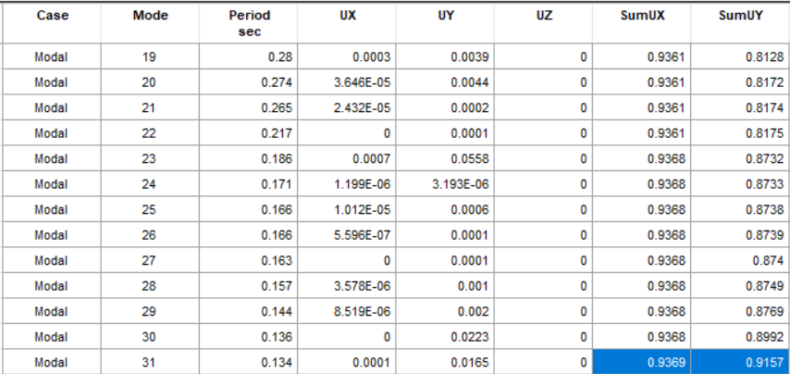
Structural System
Seismic checks
Block 2
1. Check modal participation mass ratio

Slide 44
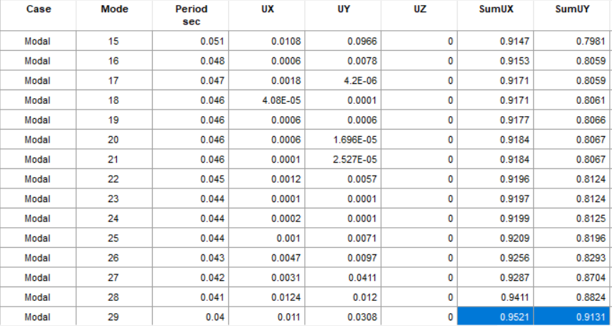
Structural System
Seismic checks
Block 3
1. Check modal participation mass ratio

Slide 45
Structural System
Seismic checks
2.Time period and base shear check
Block one
 | T ETABs | T calculated | V calculated | V ETABS | ERROR
X | 0.249 | 0.48 | 6515.014 | 6371.73 | 2.1%
Y | 0.304 | 0.48 | 6515.014 | 6515.01 | 2.3%
Block two
 | T ETABs | T calculated | V calculated | V ETABS | ERROR
X | 0.377 | 0.46 | 8121.142 | 8086.86 | 0.42%
Y | 0.250 | 0.46 | 8121.142 | 8121.126 | 0.0%
Block three
 | T ETABs | T calculated | V calculated | V ETABS | ERROR
X | 0.377 | 0.54 | 9233.135 | 9199.0931 | 0.36%
Y | 0.250 | 0.54 | 9233.135 | 9233.14 | 0.0%

Slide 46
Structural System
Seismic checks
3. Drift check
Height | Dis-X | Dis-Y | Drift-X | Drift-Y | Delta-X | Delta-Y | Delta Limitation
(mm) | (mm) | (mm) | (∆S) | (∆S) | (∆m) | (∆m) | (∆story)
0 | 0 | 0 | 0 | 0 | 0 | 0 | 0
4500 | 4.1 | 14.2 | 4.1 | 14.2 | 15.785 | 54.67 | 112.5
4500 | 21.3 | 34.1 | 17.2 | 19.9 | 66.22 | 76.615 | 112.5
4500 | 43 | 56 | 21.7 | 21.9 | 83.54 | 84.315 | 112.5
Block 1
Height | Dis-X | Dis-Y | Drift-X | Drift-Y | Delta-X | Delta-Y | Delta Limitation
(mm) | (mm) | (mm) | (∆S) | (∆S) | (∆m) | (∆m) | (∆story)
0 | 0 | 0 | 0 | 0 | 0 | 0 | 0
4500 | 26 | 10 | 26 | 10 | 100.1 | 38.5 | 112.5
4000 | 48 | 38 | 22 | 28 | 84.7 | 107.8 | 112.5
4000 | 64 | 52 | 16 | 14 | 61.6 | 53.9 | 112.5
Block 2
Height | Dis-X | Dis-Y | Drift-X | Drift-Y | Delta-X | Delta-Y | Delta Limitation
(mm) | (mm) | (mm) | (∆S) | (∆S) | (∆m) | (∆m) | (∆story)
Block 3
0 | 0 | 0 | 0 | 0 | 0 | 0 | 0
9000 | 31.1 | 47.2 | 31.1 | 47.2 | 119.73 | 181.72 | 225
4000 | 51.6 | 57.7 | 20.5 | 10.5 | 78.925 | 40.425 | 112.5

Slide 47
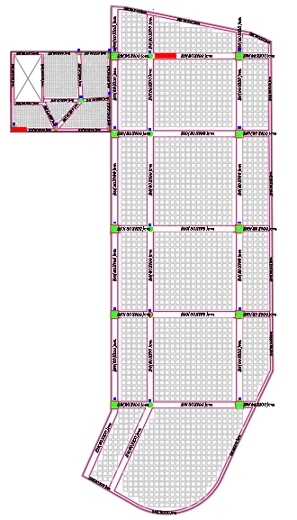
Design and Details
Slab design

Slide 48
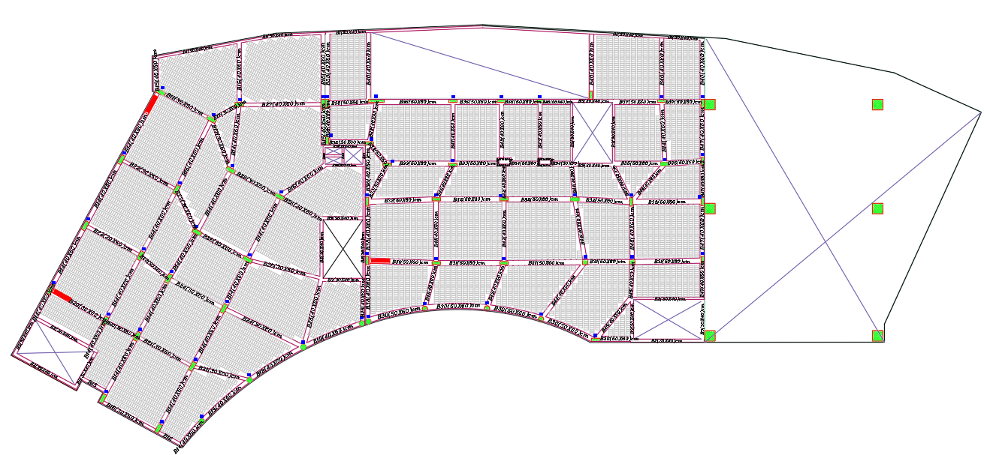
Design and Details
Slab design

Slide 49
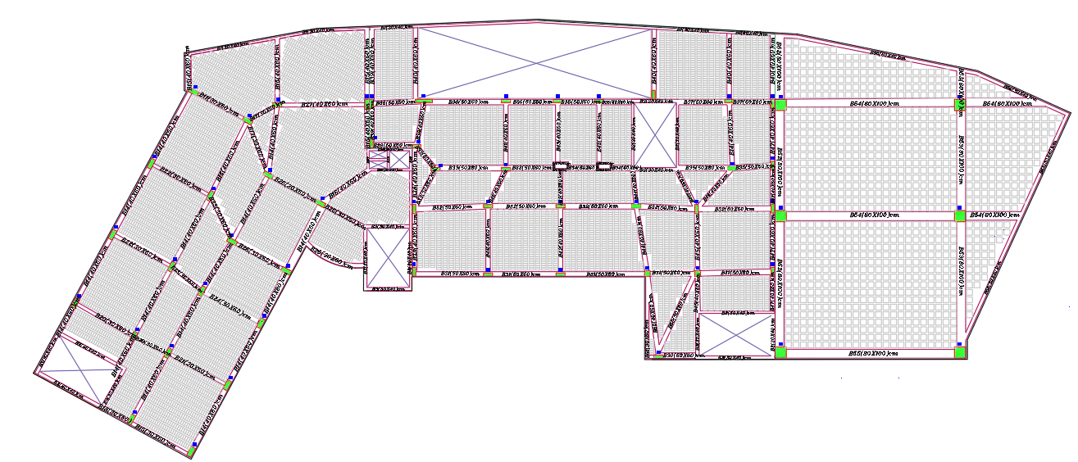
Design and Details
Slab design

Slide 50
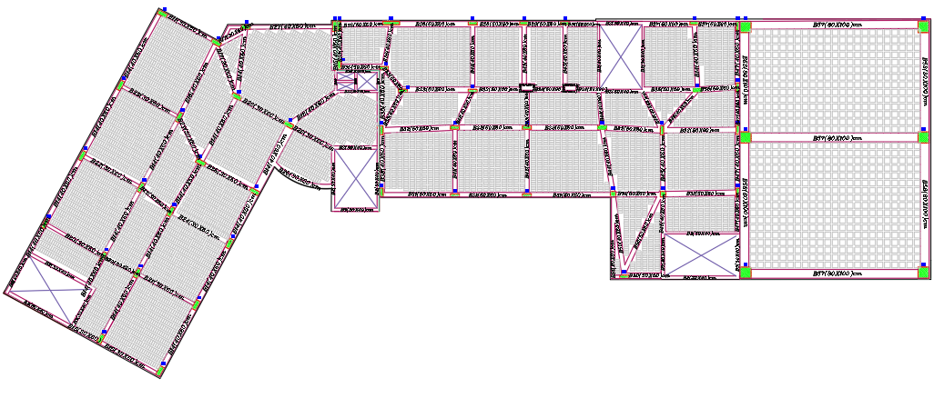
Design and Details
Slab design

Slide 51
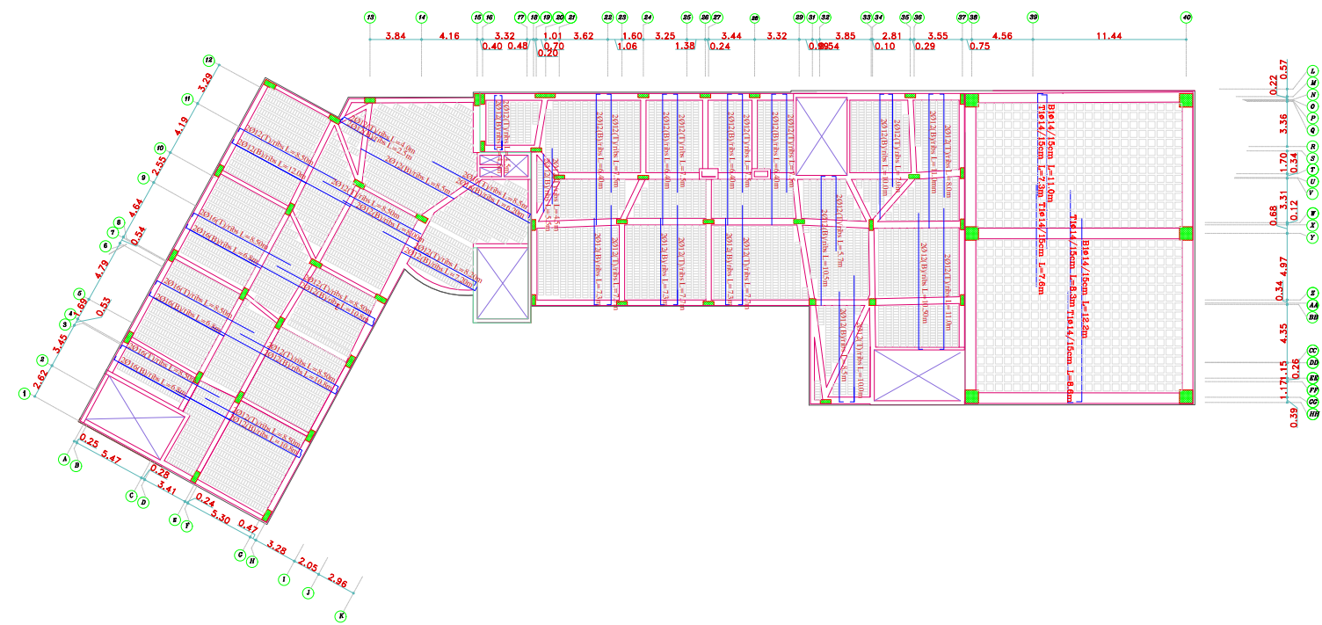
Design and Details
Ground floor Slab

Slide 52

Design and Details
Ground floor Slab

Slide 53




Design and Details
Column design and Detailing

Slide 54




Design and Details
Column design and Detailing

Slide 55



Design and Details
Footing design and Detailing

Slide 56

Design and Details
Footing design and Detailing

Slide 57



Design and Details
Beam design and Detailing

Slide 58





04
Electro-Mechanical Aspects
HAVC System
Water Supply and Drainage
Power Design and photovoltaic system design
Artificial Lighting
Acoustical Design

Slide 59



HAVC System
VRF System has been considered
Four outdoor units with a capacity of 84 kW for each unit.
Indoor units –wall mounted with airflow = 357 CFM, diffuser with airflow = 468 m3/h , 140 CFM ,270 m3/h.
Split unit
Outdoor unit
Ceiling diffuser

Slide 60

HAVC System
HVAC system in Basement 2

Slide 61

HAVC System
HVAC system in Basement 1

Slide 62

HAVC System
HVAC system in Ground floor

Slide 63


Water Supply system
Vertical (steel) | Horizontal (PVC) | Branch (PVC)
2" | 1 1/4" | 3/4"
Vertical (steel) | Horizontal (PVC) | Branch (PVC)
- | 1 1/4" | 3/4"
Vertical (steel) | Horizontal (PVC) | Branch (PVC)
1” | 3/4" | 3/4"
Vertical (steel) | Horizontal (PVC) | Branch (PVC)
- | 3/4" | 1/2"

Slide 64


Drainage system

Slide 65

Rain water system

Slide 66


Fire fighting

Slide 67

Sprinkler system in Basement 2 floor

Slide 68


detector system in Basement 2 floor

Slide 69

escape routes in Basement 2 floor

Slide 70
Artificial Lighting
Space Analysis and Design have both been done with DIALux.
administration room 12. corridor
Cafeteria 13. First Aid
Art room 14. Dressing room
Class Room 15. Computer lab
Dressing Room 16. Library
Kitchen 17. Entrance hall
Sport hall
Teacher room
Laboratory

Slide 71






Artificial Lighting
Class room
Library
Computer lap
Entrance hall
Art room
Kitchen

Slide 72




Artificial Lighting
First Aid

Slide 73




Artificial Lighting
Meeting room

Slide 74

Artificial Lighting
Lighting Plans

Slide 75

Power Design
Socket and Distribution Boards Plans
Groung Floor

Slide 76

Power Design
Main Distribution Board

Slide 77

Photovoltaic system design

Slide 78

Photovoltaic system design

Slide 79



Acoustical design
Designed spaces:
Auditorium
Cafeteria
Classroom
Corridor
Massing, shape and arrangement of seating
Assumptions

Slide 80




Acoustical design
Designed spaces:
Auditorium
Cafeteria
Classroom
Corridor

Slide 81




Acoustical design
Designed spaces:
Auditorium
Cafeteria
Classroom
Corridor
analysis

Slide 82



Acoustical design
Designed spaces:
Auditorium
Cafeteria
Classroom
Corridor

Slide 83



Acoustical design
Designed spaces:
Auditorium
Cafeteria
Classroom
Corridor

Slide 84

Acoustical design

Slide 85
05
Quantity Surveying & Cost Estimations
Cost Estimation of the School has been conducted based on the Calculate in details for all work and activities

Slide 86


Quantity Surveying & Cost Estimations
Total school cost = 19777711.92N NIS. Area of School = 5084.2 SM.
Unit cost = 3890.03 NIS/SM

Slide 87
Thanks!
Does anyone have any questions?

