Slide 1
Integrated Fire Alarm System with Automatic Transfer Switch (ATS)

Slide 2
Done By:
Manal Jebreel
Supervised by:
Dr. Jamal Kharousheh
Presented in partial fulfilment of the requirements for
Bachelor Degree in Electrical Engineering

Slide 3
what is Integrated Fire Alarm System with Automatic Transfer Switch (ATS)?
Integrated Fire Alarm System with Automatic Transfer Switch (ATS) is a fire alarm system that ensures continuous operation even during a power outage. An automatic transfer switch runs the fire alarm system on backup power (battery or generator) when the main power is out, ensuring fires can continue to be detected and residents are notified in a timely manner.

Slide 4
Key Benefits:
Enhanced fire safety: Ensures continuous operation of the fire alarm system during power outages, enabling timely detection and evacuation.
Improved System Reliability: Eliminates power outages, promoting consistent and reliable operation.
Code Compliance: Meets all relevant building and fire safety regulations.
Reducing injuries: Early fire detection and evacuation reduces human injuries and property damage.

Slide 5
Limitations:
Budget constraints may affect the choice of ingredients.
Changing regulations may require future system updates.
Integration complexities may arise with existing building management systems.

Slide 6
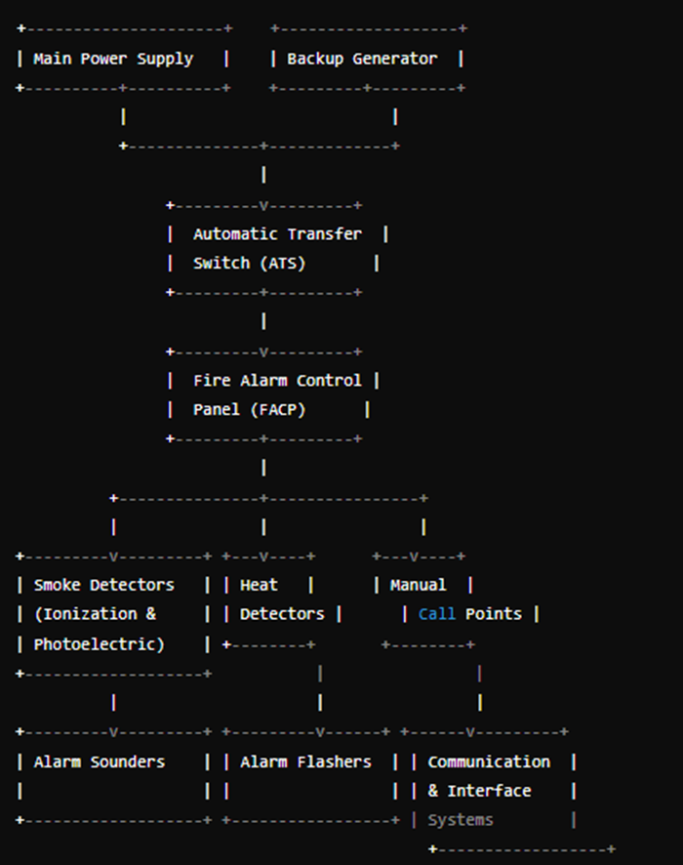
Block Diagram for ATS Fire Alarm System:

Slide 7
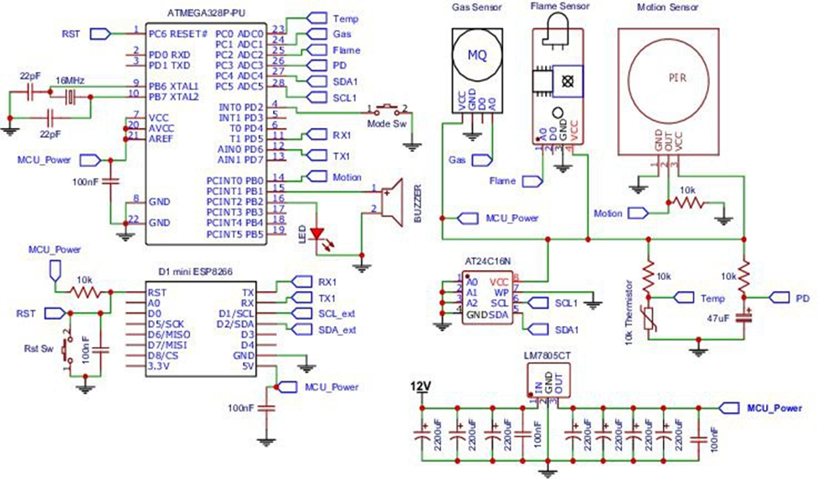
Circuit Design:

Slide 8
Challenges and solutions:
Challenges:
Complex Building Layouts
Existing Infrastructure
Access coordination
Unexpected Obstacles
Solution:
Leverage System Design Software and Experienced Technicians
Open communication and planning
Flexibility and alternative solutions

Slide 9
This project successfully enhanced the building's fire safety through
Early fire detection
Safe evacuations
Reduced false alarms
Regulation compliance

Slide 10
For continuous fire safety
Regular maintenance
Resident training
Building system integration
Advanced notification systems
Cybersecurity measures

Slide 11
Thank you

