Slide 1
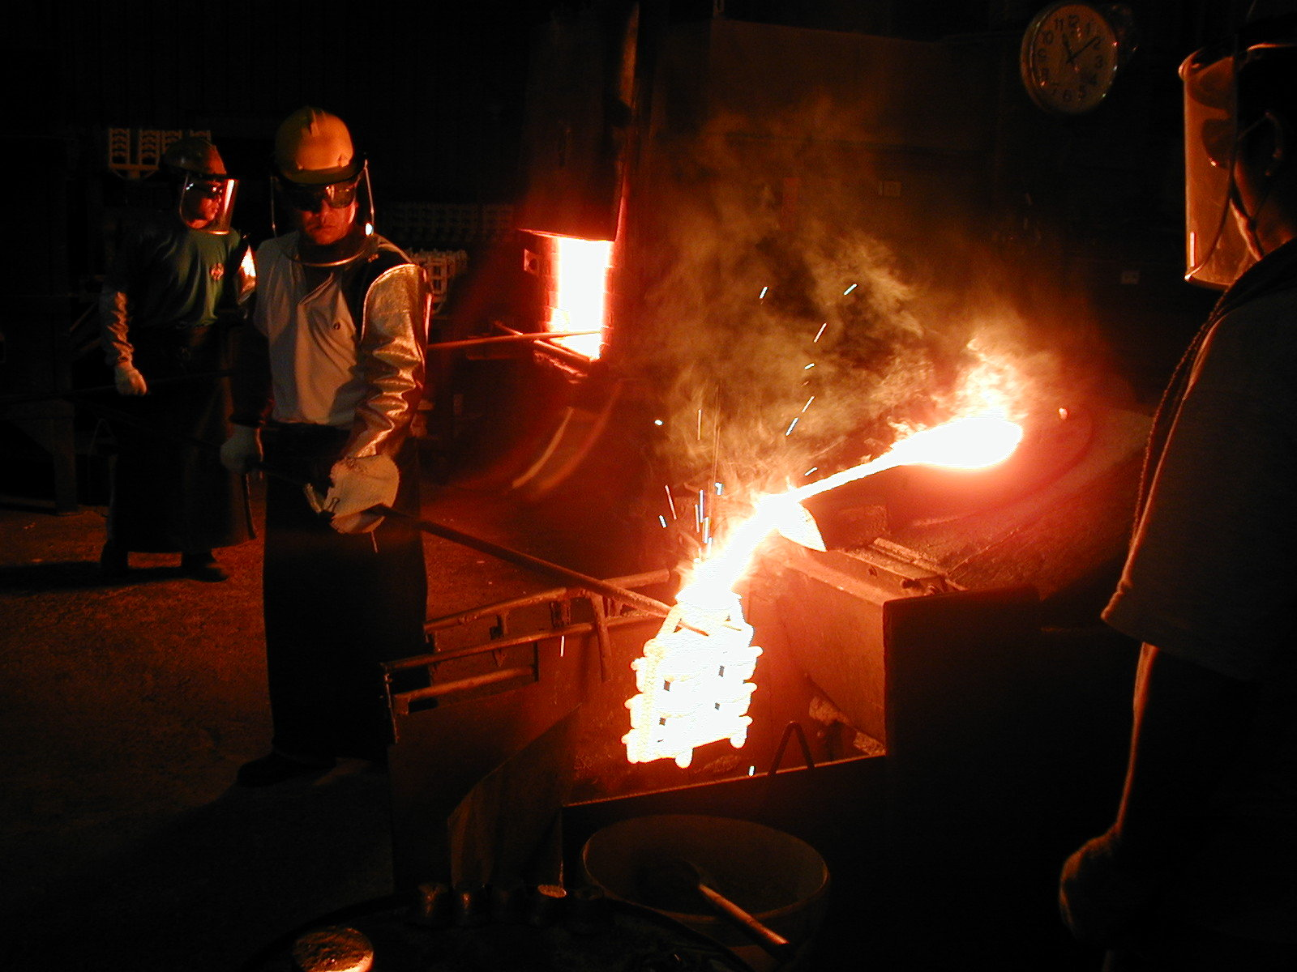
Aluminum Melting
Furnace
Supervisor:
Dr.Osayd Abdul-Fattah
Prepared By:
Anas Al-Banna
Yahya Abu-Jneid
Orwa Abbas
Ahmad Abu-Salama
Abdul-Rahman Mohammed

Slide 2
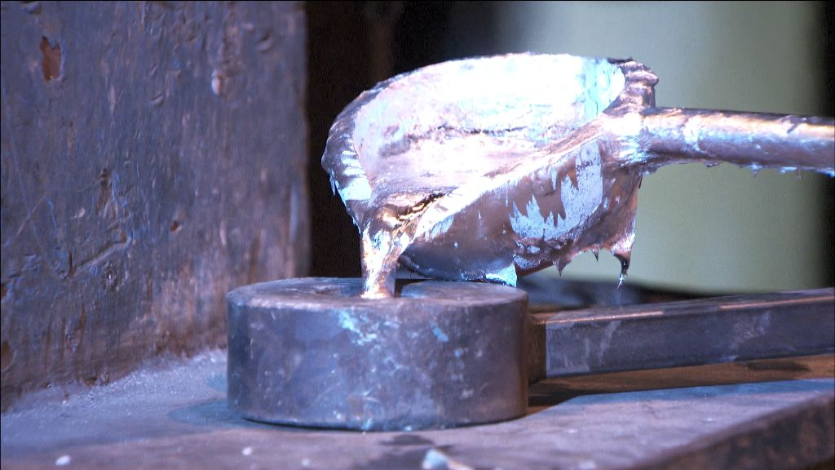

Slide 3
Outline
Introduction
Insulation Materials (Fire Brakes & Cement Refractory)
Furnace Design and Calculations
Furnace cost
Apparatus and Procedures
Recomandation

Slide 4
Introduction:
In this section you will be presented to the project with a briefly description, and the aim of it .
The Aim of the project:
The aim of this projects is to design theoretically and practically an Aluminum Melting Furnace
with a specific Characteristics

Slide 5
Characteristics of project (Melting Furnace):
Inside and Outside Temperature
Power Supply (LPG)
Motor and Gear Box
Capacity 20Kg

Slide 6
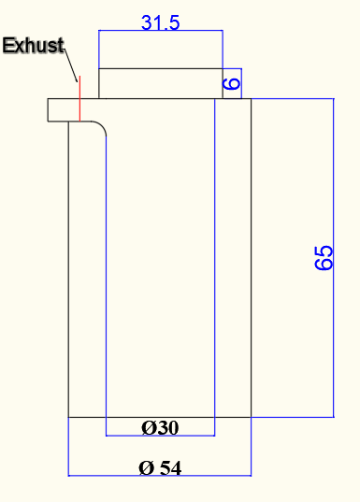
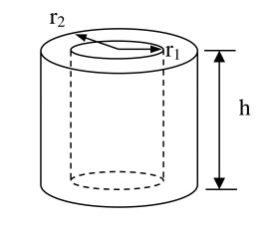
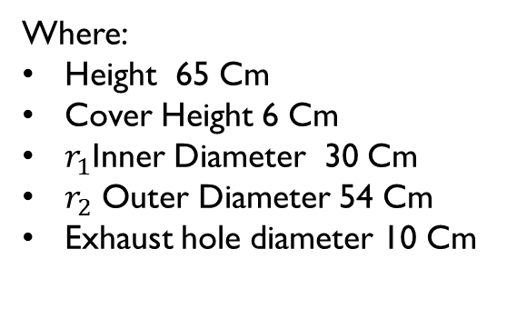
Furnace Shape:
The shape of the furnace is a Hollow with inside and outside diameter
Where:
Height 65 Cm
Cover Height 6 Cm
$r_{1}$Inner Diameter 30 Cm
$r_{2}$ Outer Diameter 54 Cm
Exhaust hole diameter 10 Cm

Slide 7
Why Aluminum ?
Aluminum one of the most versatile metallic material in the world due to different mechanical and physical properties:
Low Density
Corrosion Resistance
Good Thermal and Electrical Conductivity
High Strength Weight Ratio

Slide 8
Aluminum Alloys Categories:
Aluminum Alloys
Wrought Aluminum Alloys
Non-Heat Treatable Alloys (Mg,Mn,Si)
Heat Treatable Alloys (Cu,Si,Zn)
Cast Composition Alloys
AL favorable for casting (Melting point, Surface finish)

Slide 9
Aluminum Alloys Applications:
Aluminum alloys used in many applications , such as
Automotive Industry
Aerospace Industry
Machine and Building Constriction
Electronic Equipment's

Slide 10
Insulation Materials
Insulating materials greatly reduce the heat losses through walls. Insulation is achieved by providing a layer of material with low heat conductivity between the internal hot surface of a furnace and the external surface, thus keeping the temperature of the external surface low.

Slide 11
Refractory brick
Refractory brick is also called fire brick. It is a kind of refractory material that is sintered by raw refractory material with a certain shape and size, withstanding various physical and chemical changes and mechanical interaction in high temperature.

Slide 12
Fire Clay Bricks (Arch Fire Brick)
Fireclay brick is made from clinker clay by mixing, forming, drying, sintering and matching characterized by good resistance to corrosion and abrasion.
Fire clay bricks rated to 1300°C (2400°F) for use in fireplace, wood-fired ovens, stoves, furnaces.
Arch Fire Brick Feature
High mechanical strength.
Good thermal shock resistance.
Good resistance to abrasion and corrosion.
Good volume stability at high temperature.
Low thermal conductivity.

Slide 13
Technical Data
Brand | Brick NA-44/46
Al2O3 (%) | 44-46
SiO2 (%) | 46-48
Fe2O3 (%) | 1.6-1.8
CaO (%) | 0.4
MgO (%) | 0.2
Alkalis | 0.4
Service limit (Cº) | 1300
B.D (g/cm³) | 2.15-2.25
Heat-Expansion (1200 Cº) (%) | 0.5-0.6
Thermal conductivity (W/mK) | 0.9
Cold crushing strength (C.C.S) | 400-450

Slide 14
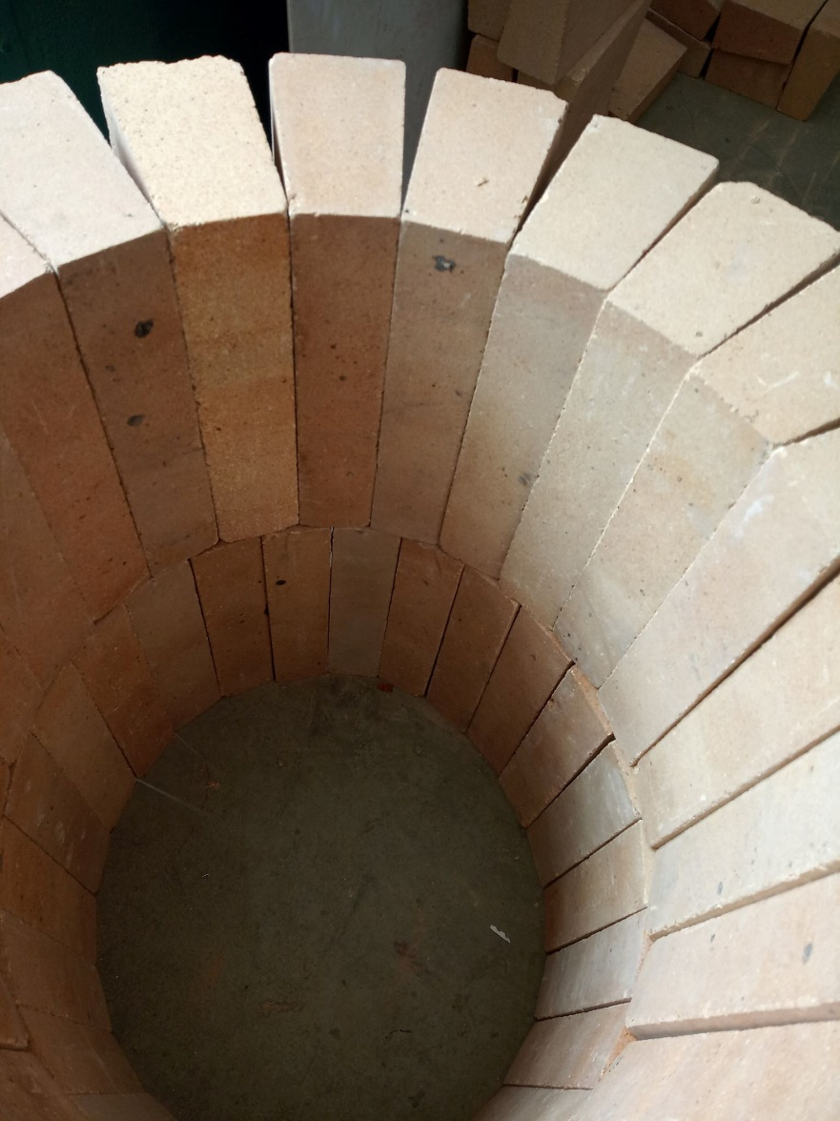
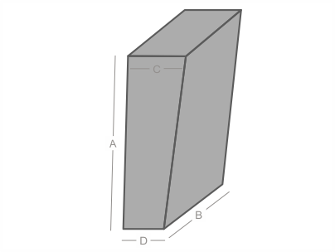
Size and shape
Shape: Arc
Size: 21 x 11 x 7 x 5cm
A: 21 cm
B: 11cm
C: 7 cm
D: 5 cm
Weight about 3.5 Kilos each firebrick

Slide 15
Refractory cement
Refractory cement it is a material put in furnace and cover the refractory bricks and acts as an insulator material for high temperature inside aluminum
furnace.

Slide 16
High Alumina Cement
High Alumina Cement is an excellent unshaped refractory material.
High aluminous cement is called bauxite cement before. It is a kind of hydraulic binder, being produced after the calcining and grinding with the bauxite and limestone as the raw material, so it is also called calcium aluminate cement.
High Alumina cement Features
High initial strength.
Sulfate corrosion resistance
biological acid erosion.
High temperature resistance.

Slide 17
Technical Data
Brand | IZODUR 95
Al2O3 (%) | 92.9
Fe2O3 (%) | 0.2
CaO (%) | 4.0
MgO (%) | 2.9
Service limit (Cº) | 1750
B.D (g/cm³) | 1.58
Thermal conductivity (W/mK) | 0.96

Slide 18
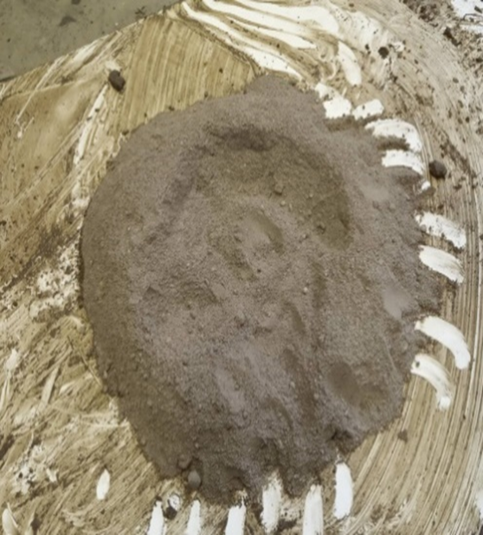
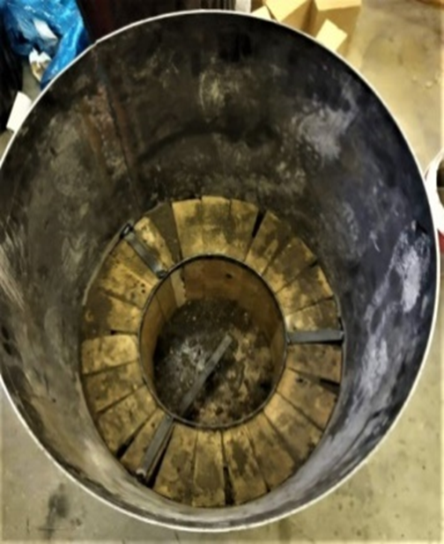
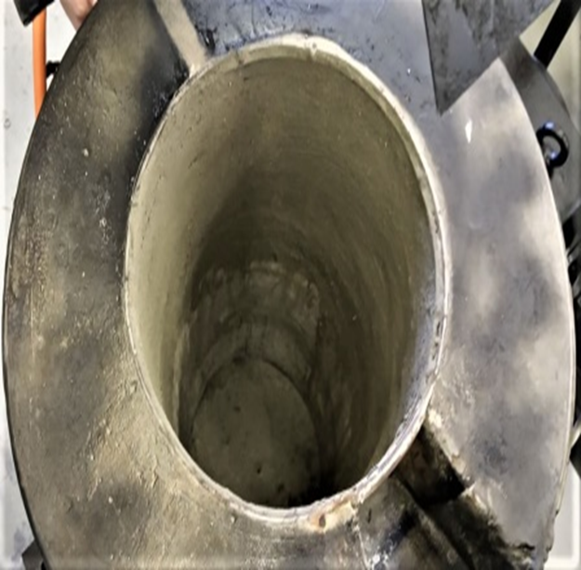
Shape

Slide 19
Methodology
design
In this part, the theoretical design of each part of the project .

Slide 20
power supply
Liquefied Petroleum Gas “LPG” has been selected as a source of energy of the furnace .why ?
1
High thermal content.
high flame temperature.
2
Its relative density makes it lighter than air, so that leaks or emissions quickly dissipate into the upper layers of the atmosphere.
It is non-corrosive.
3
LPG is one of the cleanest fossil fuel energy sources.
It is efficient and abundant.

Slide 21
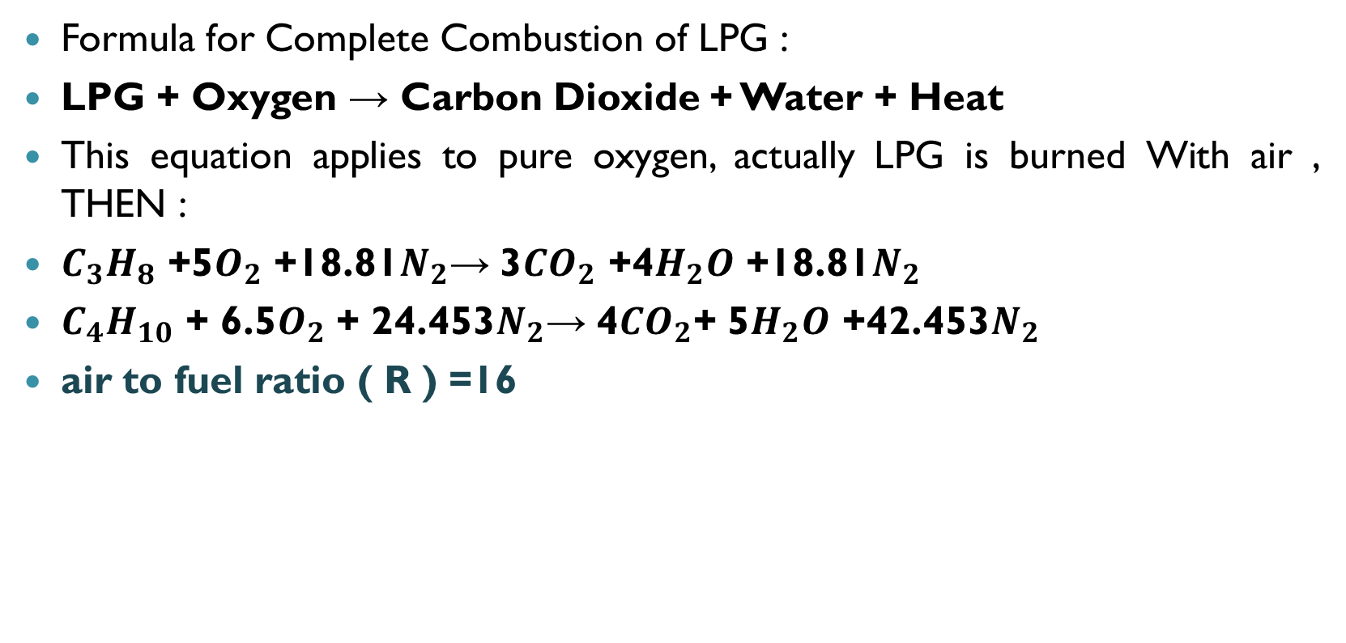
LPG gas combustion
Formula for Complete Combustion of LPG :
LPG + Oxygen → Carbon Dioxide + Water + Heat
This equation applies to pure oxygen, actually LPG is burned With air , THEN :
$C_{3}H_{8}$ +5$O_{2}$ +18.81$N_{2}$→ 3${CO}_{2}$ +4$H_{2}O$ +18.81$N_{2}$
$C_{4}H_{10}$ + 6.5$O_{2}$ + 24.453$N_{2}$→ 4${CO}_{2}$+ 5$H_{2}O$ +42.453$N_{2}$
air to fuel ratio ( R ) =16

Slide 22
Energy from combustion
When the carbon bonds are separated from hydrogen in the combustion reaction, they will produce a large amount of energy.
1 kg of gas → 0.5 kg of propane + 0.5 kg of butane
1 kg of gas = 48.485 MJ

Slide 23
Energy for melting aluminum
The aluminum needs energy to transform from the solid phase to the liquid phase.
Energy for melting aluminum
Energy Require to raise the temperature to the melting point
=11557 KJ
Latent heat
=6420 KJ

Slide 24
Components of furnace wall
Refractory lining layer
fire brake layer
thin layer of steel

Slide 25
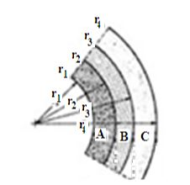
layer | Thickness (mm) | Thermal conductivity “k”
Refractory lining A | 20 | 0.45
fire brake layer B | 110 | 0.9
thin layer of steel C | 3 | 50

Slide 26
Losses
oven walls
cylindrical oven wall
oven base
exhaust gas

Slide 27
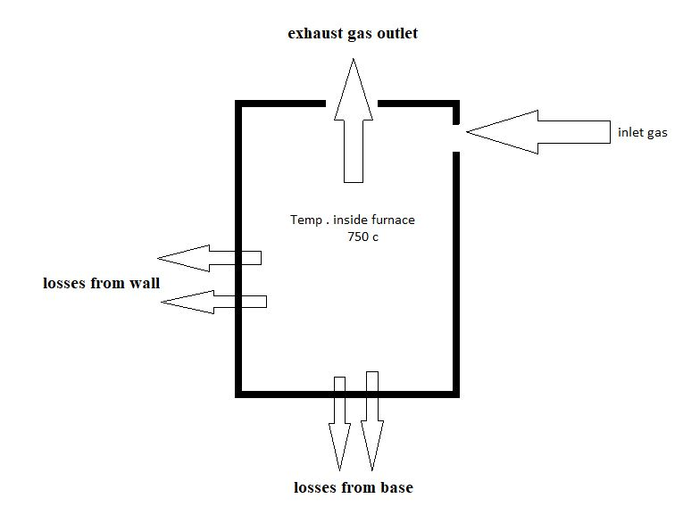

Slide 28
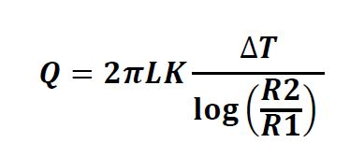
The energy lost from the oven walls
The most common shape is a hollow cylinder, which has a circular internal and external diameter and internal and external surface as shown in fig . Using Fourier law for conduction heat transfer of cylinder, the equation [1] as the following:
The oven is designed at a height of 65 cm .
❖ The outer diameter of the cylinder is 54 cm

Slide 29
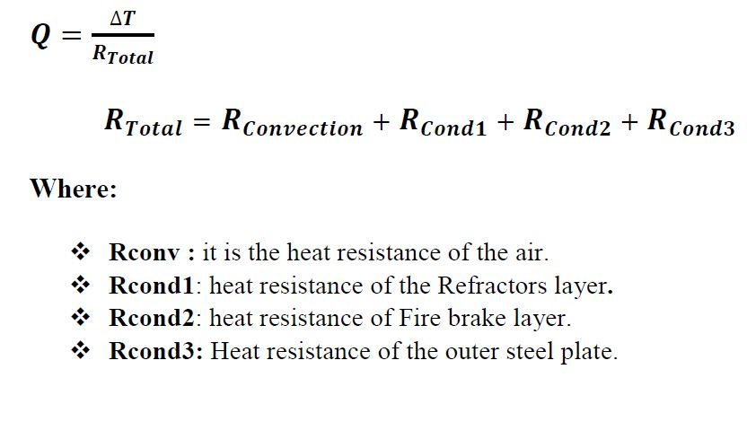

Slide 30
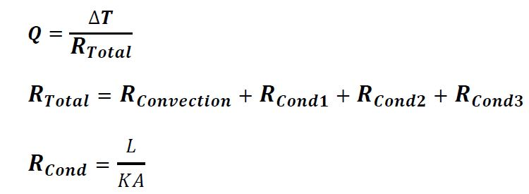
The energy lost from the oven base
Apply Fourier law for conduction heat transfer of wall

Slide 31
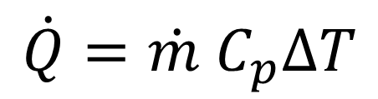
The energy lost from the exhaust gas outlet
An exhaust gas outlet must be found in the oven due to the avoidance of gas compression in the oven.
In steady state conditions, the temperature of the oven is 750 degrees Celsius and therefore the gas will flow from the high temperature (inside the furnace) to the less temperature (outside the oven) .
The exhaust gas outlet is designed in the shape of a 10 cm in diameter circular hole located at the top of the furnace.
$$\dot{Q}=\dot{m} C_{p}∆T$$

Slide 32
Total losses
Apply conservation of energy
When burn 1 g of LPG will produce 48 .5 KJ at 1 second
1 g of LPG content 48.5 kJ
Wall losses
1.28 KJ
exhaust gas losses
14.8 KJ
Energy absorbed by aluminum
32.42 KJ

Slide 33
Time required for aluminum melting
The furnace needs a certain time to melt the required amount of aluminum, and this time depends on several factors including:
TIME
mass of
AL
losses
K of
AL
shape
Burner flow rate
Heat of flame

Slide 34
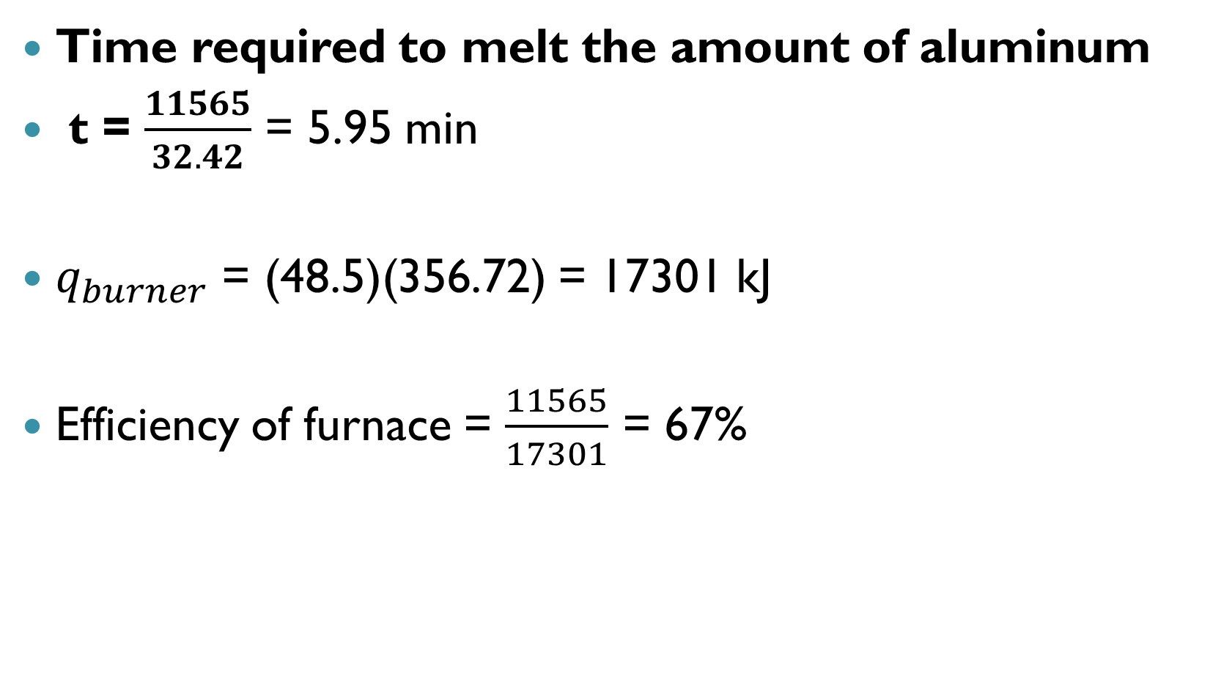
Time required to melt the amount of aluminum
t = $\frac{11565}{32.42}$ = 5.95 min
$q_{burner}$ = (48.5)(356.72) = 17301 kJ
Efficiency of furnace = $\frac{11565}{17301}$ = 67%

Slide 35
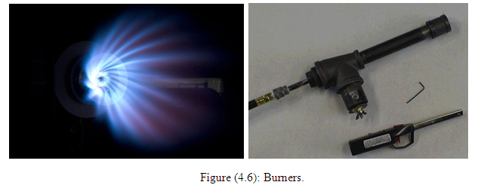
Burner
The burner works to mix the gas with the air at a constant rate to avoid the problem of incomplete combustion.
The burner must withstand high temperatures.
1. Quantity of gas entering it .
2. The amount of air entering it.
3. required time.

Slide 36
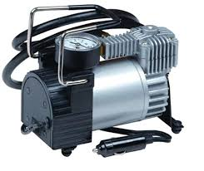
Air pump
To provide the burner with sufficient air for the combustion process, an air pump is designed .
From the combustion equation
1 gram of gas need 16 gram of air .
Then mass flow rate of pump must
be 16 gram / second
Mass flow rate of LPG gas = 1 gram / second
Burner flow rate = 17 gram / second

Slide 37
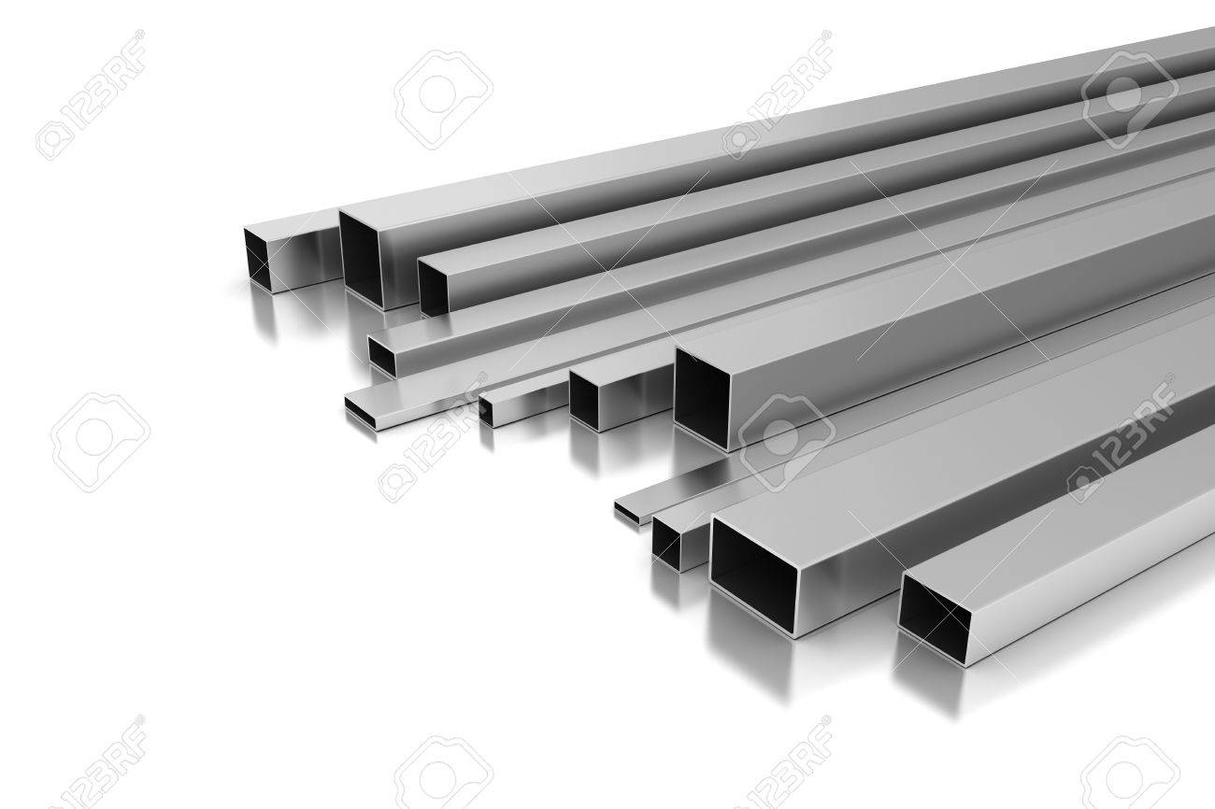
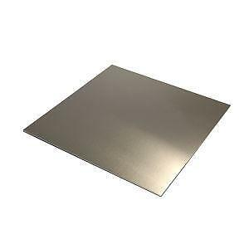
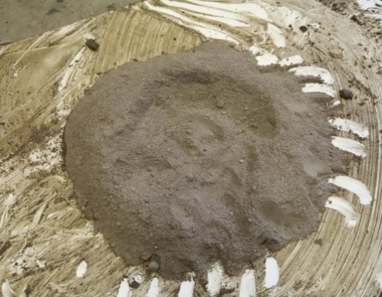
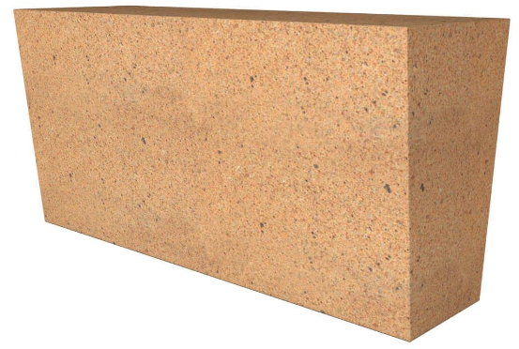
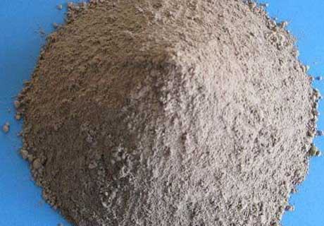
Apparatus and Procedures
Apparatus:
Thermal cement
Sheet metal
profile
Fire brick
refractory

Slide 38
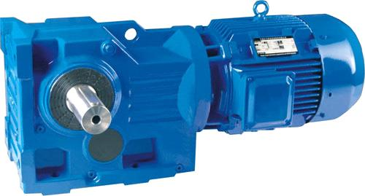
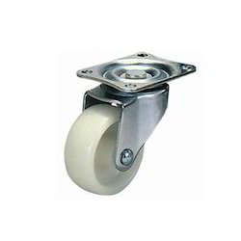
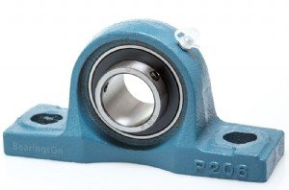
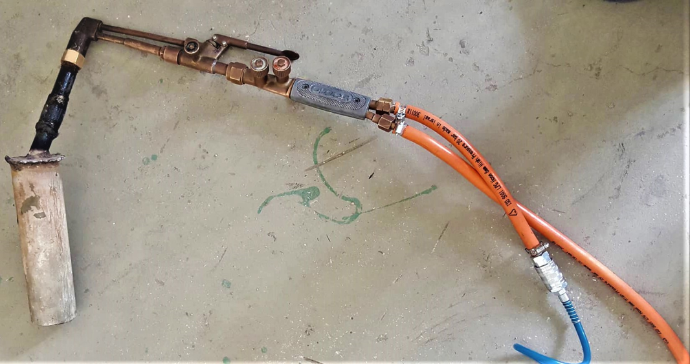
wheels
Electrical motor
With gearbox
burner
bearing

Slide 39
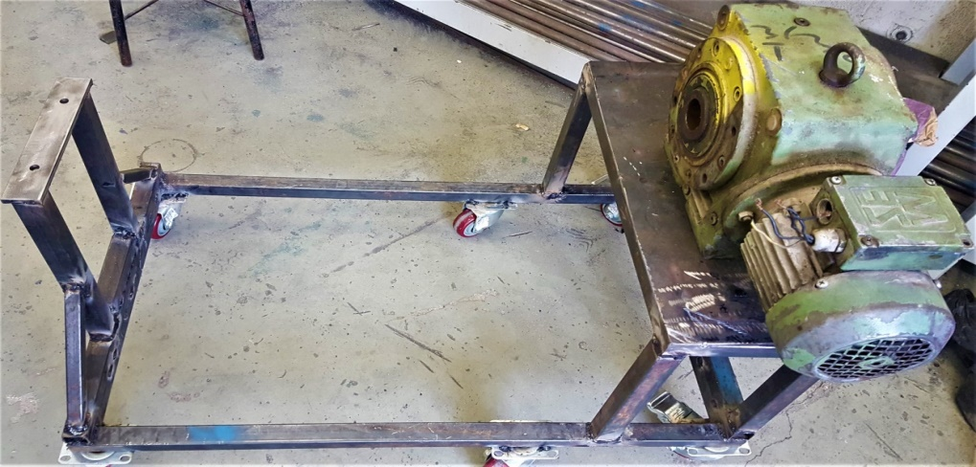
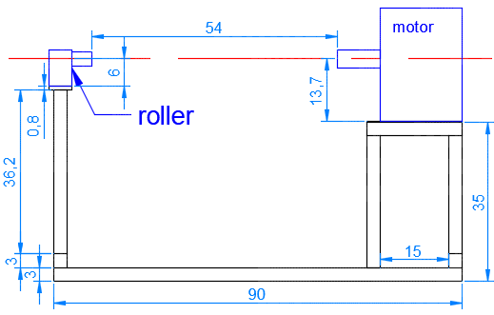
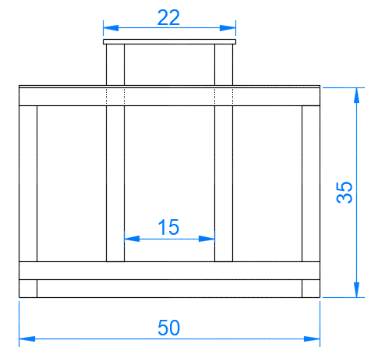
Procedure
1. Profile cutting and install the wheels
Side View of Furnace Structure
Front View of Furnace Structure

Slide 40
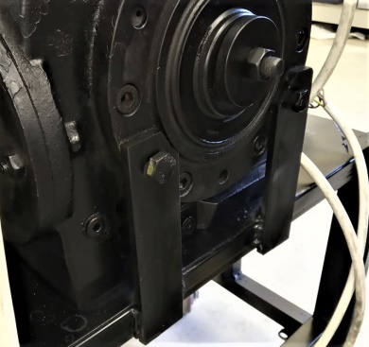
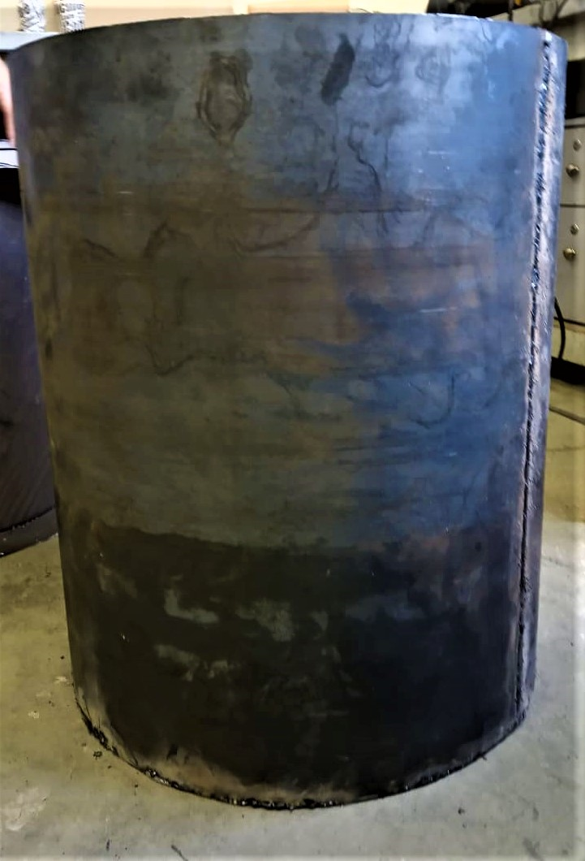
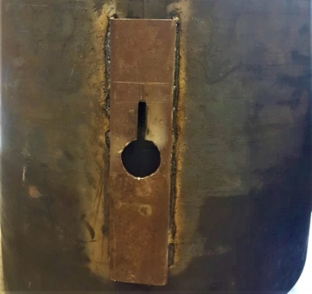
2. Install the motor
3. Cylinder and base
4. The hole
of the shaft

Slide 41
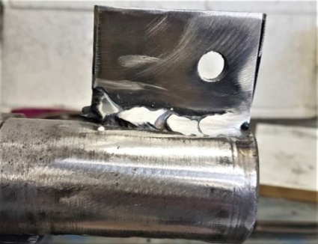
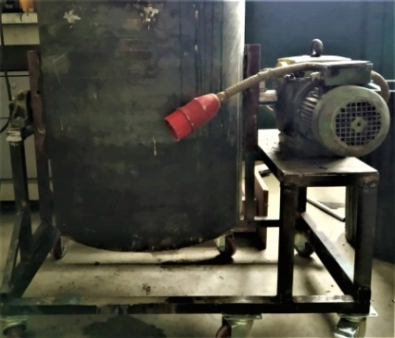

5. Key oh the Shaft.
6. Final Assembly of Furnace Structure.
7. First layer of fire brick and steel ring.

Slide 42

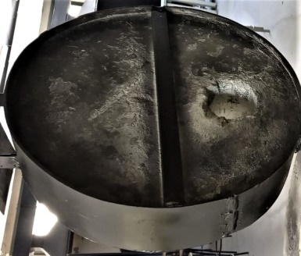
8. refractory
9. Lid of the furnace.

Slide 43
Furnace cost
Cost in dollars | Apparatuses
30$ | profiles
90$ | Sheet metal
100$ | motor
10$ | bearing
30$ | Electrical cables and switch
200$ | Thermal cement and refractory
200$ | Fire brick
50$ | burner
20$ | Gas cylinder
40$ | wheels
20$ | paint
30$ | Others
810$ | Total cost

Slide 44
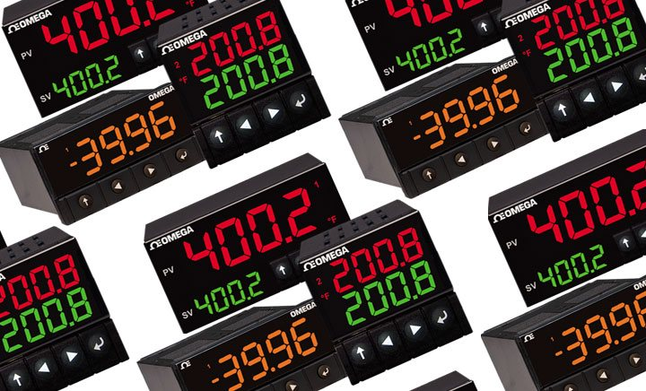
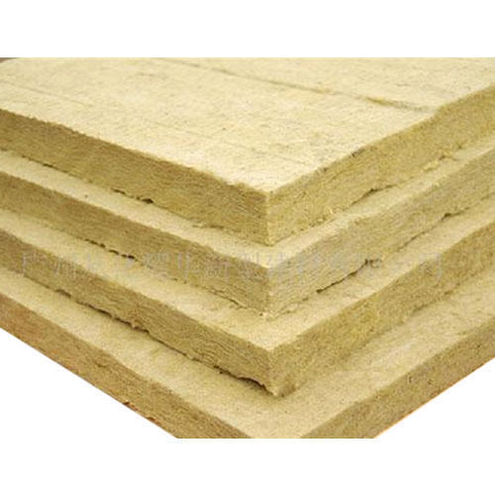

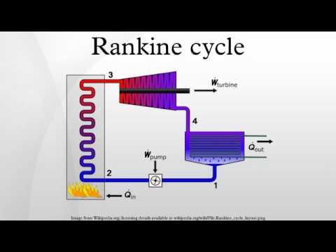
recommendation
Add control system.
Add external layer of rock wool.
Add emergency switch.
Exploitation of wasted energy (Rankin cycle).

Slide 45

discussion

Slide 46


