Slide 1
Applying Lean Six Sigma- DMAIC Methodology in Troubleshooting and Ticketing System at Paltel’s Customer Care Directorate
Industrial Engineering Department
Graduation Project II.
Submitted By: Mohammed Shou’Bi
Under The Supervision of: Dr. Yhaya Saleh.

Slide 2
Service Sector
The use of quality techniques that had been typically employed in the production sector to apply them in the service sector is one of the biggest difficulties facing modern business, as trends in the service sector have shown.

Slide 3
Palestinian Telecommunications Company " Paltel"
The year 1995 marked the founding of Paltel It is one of the companies of the Palestine Telecommunications Group, whose board of directors is chaired by Sabih Al-Masri.
Paltel provides huge number of customers in many types of services in this sector, like; XDSL, FTTH, FiLINE, FiLite and corporate in addition to added services, like; IPTV, Fixed IP, Parental Control and safe kids.

Slide 4
Synergy of Lean Management and DMAIC-Six Sigma
Lean focuses on waste reduction and process flow, while DMAIC-Six Sigma emphasizes data analysis, root cause identification, and performance measurement.
DMAIC-Six Sigma's analytical approach complements the visual and practical aspects of Lean Management.

Slide 5
Importance of Troubleshooting and Ticketing Systems:
Customer Support.
Issue Tracking.
Data Collection.

Slide 6
Problem Statment
Leverage Lean principles and the DMAIC (Define, Measure, Analyze, Improve, and Control) framework from Six Sigma. By integrating these methodologies, the project aims to transform PALTEL's troubleshooting and ticketing system into an agile, waste reducing, and customer-centric mechanis

Slide 7
Data Collection
Primary Sources:
Observation.
Key Person Interviews.
Gemba Walk Technique.
Secondary Sources:
Unpublished Data.

Slide 8
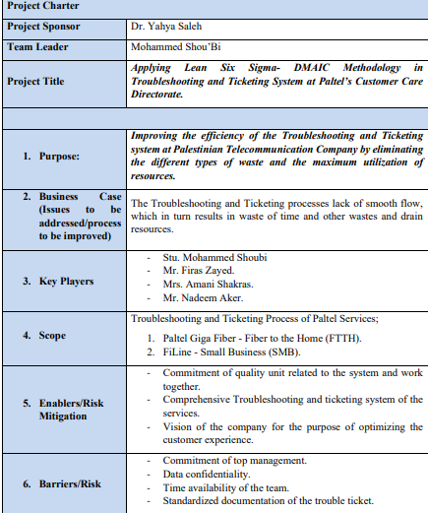
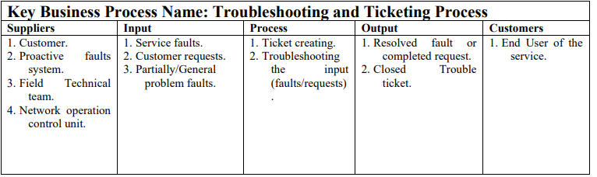
Define Phase

Slide 9
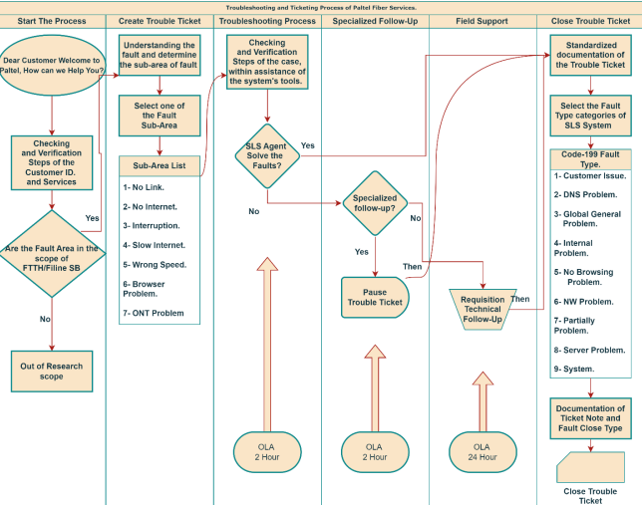
Measure Phase

Slide 10
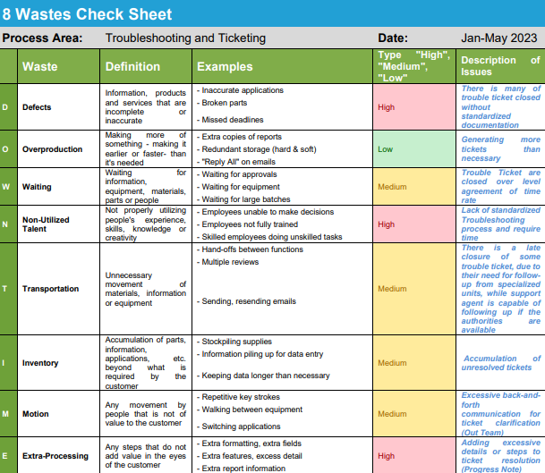
Measure Phase

Slide 11
Analysis Phase
Data Collection: Collaboration with Quality Unit enabled comprehensive data analysis despite initial challenges.
Criteria:
  First Criterion:
    2-hour response for second-line support
    24-hour response for field support
  Second Criterion:
    1-hour response for second-line support
    8-hour response for field support
    Excludes Fridays and 8 PM-8 AM tickets.
Findings:
Ticket Convergence:
  Consistent number of tickets across the study period.
  Variation observed in April & May exceeding OLA thresholds.

Slide 12
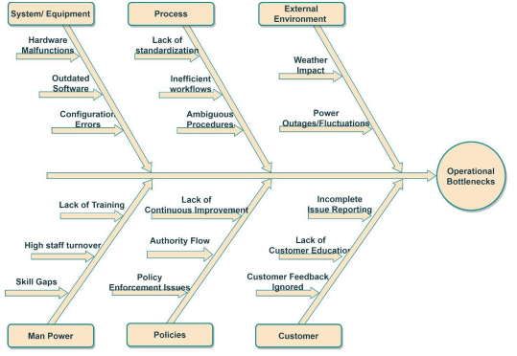
Future Research

Slide 13
Improvement Phase
Proposal of Improvement:
Operational Procedure/Policies.
Human Power Issues.
Quality Assurance Policies.
Customer-Self Troubleshooting.
Overall Process Integration.

Slide 14
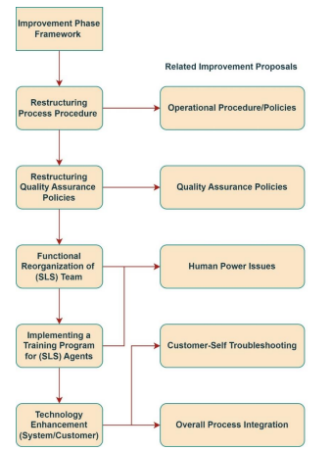
Improvement Phase

Slide 15
Recommendations for Control
Proposal of Improvement:
Operational Procedure/Policies.
Human Power Issues.
Quality Assurance Policies.
Customer-Self Troubleshooting.
Overall Process Integration.

Slide 16
Thank you
Mohammad
2023-2024

