Slide 1
Tulkarem Multipurpose Sport Hall
Prepared by:
Moatasem Ghanim
Abdul-Rahman Alsaabneh
Malek Salatneh
Supervisor: Dr. Shaker Albitar

Slide 2
Contents
Chapter 1: Introduction
Chapter 2: Concrete Elements Design
Chapter 3: Steel Structure Design

Slide 3
Chapter 1: Introduction

Slide 4
Chapter 1: Introduction
Overview
This project is a design of multipurpose sport hall with concrete walls, slabs and steel roof.

Slide 5
Chapter 1: Introduction
Scope
The goal of the new design is to increase the hall capacity by adding more seats for audience and adding more storage area. The area of the building will remain the same, this is expected to increase the functionality of the hall.

Slide 6
Chapter 1: Introduction
Codes of Design
This project is designed using
ACI 318-08.
IBC 2009.
AISC.

Slide 7
Chapter 1: Introduction
Units of Measure
The units of measure used in this project are the SI units (meter, KN).

Slide 8
Chapter 1: Introduction
Material Properties
The main materials used are:
Concrete of ƒc= 28 Mpa.
Reinforcement Steel of Fy= 420 Mpa.
The properties of the Steel Structure’s material will mentioned later.

Slide 9
Chapter 1: Introduction
Loads
The design was performed considering gravity loads which include both, dead and live loads.
Dead loads associated with the weight of structure itself.
Live loads is pre-determined by the IBC code with value of 3 KN/m².
The loads assigned to the roof will mentioned later.

Slide 10
Chapter 1: Introduction
Description of Building and Location
The hall consist of reinforced concrete walls and a steel roof.
The soil has a bearing capacity of 150 KN/m².

Slide 11
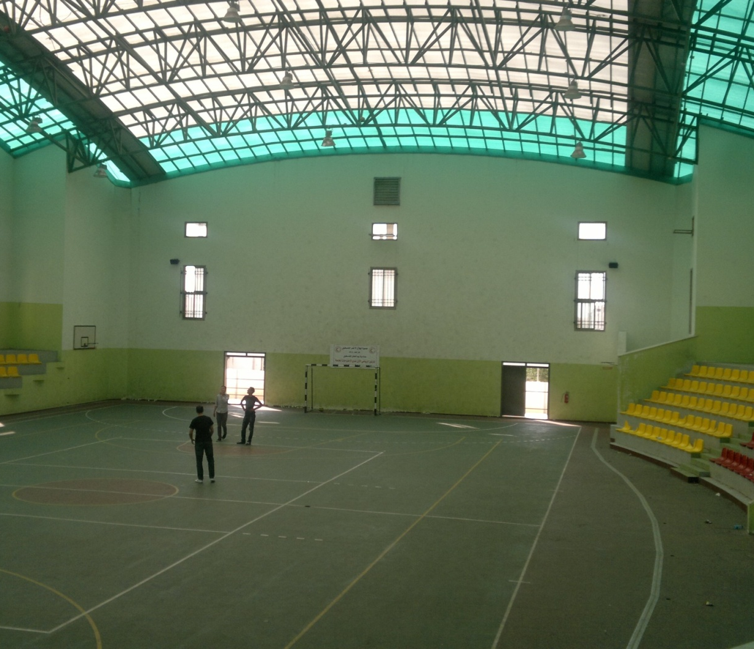
Chapter 1: Introduction
Two sets of spectators seats that are opposite to each other in the northern and southern sides. Both groups of seats can hold up to 525 persons. There are utility rooms for players beneath audience seats.
The hall has an area of 1744 m²

Slide 12

Chapter 1: Introduction
The roof system is truss.

Slide 13
Chapter 1: Introduction
Modification of the Design
Number of seats is to be increased by 40% with increasing the number of storage area.

Slide 14
Chapter 2: Concrete Elements Design
Design of Concrete Slabs

Slide 15
Design of Concrete Slabs
Structural System
The structural system used was one way solid slab with different thicknesses. The thickness of each slab is shown in table 4 page 10.

Slide 16
Design of Concrete Slabs
Loads
The loads were assigned to each slab as the flowing table shows
Load Pattern | Load Value (KN/m²)
Superimposed | 9.75
Live | 3
Dead | Calculated Automatically

Slide 17
Design of Concrete Slabs
Design Process
The methodology used here is to take the ultimate moment in each slab and design for it. Take slab 2 as an example. The plan of this slab is shown in the appendices drawings.

Slide 18
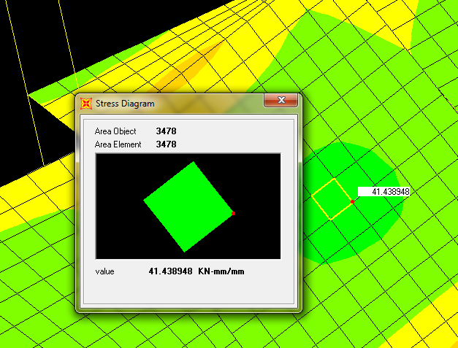
Design of Concrete Slabs

Slide 19

Design of Concrete Slabs

Slide 20
Design of Concrete Slabs
The same method was used to design the other types of slabs.

Slide 21
Chapter 2: Concrete Elements Design
Design of Beams

Slide 22
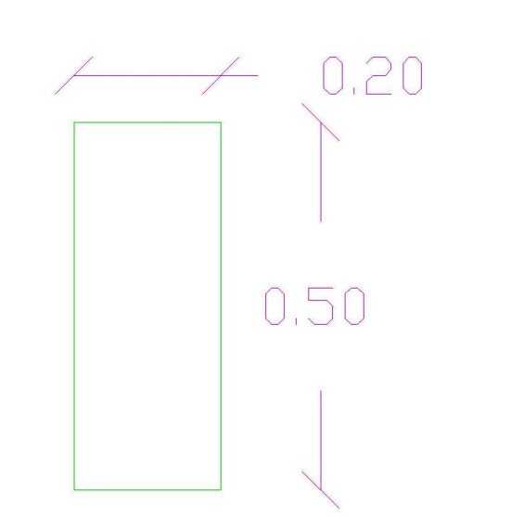
Design of Beams
The design process used was illustrated in the following example:
Take beam B1 as example

Slide 23
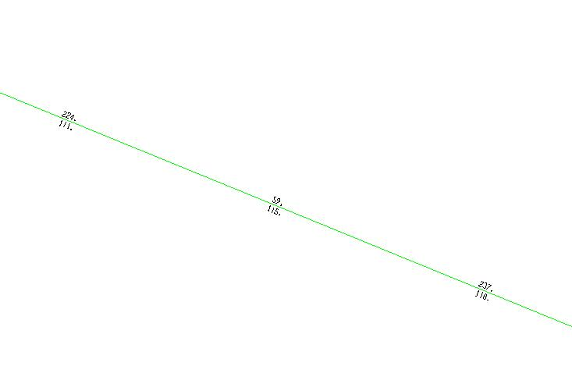
Design of Beams
Design for Moment
From Sap the area of steel was taken directly and compared with the minimum area of steel

Slide 24
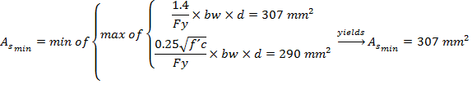

Design of Beams
Design for Moment

Slide 25
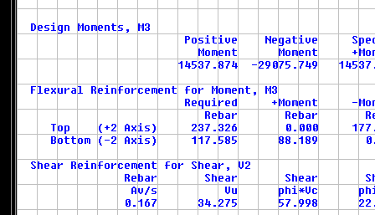
Design of Beams
Design for Shear
From Sap the reading of was taken and compared with the maximum spacing between stirrups.

Slide 26



Design of Beams
Design for Shear

Slide 27
Design of Beams
Hand Calculation ??
This calculation aims to check the results of Sap, so it will perform to B1-type beams:

Slide 28



Design of Beams
Hand Calculation

Slide 29
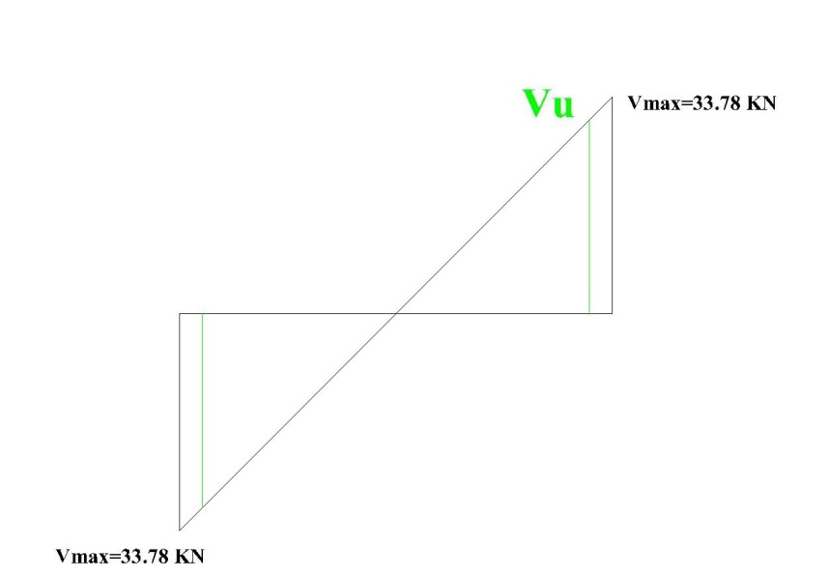

Design of Beams
Hand Calculation

Slide 30




Design of Beams
Hand Calculation

Slide 31
Design of Beams
Hand Calculation
Compare this result with the result from sap; it’s noticeable that the two results are very close, so it’s fair to say that the Sap is accurate.

Slide 32
Chapter 2: Concrete Elements Design
Design of Columns

Slide 33
Design of Columns
The following example illustrate the design process:
Take Type D as an example:
Since we have rectangular columns
Assume the steel will be distributed in all direction, and assume the cover = 40 mm

Slide 34



Design of Columns
The bending occurs about the strong axis which has larger moment of inertia.

Slide 35

Design of Columns
Refer to graph A.8 which is mentioned in reference 3.
Assume using Stirrups.

Slide 36
Chapter 2: Concrete Elements Design
Design of Shear Wall

Slide 37

Design of Columns
To design the shear wall, a 1m representative strip which is the critical one was taken and designed for both axial force and moment. This strip will be designed as a column with 0.20×1 m section.

Slide 38


Design of Columns
Refer to graph A.9 in reference 4.

Slide 39
Design of Columns
Use minimum steel in horizontal direction

Slide 40
Chapter 2: Concrete Elements Design
Design of Footings

Slide 41


Design of Footings
There are 3 types of footings single, combined and wall footings, all of them was designed manually. The methodology of design for each type was shown below:
Single footing
Take column 33 which is the critical column of F2 type.

Slide 42
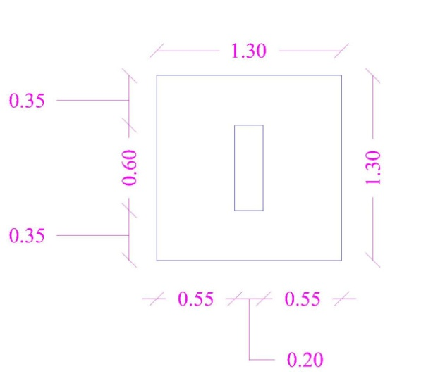
Design of Footings
Assume

Slide 43
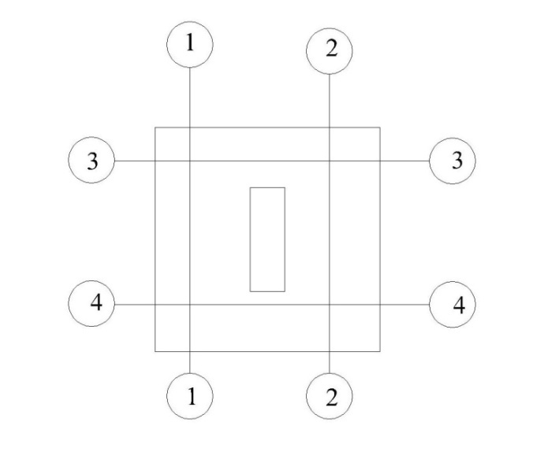
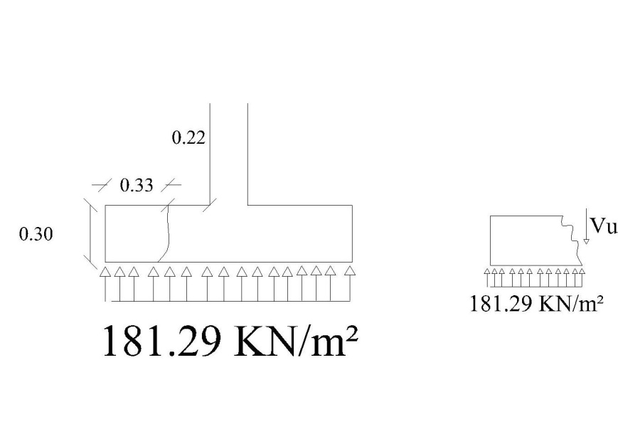
Design of Footings
Wide Beam Shear

Slide 44

Design of Footings
Wide Beam Shear
From the figure, section 1-1 is the section to be checked.

Slide 45
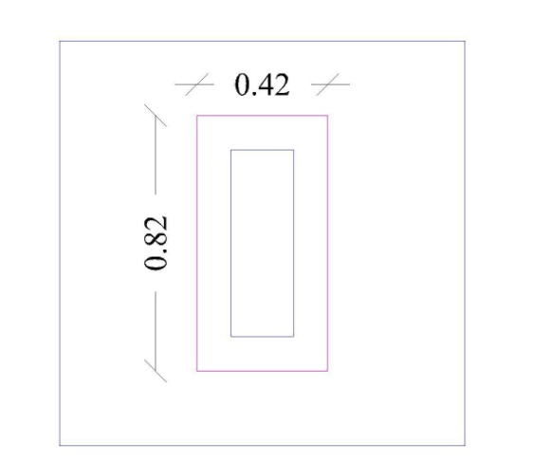

Design of Footings
Punching Shear

Slide 46

Design of Footings
Punching Shear

Slide 47
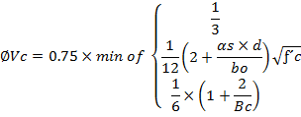


Design of Footings
Punching Shear

Slide 48
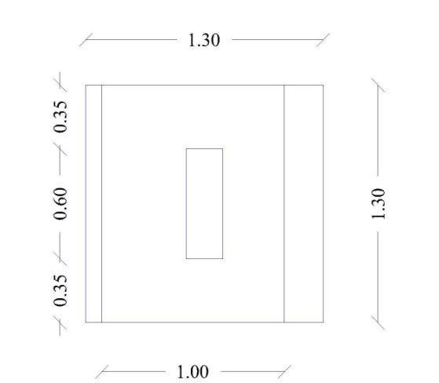
Design of Footings
Reinforcement (N-S Direction).
Take a strip of 1 m wide and perform the calculation on it.

Slide 49


Design of Footings
Reinforcement (N-S Direction).

Slide 50
Design of Footings
The reinforcement of the E-W direction will be the same.

Slide 51
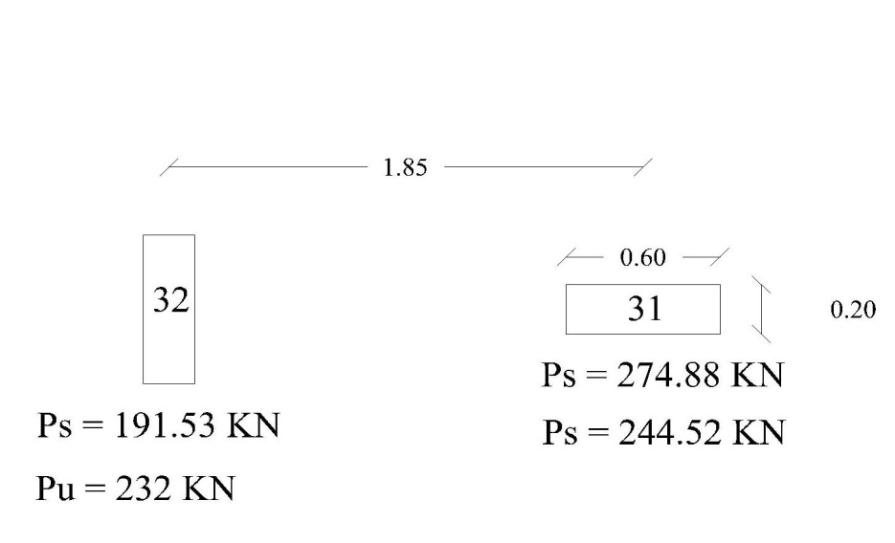
Design of Footings
Combined Footing
Calculate the center of loading.

Slide 52



Design of Footings
Combined Footing

Slide 53
Design of Footings
Combined Footing

Slide 54
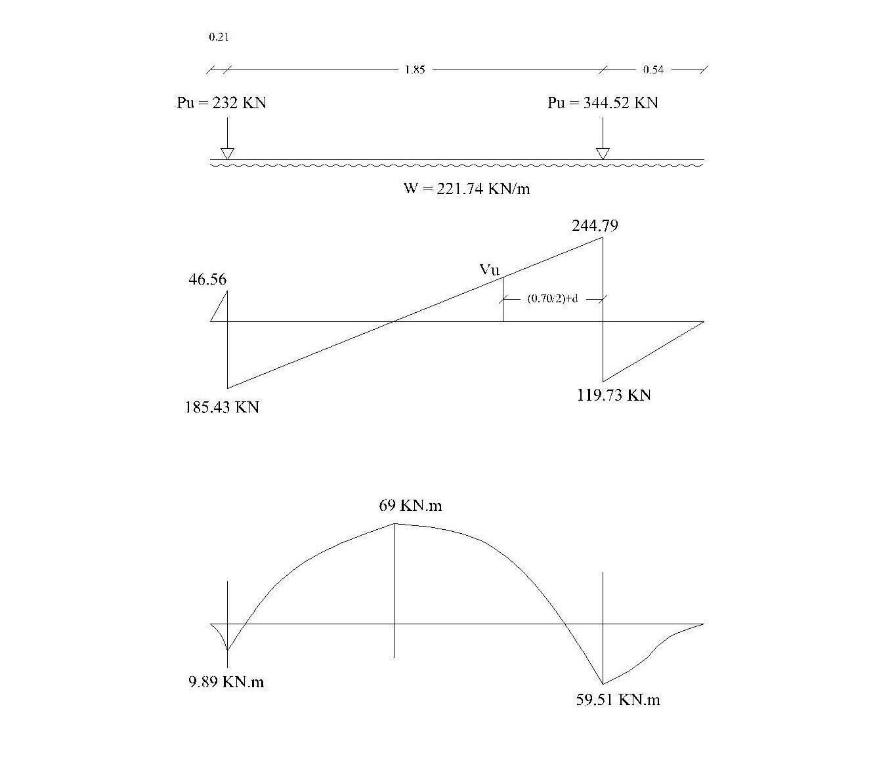

Slide 55

Design of Footings
Combined Footing

Slide 56
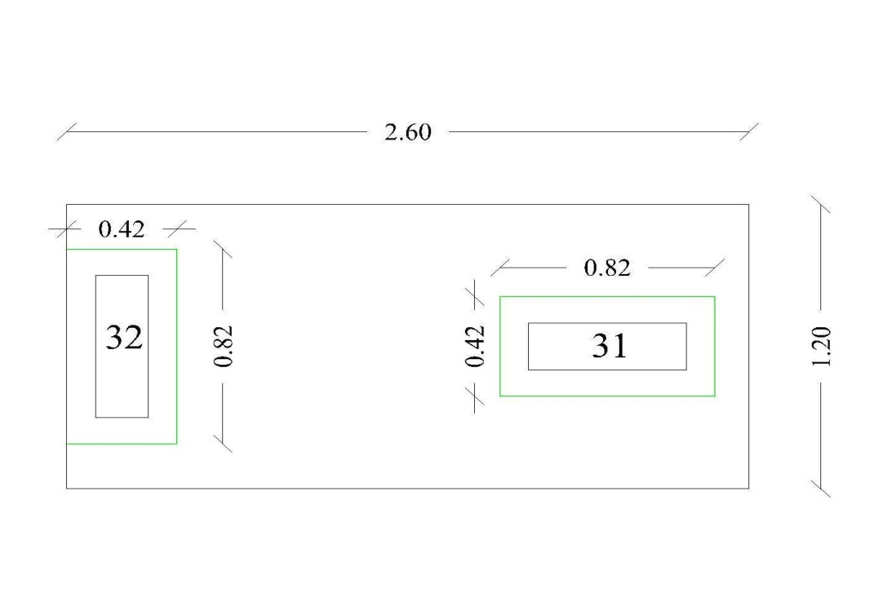
Design of Footings
Combined Footing
Check Punching

Slide 57
Design of Footings
Combined Footing
Check Punching
Since Pu of column 32 is less than for column 31, and it have the same critical area, there is no need to check column 32.

Slide 58
Design of Footings
Combined Footing
Reinforcement for Longitudinal Direction:

Slide 59
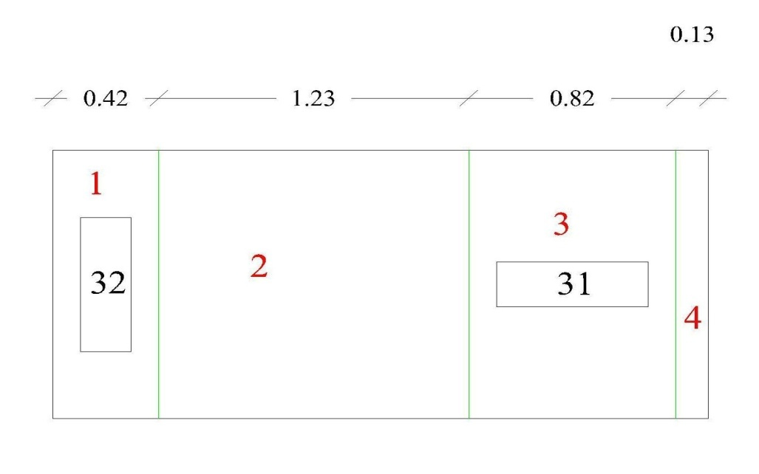
Design of Footings
Combined Footing
Reinforcement for Lateral Direction:

Slide 60


Design of Footings
Combined Footing
Reinforcement for Lateral Direction:
Zone 1 and zone 3 will designed for lateral moment, but zone 2 and zone 4 will designed for shrinkage only.
The design of zone 1 was shown below:

Slide 61


Design of Footings
Combined Footing
Reinforcement for Lateral Direction:

Slide 62



Design of Footings
Wall Footing
Footing Dimensions
Calculating of Thickness

Slide 63


Design of Footings
Wall Footing
Calculating of Thickness
Reinforcement

Slide 64
Design of Footings
Wall Footing
Reinforcement
Use As minimum for longitudinal direction.

Slide 65
Chapter 3: Steel Structure Design

Slide 66
Design of Steel Structure
Assumptions
The Material used in this project is steel A-36 which has the following characteristics:
Fu = 400 Mpa.
Fy = 248 Mpa.

Slide 67
Design of Steel Structure
Assumptions
The loads resisted by the structure are:
Live Load with a value of 1.20 KN/m².
Superimposed dead load with a value of 0.30 KN/m².
Wind Load with a value of 0.27 KN/m², the calculation of wind load will be illustrated later.

Slide 68

Design of Steel Structure
Number of Trusses Needed
Since the spacing between trusses is equals the spacing between columns = 5m; the number of trusses needed was calculated from following equation:
The design was performed on the critical truss which is the longest interior truss.

Slide 69
Design of Steel Structure
Wind Load Calculations

Slide 70

Design of Steel Structure
Wind Load Calculations
Since the minimum load is greater than the computed one, take the minimum as a design load.

Slide 71
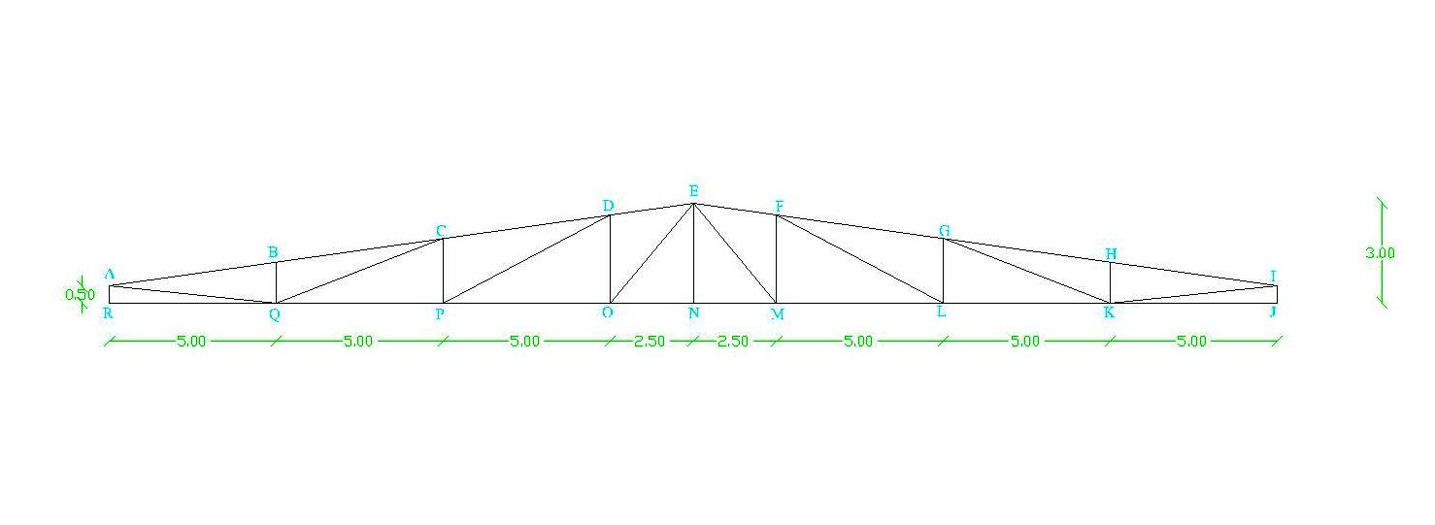
Design of Steel Structure
Model Layout

Slide 72
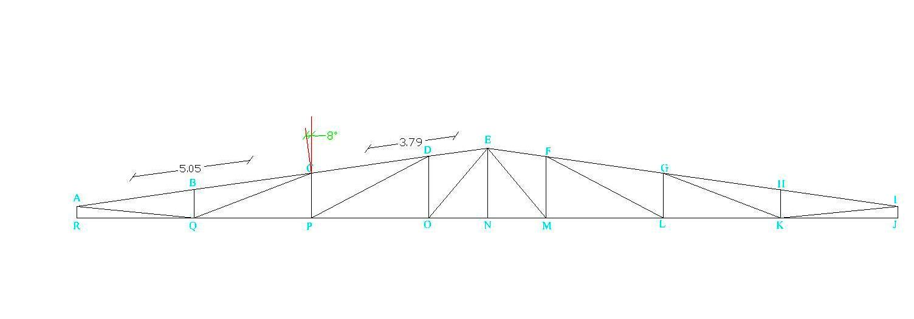
Design of Steel Structure
Calculation of Joint’s Loads
The load was calculated using the method of tributary area.
Wind Load

Slide 73

Design of Steel Structure
Calculation of Joint’s Loads
Wind Load
Each load must be converted to vertical and horizontal components.

Slide 74
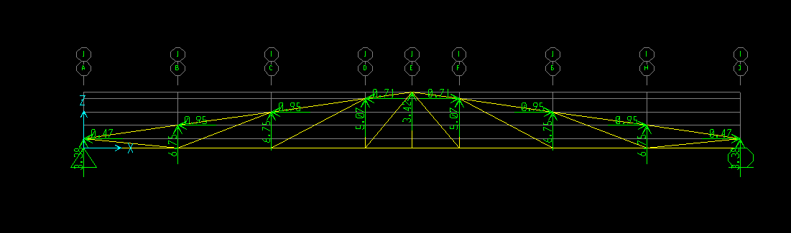
Design of Steel Structure
Calculation of Joint’s Loads
Wind Load

Slide 75
Design of Steel Structure
Calculation of Joint’s Loads
And with the same way superimposed and live load were calculated.

Slide 76
Design of Steel Structure
Performing Analysis and the Model’s Checks
After drawing 2-D model on SAP, importing the values of loads, defining load combinations and running the model, many checks should be done.

Slide 77
Design of Steel Structure
Performing Analysis and the Model’s Checks
Compatibility Check:
Check Equilibrium
This check will done for each load pattern separately, here we will check Live Load pattern:

Slide 78
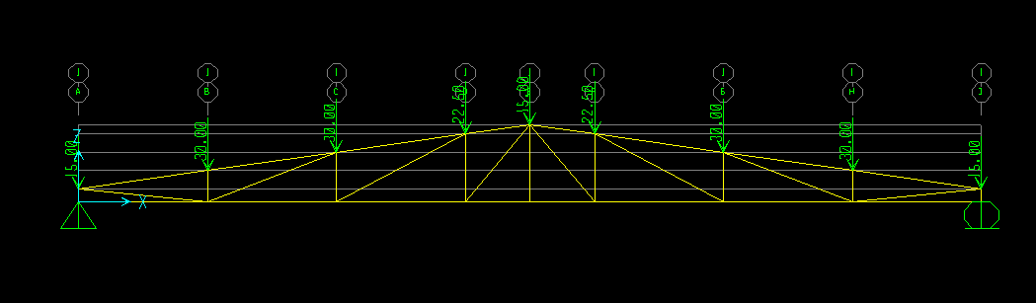
Design of Steel Structure
Performing Analysis and the Model’s Checks

Slide 79
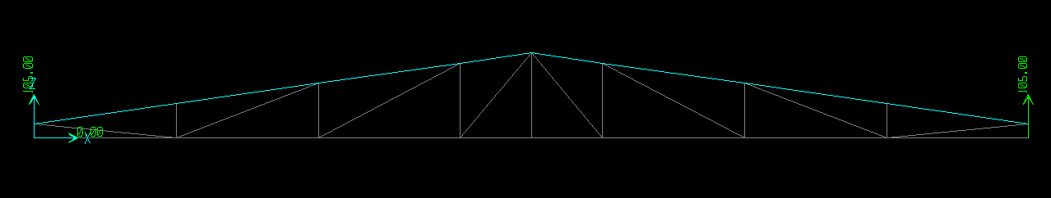
Design of Steel Structure
Performing Analysis and the Model’s Checks
Reactions due to live load.

Slide 80
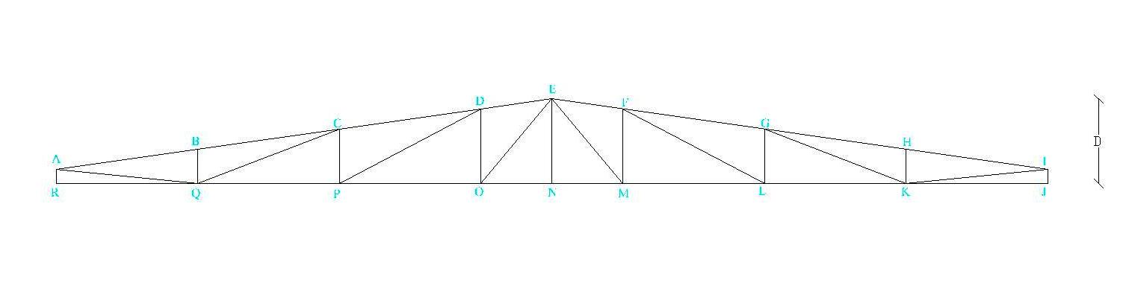
Design of Steel Structure
Performing Analysis and the Model’s Checks
Stress-Strain Relationship

Slide 81
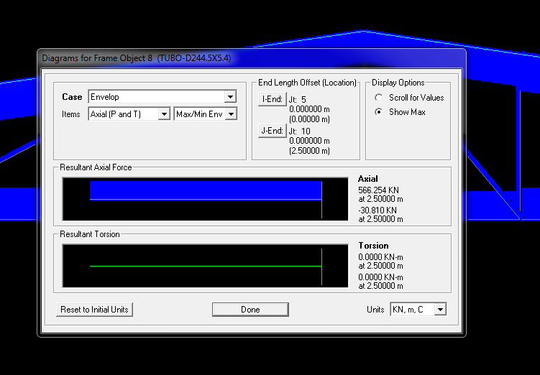
Design of Steel Structure
Performing Analysis and the Model’s Checks
Axial force in member MN.

Slide 82
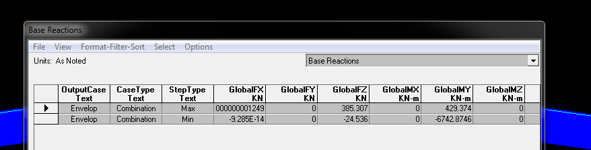
Design of Steel Structure
Performing Analysis and the Model’s Checks
Global Fz

Slide 83


Design of Steel Structure
Performing Analysis and the Model’s Checks
Stress-Strain Relationship

Slide 84
Design of Steel Structure
Design of the truss’s members
The design was performed using SAP with selecting Pipe-sections.
The output results are shown in table 12 page 36.
Its clear that there are 3 different pipe sections due to defining design groups. The upper members will have the same section, also the internal members and lower members do.

Slide 85
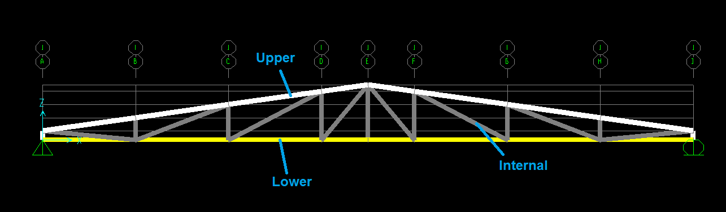
Design of Steel Structure
Design of the truss’s members

Slide 86


Design of Steel Structure
Design of the truss’s members
Manual Verification of Tension Members:
Lower Chord Design Group:
Take member QP

Slide 87
Design of Steel Structure
Design of the truss’s members
Manual Verification of Tension Members:
Internal Chord Design Group
Take member AQ

Slide 88


Design of Steel Structure
Design of the truss’s members
Manual Verification of Compression Members:
Internal Chord Design Group
Take member DO

Slide 89


Design of Steel Structure
Design of the truss’s members
Manual Verification of Compression Members:
Internal Chord Design Group
Take member GK

Slide 90


Design of Steel Structure
Design of the truss’s members
Manual Verification of Compression Members:
Upper Chord Design Group
Take member CD

Slide 91


Design of Steel Structure
Design of the truss’s members
Check Local Buckling
For Upper Chord Design Group
For circular hollow sections that have uniform compression, must not exceed

Slide 92

Design of Steel Structure
Design of the truss’s members
Check Local Buckling
For Internal Chord Design Group

Slide 93

Design of Steel Structure
Design of the truss’s members
Check Zero Force Members
Since all zero force members have the same section, we have to check the longest one.
Take member RQ as an example:

Slide 94
Design of Steel Structure
Design of Connections
E70xx weld is used Fu = 482 Mpa.
Partial weld is used for all connections.
The results of the design process are shown in table 13 page 41. here a sample calculation of weld size was illustrated below:
Take Connection B

Slide 95
Design of Steel Structure
Design of Connections

Slide 96
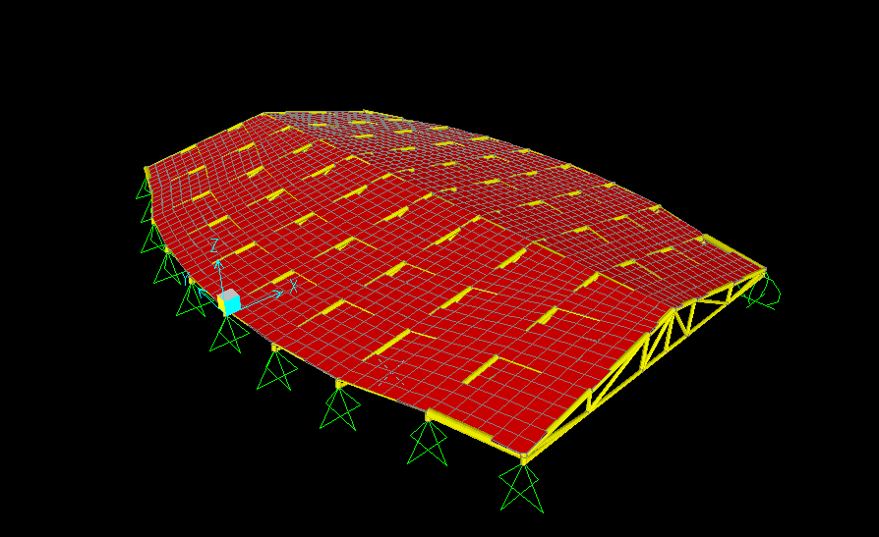
Design of Steel Structure
3D Model

Slide 97


