Slide 1
NAQSH
By: Haya Al-Barghouthi
Hadeel H. Hamdan.

Slide 2
Outline:
Introduction (What it NAQSH).
The importance of NAQSH.
Hardware Components.
Software Part.
Problems & Constraints.
Our Future Vision.
Demo.

Slide 3
Introduction
Project Description
Naqsh, is a CNC laser Engraving machine, that is a CNC machine moving in two axises X and Y, in order to move the engraver part, which is the laser in both directions.

Slide 4
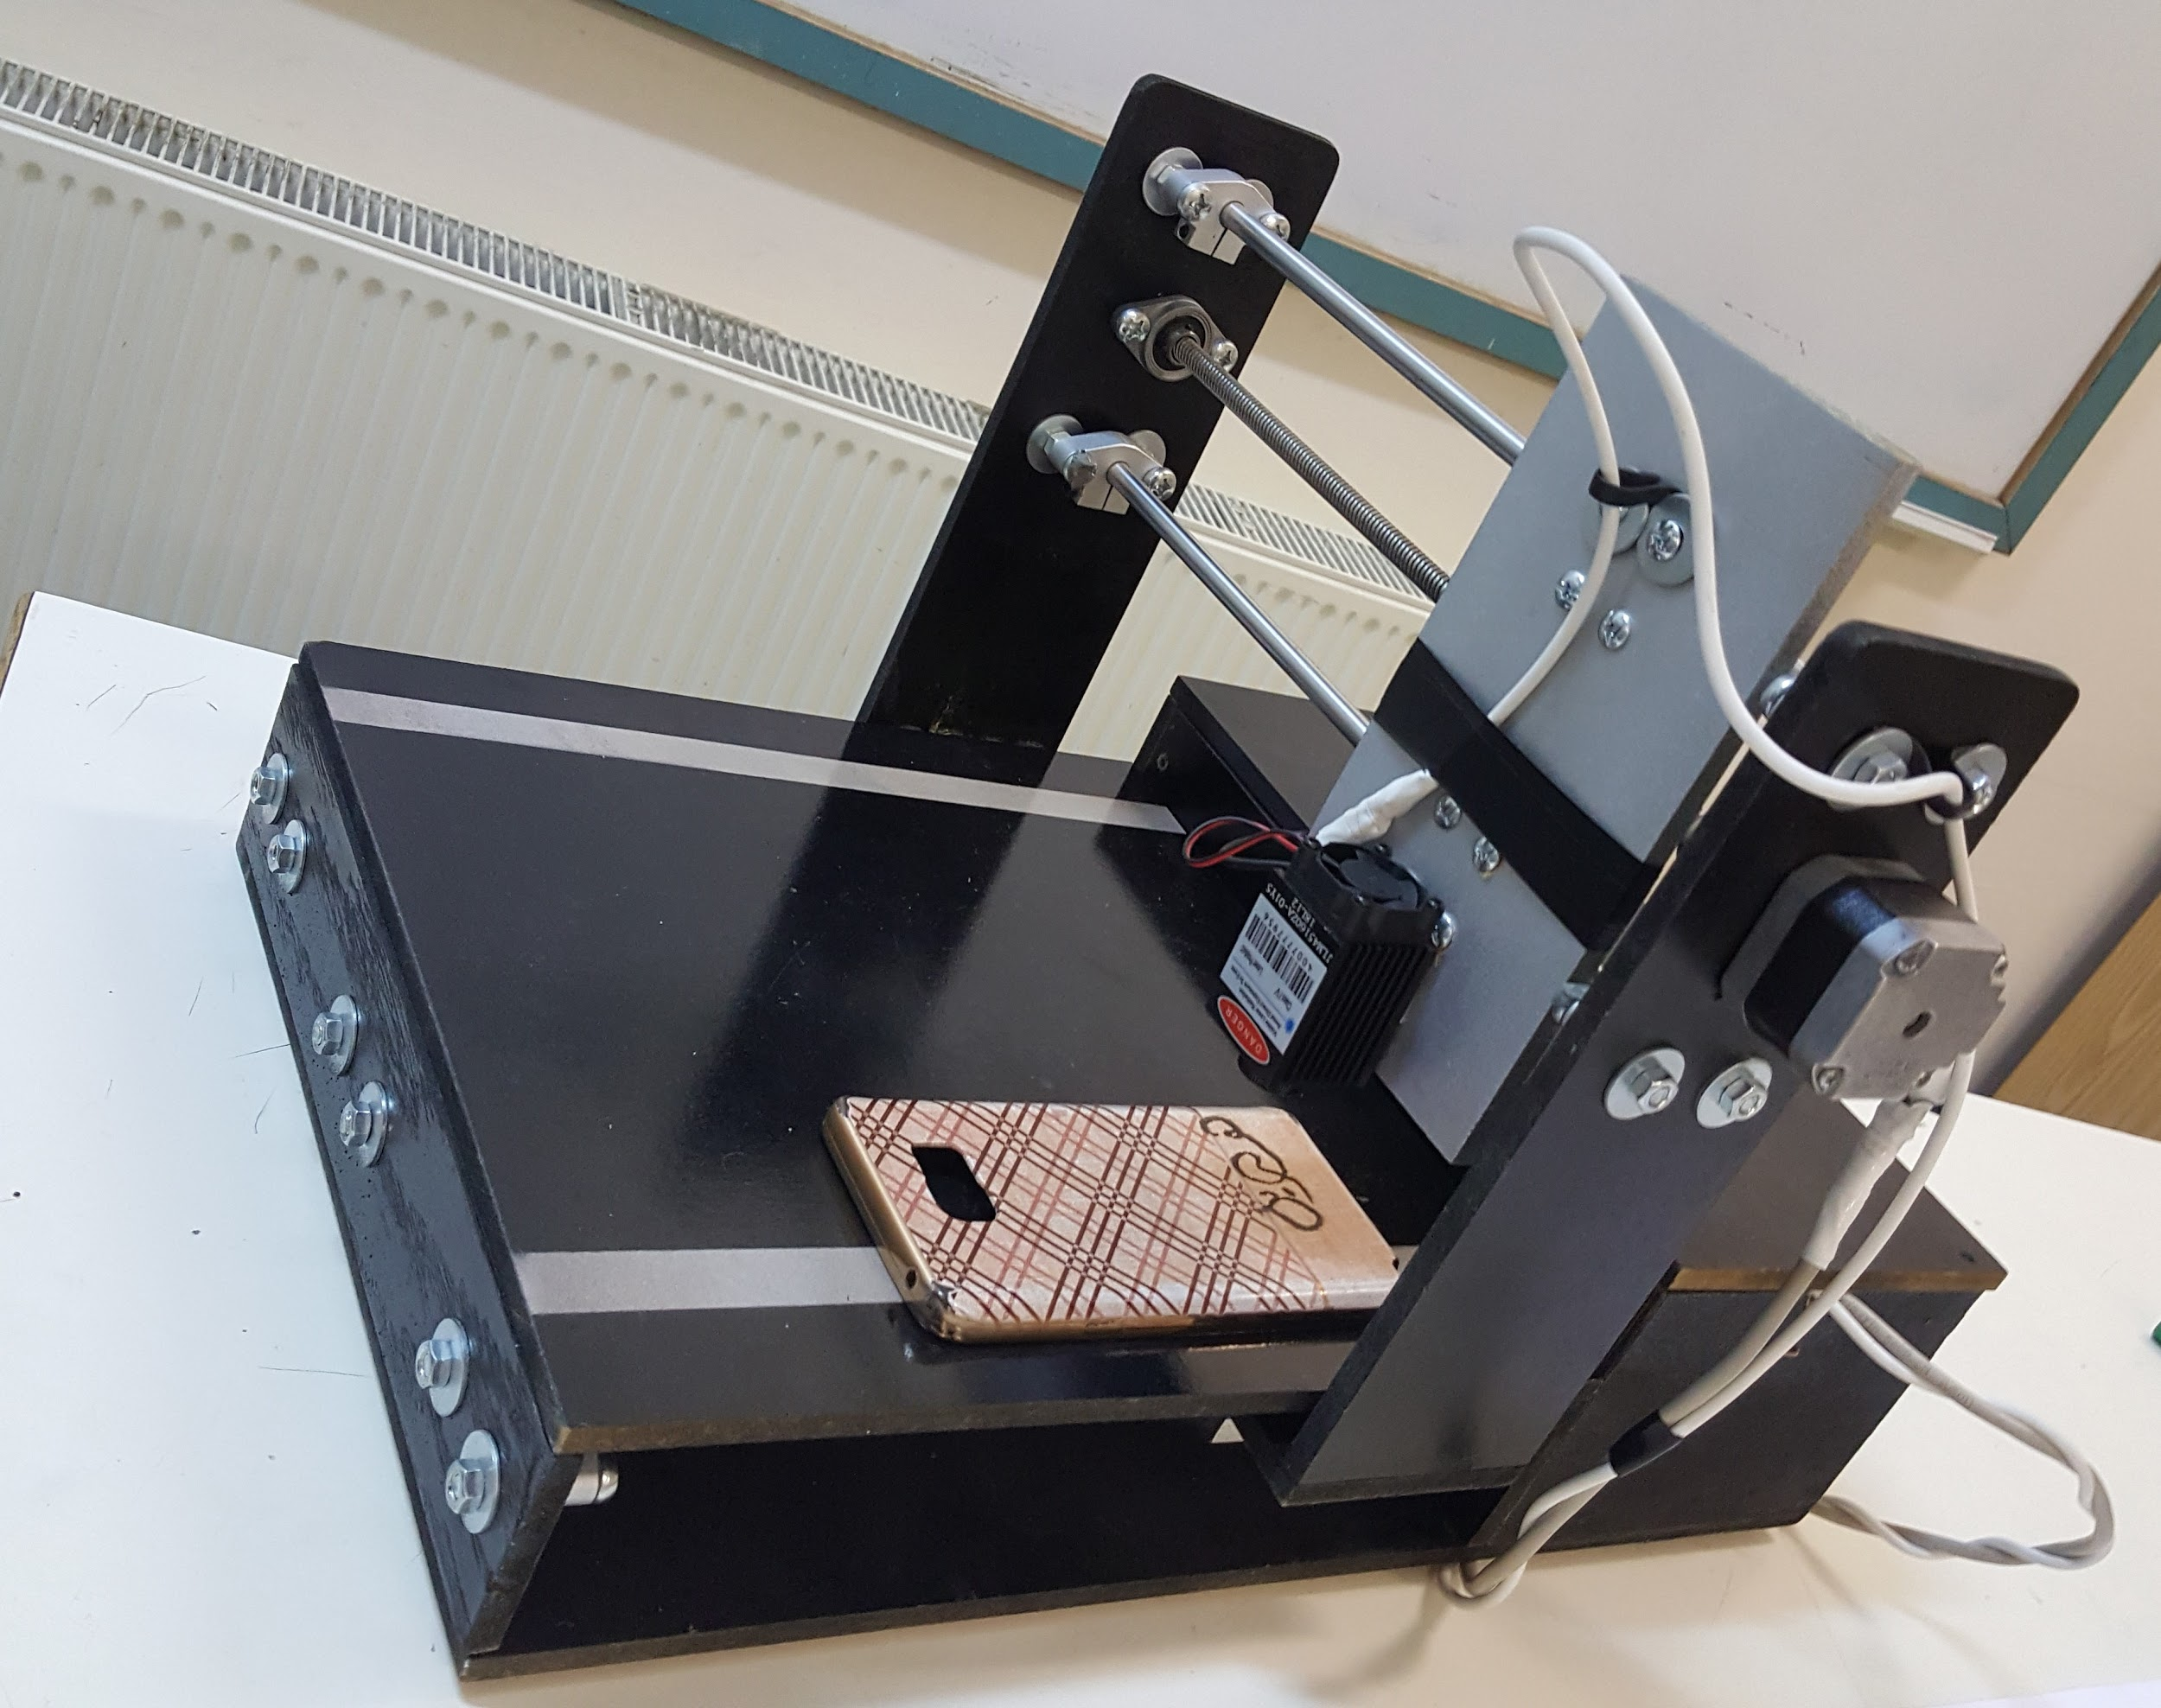
Intoduction Cont...
Project Description
The design will be loaded on the computer, which will communicate with the Arduino via serial port to move the stepper motors.

Slide 5
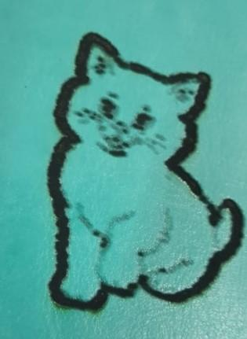
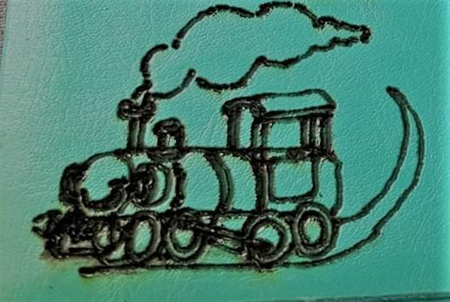
The Importance of NAQSH
By using Naqsh, we can engrave any design in different material, such as woods, plastics, cartons and paper. Naqsh is a beautiful project that aim to help you personalize most of your items with any design.

Slide 6
The Importance of NAQSH
The basic idea of Naqsh is to build a product that you can give it the design you like whatever it is, and to apply it instantly to your custom things cheaply, quickly and accurately.
People are getting more and more interested in having their special and own marks within their things, and that requires an expert, money and time.

Slide 7
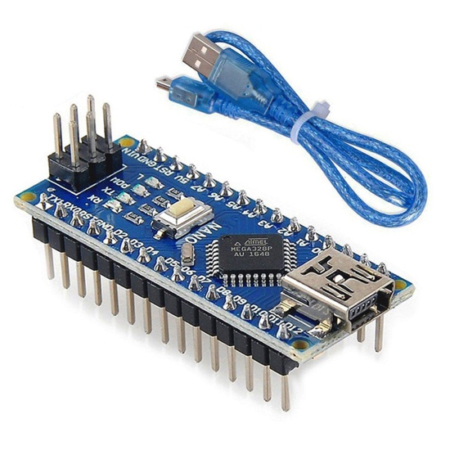
Hardware Component
Control Unit.
This system use Arduino nano board, which is a microcontroller board concept on the ATmega328P.

Slide 8
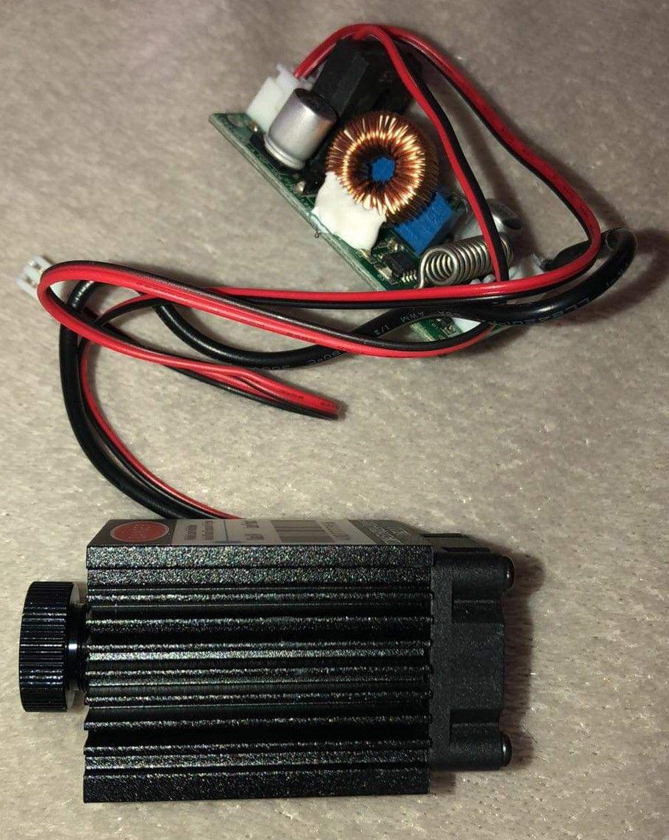
Hardware Components, Cont ...
Laser
It produces a 2.5W power and
445nm - 450nm wavelength
(Blue Purple-Ray).
and needs a 12V DC voltage.
the laser came with a TTL Driver Board.

Slide 9
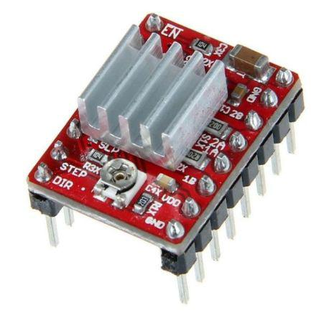
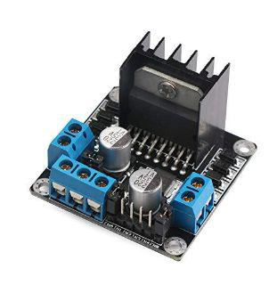
Hardware Components, Cont ...
Drivers
Stepper Motor Driver
Laser Driver

Slide 10
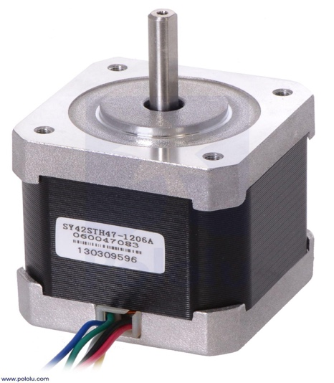
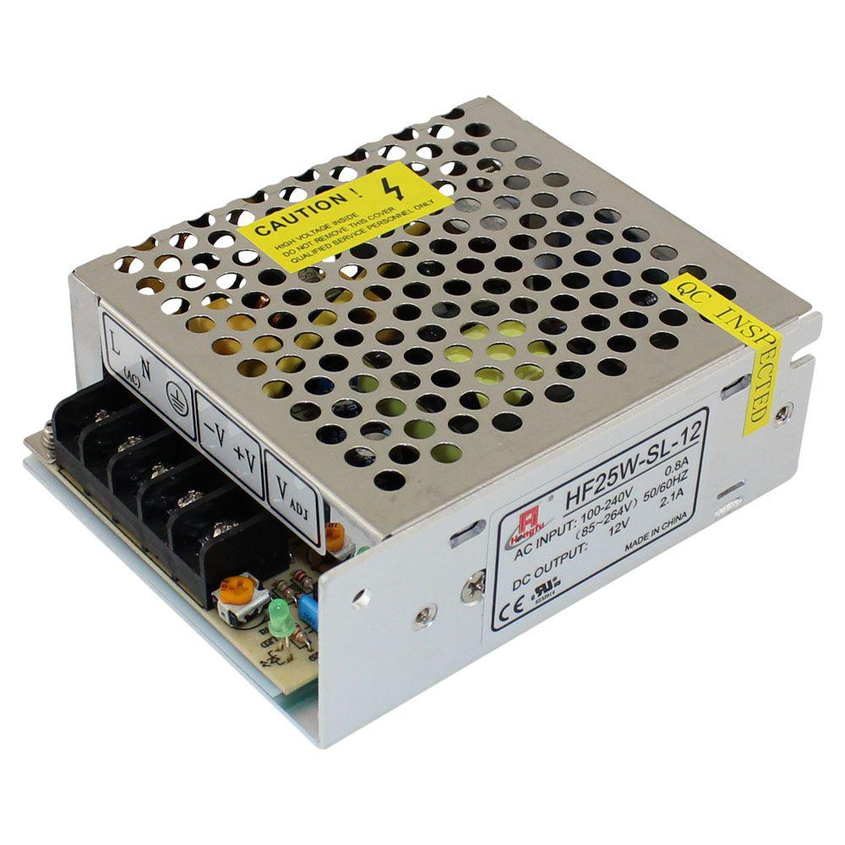
Hardware Components, Cont ...
Electronic Parts
Stepper Motor
Power Supply

Slide 11
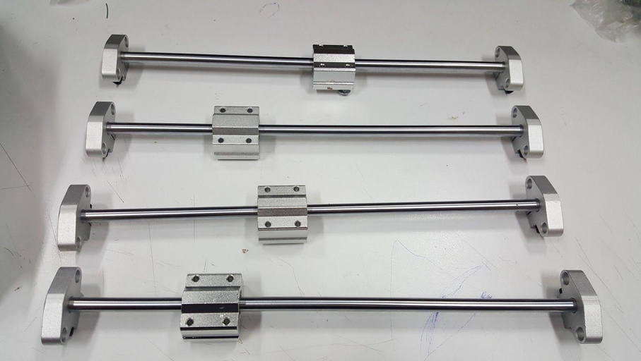
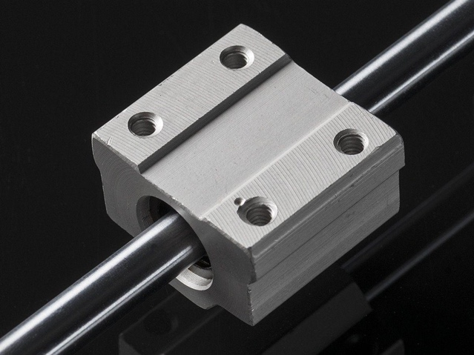
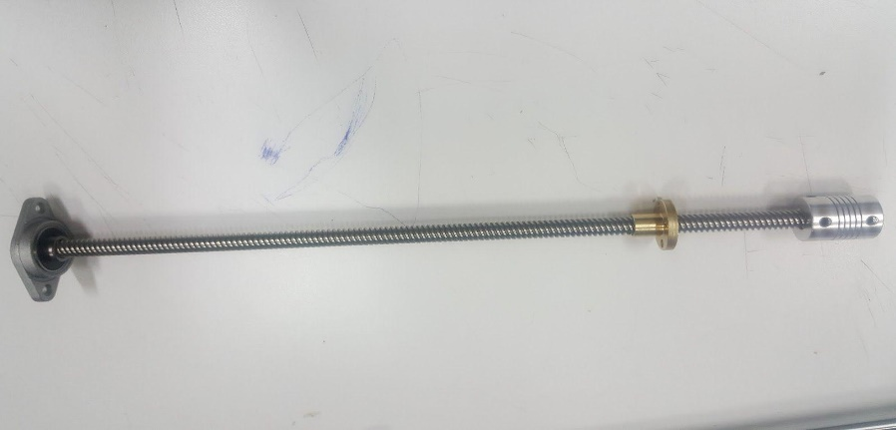
Hardware Components, Cont ...
Mechanical Parts
Rods
Linear Bearing
Load Screw

Slide 12
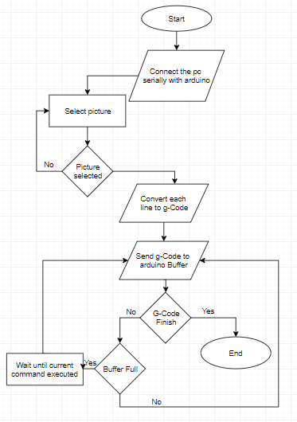
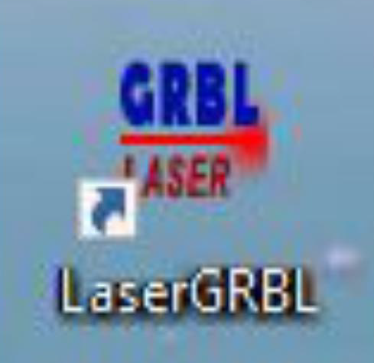
Software
We used LaserGRBL as a software.

Slide 13
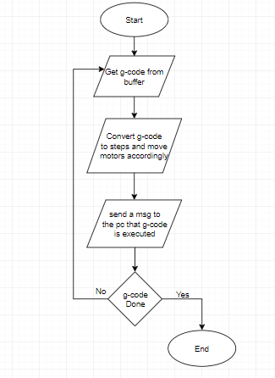
Software, Cont...
Arduino Procedure
First in the arduino we must import the grbl v1.1 library
The algo. will be similar to this

Slide 14
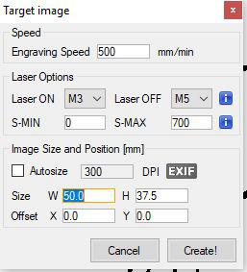
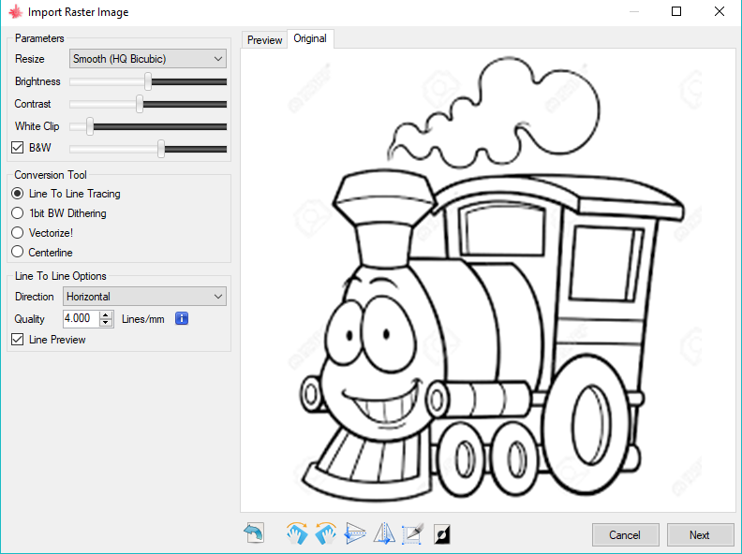
Software, Cont...
Software Editing Settings

Slide 15
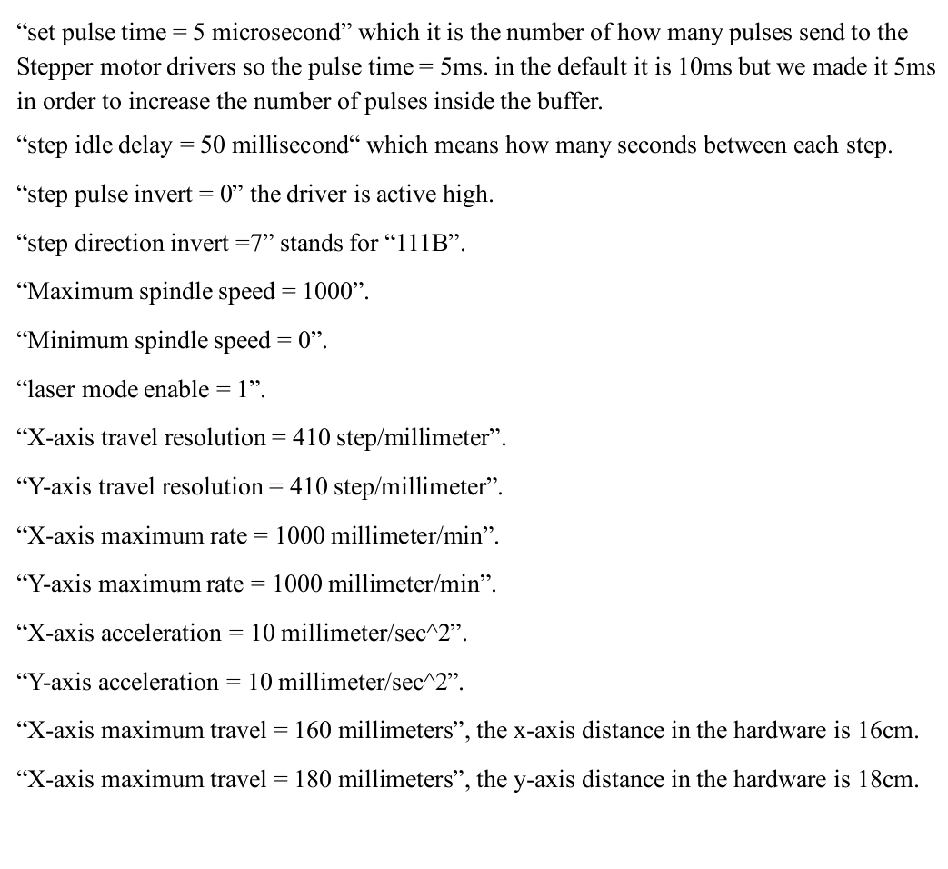
Software, Cont...

Slide 16
Problems & Constraints
Tools Constraints
The danger of the laser itself, as you know it is 2.5W and 450nm wavelength which danger for human eyes.
The fault in the laser driver that the laser stopped working at some points, so we used H-Bridge like a driver for the laser.
Time problem
the delay in getting the laser and controlling its movement.

Slide 17
Future work
Getting the product to be used more widely, and publish more artworks to people. In addition to adding Z-axis. In order to get 3D designs not only 2D drawings.
Make the box as a part of the body, and disable the run button unless the box is close.

Slide 18
DEMO

Slide 19


Slide 20


