Slide 1
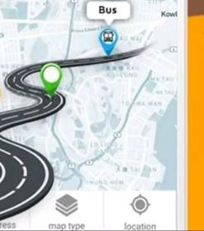

SMART SCHOOL TRACKING SYSTEM
Supervisor: Dr. Mai Abu Sair
An-Najah National University
2020
Notes:
Image used in the preview file :
https://unsplash.com/photos/bXq8pVfP-fY
https://unsplash.com/photos/dPQSboG6b_0

Slide 2


SMART SCHOOL TRACKING SYSTEM
Our Awesome Team
Baraa Saeed Dwaikat
Dana Bassam Raddad
Hillel Hussein Hamayel
Notes:
Image used in the preview file : https://unsplash.com/photos/amn3wfTkU_c

Slide 3

Vertical Timeline
Think Create Innovate
Idea Formation
Problem
Solution
Goals & Objectives
how are we doing this?
Geo-Fence
Two Factor Authentication
GPS tracking Device
Notes:
Multiple image used in Unsplash collection : https://unsplash.com/collections/4735930/thepress

Slide 4


Design
• Adobe XD WireFrames
• Application Demo
Development
Technologies & Services
Firebase
Node.js
React
Java
Google Cloud Functions
Competitors Features
&
Value Proposition
• PITS-School Nablus & DLBSS Gaza
• Smart School Tracking System
Notes:
Multiple image used in Unsplash collection : https://unsplash.com/collections/4735930/thepress

Slide 5

Difficulties
&
Challenges
Future Works
Monitoring cameras
Text to speech
Accuracy of estimation on Arrival time
Performance
2020
zoom meetings
Thanks
Notes:
Multiple image used in Unsplash collection : https://unsplash.com/collections/4735930/thepress

Slide 6

Idea Formation
Problem
Solution
Goals & Objectives
Notes:
Image used in the preview file : https://unsplash.com/photos/NbzjTLL95DM

Slide 7
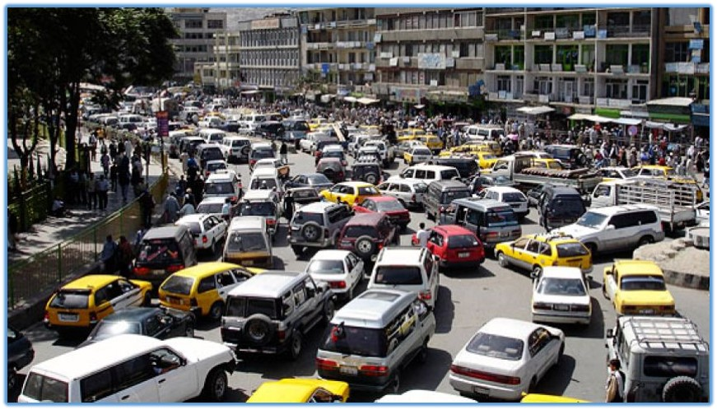
Problem
Traffic Jam
Affected people/institutions
01
School
02
Parents
04
Other Drivers
03
Nearby Institutions
Notes:
Image used in the preview file : https://unsplash.com/photos/CCy2UFLO1Mg

Slide 8
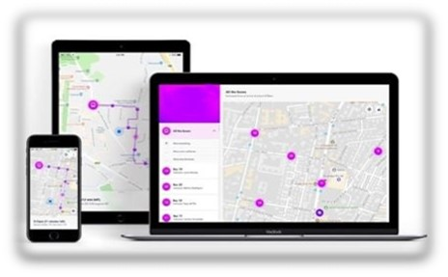
Solution
Smart School TRACKING System
The primary purpose: is to replace the traditional way of getting students to school and bringing them back, with a new and modern process that gave schools a good experience in solving this problem that resulted mainly in traffic jams.
Reduce the time lost in communication between parents and supervisors at the school entrance.
Takes safety and comfort for students and parents in less time.
Notes:
Image used in the preview file : https://unsplash.com/photos/ej7RYC0ED_c

Slide 9
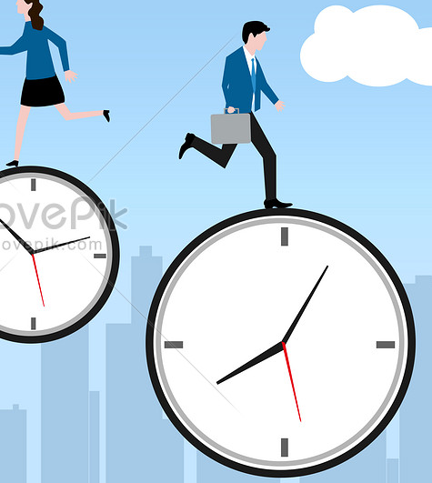
Goals & Objectives
01
Find a solution to traffic
congestions at the entrance
of the school.
02
Delivering students to their parents in a safe and fast way.
03
the principal can track the bus route in the city.
Notes:
Image used in the preview file : https://unsplash.com/photos/gMes5dNykus

Slide 10
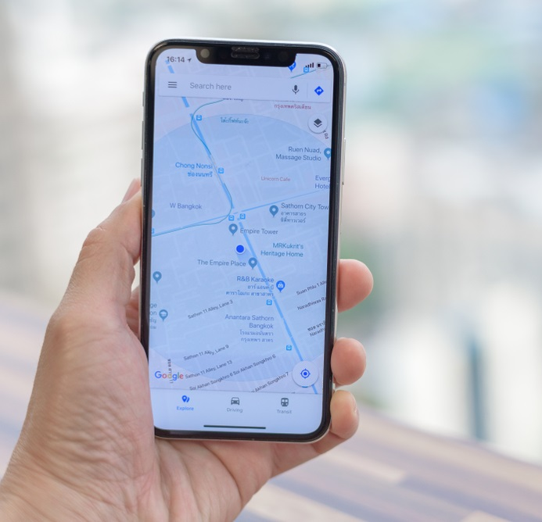
04
Enabling parents to know the location of the bus with a notice of the time to reach home.
05
Enabling parents to send a notification in the absence of the student.
06
the bus driver can view a map showing the location of the student house.
Notes:
Image used in the preview file : https://unsplash.com/photos/N2zk9yXjmLA

Slide 11

How Are We Doing This?
Notes:
Image used in the preview file : https://unsplash.com/photos/nenX2J7JltU

Slide 12
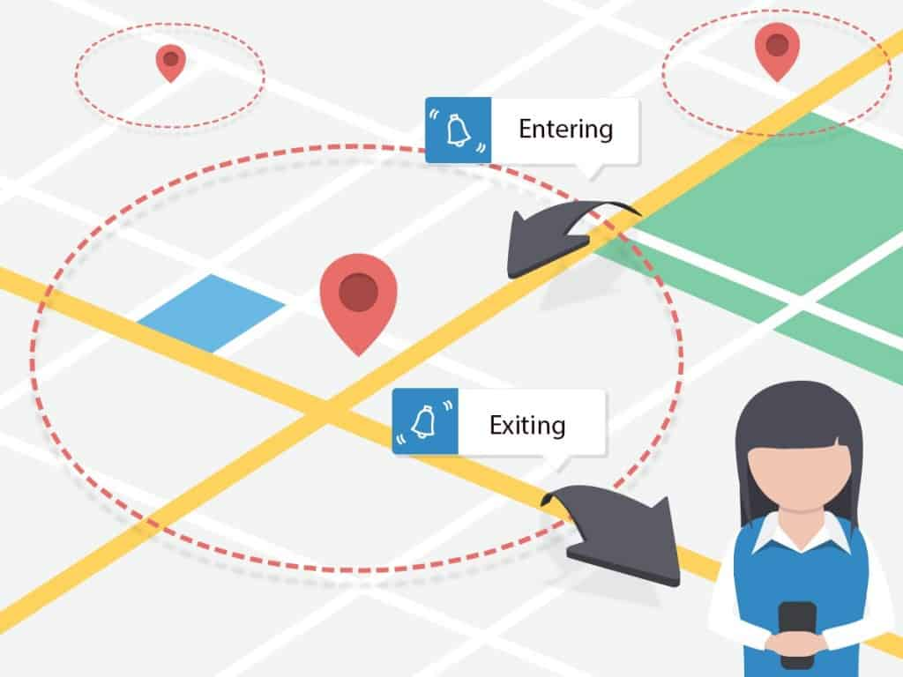
Geo-Fence
Global Positioning Systems (GPS)
Create a Geo-Fence by GPS location.
How does it?
1. Make a radius around that GPS location.
2. Creating an invisible fence that once the user enters.
3. Trigger a specific function.
01
How use?
The message will be received if a user enters that
Geo-Fence.
the message will
disappear if the user
leaves the Geo-Fence.
Notes:
Image used in the preview file : https://unsplash.com/photos/B933FT2BO5k

Slide 13
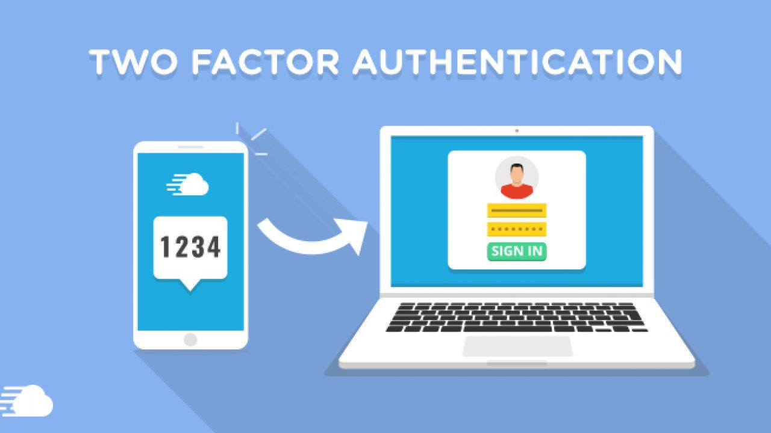
Two Factor Authentication
To ensure greater security for all users, and increase the safety for all the students and the human factor.
02
Twilio
Authentication on your mobile device.
How to use?
sign in(parent):
-when entering the school Geo-Fence the TFA sign-in method.
-Input a code generated via the mobile app .
- In addition to your account password to
sign in.
Notes:
Image used in the preview file : https://unsplash.com/photos/iGrsa9rL11o

Slide 14
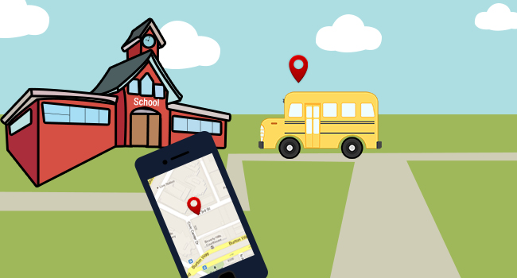
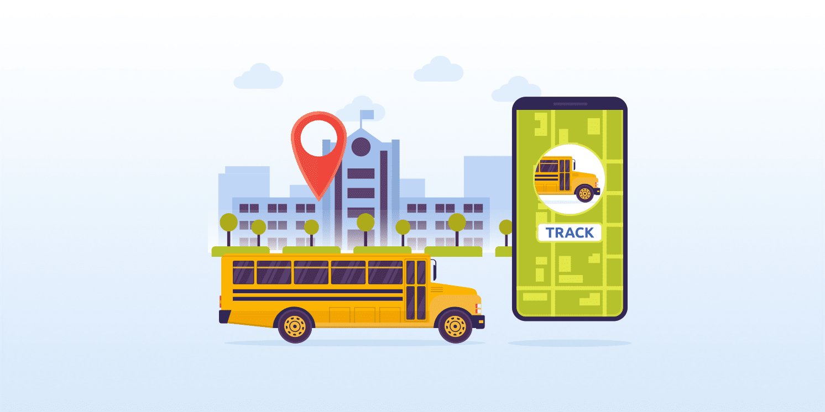
GPS Tracking
Tracking Buses
The real-time GPS location of school buses, both to parents and administrators..
Parent notifies : if a parent notifies the school that their child is sick and won’t be attending, the driver can receive notification and change the route while driving.
Geo-Fence Around Parent's house:
.
03
Notes:
Image used in the preview file : https://unsplash.com/photos/iGrsa9rL11o

Slide 15
Design
APPLICATION DEMO

Slide 16
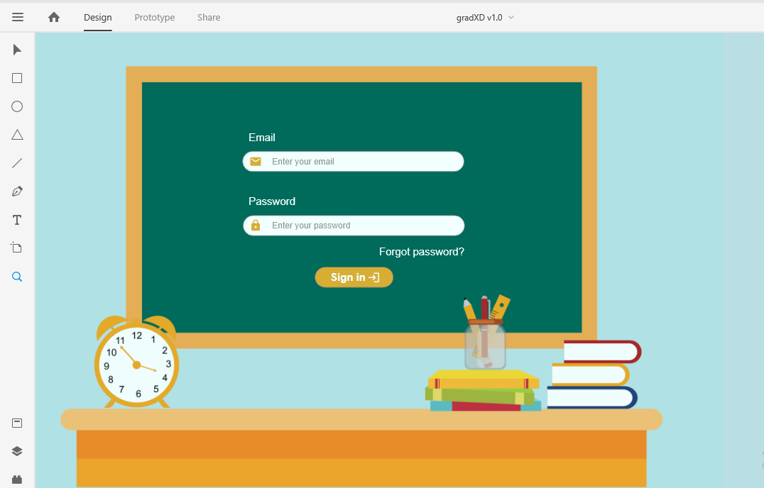
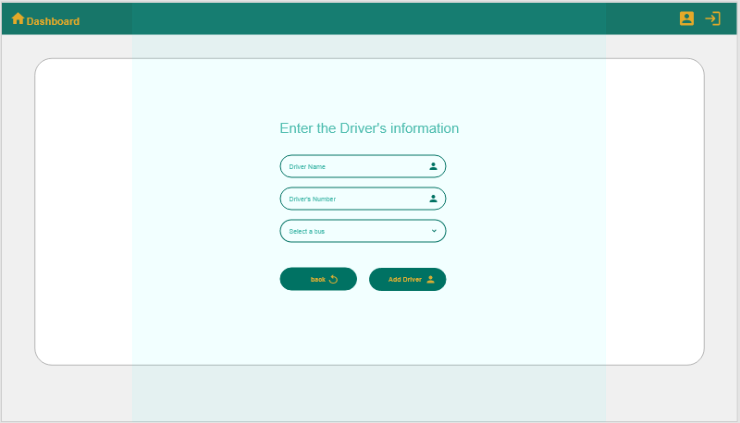
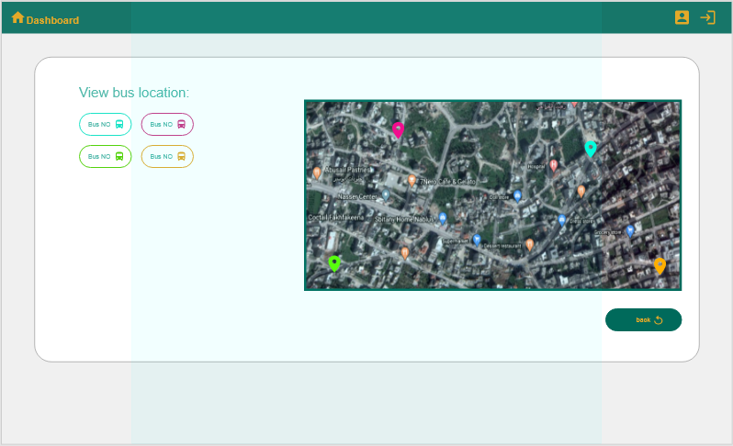
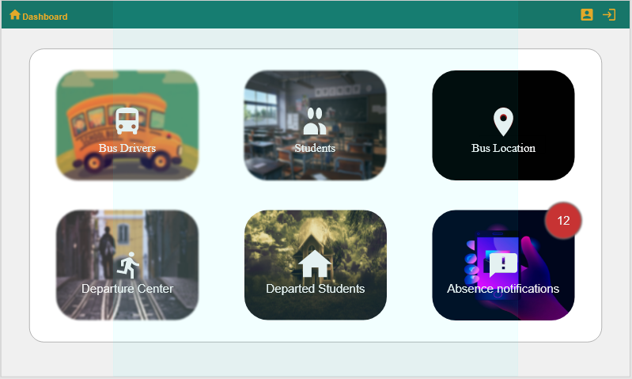
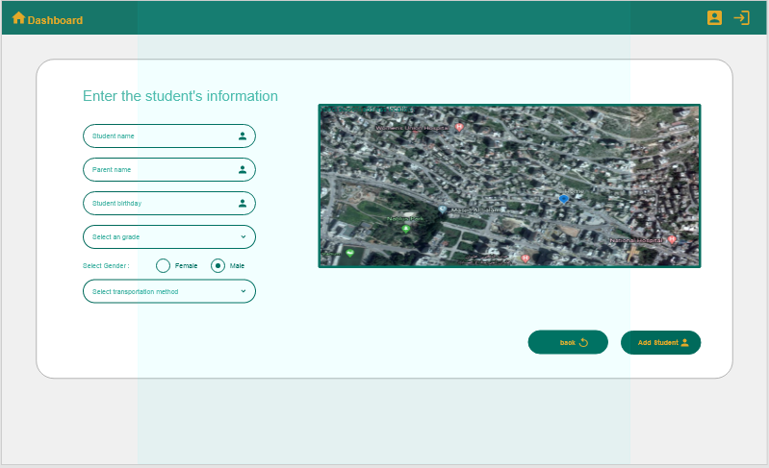
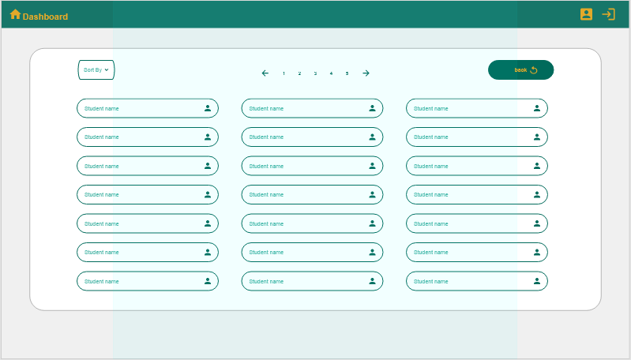
REACT APPLICATION DEMO

Slide 17

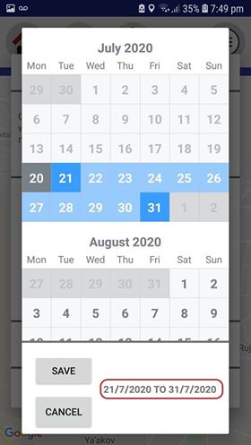
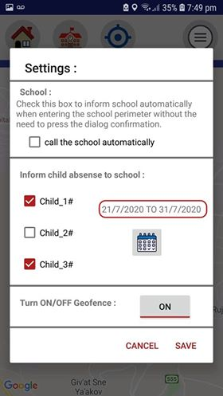
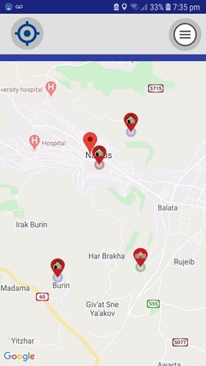
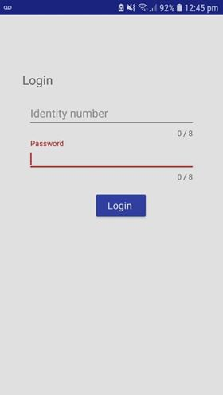
Mobile App
Tracker

Slide 18
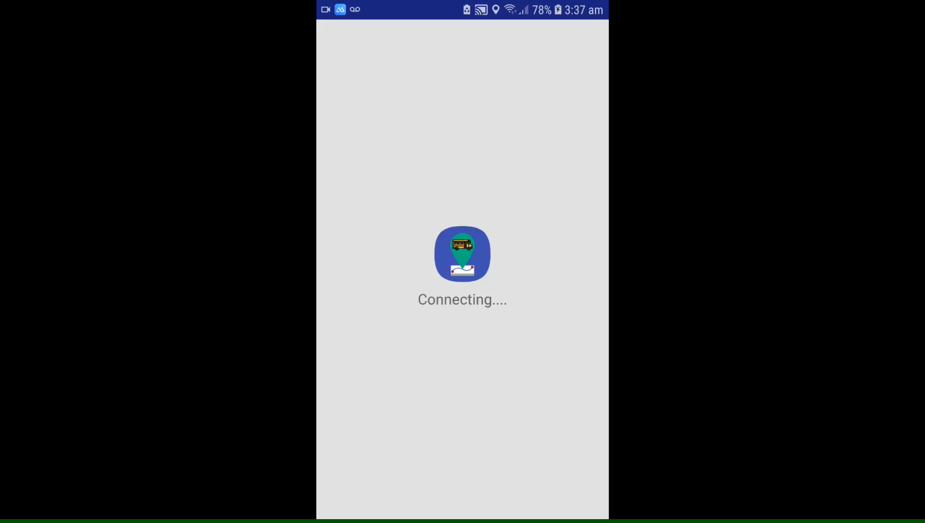
Presentation Template
Notes:
Image used in the preview file : https://unsplash.com/photos/ej7RYC0ED_c

Slide 19
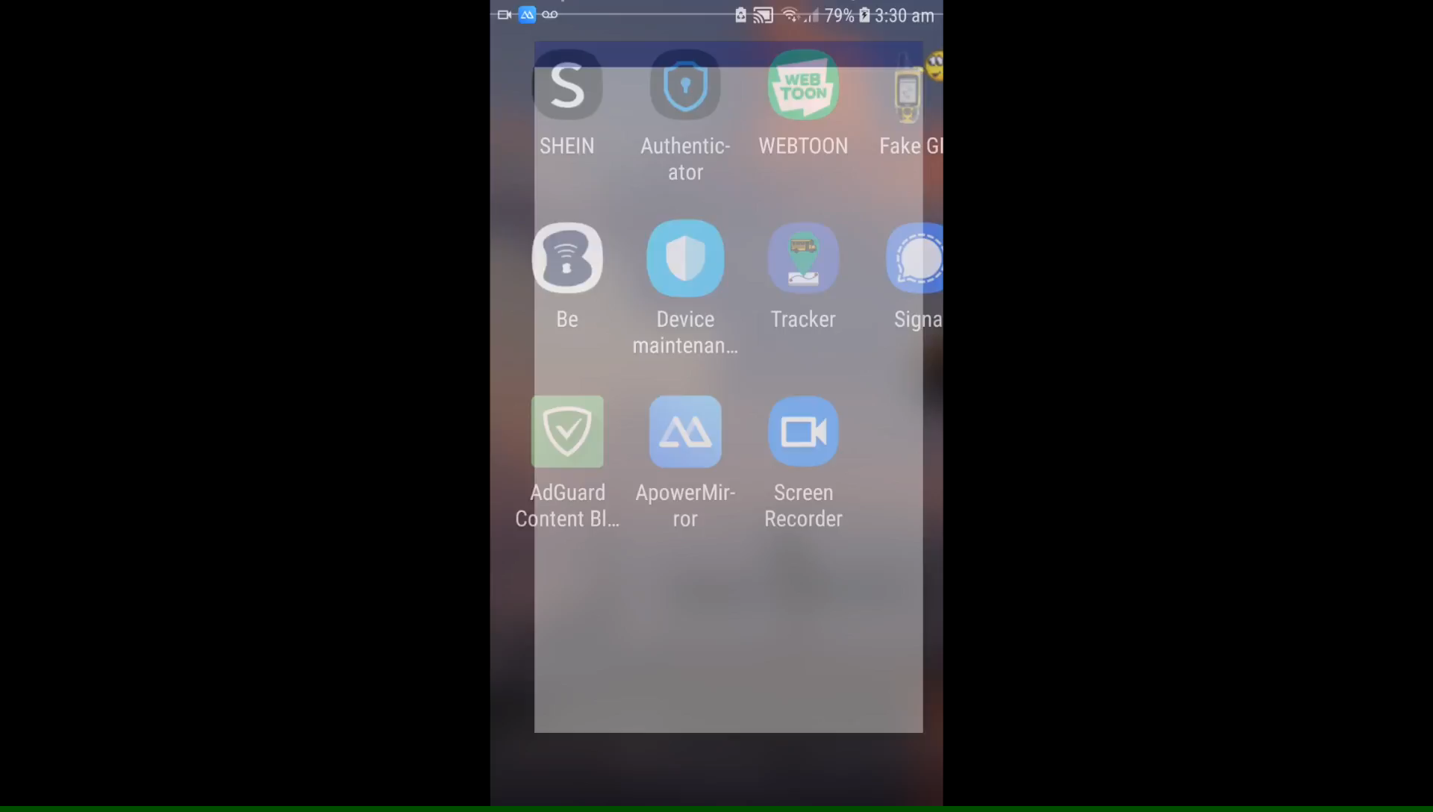

Slide 20
Development
Technologies & Services

Slide 21





Back-End &
Front-End
Back-End
Back-End
Front-End
Services
Google Cloud
Functions
Firebase
Node.js
React
Java

Slide 22



Firebase (Back-End)
What?
Development platform with real-time database and backend as a service.
Why?
1. Real-time Database
2. Fast Development
3. Authentication
4. Hosting
5. Geo Database
Notes:
Image used in the preview file : https://unsplash.com/photos/pfNmcyaT_es

Slide 23



Node.js (Back-End)
What?
The Node.js run-time environment includes everything you need to execute a program written in JavaScript.
Why?
1. Node.js® is a JavaScript runtime built on
Chrome’s V8 JavaScript engine.
2. Node.js uses an event-driven, non-blocking
I/O model that makes it lightweight and
efficient.
3. Node.js’ package ecosystem, npm, is the
largest ecosystem of open source libraries in
the world.
Notes:
Image used in the preview file : https://unsplash.com/photos/pfNmcyaT_es

Slide 24



React (Front-End)
What?
React is a declarative, efficient, and flexible JavaScript library for building user interfaces. It lets you compose complex UIs from small and isolated pieces of code called “components”.
Why?
1. Simplicity
2. Easy to handle
3. Data Binding
4. Testability
5. Performance
Notes:
Image used in the preview file : https://unsplash.com/photos/pfNmcyaT_es

Slide 25



Java (Back-End & Front-End)
Google Cloud Functions (Service)
What?
Is a programming language and computing platform. There are lots of applications and websites that will not work unless you have Java installed, and more are created every day. Java is everywhere!
What?
Serverless execution environment to run and scale code in the cloud.
Why?
1. Cloud Messaging
2. Push Notification
Why?
1. Secure
2. Platform independence : that means Java programs can be run on many different types of computers.
Notes:
Image used in the preview file : https://unsplash.com/photos/pfNmcyaT_es

Slide 26

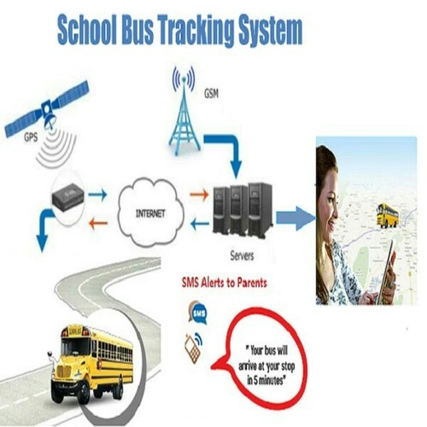
Competitors Features
&
Value
Proposition
Notes:
Image used in the preview file : https://unsplash.com/photos/Pf5Pj7A5ddA

Slide 27


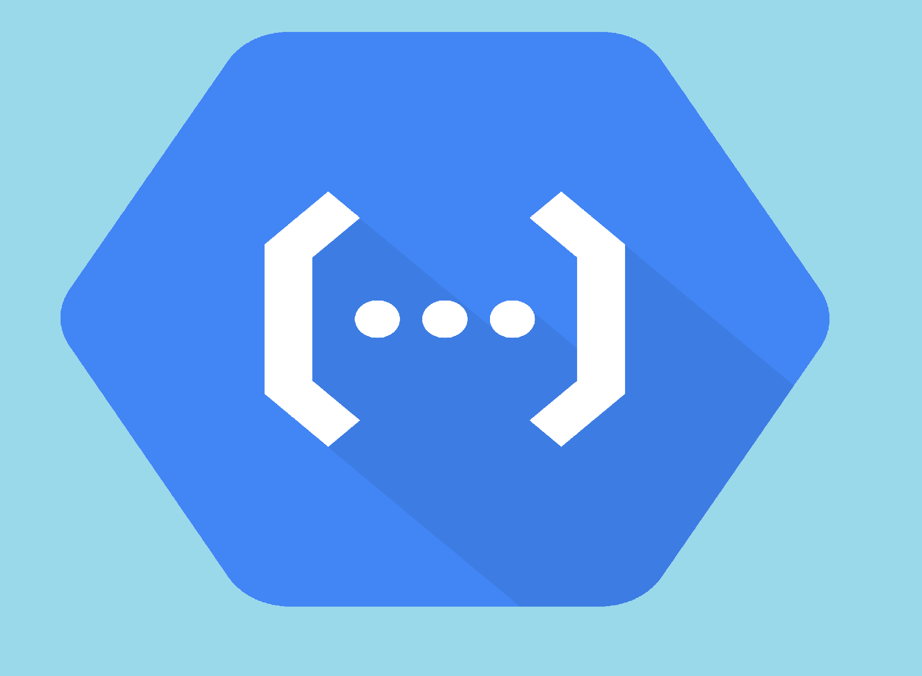
Competitors Features
Value
Proposition
Smart School Tracking System
PITS-School Nablus
&
DLBSS Gaza
Clear and accurate maps.
Solution for parents who self-drive their children.
Traffic jams solutions.
Tracking busses.
Notifications between parents and supervisors.
Bus estimated arrival time.
Solid performance with an intuitive user interface.
Tracking busses by the school administration.
The Bus Driver can view the map on his phone.
Notes:
Image used in the preview file : https://unsplash.com/photos/6_9TzlWhpdM

Slide 28

Difficulties
& Challenges

Slide 29
Difficulties and Challenges
Development of 2 different types of software: Web & Android.
01
Difficulty and time needed to learn and integrate new development tools like React.js and Firebase.
02
Short Period of time for research, development, testing, ...etc.
06
03
Lack of similar solutions and apps that solve this exact problem to research from.
The closing of related institutions and schools due to Covid-19. Inability to test the app, meet and get direct feedback from parents and school administrators due to the lockdown.
05
.
04
Difficulty acquiring hardware parts duo to cost & unavailability.

Slide 30

Future Work
Notes:
Image used in the preview file : https://unsplash.com/photos/2t-DQlQo0oU

Slide 31
Monitoring Cameras

At the school entrance to identify the car number of the guardian upon arrival to receive the student, and send a confirmation of receipt to prepare the student for departure.
01
Image Processing
automatic audio

Generate human-like audio from written text.
The presence of an automatic audio system which calls the names of students to leave.
02
Text to
Speech
Accuracy of Estimation on Arrival Time

03
Artificial Intelligence
Create an artificial intelligence program to automatically study and analysis bus route data to provide the most optimum estimated arrival time.
Shortest path
The least traffic jam
Performance (increase battery life and decrease network usage)
04
Smart Algorithms

If the user is not on moving, there is no need to contact the server, send their location, or initialize listeners as there is no need while stationary. will make sure only up-to-date and relevant messages will be tracked by the device.

Slide 32
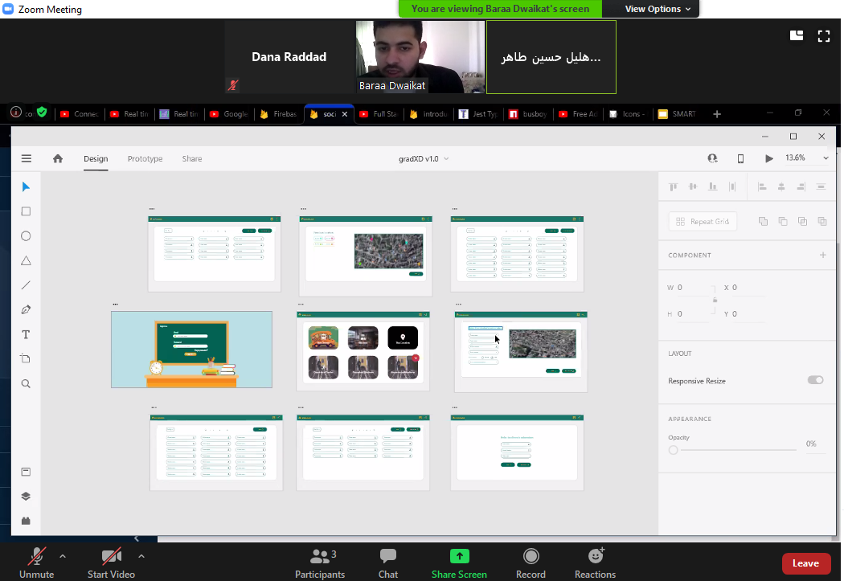
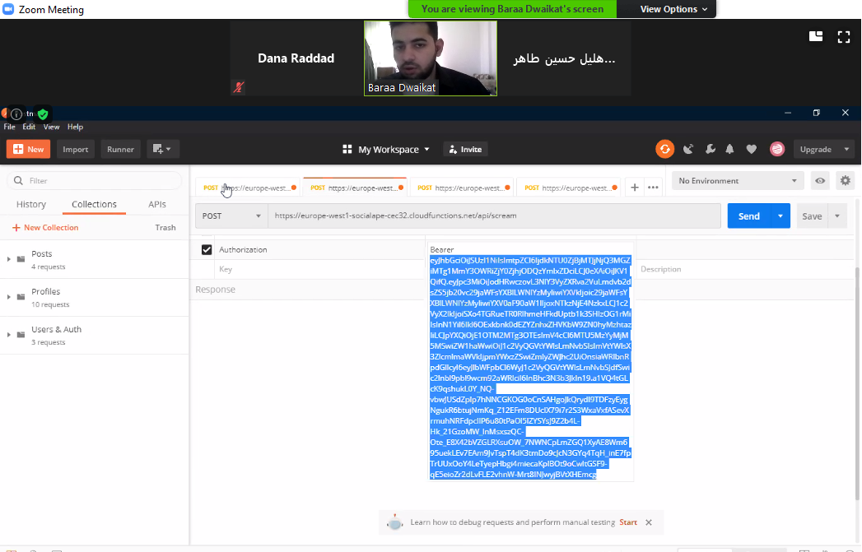
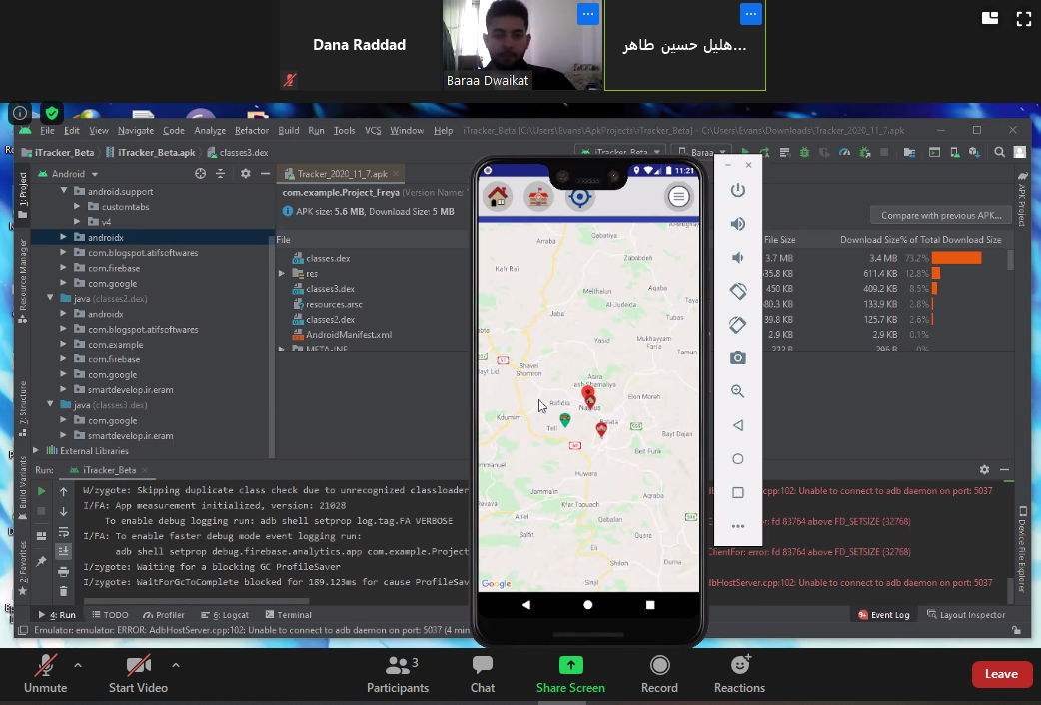
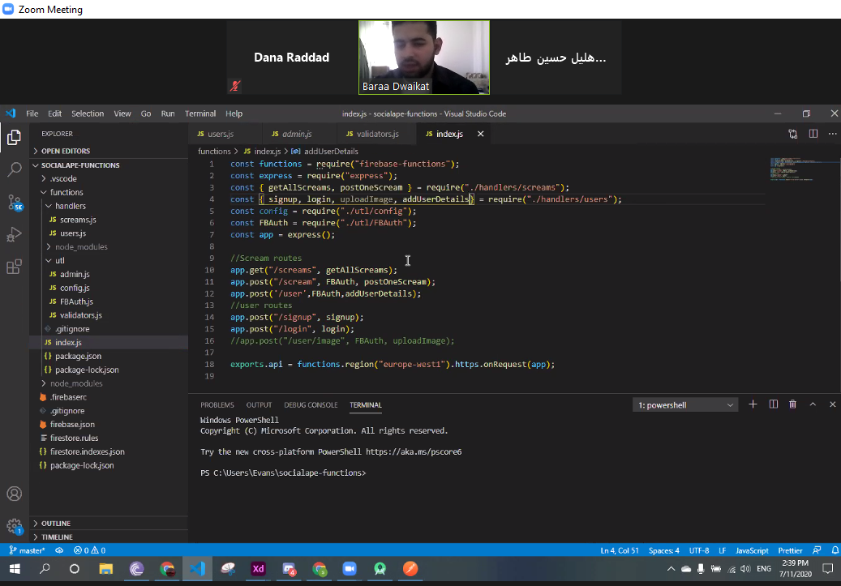
zoom meetings
Notes:
Multiple image used in Unsplash collection : https://unsplash.com/collections/4735930/thepres

Slide 33
Thanks
SMART SCHOOL
TRACKING SYSTEM
An-Najah National University
2020
Notes:
Image used in the preview file : https://unsplash.com/photos/jeWWV3OqN78

