Slide 1


Aug 2023
Smart Vending Machine
By :
Zeina Abu-Dheir & Mohammad Jury
Supervisor :
Dr. Hanal Abu-zant

Slide 2

Agenda
1
Main idea
2
Features
3
Hardware Modules
4
Constraints
5
Future work

Slide 3


Main Idea
Smart vending machine is a machine that serves pharmacists in dispensing medications effortless.
Our aim from this machine is to save effort and time for the user .

Slide 4

Features
1
Efficient Medication Retrieval
2
User-Friendly Interface
3
Cell-Based Storage
No need to search through different locations for medicines.
The interface is intuitive and designed to be easily understood and operated by pharmacy staff.
Each medicine type is placed in a specific cell.

Slide 5
Features
4
Secure Cabinet
5
Enhanced Pharmacy Operations
6
Temperature Control
Access is restricted through a fingerprint recognition or a passcode.
Optimize pharmacy operations by offering a solution that minimizes disruptions and streamlines medication management, leading to improved overall workflow.
The machine maintains a constant temperature by using a temperature sensor and a fan.

Slide 6

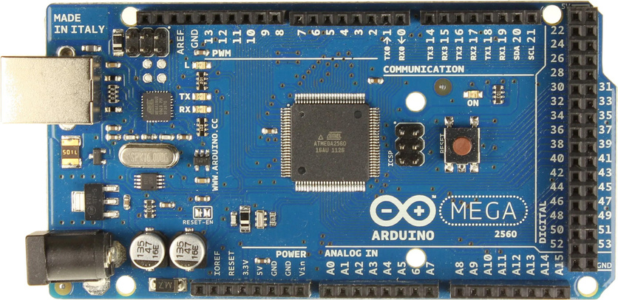
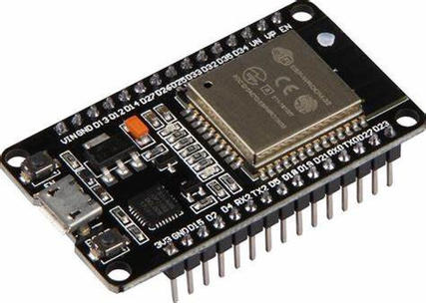
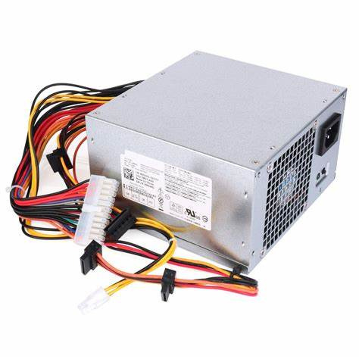
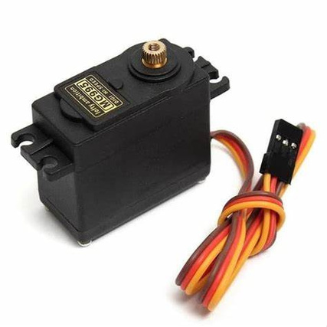
Hardware Modules
Arduino mega
ESP32-WROOM
Power supply
Servo motors

Slide 7
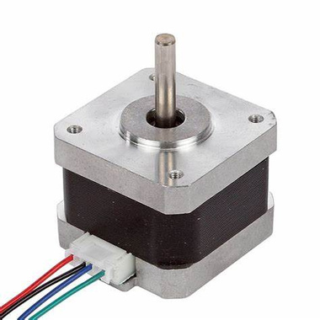
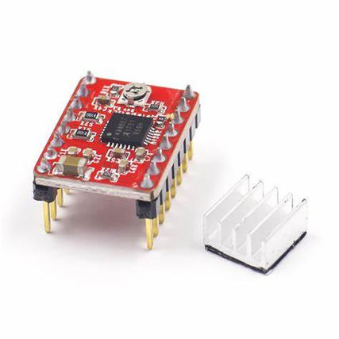
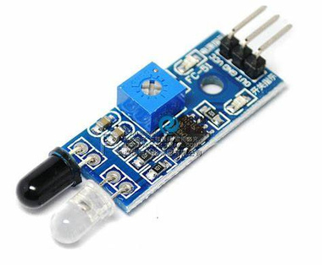
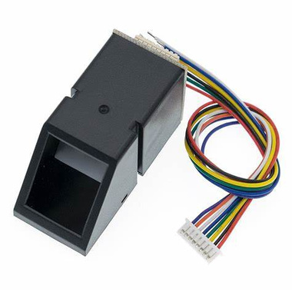

Hardware Modules
Stepper motors
Stepper driver
IR Sensors
Fingerprint Sensor

Slide 8
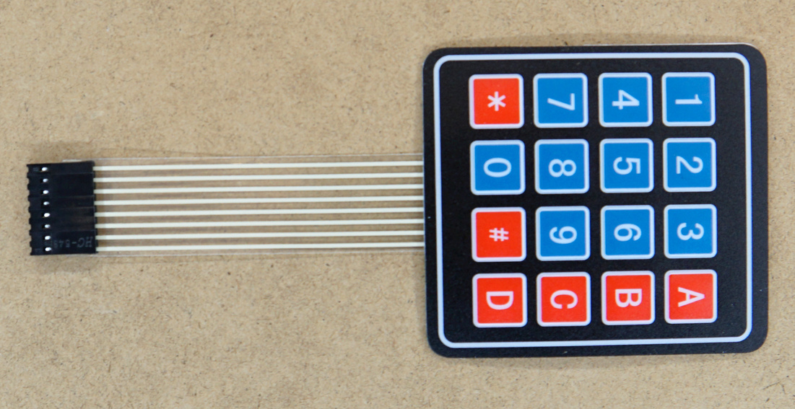
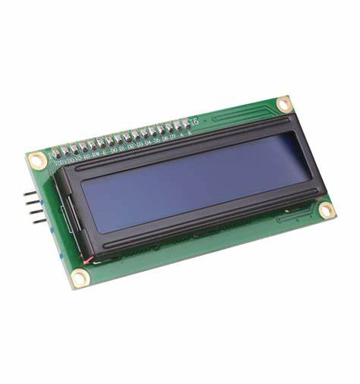
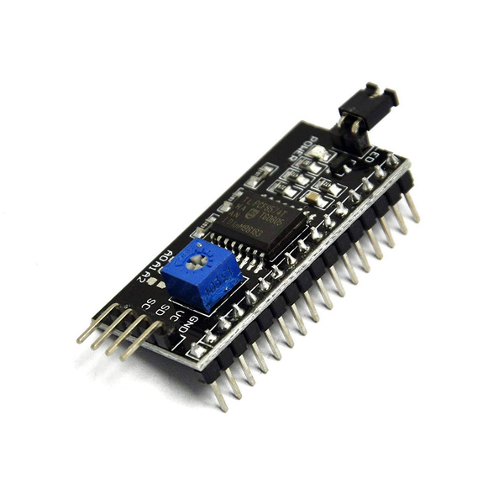
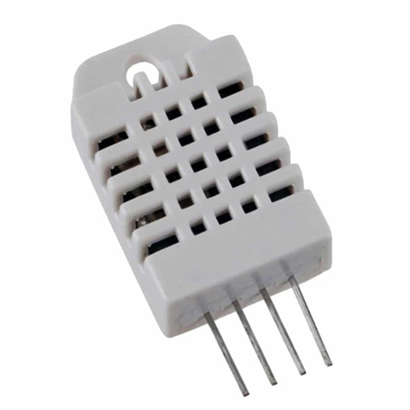

Hardware Modules
Keypad
4x4
LCD 16X2
I2C module
Temperature sensor

Slide 9
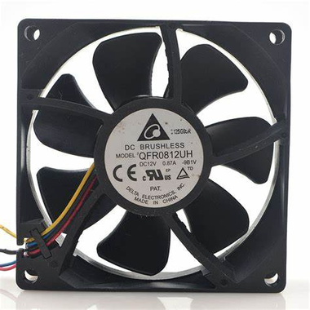

Hardware Modules
Fan

Slide 10
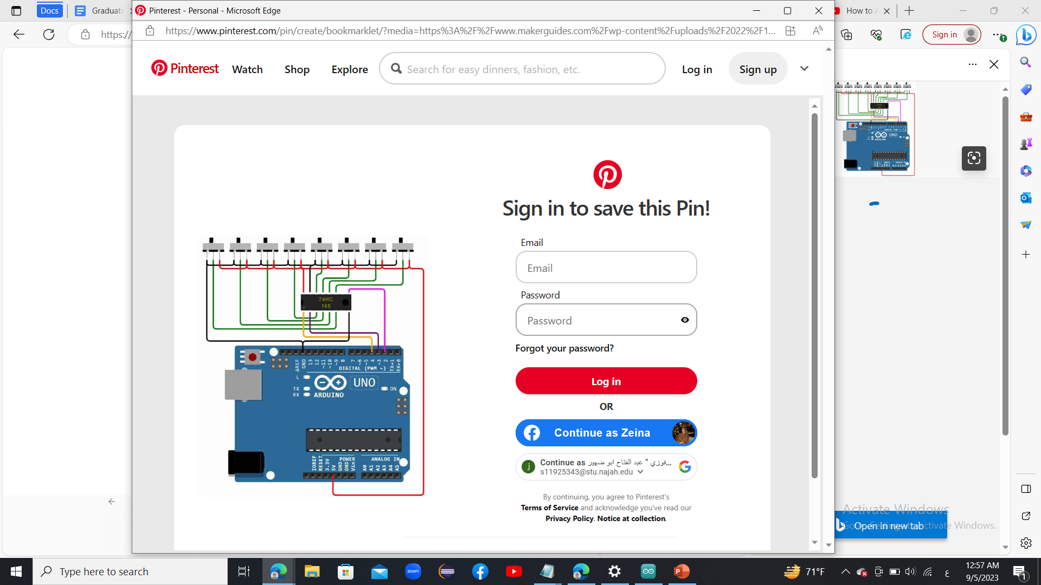
Expandability
  using a shift register

Slide 11
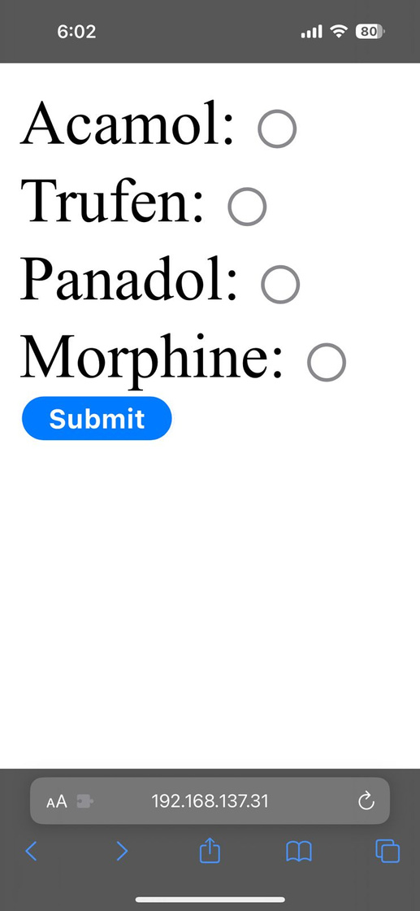
User Interface

Slide 12
Constraints
  Servo motors
  Size of the basket
  Design of the outer shape of the machine

Slide 13
Future work
  Adding a filling mechanism to the machine
  Replacing the basket with an arm
  Adding a payment method to the machine
  Adding a database so that we can add new medicines easily

Slide 14
Thank you for Listening!

