Slide 1


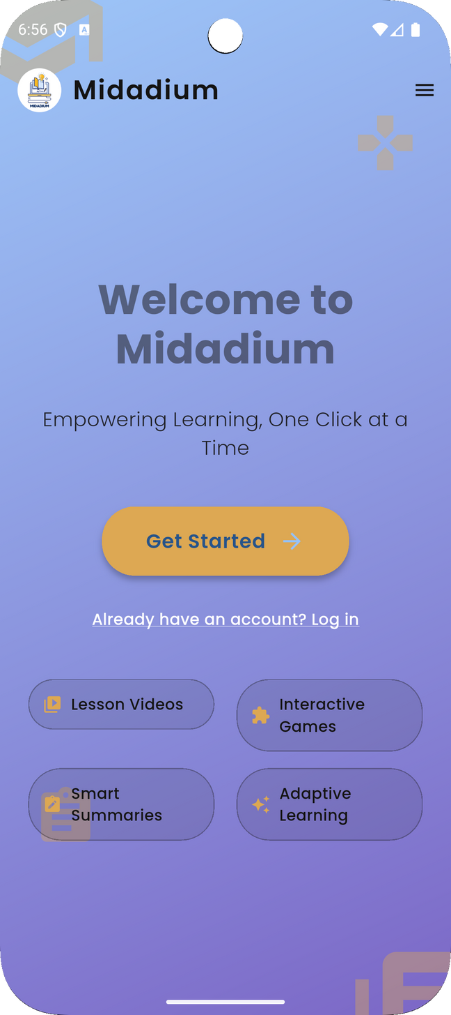



Introducing Midadium
Revolutionizing School Learning with AI-Powered Personalization

Slide 2


















PRODUCT DEVELOPMENT ROADMAP
Introduction
Features Overview
Screens & Demo
System Architecture
Core & AI-powered features
Show UI in action
Problem & Solution
System Architecture
Future Work & Q&A
Why Midadium is needed
Tech Stack & Data Flow
What’s next for Midadium

Slide 3





WHY MIDADIUM?
  AI-generated flashcards & summaries
  Smart content conversion from video
  Personalized learning roadmap (by AI)
  Real-time chat & notification system
  Feedback-driven recommendations
  One-size-fits-all lessons
  Manual workload for teachers
  No personalized learning paths
  Poor student engagement
  Delayed feedback & interaction

Slide 4


FEATURES OVERVIEW
What Can Midadium Do
🧑‍🎓 STUDENT
👩‍🏫 TEACHER
🛠️ ADMIN
  View Enrolled Courses
  Watch Video Lessons
  AI Content Converter
  AI Roadmap Generator
  Submit Assignments
  Send Reviews to Teachers
  Real-Time Chat + Chat Room
  Report Problems to Admin
  Upload Lessons (Video/Audio)
  Create Assignments
  Review Submissions
  Request New Courses
  AI Suggestions from Student Reviews
  Real-Time Chat (with Students)
  Create Teacher Accounts
  Approve / Reject Course Requests
  Manage Courses & Enrollments
  Manage Students & Assignments
  Resolve Reported Problems
  Full System Monitoring & Control

Slide 5

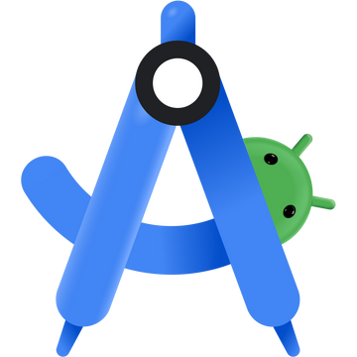



System Architecture
Frontend (Flutter App)
01
04
Socket.IO (Node.js Layer)
Role-based interface (Admin / Teacher / Student)
Sends requests to backend via REST API
Real-time notifications
02
AI Services
Backend (Node.js + Express)
05
AssemblyAI
Gemini
AI Roadmap Generator
REST API logic
Controllers, Models
JWT Authentications
Firebase
Database: MongoDB
06
Realtime Database or Firestore for Chat
Firebase Storage
03
Users (admin, teacher, student)
Courses, Assignments, Reviews
Lessons, Feedback, Roadmaps

Slide 6
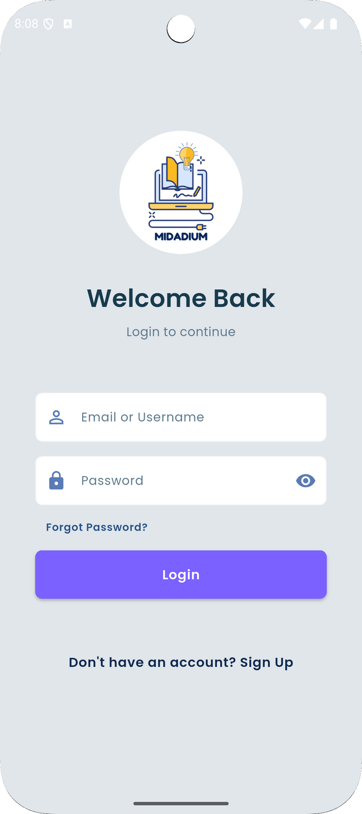
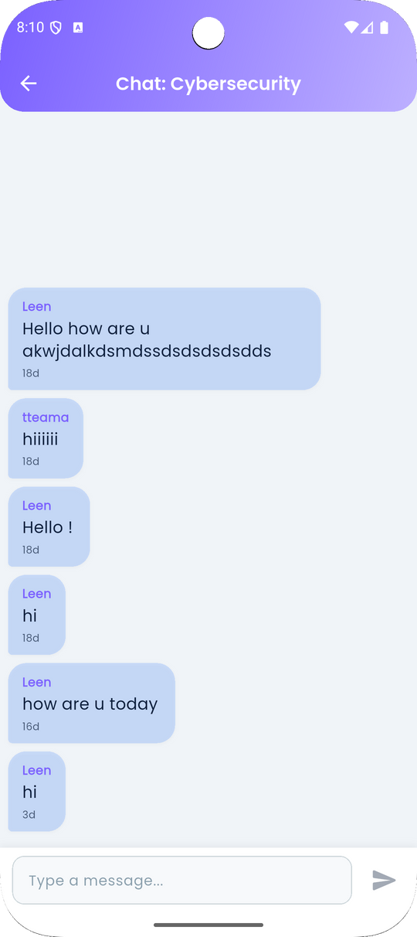
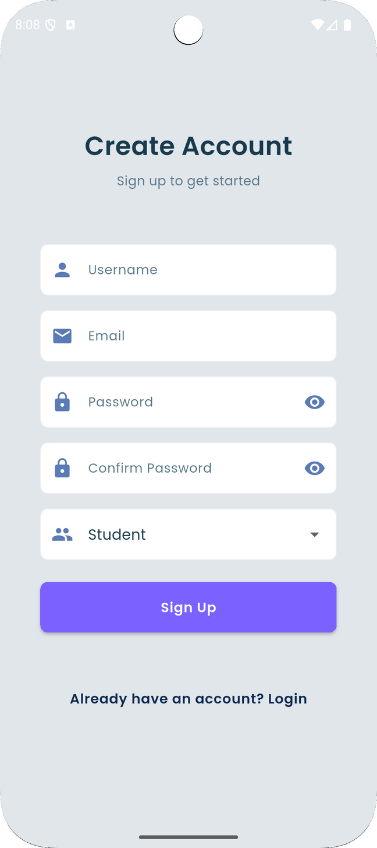
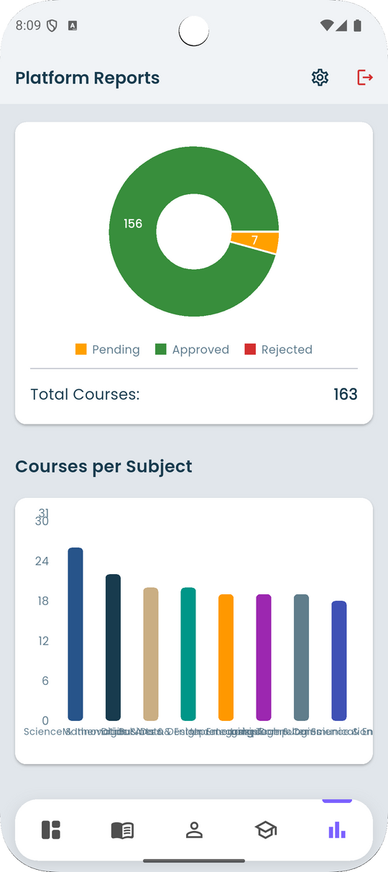
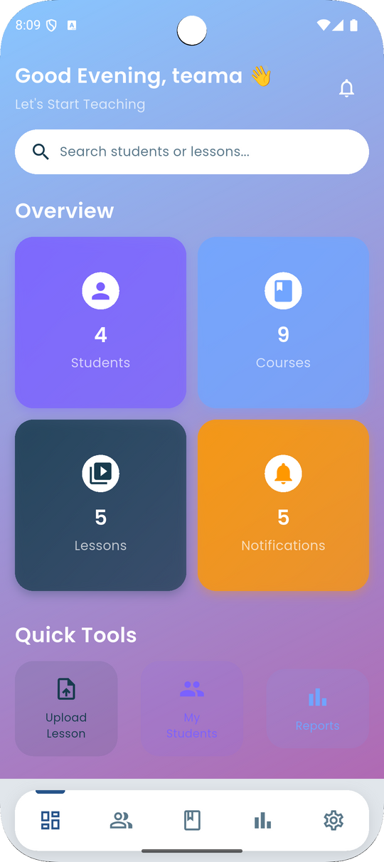
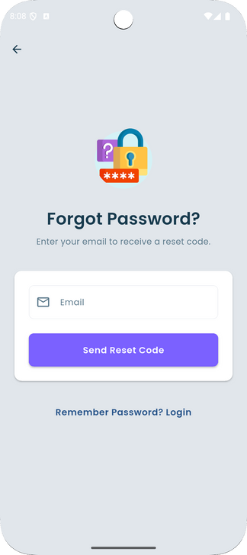
Screens & Demo
Midadium In Action

Slide 7
Welcome Screen
Signup Screen
Log in Screen

Slide 8
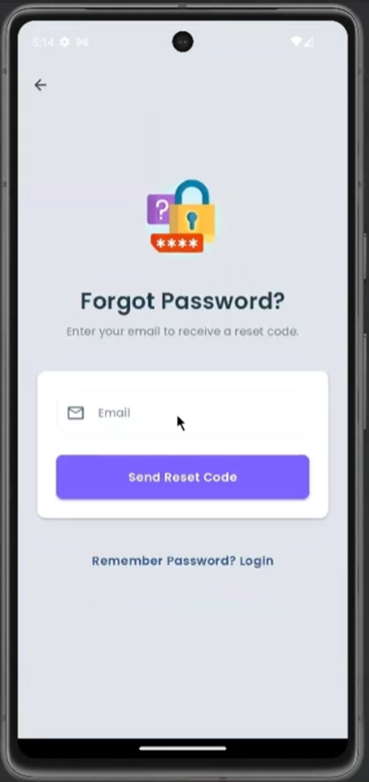
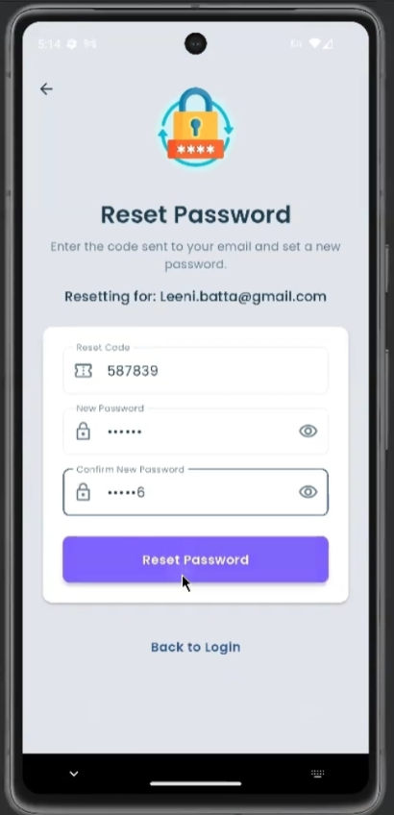
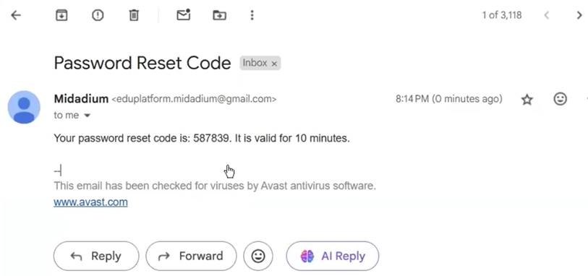
Forgot Password

Slide 9
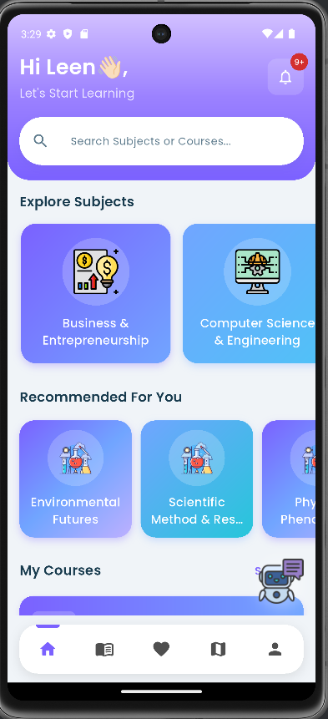
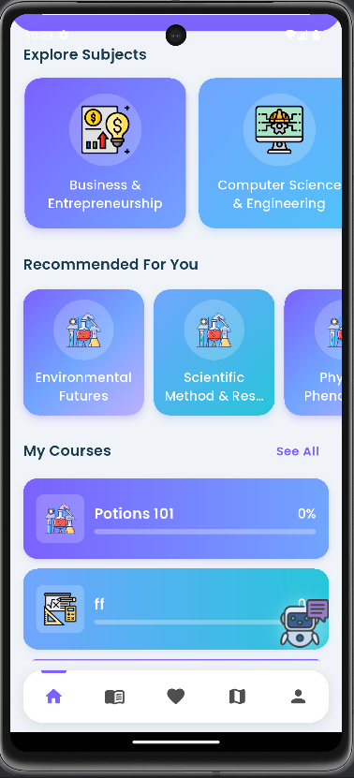
Student Dashboard
Student Home Screen

Slide 10

Courses Recommendation System

Slide 11
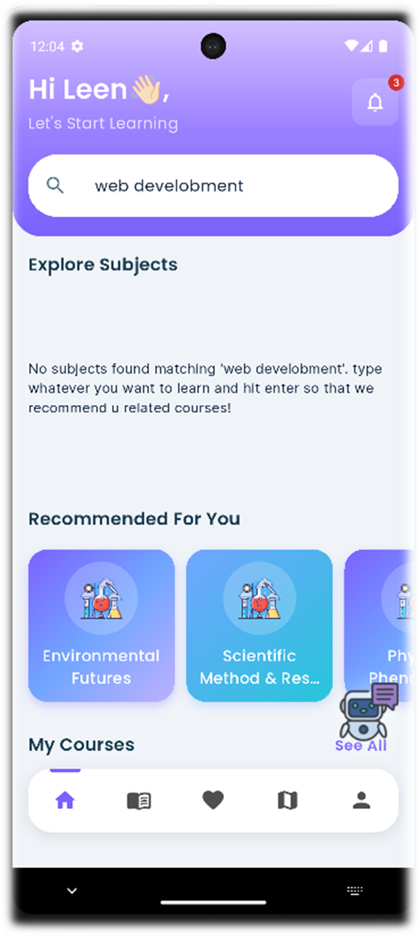
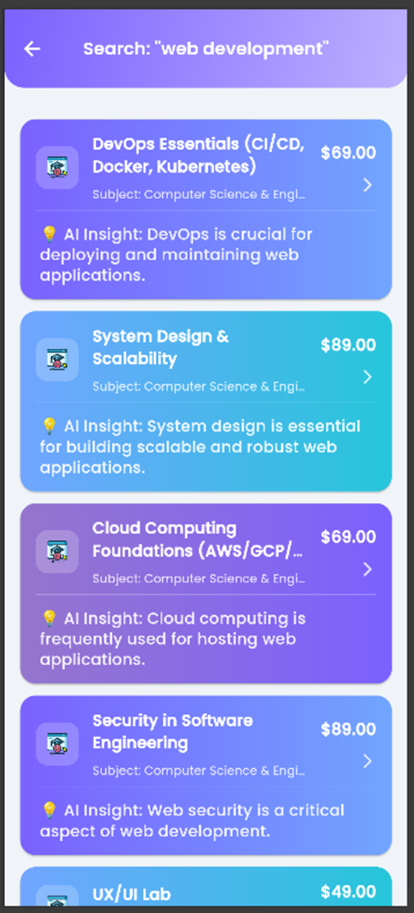
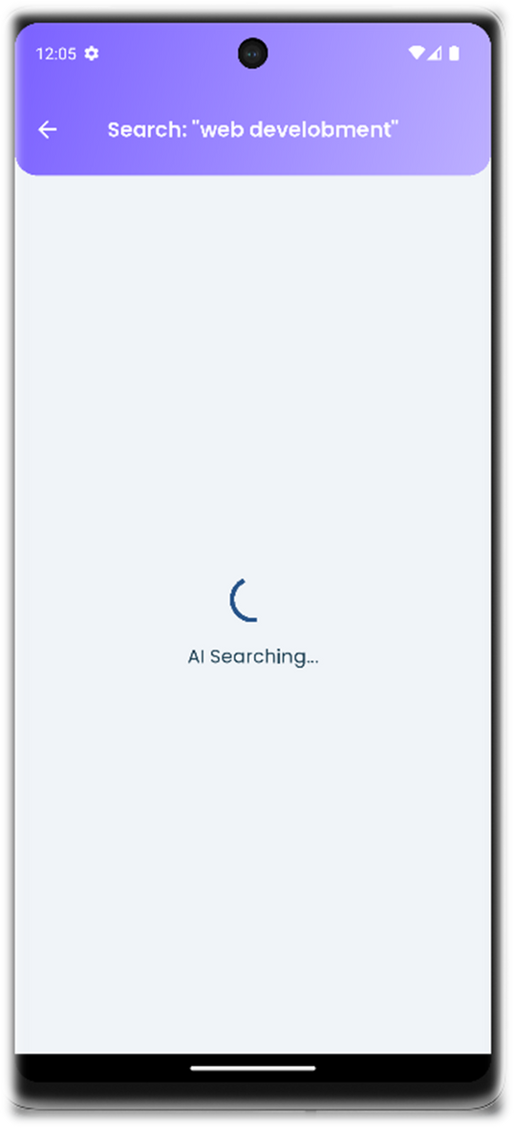
Ai enhanced Search

Slide 12
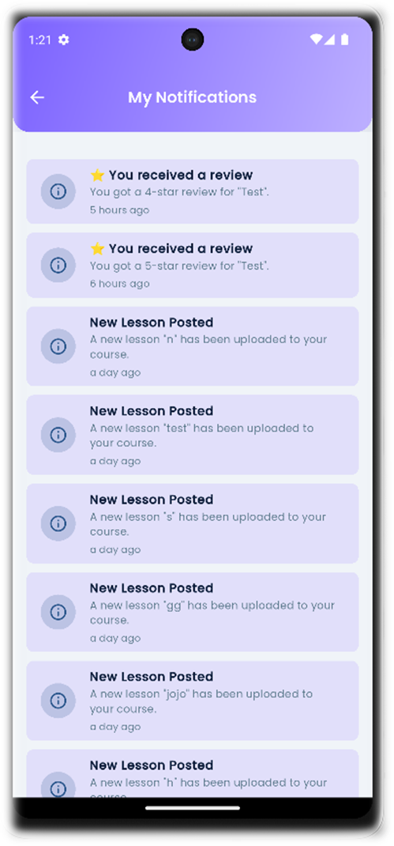


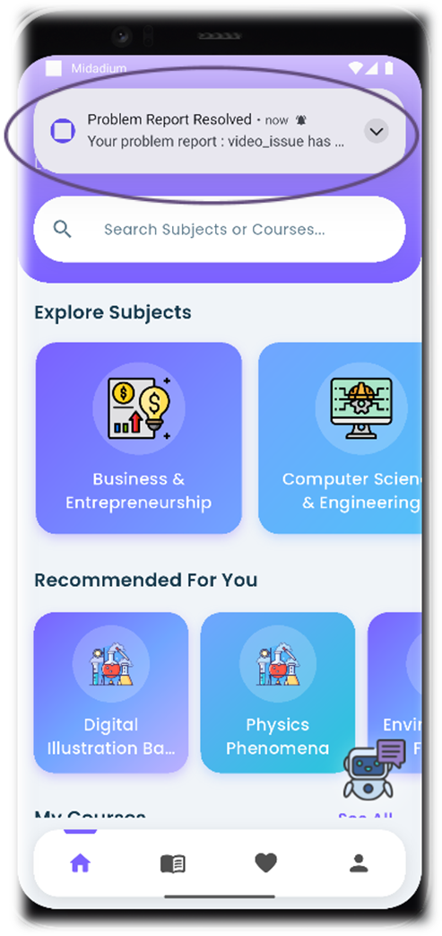
Real-Time Notifications
Using Socket.io

Slide 13
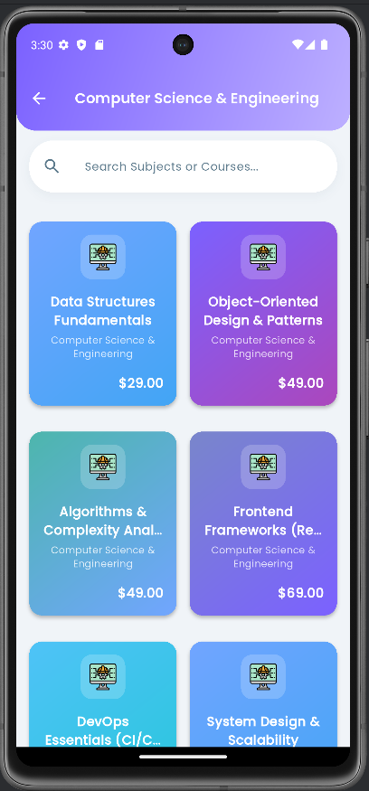


Course Catalog

Slide 14
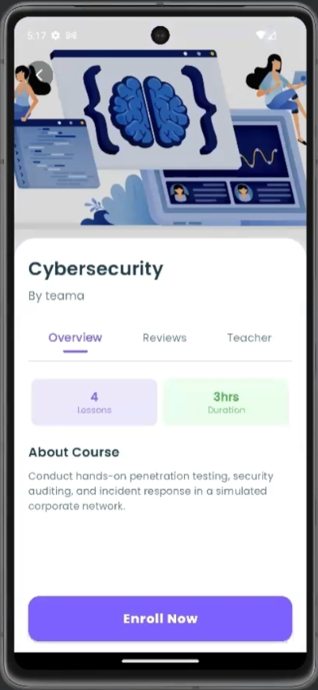
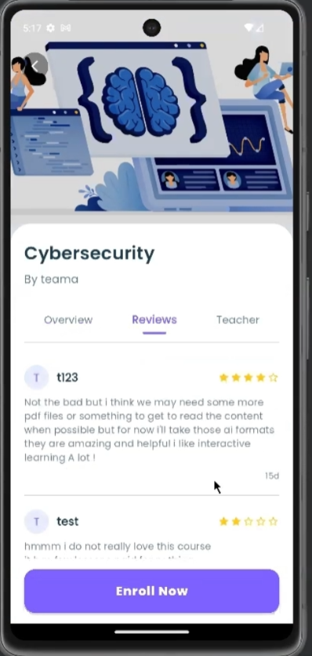
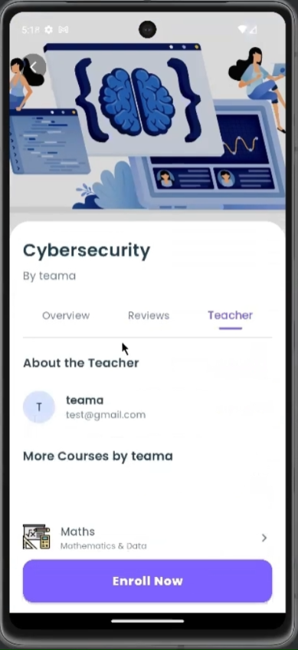
Course preview
Reviews tab
Teacher tab

Slide 15
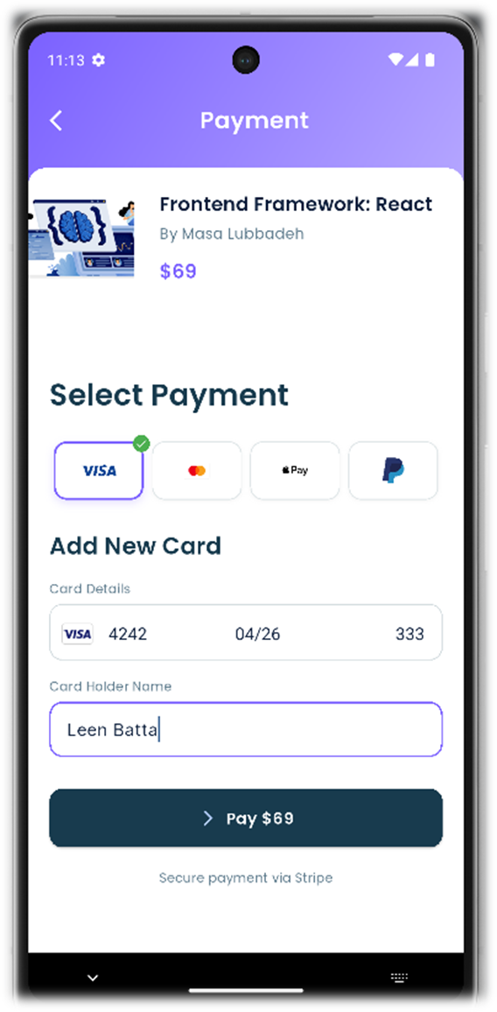
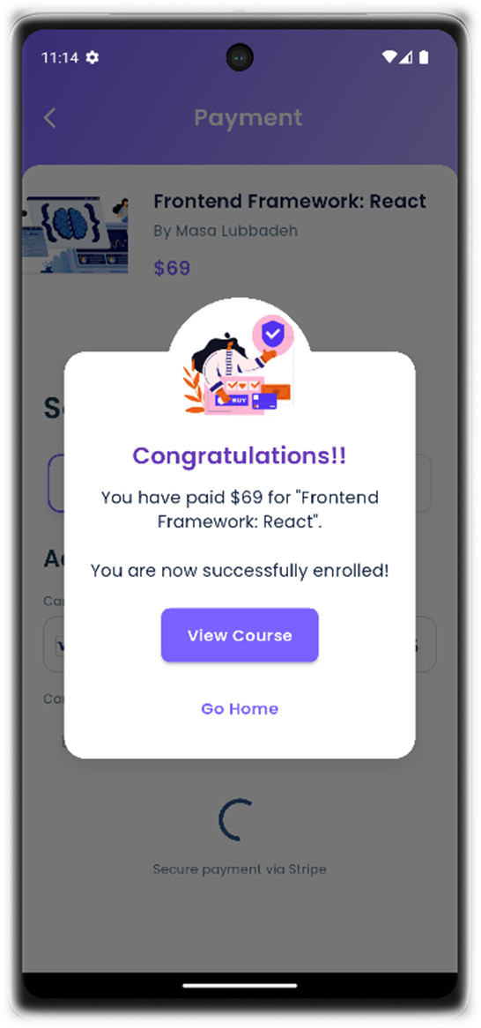
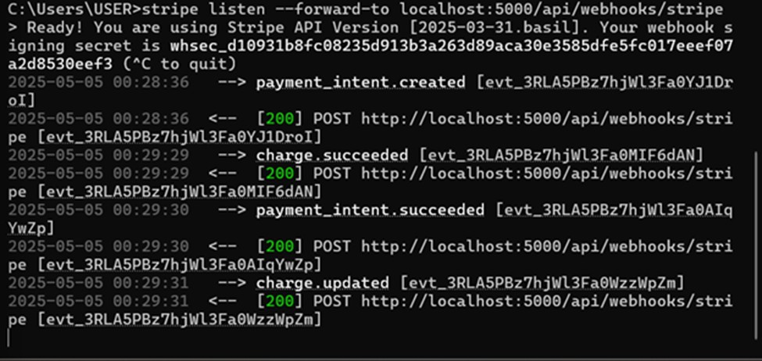
Payment Process

Slide 16
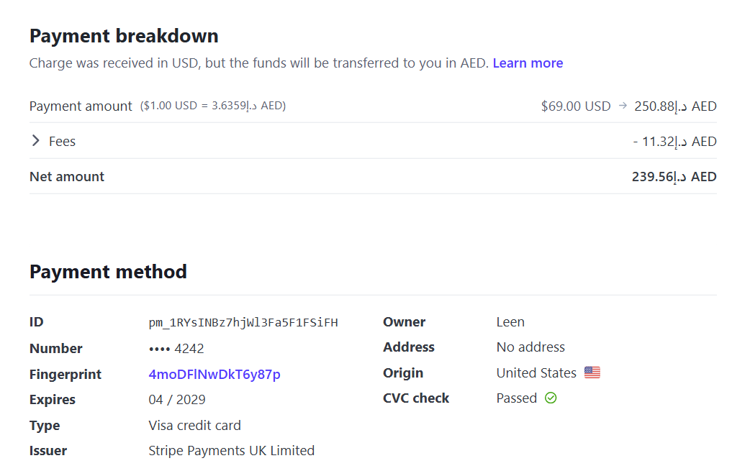
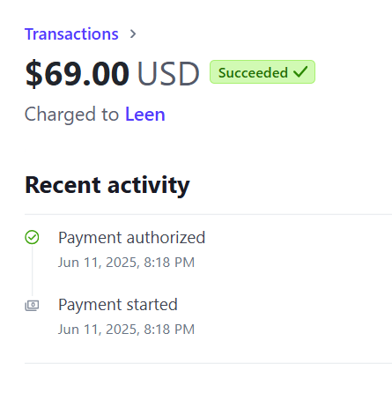
Payment Success on Stripe Dashboard

Slide 17
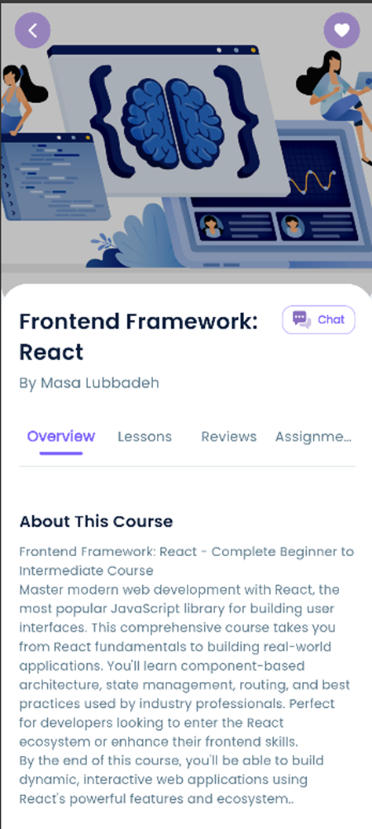
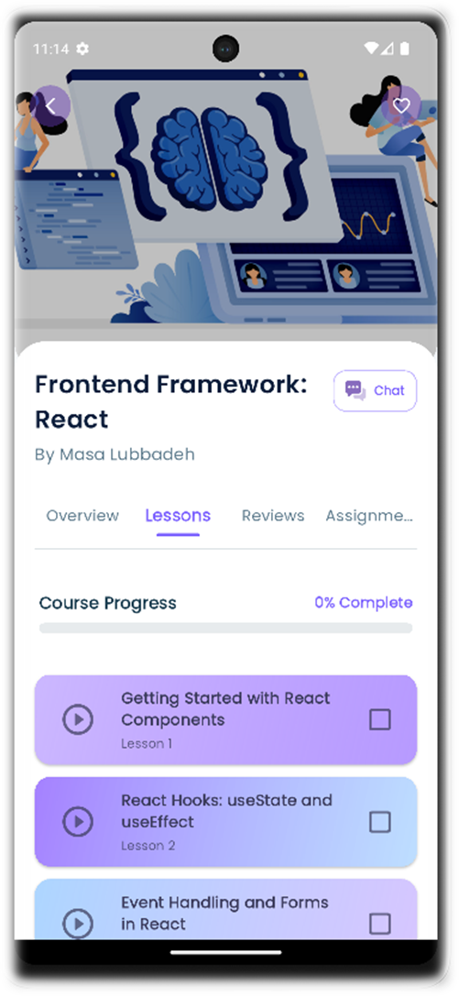
Course Details Screen
(after purchase)
Course overview
Lessons Tab

Slide 18
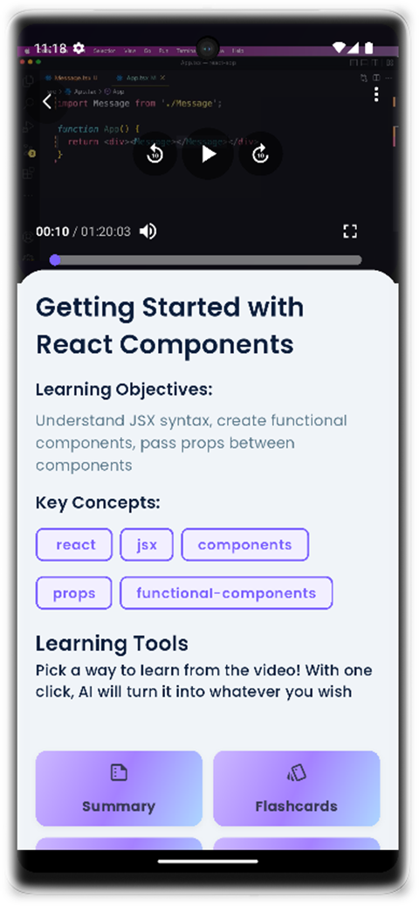
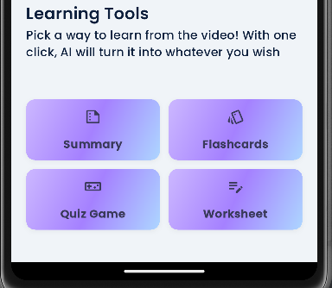
Lesson Info Screen
Available AI Formats
(Video Player + details about this Lesson’s video )

Slide 19
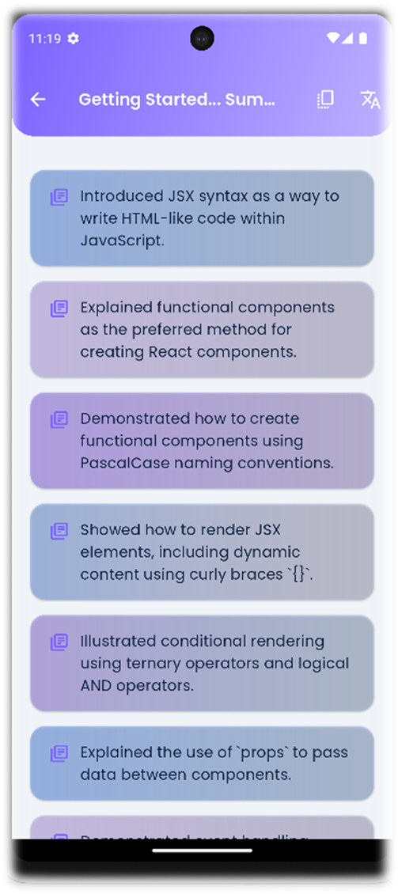
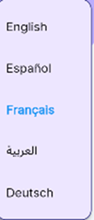



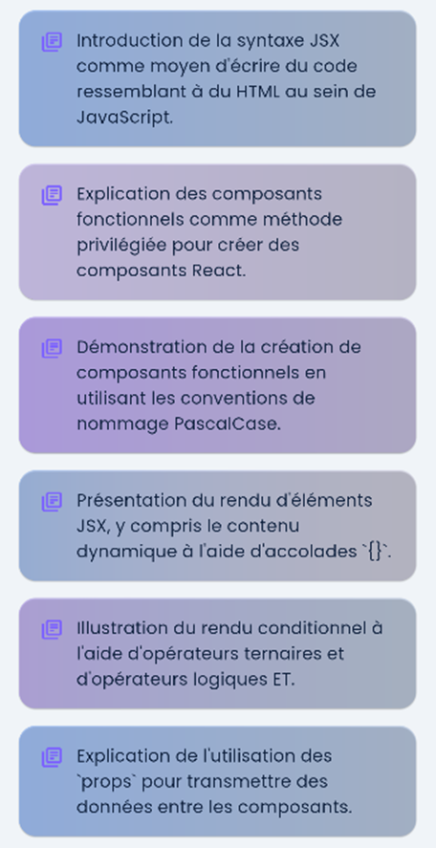

Summary AI Format

Slide 20

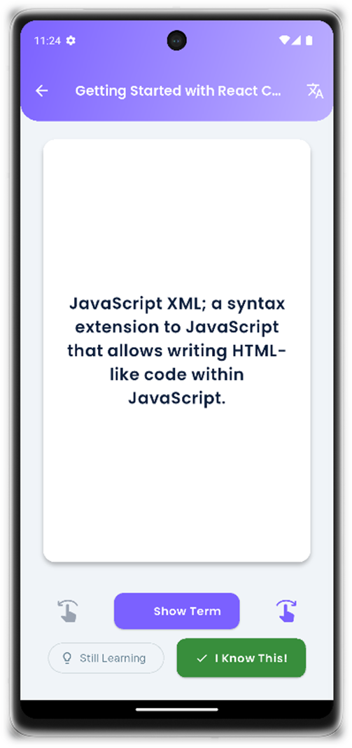
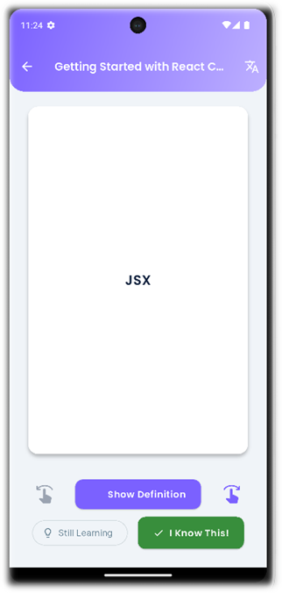

Flashcards AI Format
term
Definition

Slide 21
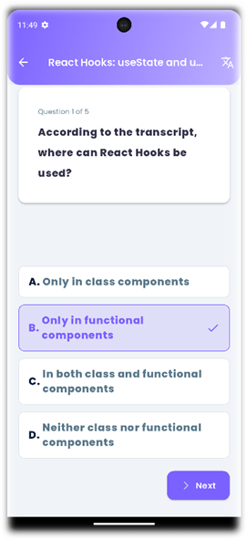
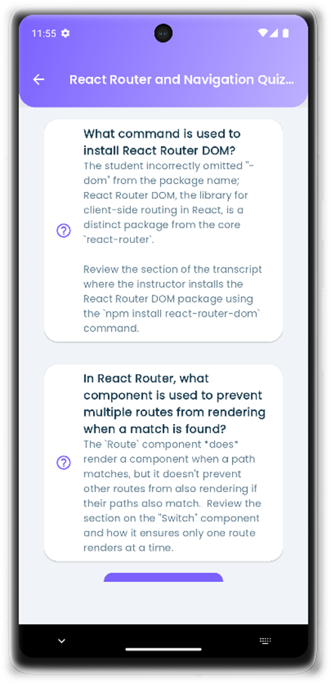
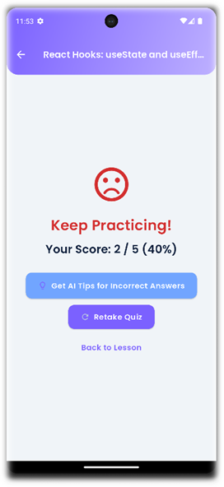



QuizGame AI Format
Result after submission
AI feedback for incorrect answers

Slide 22
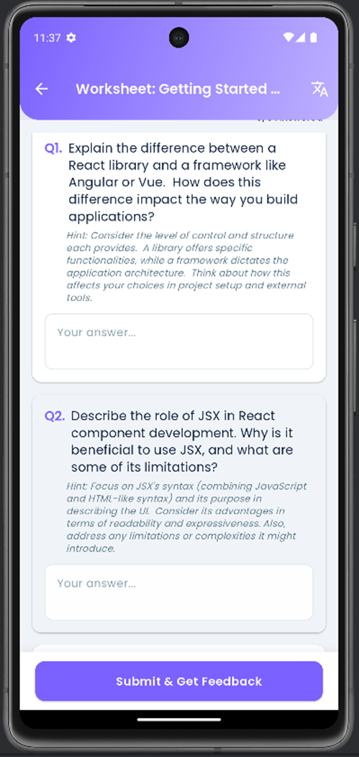
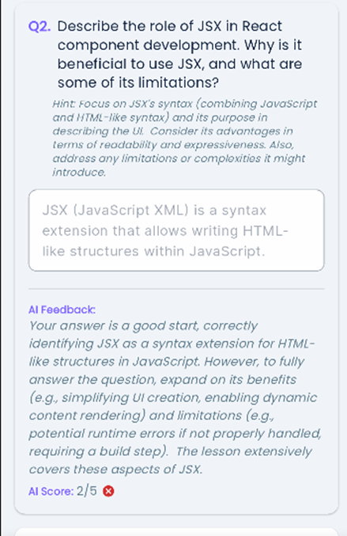
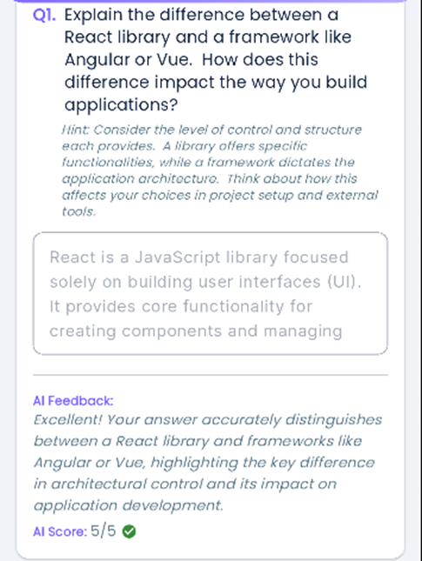
Worksheet AI Format
AI feedback and score for worksheet Answers after Submissiom

Slide 23
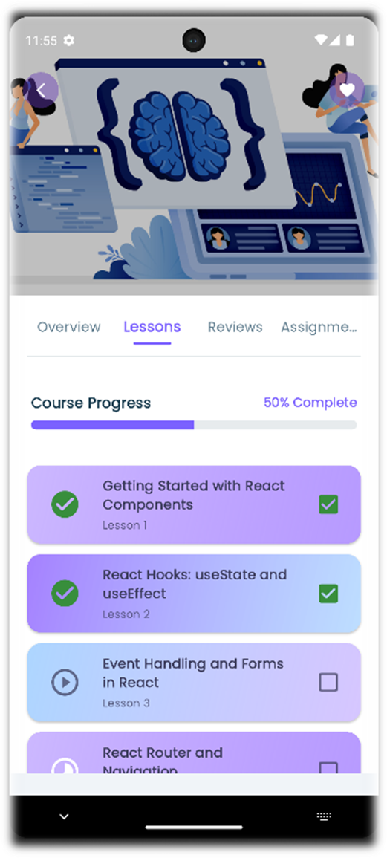
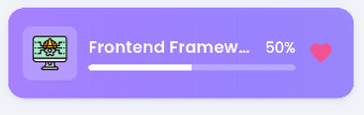
Course Progress Tracking
Course card in home screen

Slide 24
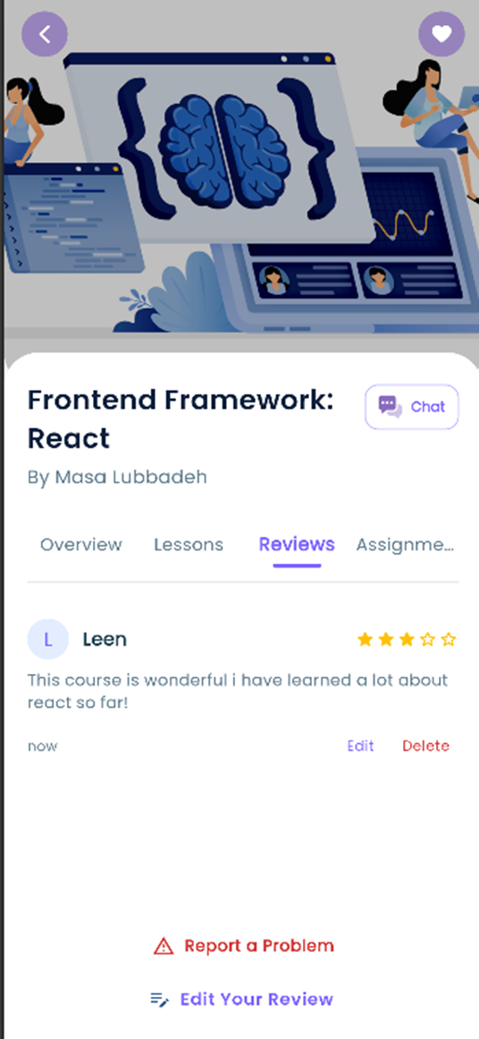
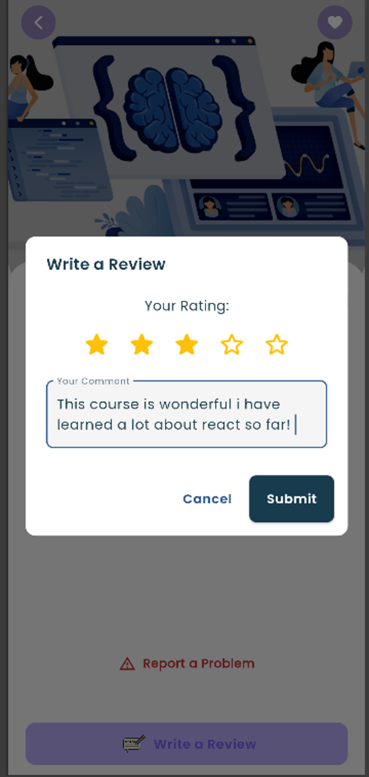
Reviews Tab

Slide 25
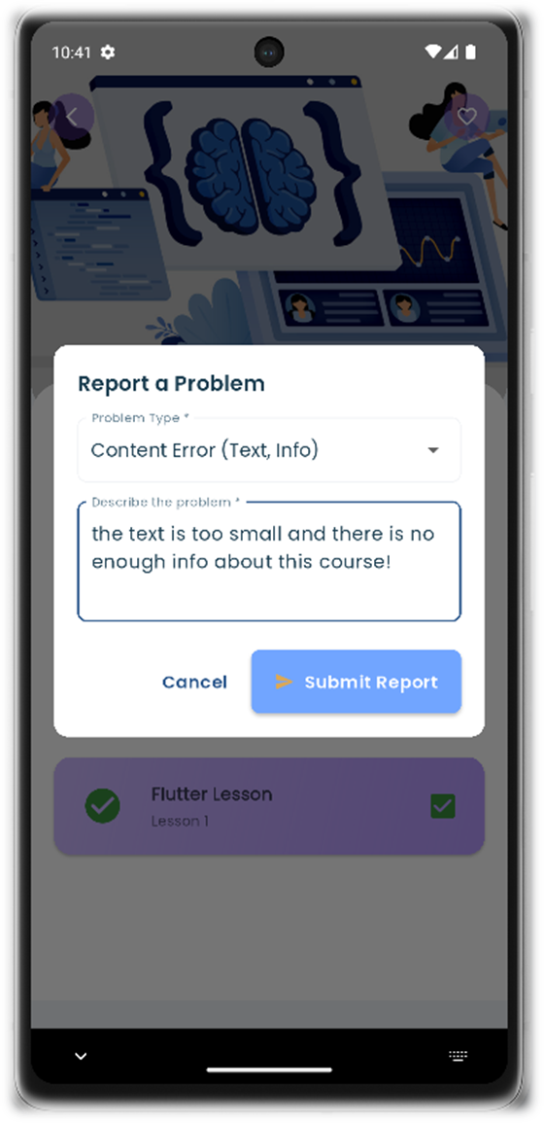
Report a problem to the Admin
Problem type
and
its Description

Slide 26
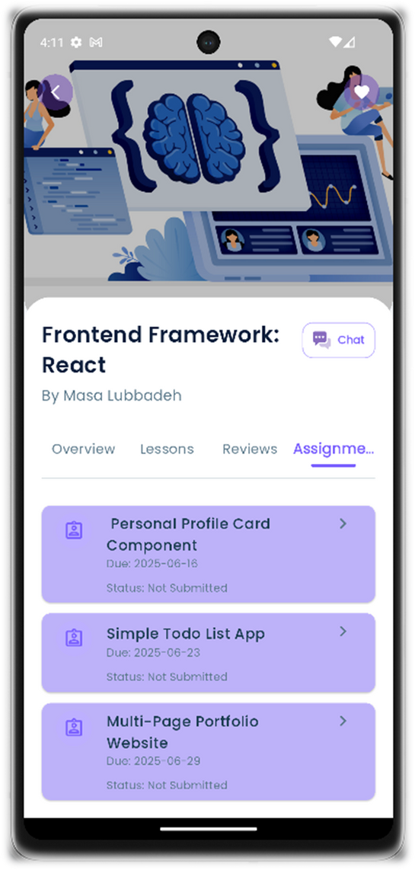
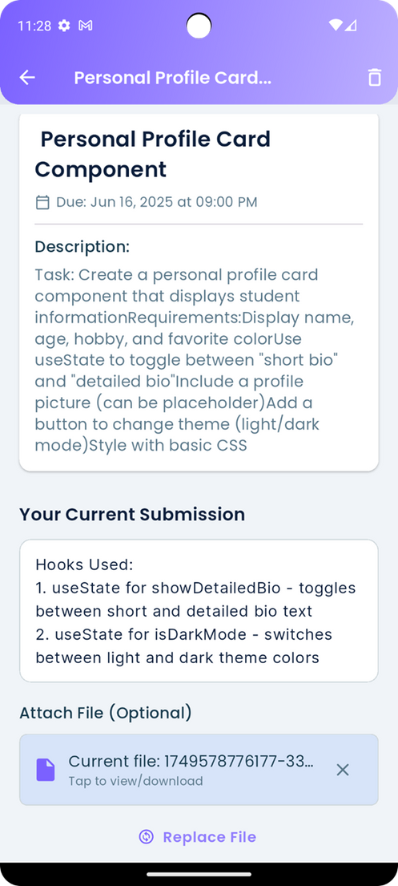
Assignments Tab

Slide 27
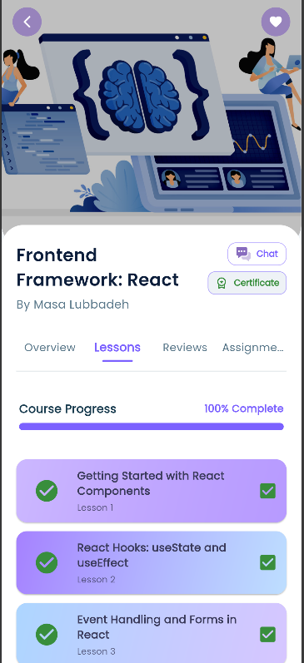

Certificate on Course Completion

Slide 28


Course Chatroom

Slide 29



Midadium Chatbot

Slide 30





Slide 31


My Courses
My Favorite Courses

Slide 32



AI-Generated
Roadmaps

Slide 33





Roadmap Display Screen

Slide 34



Courses package purchase

Slide 35

Saved Roadmaps

Slide 36


Student Profile
Change Password

Slide 37



Teacher Dashboard

Slide 38







Slide 39




Slide 40



Slide 41




Slide 42




Slide 43


Admin dashboard

Slide 44


Subjects Management

Slide 45


Subjects Details Screen

Slide 46


Add New Subject
Edit Subject

Slide 47


Course Details

Slide 48

Edit Courses Details

Slide 49


Manage Teachers

Slide 50



Teacher Details

Slide 51


Mange Students

Slide 52


Add New Student

Slide 53


Student details

Slide 54

Platform Reports

Slide 55


Platform Reports

Slide 56


Problem Reports

Slide 57

Problem Reports Filtering by types and Status

Slide 58

Problem Report Details

Slide 59


Admin Settings

Slide 60

Future Work
  Student-Created Content Sharing: Allow students to create and share their own flashcards or study notes for a course.
  Multilingual Platform UI: Translate the entire Midadium platform interface itself, not just the AI-generated content.
  Project-Based Learning & Group Assignments: Facilitate
collaborative projects with shared workspaces and submission tools.
  Third-Party Content Integration: API integrations to pull in relevant
articles, videos, or tools from other educational resources.
  Develop skill-based career alignment, where AI analyzes course
content and student goals to recommend tailored learning paths
for professional development.

Slide 61





Thank You!

Slide 62


About Our Team
TEAMA
MIDADIUM
LEEN

