Slide 1


MARS
Management and Retail System
Graduation Project
Abdulkreem Abuzahra
Ahmad Tubaila

Slide 2

Project Goal
Provide a unified system to run an electronic retail store plus internal operations.
Support sales (POS), inventory, contracts, payments, employee duty hours, projects & tasks.
Role-based access: customers, workers/POS, admins/co-admins.

Slide 3


Main Features
Point-of-Sale (POS) and item management (CRUD for products).
Contract management and contract applications.
Payments and overdue/payment tracking.
Employee management & duty hours tracking.
Project and task management with file attachments.
OCR and recommendations services
Chat/notifications and role-based UI controls.

Slide 4

Architecture Overview
Frontend: React + Vite SPA
Backend: Node.js + Express REST API + Postman for API calls testing
Database: MySQL (access via mysql2).

Slide 5
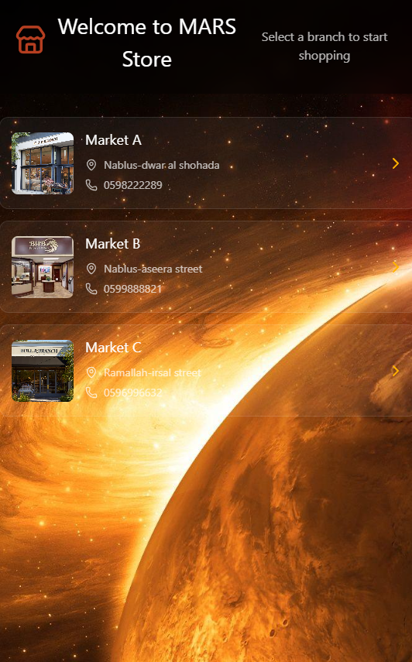
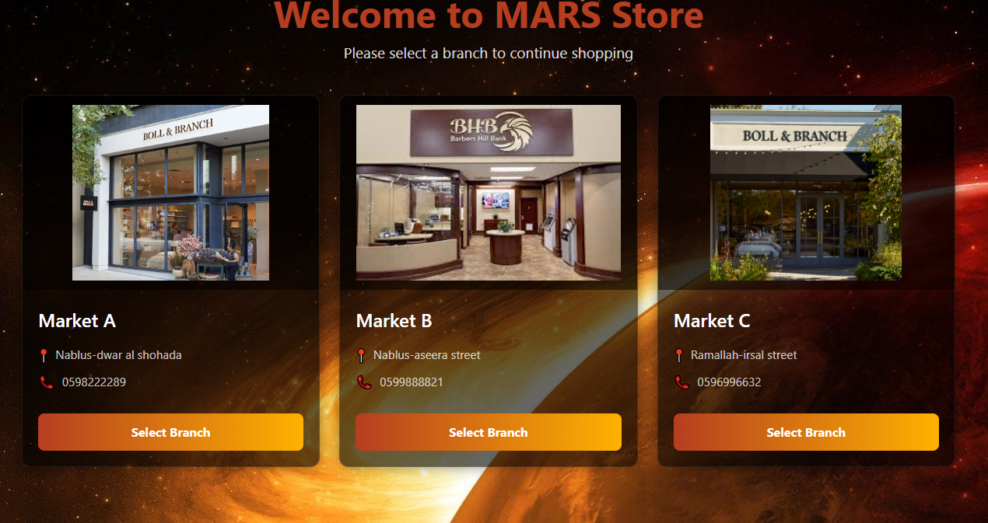

Slide 6
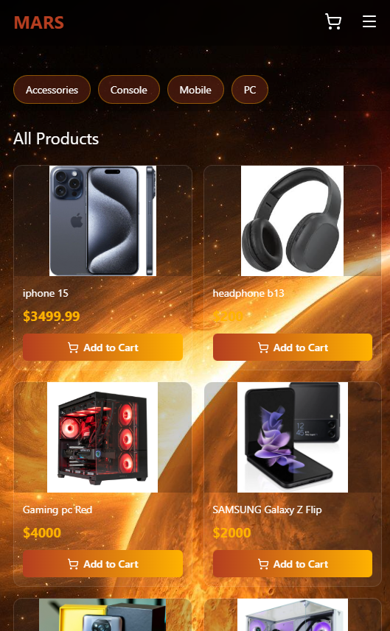
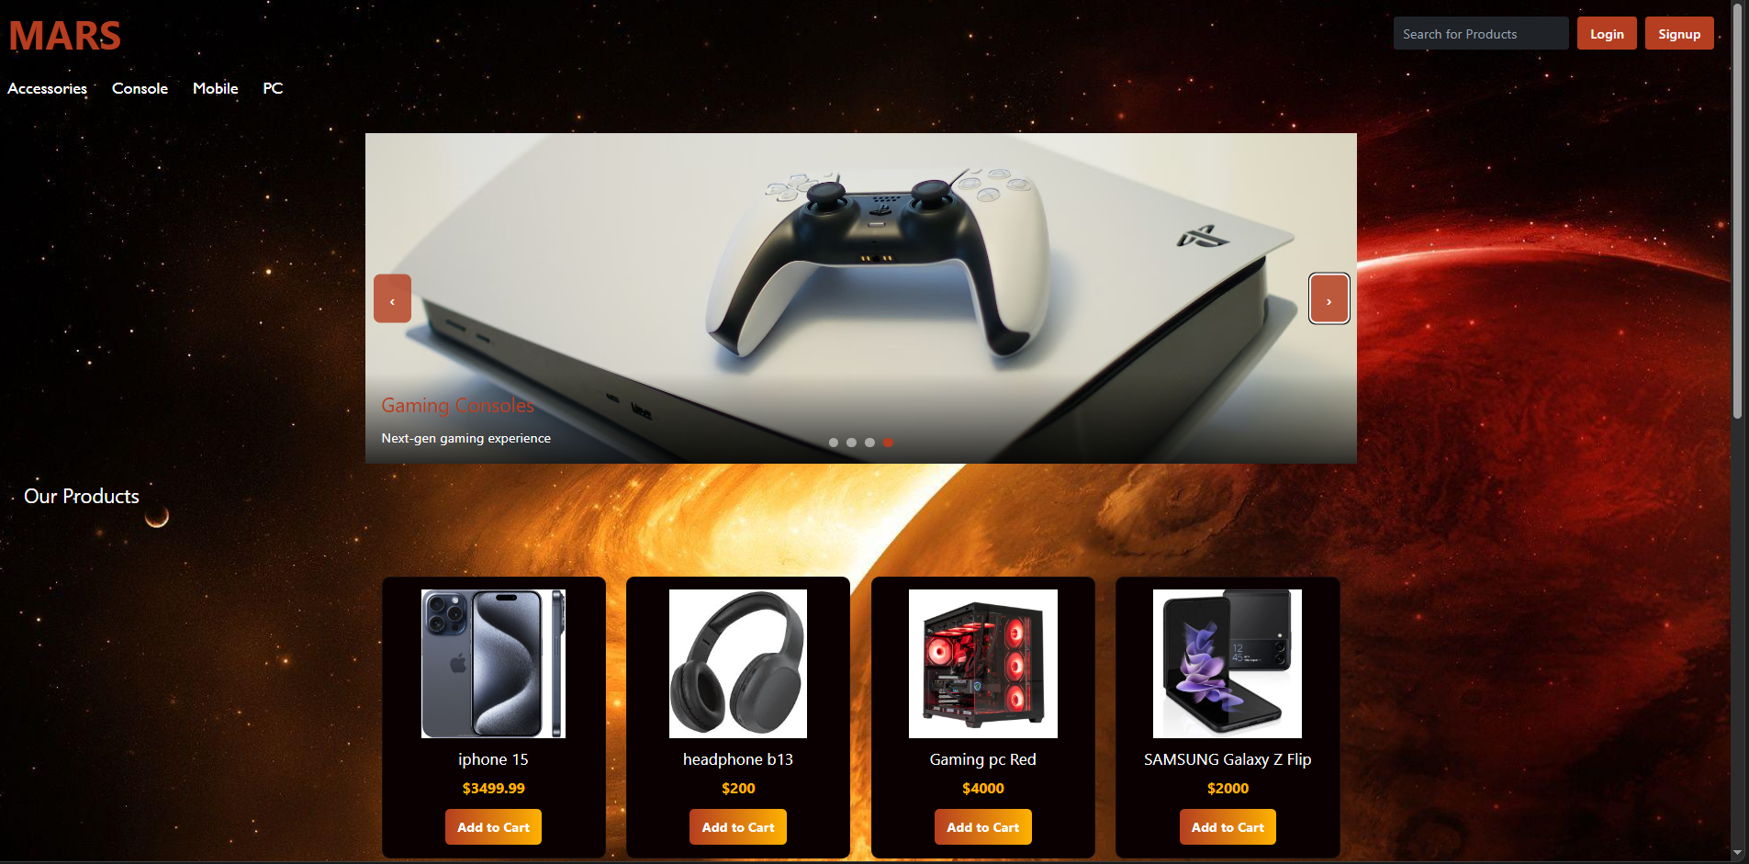

Slide 7
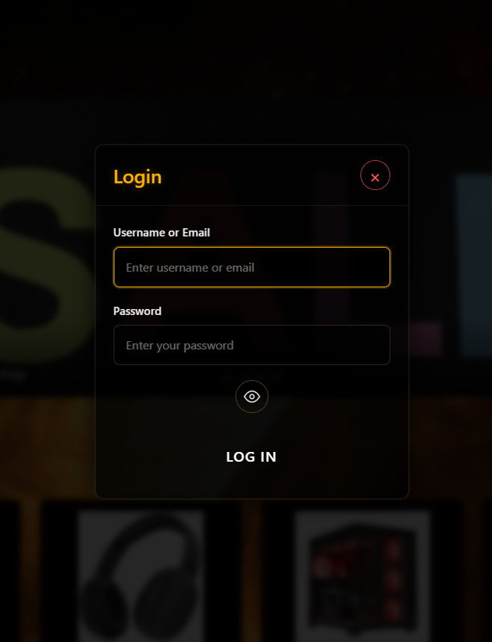
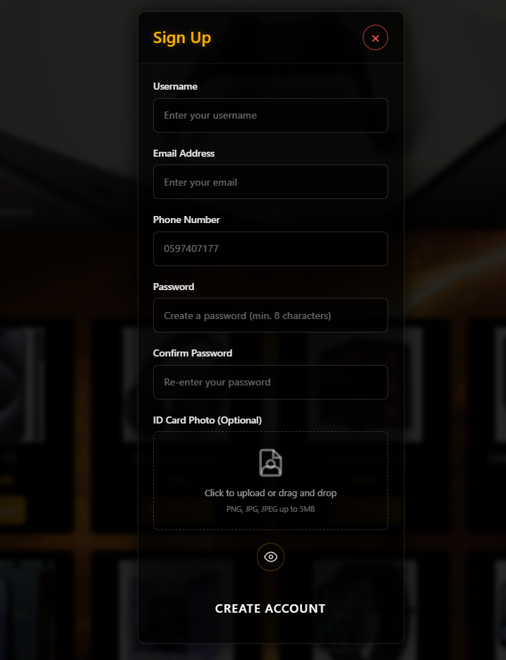

Slide 8
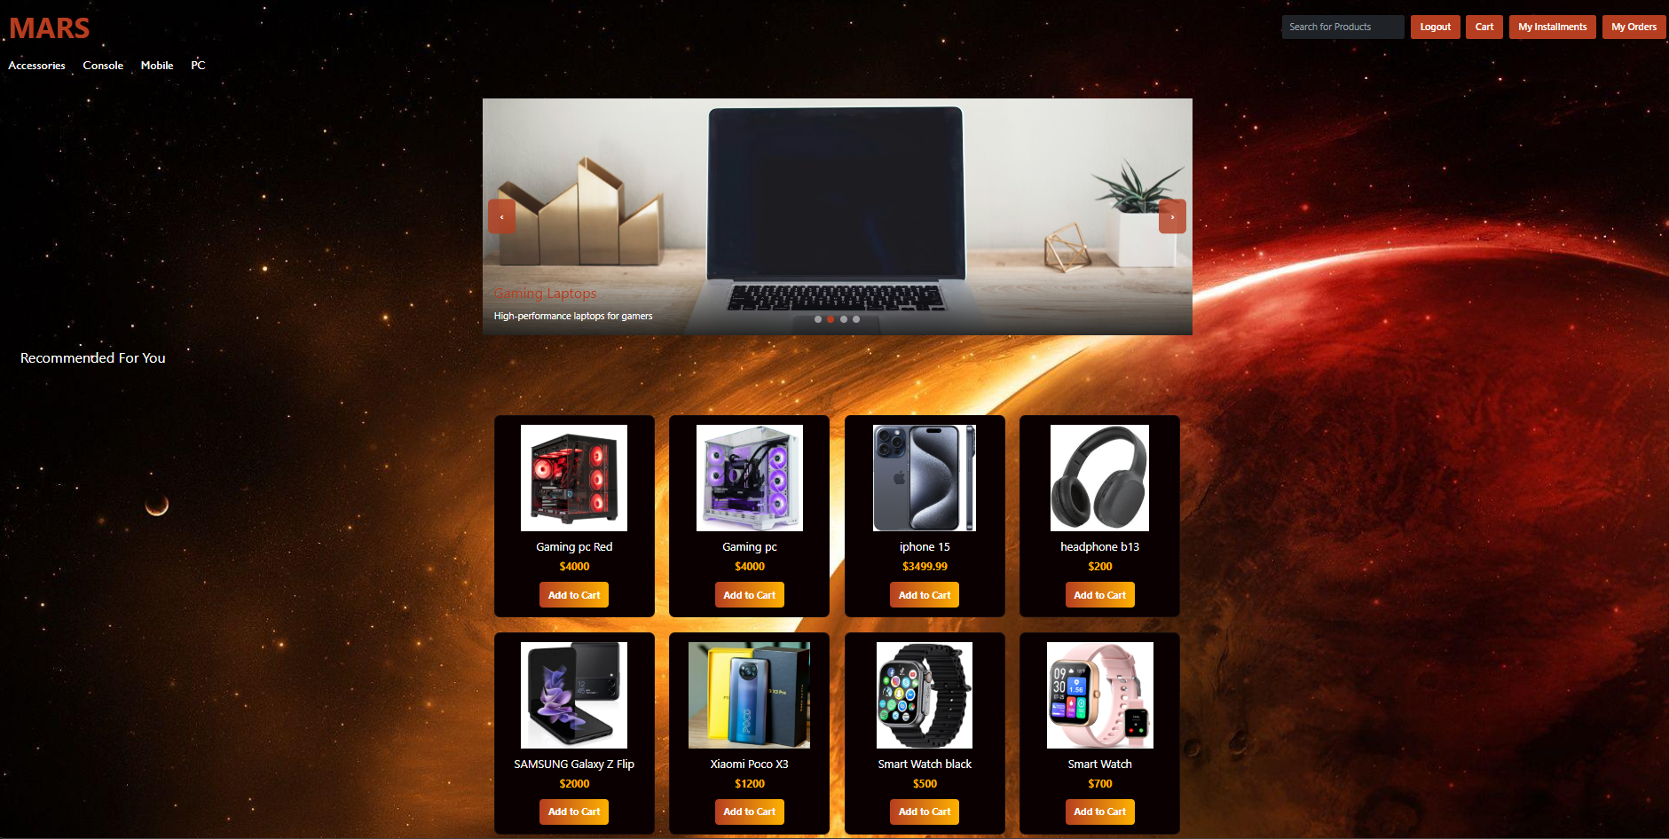

Slide 9
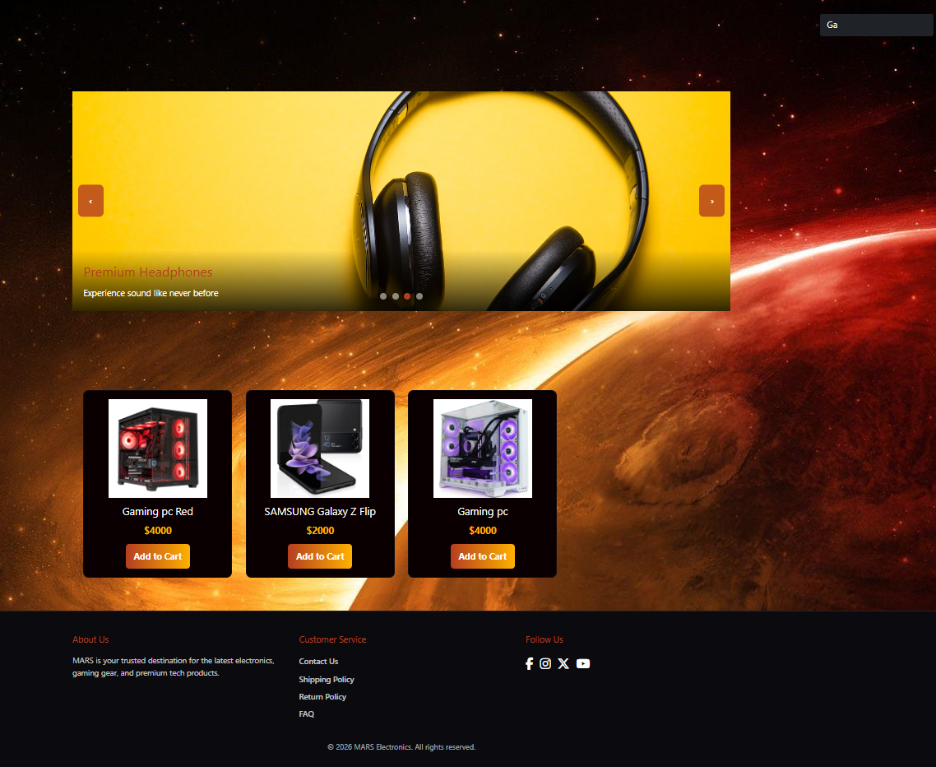

Slide 10


Slide 11
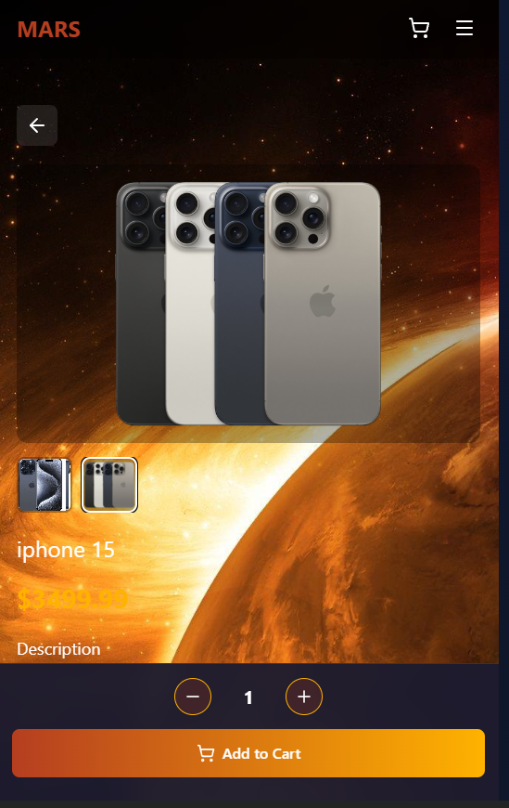
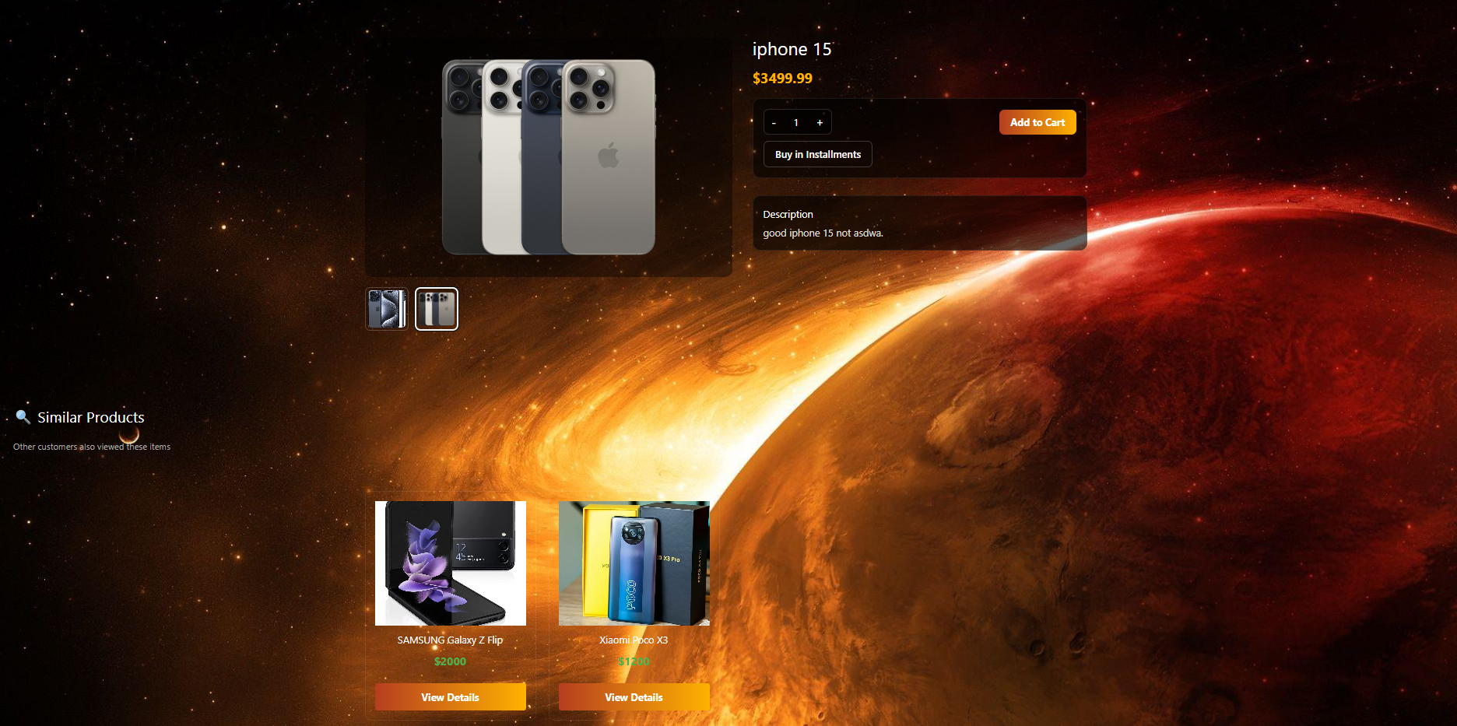

Slide 12
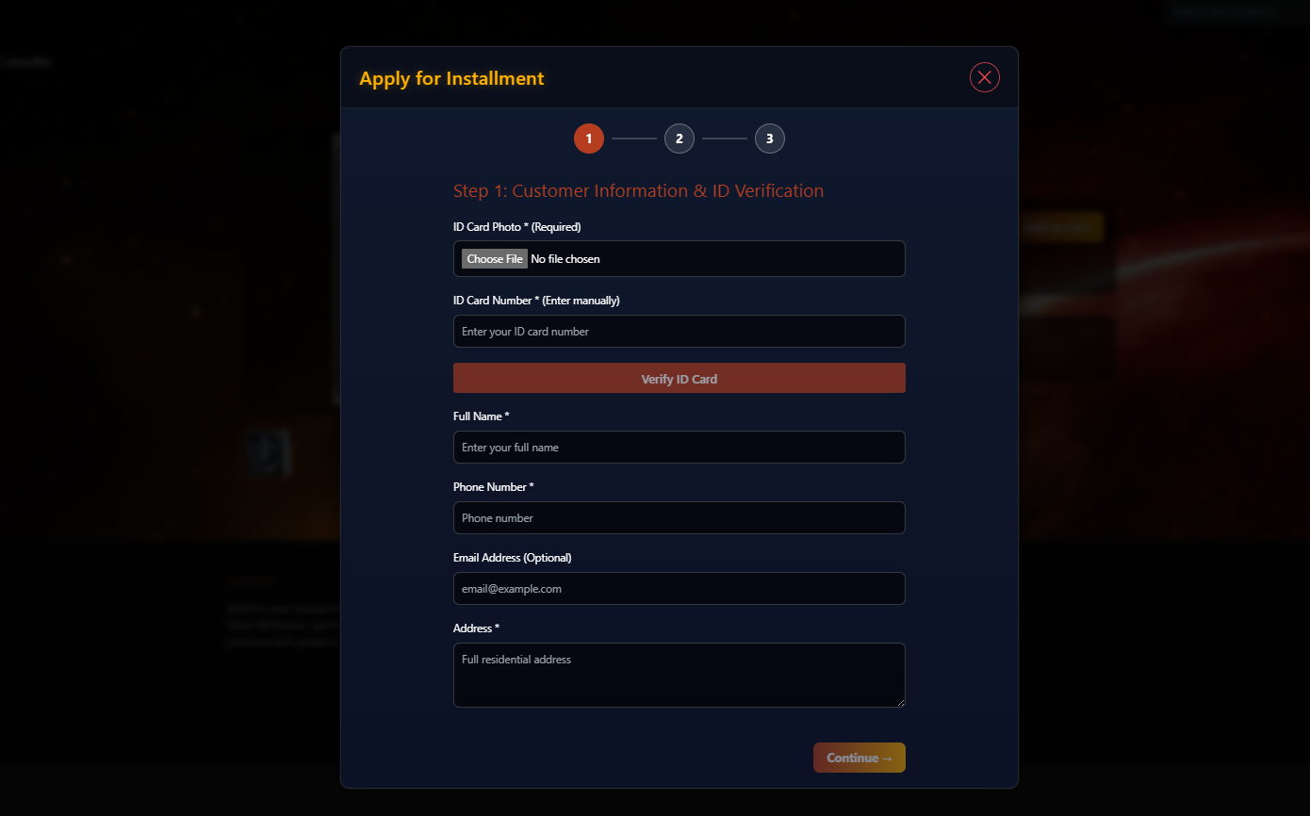

Slide 13
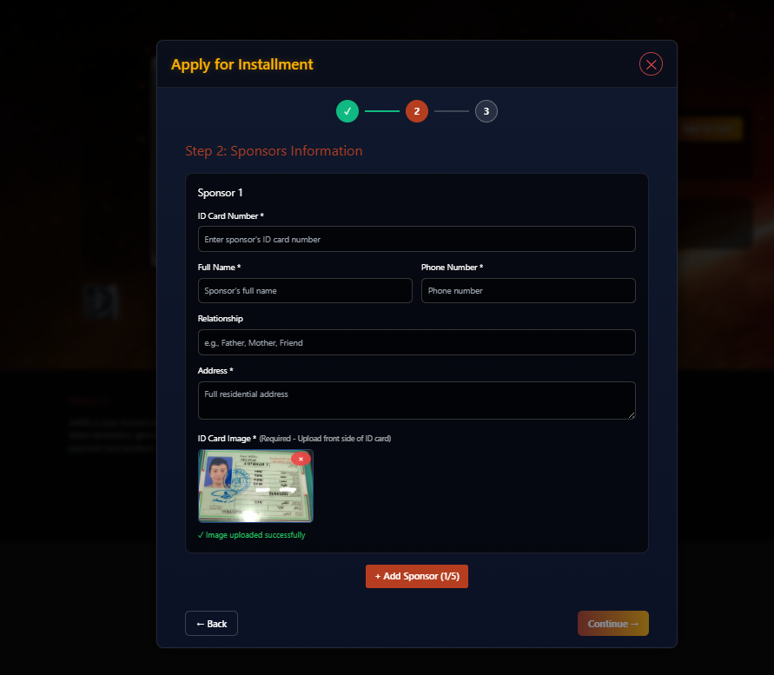

Slide 14
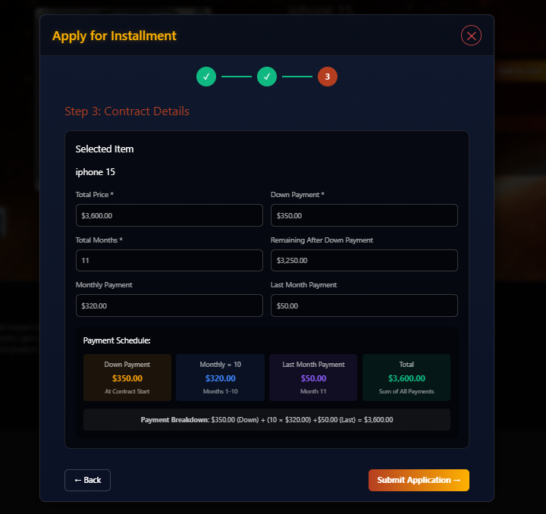

Slide 15
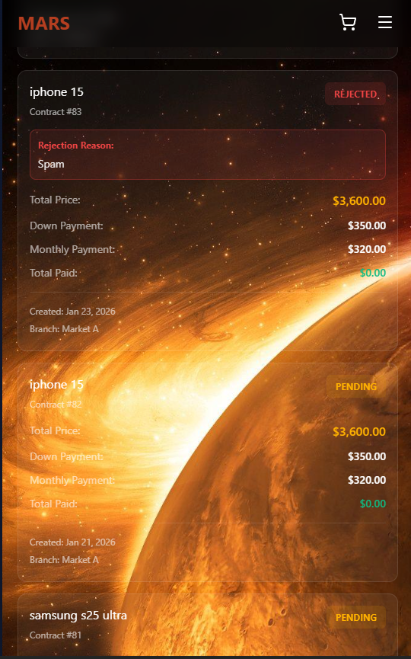
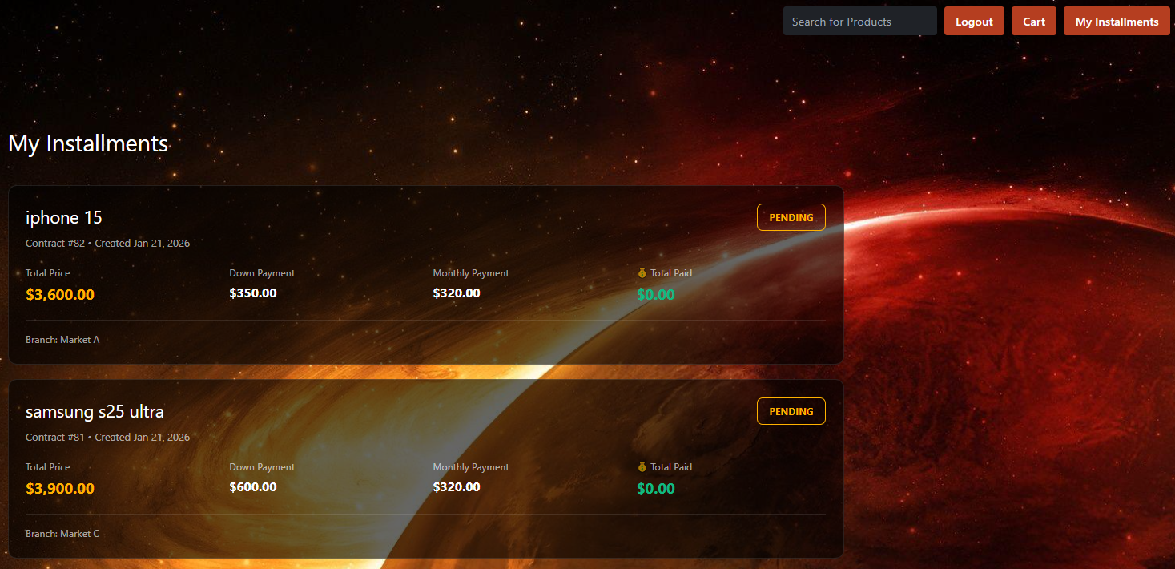

Slide 16
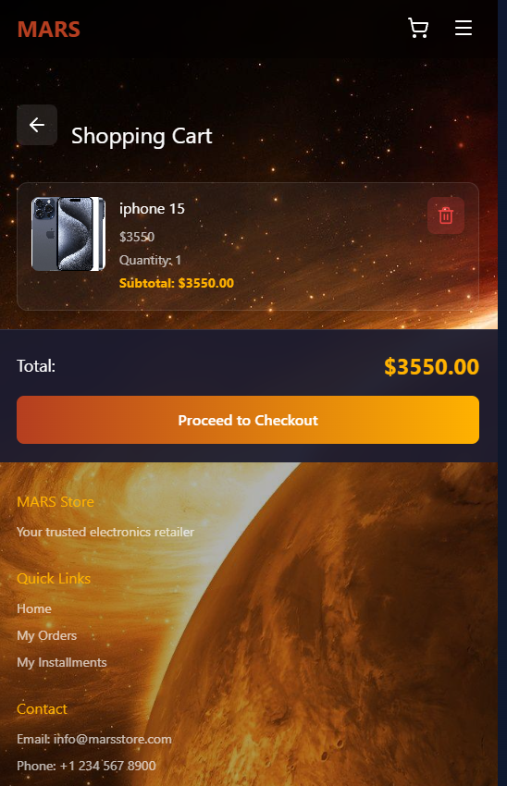
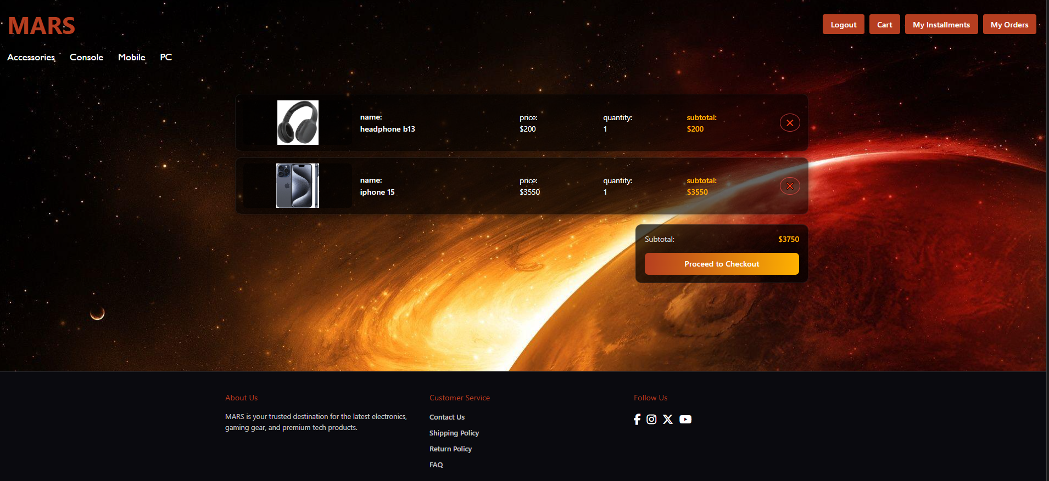

Slide 17
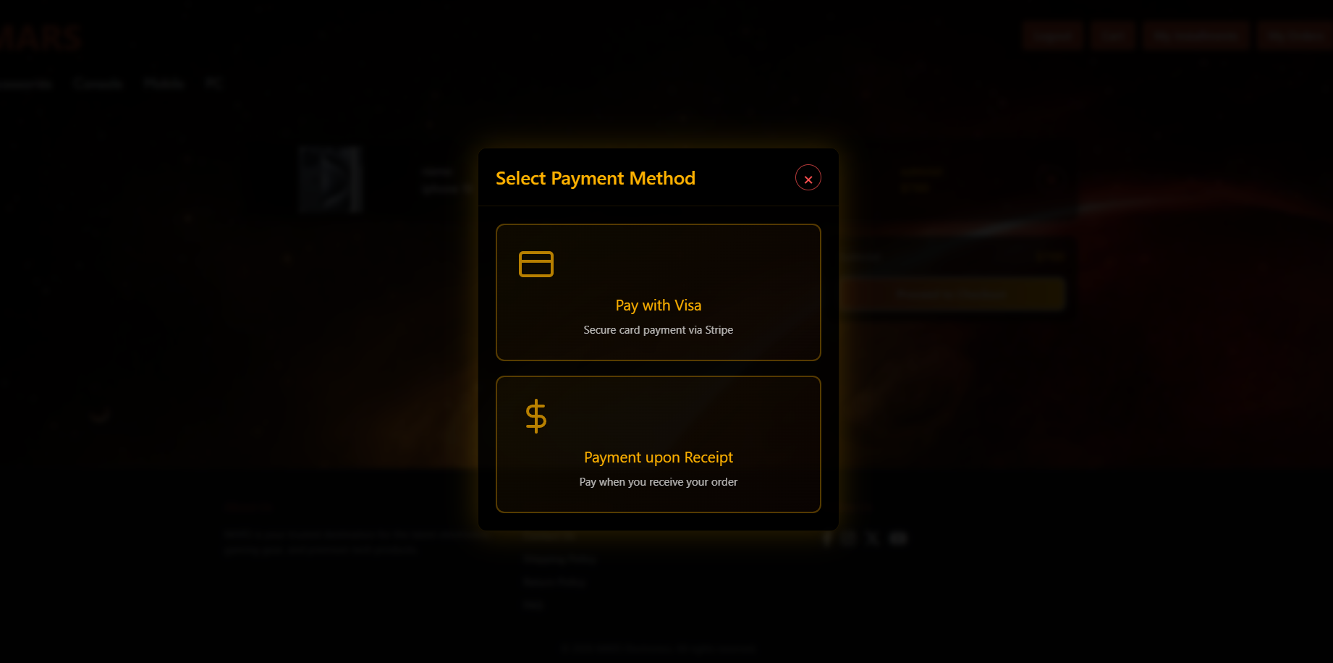

Slide 18
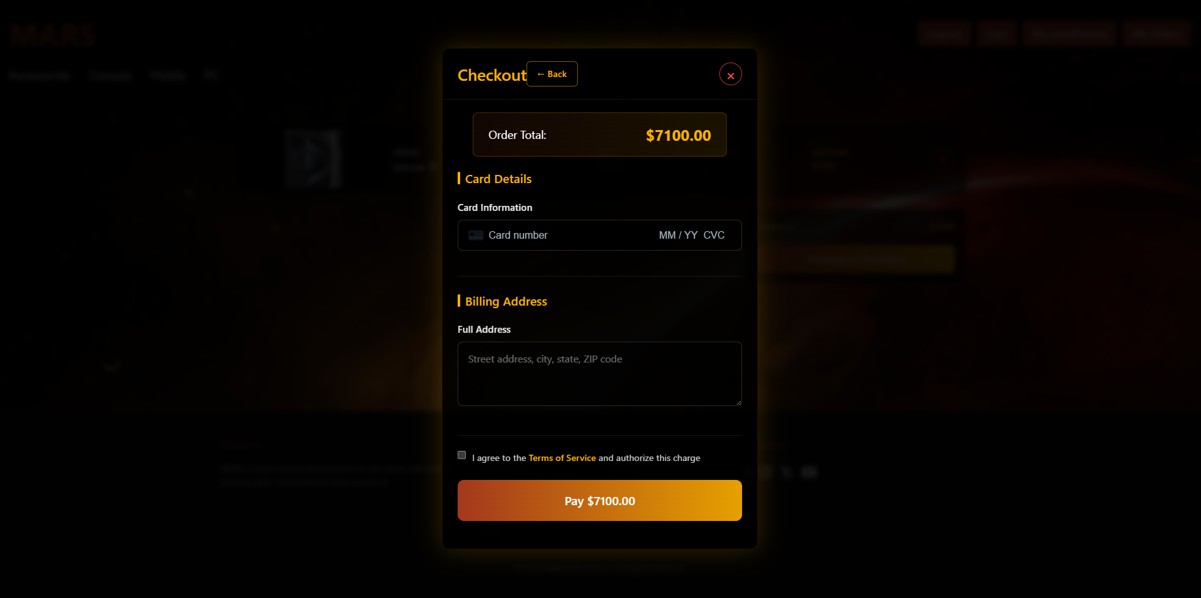

Slide 19
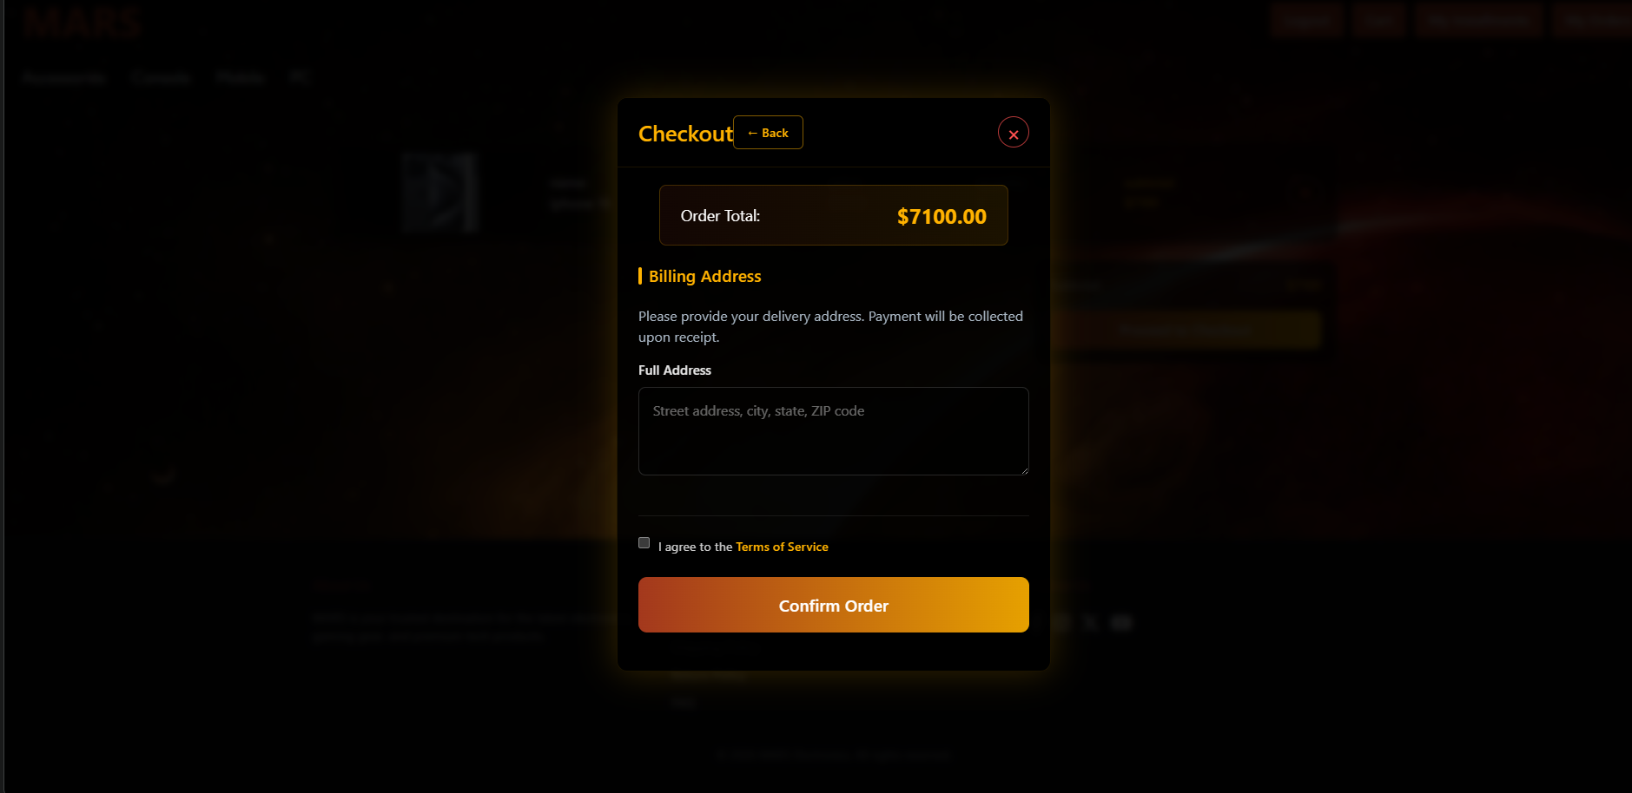

Slide 20
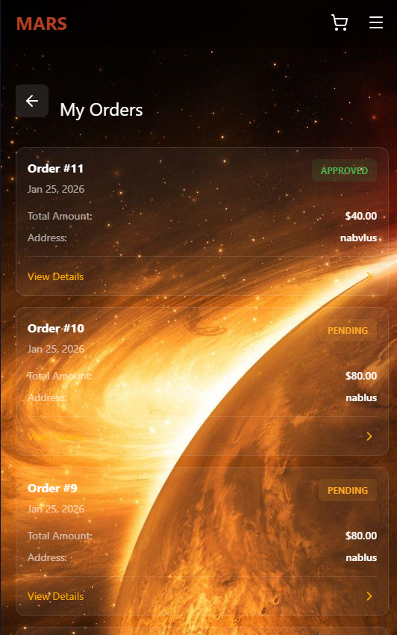
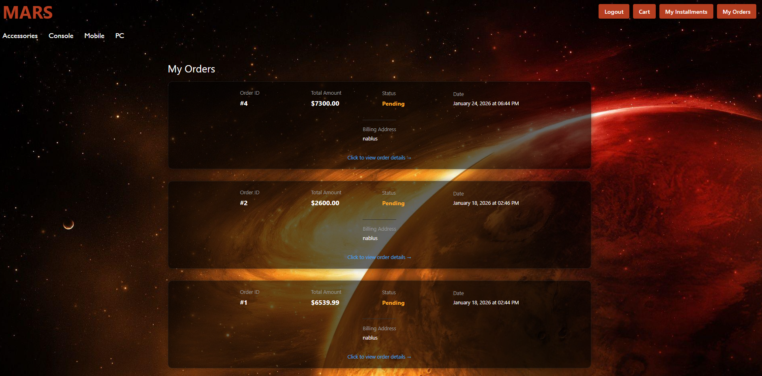

Slide 21
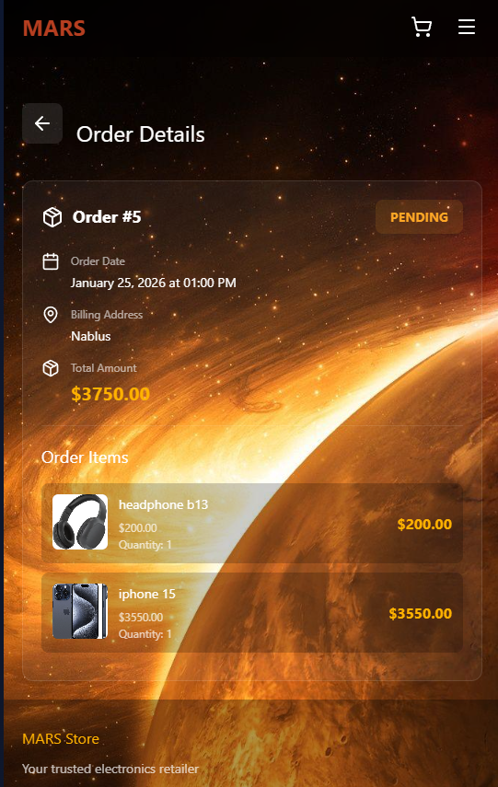
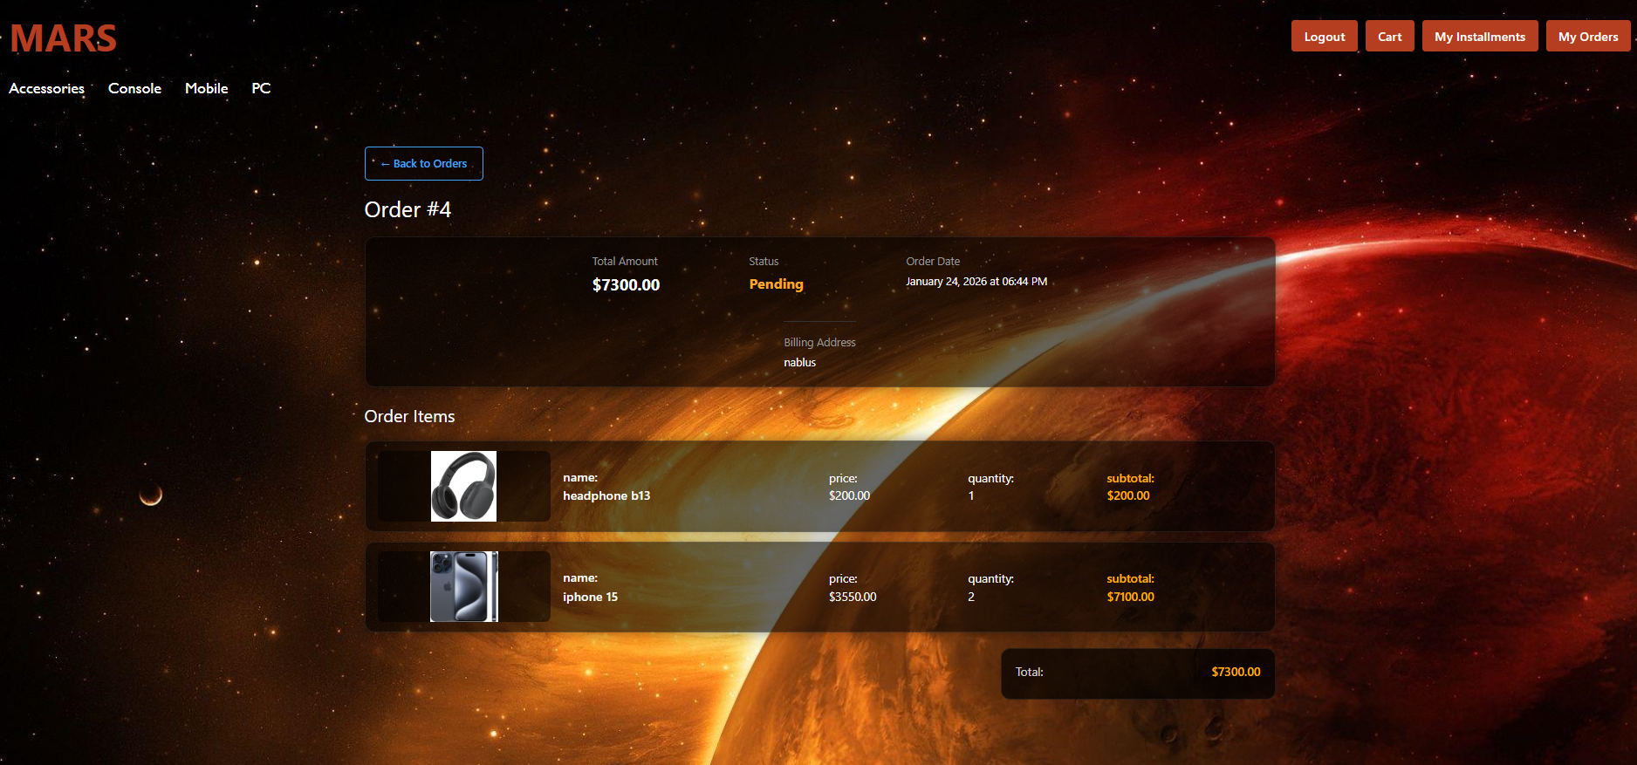

Slide 22
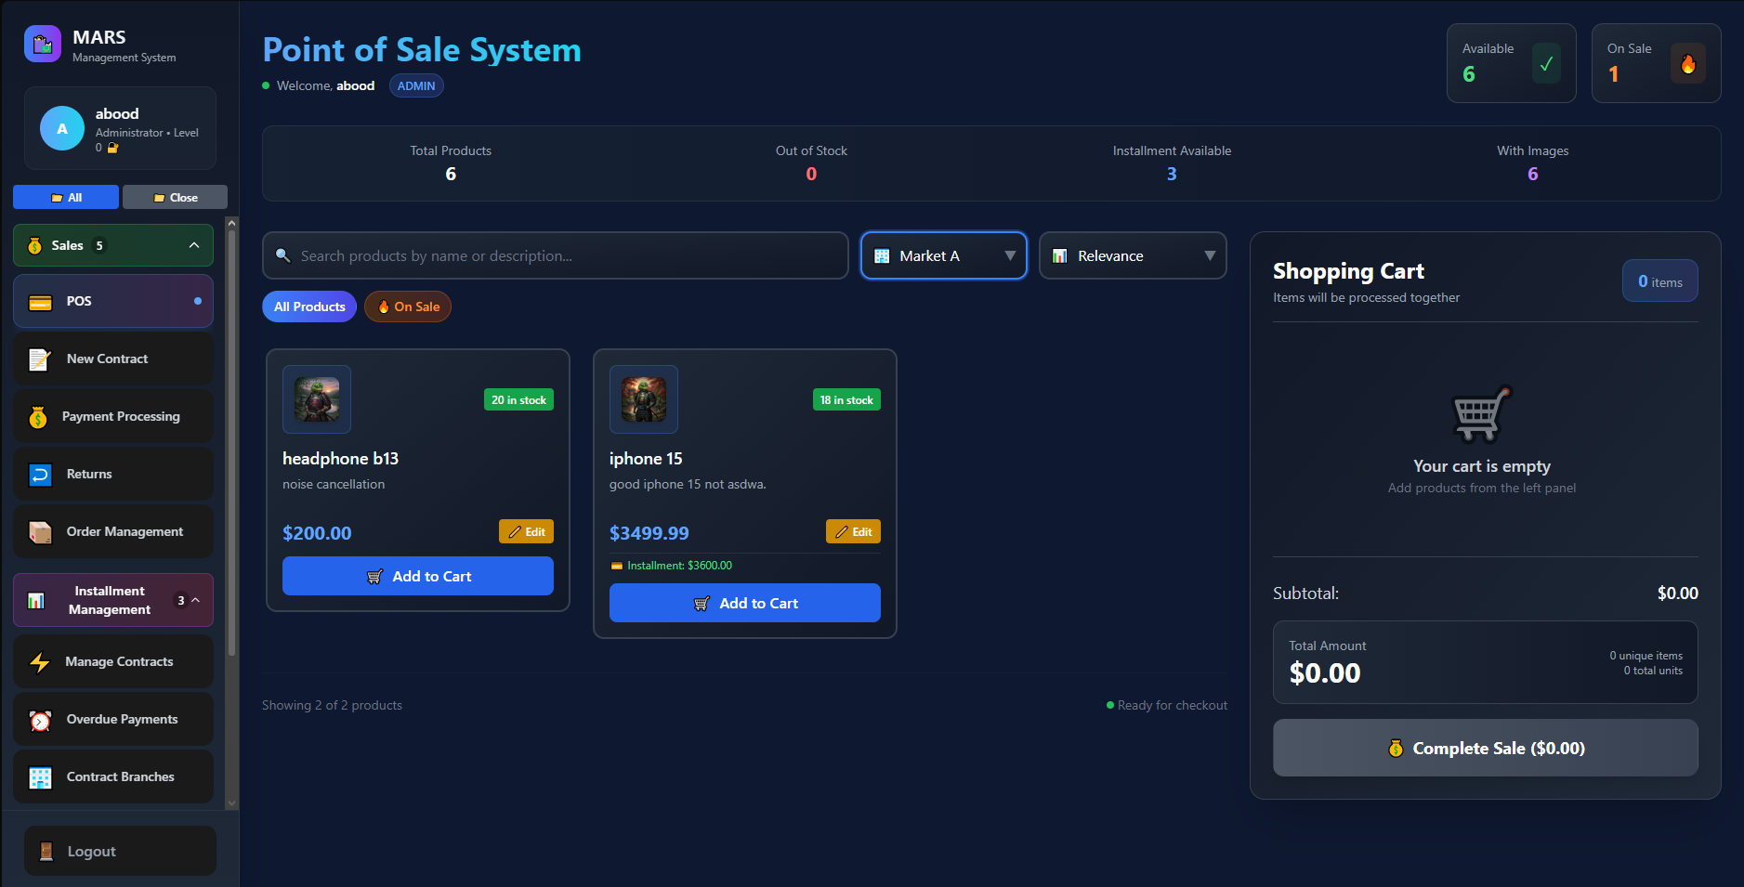
Point Of Sale-page

Slide 23
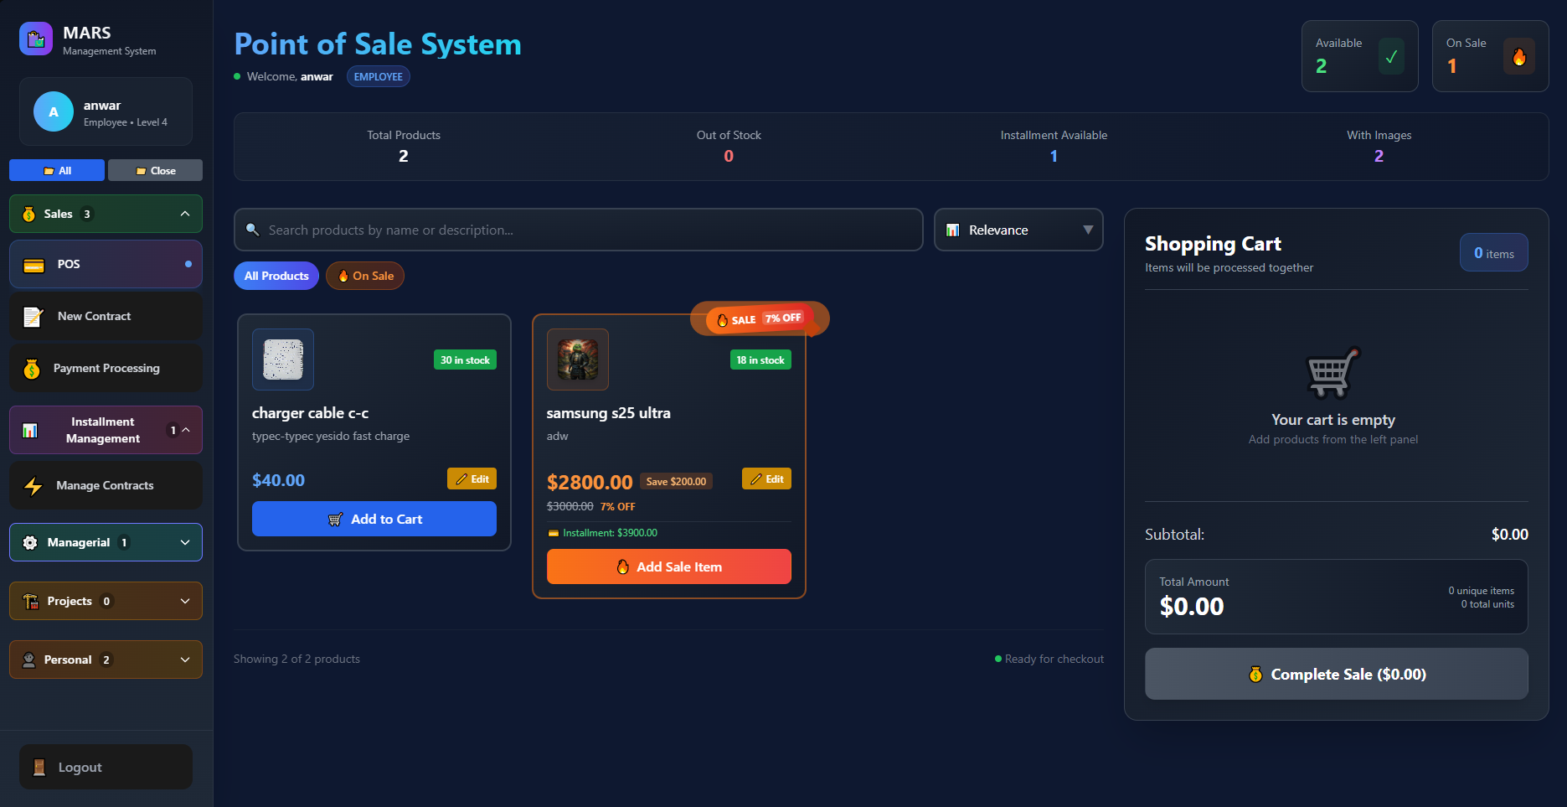
Point Of Sale-page

Slide 24
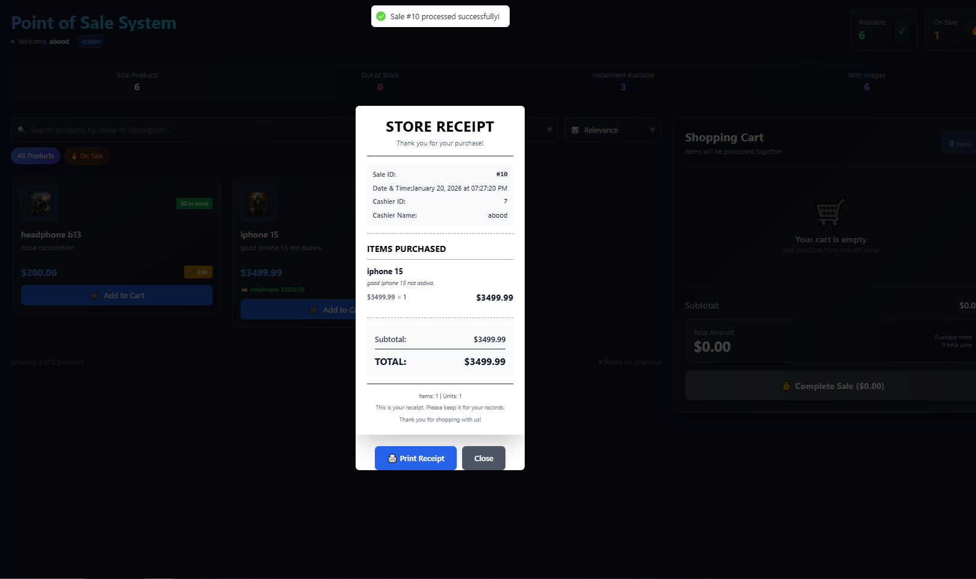
Point Of Sale-page

Slide 25
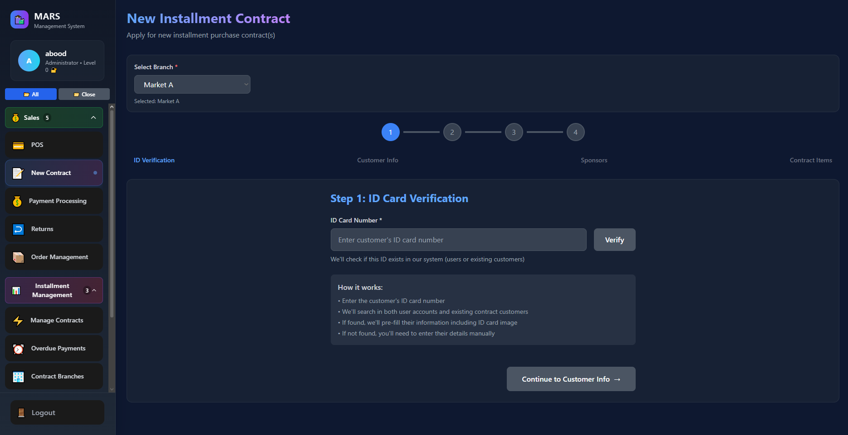
Installment Apply Page

Slide 26
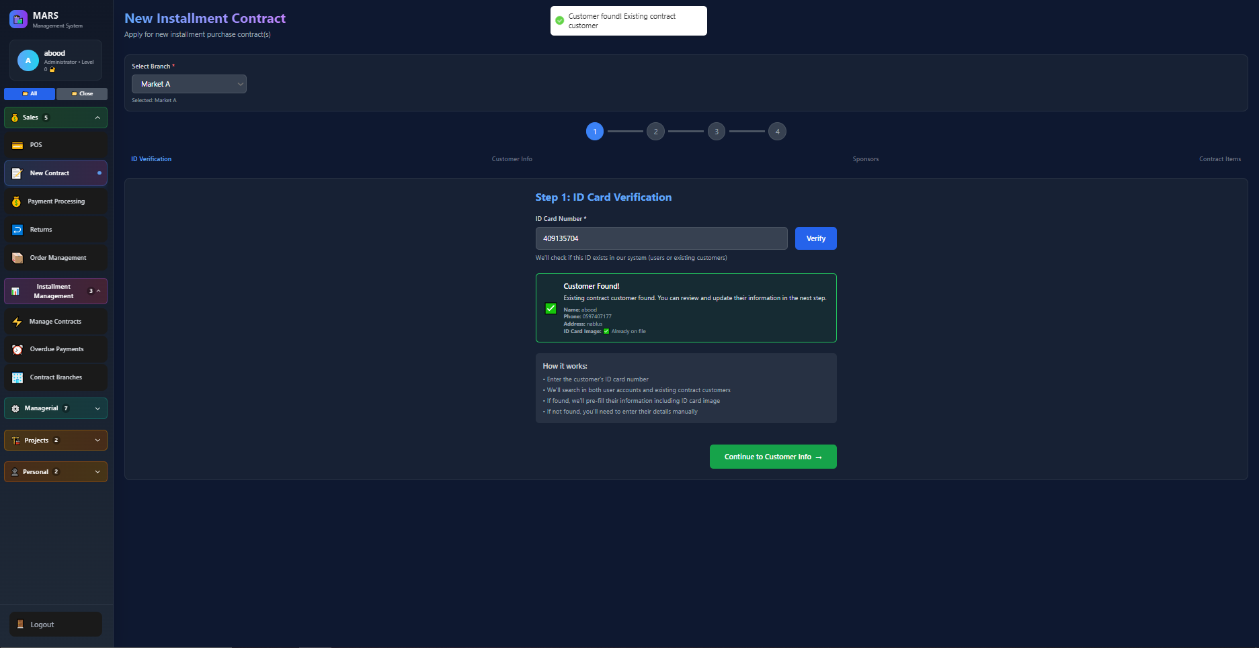
Installment Apply Page

Slide 27
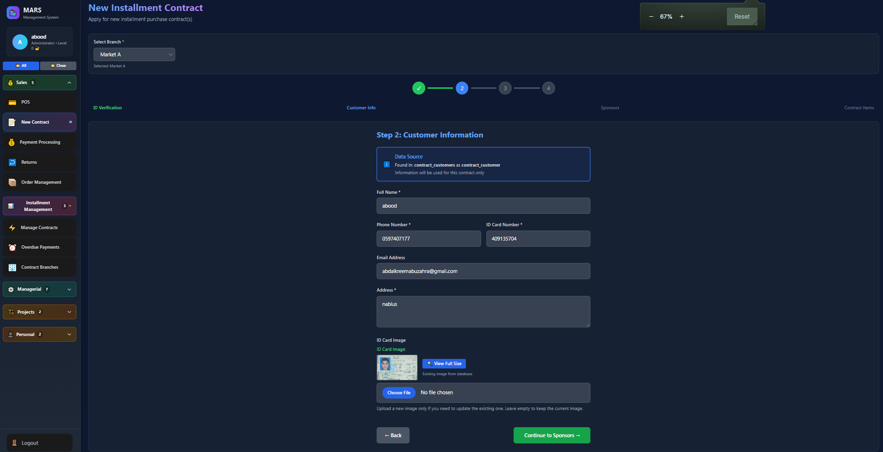
Installment Apply Page

Slide 28
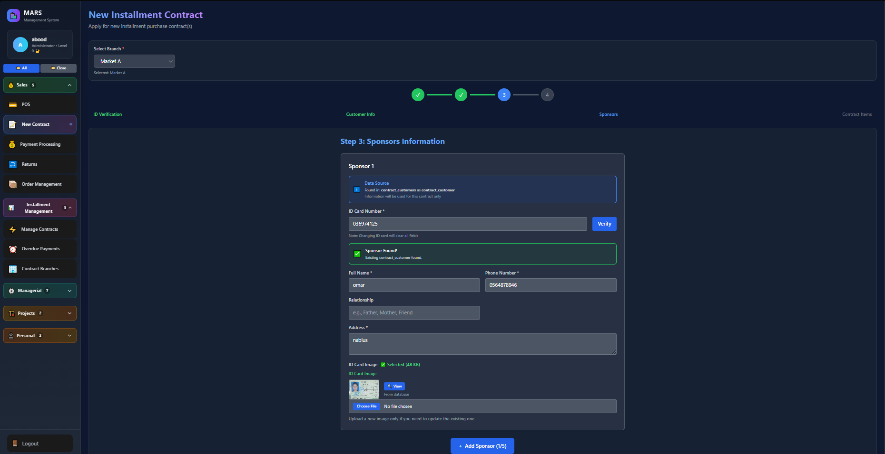
Installment Apply Page

Slide 29
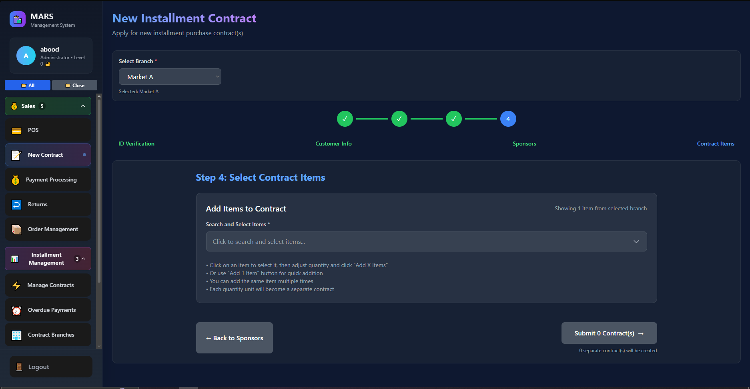
Installment Apply Page

Slide 30
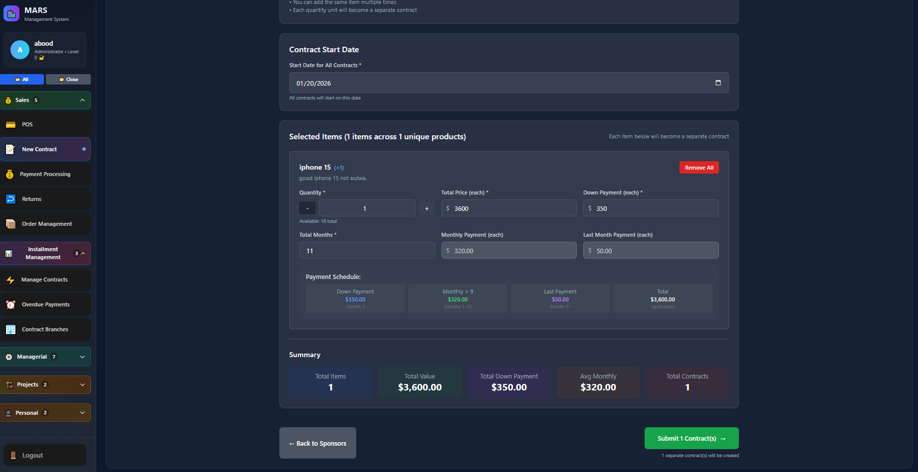
Installment Apply Page

Slide 31
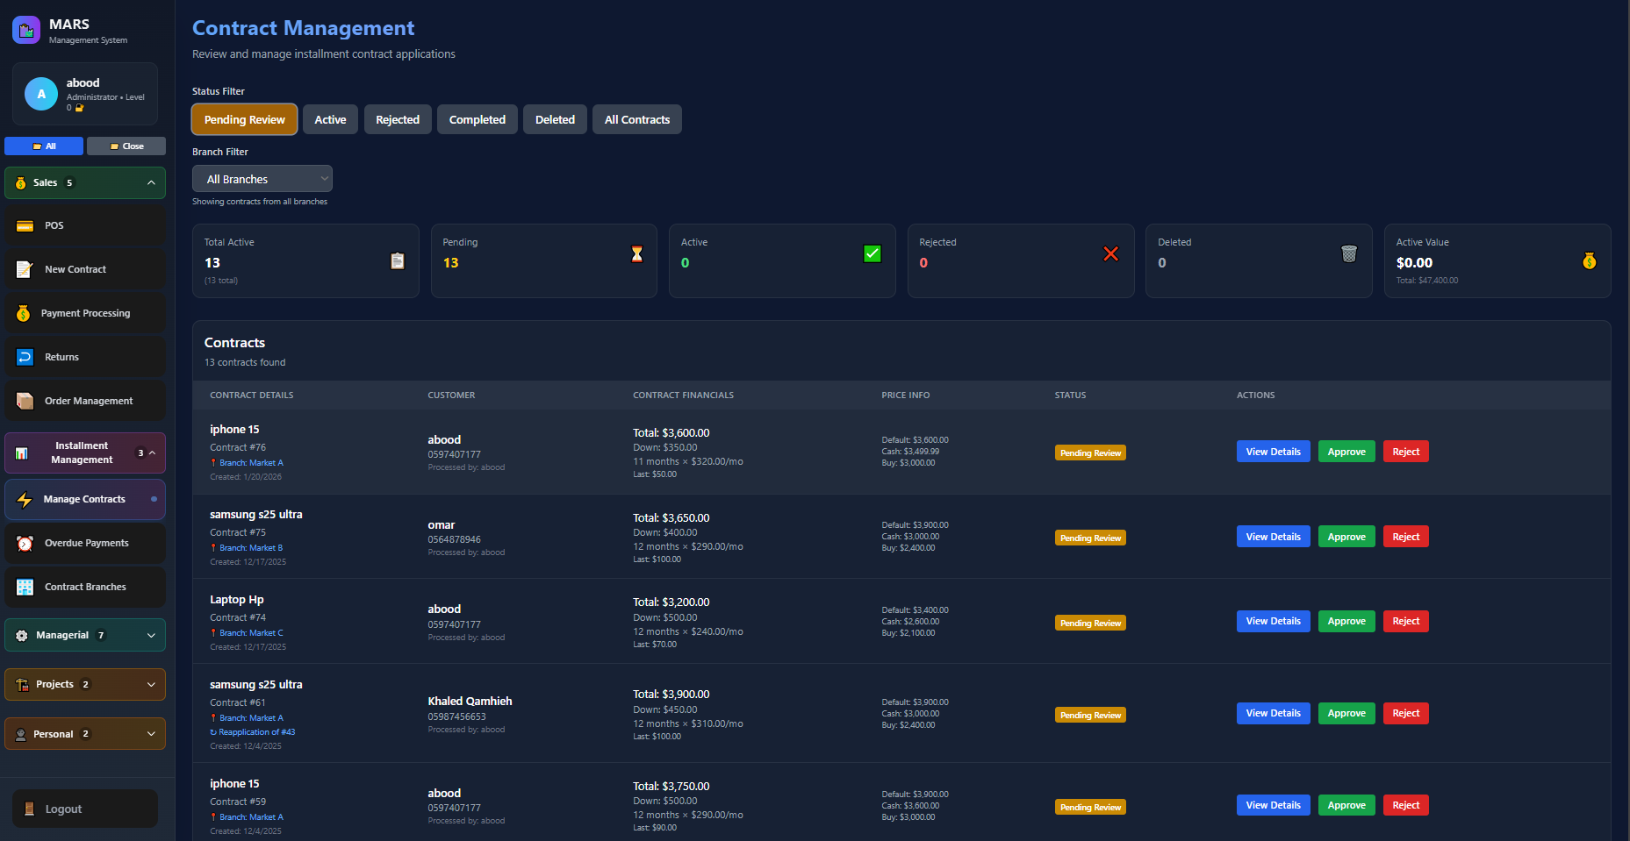
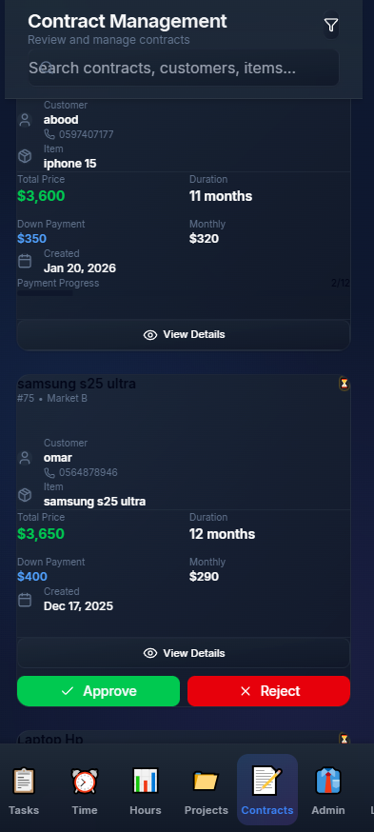
Installment Management Page

Slide 32
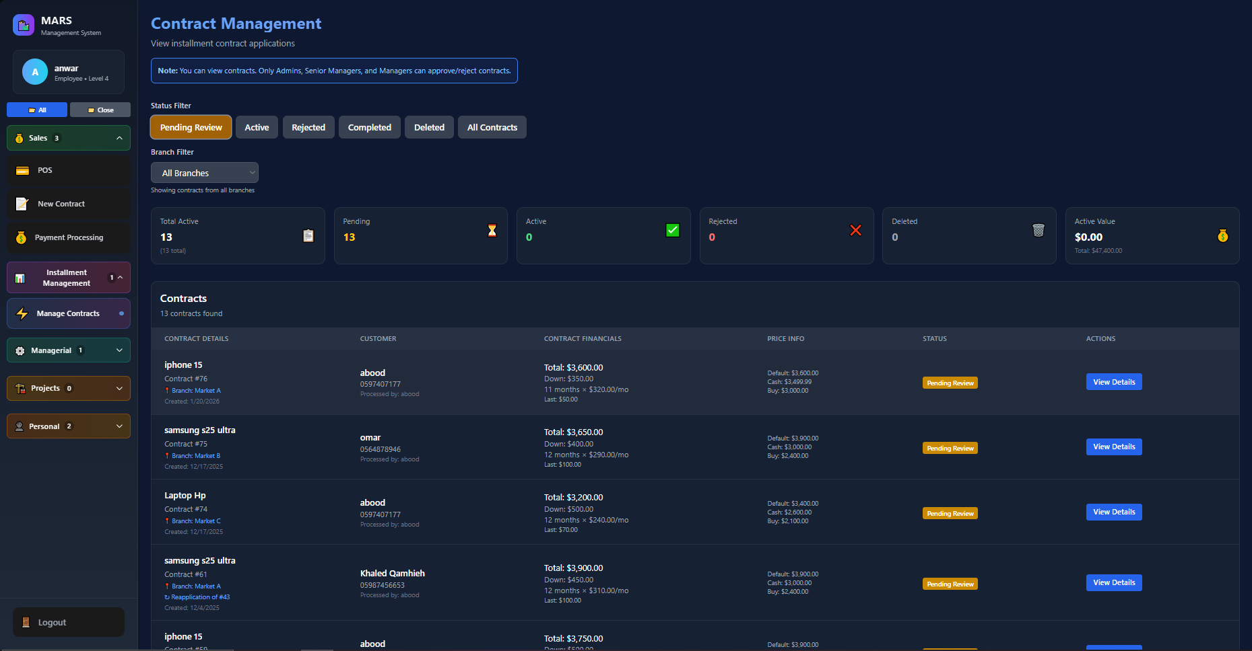
Installment Management Page

Slide 33
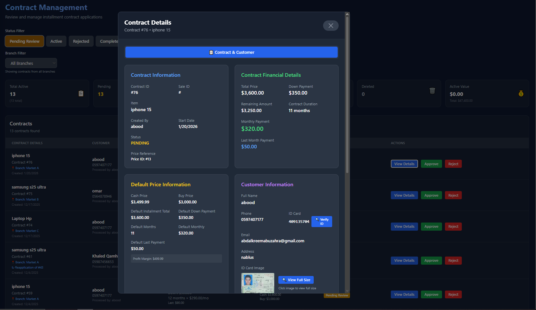
Installment Management Page

Slide 34
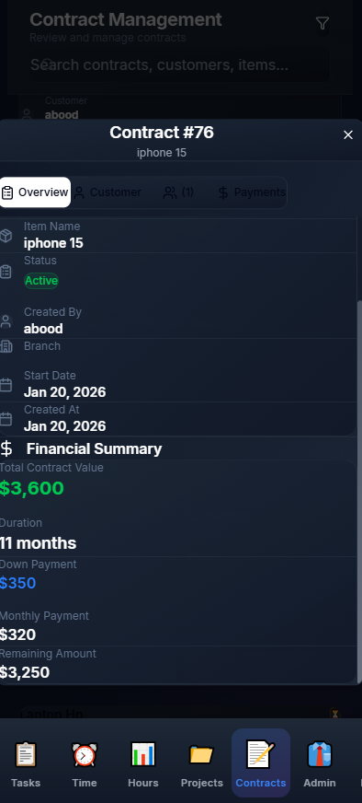
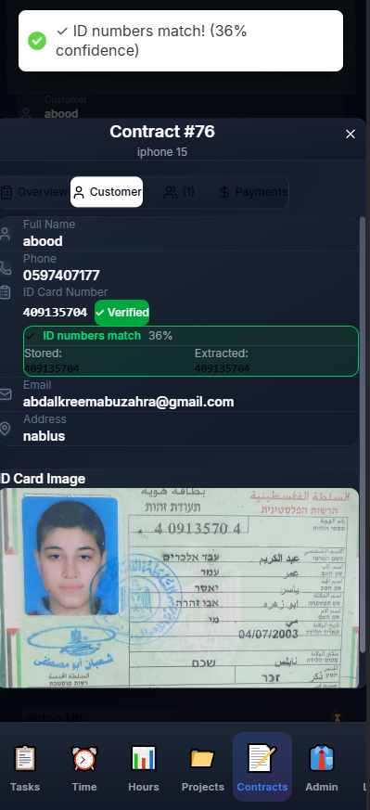
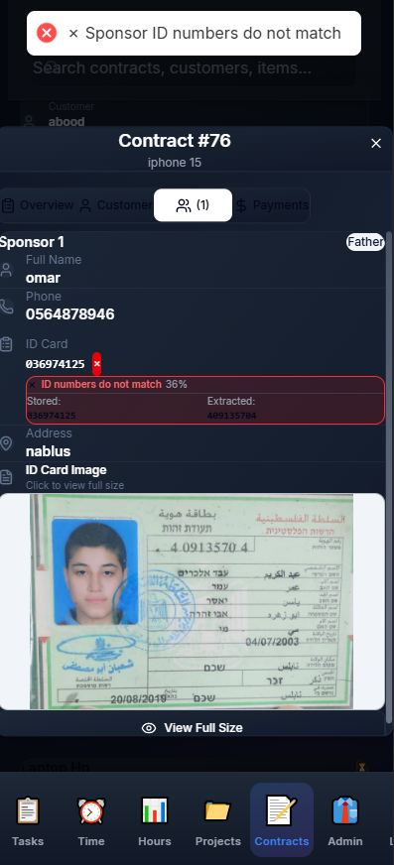
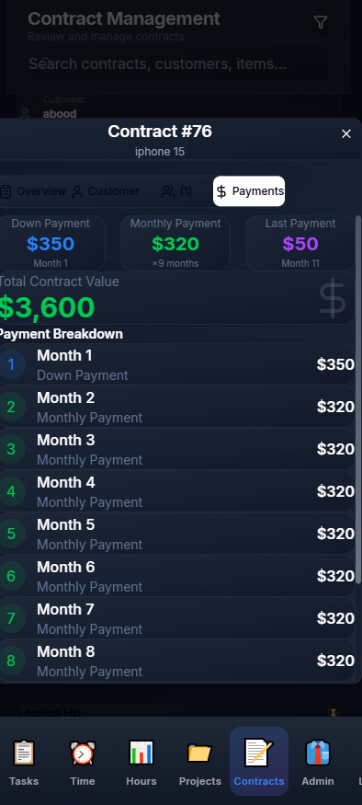

Installment Management Page

Slide 35
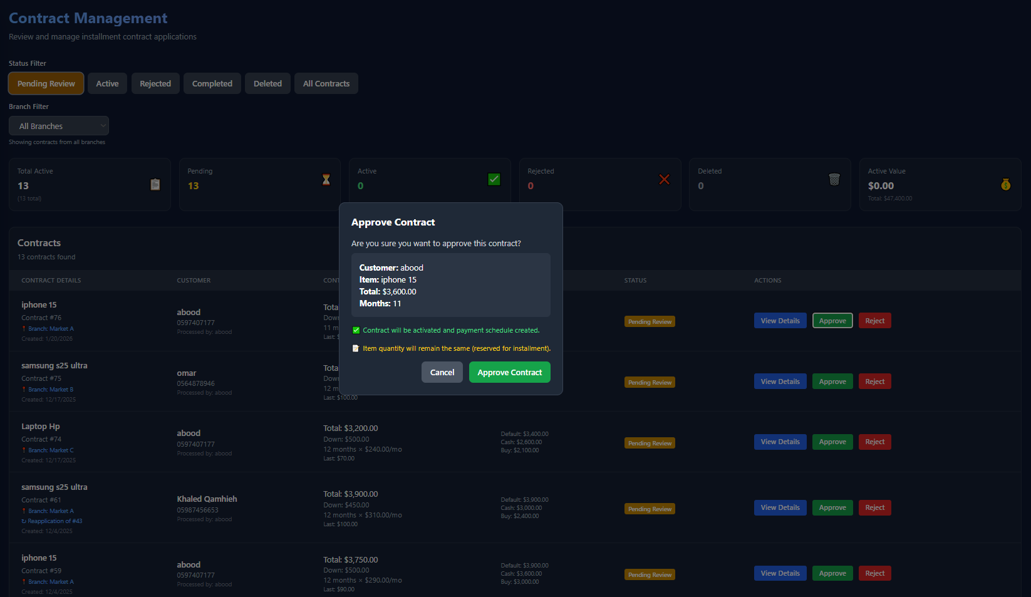
Installment Management Page

Slide 36
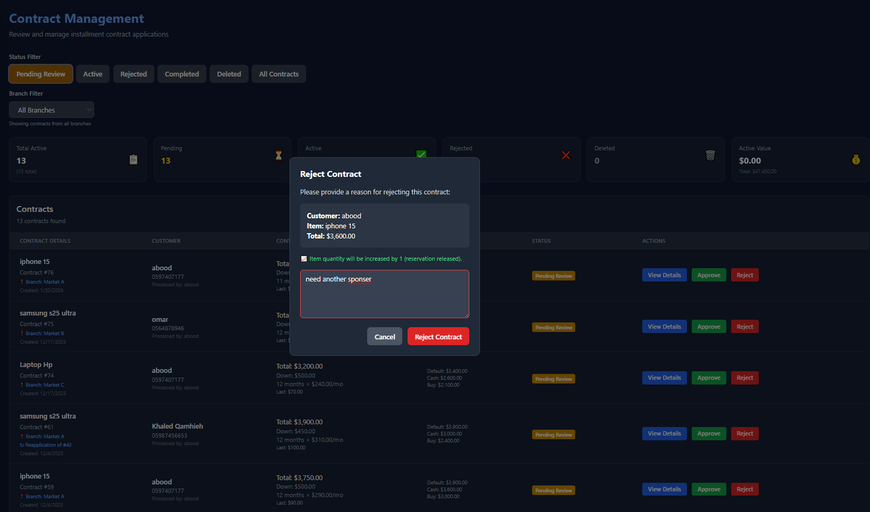
Installment Management Page

Slide 37
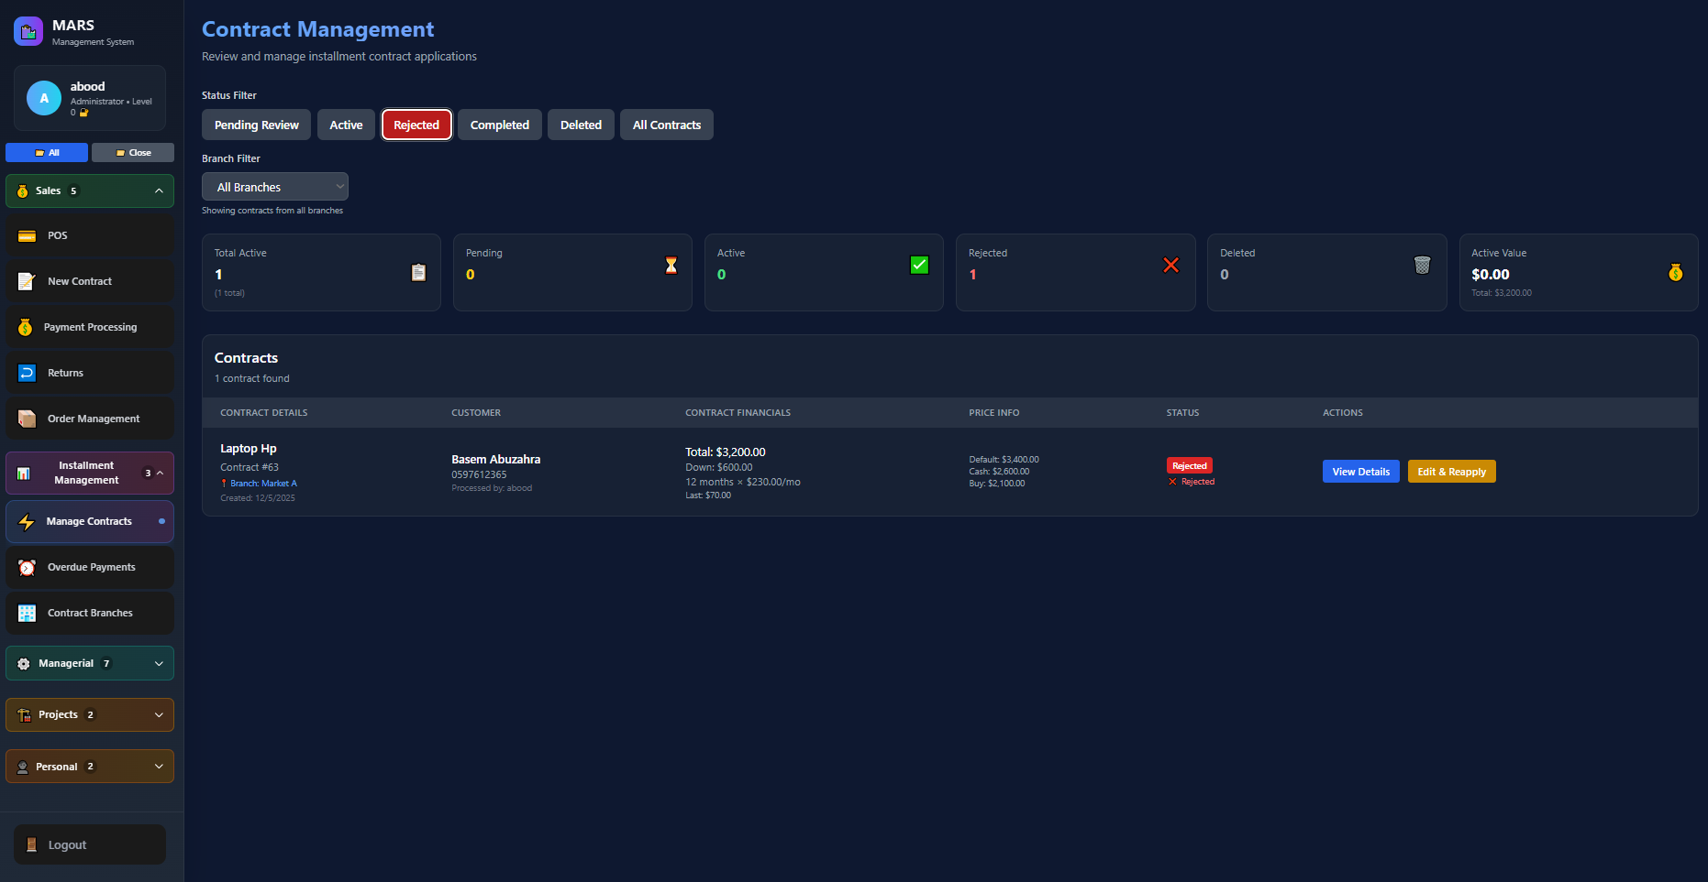
Installment Management Page

Slide 38
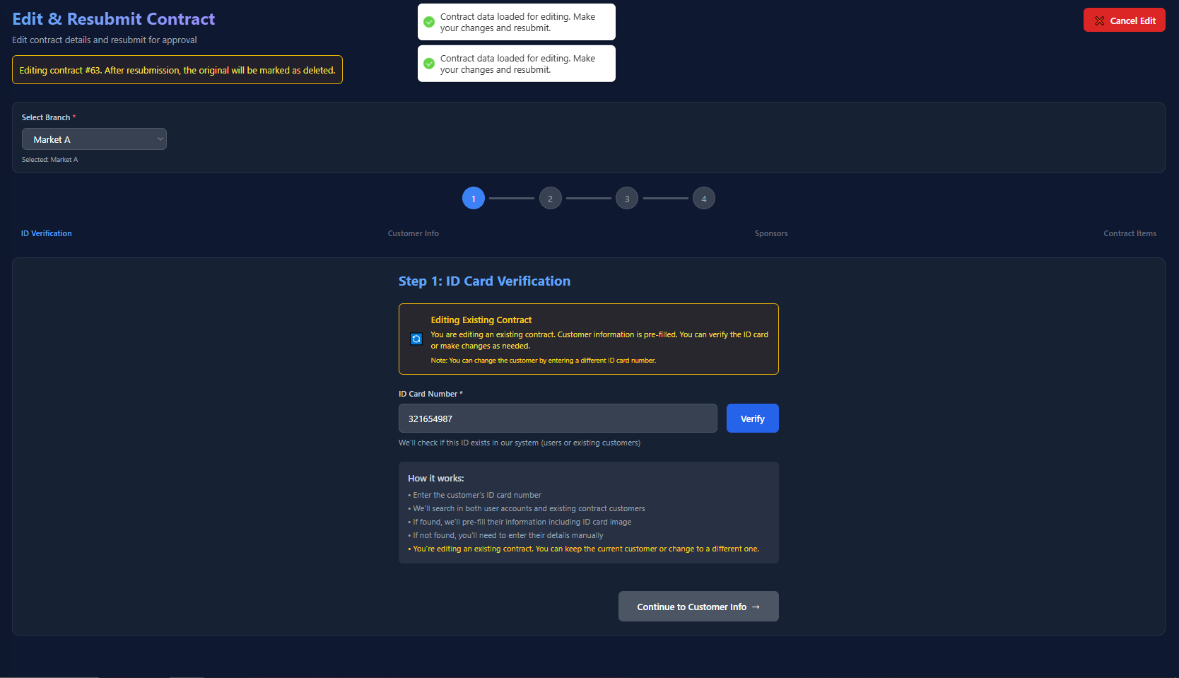
Installment Management Page

Slide 39
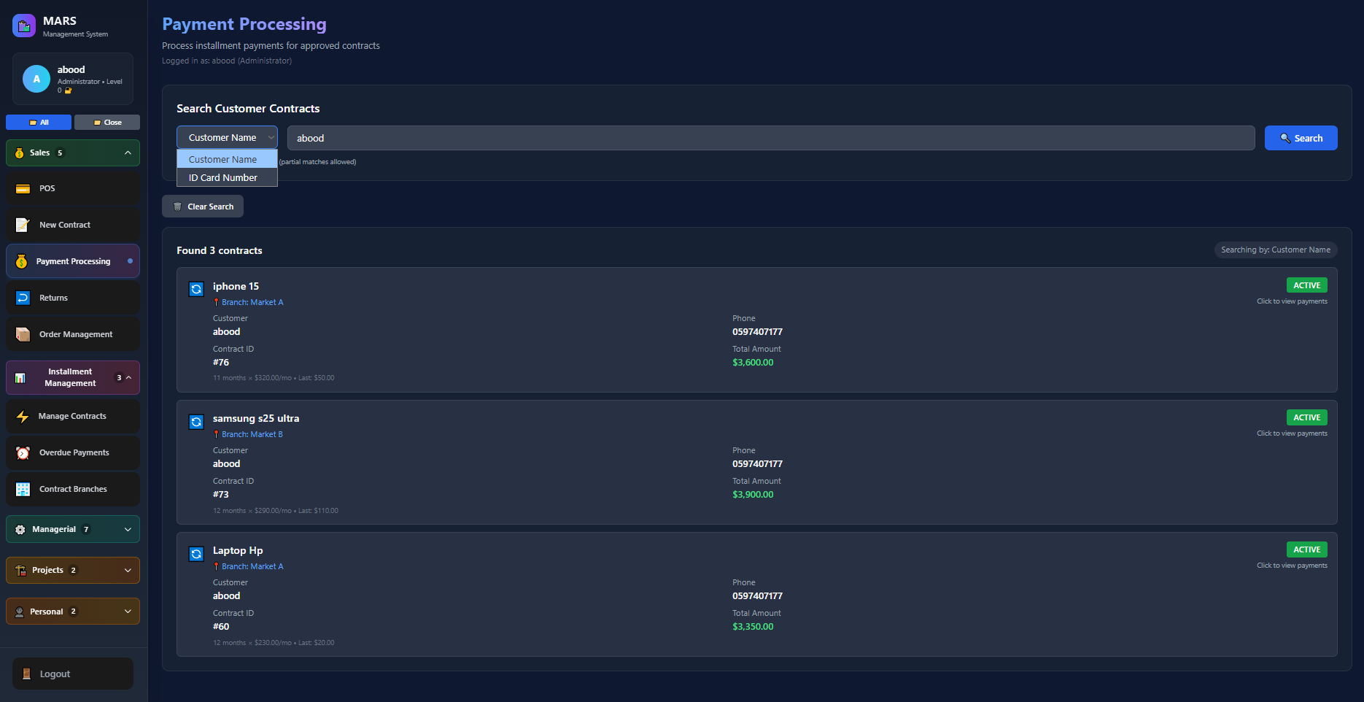
Installment Payment Page

Slide 40
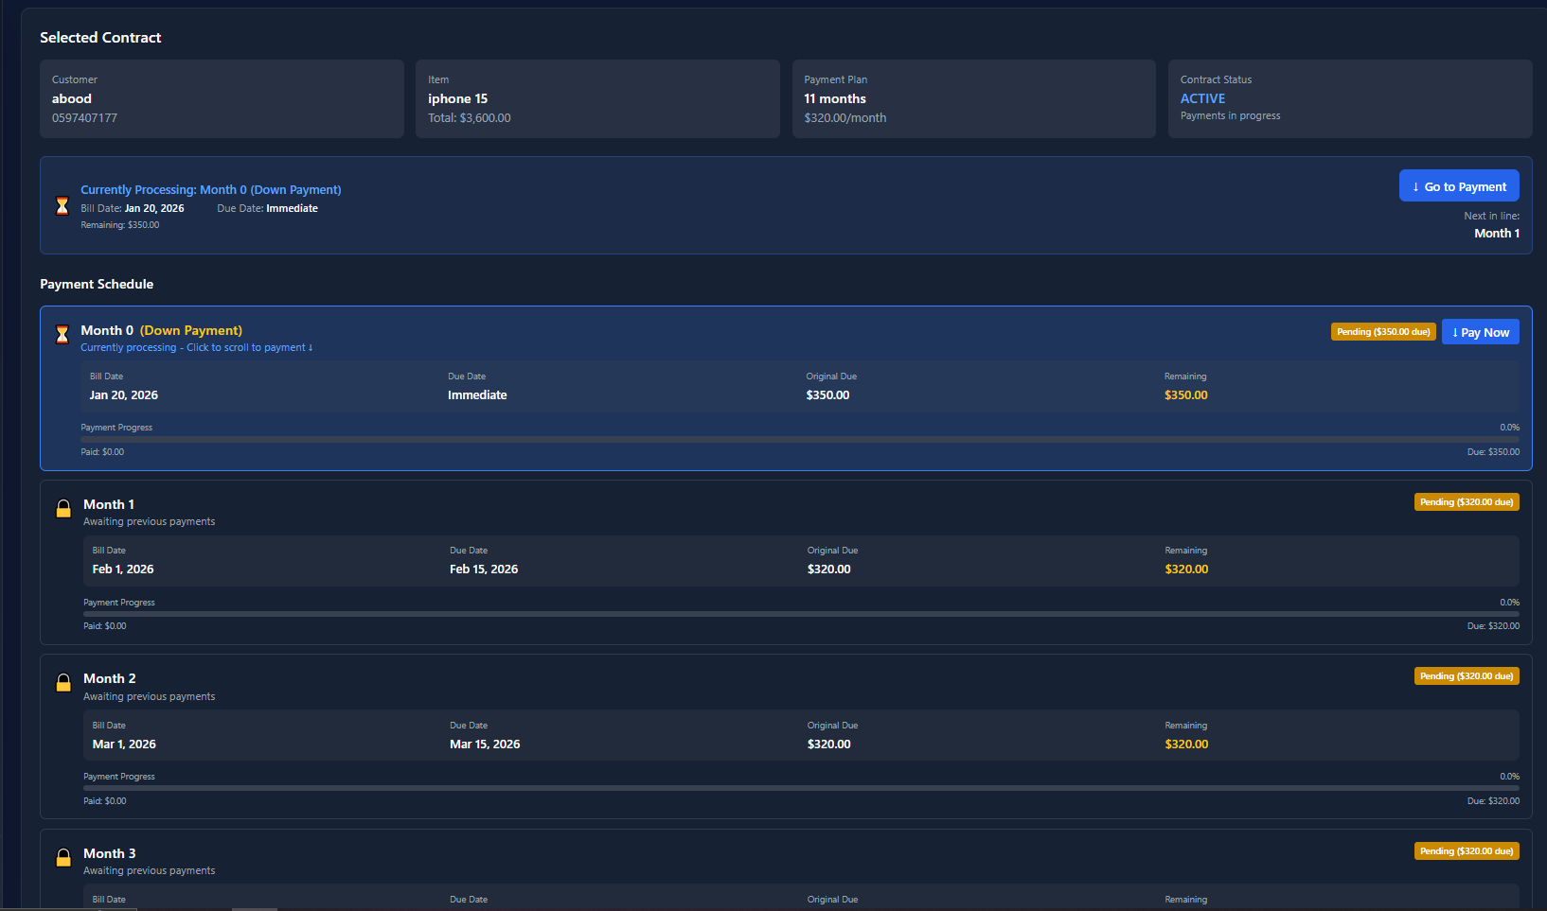
Installment Payment Page

Slide 41
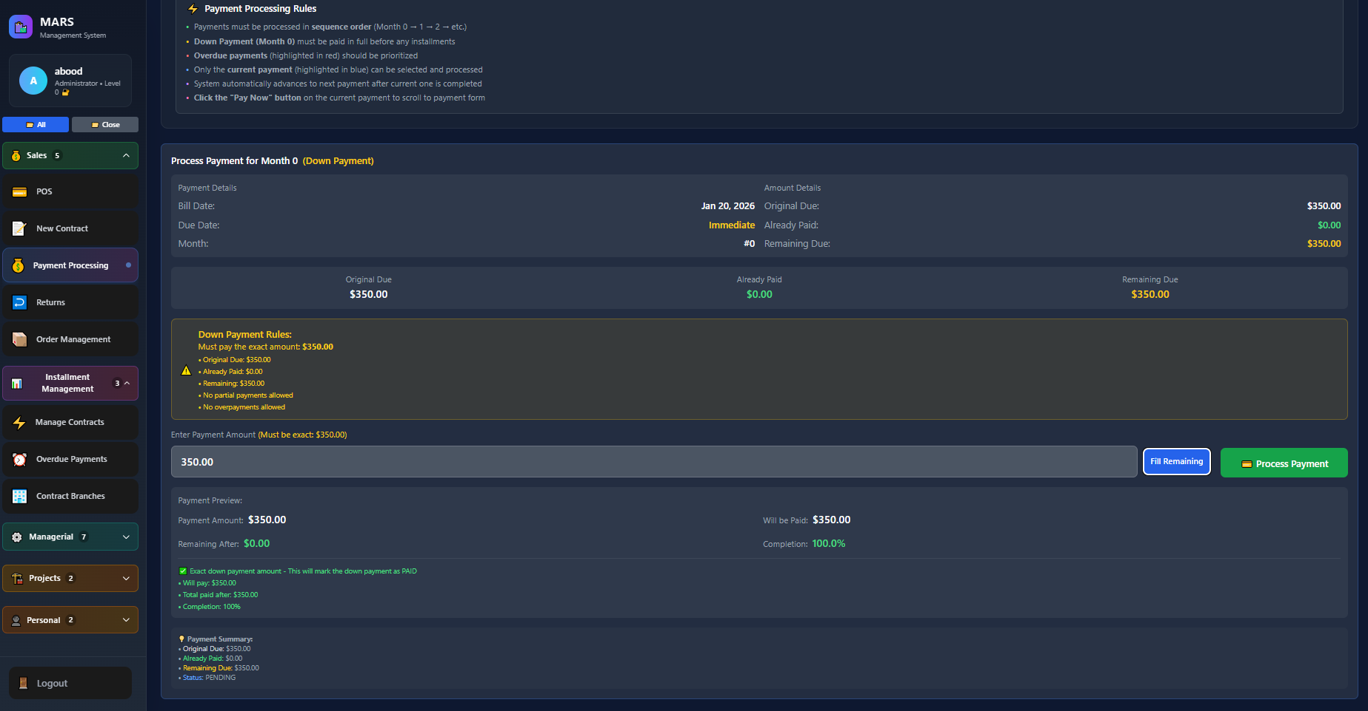
Installment Payment Page

Slide 42
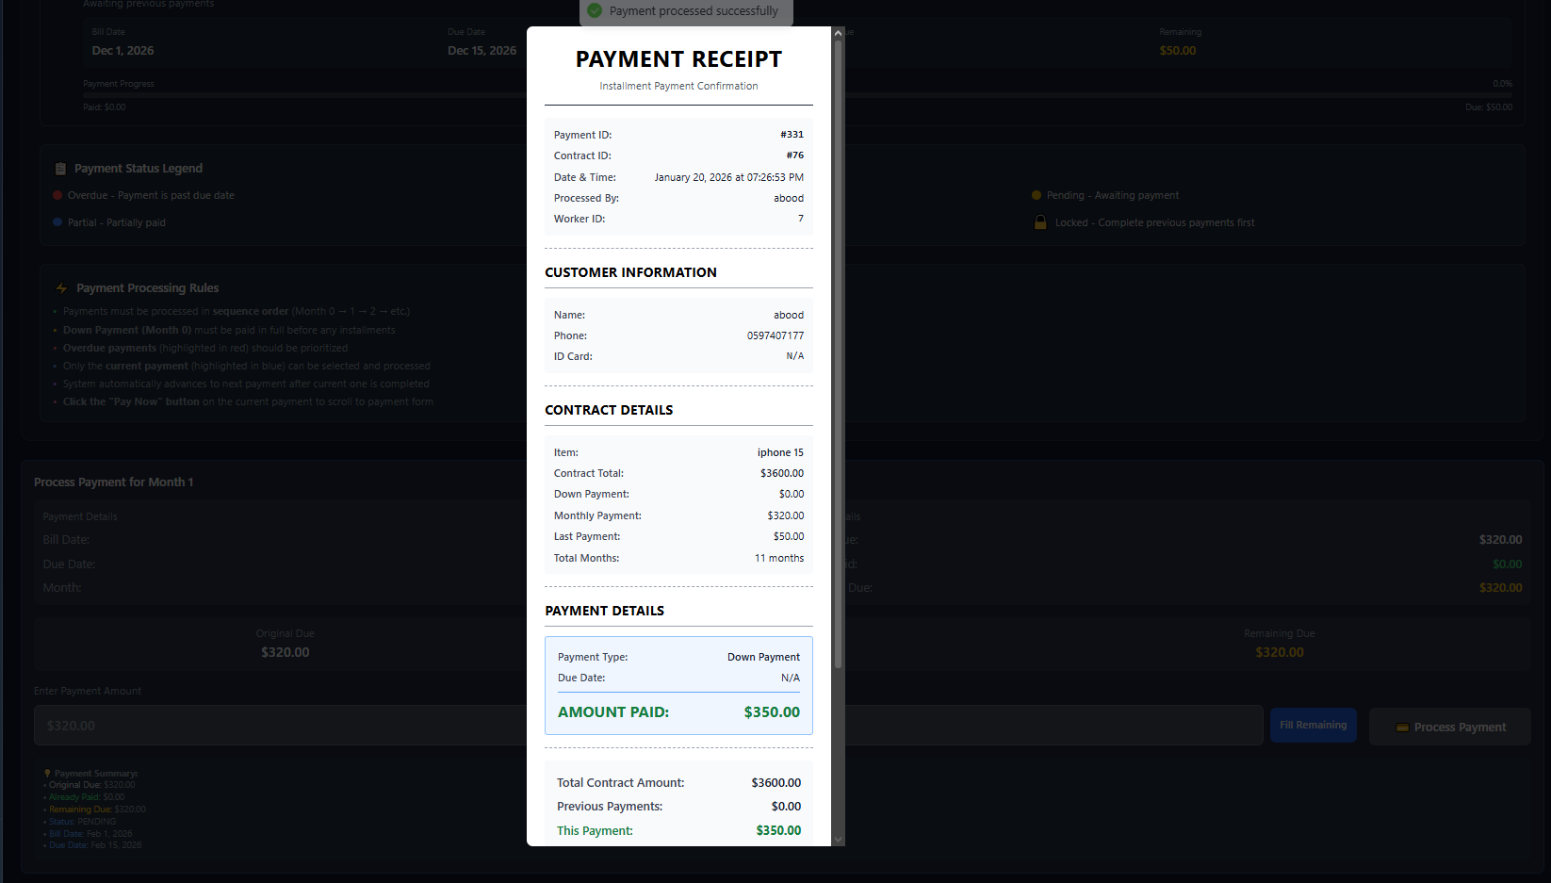
Installment Payment Page

Slide 43
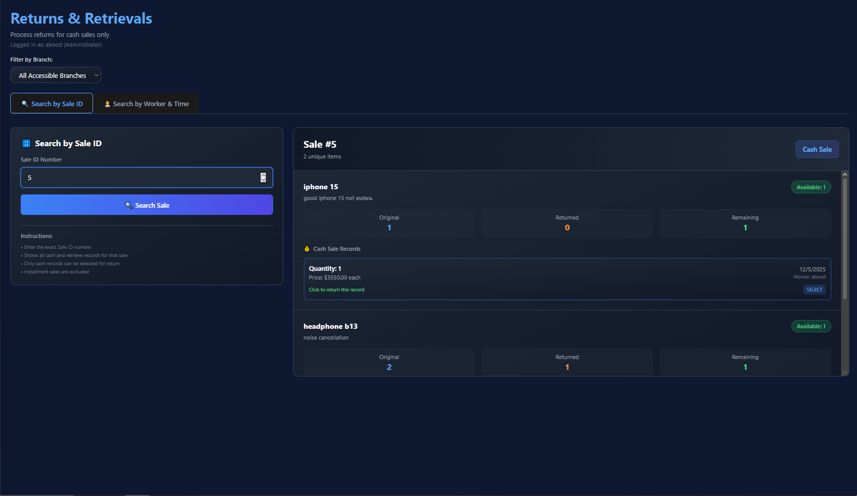
Return Page

Slide 44

Return Page

Slide 45

Return Page

Slide 46

Order Mangement Page

Slide 47

Order Mangement Page

Slide 48

Overdue Payments Page

Slide 49

Order Mangement Page

Slide 50

Order Mangement Page

Slide 51

Branch-Contract Management Page

Slide 52

Inventory Management Page

Slide 53

Employee Management Page

Slide 54

Employee Management Page

Slide 55

Branch Management Page

Slide 56

Items Management Page

Slide 57



Project Management Page

Slide 58




Project Management Page

Slide 59

Task History Page

Slide 60


Duty-Hours Management Page

Slide 61

Duty-Hours Management Page

Slide 62




Duty-Hours Management Page

Slide 63



Employee Task Management Page

Slide 64

Employee Task Management Page

Slide 65



Project –task Page

Slide 66

Project –task Page

Slide 67



Project –team members Page

Slide 68

Project –team members Page

Slide 69

Project –Chat Page

Slide 70


Project –Chat Page

Slide 71

Project –info Page

Slide 72


Project –info Page

Slide 73


Project –team leader Page

Slide 74

Project –team leader Page

Slide 75


Time Tracking Page

Slide 76


Employee Duty Hours Page

Slide 77
Engineering Complex Solutions
Developing MARS involved overcoming intricate technical hurdles to deliver a robust and reliable system.
Challenge: Complex Installment Logic
Challenge: Secure Data Separation
Managing diverse installment plans with multiple status states required a sophisticated approach.
Ensuring secure data separation for multiple retail stores within a single system was critical.
Solution: Automated Scheduler
Solution: Multi-Tenant Architecture
An intelligent flagging system with an automated scheduler efficiently manages and tracks all installment statuses.
We implemented a multi-tenant database architecture from day one, guaranteeing robust data isolation and security.

Slide 78


Beyond the Launch: What's Next?
Real-Time Features Using WebSockets
Integrating WebSocket-based communication (e.g., Socket.IO) would
enable real-time updates for (POS sales, Inventory Changes,
Internal chat messages, Overdue payment alerts)
Predictive Stock Alerts
AI-powered recommendations for optimal inventory levels.
Mobile App Expansion
Enhanced customer notifications and engagement features.
Enhanced Recommendation System
Changing from scoring-based to percent-based system.
Our vision extends beyond the current capabilities of MARS. We are committed to continuous innovation, turning data into actionable business intelligence to empower retailers even further.

Slide 79


Conclusion:
Developed a full-stack electronic store with internal management system.
Supports multi-tenant, multi-branch operations with secure data isolation.
Integrates payments, installments, OCR, and AI recommendations.
Enables efficient employee, inventory, and contract management.
Provides a scalable foundation for real-world deployment and future growth.
Abdulkreem Abuzahra
Ahmad Tubaila

