Slide 1
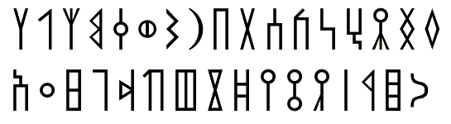

ERA
“Ancient Script Recognition”
An-Najah National University
Faculty of Engineering and Information Technology
Department of Computer Engineering
Prepared by: Ghadeer Abu Alrob and Eman Sawalha
Supervisor: Dr. Samer Arandi

Slide 2
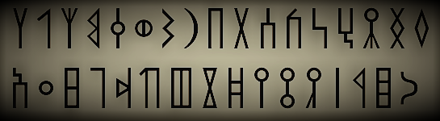
Welcome
Thank you all for coming and supporting us

Slide 3
What we will cover?
01
What is ERA?
02
How was ERA designed?
What are the obstacles that we faced?
03
04
Future works

Slide 4
Don’t be afried they are only aphabets for ancient scripts ☺
Language | Alphabets
Old South Arabian | 𐩠𐩡𐩢𐩣𐩤𐩥𐩦𐩧𐩨𐩩𐩪𐩫𐩬𐩭𐩮𐩯𐩰𐩱𐩲𐩳𐩴𐩵𐩶𐩷𐩸𐩹𐩺𐩻𐩼𐩽𐩾𐩿
Old North Arabic (Dadanitic, Safaitic, Taymanitic, and Hismaic) | 𐪀𐪁𐪂𐪃𐪄𐪅𐪆𐪇𐪈𐪉𐪊𐪋𐪌𐪍𐪎𐪏𐪐𐪑𐪒𐪓𐪔𐪕𐪖𐪗𐪘𐪙𐪚𐪛𐪜𐪝𐪞𐪟
Nabataean | 𐢀𐢁𐢂𐢃𐢄𐢅𐢆𐢇𐢈𐢉𐢊𐢋𐢌𐢍𐢎𐢏𐢐𐢑𐢒𐢓𐢔𐢕𐢖𐢗𐢘𐢙𐢚𐢛𐢜𐢝𐢞𐢧𐢨𐢩𐢪𐢫𐢬𐢭𐢮𐢯
Greek | Αβγδεζηθικλμνξοπρστυφχψωάέήίόύώϊϋΐΰ ΑΒΓΔΕΖΗΘΙΚΛΜΝΞΟΠΡΣΤΥΦΧΨΩ ΆΈΉΊΌΎΏ
Roman | Aa Ăă Ââ Bb Cc Dd Ee Ff Gg Hh Ii Îî Jj Kk Ll Mm Nn Oo Pp Qq Rr Ss Șș Tt Țț Uu Vv Ww Xx Yy Zz
Note:
To make these letters appear you need to download a font that support these Unicode.
We recommend using Unifont Upper.
Table 1: All the Alphabets for the languages that were supported in this Project

Slide 5

1.What is ERA?

Slide 6
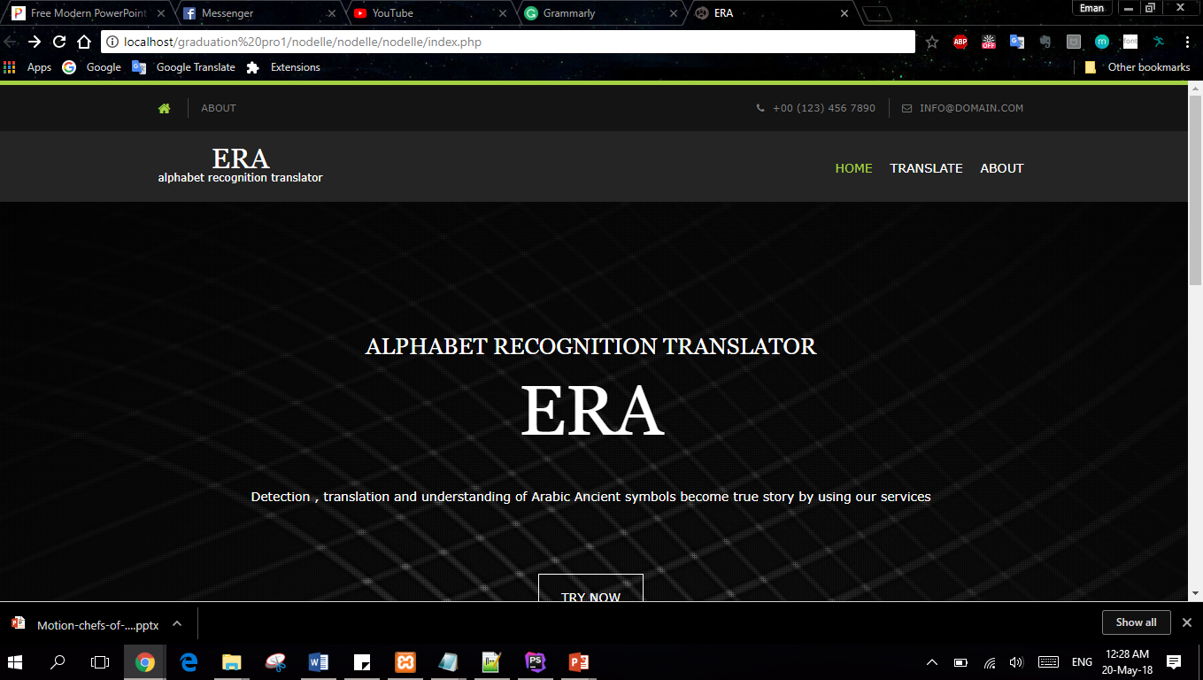
ERA is a system that is developed to extract the ancient scripts characters from images using OCR technique.

Slide 7
It is designed to support 5 ancient script languages:
Old South Arabian
Greek
Nabataean
Old North Arabian
Roman

Slide 8
2.How was ERA designed?

Slide 9

We followed 7 phases to design ERA:
Final phase
Testing phase
Training phase
Character recognition phase
Segmentation phase
Pre-processing phase
Data collection phase

Slide 10

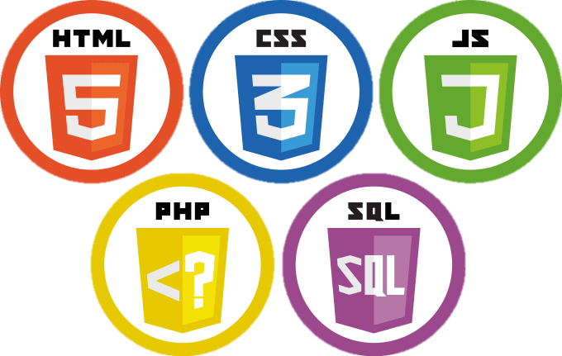
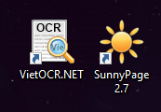

The tools/programs/programming languages that we used:
Tesseract OCR Engine

Slide 11
1)Data collection phase
Collect images to use it in training Tesseract
Language | Number of Images
Old South Arabian | 557
Old North Arabic (Dadanitic, Safaitic, Taymanitic, and Hismaic) | 568
Nabataean | 159
Greek and Roman (Latin) | 284
Table 2: Shows the number of images that were collected for each language

Slide 12
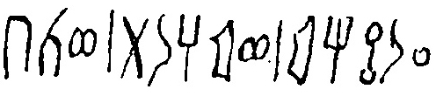
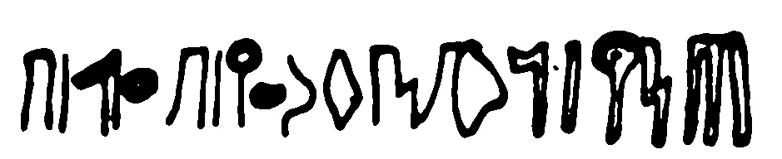
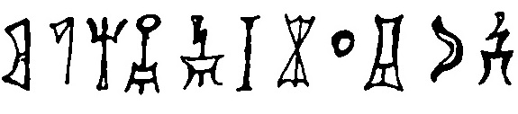
Old South Arabian

Slide 13
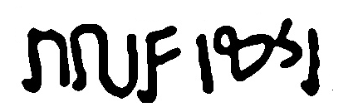
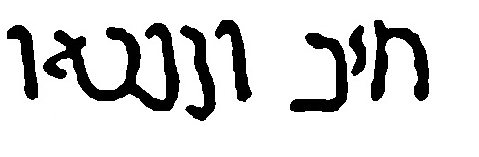
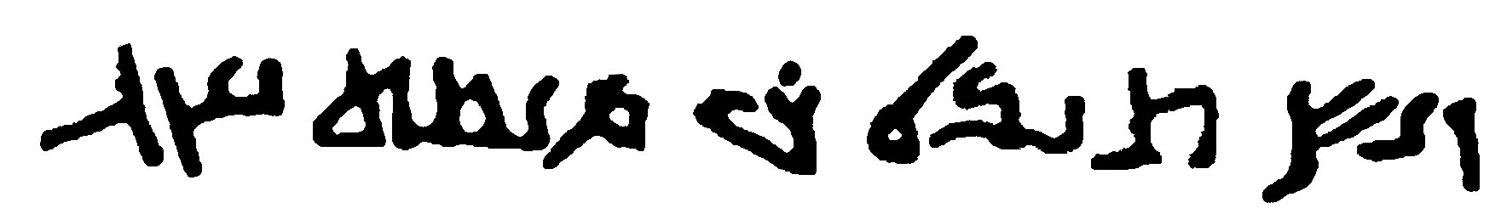
Nabataean

Slide 14
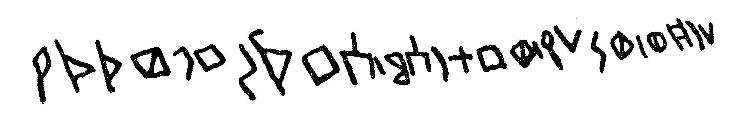
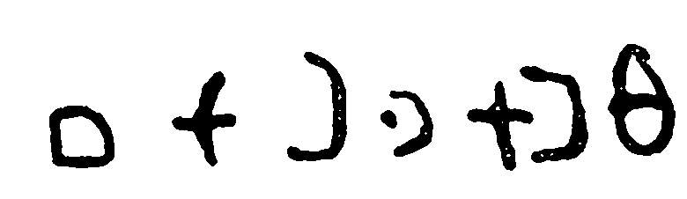
Old North Arabian

Slide 15
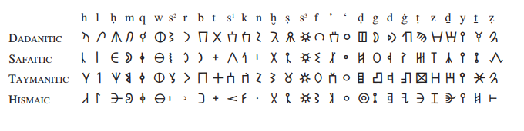

Slide 16
2) Pre-processing phase
For this phase we here take each image and apply several filters on the image.
3) Segmentation phase
4) Character recognition phase
This stage is responsible for dividing the image into its desired contained characters and draw squares on each character.

Slide 17
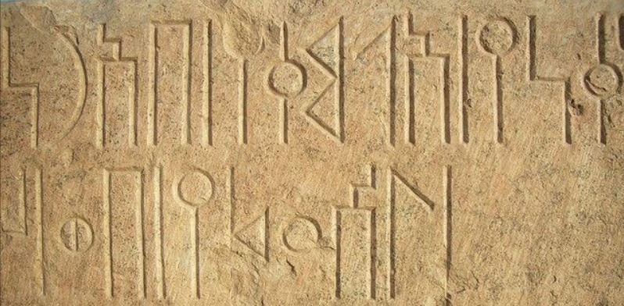
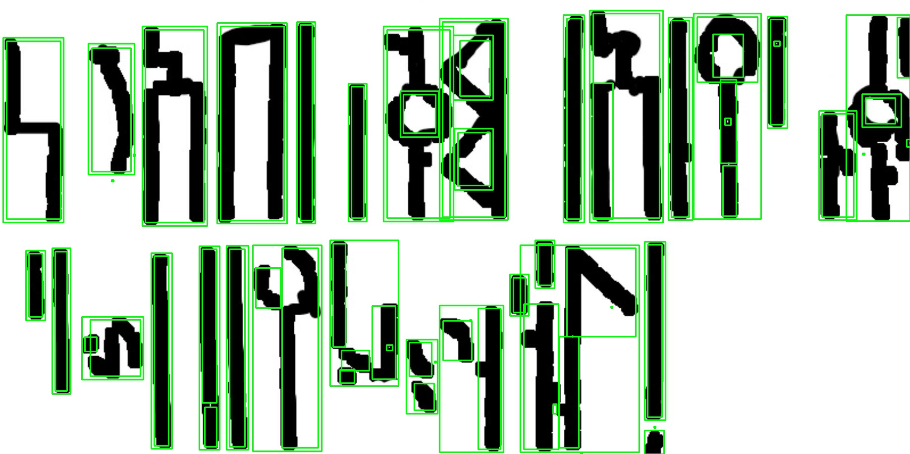
Automatic and manual segmentation
Original
Automatic

Slide 18
5) Training phase
Here we started to train Tesseract OCR which is based on neural networks. We trained 3 languages Old South Arabian, Old North Arabian, Nabataean but for Roman and Greek they were already supported by Tesseract Alpha V4.00.
Tesseract as a engine support over 130 languages and over 35 scripts on GitHub. So we looking forward to share our files with the world.

Slide 19
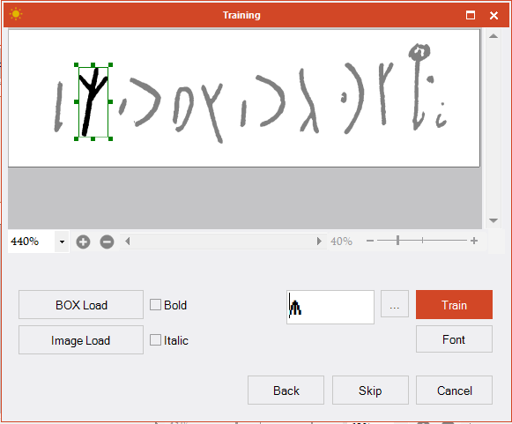

Slide 20
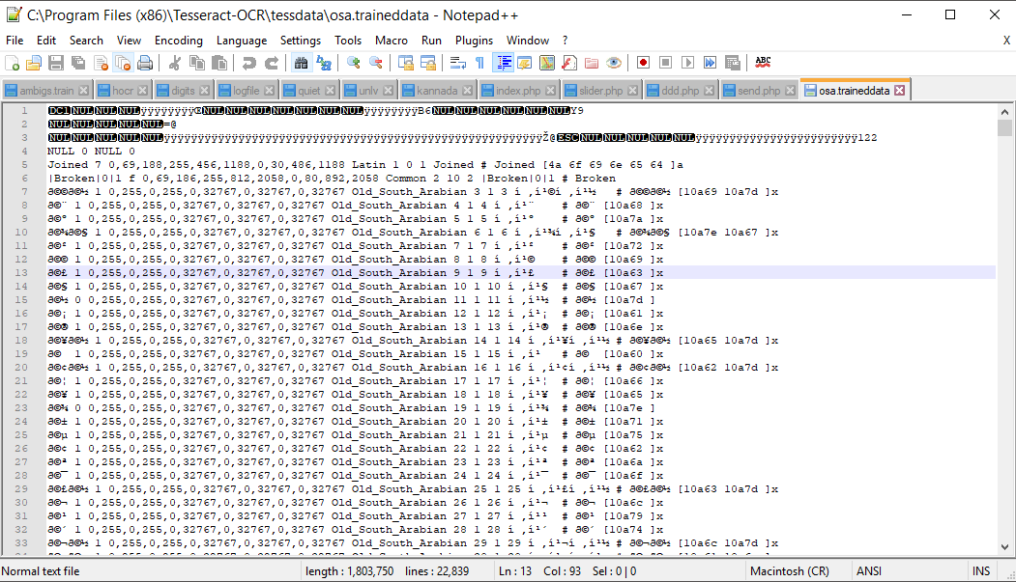

Slide 21
6) Testing phase
In this phase we tested the trained files that we create using command cmd and using a GUI program called VietOCR.
7) Final phase
This is the puzzle stage were we merge every thing into a single system.

Slide 22

Now we will leave you with a small demo

Slide 23
3.What are the obstacles that we faced?

Slide 24
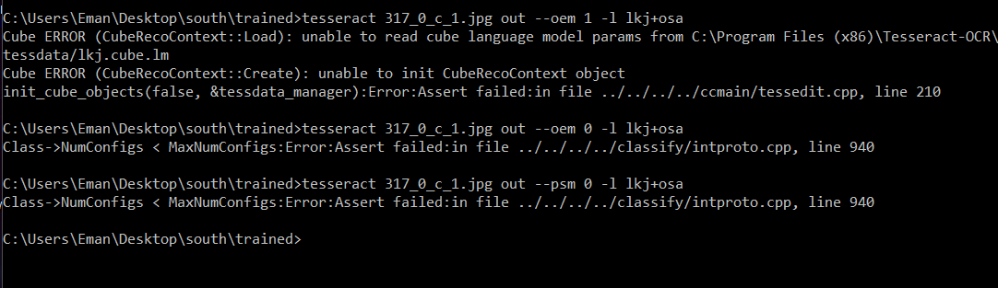
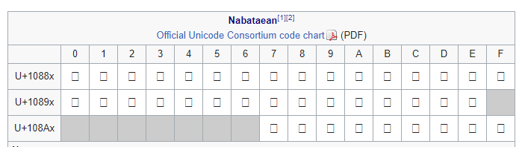
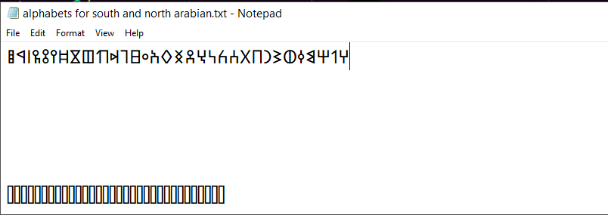
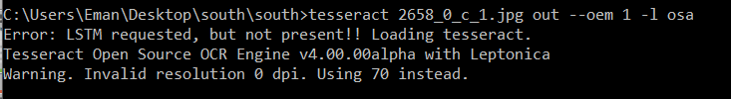
Time line for our work:
Unicode Problem
Merge Problem
Resolution
Start to design website
Training tool problem Sunnypage
Segmentation for the images

Slide 25
4. Future works

Slide 26
Future Works
There are a lot of things that ERA should cover but due to the timing we hope someday we will be able to cover these features:
Support having translation option
Support more ancient script languages
Having a more attractive GUI
Support more platform as mobile applications

Slide 27
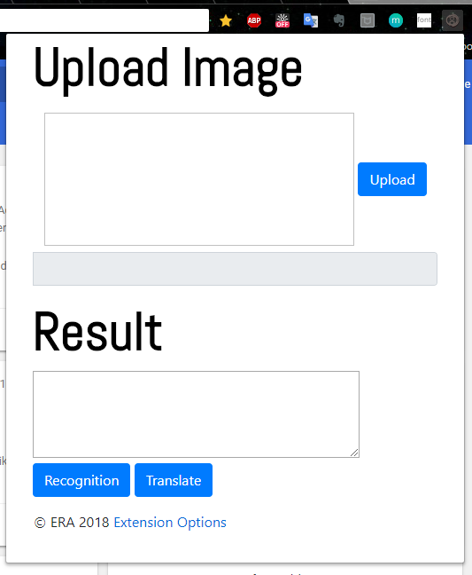
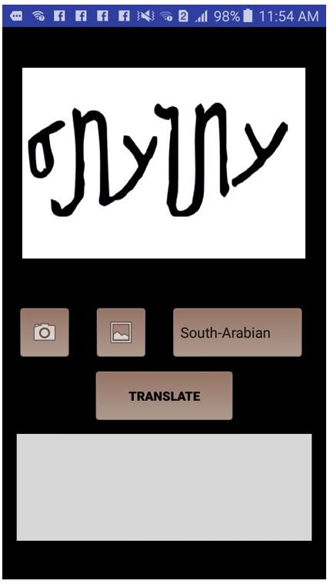
Future Works

Slide 28
Thank you for Listening

