Slide 1




SMART SECURE STUDENT DEPOT

Slide 2


in light of the frequent incidents involving defacement, loss, or theft of books and belongings exchanged among students using conventional lockers. In this project we propose the development of an advanced student locker system
Where did we get the idea?

Slide 3


Project goal
This smart and secure system aims to facilitate the safe and efficient exchange of items, eliminating the need for students to spend time searching for their belongings inside the locker room.

Slide 4
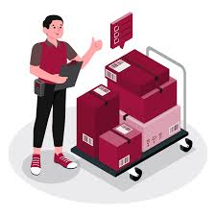
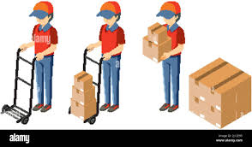
MAIN FEATURE
STORE
RETRIVE

Slide 5
How our machine work?
Add more text
01
homing
02
02. Choose the type of user
03
If store or retrive
04
Machine movement

Slide 6
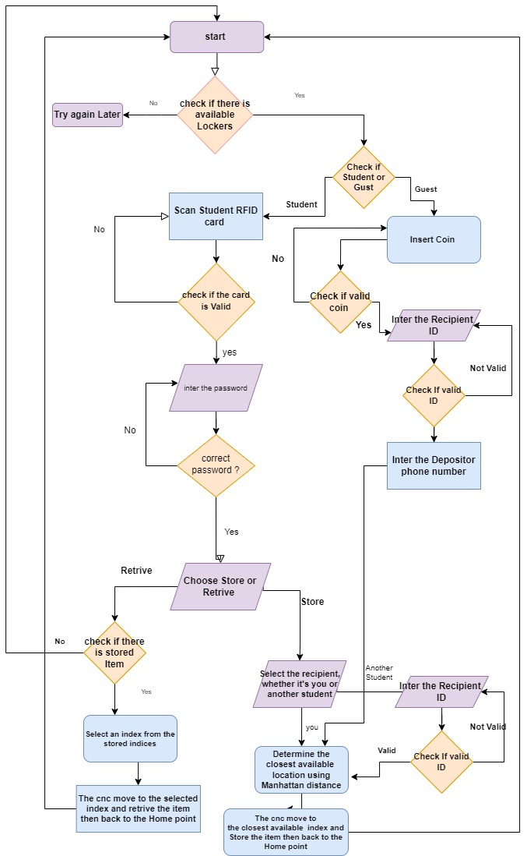
BLOCK DIAGRAM

Slide 7
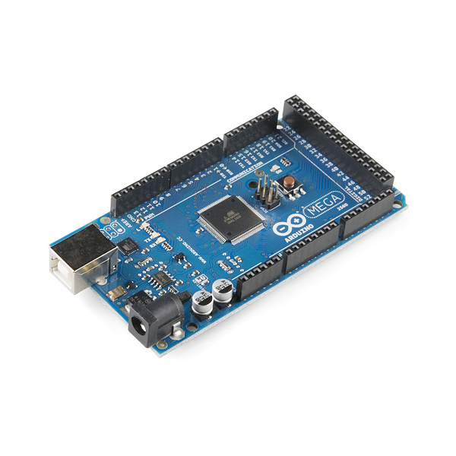
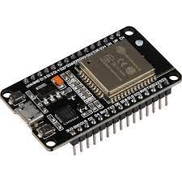
Microcontrollers
Arduino Mega 2560
ESP32

Slide 8
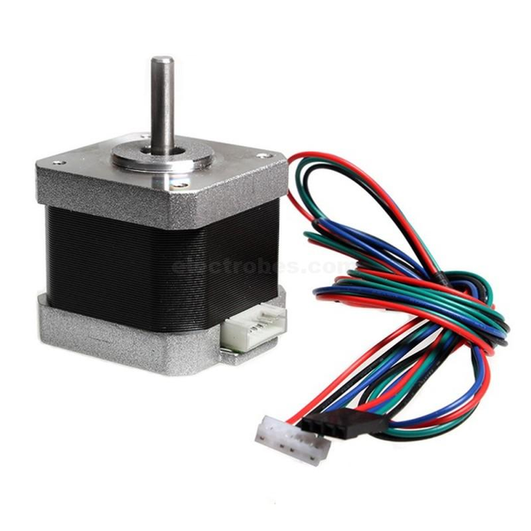
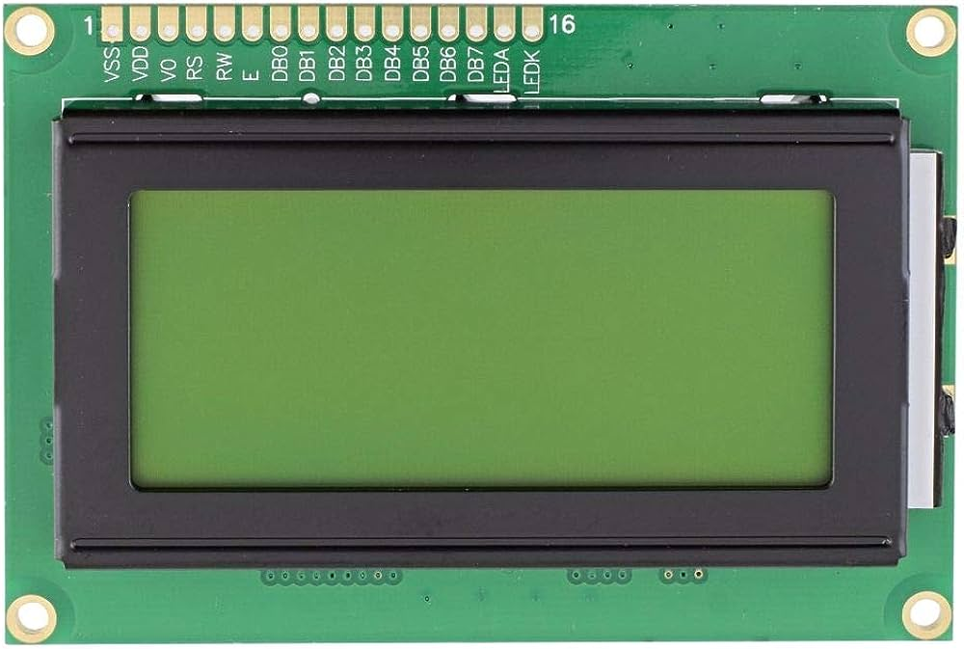
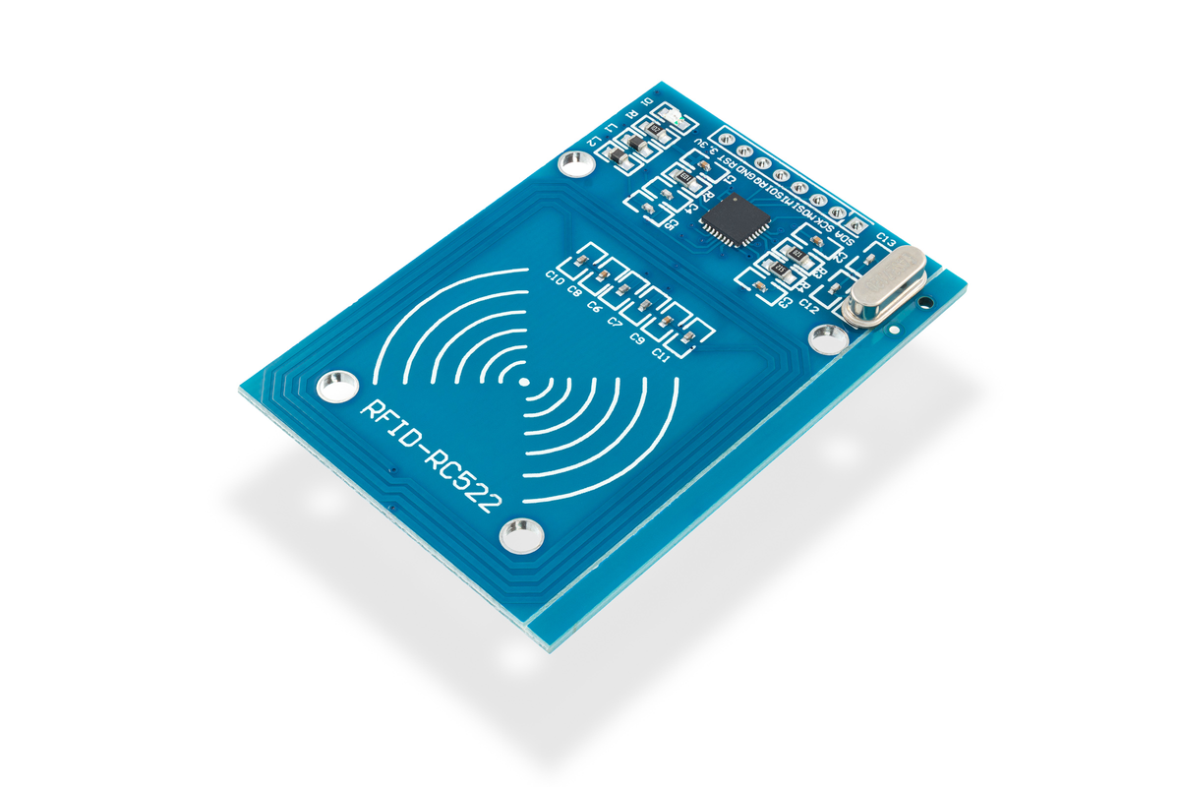
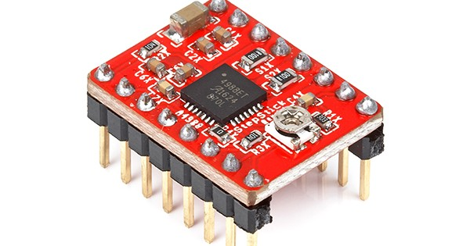
Other components
Stepper Motor
Driver A4988
LCD Display (20x4)
RFID

Slide 9
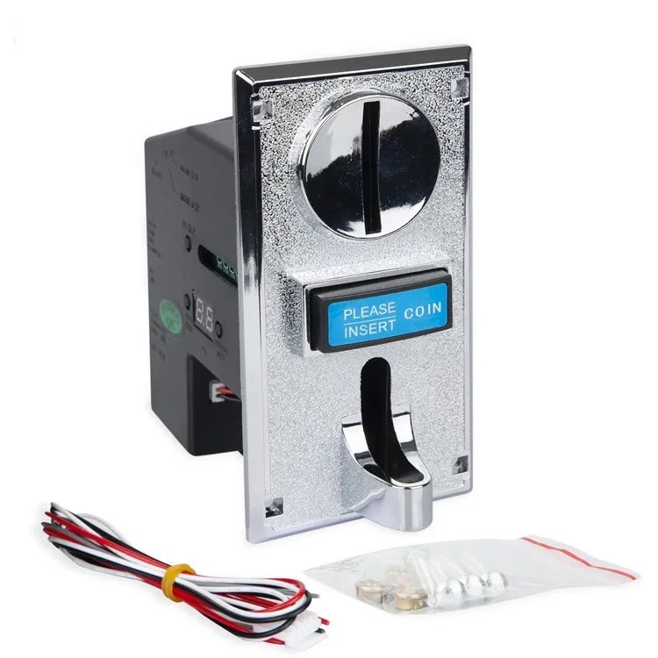
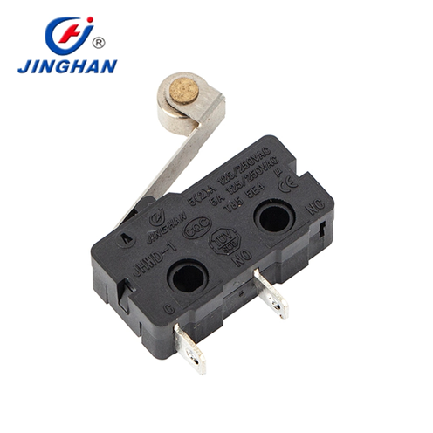
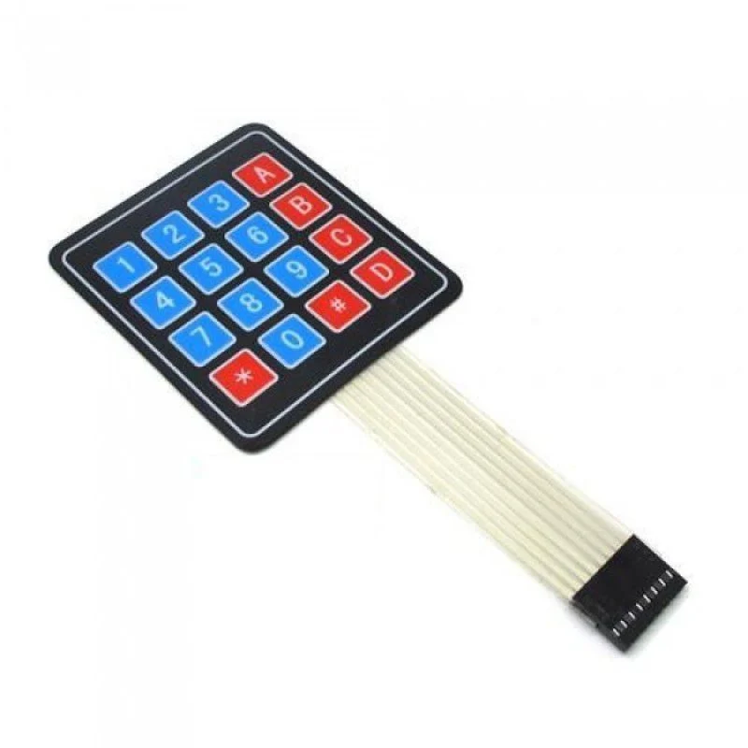
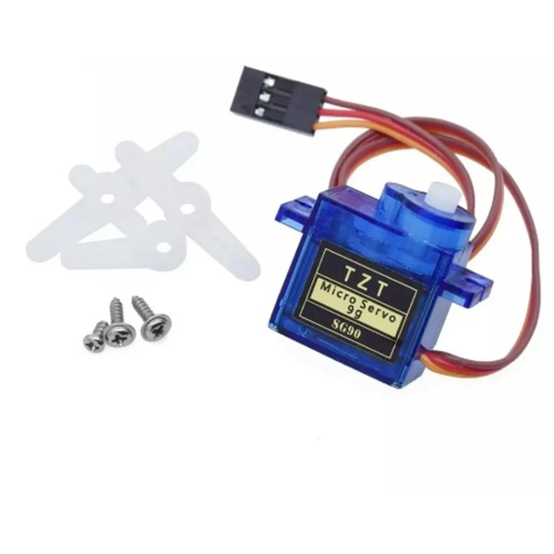
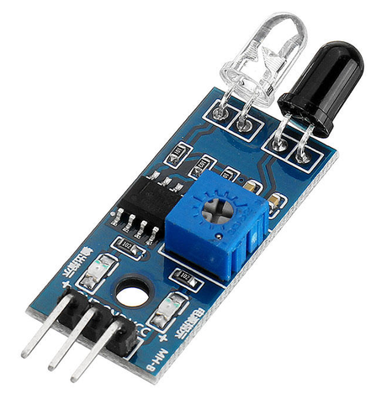
Other components

Slide 10






Scalable machine
Our machine is scalable : our prototype is 3*2 boxes but if we want to apply this project to larger one we can because we do boxes as matrix in code so we can change the indexes of the matrix and become larger we also do scalable functions for the distances of the boxes we need to enter one distance of them and all other distances for boxes will be counted automatically according to functions .

Slide 11
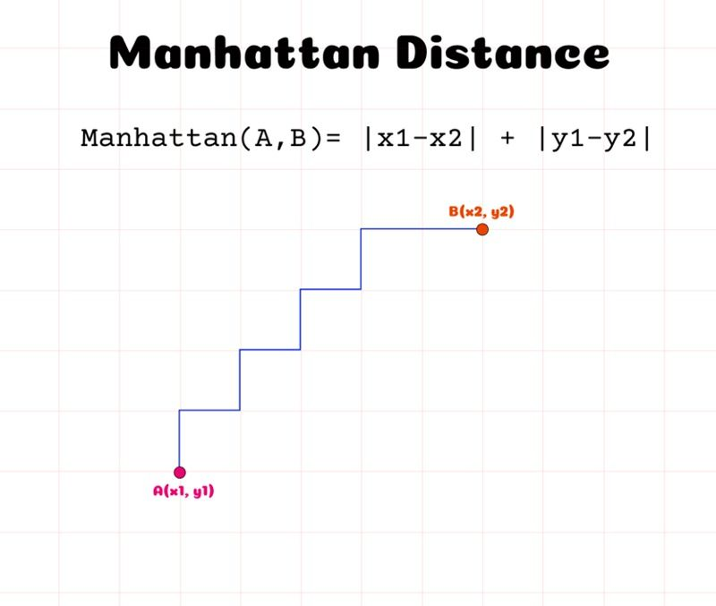
It is perhaps more useful to vectors that describe objects on a uniform grid, like a chessboard or city blocks so we use this algo in our project to compute nearest box
Manhattan distance is calculated as the sum of the absolute differences between the two vectors.
p1 at (x1, y1) and p2 at (x2, y2), it is |x1 - x2| + |y1 - y2|.-->the original point will always be one of these point because we want nearest point to origin

Slide 12

Future work
Enhanced Surveillance System: Integrated cameras linked to the mobile app for real-time monitoring and heightened security.
Size-Based Storage: Customizable storage spaces to accommodate packages of various dimensions.
Intelligent Package Routing: Automated transport to a designated location if recipients are unable to collect their packages within a specific timeframe.

Slide 13





Do you have any questions?
thank
you
Done by Arwa Maroof and Roua Awaysa

