Slide 1
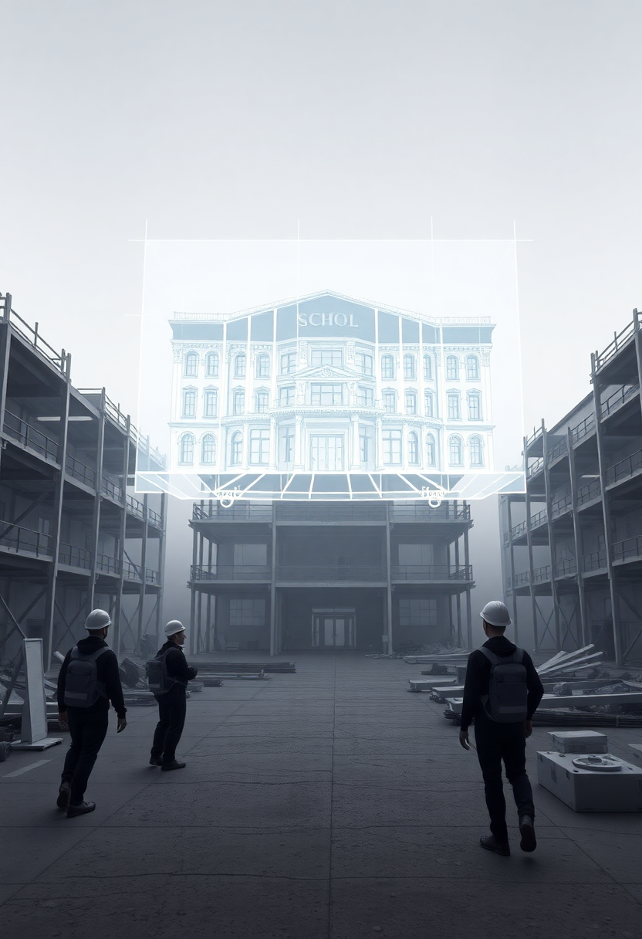

An-Najah National University
Faculty of Engineering & Information Technology
Civil Engineering Department
Graduation Project 2
Quantity Surveying and Cost Estimate of The Al-Hudhud Vocational School in Nablus
by
Ahmad Salahat
Abdulrahman Khilfeh
Motasem Awwad
Mohammad Mardawi
Under Supervision of : Eng- Reema Nassar

Slide 2
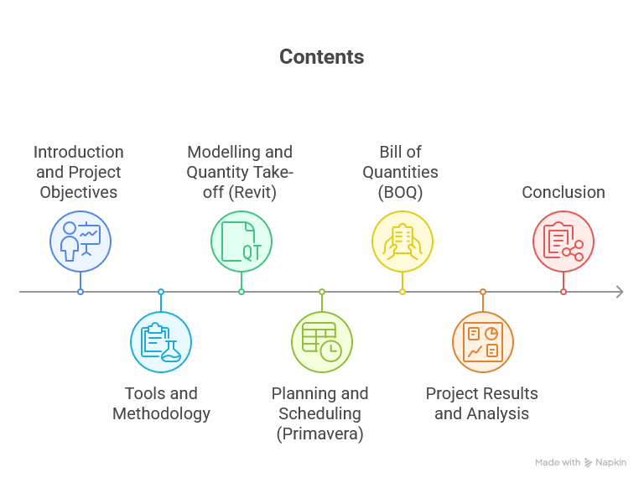

Slide 3
Introduction and Project Objectives
General Building Information
Project Type
Number of floors
Total Area
Vocational School Project
3 Floors
3394 m²
Location
Contract Type
Nablus, Palestine
Unit Price Contract

Slide 4
Project Objectives
To accurately extract quantities using Revit.
To prepare an accurate schedule via Primavera P6.
To prepare the Bill of Quantities (BOQ) and cost estimate.
To analyze challenges and results.

Slide 5


Methodology
Modelling and Quantity Take-off Phase: Using Autodesk Revit to create the Building Information Model (BIM).
Planning and Management Phase: Using Primavera to create the schedule and budget.

Slide 6
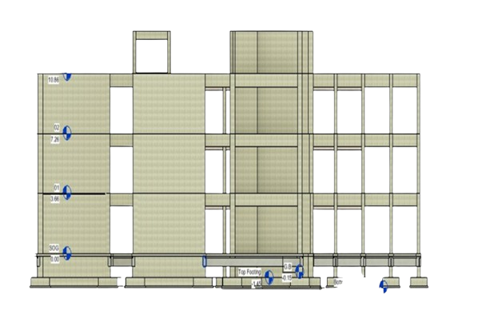
Modelling:
Defining Levels
The first step in any model is to define the floor elevations.
Floor Heights:
Ground Floor: 3.6 meters
First Floor: 3.66 meters
Second Floor: 3.66 meters
Roof Floor: 2.57 meters

Slide 7
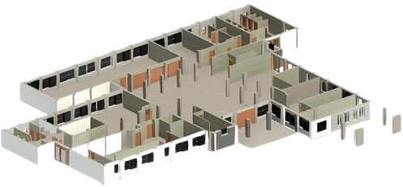
The Architectural Model
The architectural model illustrates the external and internal form of the building and its layouts.
Concrete hollow block 10 cm
Concrete hollow block 20 cm
Concrete 10 cm
Concrete 15 cm
Stone
Ceiling and staircase
Doors & Windows
Curtain walls

Slide 8
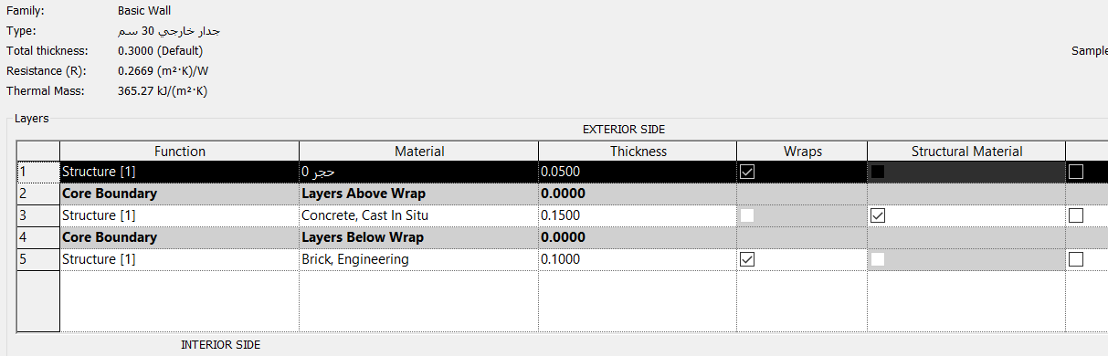

The Architectural Model
External wall details

Slide 9

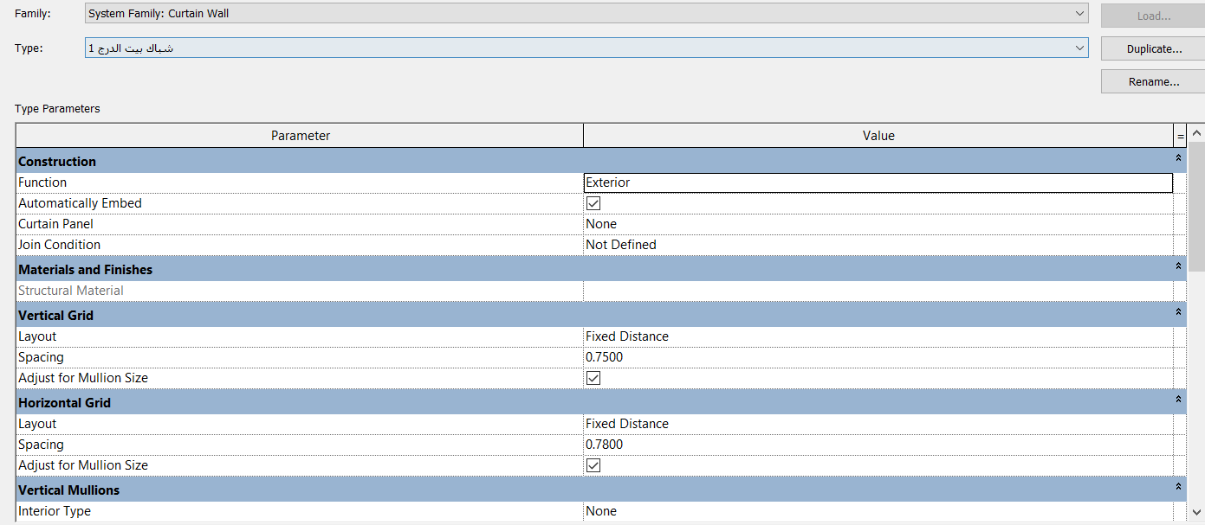
The Architectural Model
Curtain walls details

Slide 10
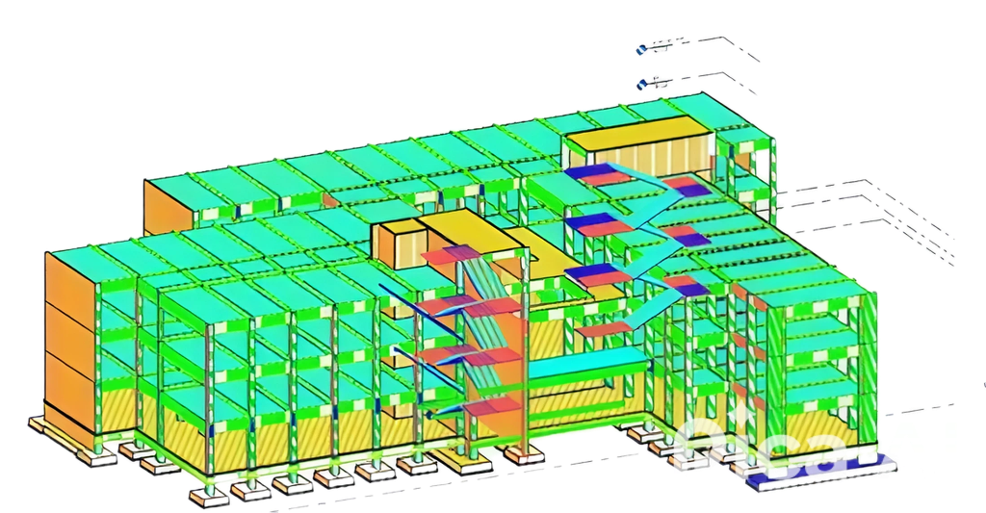
The Structural Model
The structural model illustrates the load-bearing concrete structure of the building.
The structural model and layout included :
Footings
Columns
Shear walls
Beams
Slab
Stairs

Slide 11
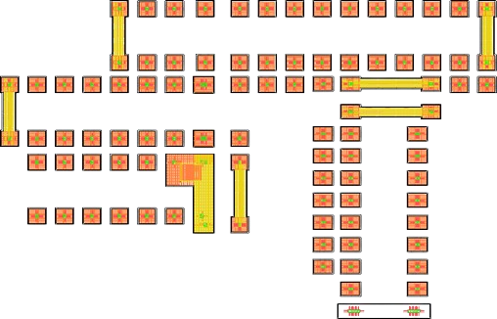
Number of Footing | Volume (m3) | Rienforced (Kg)
SFW1 | 19.98 | 1571.76
SFW2 | 15.47 | 2021.05
CF1 | 7.91 | 1276.31
F1 | 143.74 | 15100.60
F2 | 4 | 537.95
Total | 191.1 | 20507.67
Footing

Slide 12
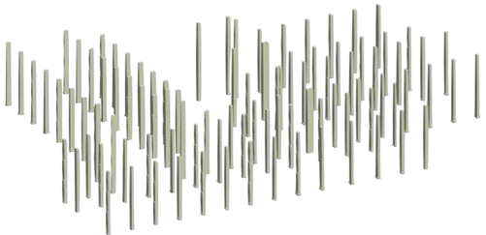
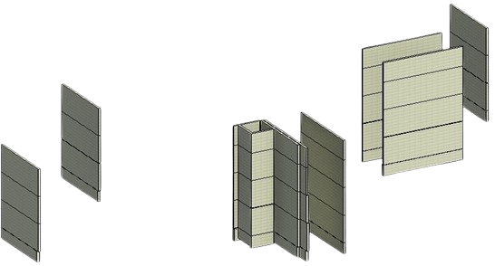
Columns
Walls

Slide 13
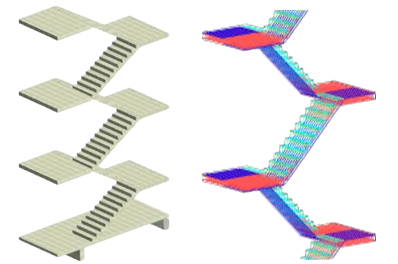
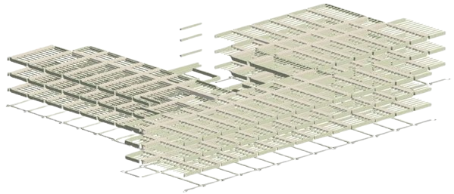
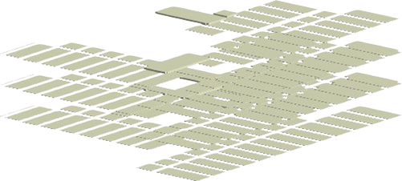
Beams
Stairs
Slabs

Slide 14
Quantity Take-off
Type Structural | Volume (CM) | Rienforced (Ton)
Footings | 191.1 | 20.5077
Shear Walls | 181.08 | 28.05372
Columns | 198.06 | 47.761794
Slabs | 147.63 | 19.14762
Stairs | 39.91 | 8.1769
Framing | 538.97 | 90.64098

Slide 15
Accuracy Verification
Manual calculations were performed for selected elements and compared with the Revit outputs.
Type | Error %
Footing | 5.3 %
Column | 3.9%
Slab | 3.2%
Beam | 3%
The error percentage was low and acceptable.

Slide 16

Primavera P6
It is a software for managing and scheduling projects.
It was used to create the schedule, allocate resources, and monitor project costs.

Slide 17

Project Definition
The project's basic data, such as its name and planned start date (13-Apr-2019).

Slide 18
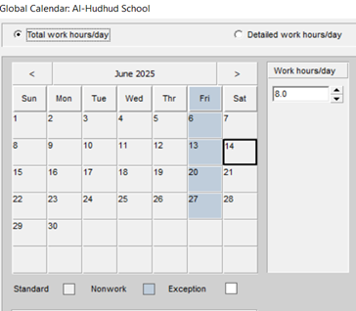
Calendar Definition
A specific work calendar was created for the project, defining 8 work hours per day and Friday as a non-workday.

Slide 19
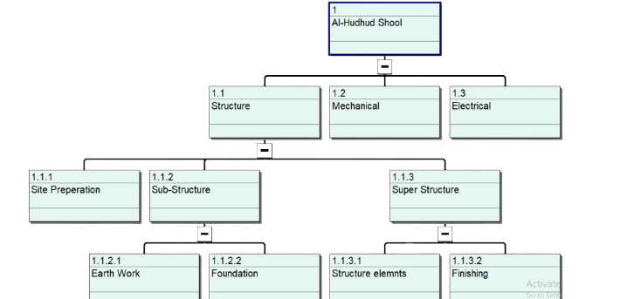
Work Breakdown Structure (WBS)
The project was divided into major manageable work packages to facilitate planning and monitoring.

Slide 20
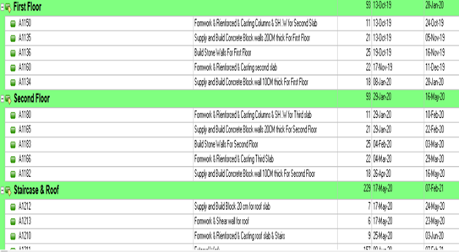

Defining Activities and Relationships
The work packages were broken down into detailed activities (e.g., concrete pouring, blockwork, plastering).

Slide 21
Defining the Duration for activities
Estimate activity duration
Time unit : day
Duration = Quantities / Productivity

Slide 22
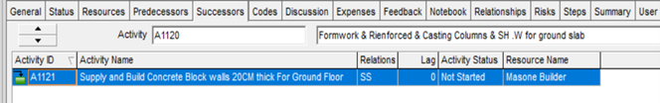
Logical relationships (e.g., Start-to-Start) were defined between activities to determine the correct work sequence.

Slide 23
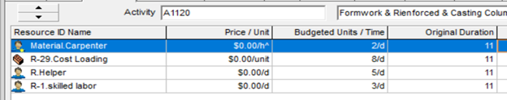
Resource and Cost Allocation
The necessary resources (Labor, materials, equipment) were assigned to each activity.

Slide 24
Output Data
Critical activities
Time scheduling
Resource usage profile
Budgeted total unit
S-Curve

Slide 25
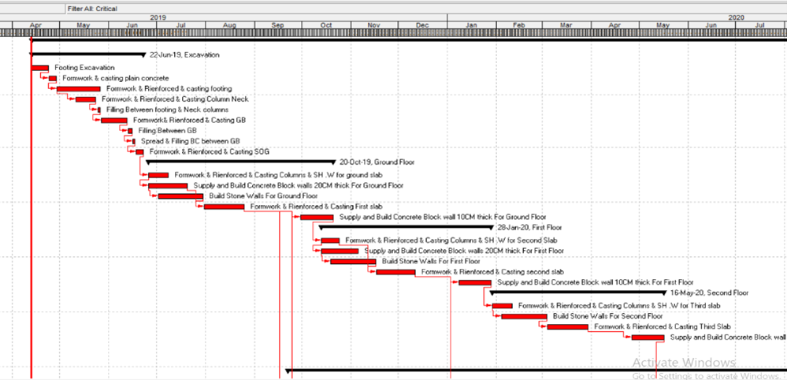
The Critical Path Method (CPM)
It is a project management technique that identifies the sequence of activities that determines the total project duration.
Any delay in an activity on the critical path will delay the entire project.
The Percentage of Critical 68%

Slide 26
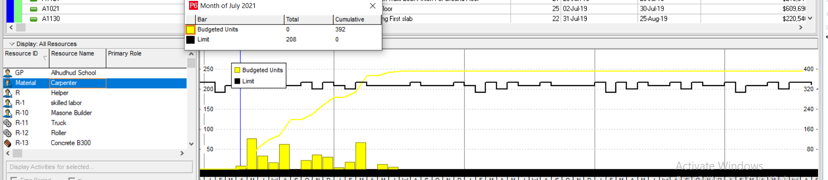
Resource usage profile
Carpenter usage profile

Slide 27
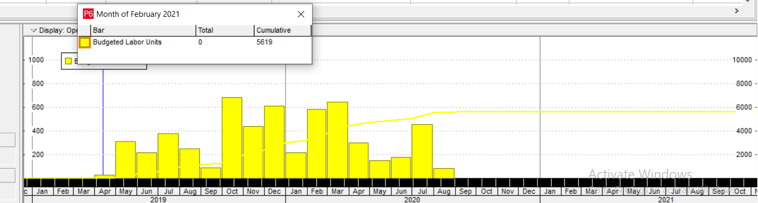
Budgeted Labor unit

Slide 28
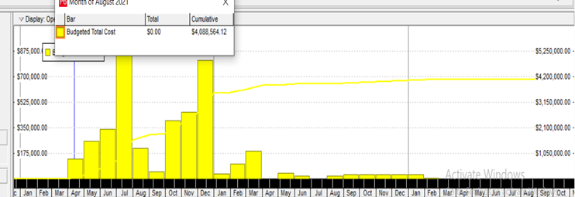
S-Curve
The S-Curve illustrates the planned budget flow over the project's duration.
It is an essential tool for monitoring financial performance and comparing actual spending to the planned budget.

Slide 29
Bill of Quantities (BOQ)

Slide 30
Costing Methodology
Costing for each item
Total Cost = (Formwork Quantity x Price) + (Reinforcement Quantity x Price) + (Concrete Quantity x Price) + Labor Cost + (Profit + Job Overhead + Operating Overhead)

Slide 31
Criteria of Indirect Costs
Profit
Job Overhead
Operating (Overhead)
20%
15%
5%

Slide 32
Time and Cost Result
Total Project Duration
Latest Finish Date
667 calendar days (572 working days)
February 7, 2021
Total Final Project Cost: 6,981,538.2 ILS
Direct and indirect costs were calculated for all items

Slide 33
Conclusion and Recommendations
Conclusion: The project successfully demonstrated the effectiveness of integrating BIM tools (Revit) with project management software (Primavera) to achieve accurate planning.
Recommendations: We recommend adopting this integrated methodology in future engineering projects to increase efficiency and reduce risks.

Slide 34
Thank you
Any questions?

