Slide 1
Mechanical system for building of Tobas Hospital
Prepared by :
Abd Aljabbar Rabaya 10611364
Ammar Salloum 10715642
Sameh Shawahni 10614773
Supervisor :
Dr. Eyad Assaf

Slide 2
Presentation out line
- Building Description.
- Heating load calculation.
- Cooling load calculation.
- Duct Design.
- Plumbing System.
- Fire System
- Equipment Selection.
- Summary

Slide 3
Building Description
Building Location :
Country: Palestine.
City: Tobas
Elevation: 500 m above sea level
Latitude: 32˚.
Building face sits at the North West direction
The wind speed in Ramallah above 5 m/s.

Slide 4
Building details
Floor number
Basement 1
Ground
First floor
Second floor

Slide 5
Heating load
    The heat loss is calculated by this equation :
Outside design condition | Inside design condition | Parameters
5.7 °C | 22 °C | T: temperature
68 % | 50 % | Φ : relative humidity
3.8 g of water/kg of dry air | 8.2 g of water/kg of dry air | W : moisture content
13.85 °C |  | Tun: unconditioned temperature
5 °C |  | Tg : ground temperature

Slide 6
Summary for heating load
Heating load (kw) | Floor
8.455 | Basement
110.56 | Ground floor
65.78 | First floor
82.19 | Second floor
267 | Total

Slide 7
Cooling Load
Outside design condition | Inside design condition | Parameters
31.9 °C | 22 °C | T: temperature
55.5 % | 50 % | Φ : relative humidity
17 g of water/kg of dry air | 8.2 g of water/kg of dry air | W : moisture content
28.6 °C |  | Tun: unconditioned temperature
5 °C |  | Tg : ground temperature
    The general conduction equation in cooling calculation is:
For transmitted through glass:
For convection through glass:

Slide 8
Summary of cooling load
Cooling load (ton) | Floor
1.125 | Basement
49.4 | Ground floor
31 | First floor
36 | Second floor
117.525 | Total

Slide 9
Duct Design
Design procedures
* The total sensible heat of room is calculated.
* The Vcirculation of floor is calculated.
* The flow rate (CFM) is calculated.
* Number of diffusers are calculated and distributed uniformly.
* The initial velocity for the main duct must ≤ 5 m/s.
* The pressure drop is depend on the initial velocity for the main
duct and flow rate (CFM).
* The main diameter is calculated.
* The height and width of the rectangular ducts are determined from the tables.

Slide 10
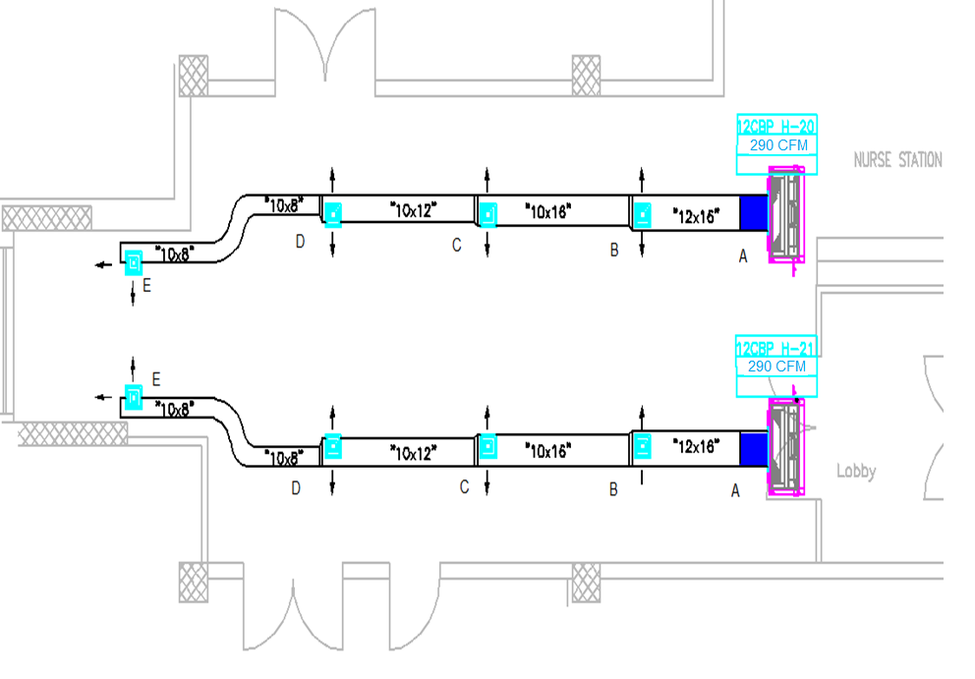

Slide 11
Sample calculation For duct DESIGN :
section | CFM | Vcirc | velocity | ∆P/L | Area | D(m) | H(in) | W(in)
AB | 1200 | 0.545 | 5 | 0.8 | 0.109 | 0.373 | 16 | 12
BC | 900 | 0.409 | 4.75 | 0.8 | 0.086 | 0.331 | 14 | 10
CD | 600 | 0.273 | 4.15 | 0.8 | 0.066 | 0.289 | 12 | 10
DE | 300 | 0.136 | 3.6 | 0.8 | 0.038 | 0.22 | 10 | 8

Slide 12
Plumbing System
Total demand water :
Demand Water (GPM) | Totally Fixture Unit | Type Of Supply Water
131 | 541.25 | Cold
68.7 | 218.75 | Hot
pipe size for cold water :
Name of pipe | Size in inches
Main pipe | 3
Riser 1 | 2
Riser 2 | 2
Pipe for roof tank | 2 1/2

Slide 13
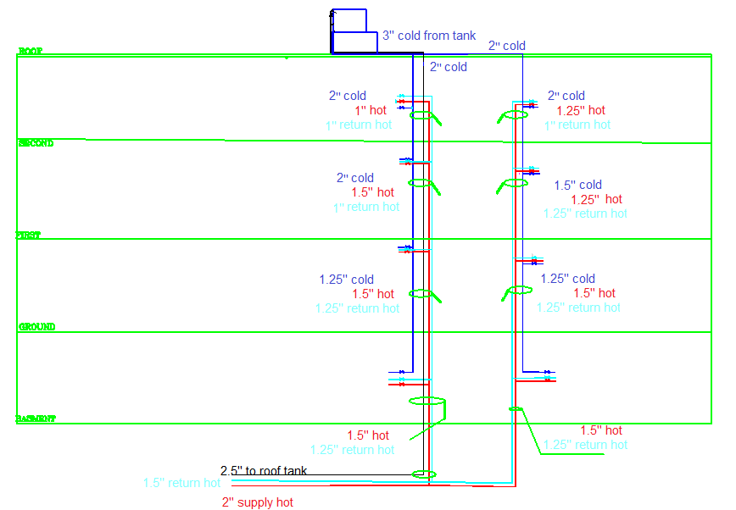

Slide 14
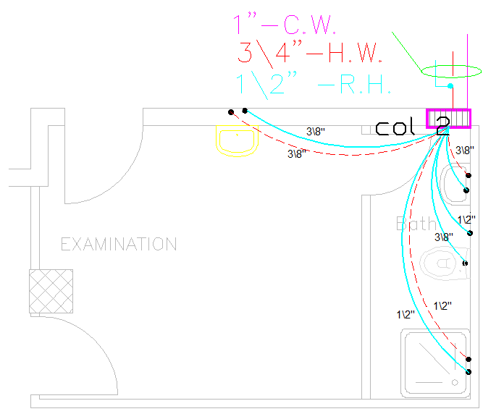

Slide 15
Sample of calculation for determined number of fixture unit:
Total Fixture |  |  | Quantity | Pipe Size |  | Fixture |  |  | Type
total | hot | cold |  | hot | cold | total | hot | cold
5 |  | 5 | 1 |  | 3/8 | 5 |  | 5 | W C
4 | 3 | 3 | 2 | 3/8 | 3/8 | 2 | 1.5 | 1.5 | Lavatory
2 | 1.5 | 1.5 | 1 | 1/2 | 1/2 | 2 | 1.5 | 1.5 | shower
2 |  | 2 | 1 |  | 1/2 | 2 |  | 2 | Bidet
13 | 4.5 | 11.5 |  |  |  | 11 | 3 | 10 | Total Fixture
16.5 | 8.7 | 15.6 |  |  |  | 15.3 | 6.5 | 14.6 | Total Demand ( GPM )

Slide 16
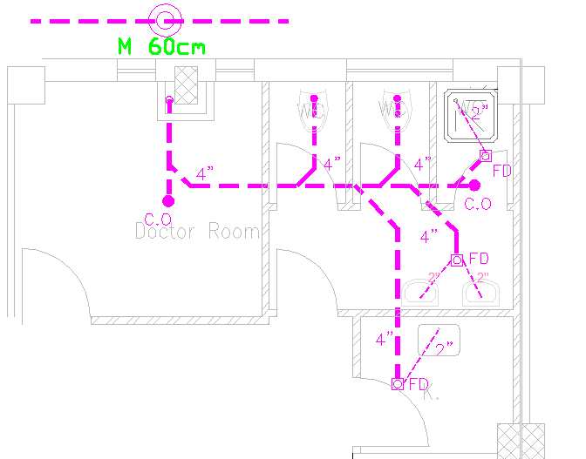

Slide 17
Fire System
The Class III is used for design the fire system
Pipe size
Size (in) | Demand(GPM) | Name of pipe
4’’ | 750 | Main pipe
4’’ | 500 | Riser 1
4’’ | 250 | Riser 2
4’’ | 250 | Pipe enter the floor
2 1/2’’ | 250 | Pipe for landing valve
1 1/2’’ | 100 | Pipe for Cabinet

Slide 18
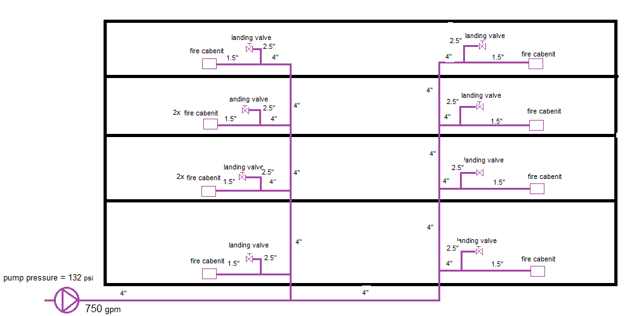

Slide 19
Equipment Selection
Boiler :
From mansour catalog of steam boiler is
311.2 kw. MS-10 which has capacity is
Chiller :
From Petra catalog we select a model
Which has capacity is 132 ton. WPS a 205 2 S
Fan coil :
RAC 4 H/C CBP 3
400 cfm

Slide 20
Equipment selection cont.
:Air Handling Unit
From Petra catalog we select
The suitable A.H.U for the operation room in the Ground floor (2376CFM) is
PAH H C 24 C6
The suitable A.H.U for the first operation room in the second floor (2222 CFM) is
PAH H C 24 C6
The suitable A.H.U for the second operation room in the second floor (2836 CFM) is
PAH H C 32 C4

Slide 21
Equipment selection cont.
Fresh air and Exhaust fans:
For the building the selection of exhausted fan were been as the following:
Basement floor PEX T- 170 [NO.2].
Ground floor PEX T- 500 [NO.2], PEX T- 320.
First floor PEX T- 320 [NO.2], PEX T- 170 [NO.2].
Second floor PEX T- 240, PEX T- 320, PEXT- 170.
For the building the selection of Fresh fan were been as the following:
Ground floor PEX T- 500, PEX T- 320, PEX T- 170.
First floor PEX T- 320 [NO.2], PEX T- 500, PEX T- 170.
Second floor PEX T- 500, PEX T- 320, PEXT- 170.

Slide 22
Equipment selection cont.
Pumps:
Pump Model | Head (m) | Flow Rate (l/s) | Pump
NM 100\200 | 92 | 47.318 | Firefighting pump
SMC 340-3 | 8 | 18.29 | Chiller and boiler pump
SMC 240-1 1/2 | 11 | 1.055 | Air Handling Unit
SMC 240-3 | 14 | 5.11 | Potable water (cold water) pump
SMC 240-2 | 12 | 4.328 | Potable water (Hot water) pump

Slide 23
SUMMARY
*All steps of design and plans of HVAC system are done.
*All steps of design and plans of plumping system are done.
*we select a suitable equipment for the system which satisfied the required conditions.

Slide 24
The end

