Slide 1


NAJAH UNIVERSITY
ONLINE
STORE
SUPERVISOR: DR. SAMER ARANDI
PARTICIPANTS: OSAMA DAWABSHEH

Slide 2

PROBLEM AND OBJECTIVE

Slide 3


Motivation
1
TIME SAVING
It saves your time and makes you use it wisely
2
CONVENIENCE
You can rely on it to save the search effort, obtain the product, and ease to use from anywhere.
3

Slide 4
IMPLEMENTATION
WEPSITE & MOBILE APP

Slide 5
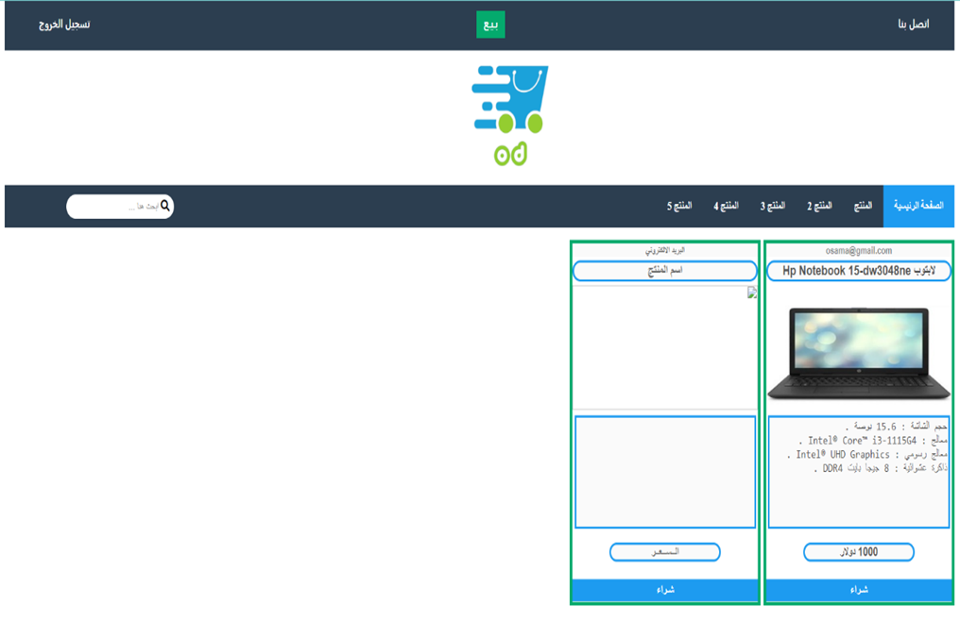
1 WEBSITE
An application where the user can create an account for him, sell or buy a product, search for a product.
Frontend :
  HTML
  CSS
  JavaScript
Backend :
  PHP

Slide 6
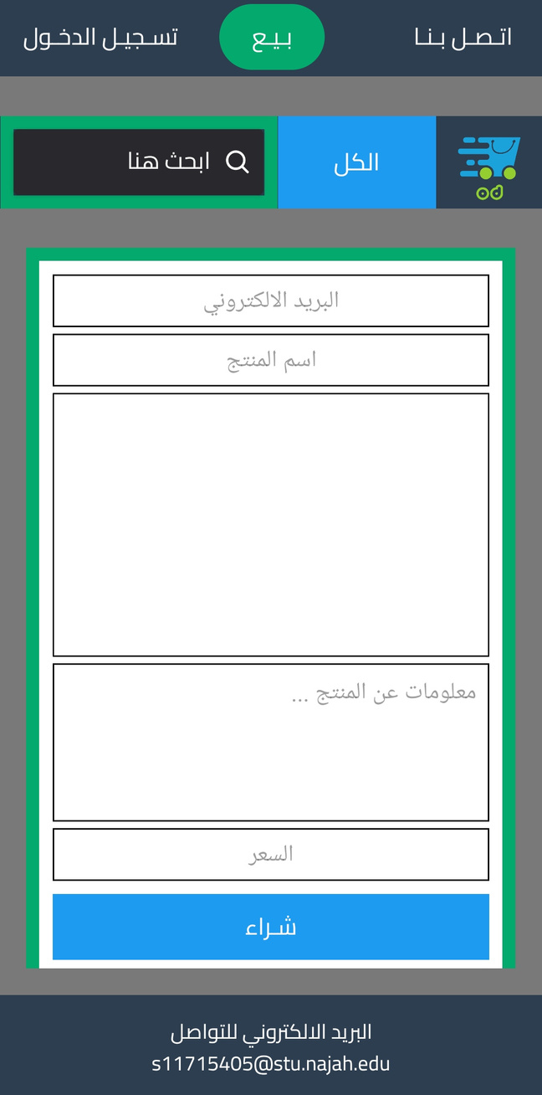
1 MOBILE APP
An application where the user can create an account for him, sell or buy a product, search for a product, and send the website if he bought it.
Frontend :
  React Native
Backend :
  Node JS

Slide 7

CONSTRAINS
CHALLENGES WE FACED IN THIS PROJECT

Slide 8
CONSTRAINTS
1
Learn and master react native and node js .
2
Dealing with some parts of the project that need a special process.

Slide 9
FUTURE WORK
1
Developing the website and application and making the user able to evaluate the products.
2
Add the possibility of payment through more than one method.
3

Slide 10
THANK
YOU

