Slide 1

Design for restaurant
Prepared By:
Rasha Suwan
Ola Ziad
Lina Qassem
Supervisor: Dr. Moayad Salhab.

Slide 2
Contents
Introduction.
Site analysis.
Architectural design.
Environmental design.
Structural design.
Electrical design .
Mechanical design.
Quantity Survey and cost.
Conclusion.

Slide 3
INTRODUCTION

Slide 4
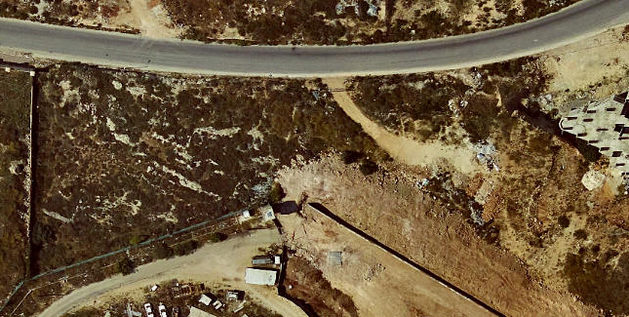
SITE LOCATION
Location: Northern west of Nablus City.
Area: The site area is about 5800 m².

Slide 5
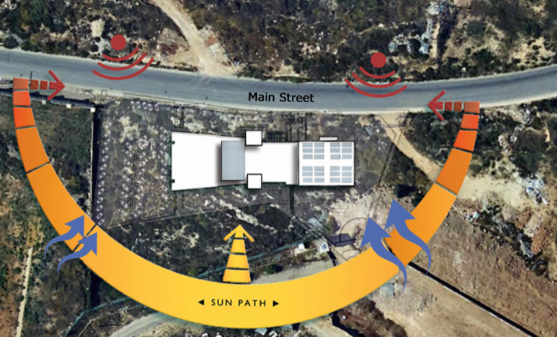

SITE ANALYSIS
Considering the sun path ,wind ,noise and pollution.

Slide 6
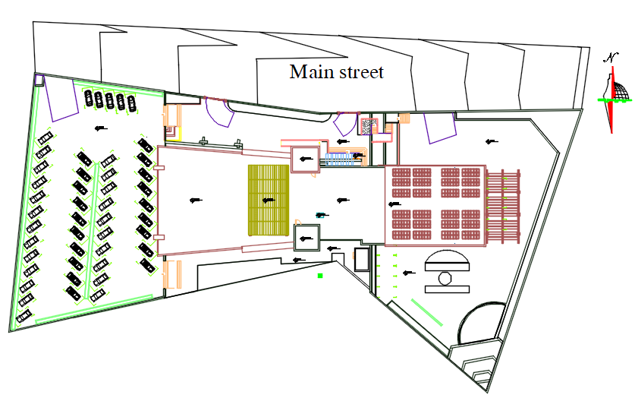
SITE PLAN

Slide 7
Architectural Design

Slide 8
Architectural Design
Plans
Elevations
Sections
Results

Slide 9
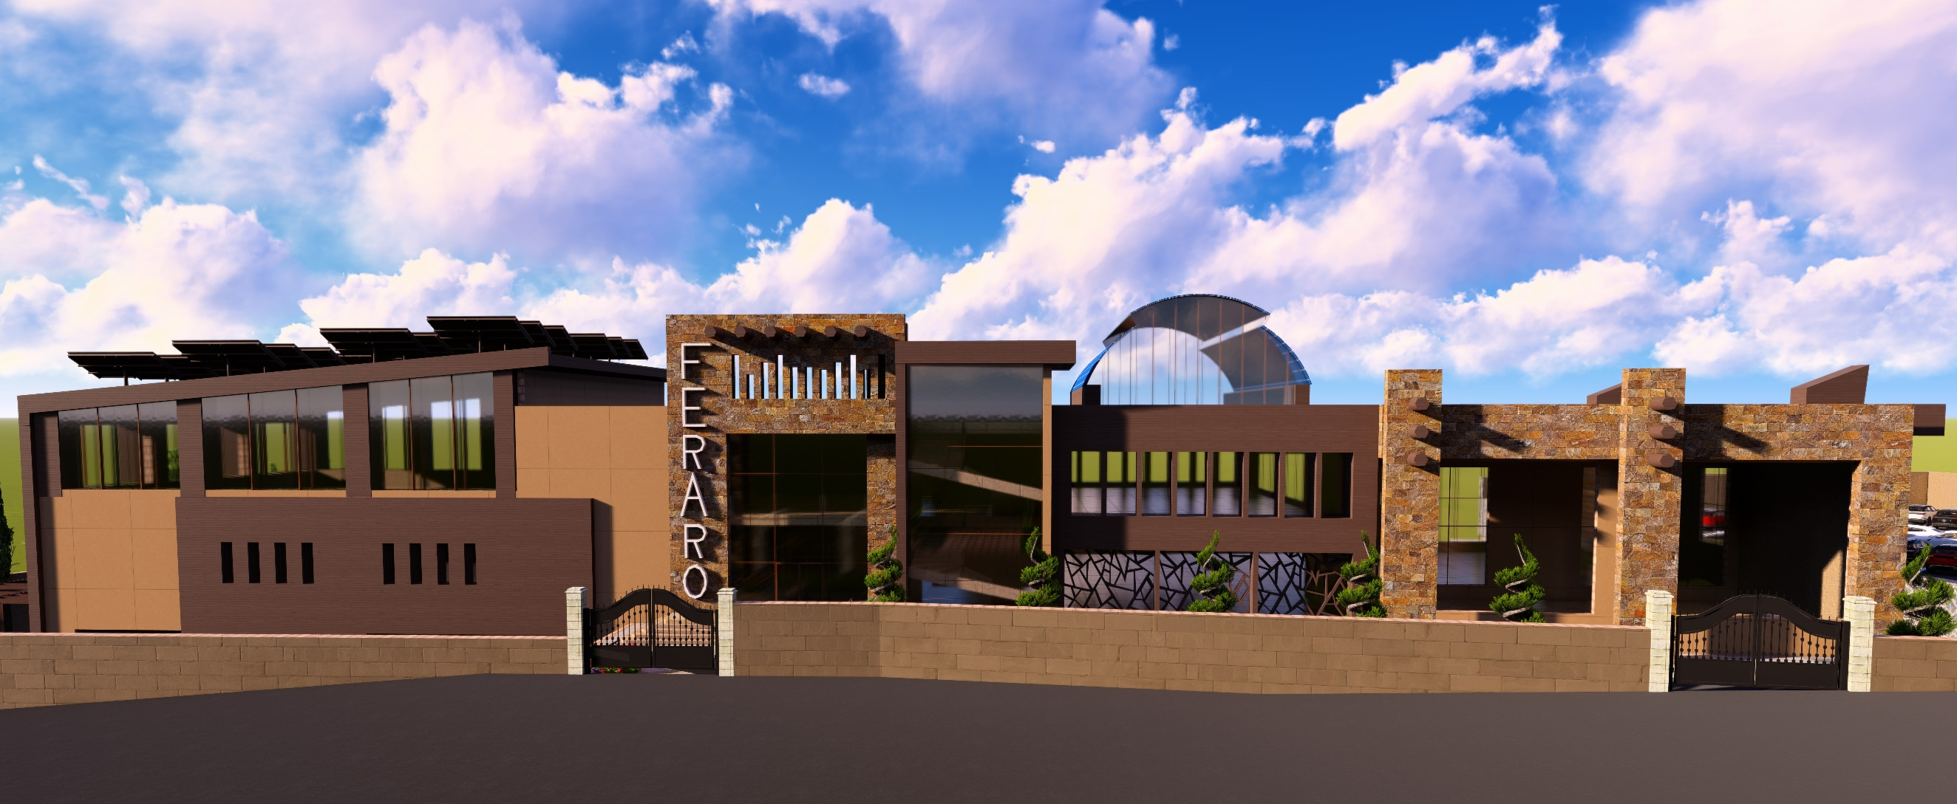
Feraro Restaurant 3D Model

Slide 10
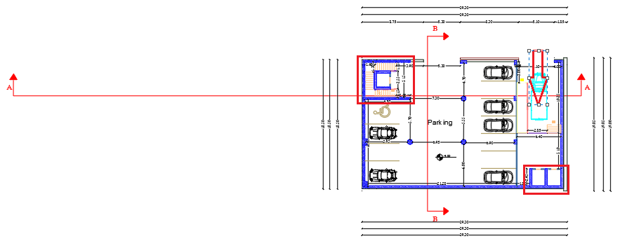
Basement floor plan
Architectural Design
Total area of this floor it is about 490 m²
It contains: parking.

Slide 11
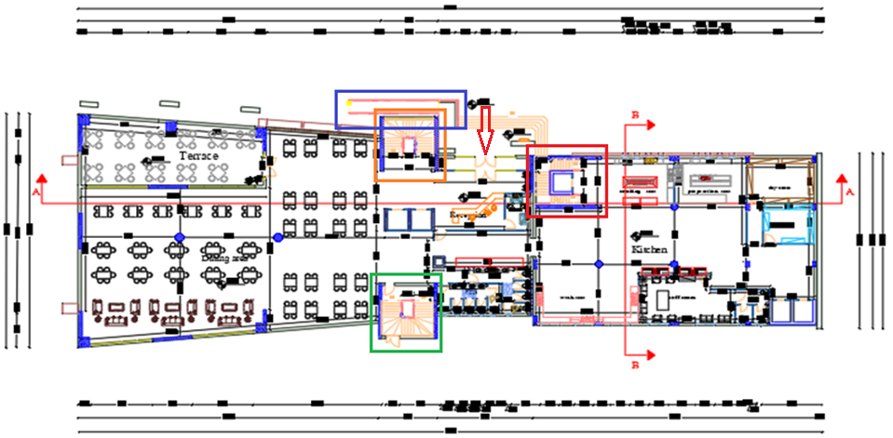
Ground floor plan
Architectural Design
Total area of this floor it is about 1550 m²
It contains: Reception, security room, hall, terrace, services, stuff room, kitchen and store.

Slide 12
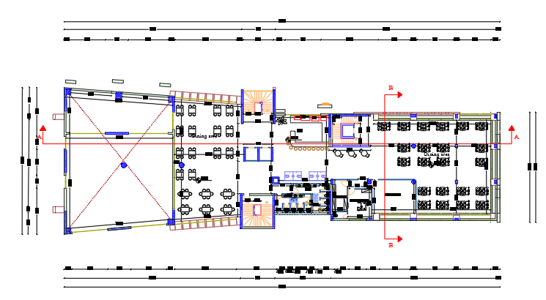
First floor plan
Architectural Design
Total area of this floor it is about 1120 m²
It contains: Hall, bar, playing area, manager room, services and store .

Slide 13
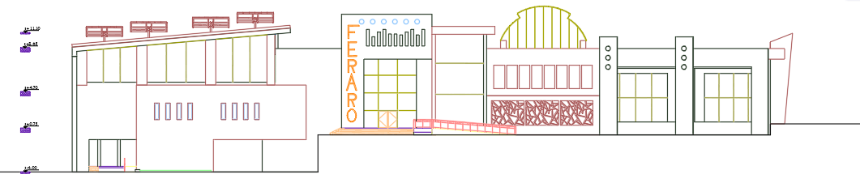
North elevation
Architectural Design

Slide 14
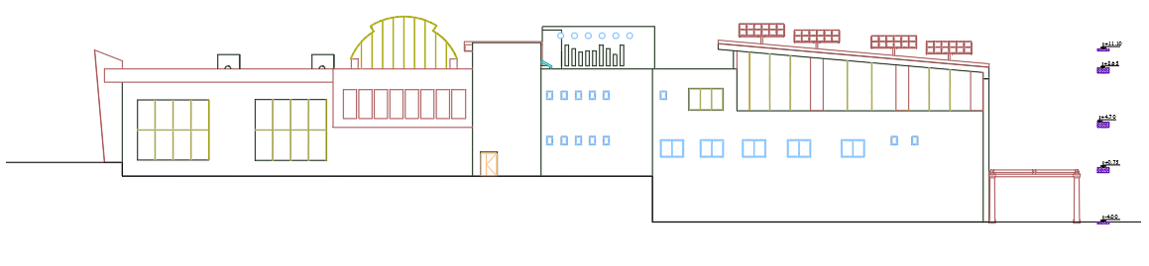
South elevation
Architectural Design

Slide 15
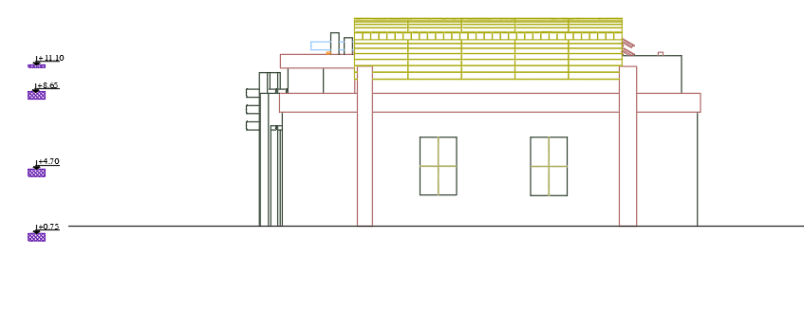
West elevation
Architectural Design

Slide 16
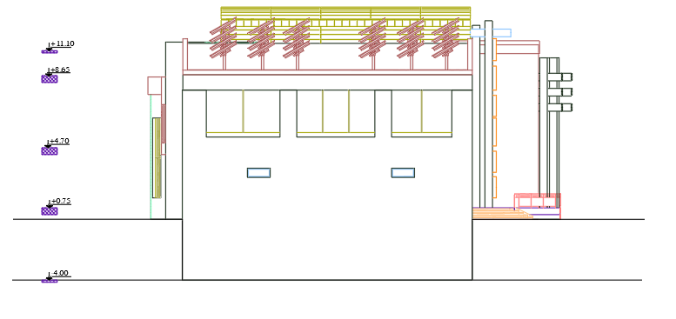
East elevation
Architectural Design

Slide 17
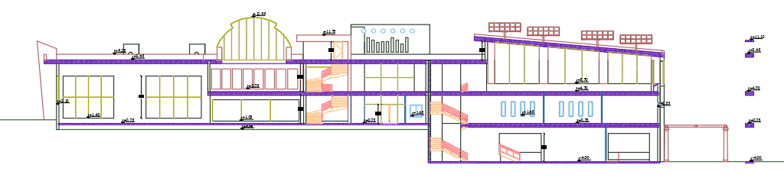
Section A-A
Architectural Design

Slide 18
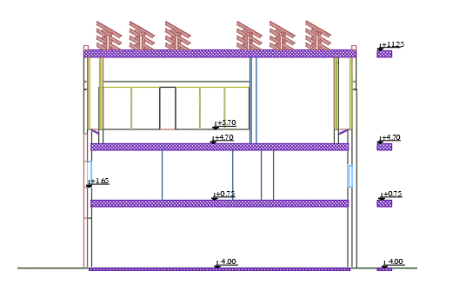
Section B-B
Architectural Design

Slide 19
Architectural Design
Result
Functions | Result area percentage for functions (%) | Standard area percentage for functions (%)
Hall | 53 | 50
Kitchen | 28 | 30
Services | 19 | 20

Slide 20
Structural Design

Slide 21
Structural Design
Codes & standards
Materials
Loads
Results
Checks

Slide 22
Structural Design
Codes and Standards:
ACI 318-14 for reinforced concrete design.
UBC-97 for seismic design and its load combinations.
ASCE for load combinations.

Slide 23
Structural Design
Materials :
Concrete strength for columns and shear wall f′c= 28MPa ,for footing f′c= 32MPa, and 24MPa for beams and slabs.
Steel yield strength Fy= 420MPa.
Bearing capacity for soil = 250 kN/m²

Slide 24

Structural Design
Lateral loads:
Nablus City.
Seismic zone is 2B (z=0.2)
Soil profile is S_{D}
Acceleration seismic coefficients, Ca=0.28
Velocity seismic coefficients, Cv= 0.4
Importance factor, I=1
Force reduction factor, R=5.5

Slide 25
Structural Design
Loads :
Dead load.
Super imposed dead load =5 kN/m² .
Live load = 5 kN/m² .

Slide 26
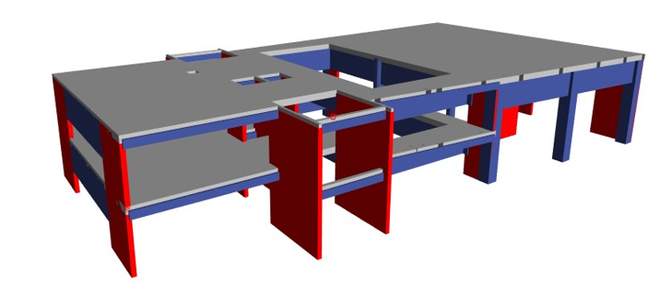
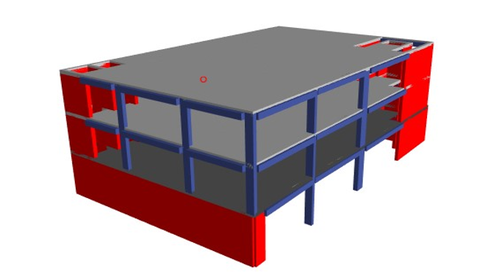
Structural Design
3D Model form ETABS

Slide 27
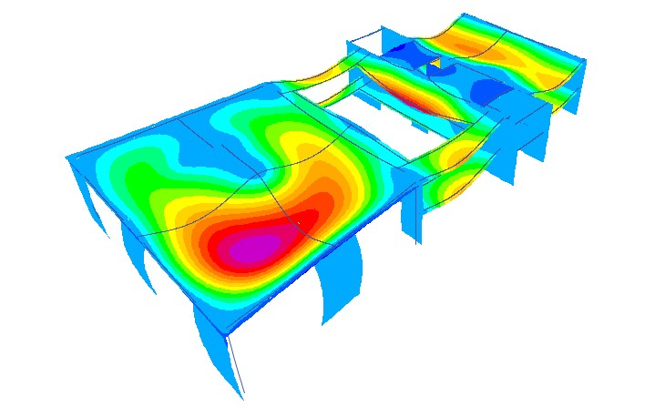
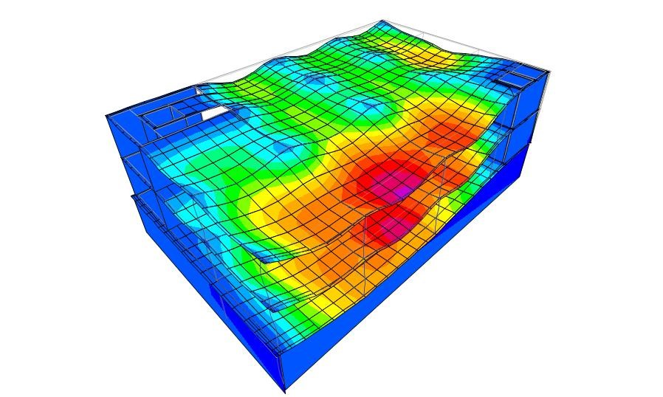
Structural Design
Checks:
Compatibility check.

Slide 28
Structural Design
Checks:
Compatibility check.
Equilibrium check.
All of the percentage error that checked from dead, live and SID less than 5%

Slide 29
Structural Design
Checks:
Compatibility check.
Equilibrium check.
Stress strain check.
All of the structural elements checked, the difference between ETABS and manual calculations was been less than 10%

Slide 30
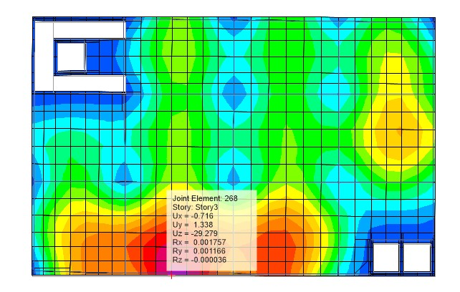
Structural Design
Checks:
Compatibility check.
Equilibrium check.
Stress strain check.
Deflection check
Deflection limitation= 32.5mm.
Maximum deflection in slab = 29.279mm.
The checks deflection is ok.
F
93
:
ETABS2016
IGURE
SHOW THE MAXIMUM DEF
LECTION FROM
.

Slide 31
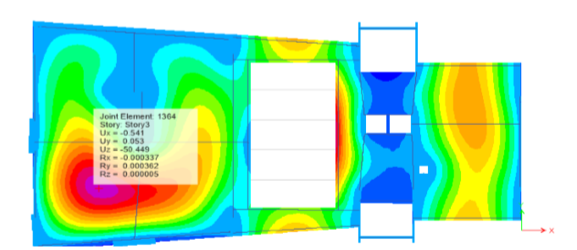
Structural Design
Checks:
Compatibility check.
Equilibrium check.
Stress strain check.
Deflection check.
Deflection limitation= 70mm.
Maximum deflection in slab = 50.449mm.
The checks deflection is ok.

Slide 32
Structural Design
Checks:
Compatibility check.
Equilibrium check.
Stress strain check.
Deflection check.
Period check.
T ETABS < T manual so check is ok.

Slide 33
Structural Design
Checks:
Compatibility check.
Equilibrium check.
Stress strain check.
Deflection check.
Period check.
Model participation mass ratio.

Slide 34
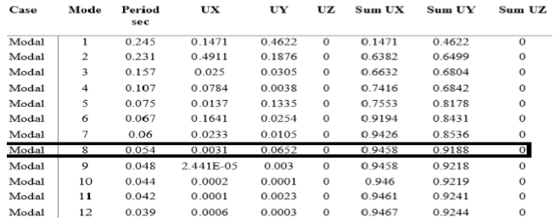
Structural Design
Model participation mass ratio.
For first model
The summation for both directions greater than 0.9 in model 8.so this check its ok.

Slide 35
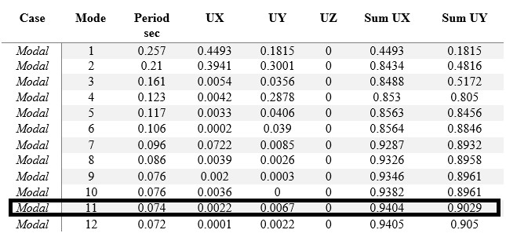
Structural Design
Model participation mass ratio.
For second model
The summation for both directions greater than 0.9 in model 11 .so this check its ok.

Slide 36
Structural Design
Checks:
Compatibility check.
Equilibrium check.
Stress strain check.
Deflection check.
Period check.
Model participation mass ratio.
Base shear.
VETABS >V manual so check is ok.

Slide 37
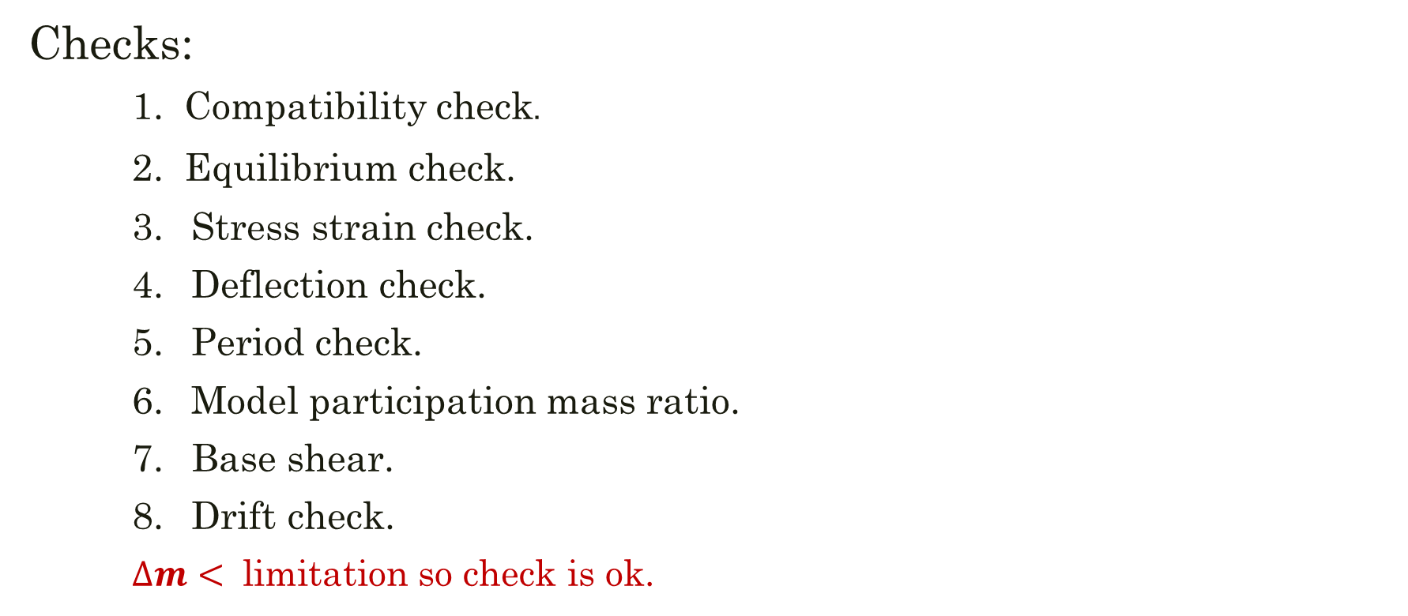
Structural Design
Checks:
Compatibility check.
Equilibrium check.
Stress strain check.
Deflection check.
Period check.
Model participation mass ratio.
Base shear.
Drift check.
$∆m<$ limitation so check is ok.

Slide 38
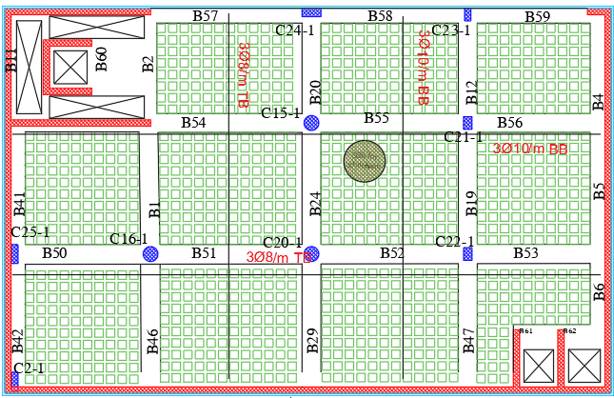
Structural Design
(Results)
Basement floor for slab & beams distributions.

Slide 39
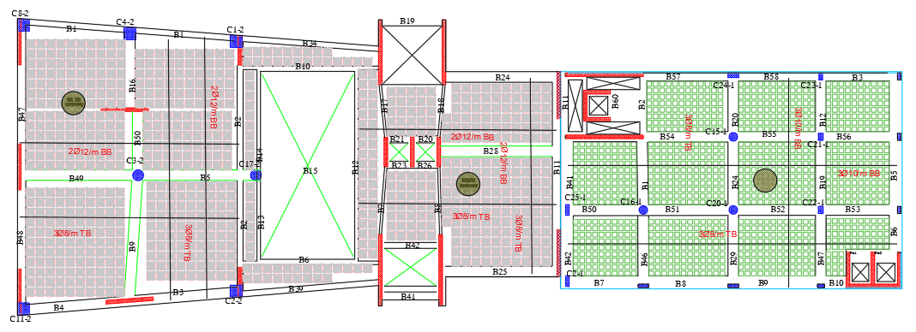
Structural Design
(Results)
Ground floor for slab & beams distributions.

Slide 40
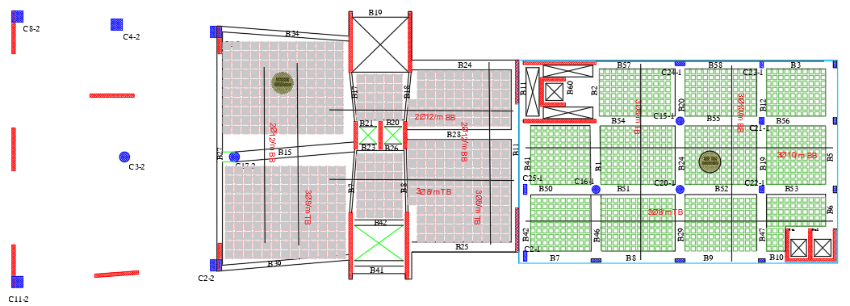
Structural Design
(Results)
First floor for slab & beams distributions.

Slide 41
Structural Design
(Results)
 | Width(cm) | Depth(cm)
U-BOOT slab |  | 45
Waffle slab |  | 45
Beams | 90 | 45
 | 70
 | 50
 | 30
 | 50 | 200
 | 30 | 100
Columns(rectangular) | 90 | 40
 | 60
 | 30
 | 100 | 100
 | 100 | 60
Columns(circular) | 90
Columns(circular) | 70
Shear walls | 30

Slide 42
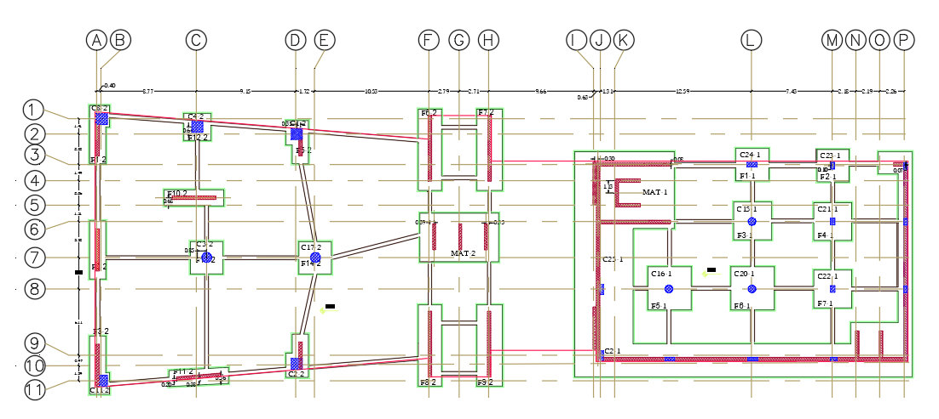
Structural Design
(Results)
Footing and tie beam distributions plan

Slide 43
Structural Design
(Results)
Model.NO | Type | Footing thickness (cm)
1 | Single footing | 100
 | Mat | 80
2 | All footing | 60

Slide 44
Environmental Design

Slide 45
Environmental Design
Thermal design
Acoustical design
Lighting design

Slide 46
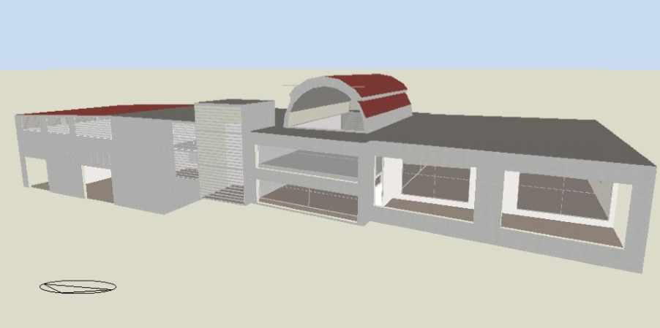
Environmental Design
Thermal design (3D model from design builder program).

Slide 47
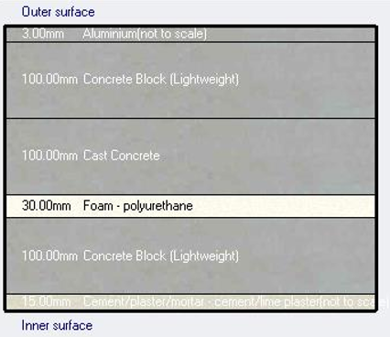
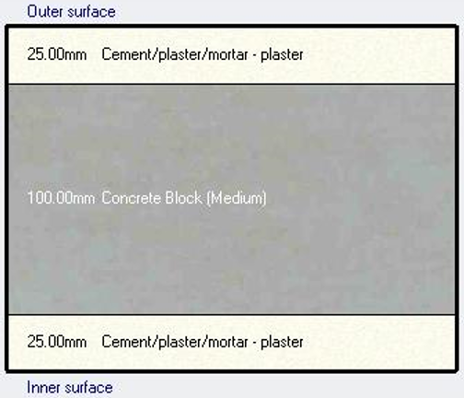

Environmental Design
Thermal design (Materials).
External walls Internal walls
U-value = 0.416 w/$m^{2}$.K U-value = 1.67 w/$m^{2}$.K

Slide 48
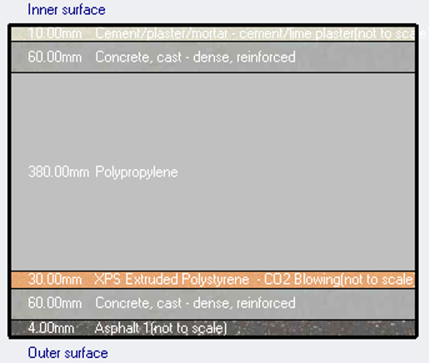
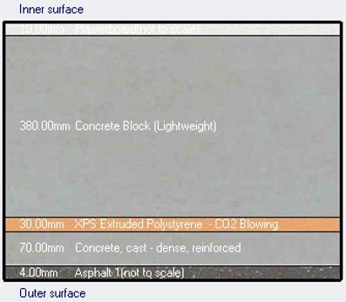

Environmental Design
Thermal design (Materials).
U-BOOT slab Waffle slab
U-value = 0.337 w/$m^{2}$.K U-value = 0.309 w/$m^{2}$.K

Slide 49
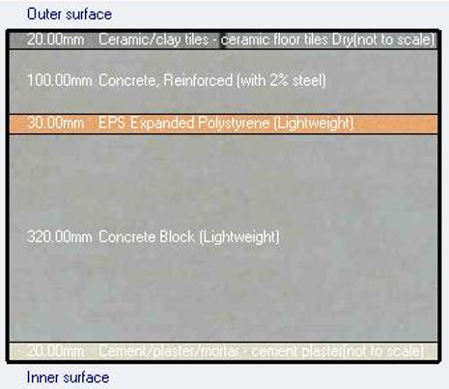

Environmental Design
Thermal design (Materials).
Internal wall layer
U-value = 0.372 w/$m^{2}$.K

Slide 50
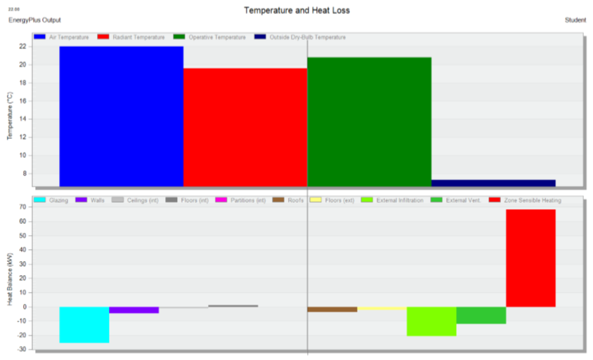
Environmental Design
Thermal design (Heating loads).

Slide 51
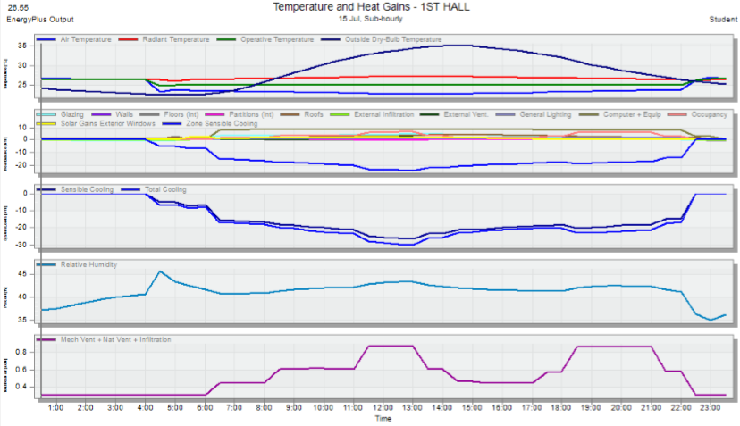
Environmental Design
Thermal design (Cooling loads).

Slide 52
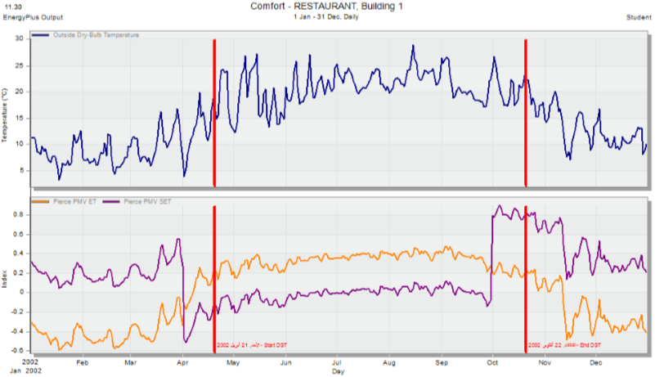
Environmental Design
Thermal design (Simulation comfort).

Slide 53
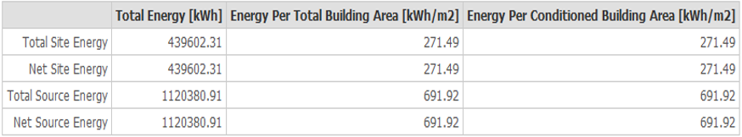
Environmental Design
Thermal design (Site energy).

Slide 54
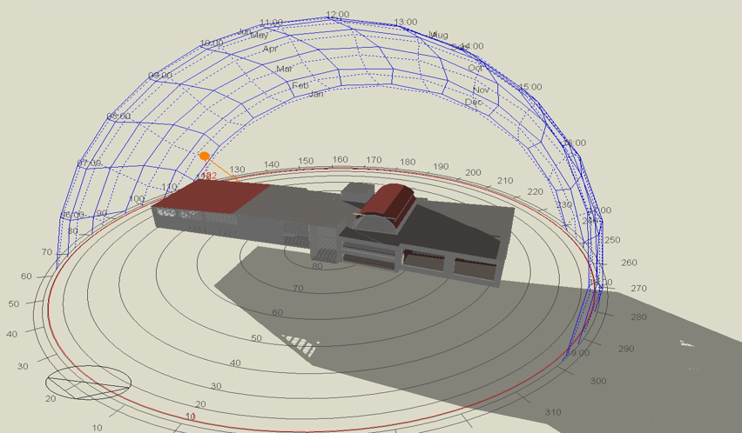
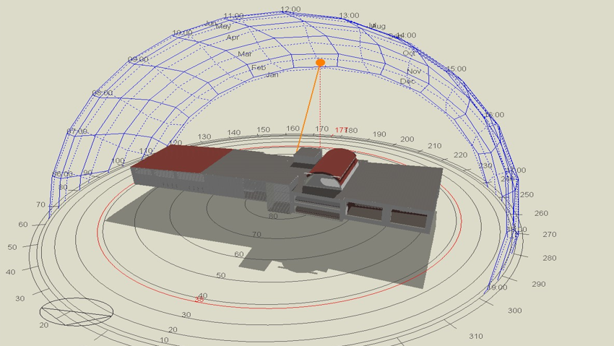
Environmental Design
Thermal design (Shading in winter).
At 8:00 am on 21/January
At 12:00 pm on 21/January

Slide 55
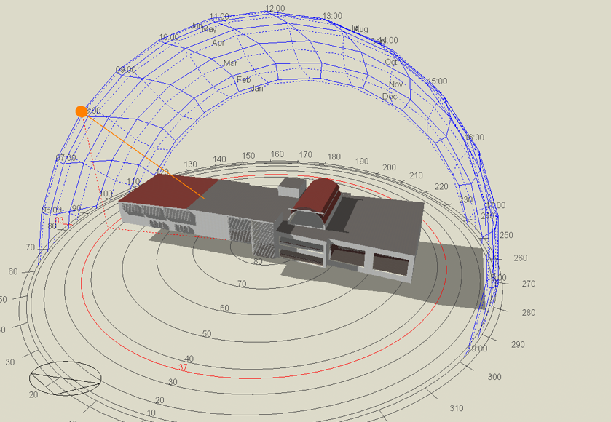
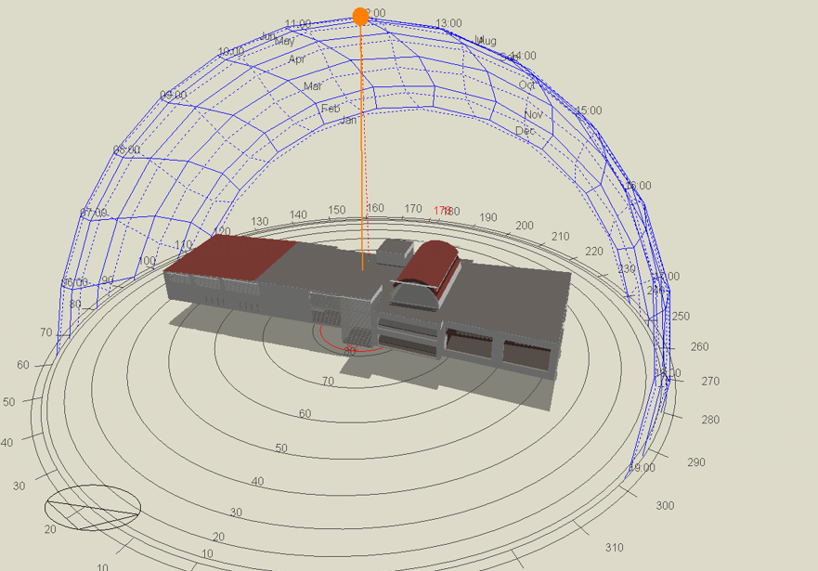
Environmental Design
Thermal design (Shading in summer).
At 8:00 am on 21/June
At 12:00 pm on 21/June

Slide 56
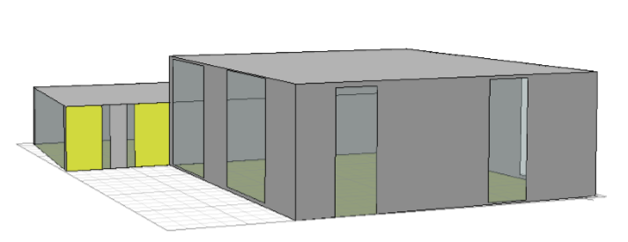
Environmental Design
Acoustical design (Reverberation time (RT60) ).
Double volume hall

Slide 57
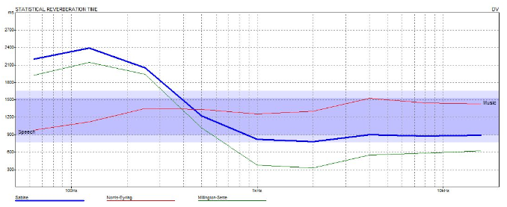
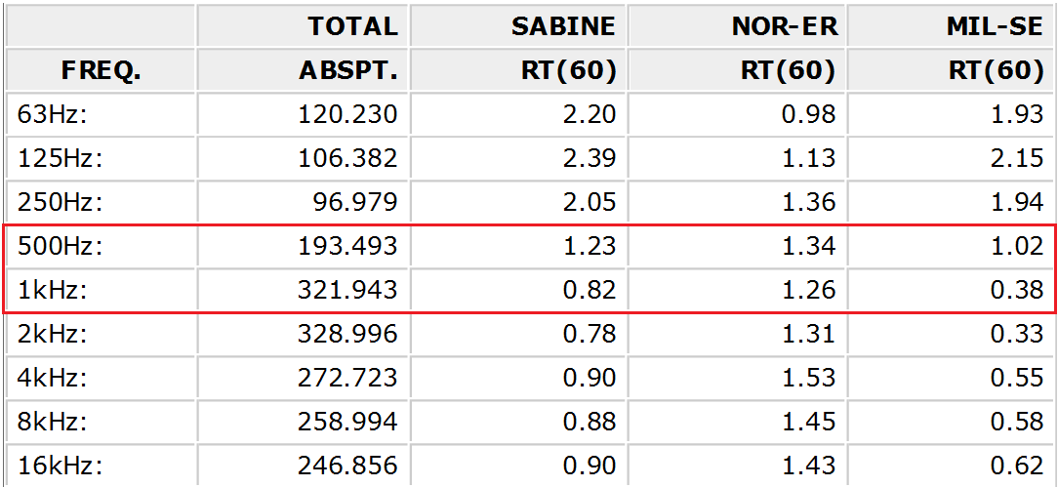
Environmental Design
Acoustical design (Reverberation time (RT60) ).
Result for double volume hall

Slide 58
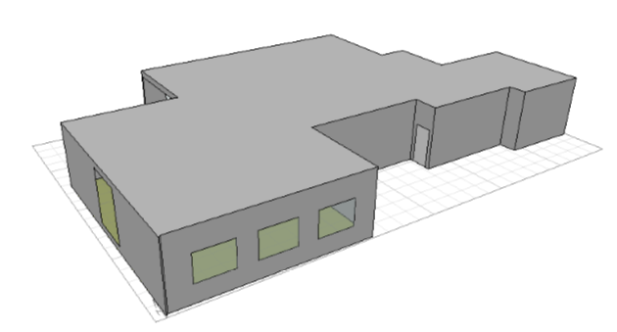
Environmental Design
Acoustical design (Reverberation time (RT60) ).
Kitchen

Slide 59
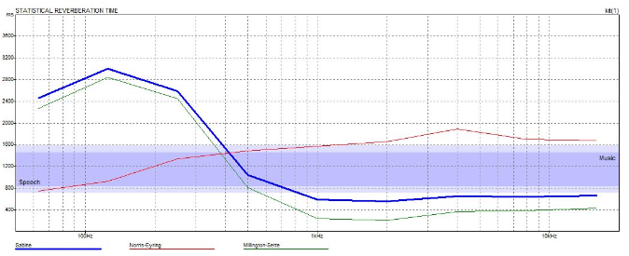
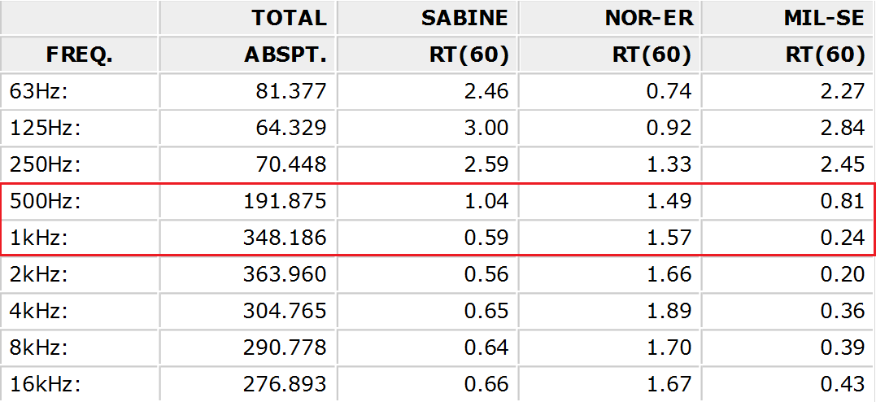
Environmental Design
Acoustical design (Reverberation time (RT60) ).
Result for kitchen

Slide 60
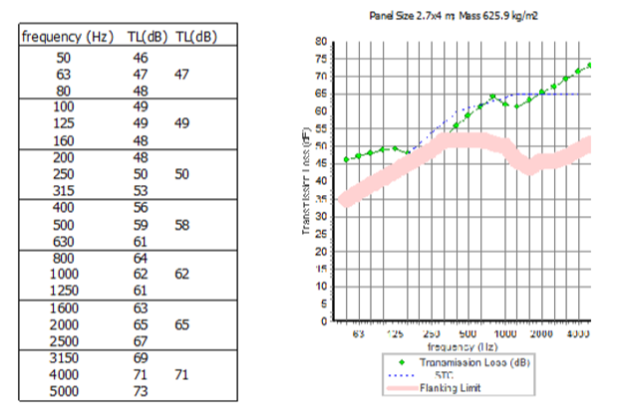

Environmental Design
Acoustical design (Sound Transmission Class (STC)).
For external walls:
Designed value by using Insul software is 61 dB.

Slide 61


Environmental Design
Acoustical design (Sound Transmission Class (STC)).
For internal walls:
Designed value by using Insul software is 47 dB.

Slide 62

Environmental Design
Acoustical design (Sound Transmission Class (STC)).
For composite walls:
Designed value by using Insul software is 45 dB.

Slide 63
Environmental Design
Lighting design.
Used DIALUX software to achieve the required artificial deign, nine zones were taken into consideration.
  Parking.
  Kitchen.
  Reception.
  Stuff room.
  Manager room.
  6. Terrace.
  7. Storage.
  8. Main Hall.
  9. Hall.

Slide 64

Environmental Design
  Lighting design (Luminaire used).

Slide 65

Environmental Design
  Lighting design (Luminaire used).

Slide 66

Environmental Design
  Lighting design (Luminaire used).

Slide 67
Environmental Design
Lighting design (Results.)
Parking assessment | Illuminance (Lux) | Glare
Standards | 75 | ____
Result | 109 | ____
Kitchen assessment | Illuminance (Lux) | Glare
Standards | 500 | ____
Result | 504 | ____
Reception assessment | Illuminance (Lux) | Glare
Standards | 300 | ____
Result | 305 | ____

Slide 68
Environmental Design
Lighting design (Results.)
Stuff room assessment | Illuminance (Lux) | Glare
Standards | 500 | 19
Result | 507 | 17.8
Manager room assessment | Illuminance (Lux) | Glare
Standards | 300 | 22
Result | 404 | 20.9
Terrace assessment | Illuminance (Lux) | Glare
Standards | 150 | _____
Result | 274 | _____

Slide 69
Environmental Design
Lighting design (Results.)
Storage assessment | Illuminance (Lux) | Glare
Standards | 100 | ____
Result | 164 | ____
Hall assessment | Illuminance (Lux) | Glare1 | Glare2
Standards | 150 | 22 | 22
Result | 204 | 17 | 20.1
Small hall assessment | Illuminance (Lux) | Glare
Standards | 150 | ____
Result | 190 | ____

Slide 70

Environmental Design
Lighting design (3D rendering view).
Parking.

Slide 71

Environmental Design
Lighting design (3D rendering view).
Reception

Slide 72


Environmental Design
Lighting design (3D rendering view).
Kitchen

Slide 73

Environmental Design
Lighting design (3D rendering view).
Stuff room

Slide 74

Environmental Design
Environmental Design
Lighting design (3D rendering view).
Manager room

Slide 75

Environmental Design
Lighting design (3D rendering view).
Terrace

Slide 76

Environmental Design
Lighting design (3D rendering view).
Store

Slide 77

Environmental Design
Lighting design (3D rendering view).
Main hall

Slide 78

Environmental Design
Lighting design (3D rendering view).
Hall

Slide 79
Electrical Design

Slide 80
Electrical Design
Lighting arrangement plans
Power distribution plans
Annual consumption

Slide 81

Electrical Design
Lighting for basement floor

Slide 82

Electrical Design
Lighting for ground floor

Slide 83

Electrical Design
Lighting for first floor

Slide 84

Electrical Design
Power distribution in ground floor

Slide 85

Electrical Design
Power distribution in first floor

Slide 86
Electrical Design
Annual consumption table:
Consumption | KWH
Electrical appliances | 322.165
Air condition system (A/C) | 168.92
lighting system | 150.8616
Total | 642.1
Annual consumption cost (NIS) in winter and summer =642.1* 0.74 = 475NIS.
Annual consumption cost (NIS) in spring season =515.4* 0.74 = 381.4NIS.

Slide 87
Mechanical Design

Slide 88
Mechanical Design
Water supply plans
Water consumption
Drainage system plans
Firefighting system
HVAC system

Slide 89

Mechanical Design
Water supply in ground floor

Slide 90

Mechanical Design
Water supply in first floor

Slide 91
Mechanical Design
Water consumption :
Water consumption by people 70 litter for cold water.
Water consumption by people 10 litter for hot water.
Total number of people 400 person /day.
Total amount of cold fresh water 28 CM.
Total amount of hot water 4 CM.
Water consumption for firefighting 9 CM.

Slide 92

Mechanical Design
Drainage for ground floor

Slide 93

Mechanical Design
Drainage for first floor

Slide 94

Mechanical Design
Rainwater drainage

Slide 95
Mechanical Design
HVAC system
VRF system was used.
Main component of VRF system is:
Outdoor unit
Fan coil (indoor units)
Ducts
Diffusers
Liner slot diffusers
Inline extract fan
Collector

Slide 96

Mechanical Design
HVAC system in ground floor

Slide 97

Mechanical Design
HVAC system in first floor

Slide 98
Mechanical Design
Firefighting system
Used several systems for firefighting:
Automatic sprinkler system
Up-right sprinkler
Extinguisher
Standpipes and hose stations.
Warning signs
Heat and smoke detectors

Slide 99

Mechanical Design
Firefighting system in ground floor

Slide 100

Mechanical Design
Firefighting system in first floor

Slide 101
QUANTITY SURVEY AND COST
Stage | Cost (NIS )
Excavation and backfilling | 150748
Structural work | 1990843.8
Finishing | 1431305.7
Mechanical work | 411665
Electrical work | 140225
PV system | 12000
Total project cost | 41367 5 .78
Total unit cost(NIS/m2) = 1880.36 NIS/m2

