Slide 1

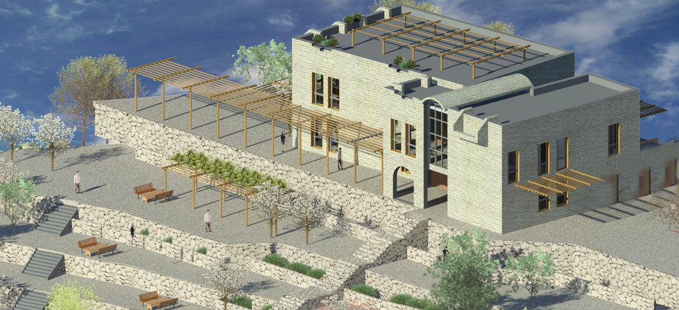



Green Building for Jalqamous multi-purpose
An-Najah National University
Faculty of Building Engineering
Dec. 2013

Slide 2
Prepared By :
Wala’ Ihbeashih- Wala’ Hourane- Ghadeer Ahmad
Graduation Project:
Green Building for Jalqamous multi-purpose
Supervised By :
Dr. Sameh Mona
An-Najah National University
Faculty of Building Engineering

Slide 3
Outlines for our presentation:
Building Engineering
Out Lines :
Introduction about Green Building.
Project General Information.
Architectural design.
Environmental design.
Structural design.
Mechanical design.
Electrical design.
Graduation Project

Slide 4
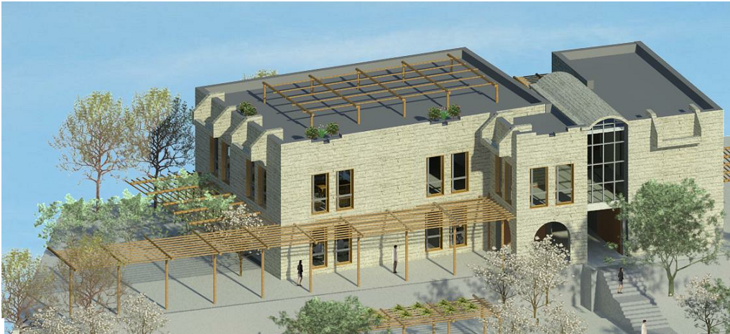
Introduction about Green Buildings:
Building Engineering
Introduction :
Green Building Aspects
Site Sustainability
15%
Indoor environment quality
15%
Energy efficiency
30%
Water efficiency
25%
Material & resources
10%
Innovation & new technologies
5%
Graduation Project

Slide 5
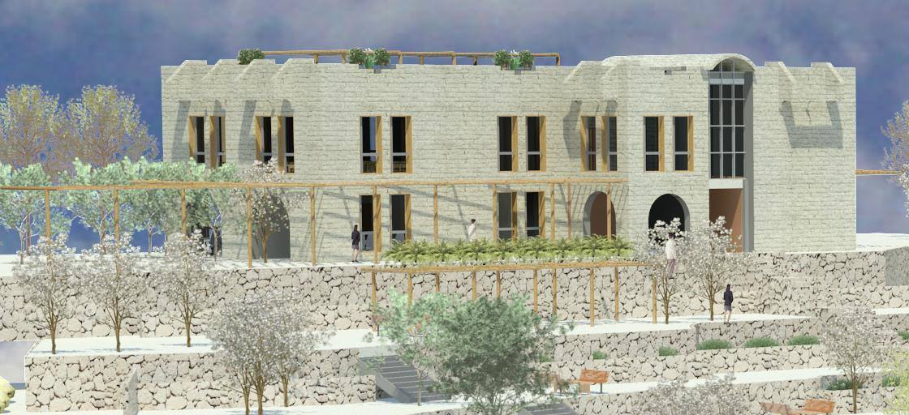
Introduction about Green Buildings:
Building Engineering
General Objectives
The Goals of having Green Buildings:
✓ Efficiently using energy, water, and other resources.
✓ Protecting occupant health and improving employee productivity.
✓ Reducing waste, pollution and environmental degradation.
Graduation Project

Slide 6
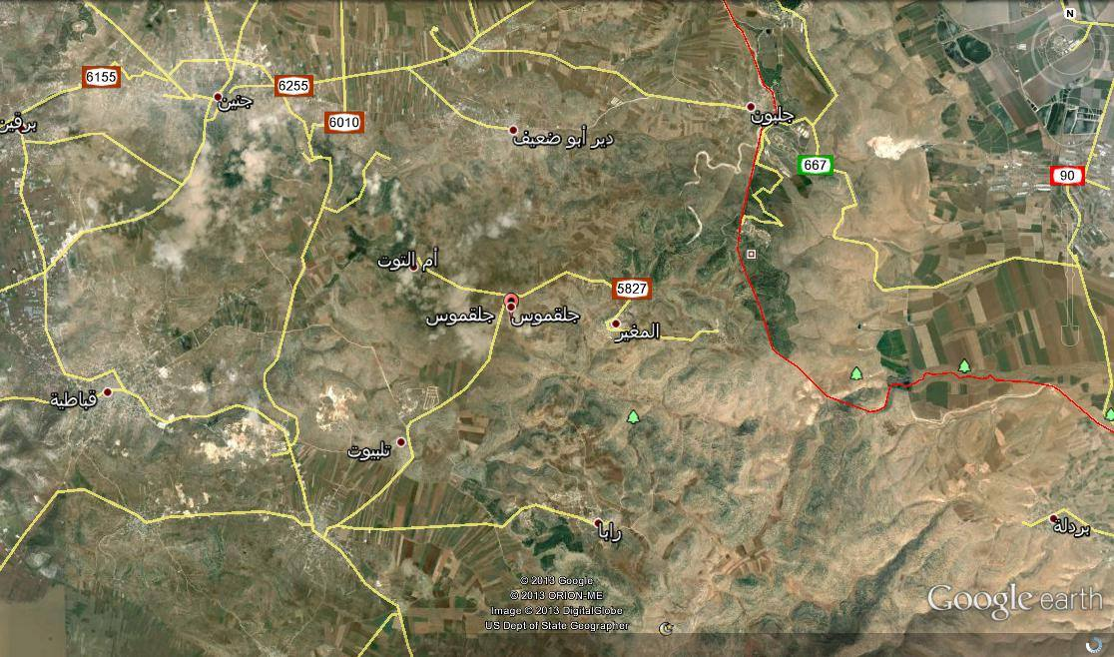
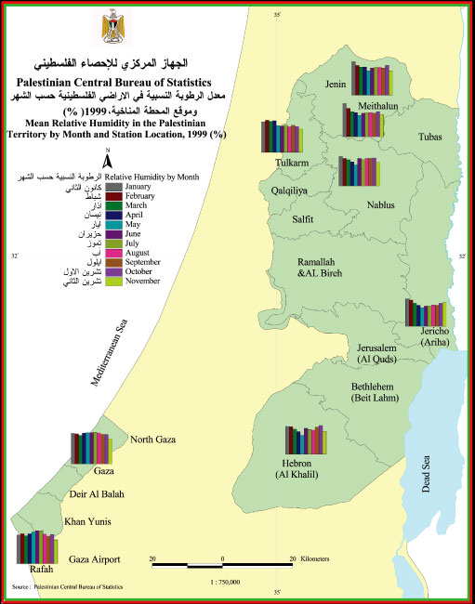
General Information
Building Engineering
A- Location & site plan
The proposed site is located in the village of Jalqamous, which is approximately 10 km to the south east of Jenin in the north of the West Bank.
Graduation Project

Slide 7
General Information
Building Engineering
A- Jalqamous climate:
Dec | Nov | Oct | Sep | Aug | Jul | Jun | May | Apr | Mar | Feb | Jan | Month
25 (78) | 29.0 (84) | 39 (102) | 370 (99) | 35.8 (96) | 37.6 (99) | 37.6 (100) | 40.4 (105) | 38.6 (101) | 26.8 (80) | 26 (79) | 25 (77) | Max Temp °C (°F)
18.8 (66) | 25.0 (77) | 30.6 (87) | 33.2 (92) | 34.2 (94) | 33.6 (92) | 32.9 (100) | 31.0 (88) | 28.3 (83) | 21.6 (71) | 18.2 (65) | 174 (63) | Average Max °C (°F)
6.0 | 11.0 | 11.0 | 17.8 | 21.0 | 21.4 | 17.0 | 12.8 | 3.4 | 5.0 | 1.0 | 2.0 | MIin Temp °C (°F)
8.7 (48) | 11.8 (53) | 16.1 (61) | 19.8 (68) | 21.1 (70) | 19.6 (63) | 17.3 (63) | 14.0 (57) | 11.2 (52) | 8.6 (48) | 7.1 (45) | 6.8 (44) | Average Min °C (°F)
13.7 (57) | 18.4 (65) | 23.3 (74) | 26.5 (80) | 27.6 (82) | 26.6 (80) | 25.1 (79) | 22.5 (73) | 19.7 (67) | 15.1 (59) | 12.6 (55) | 21.1 (54) | Average Daily °C (°F)
93 | 40 | 16 | 0 | 0 | 0 | 0 | 6 | 25 | 65 | 62 | 107 | Rainfall mm
74 | 66 | 65 | 64 | 65 | 63 | 63 | 60 | 67 | 76 | 84 | 80 | Relative Humidity %
5.4 | 6.8 | 8.1 | 9.1 | 10 | 11.1 | 11.3 | 9.7 | 7.8 | 6.8 | 5.6 | 5.4 | Sun Hour
Graduation Project

Slide 8
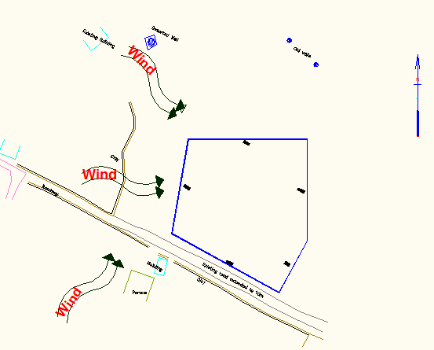
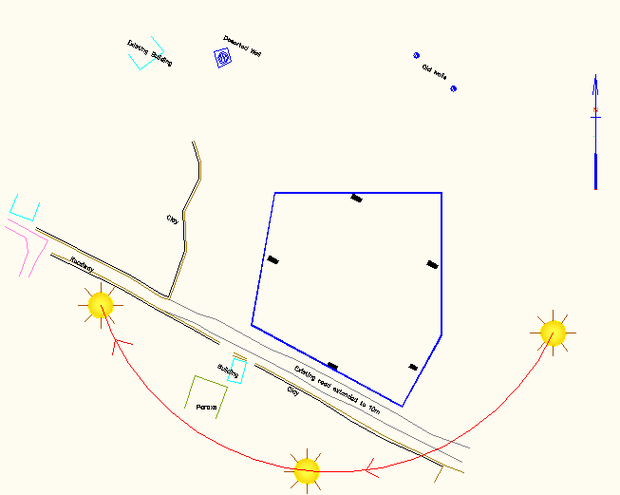
General Information
Building Engineering
A- Sun path & Wind movement:
Graduation Project

Slide 9
Architectural design
Building Engineering
Outline:
Location & site characteristics.
Site Plan.
Ground, First , Basement & Roof Plans.
Elevations.
Sections.
Graduation Project

Slide 10
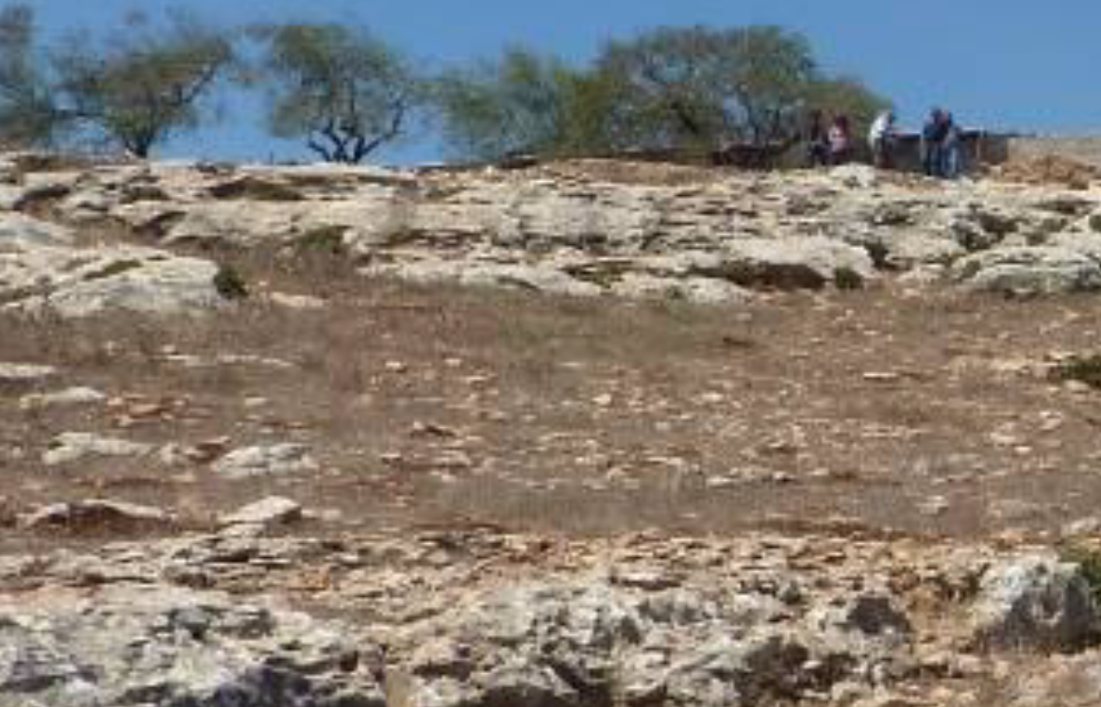
General Information
Building Engineering
A- Location & site characteristics:
Non spoiled land.
Steep Slopes.
Natural rocks.
Non planted area.
Opened view to east & south.
Access to land from North & south
Graduation Project

Slide 11
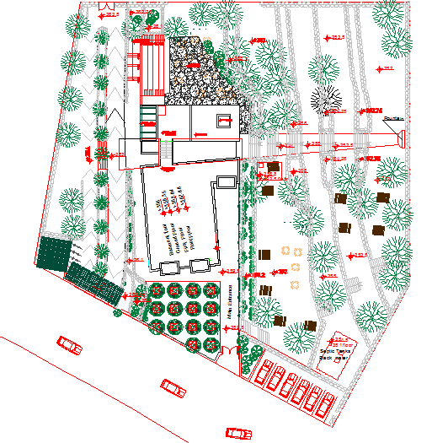
Architectural design
Building Engineering
A- Location & site plan:
Graduation Project

Slide 12
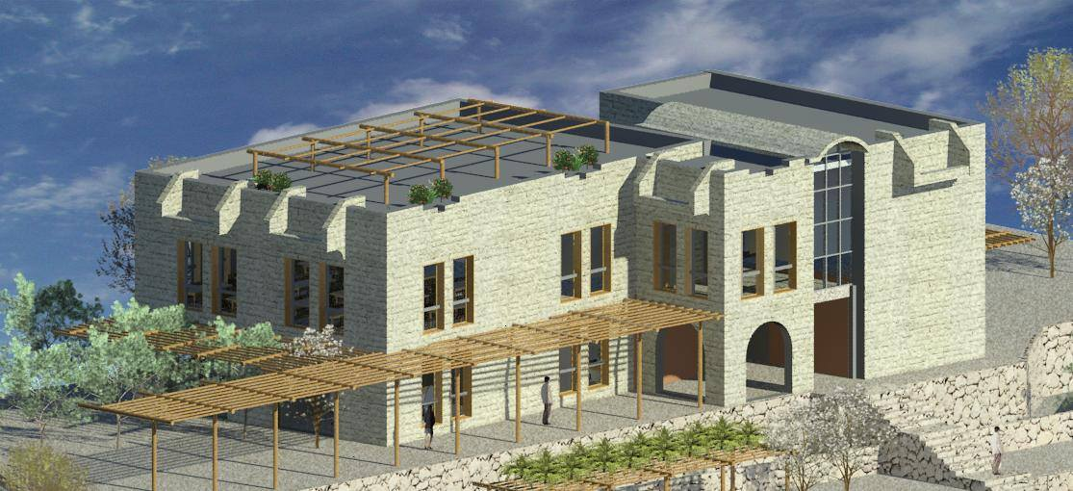
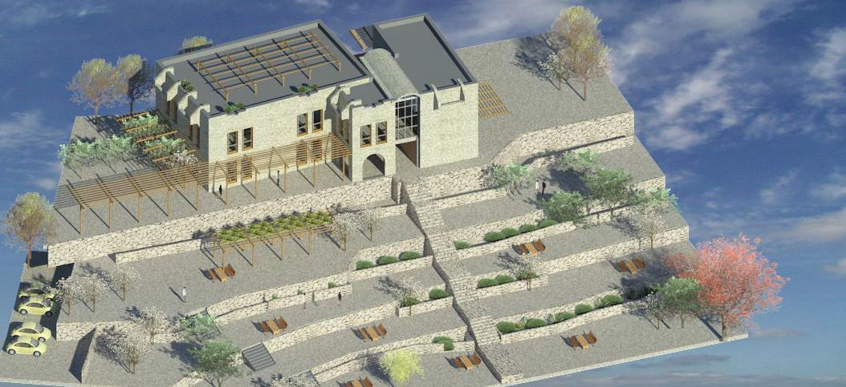
Architectural design
Building Engineering
A- Jalqamous climate:
Graduation Project

Slide 13
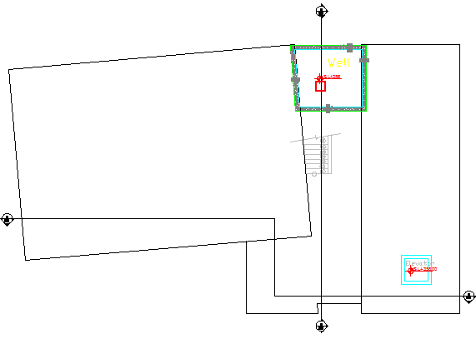
Architectural design
Building Engineering
A- Basement Floor:
Graduation Project

Slide 14
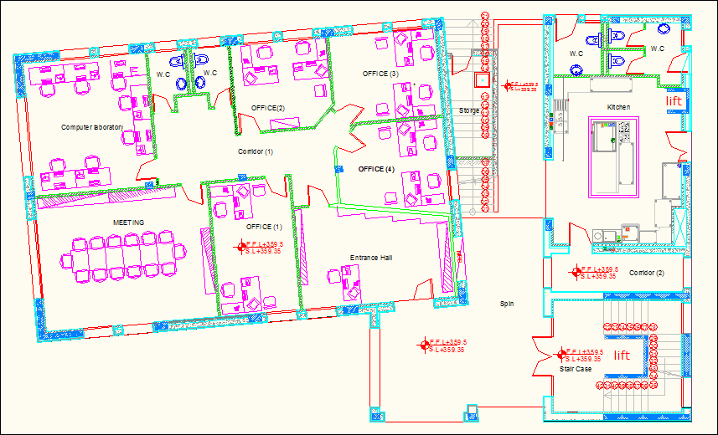
Architectural design
Building Engineering
A- Ground Floor:
Graduation Project

Slide 15
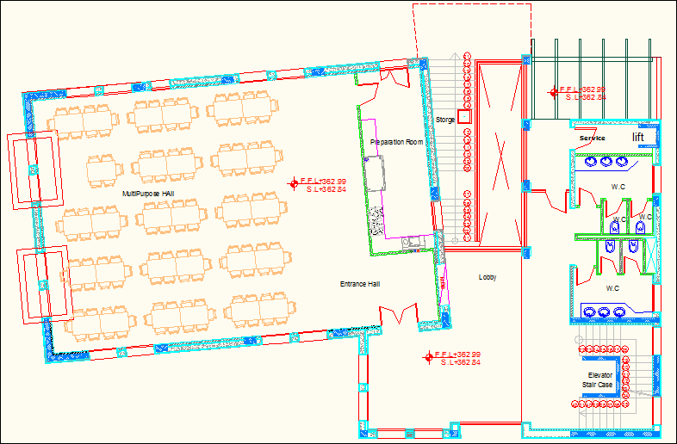
Architectural design
Building Engineering
A- First Floor:
Graduation Project

Slide 16
Architectural design
Building Engineering
A- Roof Floor:
Graduation Project

Slide 17
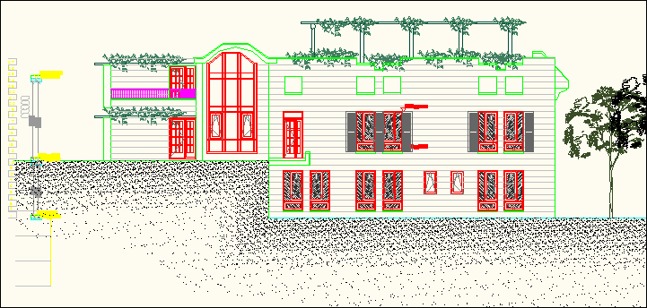
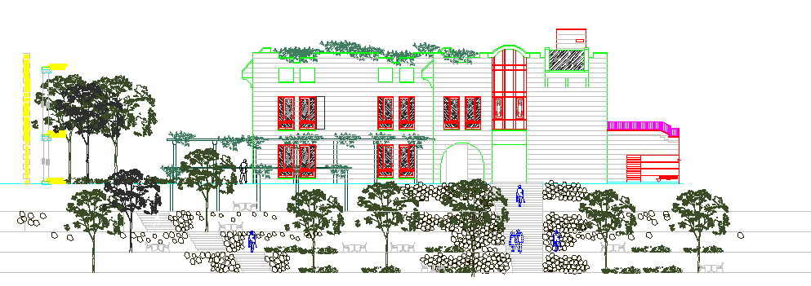
Architectural design
Building Engineering
A- Elevations:
Western Elevation
Eastern Elevation
Graduation Project

Slide 18
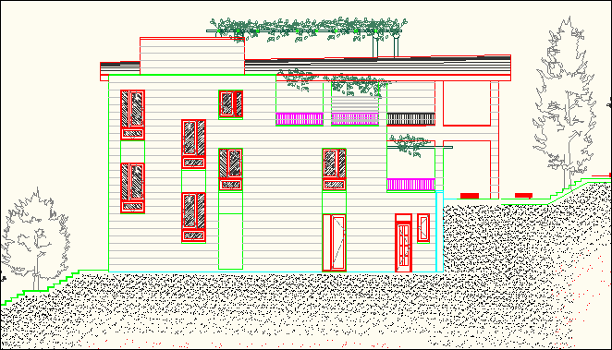
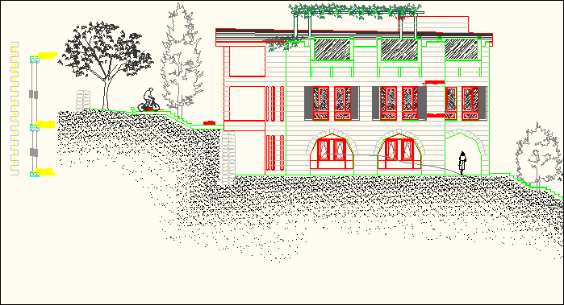
Architectural design
Building Engineering
A- Elevations:
Northern Elevation
Southern Elevation
Graduation Project

Slide 19
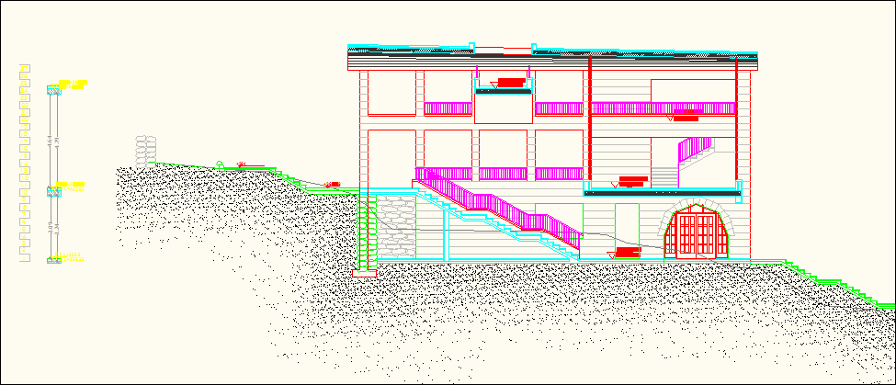
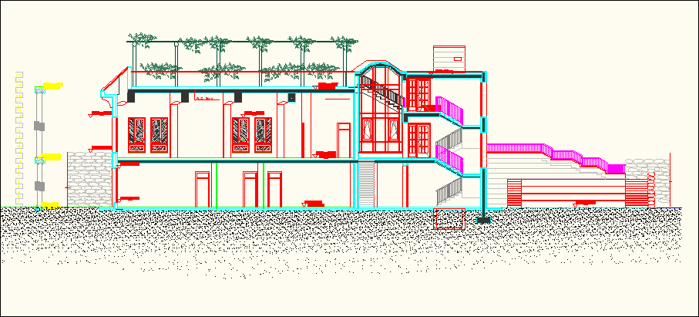
Architectural design
Building Engineering
A- Jalqamous climate:
Section B-B
Section A-A
Graduation Project

Slide 20
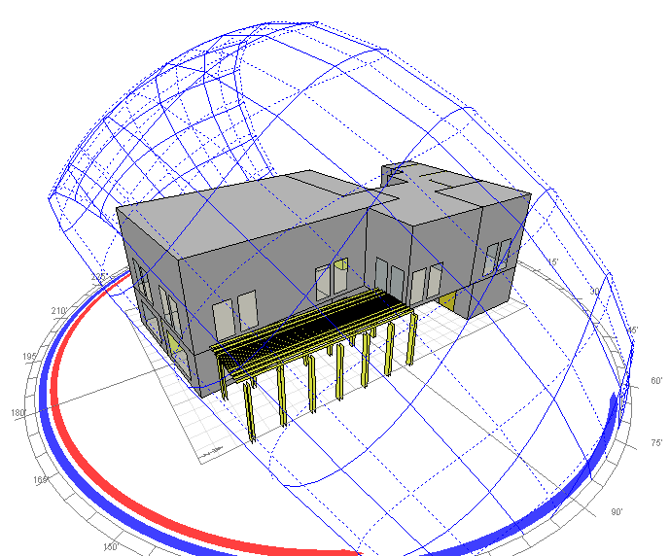
Environmental & Green building Evaluation:
Building Engineering
Outline
Orientation.
Sun path.
Natural Lighting.
Thermal Comfort.
Cooling & Heating.
Graduation Project

Slide 21
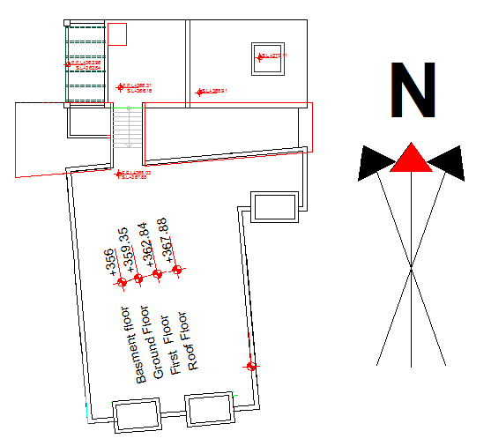
Environmental & Green building Evaluation:
Building Engineering
Orientation
The best orientation for the two models is at 137 away from north.
Graduation Project

Slide 22
Environmental & Green building Evaluation:
Building Engineering
Sun path
In 21th of January at 12:00 pm :
Second model
first model
Graduation Project

Slide 23
Environmental & Green building Evaluation:
Building Engineering
Sun path
In 21th of July at 12:00 pm :
Second model
first model
Graduation Project

Slide 24
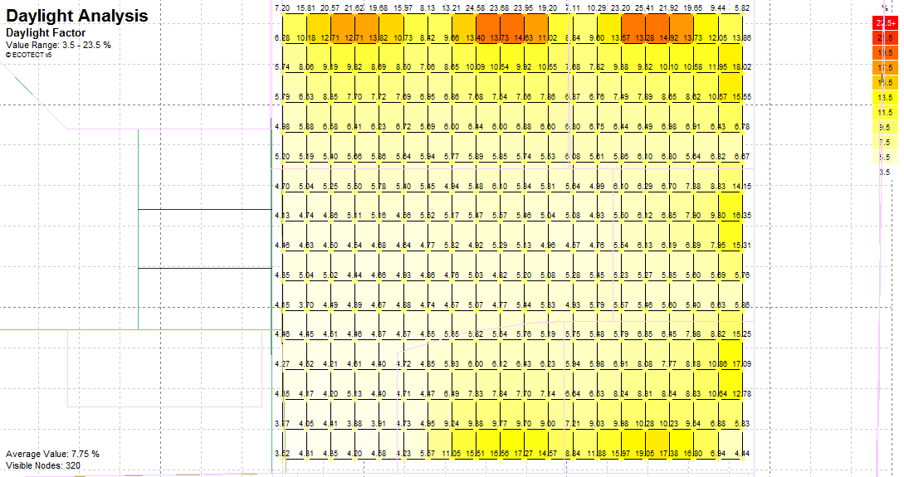
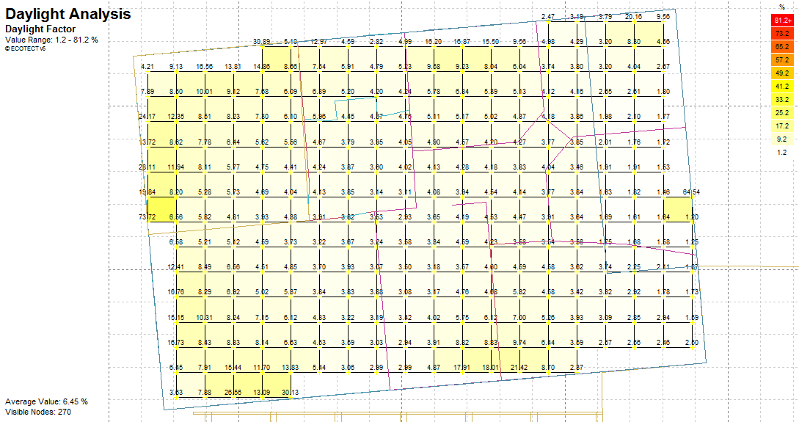
Environmental & Green building Evaluation:
Value range: 1.2-81.2 %
Average value: 6.45 %
Value range: 1.2-81.2 %
Average value: 6.45 %
Value range: 1.2-81.2 %
Average value: 6.45 %
Value range: 1.2-81.2 %
Average value: 6.45 %
Value range: 1.2-81.2 %
Average value: 6.45 %
Building Engineering
Natural Lighting( Multi-Purpose Room )
Second model:
Average Value: 7.75%
first model:
Average Value: 6.45%
Graduation Project

Slide 25
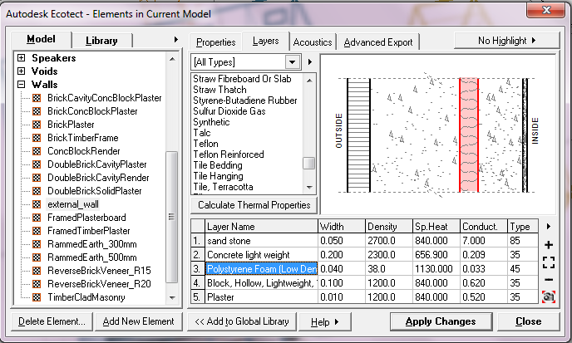
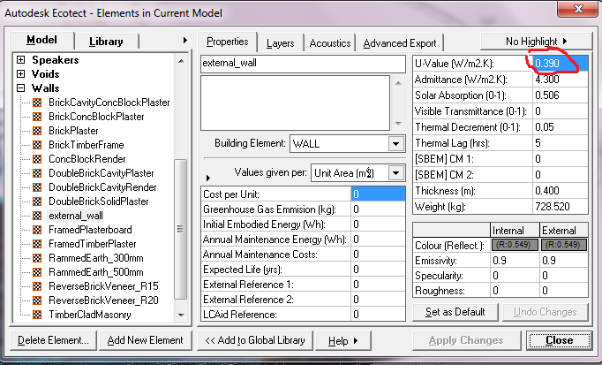
Environmental & Green building Evaluation:
Value range: 1.2-81.2 %
Average value: 6.45 %
Value range: 1.2-81.2 %
Average value: 6.45 %
Value range: 1.2-81.2 %
Average value: 6.45 %
Value range: 1.2-81.2 %
Average value: 6.45 %
Value range: 1.2-81.2 %
Average value: 6.45 %
Building Engineering
Thermal comfort ( Phase 1 & 2 )
In this project we use (Polystyrene foam low density) . The U-value and the cross section of the external wall as shown here:
Graduation Project

Slide 26
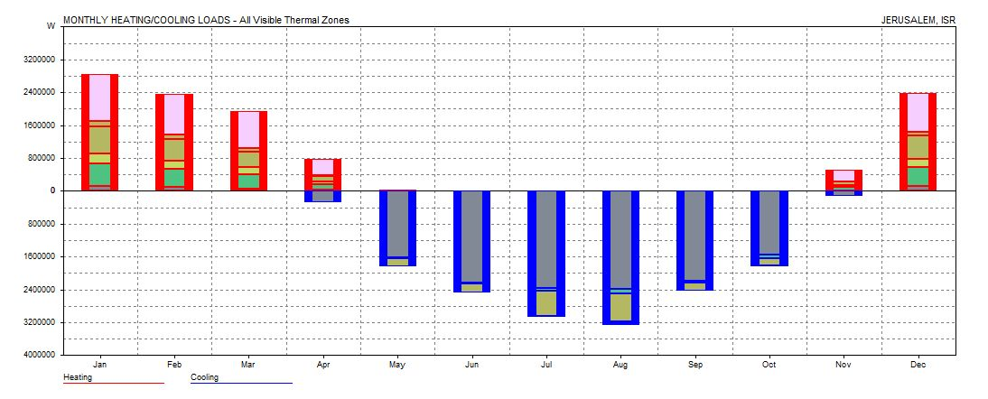
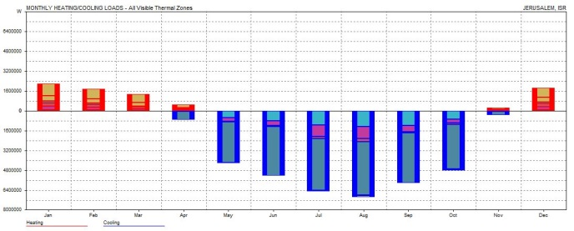
Environmental & Green building Evaluation:
Building Engineering
Cooling & Heating:
Second model
45.034 KWh/m²/year
first model
73.184 KWh/m²/year
Graduation Project

Slide 27
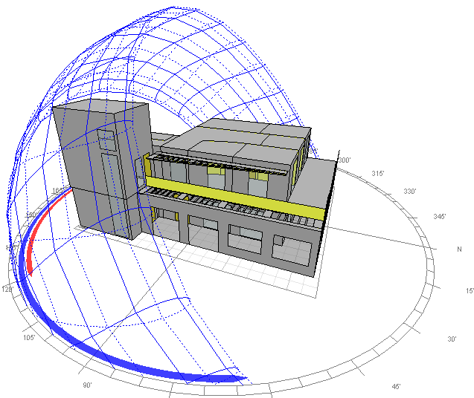
Environmental & Green building Evaluation:
Building Engineering
Comparison between two phases
Environmental standards | Phase (1) |  |  | Phase(2) |  |  | Best phase
Thermal comfort | Well sealed | Average | Cross ventilated (still air) | Well sealed | Average | Cross ventilated (still air) | Phase(2)
 | 25.4 | 27.9 | 12 | 30.5 | 29.2 | 12.6
Heating& cooling(/m²) | 73.184 KWh |  |  | 45.034 KWh |  |  | Phase(2)
Lighting(%) | 6.45 |  |  | 7.75 |  |  | Phase(2)
Graduation Project

Slide 28
Environmental & Green building Evaluation:
Building Engineering
Green Building Evaluation:
Hint:
In our evaluation of green aspects for this building,,, we depended on the New Palestinian Code for Green Buildings taking into consideration that the evaluation was focused on the design stage for every step. But the points for either construction & operation stage were put Automatically & we hope that this points will be achieved in the nearly future.
Graduation Project

Slide 29
Environmental & Green building Evaluation:
Building Engineering
Green Building Evaluation:
The evaluation of green aspects was taken for the phase(1) as shown in the tables below :
2) Indoor Environment Quality
1) Site Sustainability
Items | earned | point | Achieved points
Site Sustainability | Yes | No
Construction activity pollution prevention | Yes |  | required
Site selection | Yes |  | 1
Building Accessibility | Yes |  | 3
Site development | Yes |  | 5
Outdoor thermal comfort | Yes |  | 2
Urban heat Island | Yes |  | 3
Alternative transportation | Yes |  | 2
Storm water design | Yes |  | 4
Light pollution reduction |  | No | 0
Total Point |  |  | 20
Items | earned | point | Achieved points
Indoor environment quality | Yes | No
Minimum IAQ performance | Yes |  | required
Smoking control | Yes |  | required
Healthy ventilation delivery |  | No | 0
Material emission |  | No | 0
Car Park Air quality management | Yes |  | 2
Thermal comfort &controls | Yes |  | 6
High frequency lighting | Yes |  | 2
Daylight &glare | Yes |  | 3
View | Yes |  | 2
Indoor noise pollution | Yes |  | 2
Safe& secure Environment |  | No | 0
Total point |  |  | 17
Graduation Project

Slide 30
Environmental & Green building Evaluation:
Building Engineering
Green Building Evaluation:
3) Energy Efficiency
4) Water Efficiency
Items | earned | point | Achieved points
Energy efficacy | Yes | No
التخطيط لأنظمة الطاقة بالمبنى | Yes |  | required
تحقيق الحد الأدنى لكفاءة استهلاك الطاقة | Yes |  | required
التخطيط لإدارة أنظمة التبريد بالمبنى | Yes |  | required
تحقيق الحد الأفضل لكفاءة استخدام الطاقة | Yes |  | 10
Renewable energy | Yes |  | 14
كفاءة المعدات والأجهزة المستخدمة في المباني | Yes |  | 5
المباني الذكية |  | No | 0
Total Point |  |  | 29
Items | earned | point | Achieved points
Water efficacy | Yes | No
ترشيد استهلاك المياه |  |  | required
ترشيد استهلاك الماء البارد | Yes |  | 8
ترشيد انتاج استهلاك الماء الساخن | Yes |  | 15
Rain water harvesting& reuse | Yes |  | 4
Waste gray water recycling reuse | Yes |  | 8
Water system management, monitoring, metering& control | Yes |  | 2
Total point |  |  | 37
Graduation Project

Slide 31
Environmental & Green building Evaluation:
Building Engineering
Green Building Evaluation:
5) Materials & resources
6) Innovation, and building Integrated design
Items | Earned | point | Achieved points
Material& resource | Yes | No
Construction& operation waste management program | Yes |  | required
Hazard material elimination | Yes |  | required
Non-polluting material | Yes |  | 3
Regional materials | Yes |  | 4
Recycled materials |  | No | 0
Rapidly renewable materials | Yes |  | 2
Material reuse |  | No | 0
Material durability | Yes |  | 2
Building reuse | Yes |  | 2
Design for flexibility& disassembly |  | No
Total point |  |  | 13
Innovation, and building Integrated design | Yes | No | Achieved points
Innovation in design | Yes |  | 4
Integrated design approach | Yes |  | 3
Using new technologies |  | NO | 0
Total Point |  |  | 7
Graduation Project

Slide 32
Environmental & Green building Evaluation:
Building Engineering
Green Building Evaluation:
As a result from the previous tables, 123 points were achieved & this is can be considered as a silver degree in the Palestinian Rating System.:
Aspects of Green Building: | Possible Points | Achieved Point
Sustainable sites | 30 | 20
Water efficiency | 50 | 37
Energy and Atmosphere | 60 | 29
Materials and Resources | 20 | 13
Indoor Environmental Quality | 30 | 17
Innovation in Design | 10 | 7
Graduation Project

Slide 33
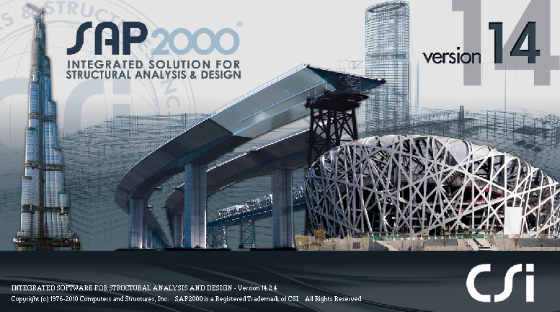
Structural design
Building Engineering
Structural design
Design Codes:
The structural design will be according to :
1) The American Concrete Institute code ACI 318-08 .
2) The seismic design according to UBC-97.
Software:
SAP 2000, V14.2.2
Graduation Project

Slide 34
Structural design
Building Engineering
Design data
Compressive strength of concrete (f\c)
beams
shear walls
columns
footing
f\c =30 MPa
Yielding strength of steel
(Fy = 420 MPa)
Bearing capacity of soil
300 KN/m²
Soil type is
Sc
Graduation Project

Slide 35
Structural design
Building Engineering
Loads
Dead load consist:
Own weight for the building comes from the weight of (beams, columns , slabs, wall).
Superimposed dead load is
Live load
3 KN/m²
3KN/m²
Seismic design load:
Importance factor=1
Seismic coefficient Cv=0.36
Seismic coefficient Ca=0.24
R=3.5
Graduation Project

Slide 36
Structural design
Building Engineering
Unit weights for different materials:
Material | Density (kN/m3)
Reinforced concrete (beams, columns) | 25
Brick | 12
Masonry stone | 26
Sand | 18
Aggregate | 17
Polystyrene | 0.3
Mortar | 2.3
Tile | 12
Graduation Project

Slide 37
Structural design
Building Engineering
Preliminary dimensions:
Slab Dimension:
-In our project, we have one way ribbed slab in the first floor and apart of the second slab is a one way solid with drop beams.
- Slab Thickness = 30 cm
Beams Dimensions:
Slab Dimension
Main beam (hidden) : (30*75),(30*50).
Main beam(drop): (50*70).
Secondary beam : (30*40).
Columns Dimensions:
Column (25*30) .
Column (25*40) .
Column (25*50) .
Column (25*60) .
Graduation Project

Slide 38
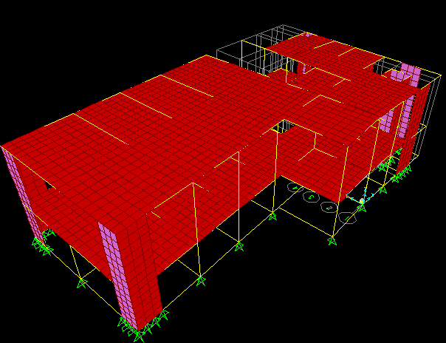
Structural design
Building Engineering
3D sap model
Graduation Project

Slide 39
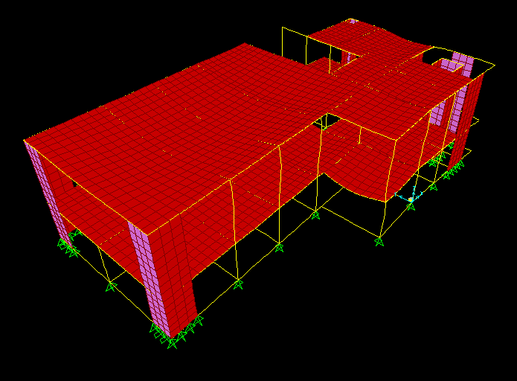
Structural design
Building Engineering
Model Validation
Compatibility check :
Graduation Project

Slide 40
Structural design
Building Engineering
Equilibrium check :
This difference between manual and SAP weight may be related to ignoring some details in manual calculations or to some assumption in manual calculations.
percentage of error shouldn’t exceed 5%
Loads | SAP | Manual | Error%
Dead Load | 16368 KN | 15667.8 KN | 4%
Live Load | 1899.52 KN | 1904 KN | 0.28%
the check it was ok because the error less than 5%.
Graduation Project

Slide 41
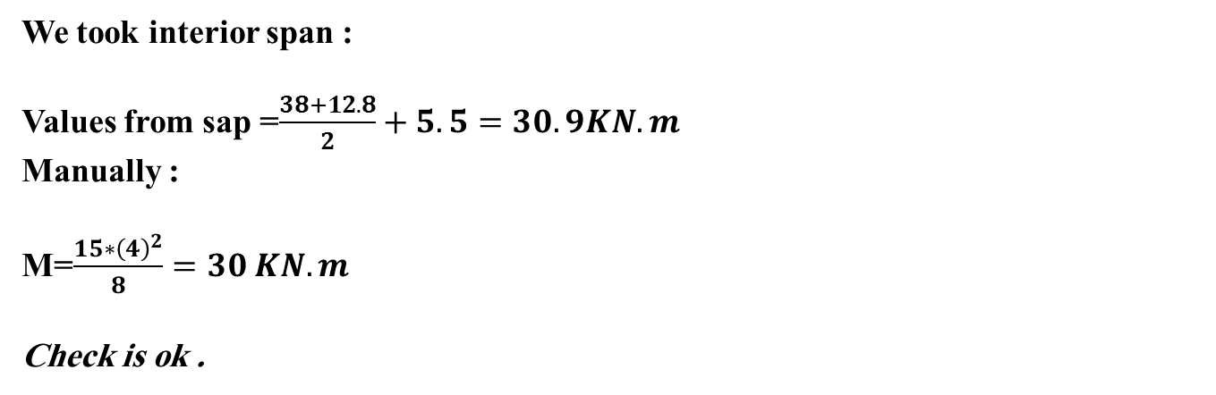
Structural design
Building Engineering
Local equilibrium check (internal loads)
Graduation Project

Slide 42
Structural design
Building Engineering
Design elements :
slab
Beams.
Columns.
Footings.
Shear wall.
Stairs.
Seismic Design.
Graduation Project

Slide 43
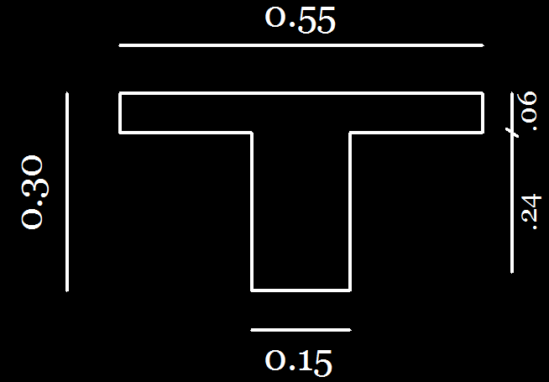
Structural design
Building Engineering
Slab design :
The Slabs are designed as one way ribbed slab with hidden beams & one way solid slab with drop beams with thickness =30cm
Section in ribbed slab
Graduation Project

Slide 44
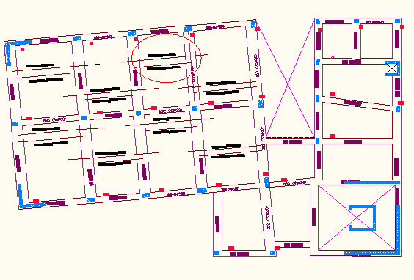
Structural design
Building Engineering
Slab Reinforcement:
Graduation Project

Slide 45
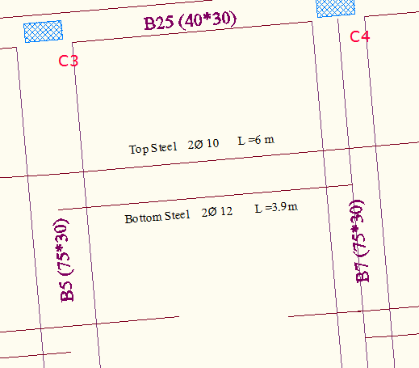
Structural design
Building Engineering
Slab Reinforcement:
Graduation Project

Slide 46
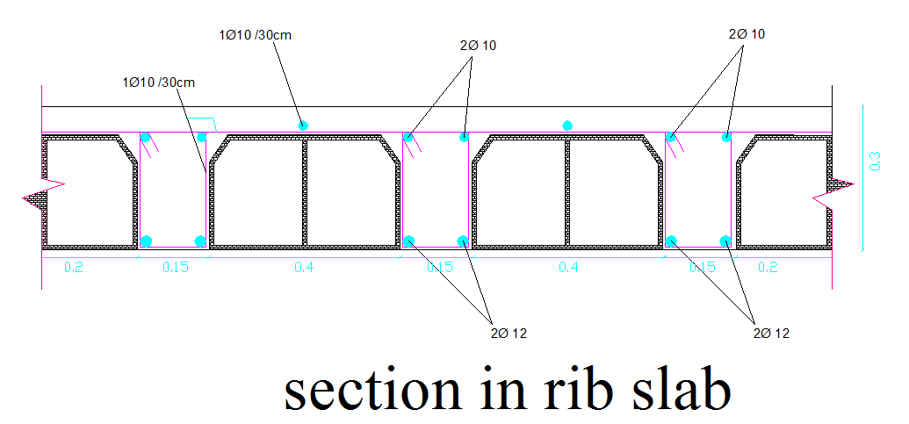
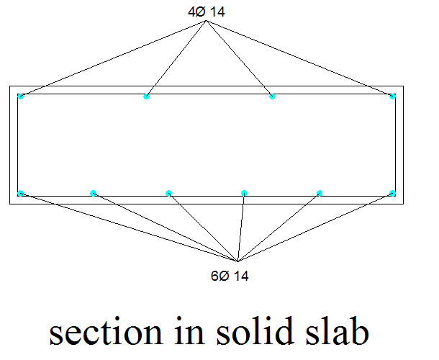
Structural design
Building Engineering
Sections in slab:
Graduation Project

Slide 47
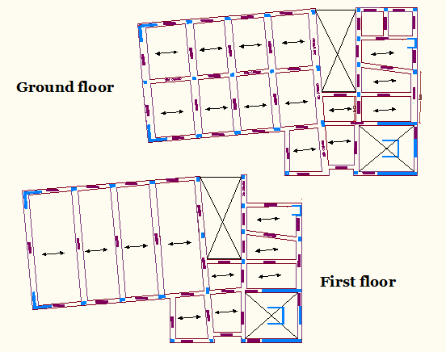
Structural design
Building Engineering
Beams Design:
Graduation Project

Slide 48
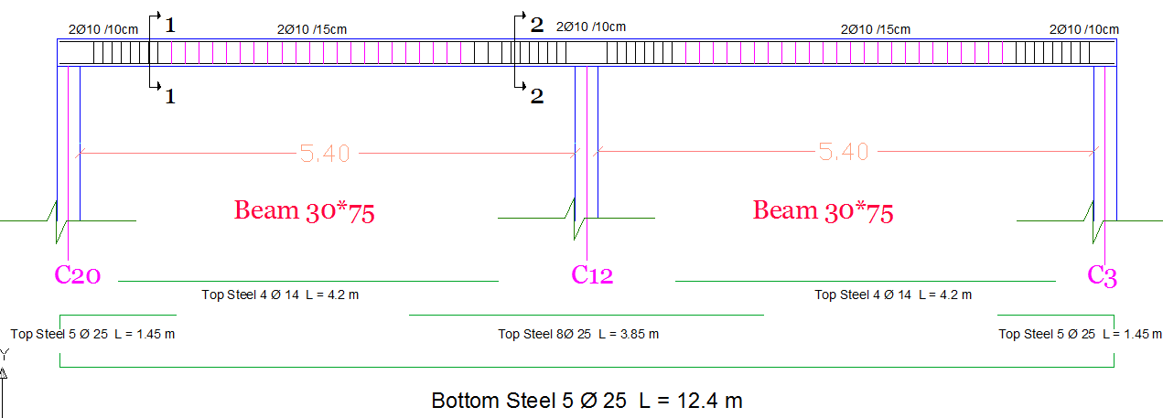
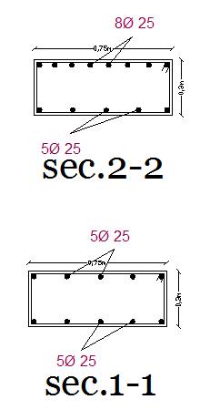
Structural design
Building Engineering
Sections in main beam (30*75)cm:
Graduation Project

Slide 49
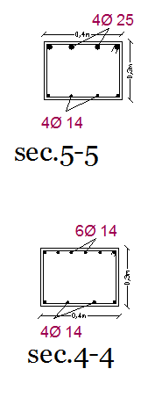
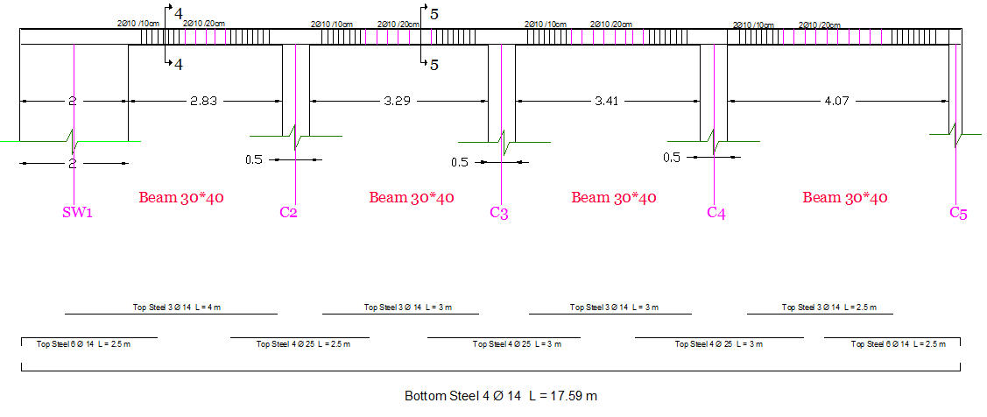
Structural design
Building Engineering
Sections in secondary beam (30*40)cm:
Graduation Project

Slide 50
Structural design
Building Engineering
Columns Design:
Columns Groups:
.
Column group | Ag | ρ | As(mm) | ϴ | #N
1 | 150000 | 0.01 | 1500 | 16 | 8
2 | 125000 | 0.01 | 1250 | 16 | 8
3 | 100000 | .01 | 1000 | 16 | 6
4 | 75000 | 0.01 | 750 | 16 | 4
Graduation Project

Slide 51
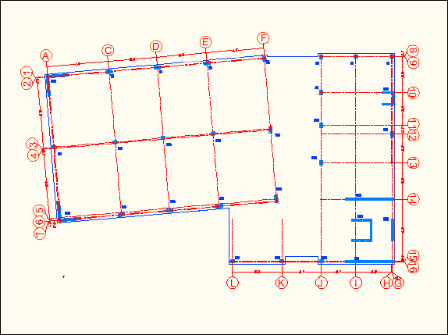
Structural design
Building Engineering
Columns Design:
Center Plan:
.
Graduation Project

Slide 52
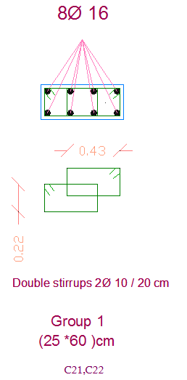
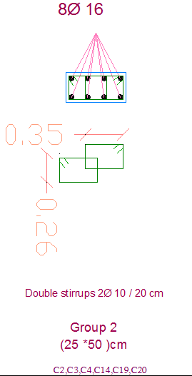
Structural design
Building Engineering
Columns Design:
Sections in columns:
.
Graduation Project

Slide 53
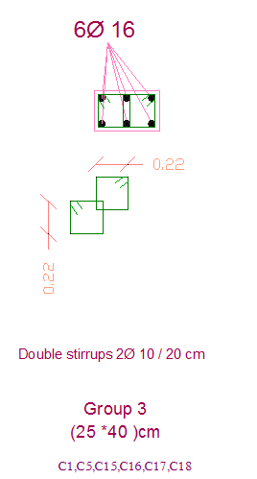
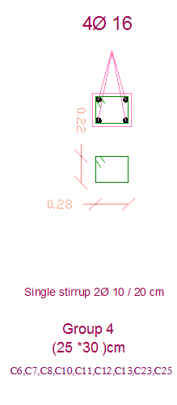
Structural design
Building Engineering
Columns Design:
Sections in columns:
.
Graduation Project

Slide 54
Structural design
Building Engineering
Footings Design:
Footings Groups:
.
We used two types of footings:
1-single footing
2-Wall footing
Group | P service | P ultimate | Dimension | As | No of bar
1 | 2400 | 2902 | L=3m B=2.7 H=0.55 m | 4522.4 mm² 4246 mm² | long direction 15 ϕ 20 Short direction 14 ϕ 20
2 | 1515 | 1852 | L=2.6m B=2m H=0.7m | 2808 mm² 2160 mm² | long direction 10 ϕ 20 Short direction 7ϕ 20
3 | 683 | 765.5 | L=1.7m B=1.4 m H=0.4m | 1224 mm² 1008 mm² | long direction 4ϕ 20 Short direction 4ϕ 20
Graduation Project

Slide 55
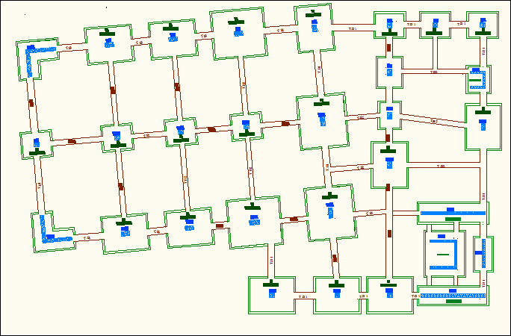
Structural design
Building Engineering
Footings Design:
Footings Plan:
.
Graduation Project

Slide 56
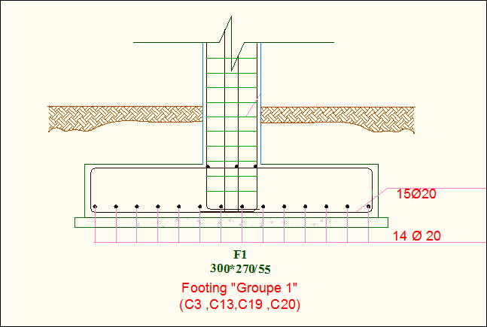
Structural design
Building Engineering
Footings Design:
Single Footing Detail:
.
Graduation Project

Slide 57


Structural design
Building Engineering
Footings Design:
Wall Footing Details:
.
Graduation Project

Slide 58

Structural design
Building Engineering
Stair Design:
Stair Dimensions:
.
Our Calculations for designing stair were taken for the element as shown below :
Graduation Project

Slide 59

Structural design
Building Engineering
Stair Design:
Stair Dimensions:
.
After Calculations for designing stair the dimensions are:
= 29⁰
Going = 30 cm
Riser = 17 cm
Floor height = 3.49 m
The stair case in our building has three parts, in each part:
No. of goings = 6
No. of risers = 7
The width of the one step = 1.35m
Stair slab thickness = 25cm
Slab waist thickness = 15 cm
Graduation Project

Slide 60


Structural design
Building Engineering
Stair Design:
Check deflection by sap:
Check shear by sap:
.
Graduation Project

Slide 61


Structural design
Building Engineering
Stair Design:
Bending moment by sap:
Area of steel by sap:
.
Graduation Project

Slide 62

Structural design
Building Engineering
Stair Design:
Stair’s Reinforcement:
.
Graduation Project

Slide 63
Structural design
Building Engineering
Seismic Design:
Seismic Zone:
.
The project is designed and analysed using UBC97 design code. The
building is in Jenin City, which in zone 2B where Z=0.2.
By using response spectrum method:
Seismic coefficient (Cv=0.36).
Seismic coefficient (Ca=0.24).
The structure system is designed as ordinary structure
The Response spectrum scale factor (gI/R) =2.8
Graduation Project

Slide 64

Structural design
Building Engineering
Seismic Design:
Check for ( T ):
.
Fundamental period of structure(T):
In this check, period calculated manually was compared with the period that results from SAP
T (manually) =0.23 sec
T (sap) =0.24 sec
Graduation Project

Slide 65

Structural design
Building Engineering
Seismic Design:
Response Spectrum Results:
.
Our results were come after using 100 modes instead of 12 modes.
Graduation Project

Slide 66

Structural design
Building Engineering
Seismic Design:
Earthquake force check:
.
The check was finding based on equivalent static method manually . After that we compared it with SAP result (Response spectrum).
Base shear value (manually) = 1123.6 KN
Base shear value (sap) = 1477.723 KN
Graduation Project

Slide 67
Mechanical Design
Building Engineering
Outline
Water Supply system.
Sanitation system.
Rain incline .
Elevator system.
Fire System.
HVAC system.
Graduation Project

Slide 68


Mechanical Design
Building Engineering
Water supply
Ground Floor:
Graduation Project

Slide 69

Mechanical Design
Building Engineering
Sanitation system
Ground Floor:
Graduation Project

Slide 70

Mechanical Design
Building Engineering
Sanitation system
For zones 2 & 3:
Graduation Project

Slide 71

Mechanical Design
Building Engineering
Sanitation system
Graduation Project

Slide 72

Mechanical Design
Building Engineering
Rain incline
Graduation Project

Slide 73
Mechanical Design
Building Engineering
Elevator design system
According to the American code, the design consists two things:
The type of the elevator
The number of the elevator
The type of the elevators
(2500Ib/400ft/min)
The number of elevators are two; the main one & another one for services.
Graduation Project

Slide 74

Mechanical Design
Building Engineering
Fire System:
Fire Exits
Graduation Project

Slide 75


Mechanical Design
Building Engineering
Fire System:
Protection Systems:
Tow manual system:
fire extinguisher ( Class K)
fire hose system(hose wheel)
Graduation Project

Slide 76

Mechanical Design
Building Engineering
HVAC System:
Distribution of diffuser:
Graduation Project

Slide 77
Electric Design:
Building Engineering
Outline
Power distribution.
Manual lighting Design.
Lighting Design by DIALux.
Distribution board .
Graduation Project

Slide 78

Electric Design:
Building Engineering
Power distribution:
In our project we use normal socket (2A,5A) and special socket(16A).
Graduation Project

Slide 79
Electric Design:
Building Engineering
Manual lighting Design:
For artificial lighting
Technical values for design
Function | Em (Lx)
Offices | 500
Meeting room | 750
Entrance hall | 300
Computer room | 500
Multipurpose hall | 500
Corridors | 150
Stairs | 100
Function | Height
Offices | Desktop-75cm
Corridors | Ground level
Stairs | The level of pedal stairs
Graduation Project

Slide 80





Electric Design:
Building Engineering
Lighting Design by DIALux.
Lighting units used in DIALux .
Graduation Project

Slide 81

Electric Design:
Building Engineering
light distribution in meeting room with DIALux:-
Graduation Project

Slide 82



Electric Design:
Building Engineering
light result for meeting room in DIALux:-
Average illuminances[lx] =Direct + indirect = 524+227 = 751>700
OSRAM 4008321380937 DEDRA T5 VABS KIT 4x14W/840
Graduation Project

Slide 83


Electric Design:
Building Engineering
light distribution in office1 with DIALux:-
light distribution in office 1
Work plane display
Graduation Project

Slide 84


Electric Design:
Building Engineering
light result for meeting room in DIALux:-
Average illuminances[lx] =Direct+indirect=354+171=515>500
OSRAM 4050737038117 Siteco louvre lum.
M,3x14W,T16,ECG,dir ALU MT
Graduation Project

Slide 85

Electric Design:
Building Engineering
Lighting units and switches distribution for ground floor
Total lighting load | 6960 watt
Total number of lamp | 119 lamp
Graduation Project

Slide 86

Electric Design:
Building Engineering
Distribution board :
Graduation Project

Slide 87
Quantity surveying
Building Engineering
  Quantity surveying
Item | Item Description | Unit | Quantity | Direct Cost (NIS/ unit) |  |  | Unit Cost (NIS/unit ) | Total Direct cost (NIS) | Unit Price (NIS ) | Total Price (NIS )
 |  |  |  | Labor Cost | Material Cost | Equipment cost
1.1 | Earth Work
1.1.1 | Excavation | CM | 306 | 3 | ـــــــ | 12 | 15 | 4590 | 17.0 | 5214.2
1.1.2 | Back Filling | CM | 219.92 | 3 | ـــــــ | ــــــــ | 3 | 659.76 | 3.41 | 749.5
1.2 | Form Work
1.2.1 | Foundation | SM | 121.84 | 8 | 50 | ـــــــ | 58 | 7066.72 | 65.89 | 8027.8
1.2.2 | Column | SM | 212.25 | 8 | 50 | ـــــــ | 58 | 12310.5 | 65.89 | 13984.7
1.2.3 | Tie beams | SM | 168.92 | 8 | 50 | ـــــــ | 58 | 9797.36 | 65.89 | 11129.8
1.2.4 | Slab | SM | 734.6 | 8 | 50 | ـــــــ | 58 | 42606.8 | 65.89 | 48401.3
1.2.5 | Stairs | SM | 34.717 | 8 | 50 | ـــــــ | 58 | 2013.586 | 65.89 | 2287.4
1.3 | Concrete Work
1.3.1 | Foundation | CM | 86.08 | 15 | 300 | ـــــــ | 315 | 27115.2 | 357.84 | 30802.9
1.3.2 | Column | CM | 16.232 | 15 | 300 | ـــــــ | 315 | 5113.08 | 357.84 | 5808.5
1.3.3 | Tie beams | CM | 38 | 15 | 300 | ـــــــ | 315 | 11970 | 357.84 | 13597.9
1.3.4 | Slab | CM | 89 | 15 | 300 | ـــــــ | 315 | 28035 | 357.84 | 31847.8
1.3.5 | Beams | CM | 50.46 | 15 | 300 | ـــــــ | 315 | 15894.9 | 357.84 | 18056.6
1.3.6 | Stairs | CM | 7.935 | 15 | 300 | ـــــــ | 315 | 2499.525 | 357.84 | 2839.5
1.4 | Steel Work
1.4.1 | Foundation | Ton | 2.03 | 300 | 21450 | ـــــــ | 3600 | 7308 | 4089.6 | 8301.9
1.4.2 | Column | Ton | 2.9 | 300 | 3300 | ـــــــ | 3600 | 10440 | 4089.6 | 11859.8
1.4.3 | Tie beams | Ton | 1.23 | 300 | 3300 | ـــــــ | 3600 | 4428 | 4089.6 | 5030.2
1.4.4 | Slab | Ton | 4.5 | 300 | 3300 | ـــــــ | 3600 | 16200 | 4089.6 | 18403.2
1.4.5 | Beams | Ton | 5.275 | 300 | 3300 | ـــــــ | 3600 | 18990 | 4089.6 | 21572.6
1.4.5 | Stairs | Ton | 14.2 | 300 | 3300 | ـــــــ | 3600 | 51120 | 4089.6 | 58072.3
1.5 | Finishing
1.5.1 | Block | SM | 4213 | 8 | 2 | ـــــــ | 10 | 42130 | 11.36 | 47859.7
1.5.2 | internal plastering | SM | 1450.65 | 5 | 5 | ـــــــ | 10 | 14506.5 | 11.36 | 16479.4
1.5.3 | Stone | SM | 712.99 | 25 | 65 | ـــــــ | 90 | 64169.1 | 102.24 | 72896.1
1.5.4 | Tiles | SM | 1043.25 | 13 | 50 | ـــــــ | 63 | 65724.435 | 71.57 | 74663.0
1.5.5 | Painting | SM | 1450.65 | 13 | 20 | ـــــــ | 33 | 47871.45 | 37.49 | 54382.0
1.5.6 | Windows | Unit | 163.2 | 10 | 300 | ـــــــ | 310 | 50592 | 352.16 | 57472.5
1.5.7 | Doors | Unit | 64.76 | 12 | 700 | ـــــــ | 712 | 46109.12 | 808.83 | 52380.0
1.5.8 | Insulation | SM | 945.29 | 2.5 | 50 | ـــــــ | 52.5 | 49627.725 | 59.64 | 56377.1
Total |  |  |  |  |  |  |  | 658888.761 |  | 748497.6
Graduation Project

Slide 88
Quantity surveying
Building Engineering
  Quantity surveying
The total cost for our project for all element without
mechanical & electrical elements.
Total price (NIS) | 748497.6
Graduation Project

Slide 89

Introduction about Green Buildings:
Building Engineering
Manual lighting Design:
Walaa’
Walaa’
Ghadeer
Graduation Project

