Slide 1
Prepared by:
Danya Al-Madani
Hiba Mansour
Ruba Adnan
Supervisors:
Dr.Mohammad Al Sayed
Dr.Yahya Saleh
Integration of LCCA & Energy simulation for green building using eQUEST as energy modeling software and Royal Wings Hotel as a case study

Slide 2
01
Retrieve Project 1
Agenda
02
Simulation Results
03
Economical Inputs
04
Financial Analysis Results
05
Sensitivity Analysis
06
Recommendations

Slide 3
Retrieve Project 1

Slide 4
Review
Fluorescent lamps
Polystyrene insulation
Case Two
LED lamps
No insulation
Case One
Case Three
LED lamps
Polystyrene insulation
Base Case
Fluorescent lamps
No insulation

Slide 5
Simulation Results

Slide 6
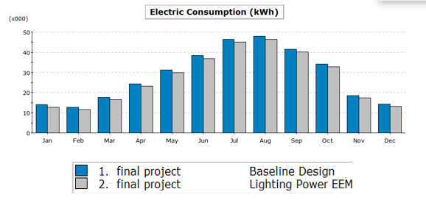
Comparison between Base Case and Case one
The total electric consumption saving was about 15470 kWh/year, which means that the annual bill dropped from 204762 NIS to 195480 NIS , about 4.5% saving.
 | Base Case (kWh *1000) | Case One (kWh *1000) | % diff from Base Case
Space Cool | 265.07 | 263.54 | -0.58%
Space heat | 0.87 | 0.88 | 1.1 %
Area lights | 30.35 | 16.40 | -46%
Total |  |  | -45.48%

Slide 7
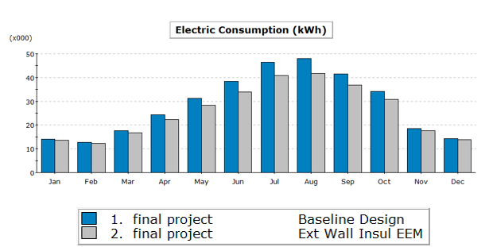
Comparison between Base Case and Case Two
The total electric consumption saving was about 32130 kWh/year, which means that the annual bill dropped from 204762 NIS to 185383 NIS , about 9.4% saving.
 | Base Case (kWh *1000) | Case Two (kWh *1000) | % diff from Base Case
Space Cool | 265.07 | 233.26 | -12%
Space heat | 0.87 | 0.55 | -36.8 %
Total |  |  | -48.8%

Slide 8
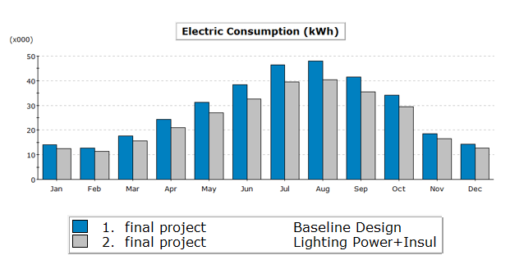
Comparison between Base Case and Case Three
The total electric consumption saving was about 47400 kWh/year, which means that the annual bill dropped from 204762 NIS to 176322 NIS , about 13.9% saving.
 | Base Case (kWh *1000) | Case Three (kWh *1000) | % diff from Base Case
Space Cool | 265.07 | 231.56 | -12.6%
Space heat | 0.87 | 0.56 | -35.6%
Area lights | 30.35 | 16.76 | -44.8
Total |  |  | -93%

Slide 9
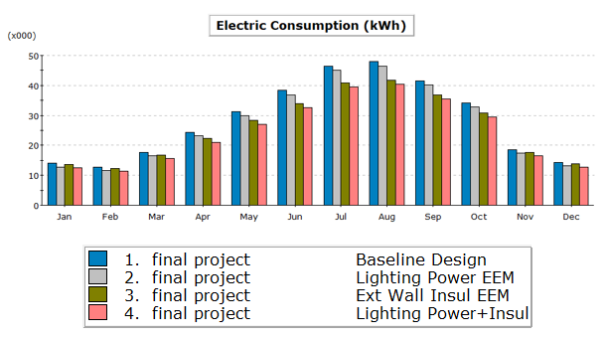
Simulation results
01
YOUR CONTENTS
Case One
Case Two
325800 kWh/year
309140 kWh/year
Base Case
Case Three
341270 kWh/year
293870 kWh/year

Slide 10
Economical Inputs

Slide 11
Economical data
Base Case
Case
One
  Initial cost = 0
  Initial cost = 10395 Nis
Estimated life =13000 hrs.
Estimated life =50000 hrs.
Lamp replacement cost= 9 Nis/lamp
Lamp replacement cost= 13 Nis/lamp
Operating hours =4015 hrs./year
Operating hours =4015 hrs./year
# of lamps=741
# of lamps=741

Slide 12

Case Two
Case
Three
  Initial cost = 30395 Nis
  Initial cost =20000
Estimated life =50000 hrs.
Lamp replacement cost= 13 Nis/lamp
Operating hours =4015 hrs./year
# of lamps=741
Electricity cost =0.6 Nis/kWh
Loan Payment =80%
Loan Period =3 years
MARR=10%
i=5%
Lifetime=25 years
Increase in Electricity cost =0.5%/year

Slide 13
Financial Analysis Results

Slide 14
LCCA for the 3 cases
01
01
Case1
Feasibility Analysis Results |  | Decision
Present value [Nis] | ₪62,603.14 | Feasible
Annual Worth [Nis/year] | ₪6,896.87 | Feasible
Simple payback Period [year] | 1.50
Discounted Payback period [years] | 1.50
Internal Rate of Return [%] | 71.8% | Feasible
02
Case2
Feasibility Analysis Results |  | Decision
Present value [Nis] | ₪162,618.41 | Feasible
Annual Worth [Nis/year] | ₪17,915.36 | Feasible
Simple payback Period [year] | 1.5
Discounted Payback period [years] | 1.5
Internal Rate of Return [%] | 97% | Feasible
03
Case3
Feasibility Analysis Results |  | Decision
Present value [Nis] | ₪234,827.07 | Feasible
Annual Worth [Nis/year] | ₪25,870.45 | Feasible
Simple payback Period [year] | 1.50
Discounted Payback period [years] | 1.50
Internal Rate of Return [%] | 91.5% | Feasible

Slide 15
What if the project was funded with a loan?
The bank usually takes very high guarantees and is satisfied with a little interest rate, and while the investor pumps this loan In a project like this, and he is confident of his profits, he begins to pay back the loan payments from what has been saved as a result of the implementation of the project, and after repaying the entire loan to the bank, he begins to reap the net profit that will be gained from the savings.

Slide 16
Comparison between cash &loan results
Cash Results
Loan Results
IRR
AW
IRR
AW
71.8% Case1
6896.14 NIS Case 1
187% Case 1
6976.4 NIS Case 1
97% case 2
17915.36 NIS Case 2
340% Case 2
18068.37 NIS Case 2
91.5% Case 3
25870.45 NIS Case 3
300% Case 3
26102.99 NIS Case 3

Slide 17
Sensitivity Analysis

Slide 18
Sensitivity Analysis
The effect of operation hours on NPV (cash)
The effect of electricity cost on NPV (cash)

Slide 19
Sensitivity Analysis
Interest rate
Interest rate VS NPV
Interest rate VS IRR

Slide 20
Sensitivity Analysis
Loan period
Loan period VS NPV
Loan period VS IRR

Slide 21
Sensitivity Analysis
Loan payments
Loan payments VS NPV
Loan payments VS IRR

Slide 22
Recommendations

Slide 23
Limitations
Recommendations for the hotel owner
The biggest challenge in the Life Cycle Cost Analysis study is that it takes place over a long period of the project’s life.
In order to be able to build the calculator on excel, we had to recalculate some of the given values in a ready-made way through the eQuest simulation program, which formed a slight difference in the final results.
.
Adding occupancy sensors.
Decreases frequency of switching and restart for the lighting system.
Use a different types of doors.
Take into consideration the presence of insulators in designing the HVAC system.
Reduce the number of windows and repair any cracks .
Install PV system to cover the load.

Slide 24
THANK YOU

