Slide 1
Eco Adventure
Ileen Shaar
Manar Mayyaleh
Dr.Mona Demaidi

Slide 2
TABLE OF CONTENTS
01
Motivation
02
Idea
03
Project’s Goal
04
Future Work

Slide 3

MOTIVATION
Sustainable Development Goals (SDGs) aim to ensure that all people can live in dignity and enjoy a better quality of life. Raising awareness about the importance of Sustainable Development Goal 13 on climate change among children is crucial as they will be the ones to inherit the consequences of the actions we take today.

Slide 4
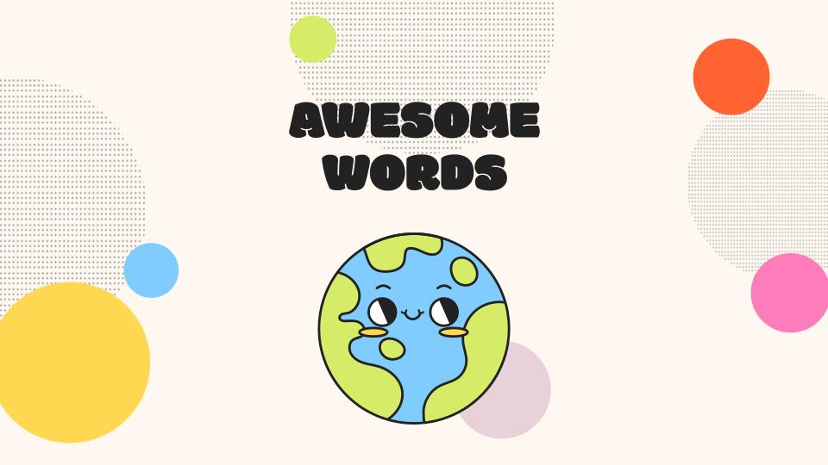
IDEA
Arabic-language smart educational mobile application for children. Age group targeted is 7-10-year-olds. This application aims to help kids understand what climate change means. Also, it introduces children to the concept of climate change, its consequences, and causes simply and clearly.

Slide 5
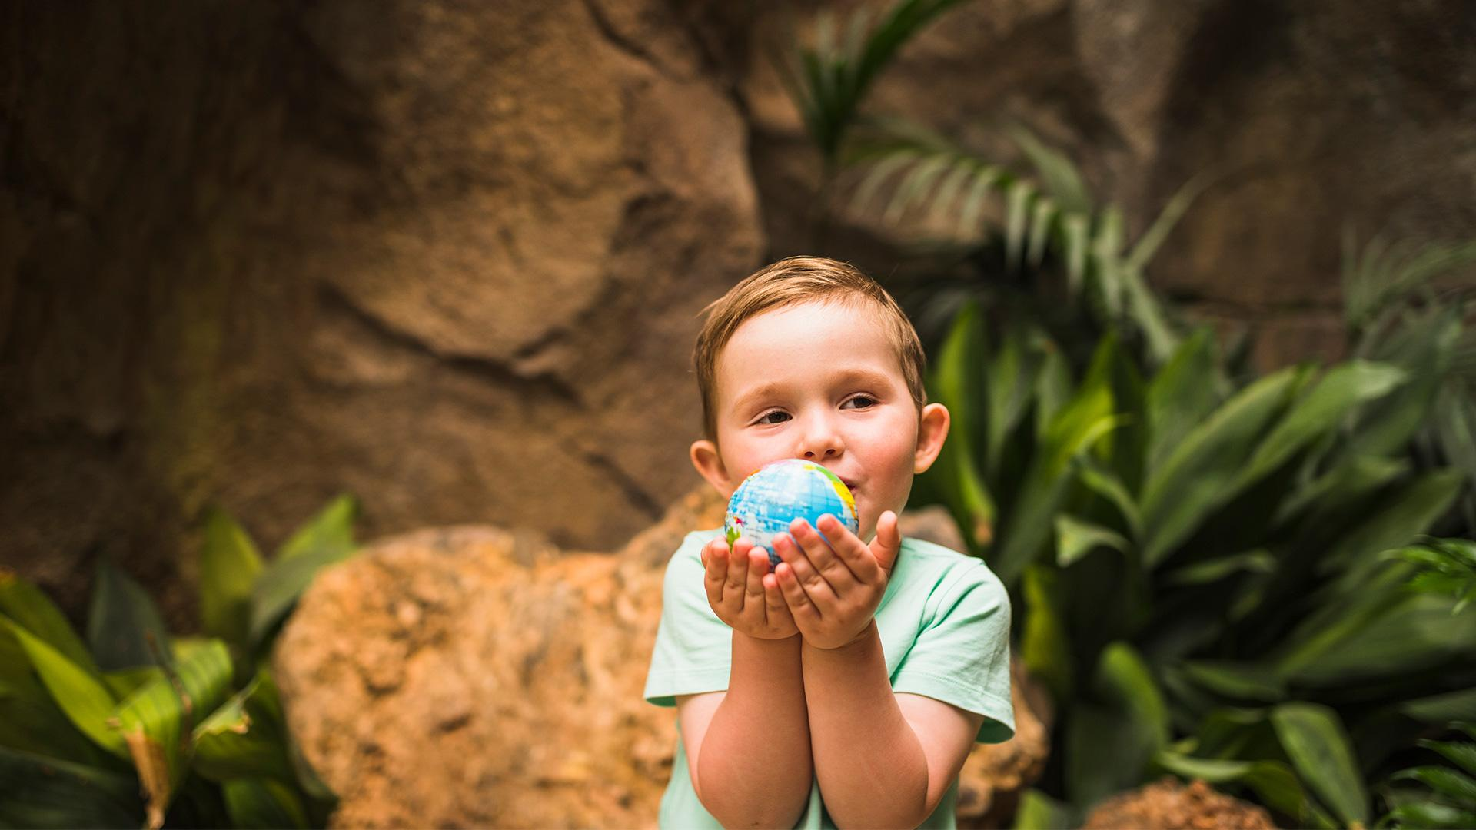
Project Goal
Educate Arabic kids about climate change in an amusing way.

Slide 6
Why did Climate change education in early grades has gained increased attention globally over the past few years
Increased awareness
Government initiatives
affecting the present
Climate Strike Movement

Slide 7
the benefits of teaching early grades about climate change
Increased understanding
Greater environmental awareness
Increased motivation to act
preventive measure
sustainable development

Slide 8
4 Levels
55%
75%
35%
Level 1
Level 3
Level 2
100%
Level 4
Level 4
What is Climate Change
Methods of prevention
Consequences
Causes

Slide 9
Game Engine
We used Unity and Visual Studio for IDE and use C# language.

Slide 10
Database
We used the database Playfab to track kids performance.

Slide 11
Feedback
Kids can give feedback about the game

Slide 12
Offline
It is possible to play the game without an Internet connection

Slide 13
Challenges
Language
1
2
Sound
Sign in
3
4
Testing

Slide 14
Testing
Kids Age
Gender
Result
7-10
90% Female
We noticed the interaction of the second and third grades with the game more than the first graders
10% Male

Slide 15
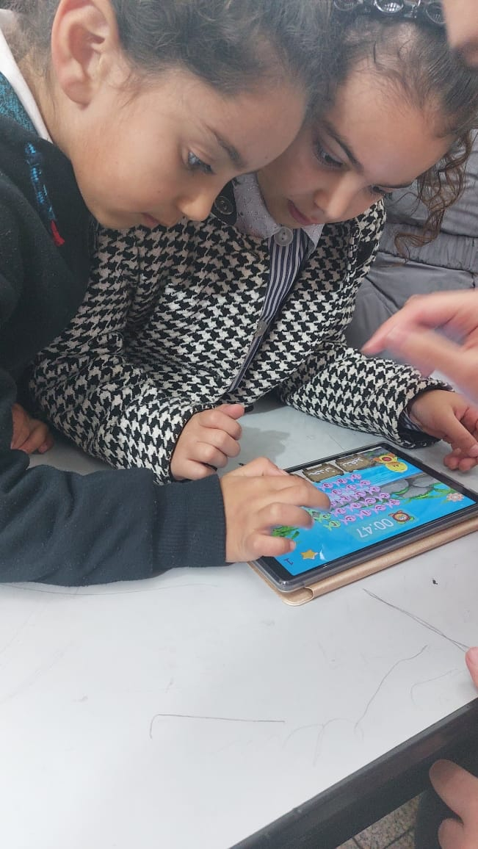
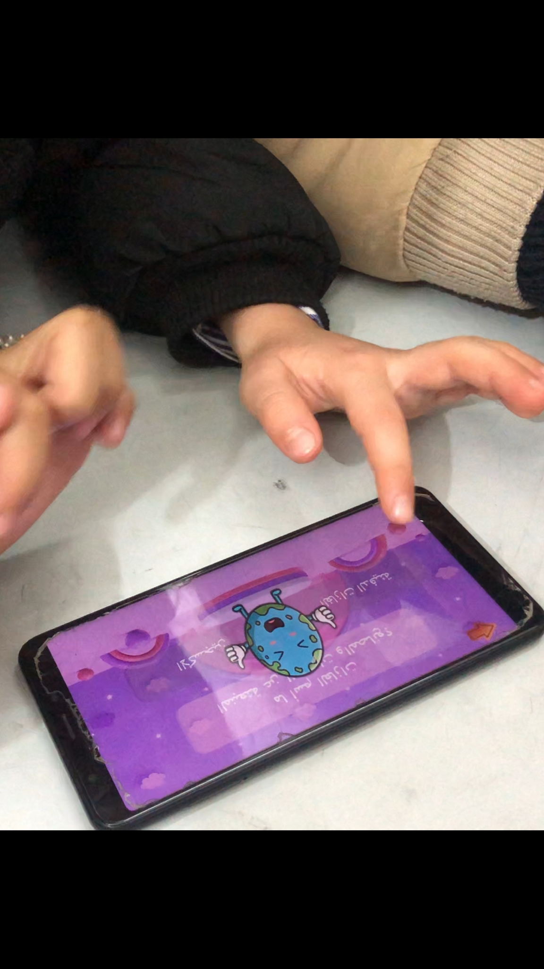
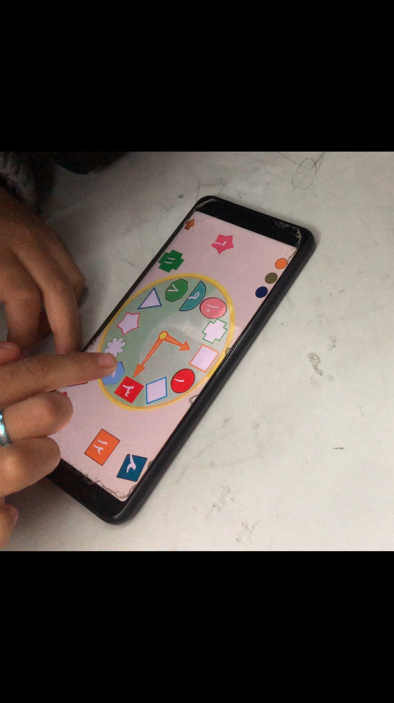

Slide 16
Future Work
1 Parental Dashboard: Create a web-based dashboard that parents can access with a login, where they can see their child's progress, scores, and performance statistics. This could include information such as the number of levels completed, the number of questions answered correctly, and the child's overall performance.
2 make the game available cross-platfom.
3 Continue to work on the remaining SDGs.

Slide 17
THANK YOUC !

