Slide 1
Structural Design of Commercial Building under Gravity and Seismic Loads
Prepared By:
Razan Zaidan Rawya Amarneh
Under Supervision of:
Dr. Mohammed Samaaneh.

Slide 2
Presentation Contents:
1- Project Description.
2- Site and Geological Information.
3- General Notes.
4- Preliminary Design of the Project.
5- 3D Modeling and Design of the Project.

Slide 3
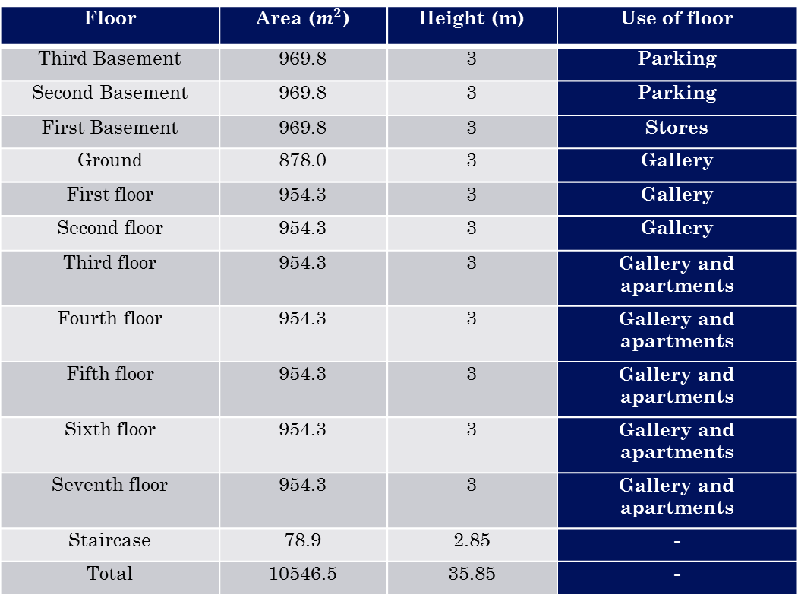
Project Description:
Use of floor | Height (m) | Area ($m^{2}$) | Floor
Parking | 3 | 969.8 | Third Basement
Parking | 3 | 969.8 | Second Basement
Stores | 3 | 969.8 | First Basement
Gallery | 3 | 878.0 | Ground
Gallery | 3 | 954.3 | First floor
Gallery | 3 | 954.3 | Second floor
Gallery and apartments | 3 | 954.3 | Third floor
Gallery and apartments | 3 | 954.3 | Fourth floor
Gallery and apartments | 3 | 954.3 | Fifth floor
Gallery and apartments | 3 | 954.3 | Sixth floor
Gallery and apartments | 3 | 954.3 | Seventh floor
- | 2.85 | 78.9 | Staircase
- | 35.85 | 10546.5 | Total

Slide 4
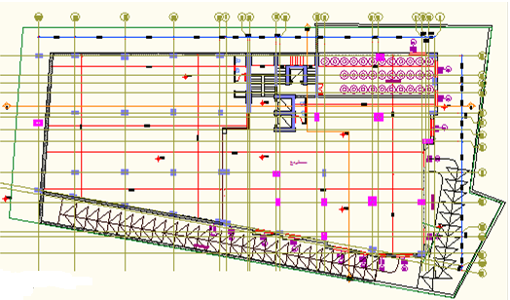
Basment Floors Plan.

Slide 5
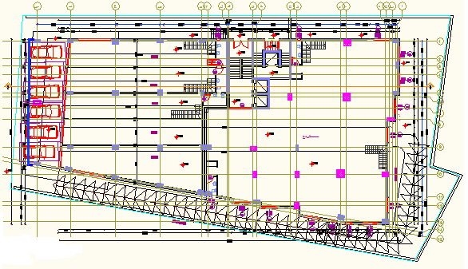
Ground Floor Plan

Slide 6
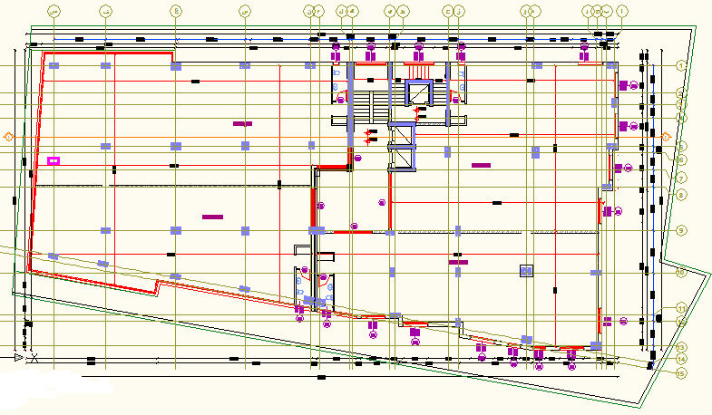
Upper Floors Plan.

Slide 7
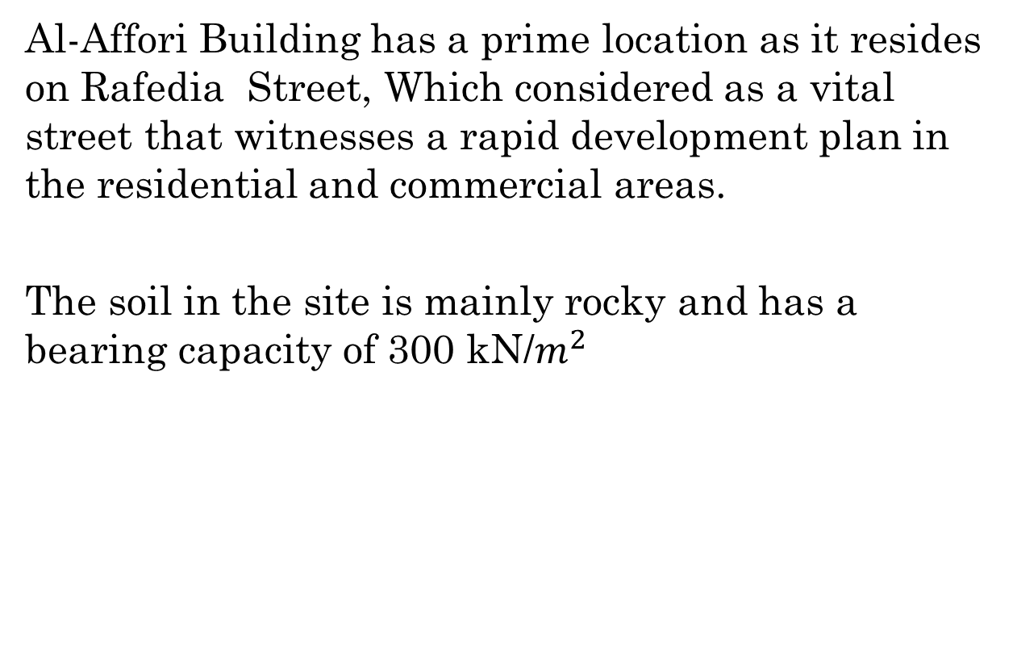
Site Geological and Information:
Al-Affori Building has a prime location as it resides on Rafedia Street, Which considered as a vital street that witnesses a rapid development plan in the residential and commercial areas.
The soil in the site is mainly rocky and has a bearing capacity of 300 kN/$m^{2}$

Slide 8
General notes:
1- Concrete compressive strength = 24 Mpa.
2- Steel yield strength of 420 Mpa.
3- The soil bearing capacity is 250 kn/m^2.
4- Design Codes:
ACI 318-11.
ASCE 7-10.
UBC 97.
5- Design Programs:
SAP2000 program.
SAFE Program.
AutoCAD.

Slide 9
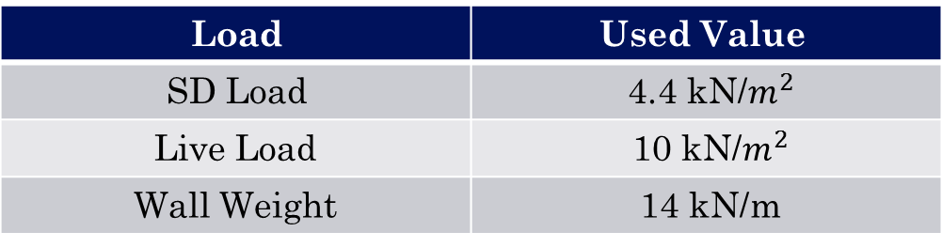
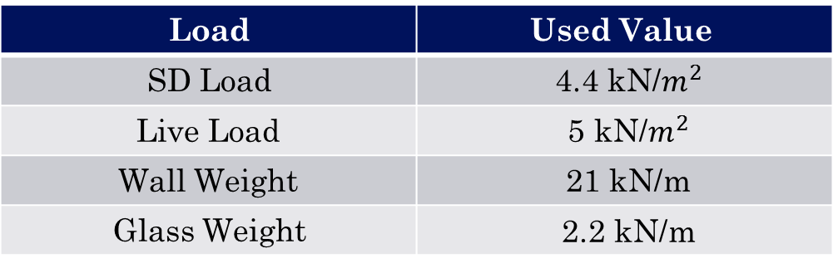
5- Design loadings:
All floors expect the roof floor:
- Roof Floor:
Used Value | Load
4.4 kN/$m^{2}$ | SD Load
5 kN/$m^{2}$ | Live Load
21 kN/m | Wall Weight
2.2 kN/m | Glass Weight
Used Value | Load
4.4 kN/$m^{2}$ | SD Load
10 kN/$m^{2}$ | Live Load
14 kN/m | Wall Weight

Slide 10
Preliminary Design of the Structure

Slide 11
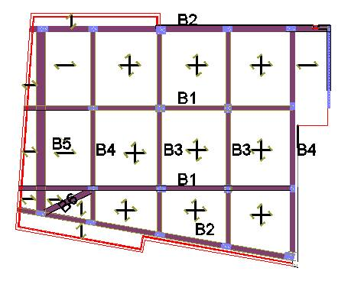
Structural system

Slide 12
Analysis and Design using SAP program

Slide 13
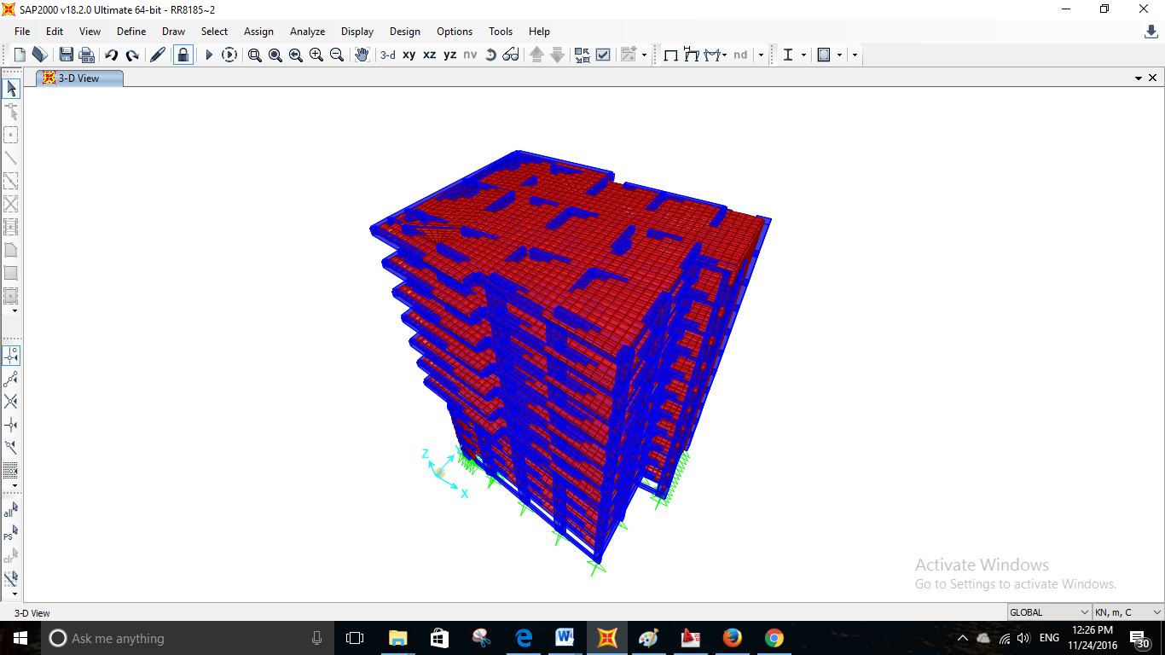
3D model of structure

Slide 14
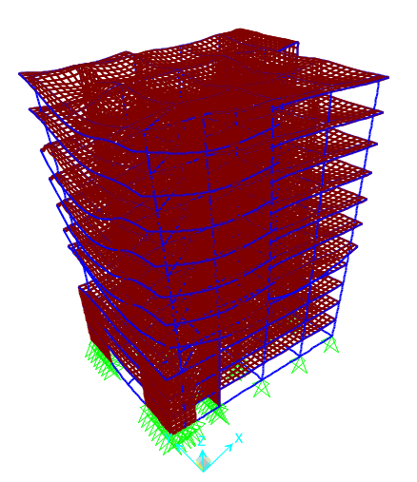
Check of model
Compatibility check

Slide 15
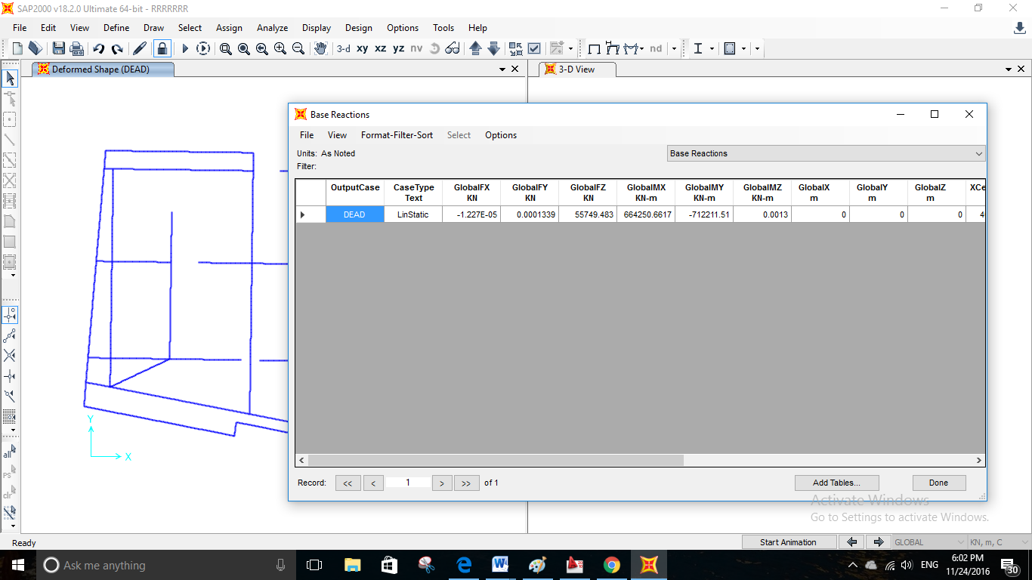

Equilibrium check
Total hand calculation Dead load = 55406.62 kN.
SAP result = 55749.483 kN.
Percent of error = $\frac{55749.483−55406.62}{55749.483}$ *100% = 0.62% < 5% → OK.

Slide 16
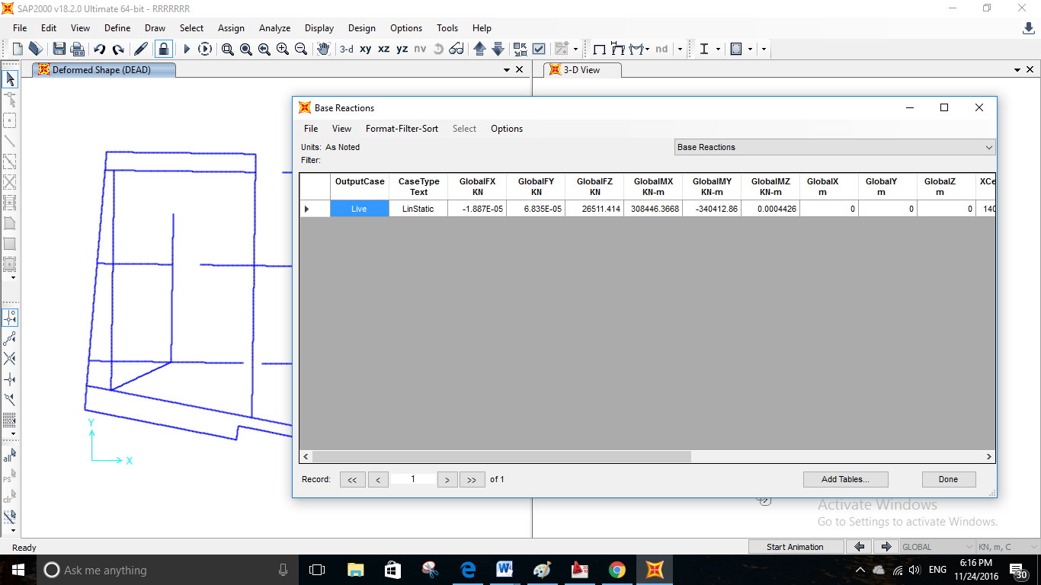

Live load:
Hand calculation:
{(427.8896*3+342.5+457.1*6)*5} +{ (457.1)*10}=26415 kN.
SAP result = 26511.4 kN.
Percent of error = $\frac{26511.4−26414.8}{26511.4}$ * 100% = .36%.

Slide 17
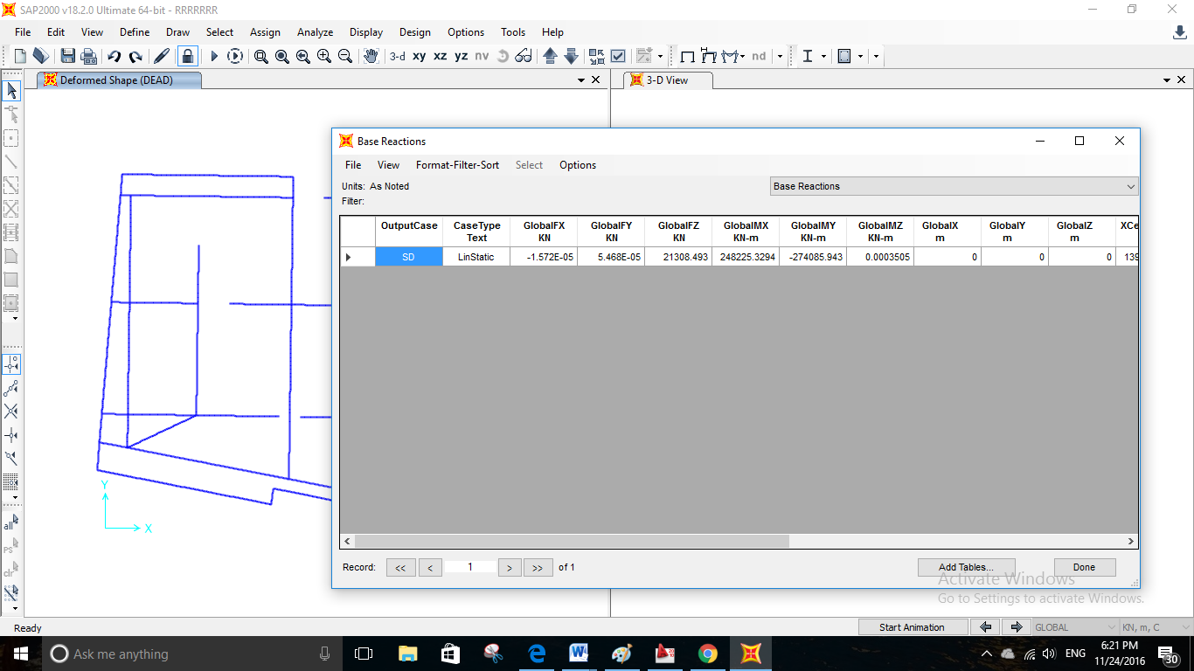

Super Imposed load
Hand Calculation
- Super Imposed load = slabs areas * 4.4 = 4825.8*4.4 = 21233.5 kN.
SAP result = 21308.5 kN.
Percent of error = $\frac{21308.5−21233.5}{21308.5}$ * 100% = .35%.< 5% Ok.

Slide 18
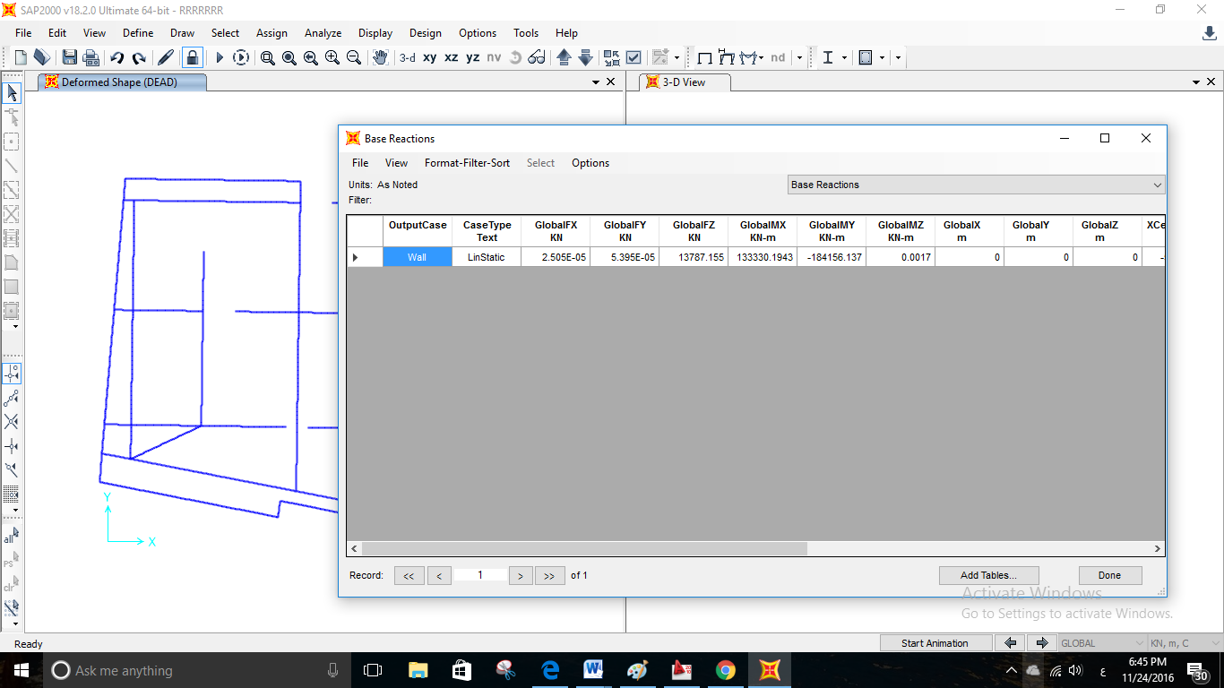

Wall weight:
Hand Calculation:
Wall weight =(78.5*3+39.4+55*6) * 21+75.2*14 = 13755 kN.
SAP result = 13787.2 kN.
Percent of error = $\frac{13787.2−13755}{13787.2}$ * 100% = .23% < 5% Ok.

Slide 19


Glass weight:
Hand Calculation:
- Glass weight = (16.23+18.44*6)*2.2 = 279.114 kN.
SAP result = 279.2 kN.
Percent of error = $\frac{279.2−279.114}{279.2}$ * 100% = .03% < 5% Ok.

Slide 20
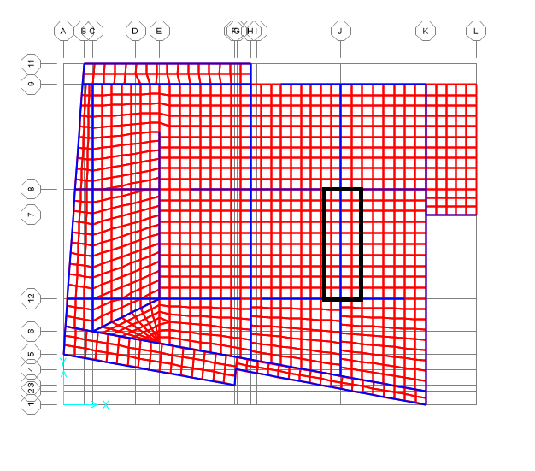

Stress Strain relationship
Slab:
${Moment}_{(1D)}$ =$\frac{42.588+26.66}{2}$ + 19.3 = 53.924 kN.m
${Moment}_{(SAP, Ultimate)}$ = $\frac{35.73+26.8}{2}$ + 24.3 = 55.55 kN.m
% of error = $\frac{55.55−53.924}{55.55}$ * 100% = 2.9% < 5% → ok.

Slide 21
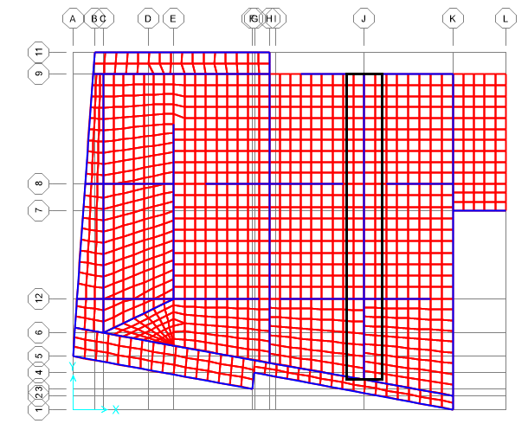

Stress Strain relationship
Beam:
${Moment}_{(1D)}$ =$\frac{22.76+10.33}{2}$ + 16 = 32.5 kN.m
${Moment}_{(SAP, Ultimate)}$ = $\frac{10.2+17.68}{2}$ + 16.45 = 30.4 kN.m
% of error = $\frac{32.5−30.4}{32.5}$ * 100% = 6.5% < 10 % → ok.

Slide 22
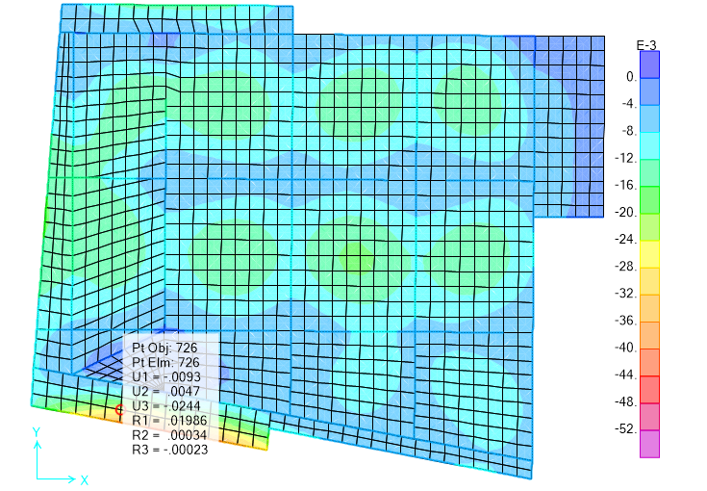
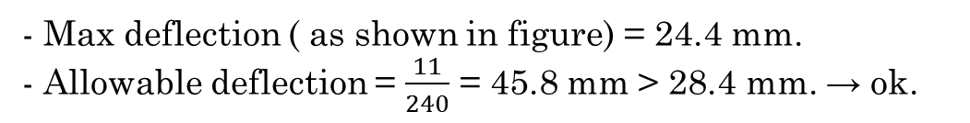
Check deflection
Slab deflection from service load:
- Max deflection ( as shown in figure) = 24.4 mm.
- Allowable deflection = $\frac{11}{240}$ = 45.8 mm > 28.4 mm. → ok.

Slide 23
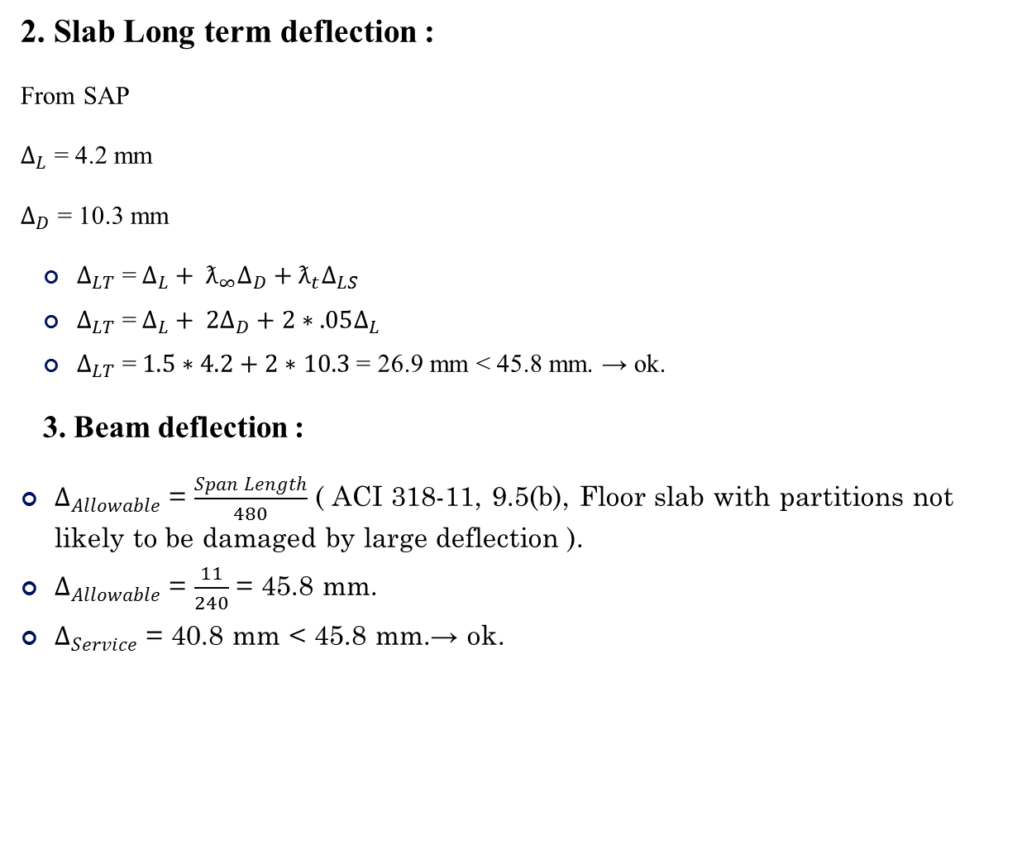
2. Slab Long term deflection :
From SAP
$∆_{L}$ = 4.2 mm
$∆_{D}$ = 10.3 mm
$∆_{LT}$ =$∆_{L}+ ƛ_{∞}∆_{D}+ƛ_{t}∆_{LS}$
$∆_{LT}$ =$∆_{L}+ 2∆_{D}+2∗.05∆_{L}$
$∆_{LT}$ =$1.5∗4.2+2∗10.3$= 26.9 mm < 45.8 mm. → ok.
3. Beam deflection :
$∆_{Allowable}$ = $\frac{Span Length}{480}$ ( ACI 318-11, 9.5(b), Floor slab with partitions not likely to be damaged by large deflection ).
$∆_{Allowable}$ = $\frac{11}{240}$ = 45.8 mm.
$∆_{Service}$ = 40.8 mm < 45.8 mm.→ ok.

Slide 24
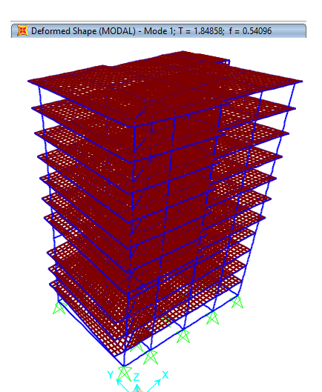
From Section 1630.2.2 in UBC 97:
T = (Ct) (hn) ^ ^{(3/4)}
T= (0.03) (108.27) ^^{0.75} = 1 sec.
SAP Result:
T = 1.85 sec.

Slide 25
Seismic Analysis of the Structure

Slide 26
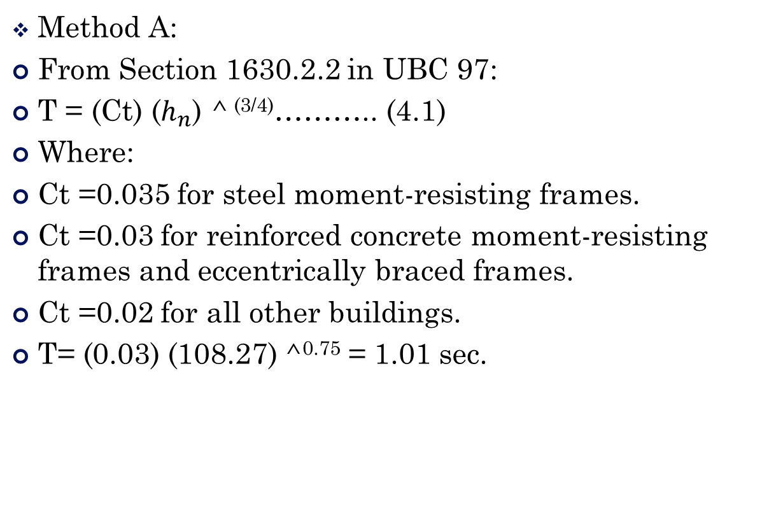
Period Calculations
Method A:
From Section 1630.2.2 in UBC 97:
T = (Ct) ($h_{n}$) ^ ^{(3/4)}……….. (4.1)
Where:
Ct =0.035 for steel moment-resisting frames.
Ct =0.03 for reinforced concrete moment-resisting frames and eccentrically braced frames.
Ct =0.02 for all other buildings.
T= (0.03) (108.27) ^^{0.75} = 1.01 sec.

Slide 27
SAP2000 Program:
The Value from SAP must be smaller than (1.4* T _{Method-A})
X-direction:-
T = 1.4 Sec.
(1.4) ( T_{method A}) = (1.4*1.01) = 1.414 Sec. > 1.4 Sec →OK
B. Y- direction:-
T = 1.28 Sec.
(1.4) ( T_{method A}) = (1.4*1.01) = 1.414 Sec. > 1.28 Sec →OK

Slide 28
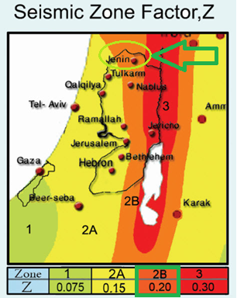
Seismic Analysis of the Structure:
Determine seismic zone factor (Z):

Slide 29
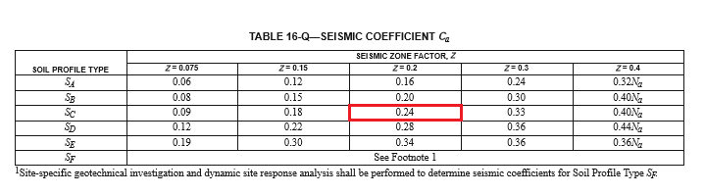
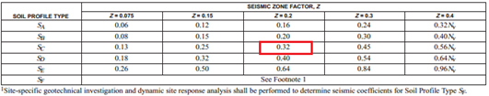
Determine site soil classification:
- The Soil profile is found to be (SC).
Determine (Ca) and (Cv) based on site soil classification:
- Seismic coefficients: Ca = 0.24, Cv = 0.32

Slide 30
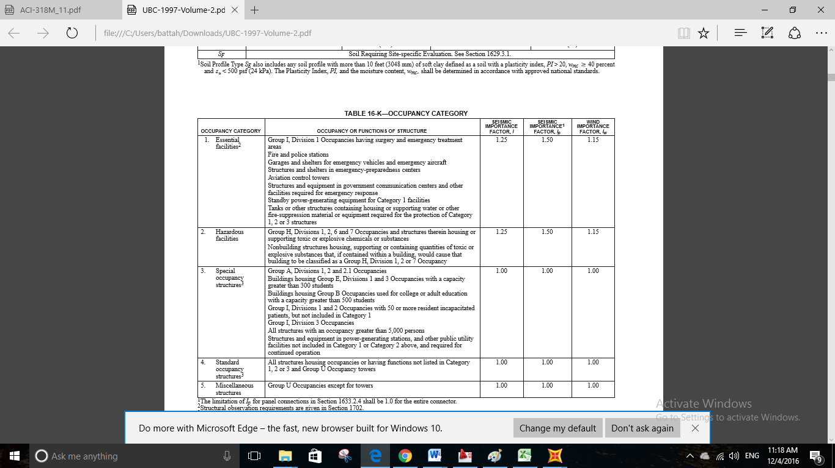
Determine occupancy type:
I = Importance Factor: From table 16-K—occupancy category in UBC-97.
I = 1.00 (Standard Occupancy Structures).

Slide 31
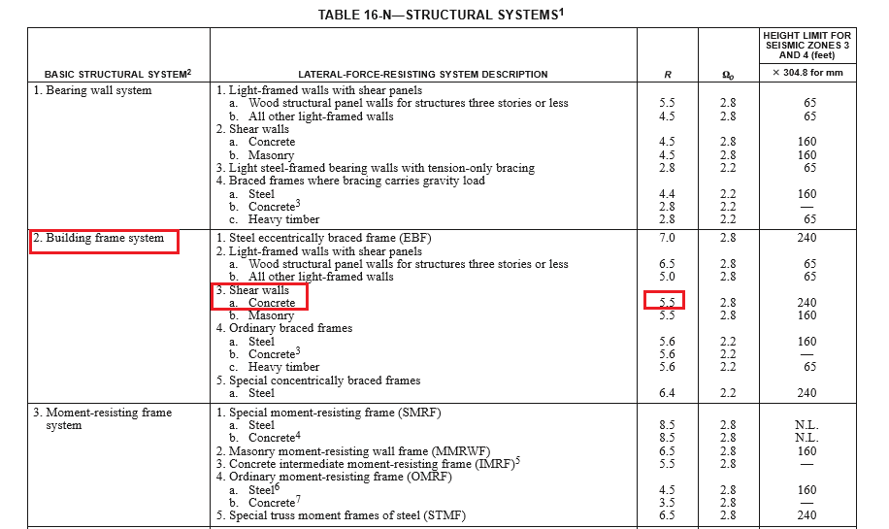
Determine modification factor(R):

Slide 32
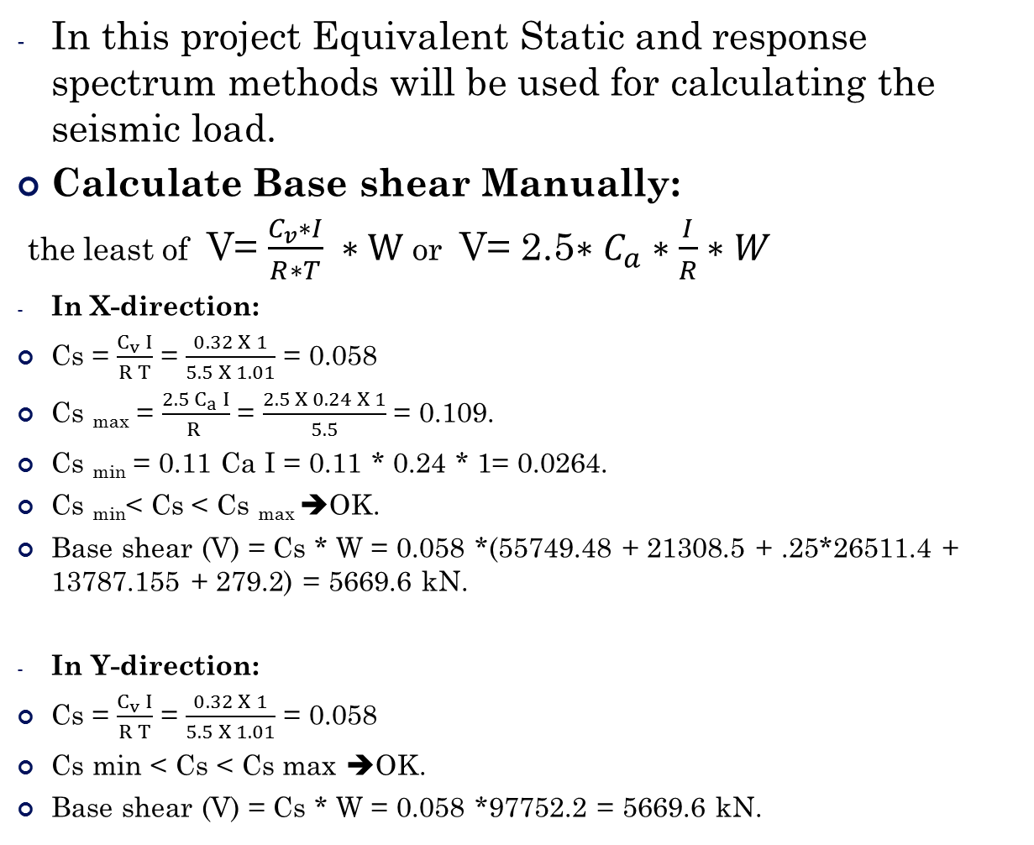
In this project Equivalent Static and response spectrum methods will be used for calculating the seismic load.
Calculate Base shear Manually:
the least of V= $\frac{C_{v}∗I}{R∗T} ∗W$ or V= 2.5$∗C_{a}∗\frac{I}{R}∗W$
In X-direction:
Cs = $\frac{C_{v} I}{R T}$ = $\frac{0.32 X 1}{5.5 X 1.01}$ = 0.058
Cs _{max} = $\frac{2.5 C_{a} I}{R }$ = $\frac{2.5 X 0.24 X 1}{5.5}$ = 0.109.
Cs _{min} = 0.11 Ca I = 0.11 * 0.24 * 1= 0.0264.
Cs _{min}< Cs < Cs _{max} ➔OK.
Base shear (V) = Cs * W = 0.058 *(55749.48 + 21308.5 + .25*26511.4 + 13787.155 + 279.2) = 5669.6 kN.
In Y-direction:
Cs = $\frac{C_{v} I}{R T}$ = $\frac{0.32 X 1}{5.5 X 1.01}$ = 0.058
Cs min < Cs < Cs max ➔OK.
Base shear (V) = Cs * W = 0.058 *97752.2 = 5669.6 kN.

Slide 33
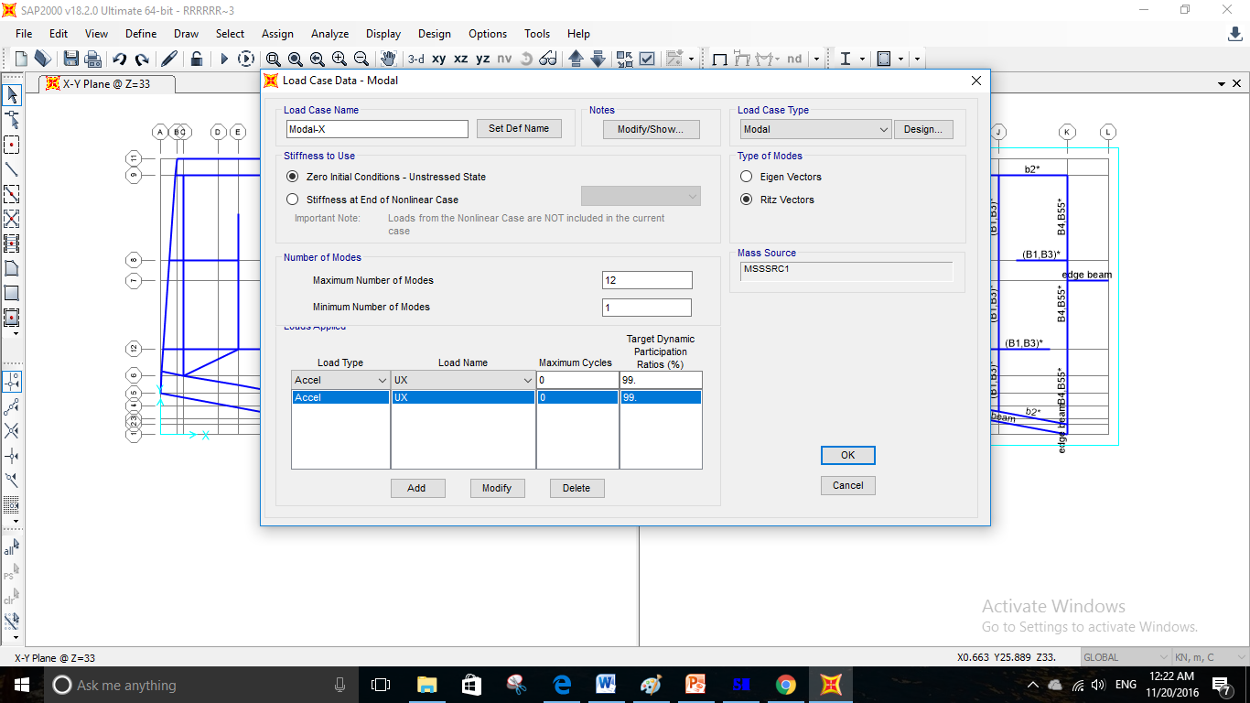
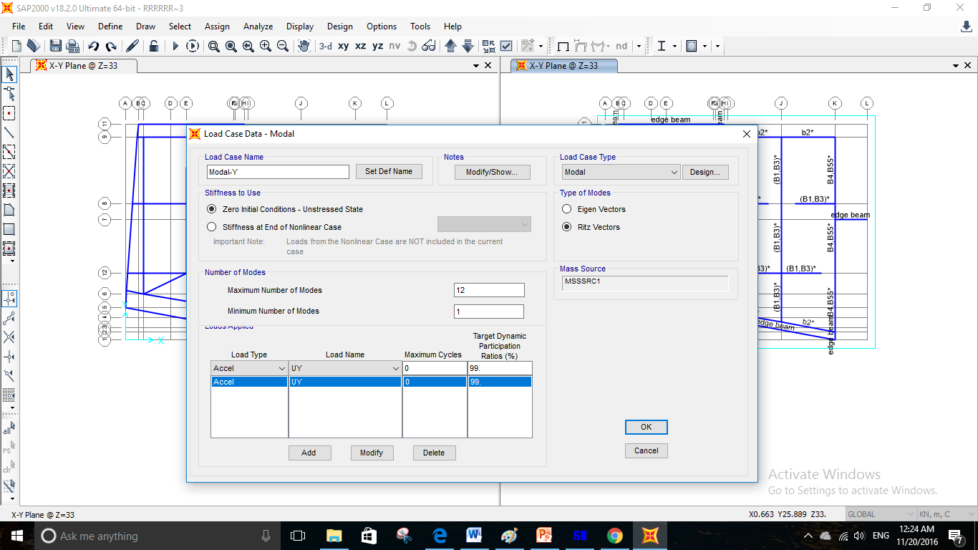
Seismic Analysis Basic Definitions :
- Define modal acceleration in X and Y according to (Ritz vectors).

Slide 34
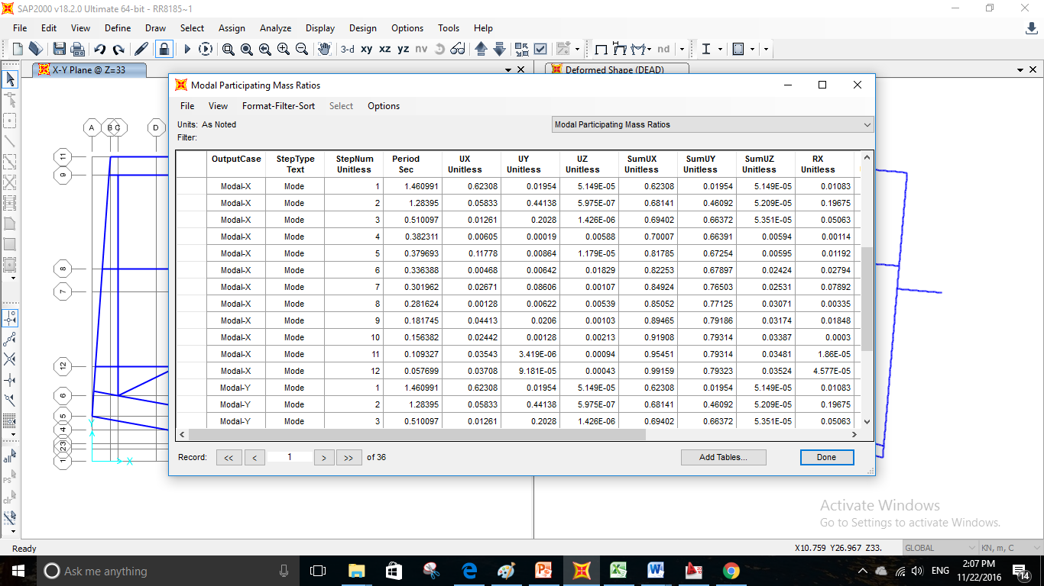
Modal Mass Participation Ratio in X-DIR

Slide 35
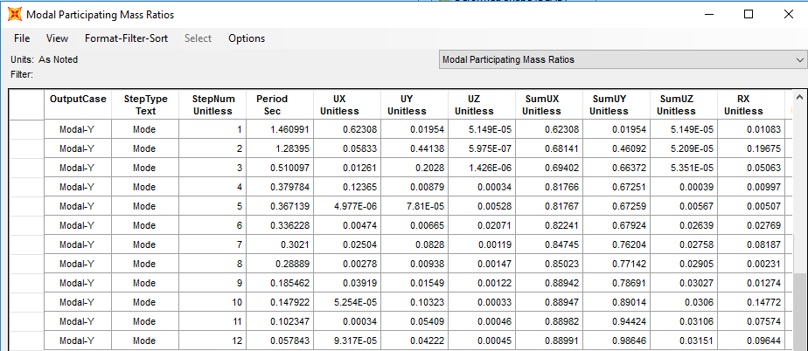
Modal Mass Participation Ratio in Y-DIR

Slide 36
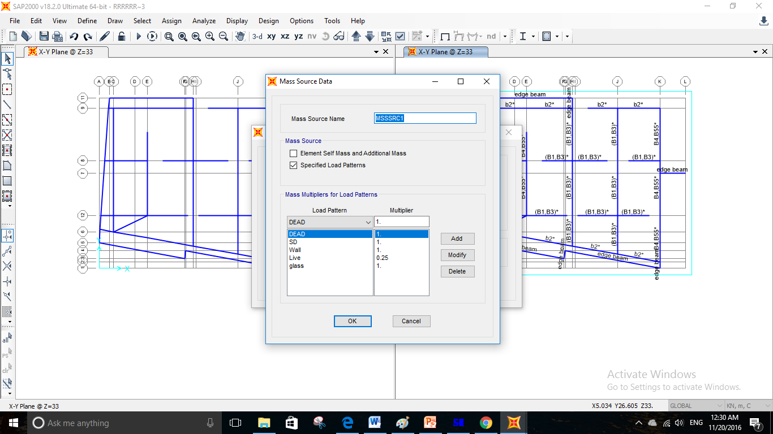
Define Mass Source:
Mass includes = mass of (Dead load + Superimposed dead load + 0.25 Live load + Wall and Glass load).

Slide 37
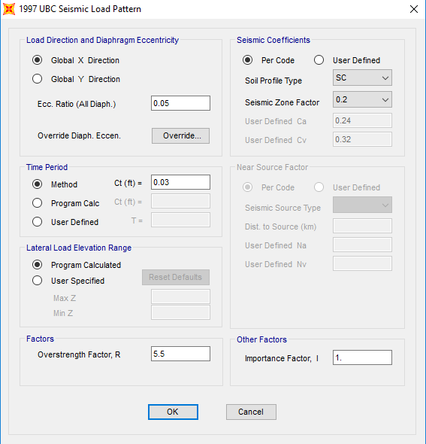
Equivalent static method:
Define function of Equivalent static:
1- In X-Dir:

Slide 38
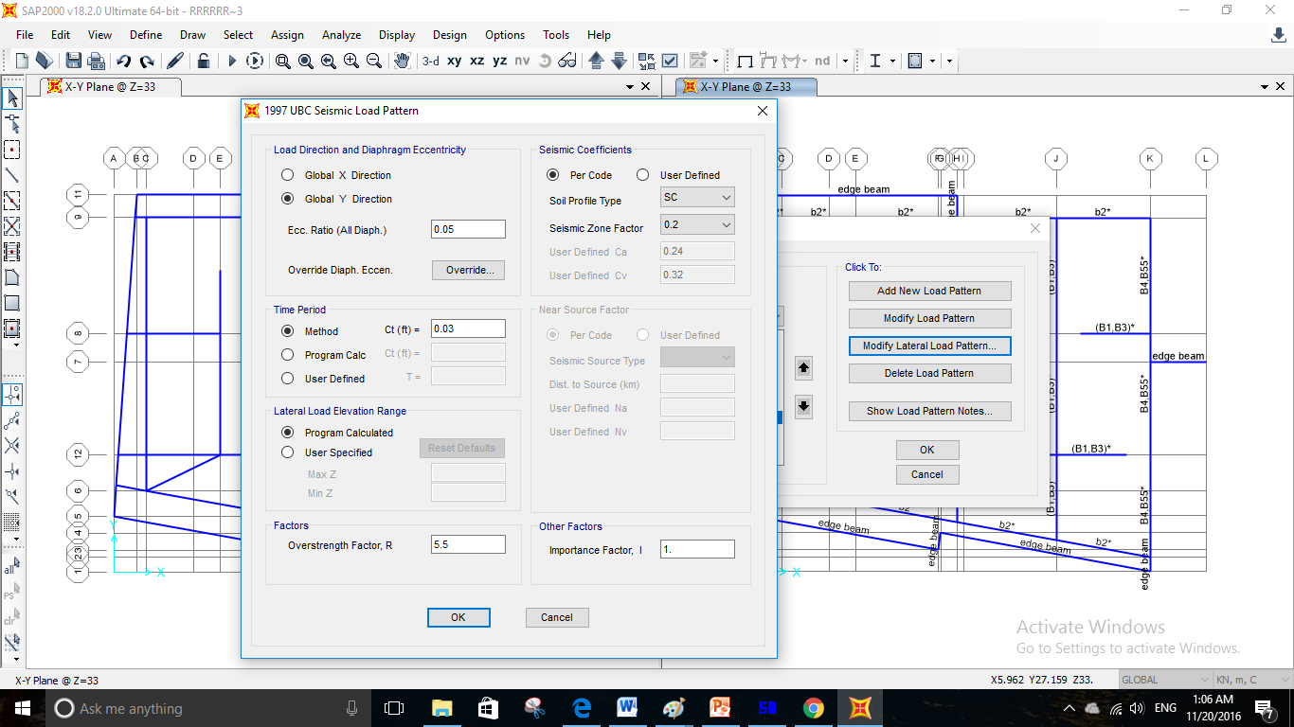
2- In Y-Dir:

Slide 39
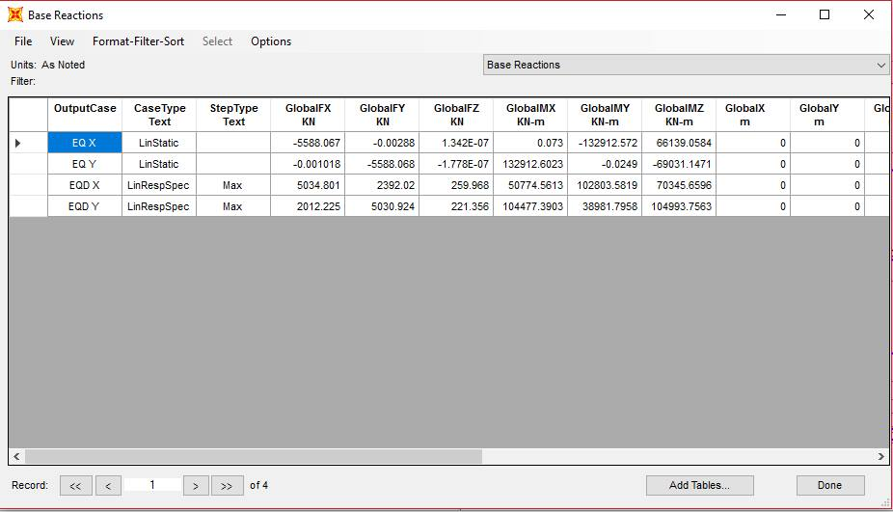

Base Reactions SAP Results:
Percent of error = $\frac{5669.6−5588.067}{5669.6}$ *100%1.4 =.% < 5% → ok.

Slide 40
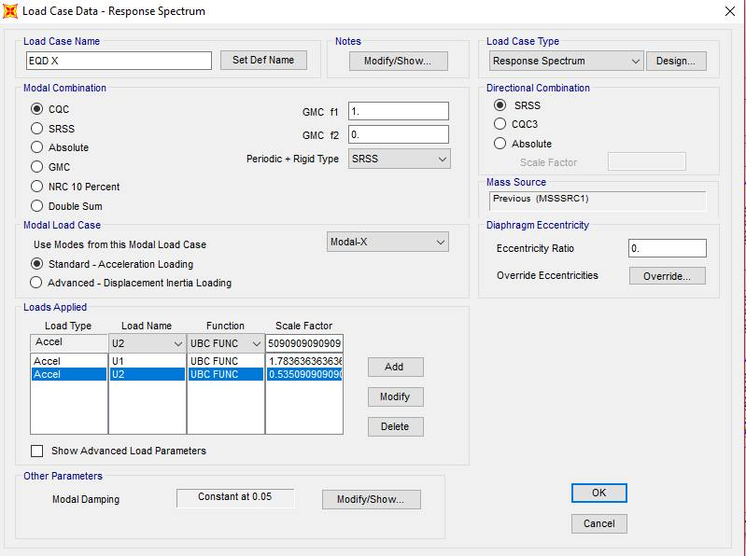
Response Spectrum method:
Define function of Response Spectrum:
1- In X-Dir:

Slide 41
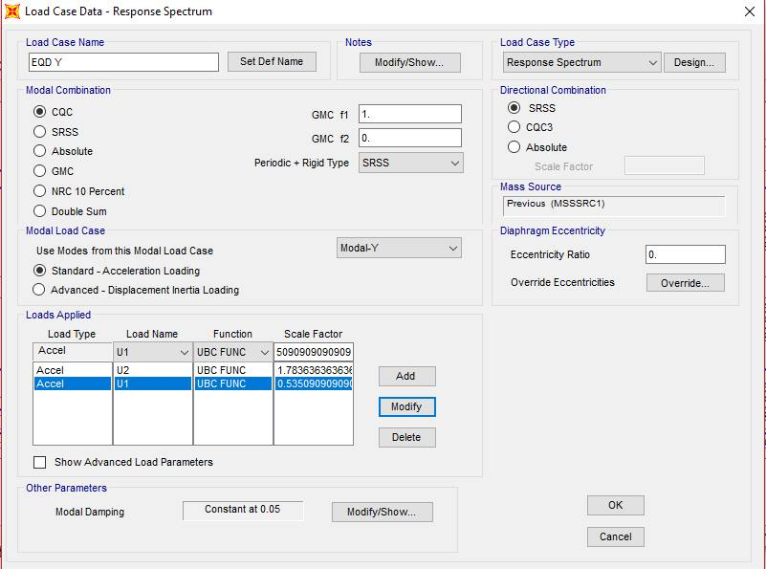
2- In Y-Dir:

Slide 42
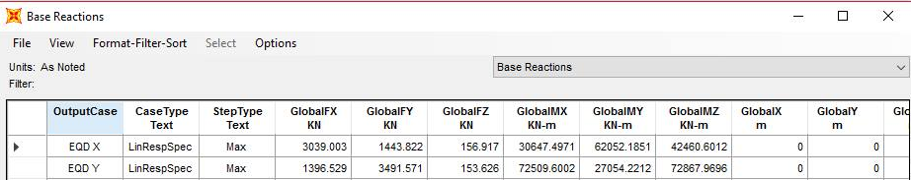

Base Reactions SAP Results:
Percent of error (in X-Dir) = $\frac{5669.6−3039.003}{5669.6}$ *100% = 46.4 > 25% →Not ok.
Percent of error (in Y-Dir) = $\frac{5669.6−3491.571}{5669.6}$ *100% = 38.4 > 25% →Not ok.

Slide 43
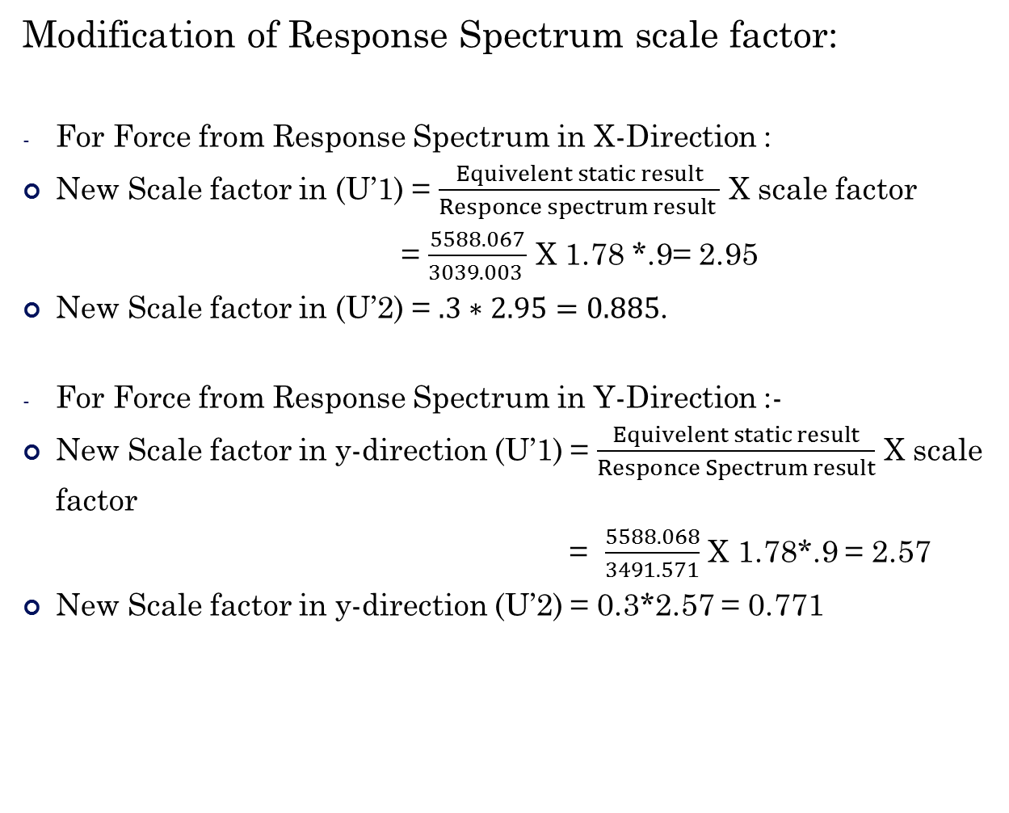
Modification of Response Spectrum scale factor:
For Force from Response Spectrum in X-Direction :
New Scale factor in (U’1) = $\frac{Equivelent static result}{Responce spectrum result }$ X scale factor
= $\frac{5588.067}{3039.003 }$ X 1.78 *.9= 2.95
New Scale factor in (U’2) = $.3∗2.95=0.885$.
For Force from Response Spectrum in Y-Direction :-
New Scale factor in y-direction (U’1) = $\frac{Equivelent static result}{Responce Spectrum result}$ X scale factor
= $\frac{5588.068}{3491.571}$ X 1.78*.9 = 2.57
New Scale factor in y-direction (U’2) = 0.3*2.57 = 0.771

Slide 44

So, after make analysis we get the expected results:
Percent of error (in X-Dir) = $\frac{5588.067−5034.801}{5588.067}$ *100% = 9.9% < 25% → ok.
Percent of error (in Y-Dir) = $\frac{5588.068−5030.924}{5588.068}$ *100% = 10% < 25% → ok.

Slide 45
Structural Design of Concrete Members
The code used for design and detailing is ACI 318-11 regarding seismic and gravity loads.
Provisions were applied to all structural members including:
  Beams
  Columns
  Shear Walls
  slabs
  Foundations

Slide 46
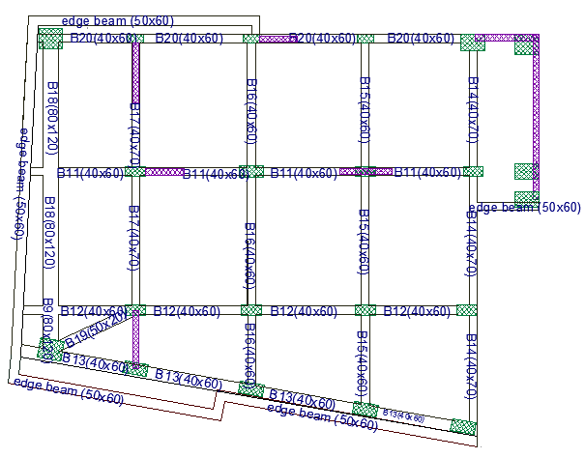
Structural Design of Concrete Members
Beams layout for the roof

Slide 47
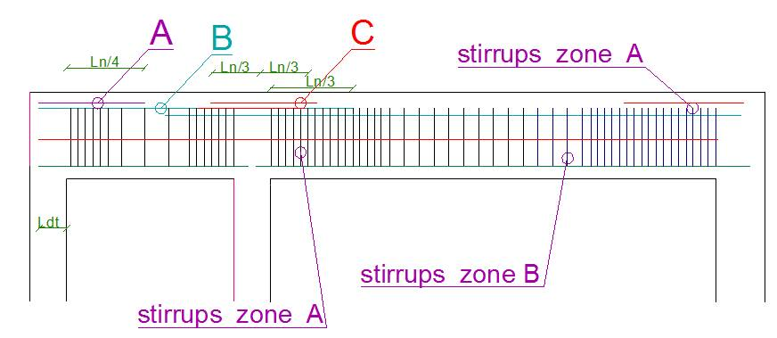
Structural Design of Concrete Members
for B20
key for reinforcement

Slide 48

Structural Design of Concrete Members
Longitudinal steel

Slide 49

Structural Design of Concrete Members
Stirrups

Slide 50


Structural Design of Concrete Members
Beams detailing

Slide 51

Structural Design of Concrete Members
Column layout

Slide 52



Structural Design of Concrete Members
Check slenderness :
For C10

Slide 53


Structural Design of Concrete Members
M2 =13.2 kN.m
M1 =33 kN.m

Slide 54


Structural Design of Concrete Members
Design load

Slide 55

Structural Design of Concrete Members

Slide 56



Structural Design of Concrete Members
Columns detailing:

Slide 57

Structural Design of Concrete Members
Columns detailing:

Slide 58

Structural Design of Concrete Members
Shear wall:

Slide 59


Structural Design of Concrete Members
Shear Wall detailing:

Slide 60

Structural Design of Concrete Members
Slab detailing for basement

Slide 61

Structural Design of Concrete Members
Footing
SAFE model:
Mat thickness = 1.3 m

Slide 62

Structural Design of Concrete Members
Deflection check:
Max deflection =0.7172 mm < 10 mm → ok.

Slide 63

Structural Design of Concrete Members
Mat deleting (Y-direction)

Slide 64

Structural Design of Concrete Members
Mat deleting (X-direction)

Slide 65

The End

