Slide 1

An-Najah National University
Building Engineering Department
An Integrated Design Of A courthouse
Presented By:
Ibrahim Suwan
Omar Khader
Anas Abu Awad
Shahd Imer
Supervisor:
Eng. Abdulhakeem Juhari

Slide 2
Outline
Introduction.
Architectural Design.
Structural Design.
Mechanical Design.
Electrical Design.
Environmental Design.
Quantity Survey.

Slide 3
Introduction

Slide 4
Courthouse Definition
Definition:
courthouse is a governmental institution that settles disputes between two or more entities,

Slide 5
Courthouses Types
Types of regular courts in Palestine:
  Magistrates' court
  Lower Court.
  Appellate Court.

Slide 6
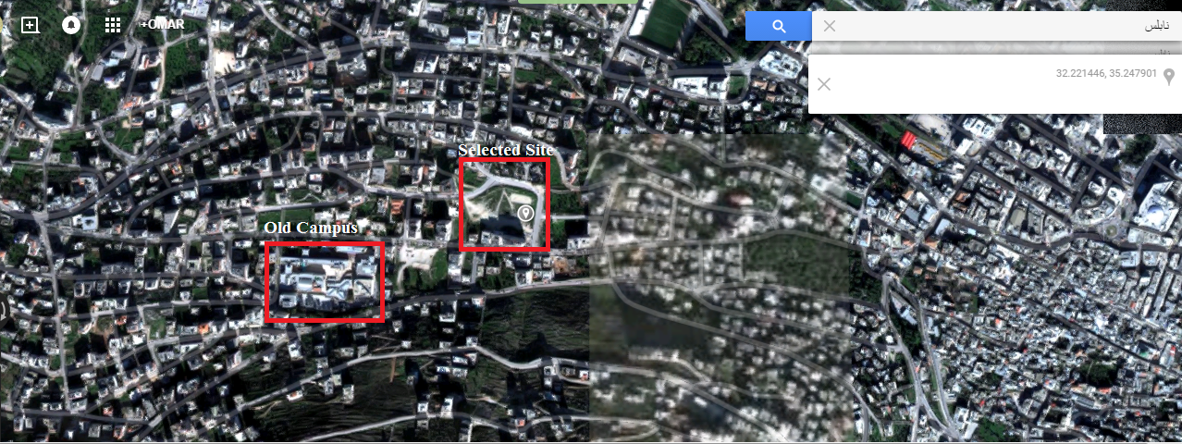
The Selected Site
The Selected site:
Design
Design

Slide 7
Architectural
Design

Slide 8
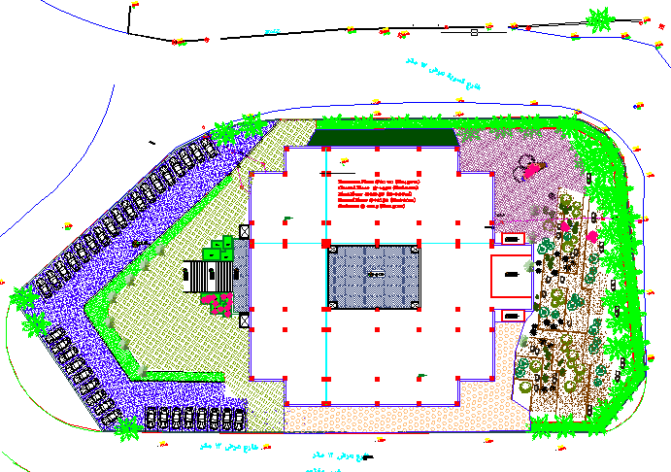
Site Plan
Site Plan

Slide 9
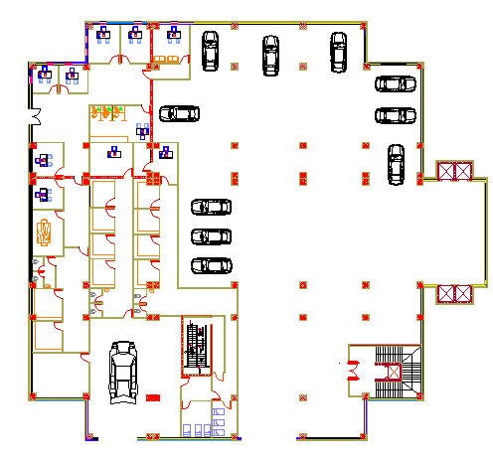
Architectural Plans
Basement Floor

Slide 10
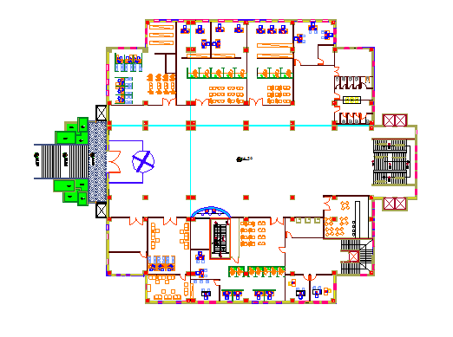
Architectural Plans cont.
Ground Floor

Slide 11
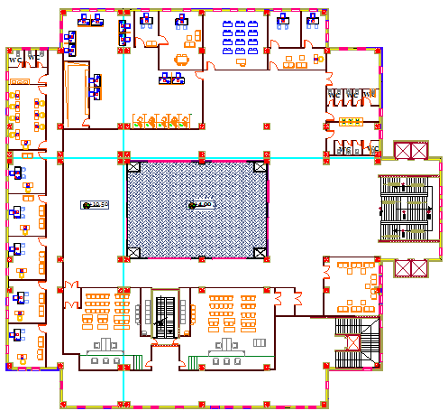
Architectural Plans cont.
First Floor

Slide 12
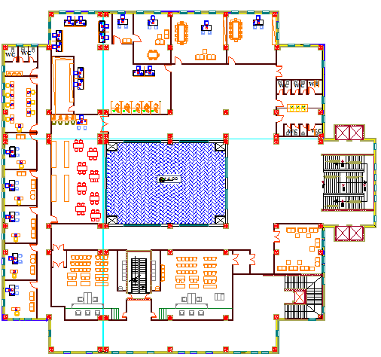
Architectural Plans cont.
Second Floor

Slide 13
Structural
Design

Slide 14
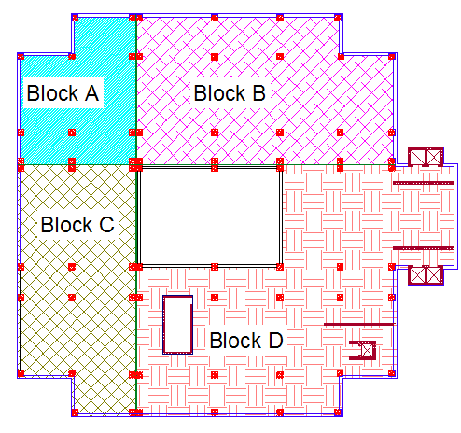
Seismic Joints and Blocks
The building consist of four blocks separated by 6 cm seismic joints

Slide 15
Materials
Materials:
Section | Material strength
Beams | 24 MPa (b300)
Slabs | 24 MPa (b300)
Columns | 28 MPa(b350)
Tie beam | 24 MPa (b300)
Footings | 28 MPa (b350)
Shear walls | 24 Mpa (b300)

Slide 16
Loads Calculation
Loads for block A:
Types of load | Load KN/m²
Dead Load (Own weight) | 5.95
Super Imposed | 4
Live Load | 5

Slide 17
Seismic Factors
Seismic Factors used in deign:
Soil type Sc and the bearing capacity of soil = 300 KN/m² .
Z=0.2
I=1.25
Cv=0.32
Ca=0.24
R=5.5

Slide 18
Structural Elements Design
Columns:
All Columns have dimensions of 80cm*80cm
Footing:
There are several types of footing:
Isolated footing.
Combined footing.
Wall footing .

Slide 19
Structural Elements Design cont.
Tie Beams:
All Tie beams have dimensions of 45cm*60cm.
Slabs:
 | Block A,C | Block B,D
Slab Thickness (cm) | 40 | 50

Slide 20
Structural Elements Design cont.
Beams:
Beam | Dim(h*b) m
External Main beam | 1.20*0.6
Internal Main beam | 1.20*0.8
Secondary beam | 0.6*0.6

Slide 21
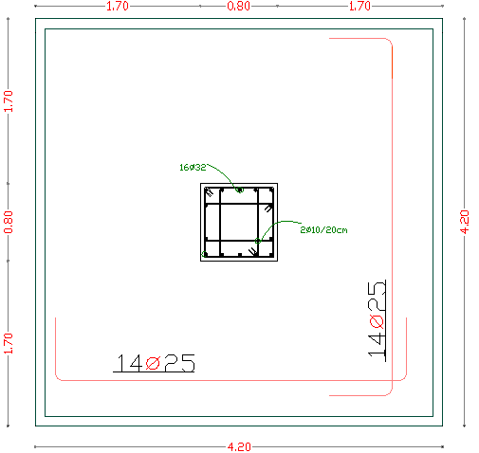
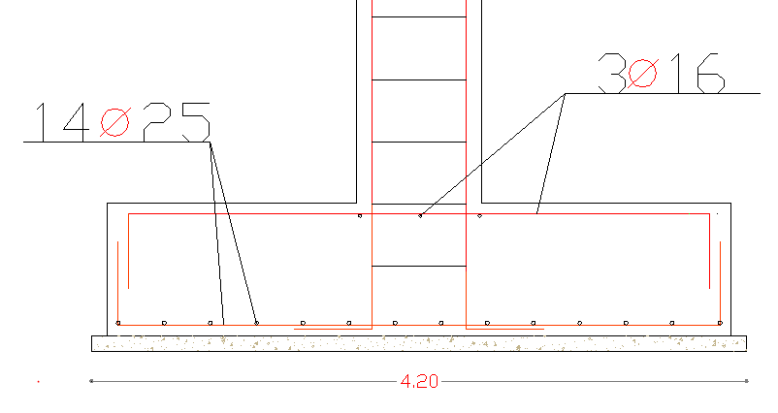
Structural Elements Details
Isolated footing :

Slide 22
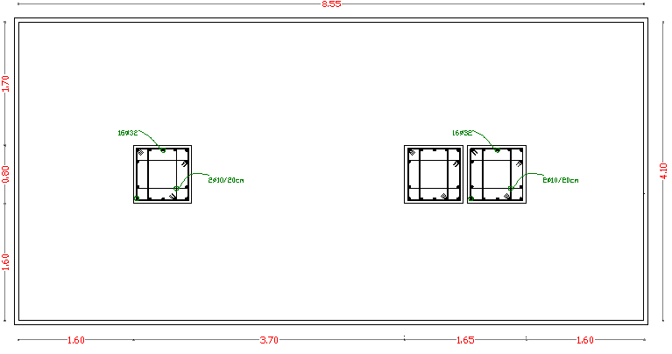
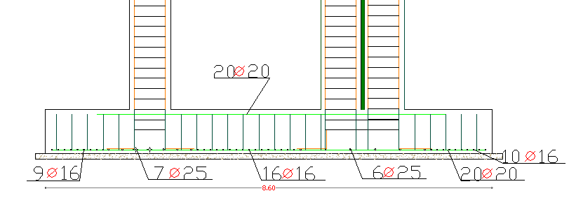
Structural Elements Details Cont.
Combined footing :

Slide 23
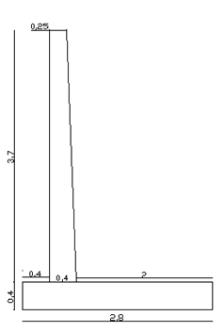
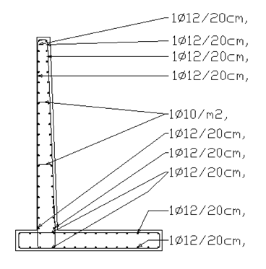
Structural Elements Details Cont.
Retaining Wall :

Slide 24
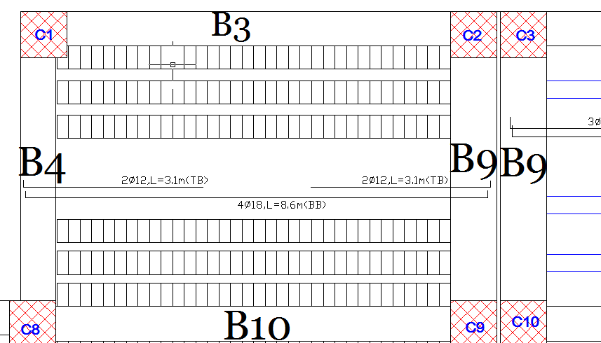
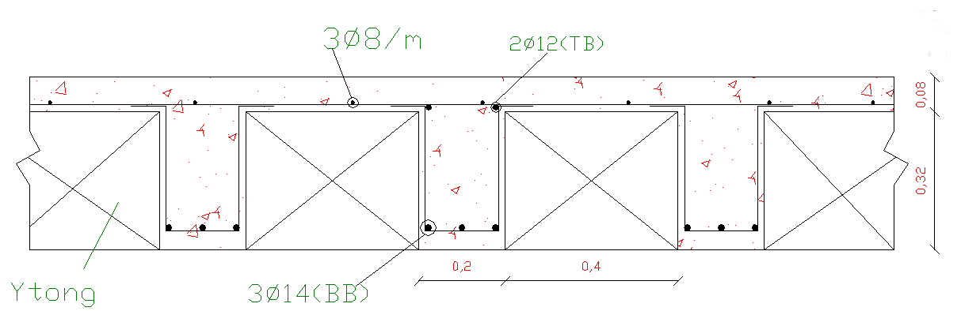
Structural Elements Details Cont.
Slab Design

Slide 25
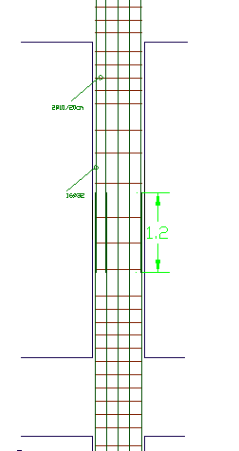
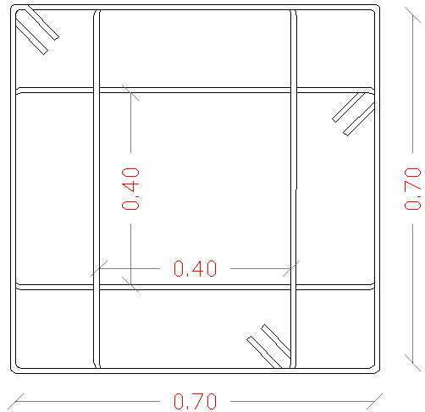
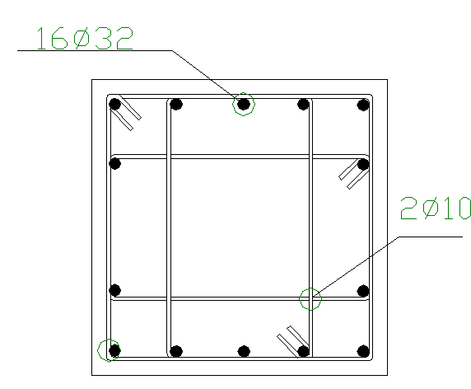
Structural Elements Details Cont.
Design for columns:

Slide 26
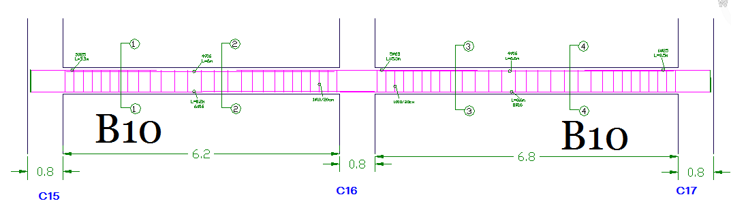
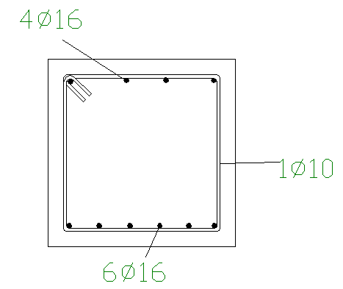
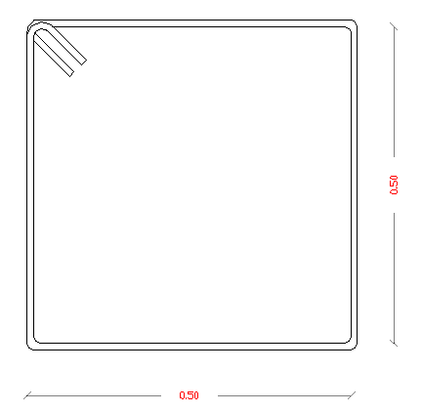
Structural Elements Details Cont.
Design for Beams:

Slide 27
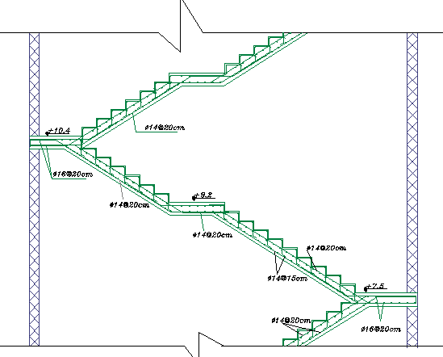
Structural Elements Details Cont.
Design for Staircase:

Slide 28
Mechanical
Design

Slide 29
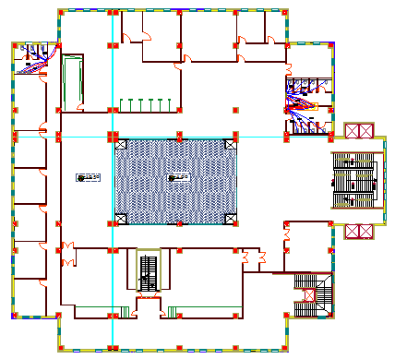
Water supply

Slide 30
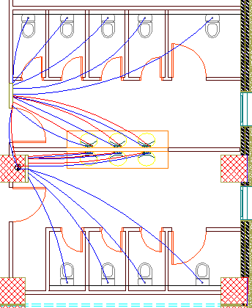
Water supply cont.

Slide 31
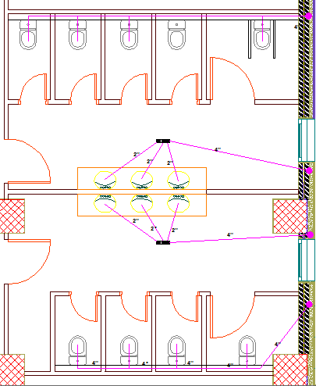
Drainage System

Slide 32
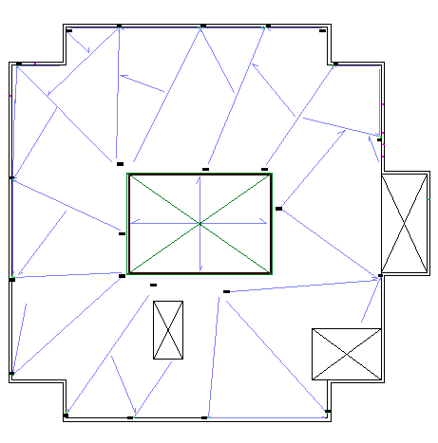
Rainwater Drainage

Slide 33
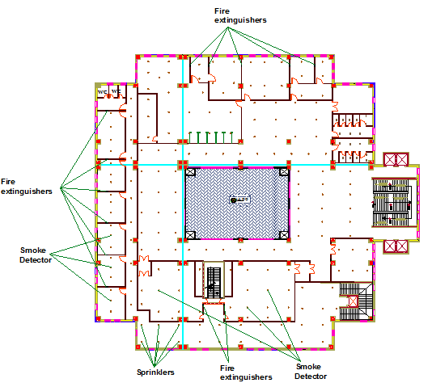
Fire Protection

Slide 34
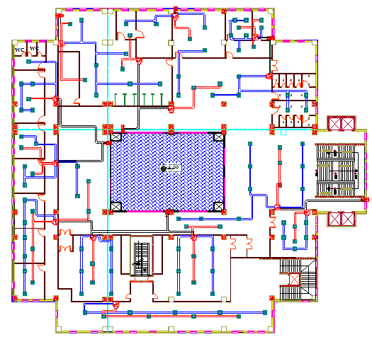
HVAC

Slide 35
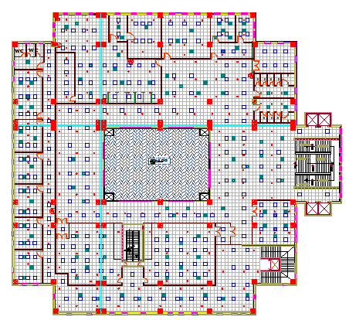
Sprinklers, HVAC & Luminaires

Slide 36
Electrical
Design

Slide 37
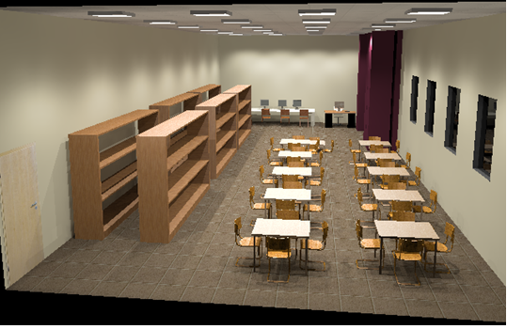
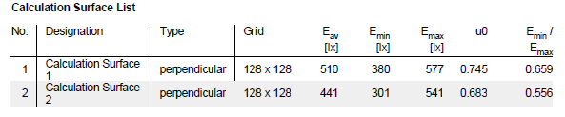
Lighting Design
Lighting design for the library

Slide 38
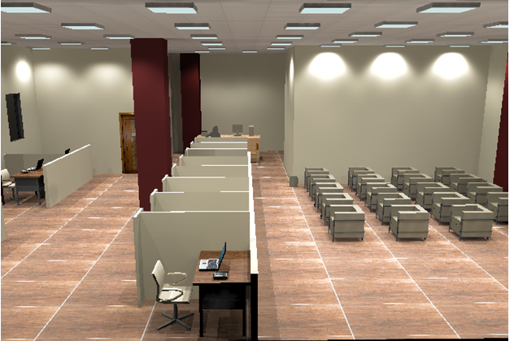
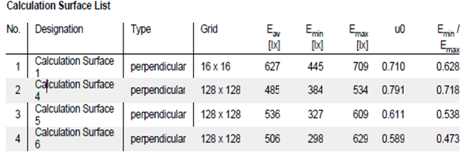
Lighting Design Cont.
Lighting design for the executive circle

Slide 39
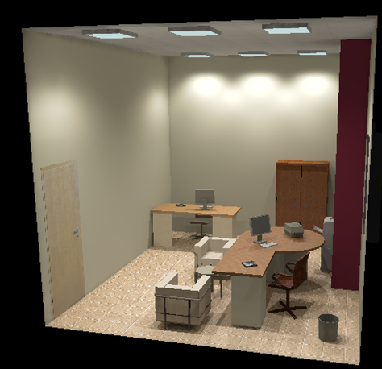
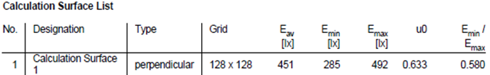
Lighting Design Cont.
Lighting design for Judge Office

Slide 40
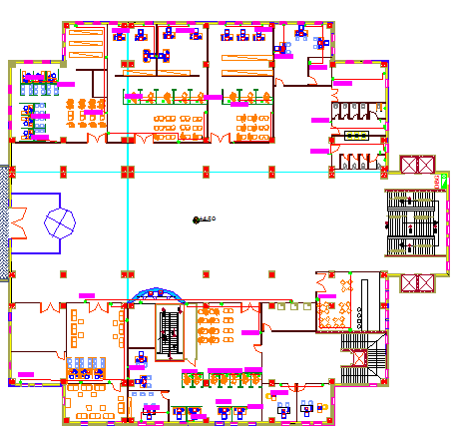
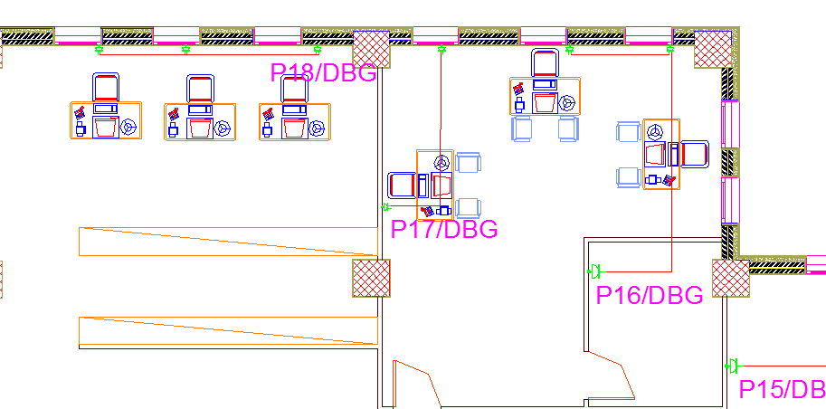
Sockets Distribution

Slide 41
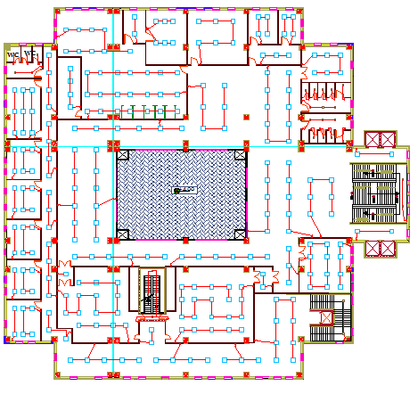
Lighting Distribution

Slide 42
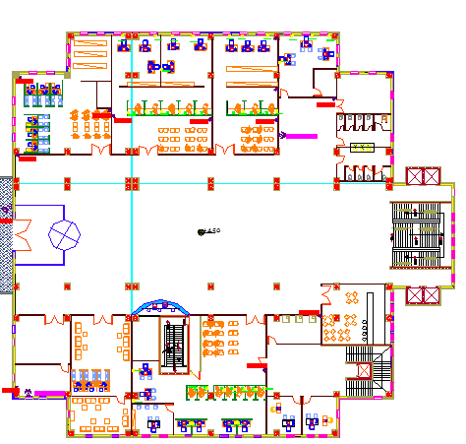
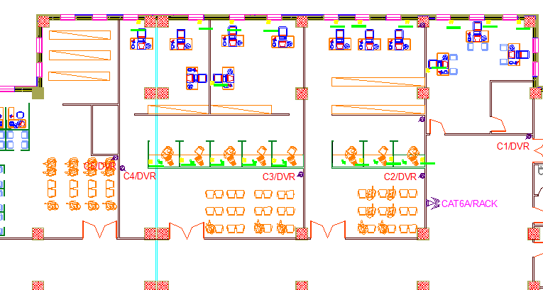
Cameras Distribution

Slide 43
Environmental
Design

Slide 44
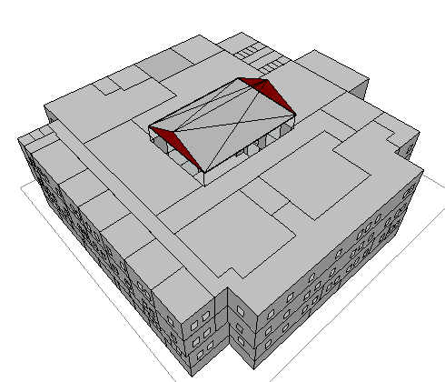
Ecotect Model
ECOTECT Program was used to:
1. Analyze sun movement and natural lighting.
2. Calculate heating and cooling loads

Slide 45
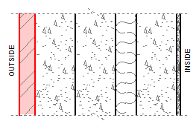
The Materials used
layers for external walls
(U = 0.39 W/m².k):
Material | Thickness (cm)
Limestone | 4
Concrete | 10
Block | 10
Insulation | 5
Block | 10
Plaster | 1

Slide 46
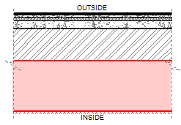
The Materials used cont.
layers for ceiling
(U = 0.41W/m².k):
Material | Thickness (cm)
Tiles | 2
Screed | 2.5
Sand | 3
Concrete | 8
Ytong block | 32
Air gap | 50
False ceiling | 1.6

Slide 47
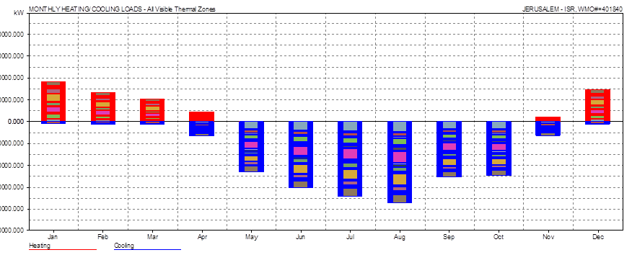
Thermal Calculation
Total heating load and cooling load per m2 =56.6 KWh
The acceptable range from 30 to 80 KWh .

Slide 48
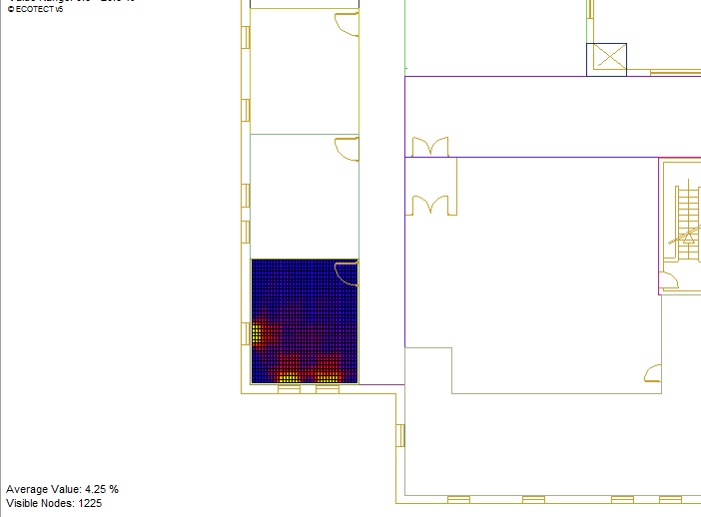
Daylighting calculation
For Judge office 1:
DF=4.25%

Slide 49
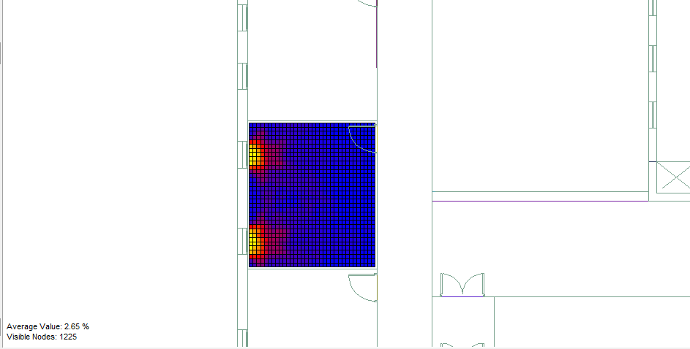
Daylighting calculation cont.
For Judge office 3:
DF=2.65% less than 3%, We need Modification

Slide 50
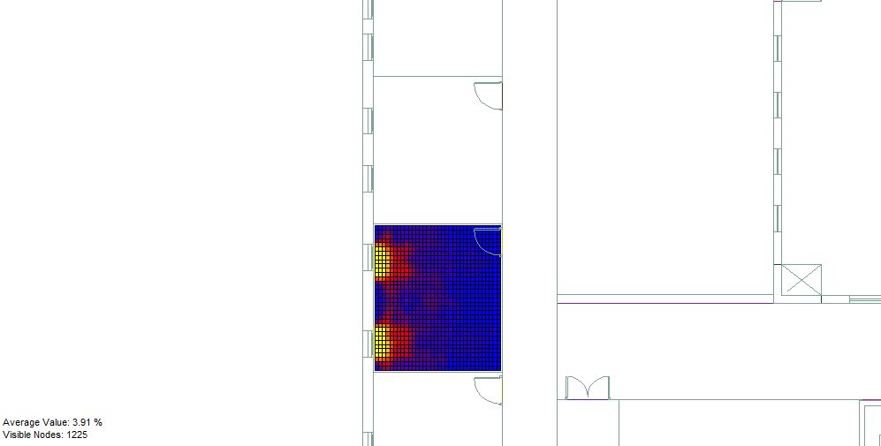
Daylighting calculation cont.
The modification we made is to expand windows
From 1m to 1.2m
After modification DF=3.91%

Slide 51
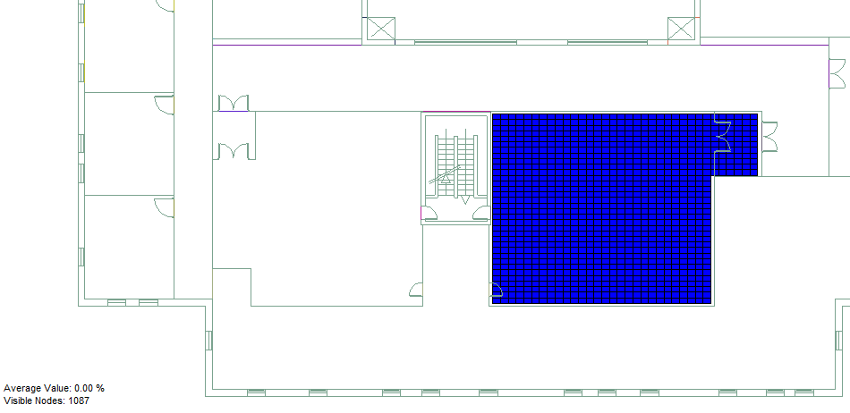
Daylighting calculation cont.
For Courtroom1:
DF=0.00% less than 3%, We need Modification

Slide 52
Daylighting calculation cont.
Duo to architectural concerns windows can’t be opened
Then compensate the lack of natural lighting with artificial lighting

Slide 53
STC Calculation
In our project we have to maintain a confidential level.
Basic partition’s STC= 36dB, so need to add modifications to reach 50 dB or more.
The modifications are:
Double gypsum board, both sides +4
Double thickness insulation +6
Plaster on both sides +4
So, 36+4+4+6 = 50 dB

Slide 54
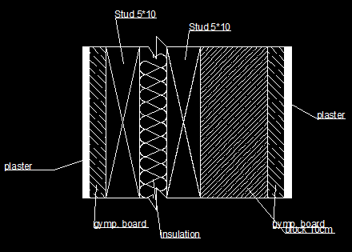
STC Calculation cont.
Section for modified partition

Slide 55

IIC Calculation
As shown in the table above, our ceiling model complies with the last model in the table.
in the model IIC was 68 dB, meanwhile our model is more dens and thicker than that model so its guaranteed that our model will provide the sufficient IIC range.

Slide 56
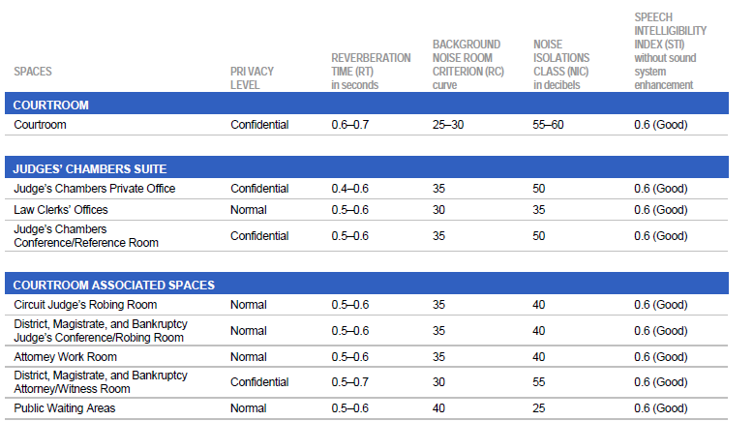
RT60
The following table shows the acoustical criteria for courthouse spaces:

Slide 57
RT60 Cont.
Material | α
Terrazzo tiles | 0.02
Wood seats | 0.88
Wood Tables | 0.07
Wooden floor | 0.07
Walls (plaster) | 0.03
Doors | 0.07
Suspended ceiling | 0.92
Window (glass) | 0.12
Acoustical tiles | 0.53
Teaching board | 0.07
The material used in the courthouse

Slide 58
RT60 Cont.
For courtroom 1 RT60= 0.67 within the range (0.6-0.7), then O.K.
Courtroom 1
 | Area describtion |  | Area | α | Area* α | RT60
 | Floor Plan | Tiles | 88.14 | 0.02 | 1.7628 | 0.671081
 |  | Wood Seats | 10.68 | 0.88 | 9.3984
 |  | Tables | 11.18 | 0.07 | 0.7826
 |  | Wooden floor | 16.72 | 0.07 | 1.1704
 | Elevations | Walls | 201.65 | 0.03 | 6.0495
 |  | Doors | 6.25 | 0.07 | 0.4375
 | Ceiling | suspended ceiling | 128.2 | 0.92 | 117.944
 |  | Total | 462.82 |  | 137.5452

Slide 59
RT60 Cont.
For courtroom 2 RT60= 0.65 within the range (0.6-0.7), then O.K.
Courtroom 2
 | Area description |  | Area | α | Area* α | RT60
 | Floor Plan | Tiles | 72.54 | 0.02 | 1.4508 | 0.652521
 |  | Wood Seats | 10.68 | 0.88 | 9.3984
 |  | Tables | 11.18 | 0.07 | 0.7826
 |  | Wooden floor | 14.27 | 0.07 | 0.9989
 | Elevations | Walls | 170.51 | 0.03 | 5.1153
 |  | Doors | 6.25 | 0.07 | 0.4375
 | Ceiling | suspended ceiling | 99.14 | 0.92 | 91.2088
 |  | Total | 384.57 |  | 109.3923

Slide 60
RT60 Cont.
For courtroom 2 RT60= 0.65 within the range (0.6-0.7), then O.K.
Registry
 | Area description |  | Area | α | Area* α | RT60
 | Floor Plan | Tiles | 149.7328 | 0.02 | 2.994656 | 0.592392
 |  | Wood Seats | 7.4172 | 0.88 | 6.527136
 |  | Tables | 26.46 | 0.07 | 1.8522
 | Elevations | Walls | 186.215 | 0.03 | 5.58645
 |  | Porous material | 55 | 0.65 | 35.75
 |  | windows | 7.5 | 0.12 | 0.9
 |  | Doors | 9 | 0.07 | 0.63
 | Ceiling | suspended ceiling | 183.61 | 0.92 | 168.9212

Slide 61
Quantity
Survey

Slide 62
Project Cost
Floor Area = 2533.6 m² , Total Building Area = 10,134 m².
Total Cost = 23,644,375 NIS.
Cost/m² = 2334 NIS

Slide 63


