Slide 1
Redesign of Malhees and Yafa streets
Hala Abu zant
Iman Muna
Razan Musmar

Slide 2
Contents
General Background
Data collection
Data analysis
Pavement design

Slide 3
Contents
Typical cross sections
Design of horizontal and vertical alignment
Design of Intersections
BOQ and cost estimation
Conclusion & Recommendations

Slide 4
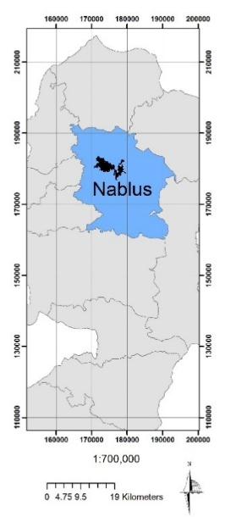
General Background
Nablus city is one of the most important Palestinian cities due to its existence in the north of the West Bank as a link between other cities.

Slide 5
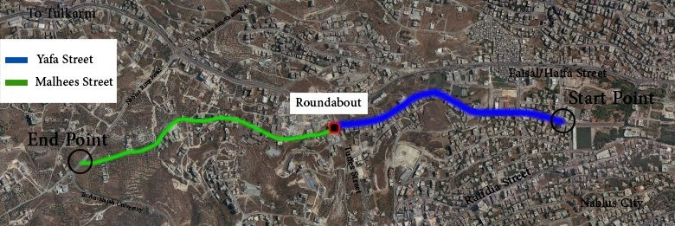
Aerial Photo for the Project Location
Yafa street is considered as urban arterial (level terrain).
Malhees street is considered as urban collector (rolling terrain).

Slide 6
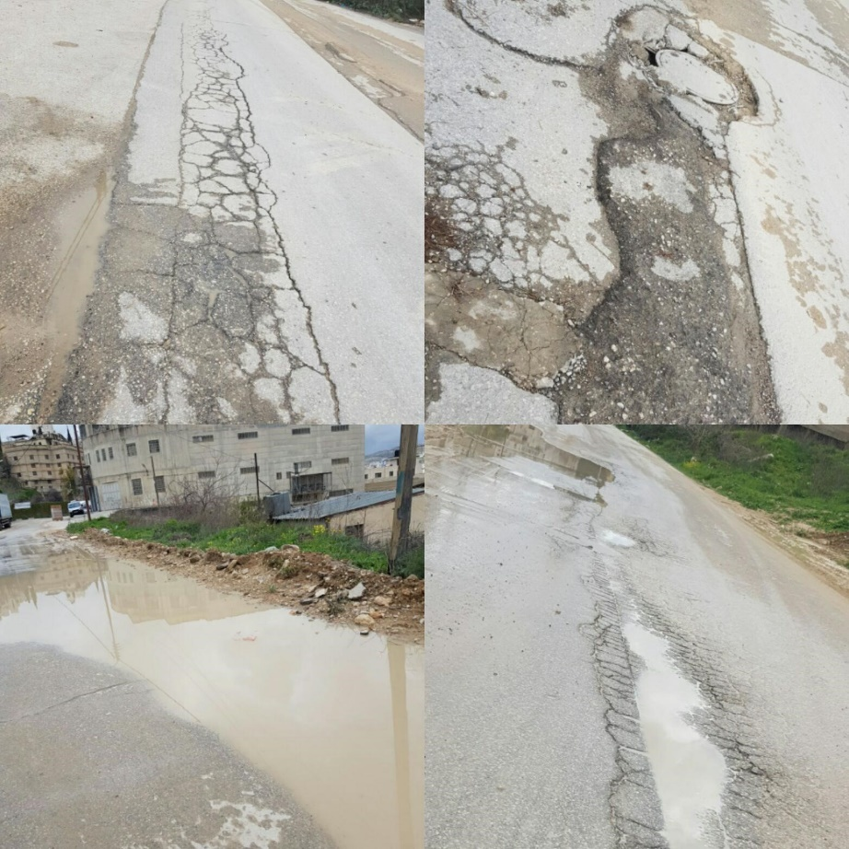
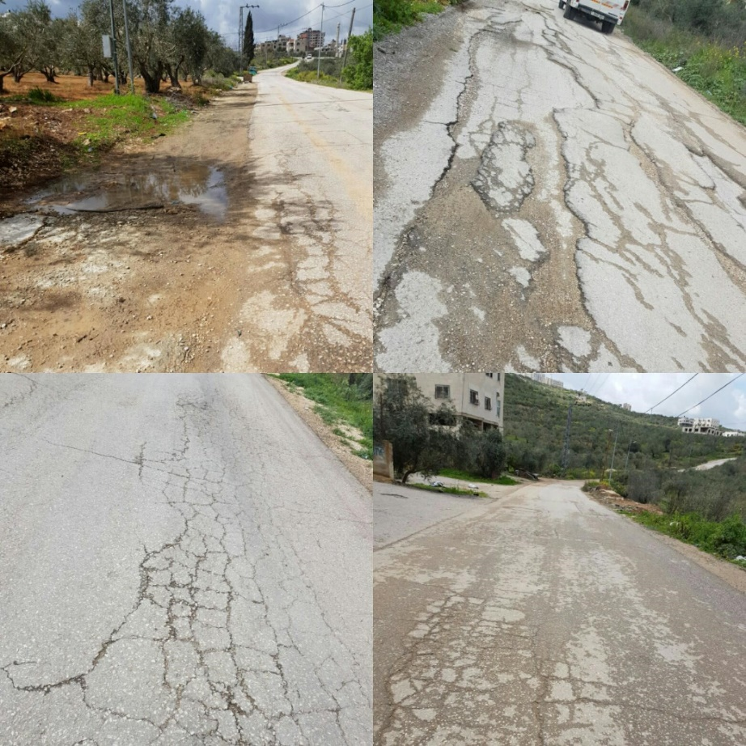
Evaluating the existing conditions
Malhees street
Bad drainage conditions
very poor pavement conditions

Slide 7
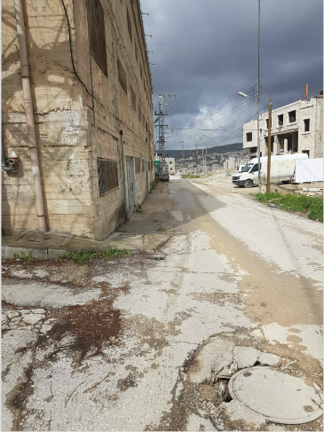
Evaluating the existing conditions
Malhees street
Building borders within the right of way

Slide 8
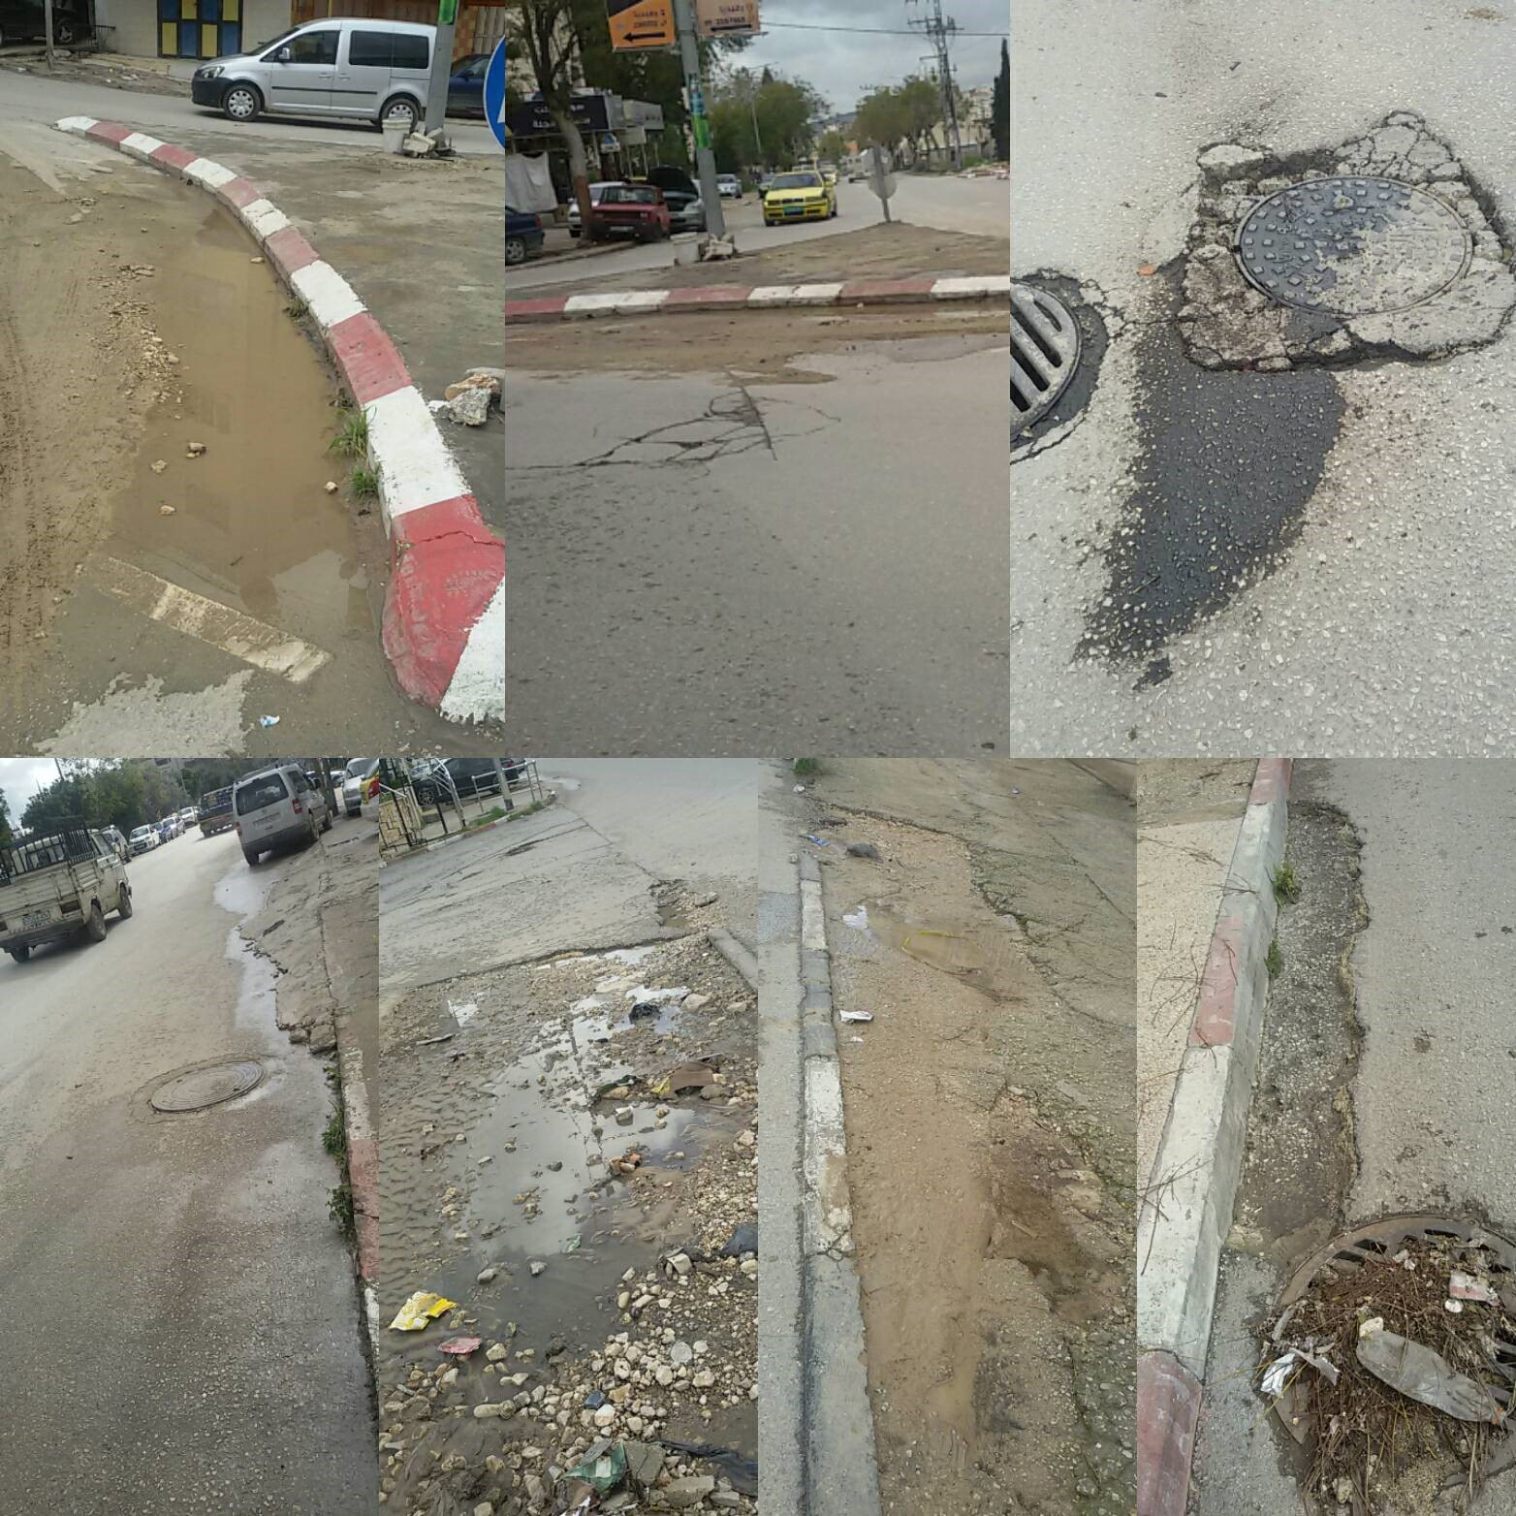
Evaluating the existing conditions
Yafa street
Bad pavement and drainage conditions

Slide 9
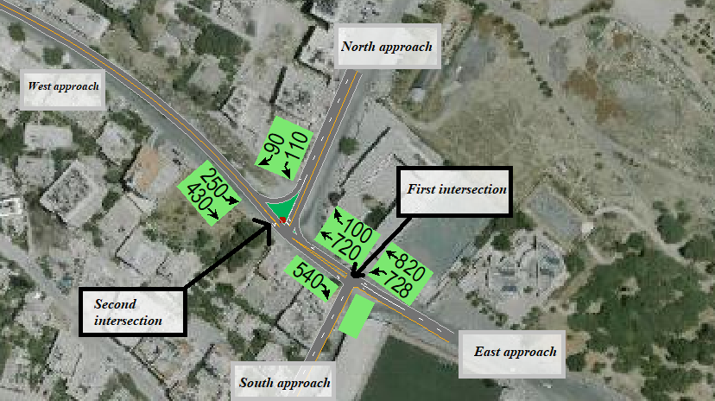
Data collection
Traffic count:
Municipality Stadium – Yafa Intersection
PH= 2:00-3:00 p.m.
PHV= 2088 veh/hr
PF= 0.89
Al-Wakalat - Yafa Intersection
PH= 7:15-8:15 a.m.
PHV= 1700 veh/hr
PF= 0.87

Slide 10
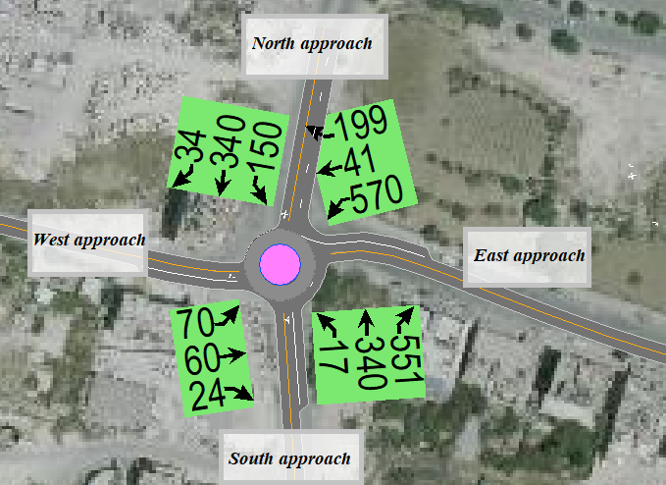
Data collection
Traffic count:
Tunis – Yafa Intersection (Roundabout)
PH= 2:15-3:15 p.m.
PHV= 2396 veh/hr
PF= 0.95

Slide 11
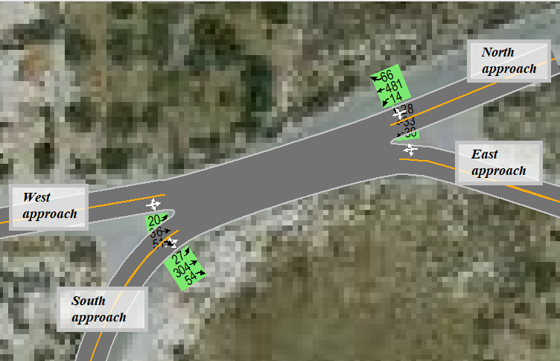
Data collection
Traffic count:
Ring Road - Fadwa Touqan Intersection
PH= 7:15-8:15 p.m.
PHV= 1144 veh/hr
PF= 0.72

Slide 12
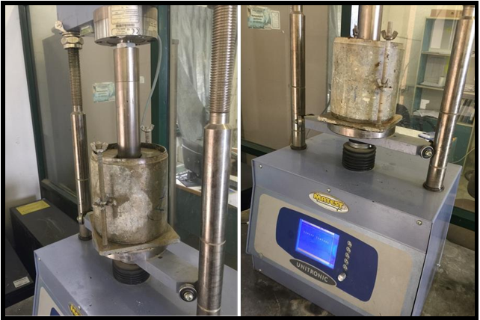
Data collection
CBR test :
• The CBR value for the first sample (Yafa street) = 2.25
• The CBR value for the second sample (Malhees street) = 3.75

Slide 13
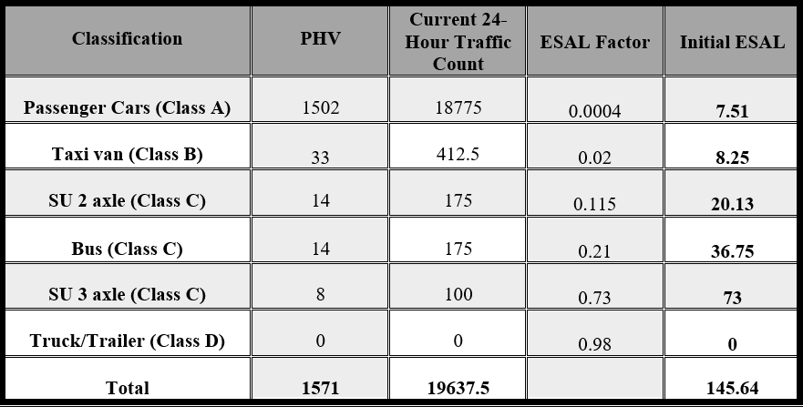
Data analysis
calculations of ESAL:
Yafa street
Year growth factor for 20 years and 3% growth rate = 26.87 Lane Factor (multi lanes) = 0.45
Design ESAL = 145.635*.45*365*26.87 = 642745.145 = 6.5*10^5

Slide 14
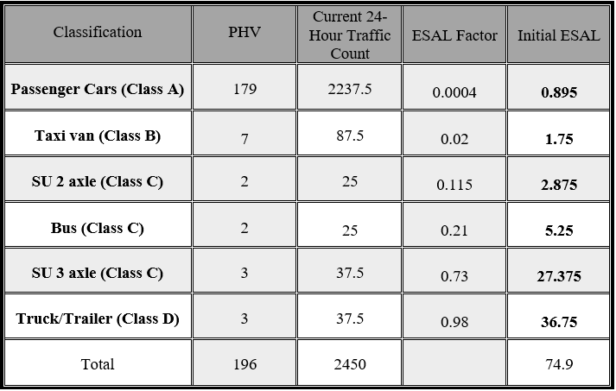
Data analysis
Calculation of ESAL:
Malhees street

Slide 15
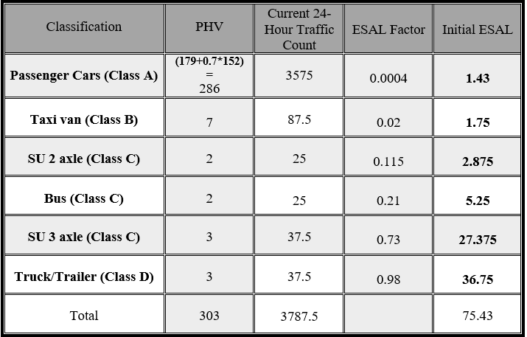
Data analysis
calculation of ESAL:
Malhees street
the modified ESAL considering taxis intend to use Malhees street.
Year growth factor for 20 years and 3% growth rate = 26.87 Lane Factor (two lanes) = 0.5
Design ESAL = 75.43*0.5*365*26.87 = 369891.7483 =3.7*10^5

Slide 16
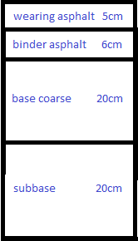
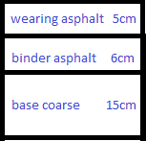
Pavement design
New layers
Existing layers
Yafa street
SN = 2.73
SN for the subgrade with 2.25 CBR value = 3.7
SN for new layers = 3.87
3.87 ˃ 3.7 → OK

Slide 17
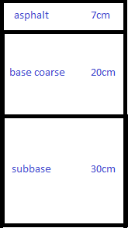
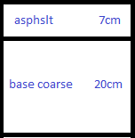
Pavement design
Existing layers
New layers
Malhees street
SN = 2.3
SN for the subgrade with 3.75 CBR value = 3.5
SN for new layers = 3.6
3.6 ˃ 3.5 → OK

Slide 18
The design has been relied on:
Master Plan (2015) of Nablus city
Contour Map of Nablus city
AASHTO 2011
Civil 3d 2018
Vehicle tracking 2018

Slide 19
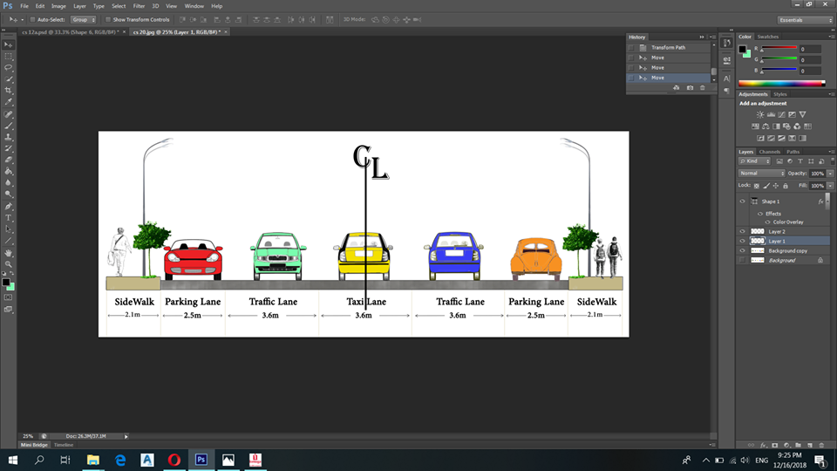
Typical cross sections
Yafa street
Right of way = 20m

Slide 20
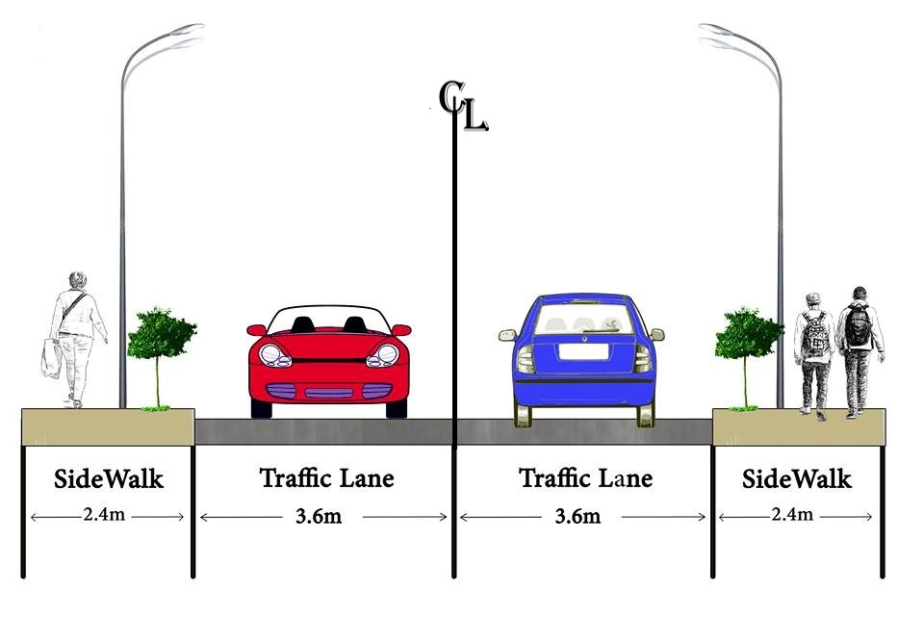
Typical cross sections
Malhees street
Right of way = 12m
First scenario: sidewalk at both sides.

Slide 21
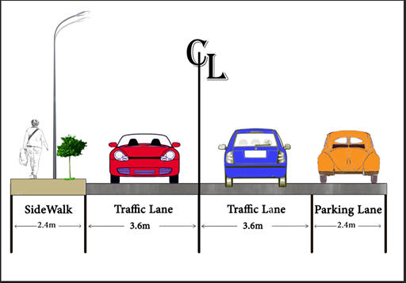
Typical cross sections
Malhees street
Right of way = 12 m
Second scenario: right side parking instead of sidewalk ( 0+60 - 0+240) &( 0+965 - 1+065)

Slide 22
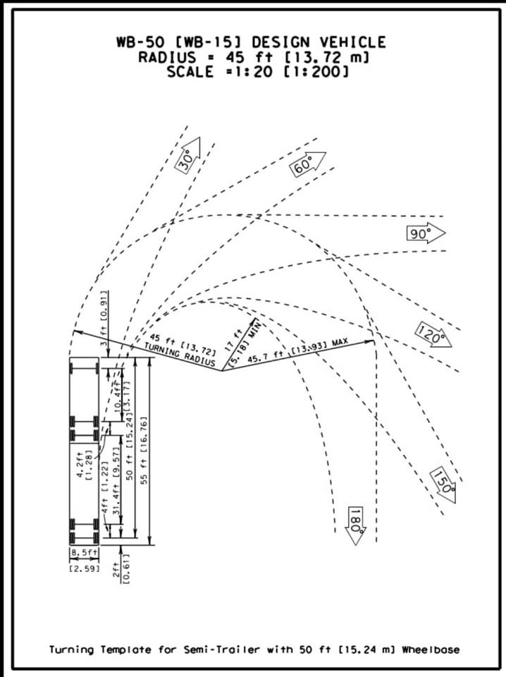
Design criteria
Design Vehicle : WB – 15
Height = 4.1 m ,
Width = 2.59 m ,
Length = 16.76 m

Slide 23
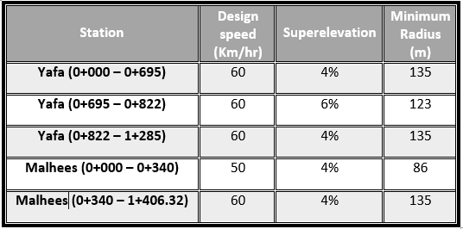
Design of Horizontal Alignment
Design speed

Slide 24
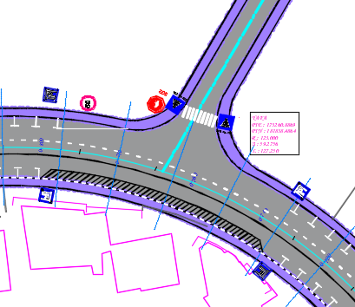
Design of Horizontal Alignment
Yafa (0+695 - 0+822)
superelevation = 6%

Slide 25
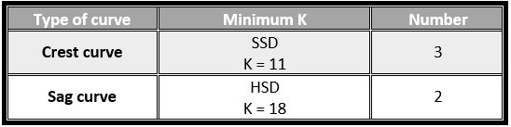
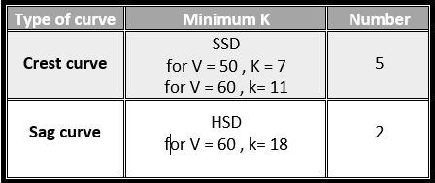
Design of Vertical Alignment (Profile)
Yafa street
Malhees street

Slide 26
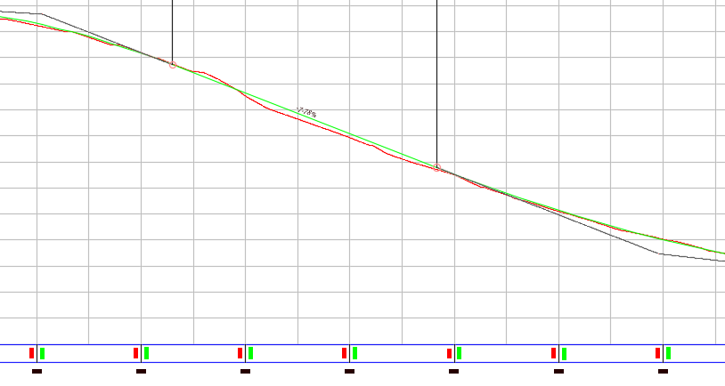
Design of Vertical Alignment (Profile)
Max. grade at Yafa street = 7% achieved at all segments except one was 7.78% from station 0+810 to 0+915

Slide 27
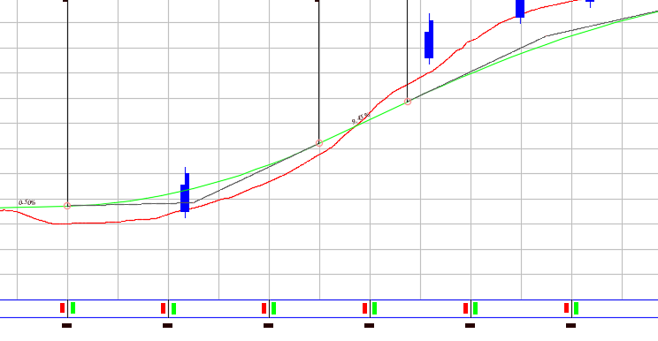
Design of Vertical Alignment (Profile)
Max. grade at Malhees street = 10%, achieved at all segments.

Slide 28
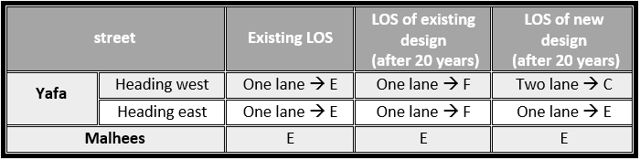
Level of service
Using HCS, the following results were achieved.

Slide 29
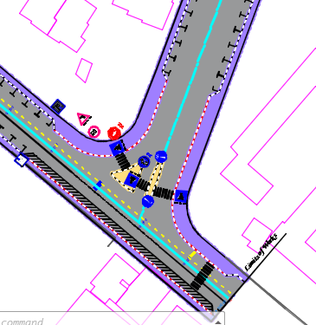
Design of Intersections
Three legs intersection (Al-Wakalat - Yafa Intersection)

Slide 30
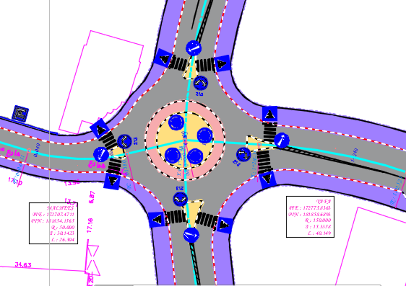
Design of intersections
Four legs intersection (Tunis-Yafa roundabout)

Slide 31
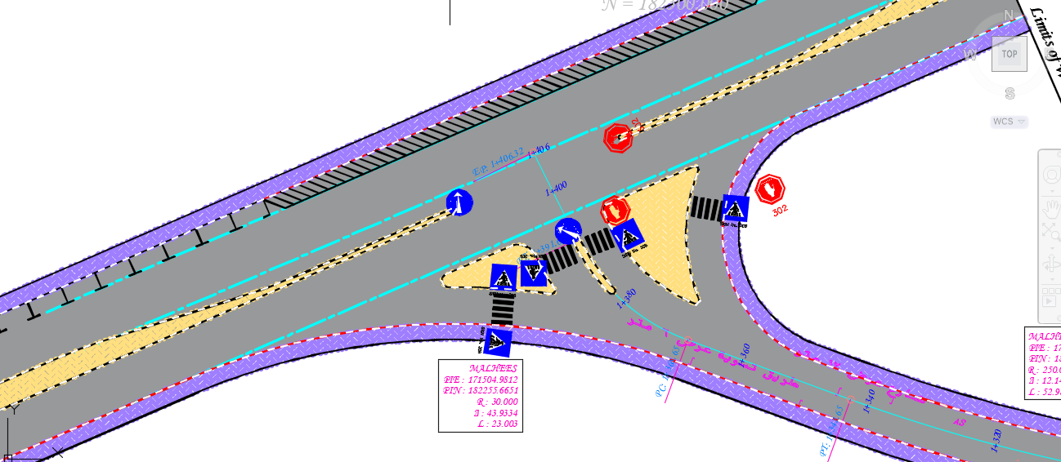
Design of intersections
Ring Road - Fadwa Touqan Intersection

Slide 32
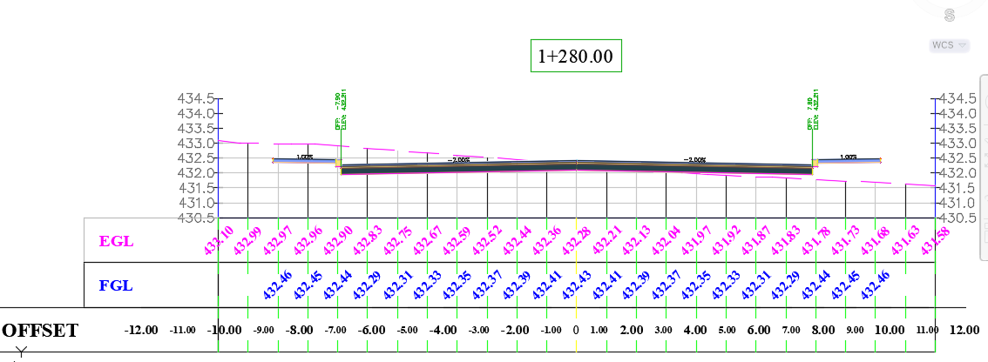
Cross sections
Yafa street

Slide 33
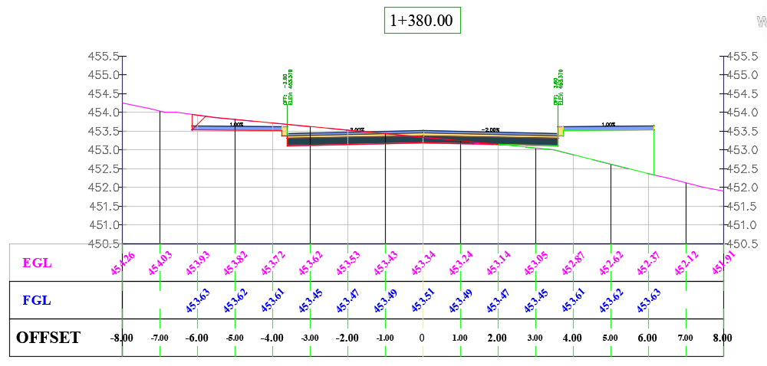
Cross sections
Malhees street

Slide 34
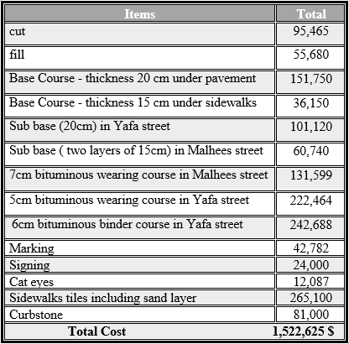
BOQ

Slide 35
Conclusion
The targeted roads will serve the students and commuters from the centre of Nablus to the western part of it.
The redesign is expected to contribute in reducing traffic jam in Tunis street.
The redesign will contribute in enhancing the safety and minimize the traffic accidents.
The redesign will minimize the travel time from CBD area to the west of the city.

Slide 36
Recommendations
Design a proper drainage system.
Design the proposed retaining walls.
Nablus Municipality is encouraged to provide high occupancy vehicles such as mini-buses and vans.
Give more attention for the traffic volume and movement of taxis in project area.
Distribute number of bus and taxi stations along roads.
To allocate the fund by Nablus Municipality needed for construction the project.

Slide 37
THANK YOU

