Slide 1

Sanitary Village Project
Raghad Hajji
Aya Salous
Supervised by Dr. Muhanned Al-jabi
Shahed Huwari
Supervised by Dr.Sufyan Samarah

Slide 2
Agenda
Problem Statement
Overview
Features
Methodology
Constraints
Future work
Demo

Slide 3








Problem Statement

Slide 4
Agenda
Problem Statement
Overview
Features
Methodology
Constraints
Future work
Demo

Slide 5
Agenda
Problem Statement
Overview
Features
Methodology
Constraints
Future work
Demo

Slide 6
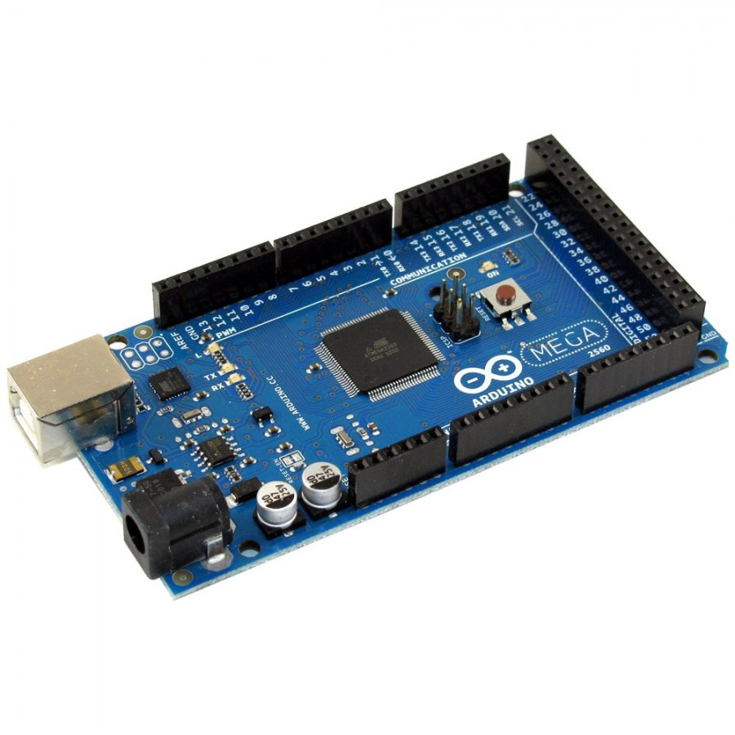
Technical Choice
Arduino Kit
We used arduino mega for some of reasons:
More pins
Easy to use

Slide 7
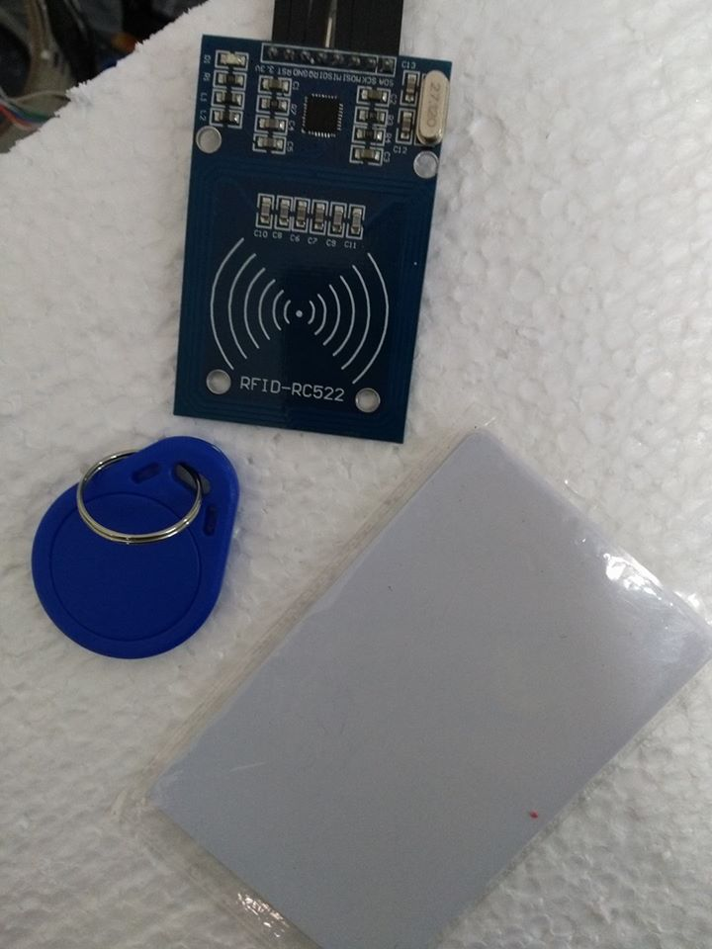
Rfid Reader and card:

Slide 8

Ifastnet.com Website:
It’s a free website hosting that allow us to create a databases and upload all files to the server .

Slide 9
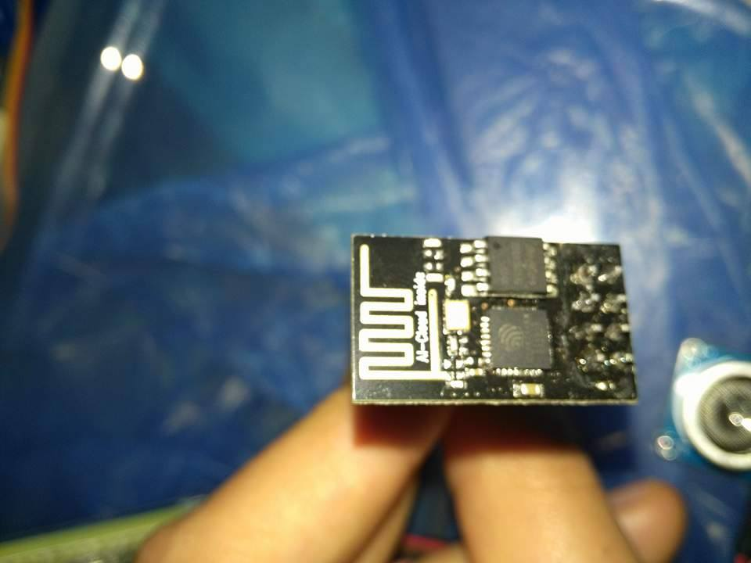
Wi-Fi Module:
Its our choice to help us connecting to the server.

Slide 10
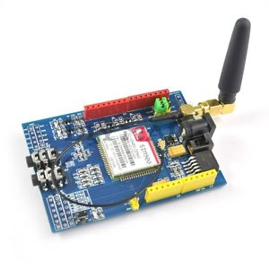
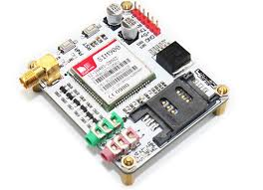
GPRS

Slide 11
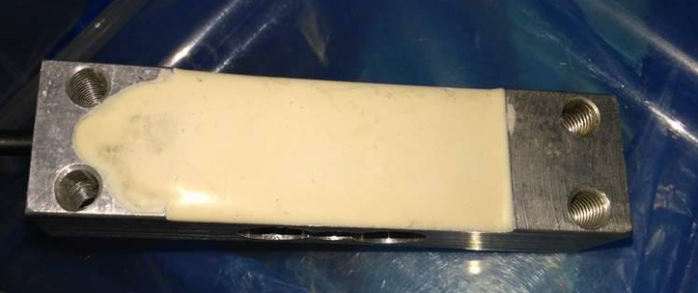
Weight sensor
To know the weight that the user throw.

Slide 12
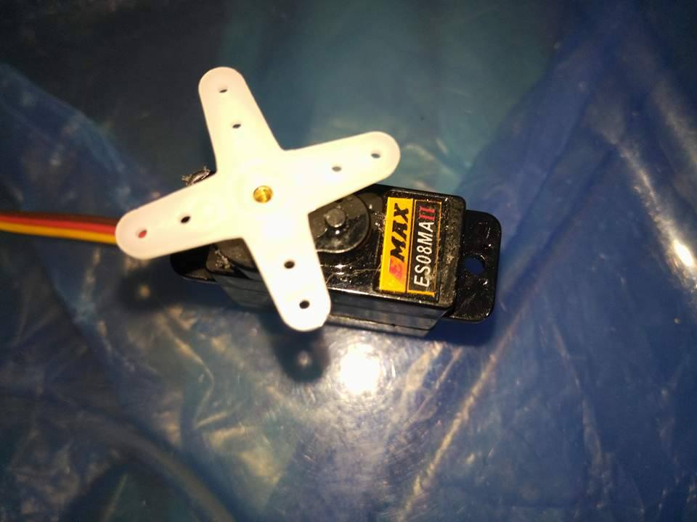
Techanical Choice
Servo sensor:
For moving

Slide 13
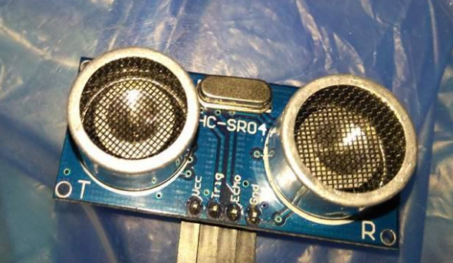
Techanical Choice
Ultra-Sonic sensor:
It gives an alarm if the garbage was filled.

Slide 14
Agenda
Problem Statement
Overview
Features
Methodology
Constraints
Future work
Demo

Slide 15
Methodology

Slide 16
The Prototype
Studding and analgising the project requirements to build pages interfaces.
Azure RP Pro Software.
Several versions of the prototype.

Slide 17
Database
Microsoft SQL Server Management Studio 2012.
Normalized database.
Layer Generator.
We can change database tables without affecting the application.

Slide 18
Notifications Report

Slide 19
Agenda
Problem Statement
Overview
Features
Methodology
Constraints
Future work
Demo

Slide 20
Future Work:
Image Processing.
Without Internet .

Slide 21
Agenda
Problem Statement
Overview
Features
Methodology
Constraints
Future work
Demo

Slide 22
Demo

