Slide 1
Analysis and Design of Nablus-Qalqilya Highway : Qusin-Jeit Section
Under Supervision of Prof. Sameer Abu-Eisheh
Prepared by: Ahmad Taha, Bilal Zedan, Lara Sabobeh and Shahd Tom

Slide 2
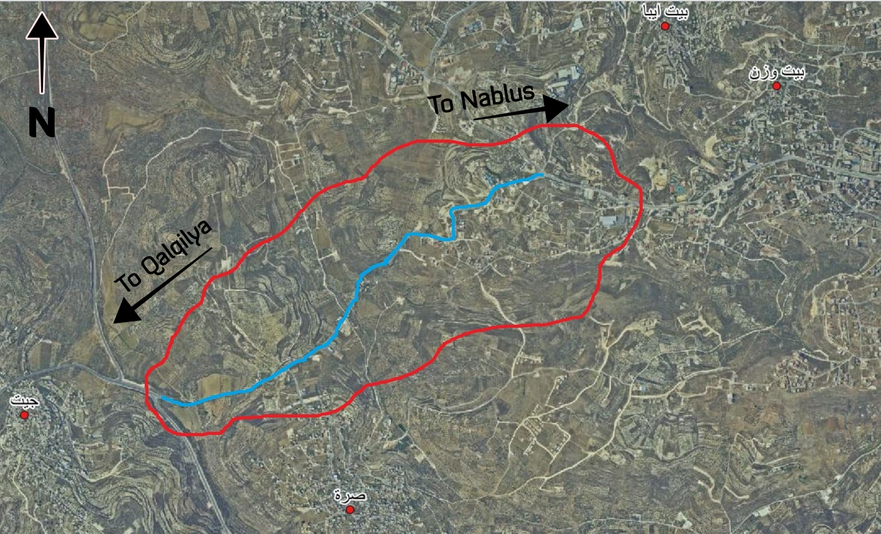
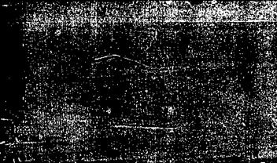
Remember what in Project 1
Study Area: Qusin-Jeit Section

Slide 3
Remember what in project 1
Why this road?
The road is of great importance on the national level.
The road is located on mountainous terrain in the southern-west of Nablus.
The study area is that section of the road that extends from Jeit intersection to Qusin intersection.
It is considered an essential arterial road for many people who enter Nablus from Tulkarem, Qalqilya, Salfeet and other areas.
The current geometry of the road is 7 m wide with 2 lanes.

Slide 4
The objective of this project:
1- Solving several problems facing this arterial road including:
• The many successive curved sections with limited radii within a short distance range.
• The drop of operating speed to very low values and therefore the project will provide acceptable improvement of the level of service on the road.
• The severe storm water drainage on the road.
2- Enhancing the safety conditions along the road.
3- Improving the riding quality of the road, as the road pavement have many defects

Slide 5
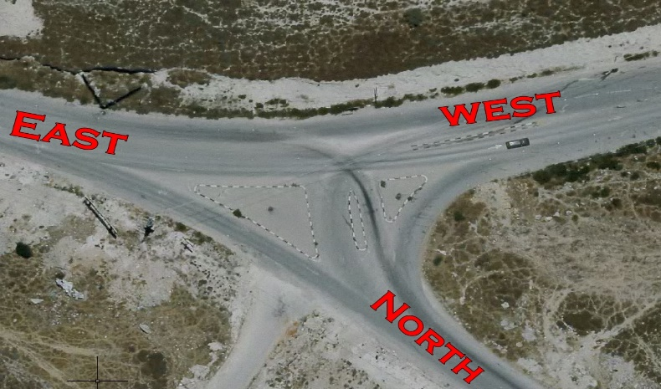
Data Collection
Link counts
Speed studies
Intersection Count
Sunday in the morning
Tuesday in the morning
Tuesday in the evening
Thursday in the evening
count | 265
Average speed | 65.67 km/hr
modified average speed | 66.68 km/hr
standard deviation | 11.38 km/hr
85th percentile speed | 75 km/hr
Origin destination study

Slide 6
Data Collection
Traffic accidents

Slide 7
Data Analysis
Capacity analysis
PHF = (Total hourly volume) / [(Peak 15-minute volume within the hour x 4)]
Design hour | 7:15-8:15
Peak hour volume | 791
Peak hour factor | 0.70
Design volume | 1124
Design hour | 7:15-8:15
Peak hour volume | 872
Peak hour factor | 0.79
Design volume | 1104
DHV=1124veh/hr
Design hour | 3:00-4:00
Peak hour volume | 933
Peak hour factor | 0.925595238
Design volume | 1008
Design hour | 1.30-2.30
Peak hour volume | 713
Peak hour factor | 0.8652
Design volume | 824

Slide 8
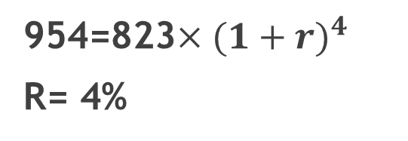
Data Analysis
Natural growth factor
 | Volume
21/9/2014 from 2 pm to 3 pm | 823
954=823$×{(1+r)}^{4}$
R= 4%
4/10/2018 from 2 pm to 3 pm | 954
Developing factor
If the road is improved, the surrounding area will flourish and traffic will increase.
In this case, the increase traffic volume is proposed to be 20%.

Slide 9
Data Analysis
Traffic distribution on the road
Two routes were used in this project, the first corresponds to the road of this project and the second road is the road that connects between the cities passing from Deir Sharaf to An-Najah National University and these cities of Tulkarem, Anabta and others.

Slide 10
Data Analysis
Traffic distribution on the road
49%*356 =175 veh.
From the 175 veh. part will be transferred to the Jet-Sarra-Nablus road.
To find out how much it will turn into every road we have to know the length of the road and the travel time
Deir Sharaf Road
Length | Travel time
6670 m | 6.5 min
Jet-Sarra-Nablus road
Length | Travel time
8670 | 8.5 min

Slide 11
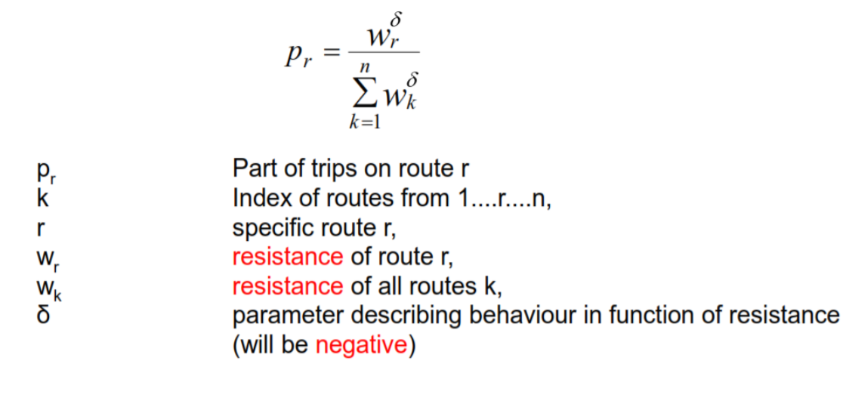

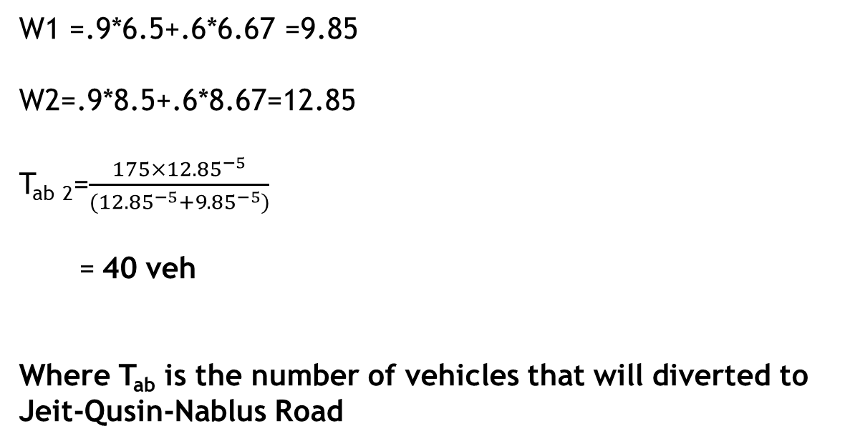
Data Analysis
Traffic distribution on the road
W1 =.9*6.5+.6*6.67 =9.85
W2=.9*8.5+.6*8.67=12.85
T_{ab} ₂=$\frac{175×{12.85}^{−5}}{({12.85}^{−5}+{9.85}^{−5})}$
= 40 veh
Where T_{ab} is the number of vehicles that will diverted to Jeit-Qusin-Nablus Road

Slide 12
Data Analysis
Design Volume:

Slide 13
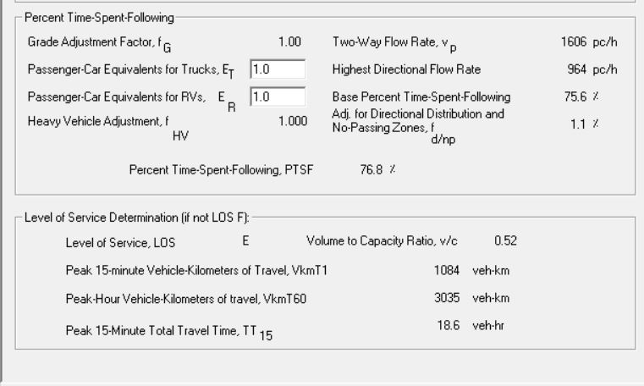
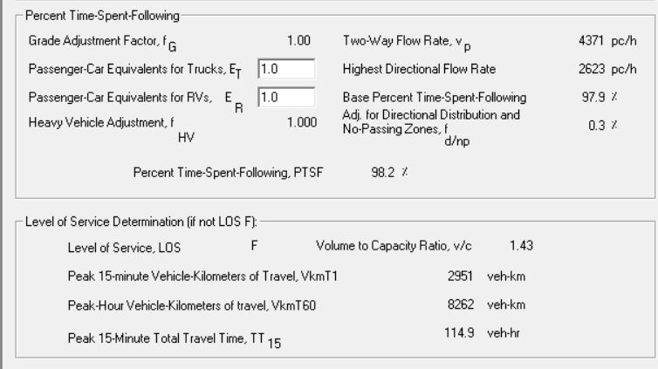
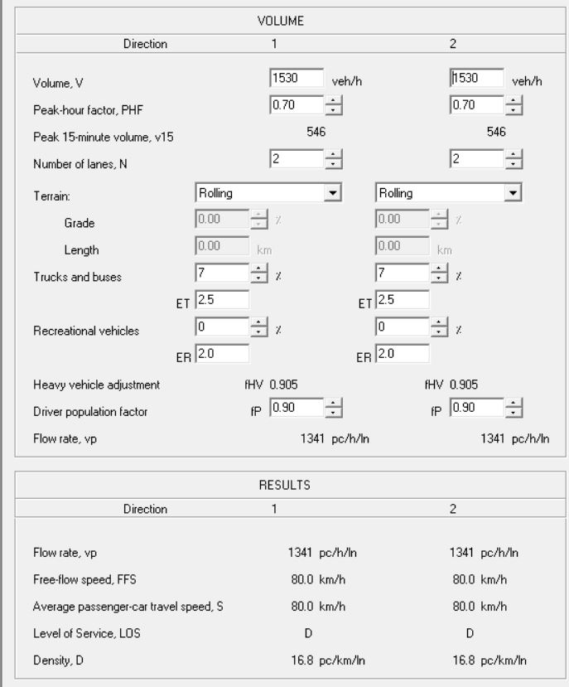
Data Analysis
Level Of Service:
LOS of the existing road
LOS in the future
LOS for Multi-Lane road in the future

Slide 14
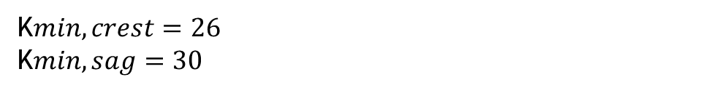
Data Analysis
Geometric analysis of the existing road:
Horizontal Alignment
Vertical Alignment
Curve No. | Start station | End station | Radius | Appropriate speed
1 | 0+300 | 0+351 | 124.7 | 55
2 | 0+660 | 0+724 | 184.1 | 67
3 | 0+860 | 0+910 | 147.3 | 60
4 | 1+035 | 1+100 | 107.1 | 50
5 | 1+275 | 1+328 | 51.7 | 35
6 | 1+524 | 1+563 | 21.7 | 25
7 | 1+686 | 1+728 | 28.9 | 27
Curve No. | PVC Station | PVT Station | Grade in | Grade out | K | Length(m) | Corresponding speed
1 | 0+232 | 0+289 | -12.99% | -9.59% | 3.4 | 56.55 | 38 km\hr
2 | 0+444 | 0+459 | -10.70% | -13.34% | 5.6 | 14.92 | 47 km\hr
3 | 0+828 | 0+895 | -2.04% | 8.54% | 6.2 | 66.55 | 38 km\hr
4 | 1+074 | 1+129 | 3.94% | 12.70% | 6.2 | 54.44 | 48 km\hr
5 | 1+226 | 1+266 | 13.46% | 11.23% | 17.9 | 40 | 71 km\hr
6 | 1+311 | 1+402 | 14.15% | 9.35% | 19 | 91.5 | 73 km\hr
7 | 2+185 | 2+217 | 8.15% | 5.43% | 11.6 | 31.66 | 61 km\hr
8 | 2+359 | 2+433 | 6.94% | -0.14% | 10.4 | 74.2 | 57 km\hr
9 | 2+507 | 2+554 | 0.17% | 2.58% | 19.5 | 47 | 74 km\hr
10 | 2+603 | 2+639 | -0.98% | 4.74% | 6.1 | 35.2 | 38 km\hr
$Rmin=\frac{V^{2}}{127(e+f)}$= $\frac{{75}^{2}}{127(0.06+0.15)}$= 210 m
K$min, crest=26$
K$min, sag=30$

Slide 15
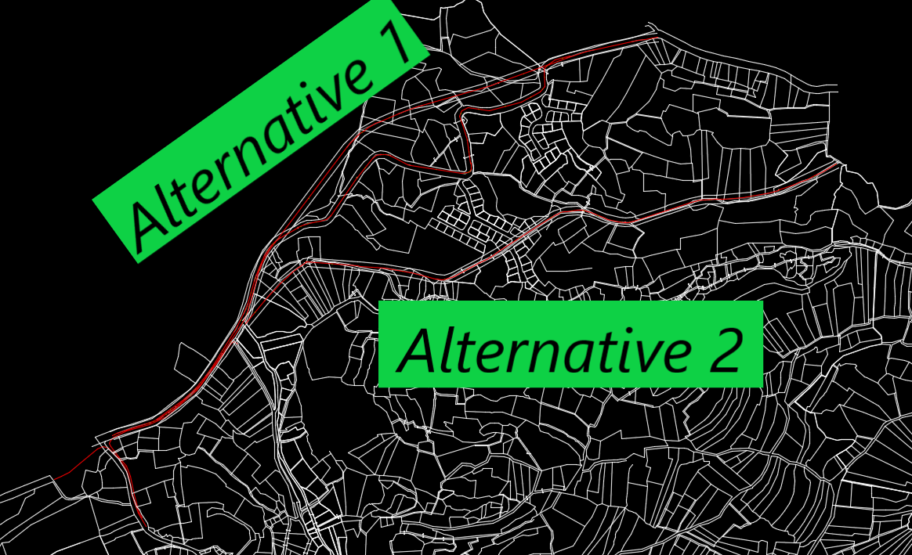
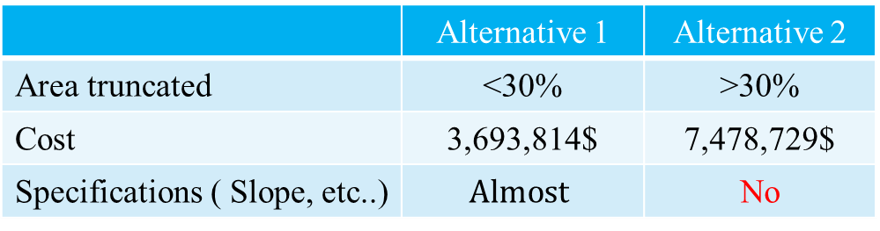
Development Solution
Comparison between two alternatives
 | Alternative 1 | Alternative 2
Area truncated | <30% | >30%
Cost | 3,693,814$ | 7,478,729$
Specifications ( Slope, etc..) | $$Almost$$ | No
So, we used alternative 1

Slide 16
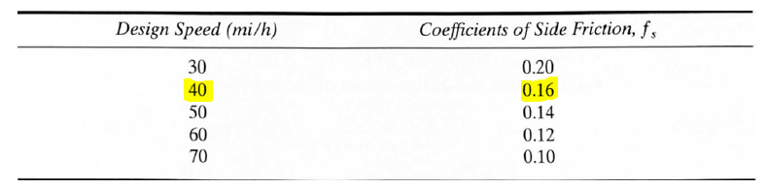
Geometric Design of Proposed Road
Horizontal Alignment:
1. Design speed: 75 km/hr. except in one curve between station 0+712 m to 0+945 m is 50 Km/hr
2. Posted speed: 70 km/hr. except in two section ( Crest curves )
3. Superelevation: 6 %
4. Side friction: 0.15 for 75 km/hr and 0.22 for 50 km/hr

Slide 17
Geometric Design of Proposed Road
Horizontal Alignment:
No. | Start sta. | End sta. | Length | Radius | M. Radius | D. S.
1 | 0+055 | 0+273 | 217 m | 280 m | 210 m | 75 km/h
2 | 0+397 | 0+419 | 21 m | 700 m | 210 m | 75 km/h
3 | 0+564 | 0+711 | 146 m | 360 m | 210 m | 75 km/h
4 | 0+712 | 0+945 | 232 m | 720 m | 70 m | 50 km/h
5 | 0+946 | 1+146 | 199 m | 320 m | 210 m | 75 km/h
6 | 1+303 | 1+413 | 109 m | 280 m | 210 m | 75 km/h
7 | 1+840 | 2+258 | 417 m | 280 m | 210 m | 75 km/h
8 | 2+439 | 2+544 | 105 m | 620 m | 210 m | 75 km/h
9 | 2+549 | 2+843 | 293 m | 1150 m | 210 m | 75 km/h

Slide 18
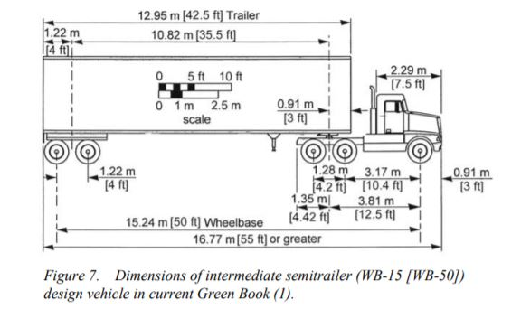
Geometric Design of Proposed Road
Horizontal Alignment:
- Design Vehicle:
WB 15
Height = 4.1 m
Width = 2.6 m
Length =16.8 m

Slide 19
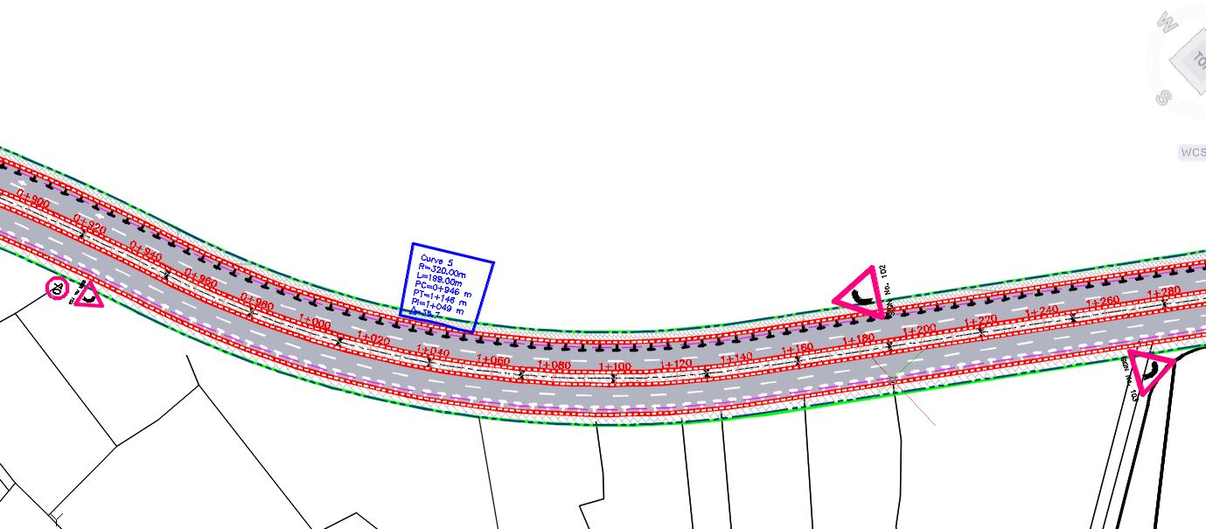
Geometric Design of Proposed Road
Horizontal Alignment:

Slide 20
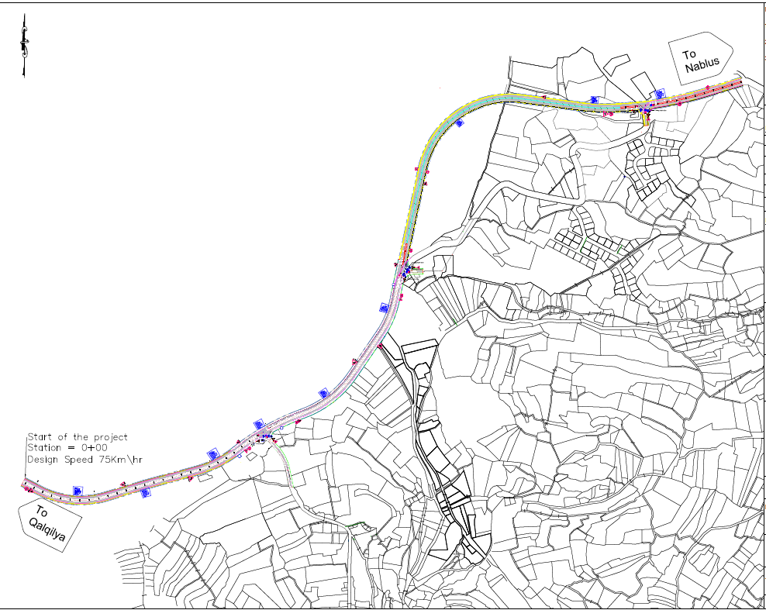
Geometric Design of Proposed Road
Horizontal Alignment:
Type of the Curve | Number
Simple curves | 9

Slide 21
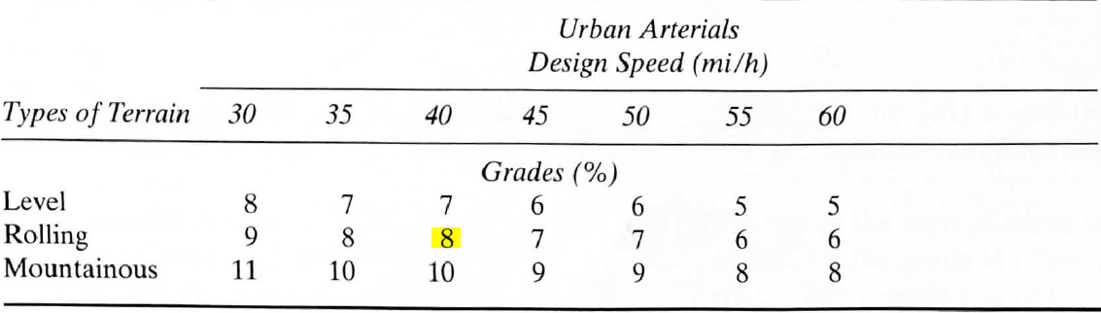
Geometric Design of Proposed Road
Vertical Alignment:
- Grades:
The max. grade fro AASHTO = 9 %, but we used in some segments up to 12% because of the terrain
- Min. grade:
It is customary to use a minimum of 0.5% which is considered for requirements for drainage of the highway in the longitudinal direction.

Slide 22
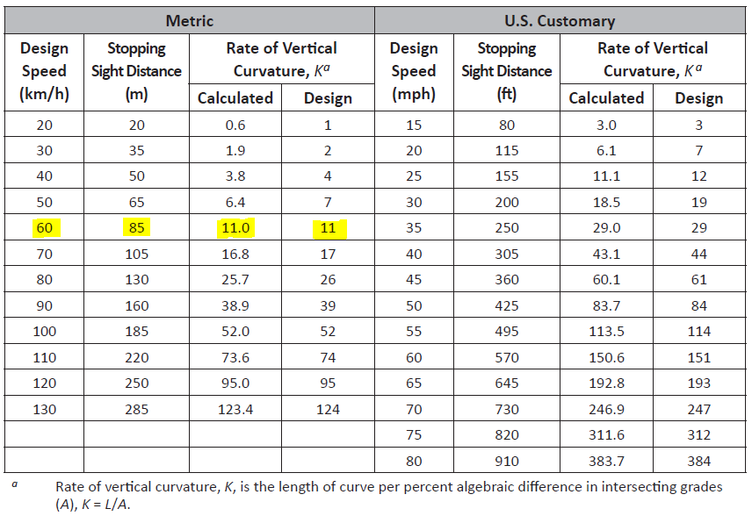
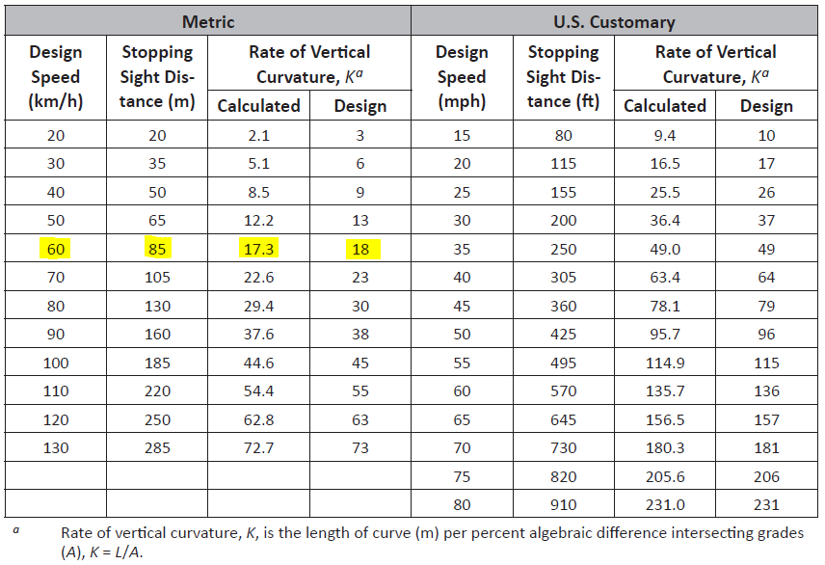
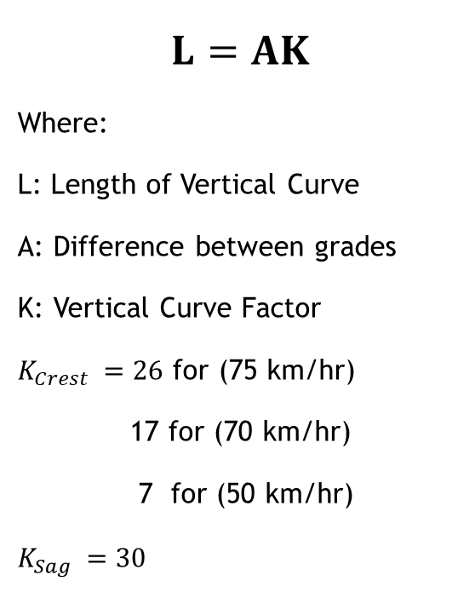
Geometric Design of Proposed Road
Vertical Alignment:
Crest and Sag Curves
$$L=AK$$
Where:
L: Length of Vertical Curve
A: Difference between grades
K: Vertical Curve Factor
$K_{Crest }=26$ for (75 km/hr)
17 for (70 km/hr)
7 for (50 km/hr)
$$K_{Sag }=30$$

Slide 23
Geometric Design of Proposed Road
Vertical Alignment:
No. | PVI | Grade In | Grade Out | A | K Value | Profile curve type | Design
1 | 0+189 | -5.87% | 9.22% | 15.09% | 24.5 | sag | 75 km/h
2 | 0+819 | 9.22% | -11.17% | 20.39% | 8.8 | crest | 50 km/h
3 | 1+214 | -11.17% | -.59% | 10.58% | 24.5 | sag | 75 km/h
4 | 1+480 | -.59% | 10.76% | 11.35% | 20.7 | sag | 75 km/h
5 | 1+674 | 10.76% | 2.68% | 8.08% | 18.56 | crest | 70 km/h
6 | 2+004 | 2.68% | 12% | 9.32% | 30.1 | sag | 75 km/h
7 | 2+709 | 12% | 5.31% | 6.69% | 23 | crest | 75 km/h

Slide 24
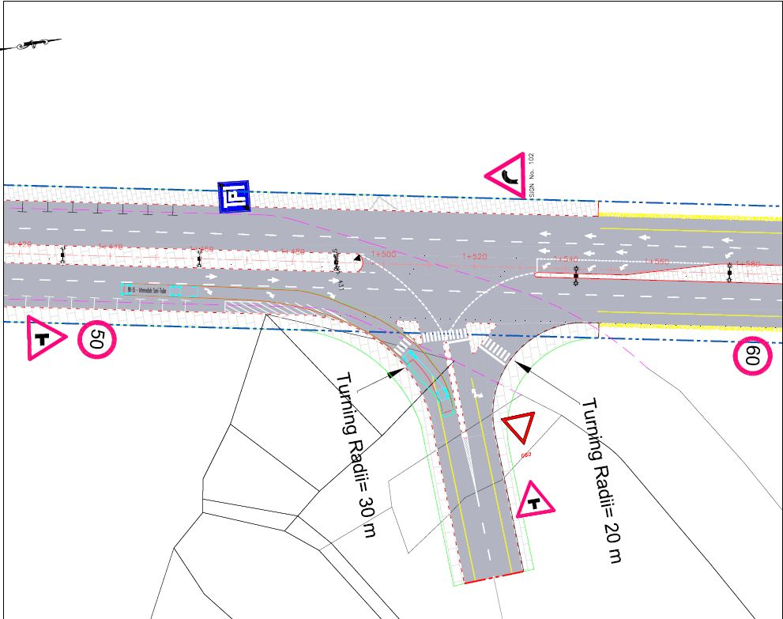
Geometric Design of Proposed Road
Intersections:

Slide 25
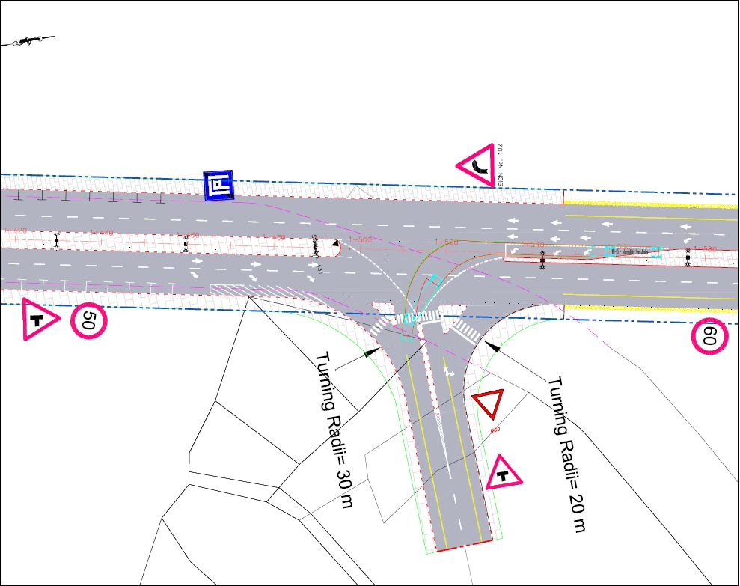
Geometric Design of Proposed Road
Intersections:

Slide 26
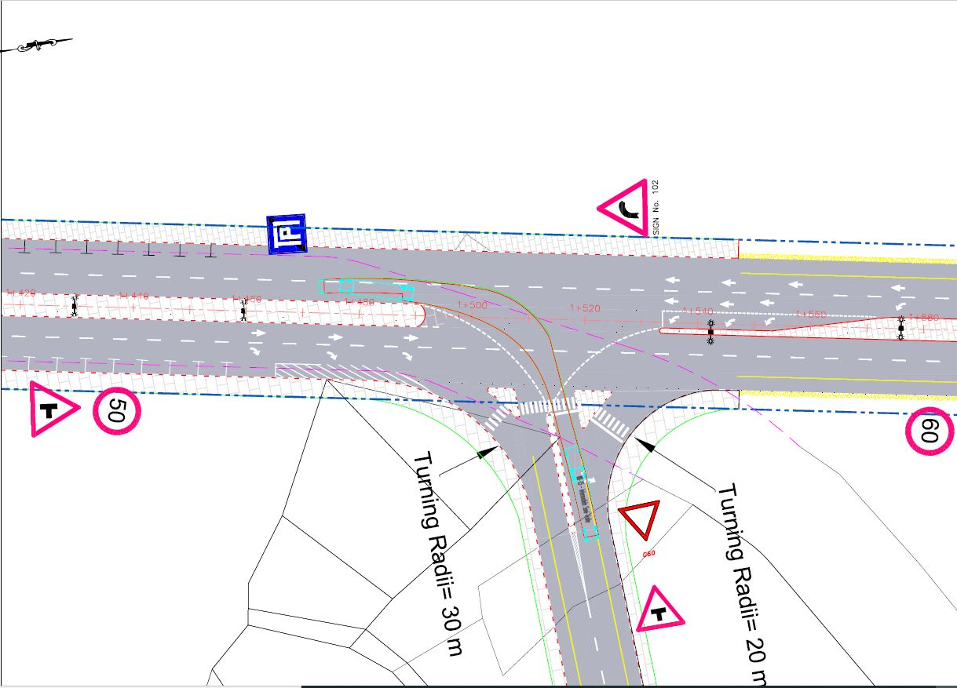
Geometric Design of Proposed Road
Intersections:

Slide 27
Geometric Design of Proposed Road
Cross Section:
We have two typical cross section scenarios:
Type of elements of cross section | Dimension | Station
Sidewalk | 3.3 m | 0+700 - 1+550
Parking | 2.5 m | 0+700 - 1+460
Shoulder | 3.3 m (Stabilized=0.8 m) | 0+000 - 0+700
 |  | 1+550 – 2+958
Flushed median with barrier | 4 m | 1+600 – 2+570
Raised median with vertical curbs | 4 m | 0+000 – 1+600
 |  | 2+570 – 2+958

Slide 28
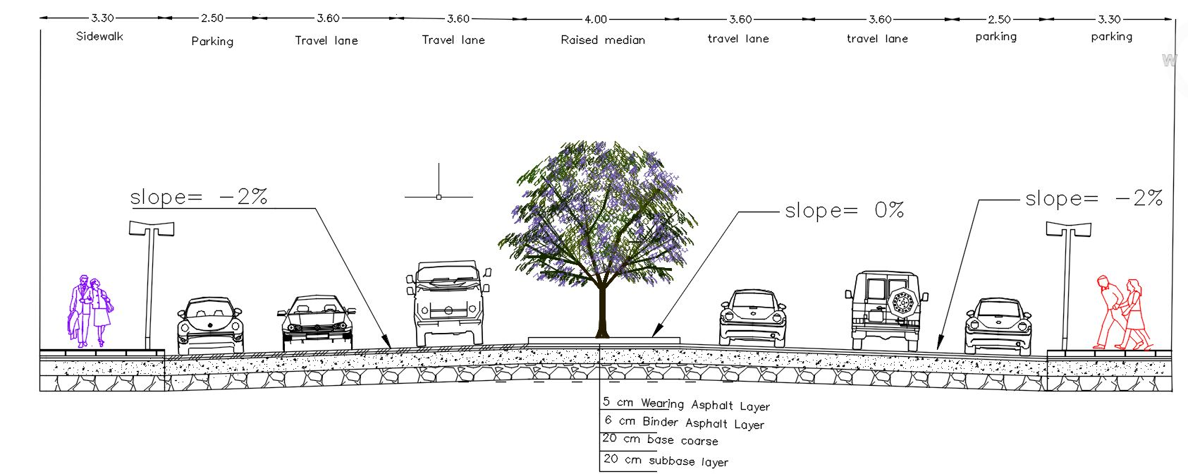
Geometric Design of Proposed Road
Typical Cross Sections:
With Sidewalk and raised median with vertical curbs:

Slide 29
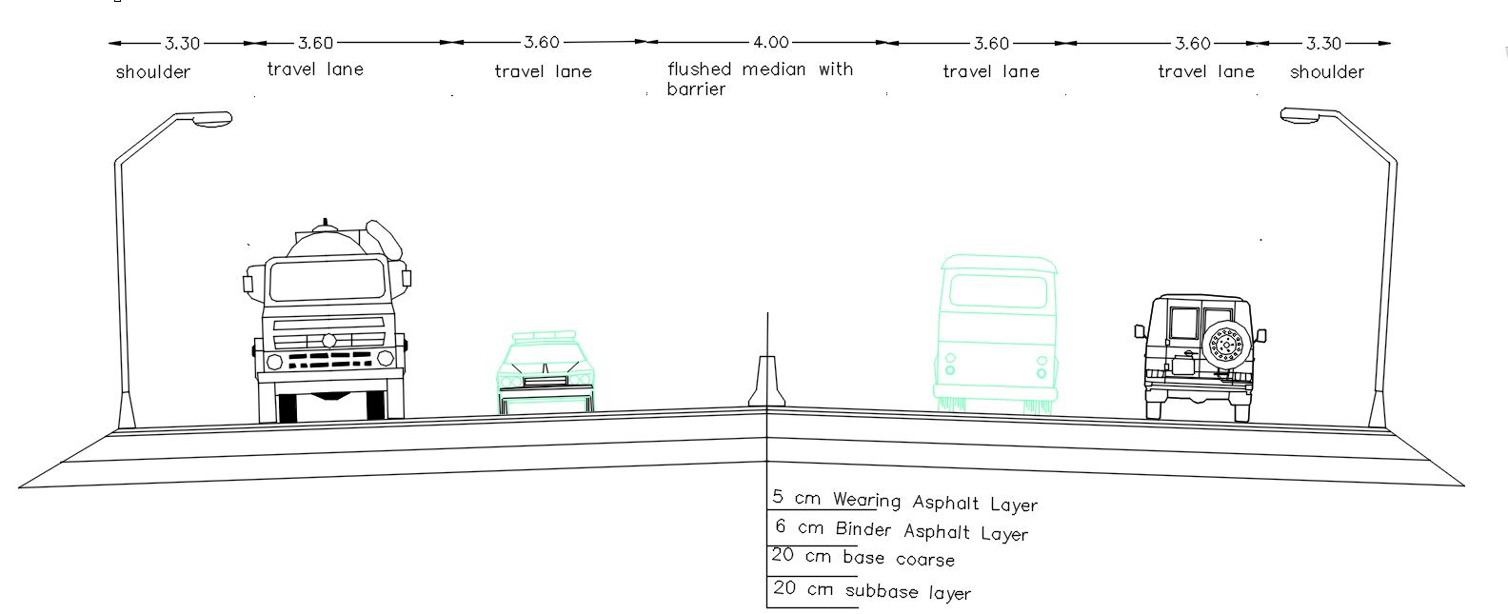
Geometric Design of Proposed Road
Typical Cross Sections:
With Shoulder and flushed median with barrier:

Slide 30
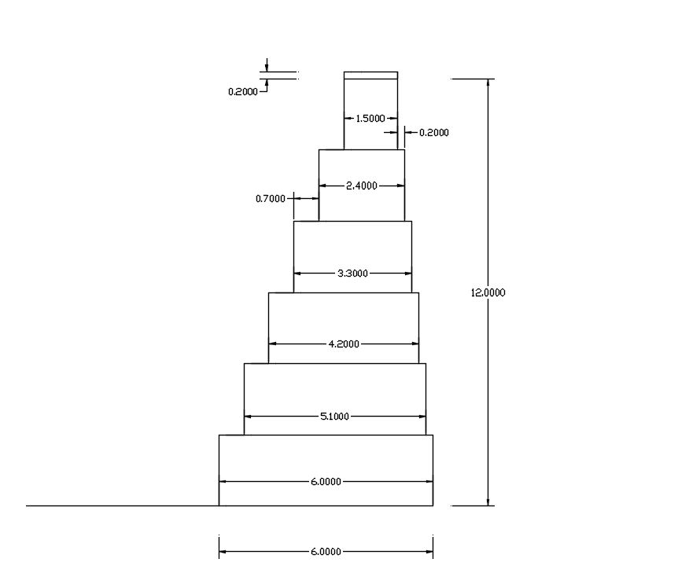
Geometric Design of Proposed Road
We used boulders at high fill sections

Slide 31
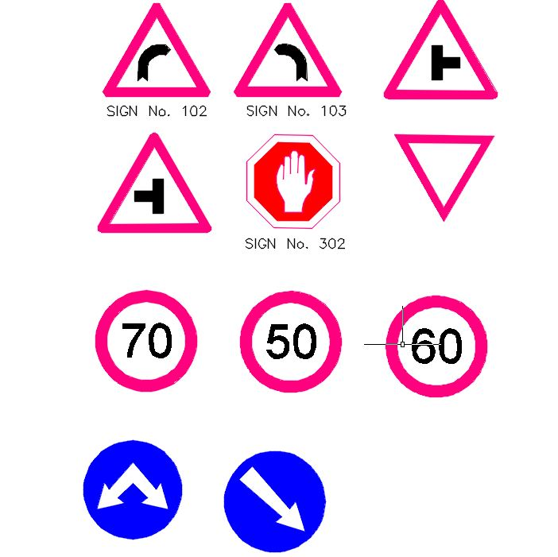
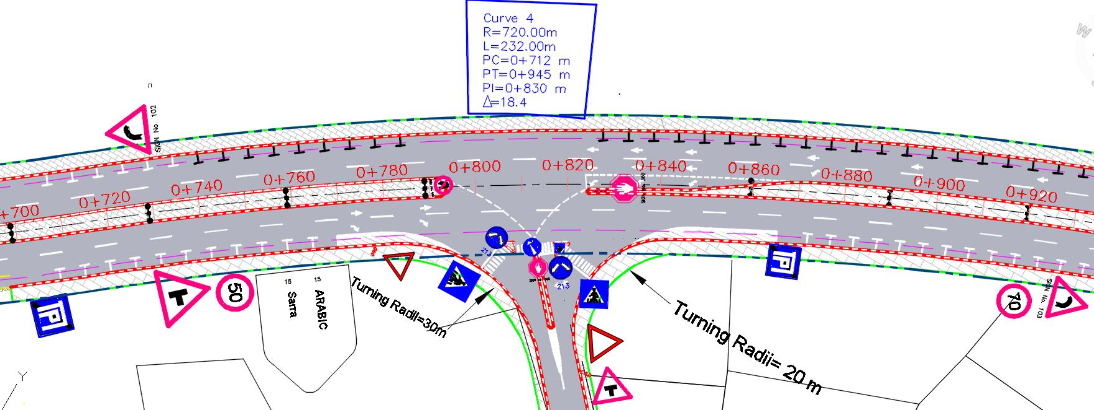
Geometric Design of Proposed Road
Signing and marking:

Slide 32
Pavement Design
ESAL = f_{d} * G_{rn}* AADT_{i}* 365 * N_{i} * F_{Ei}
Where:
ESAL = equivalent single axle load
F_{d} = design lane factor
G_{rn} = growth factor rate (r) and design period (n).
AADT_{i}= average annual daily traffic for single axle category i.
N_{i} = number of axles of axle category i.
F_{Ei} = load equivalent factor for axle category i.
CBR=16

Slide 33
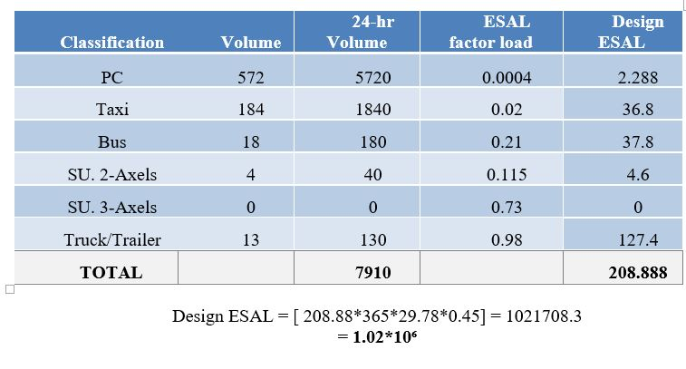
Pavement Design

Slide 34
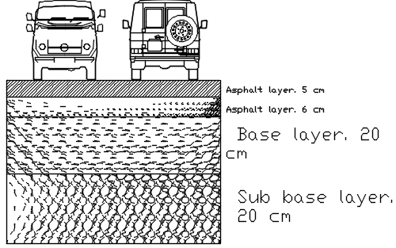
Pavement Design

Slide 35
BOQ and Cost Estimation
Item | Unit | Quantity | Unit cost ($) | Unit | Total
Cost of Cut | m³ | 118944 | 3 | $/m³ | 356,832
Cost of Fill | m³ | 88031 | 4 | $/m³ | 352,124
Sub Base & Base Coarse | m² | 141000 | 5 | $/m³ | 369,000
Pavement Area with thickness 11 cm | m² | 128240 | 26 | $/m² | 1,667,120
Curb Stone | m | 7000 | 16 | $/m | 112,000
Longitudinal Marking | m | 15600 | 3 | $/m | 46,800
Crosswalk marking | m | 1830 | 15 | $/m | 27,450
Sidewalk tiles | m² | 10800 | 20 | $/unit | 216,000
Guar rail | m | 2500 | 100 | $/unit | 250,000
Boulders | m² | 5000 | 250 | $/unit | 1,250,000
Total | - | - | - | - | 4,647,326$

Slide 36
Conclusion
The construction of the Nablus - Qalqilya road is expected to contribute in decrease the congestion problem in Nablus.
The proposed Road route has rough terrain, which makes the design process more critical and more challenge.
It was very difficult to meet the design requirements for a highway at the proposed Nablus - Qalqilya route and site. The topography of the site is very difficult.
It was necessary to make a retaining wall in areas requiring high fill volumes.
The current solutions are aimed to solve the problem completely.

Slide 37
Recommendations
Sarra Municipality is encouraged to attain the needed funds to construct the whole road.
Design a proper drainage system in order to avoid acceptable future problems in the road layers.
Check the levels of the houses located next to the street.
Design a retaining wall .

