Slide 1
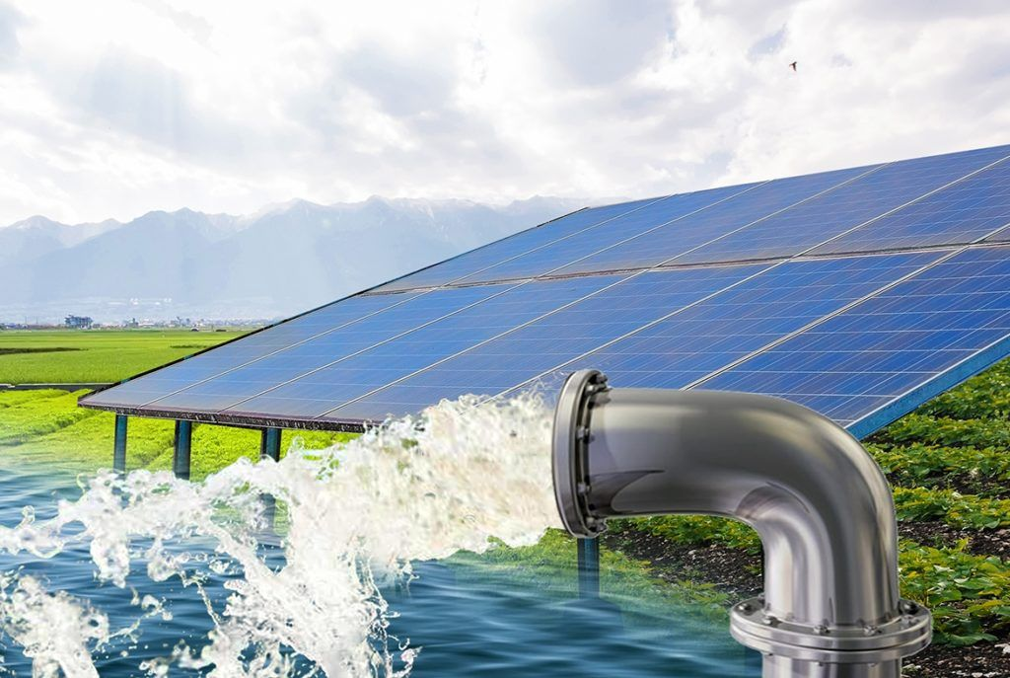
Control criteria for efficiency improvement of dual PV pumping systems

Slide 2
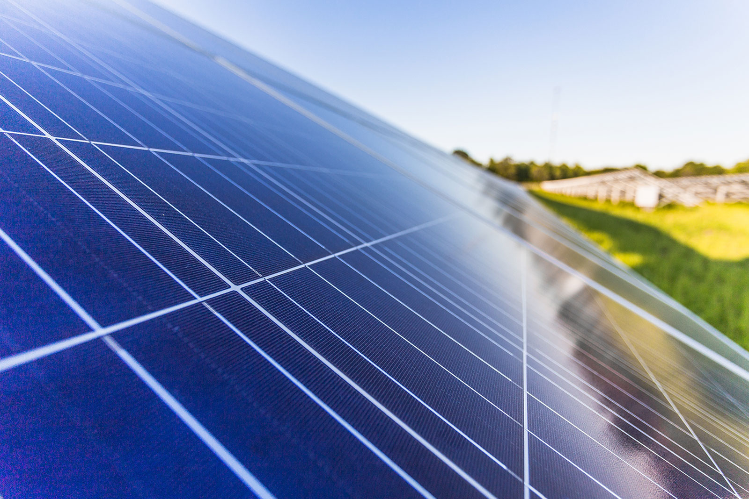
Presented by:
Khalid Waleed Alsheakh
Ahmad Raed Hamdan

Slide 3
1-Concept And Introduction
This section will contain a brief introduction to the operation of solar-powered pumps. The importance and effectiveness of using dual pumps will also be discussed.
2- Problems
This section will talk about the problems of using a single pump to get the results that the user needs.
3- Suggested solution
This section will talk about the effectiveness of using two pumps compared to using one.
4- The Expected Result
This section will discuss all the results that were noted.
5- Conclusion

Slide 4
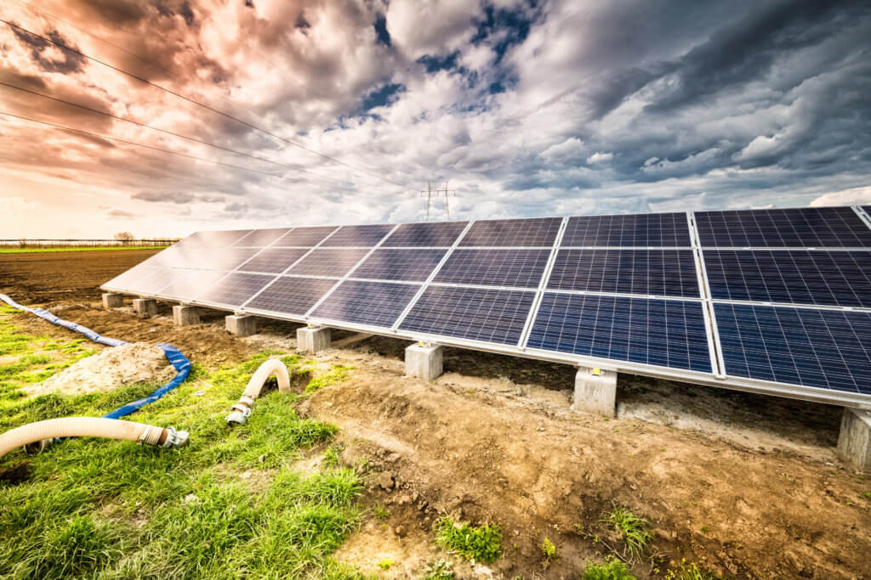
Concept And Introduction

Slide 5
Our goal in this project is to facilitate the provision of water for use for many things, but our topic is to use it to irrigate crops in Ajja-Jenin, and we want to obtain that with the best efficiency and the lowest price, as we will get water that is relatively free (regardless of the cost of establishing the project)
We carried out this project to study the effectiveness of operating two small pumps to pump water from medium depths, relying on solar energy without using batteries, taking into account pumping the required quantities of water and the depth of water in the well, and comparing the results. Using one big pump to get the same results

Slide 6
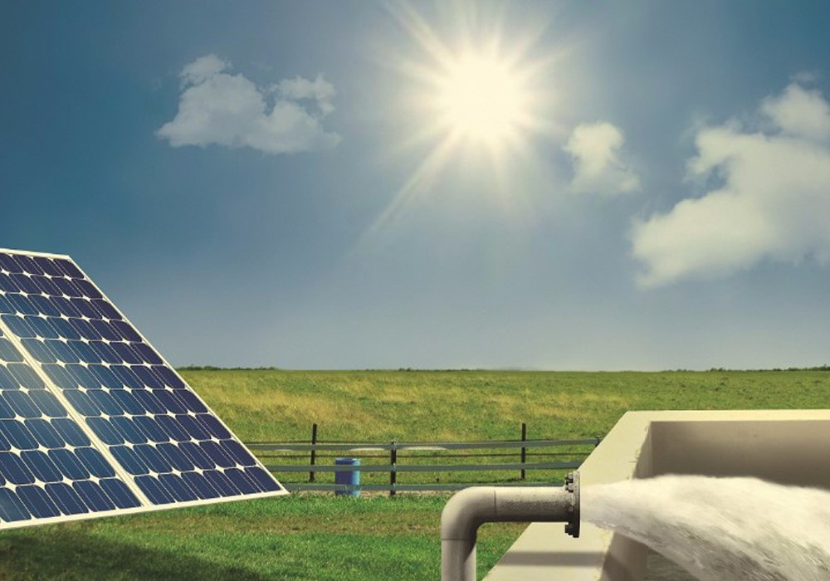
PROBLEMS

Slide 7
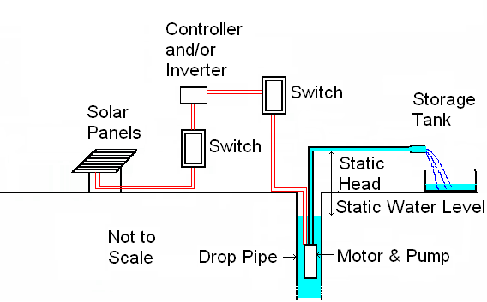
There are water pumps that you can use to pump the water in the required quantities, but they require very expensive electrical power (about 10 shekels per hour).
And we can also put one large pump to pump that water through solar energy, but it will need solar panels with double capacity to meet the required water pumping.
Or we can use fewer solar panels, but the pump will not work in certain periods due to weak solar energy at certain times of the day.
Even with the pump running all day, this will expose it to greater maintenance costs, and thus an increase in project costs in terms of the number of panels and periodic maintenance required.

Slide 8
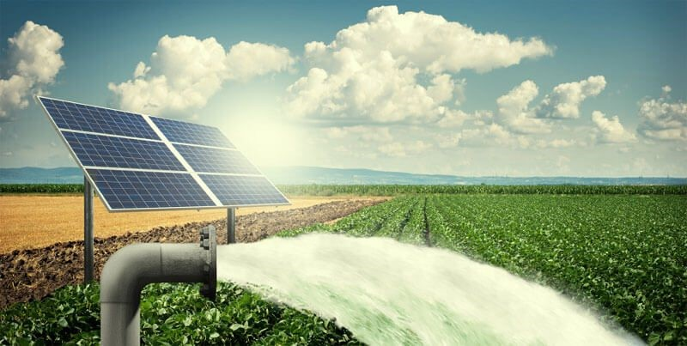
Suggested solution

Slide 9

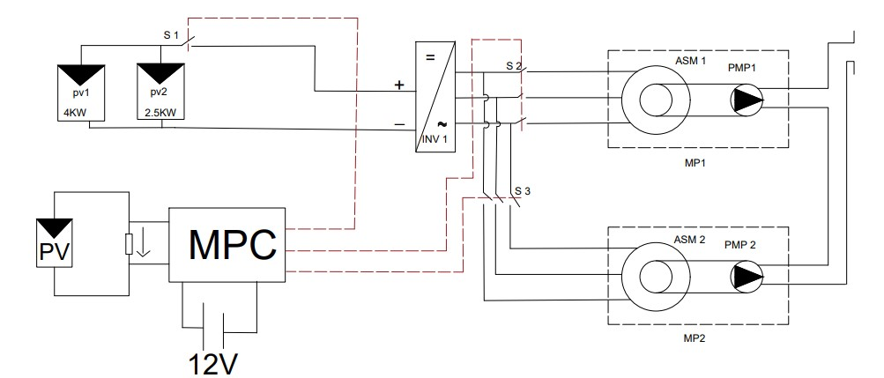
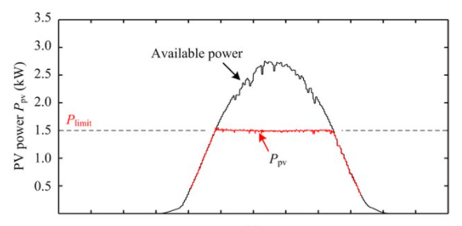
The idea of the project is to install two water pumps with small capacities to pump water at times of peak solar energy and also during times of weakness. The service life is longer and the efficiency is higher.
The control system (MPC) was designed locally to switch the appropriate load (1 or 2 pumps) according to the output power of the PV generator, or the quantity of the water that the user needs, Electrical connections between the system components occur through the controllable switches S1-S3 .

Slide 10
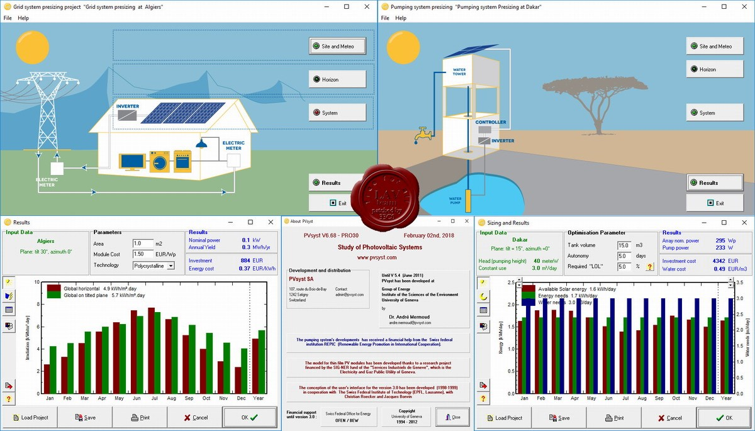
Use (Pv-system 6.8.1) to get the results

Slide 11
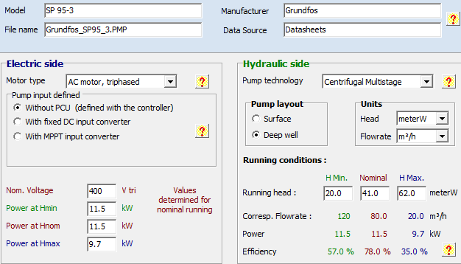
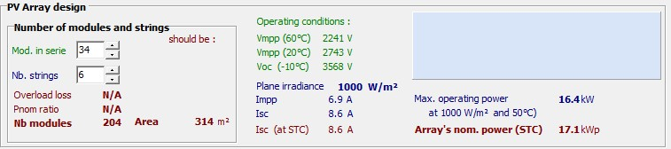
Initially, we chose one large pump to meet the required quantities, and the most suitable one (available information about it in the program) is as follows:
Also, the number of solar panels that supplied the pump with sufficient power to pump the required amount of water:
In fact, 156 units are needed to meet the input voltage requirement of the inverter to build 6 parallel chains each It consists of 34 PV modules connected in series.

Slide 12
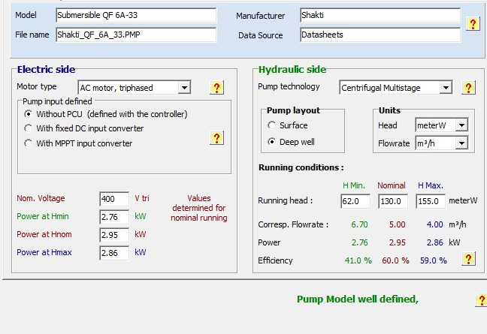
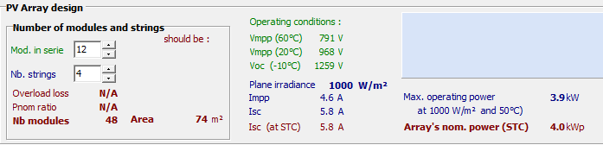
We connected two small pumps in parallel and the two pumps were as follows:
We needed 48 units (4 parallel chains each It consists of 12 PV modules connected in series).

Slide 13
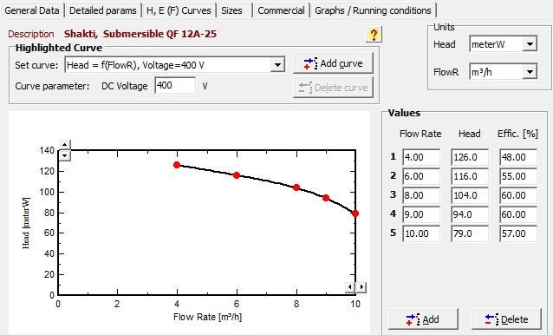
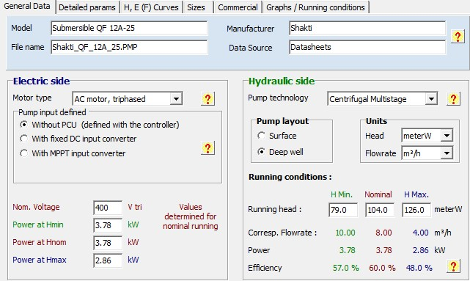
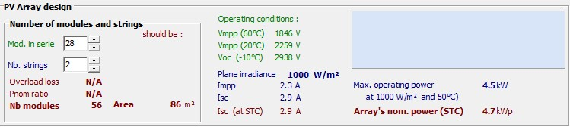
(pump 2 with pv arrays)
We needed 56 units (2 parallel chains each It consists of 26 PV modules connected in series).

Slide 14
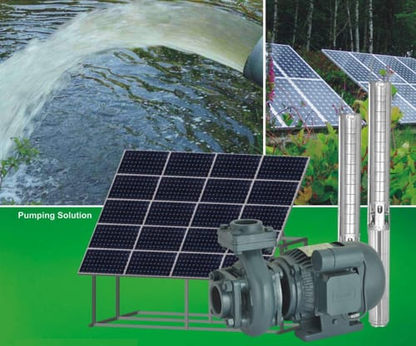
The Expected Result

Slide 15
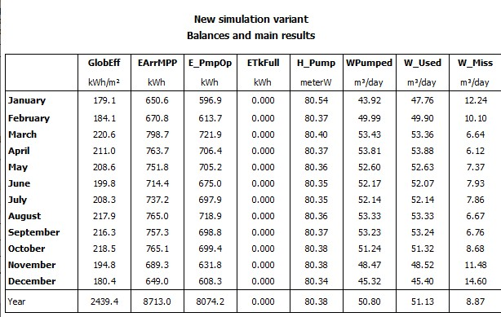
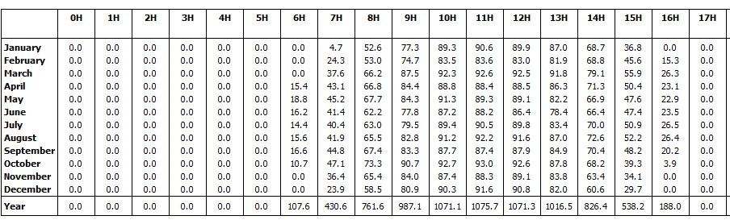
When operating the system with its two units separately (I mean running each pump using its own PV ARRAY), we get results as follows:
The average volume of water pumped by the first unit is 50 cubic meters (Figure-1), while the corresponding volume of system 2 is 67 cubic meters (Figure-2), and that is in January (at a monthly average of Esd=179kWh/m2.month)
Pump1 readings

Slide 16
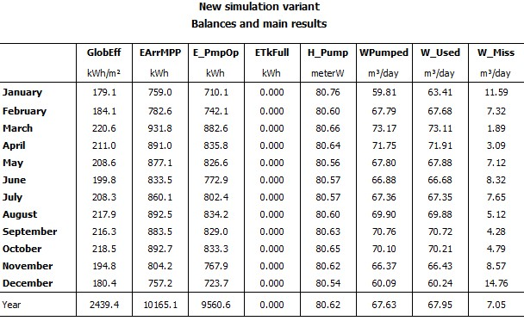
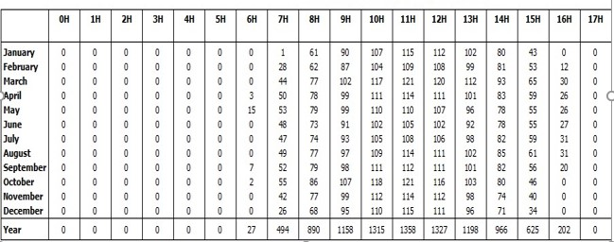
Therefore, when operating the two pumps alternately, we will get the required amount of water 150 m3 with ease, which guarantees a long life for the two pumps, but if the user wants less water, he can operate one pump depending to the solar energy generated from the full panels (8700 watts).
The first pump alone pumps at a rate of 65 m3 per day(Figure-3), and the second pump pumps at a rate of 85 m3 per day (Figure-4) (knowing that the pump will work using the two units of the photoelectric array).
Pump2 readings

Slide 17
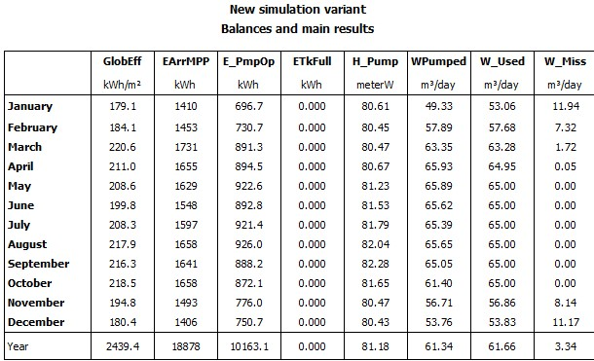
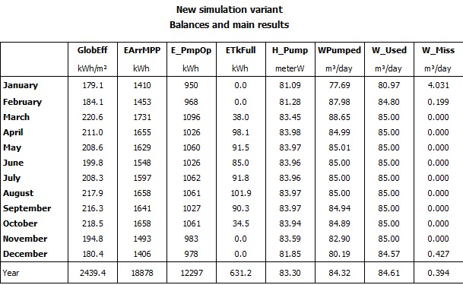
Pump1 alone with pv array =8700 watt
Pump2 alone with pv array =8700 watt

Slide 18
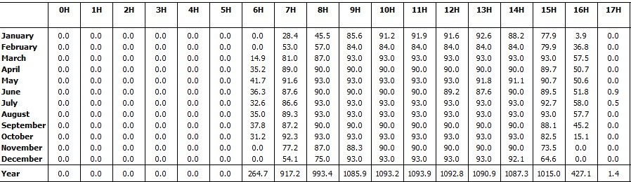
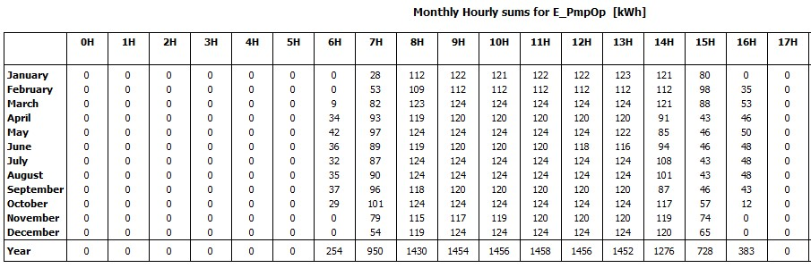

Slide 19
Conclusion

Slide 20
The design of the system using two pumps proved to be more effective and quality than the system consisting of one pump, because it provides the user with more water at an almost equal price, as well as the system needs less maintenance.
PV systems compete economically within a large range with diesel-powered system in any area of ​​high solar energy potential .
Utilizing of control system enables, during periods of low solar radiation, better exploitation of the produced PV power and driving the motor pump closer to its rated power, which increases the daily average of pumped water .
This system allows ease and flexibility for the user by controlling it using the control unit, which is considered a low price compared to the rest of the system parts and its great features.

Slide 21
Thank You

