Slide 1



An-Najah National University
Faculty of Engineering and Information Technology
Computer Engineering Department
Software Graduation Project
Farah Musa Elhasan & Alaa Anwar Hasan

Slide 2

TAREEQ | قيرط
1
INTRODUCTION
2
PROJECT EXECUTION
5
FUTURE WORK
TABLE OF CONSTANTS
3
TAREEQ FEATURE
4
CONSTRAINTS

Slide 3


INTRODUCTION

Slide 4




INTRODUCTION
THE PROBLEM

Slide 5





OBJECTIVES
INTRODUCTION
❖
❖
❖
❖
❖
❖

Slide 6



Slide 7

TAREEQ | قيرط
1
INTRODUCTION
2
5
PROJECT EXECUTION
TABLE OF CONSTANTS
FUTURE WORK
3
TAREEQ | قيرط
FEATURE
4
CONSTRAINTS

Slide 8
PROJECT EXECUTION

Slide 9
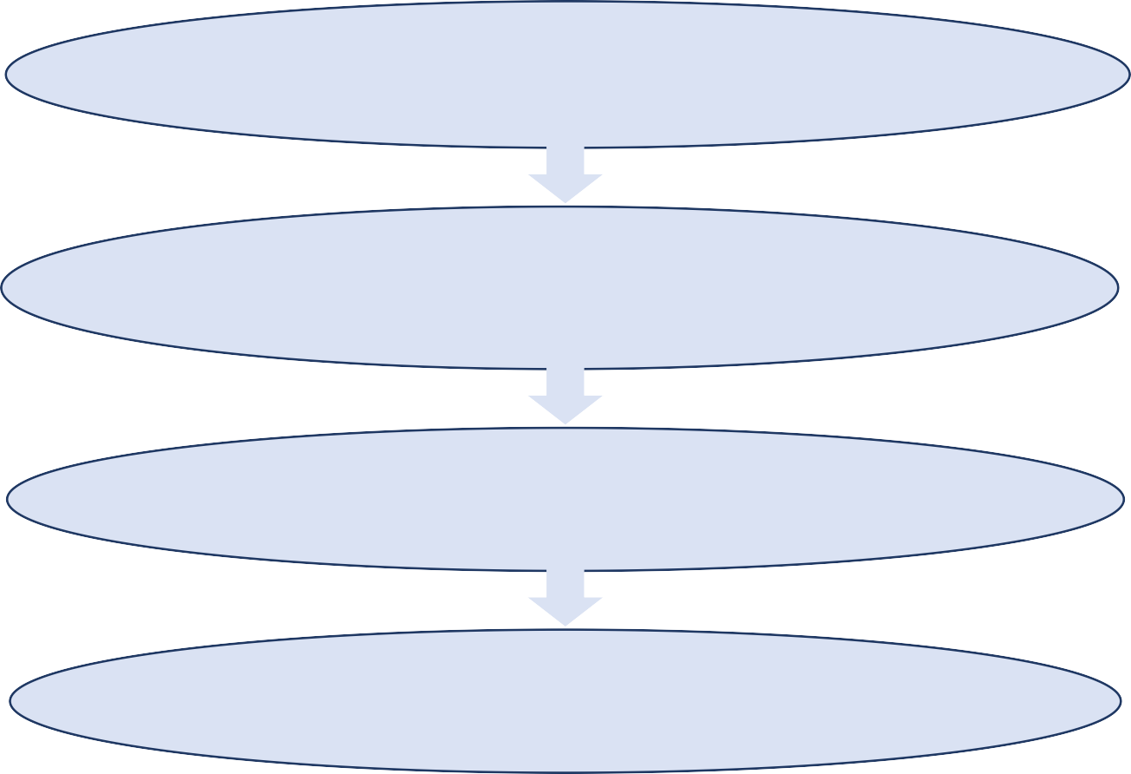
SYSTEM ARCHITECTURE
Presentation Layer (Frontend)
Business Logic Layer (Backend) Data Access Layer
Database Layer External Services Layer

Slide 10

SYSTEM ARCHITECTURE
PROJECT EXECUTION
Presentation Layer (Frontend): Handles user interactions through a responsive UI, integrating maps for navigation and displaying route information.
Business Logic Layer (Backend): Manages application logic, including route planning algorithms, user authentication, and bidirectional path handling at checkpoints.
Data Access Layer: Facilitates communication between the backend and database
Database Layer: Stores persistent data such as user profiles, checkpoints, and route information, ensuring data integrity and efficient retrieval.
External Services Layer: Integrates with external services like Google Cloud for image storage and APIs for additional functionalities such as geocoding and real-time data updates.

Slide 11






TECHNOLOGIES USED
PROJECT EXECUTION
BACK END
Node.js
Express.js
FRONT END
Flutter framework
DATA BASE
MYSQL workbench
Firebase

Slide 12

TAREEQ | قيرط
1
INTRODUCTION
2
PROJECT EXECUTION
5
TABLE OF CONSTANTS
FUTURE WORK
3
TAREEQ | قيرط
FEATURE
4
CONSTRAINTS

Slide 13
TAREEQ | قيرط
FEATURE

Slide 14
MOBILE APPLICATION USER

Slide 15

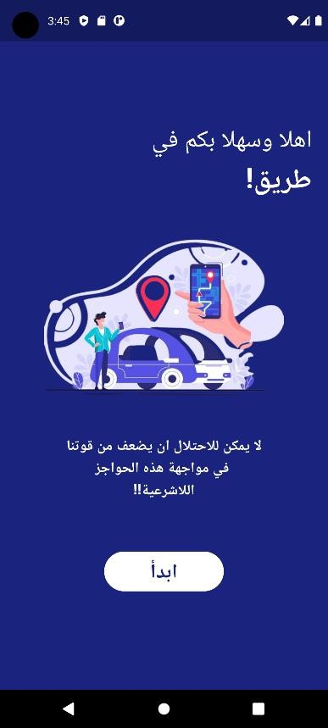

Slide 16

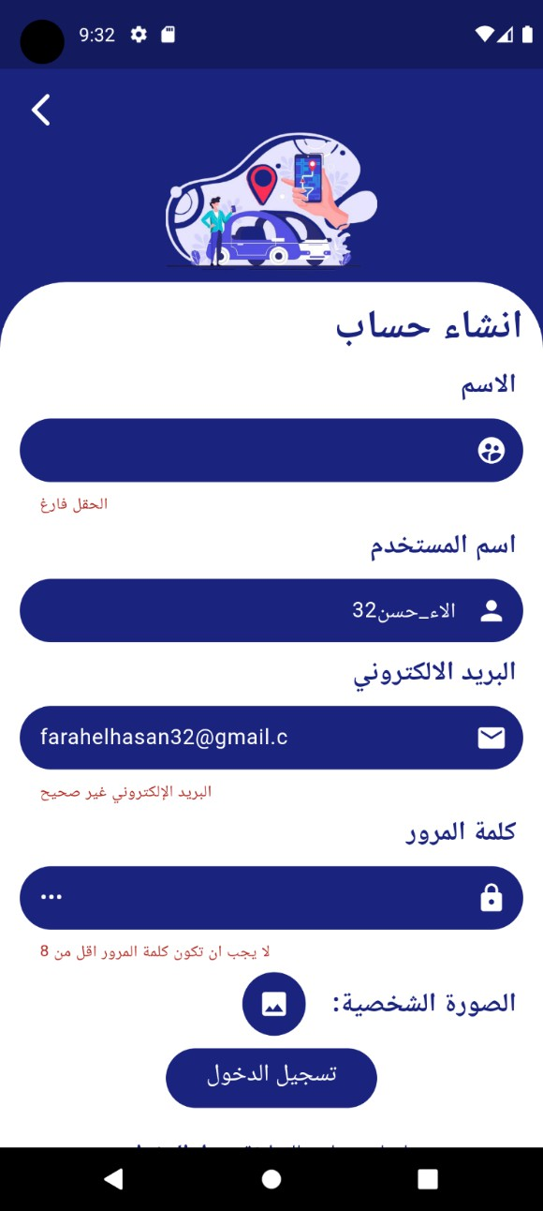

Slide 17


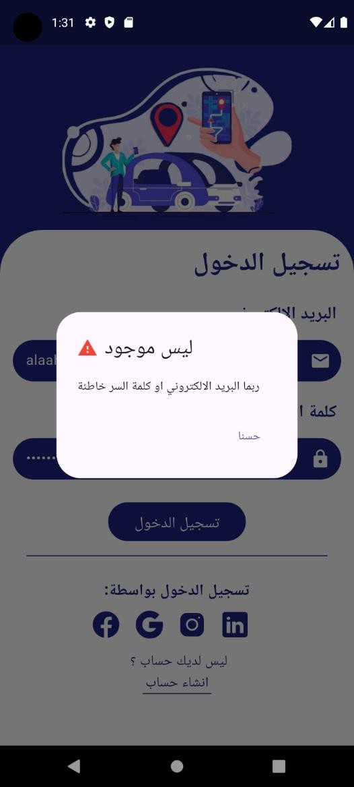

Slide 18



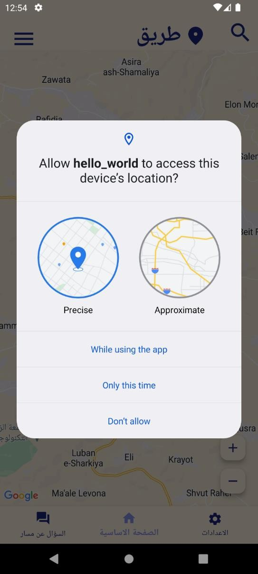
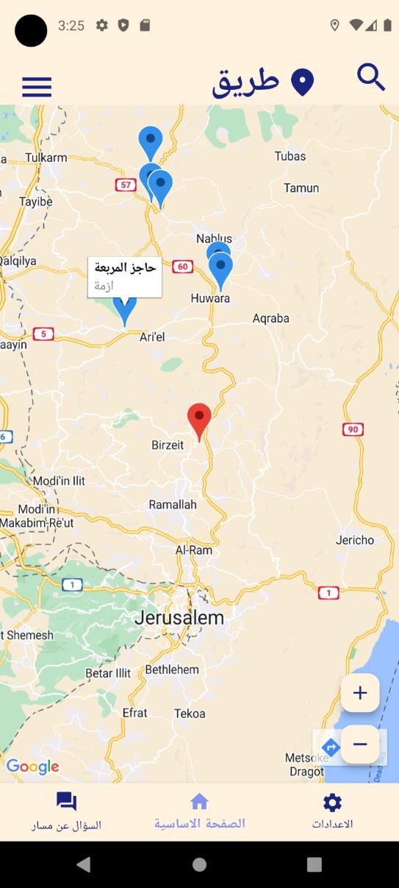
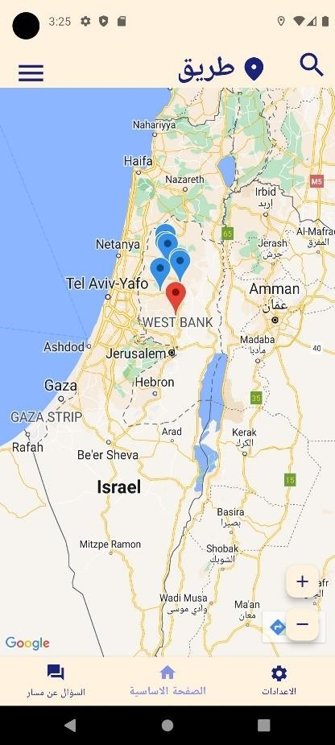
ةيسيئرلا ةحفصلا
Tareeq | قيرط
Palestine

Slide 19



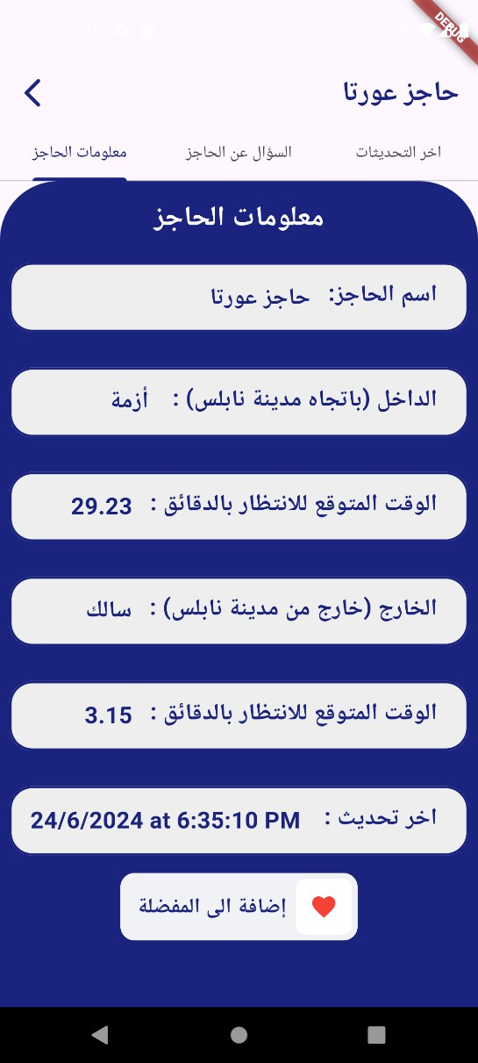
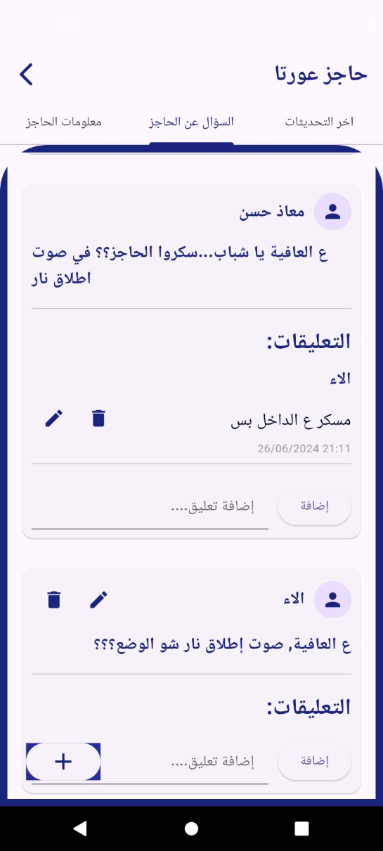
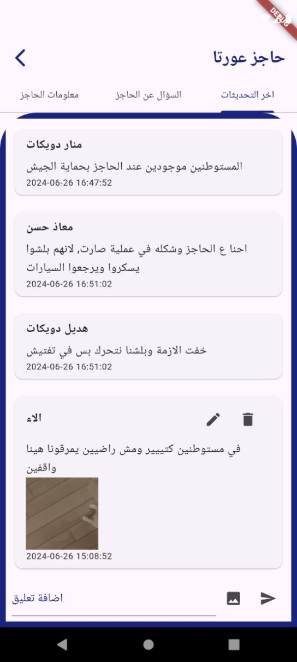

Slide 20



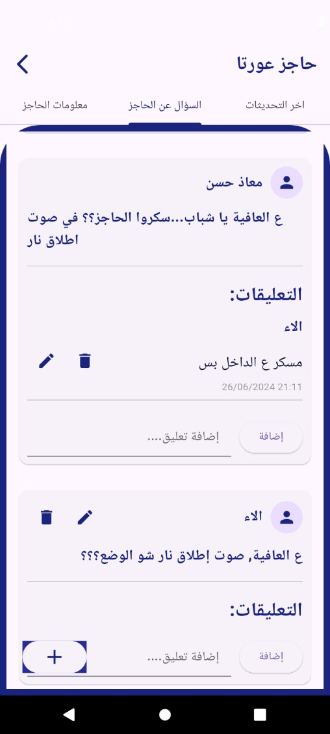
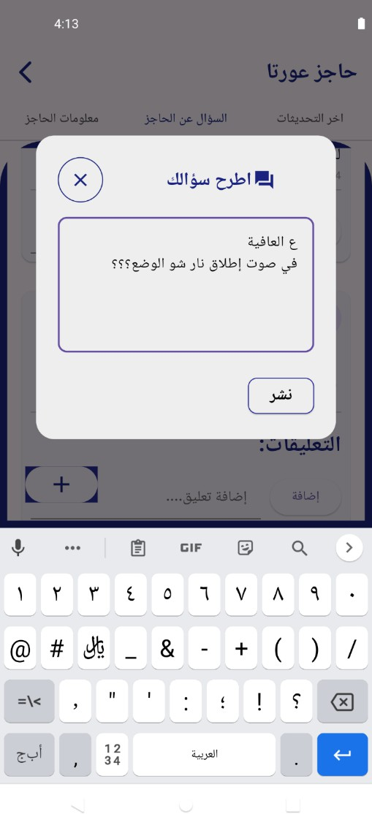
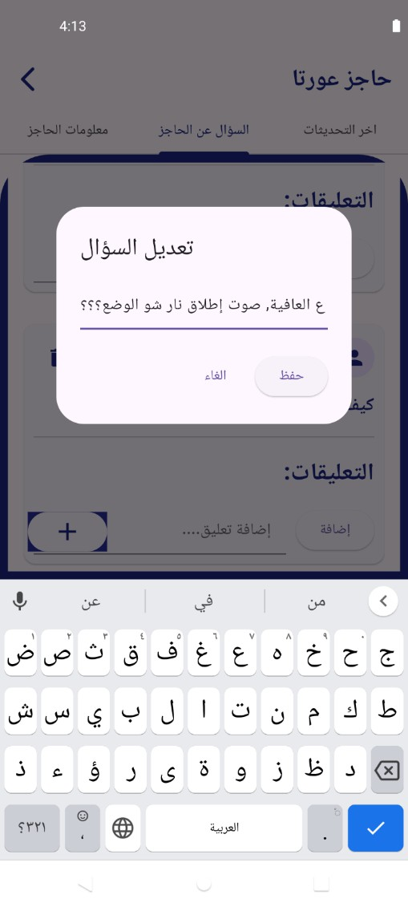
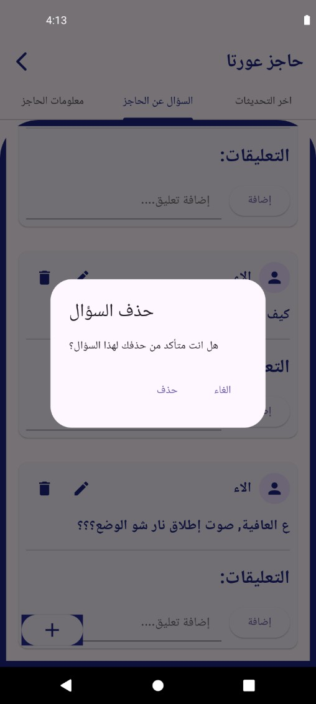

Slide 21




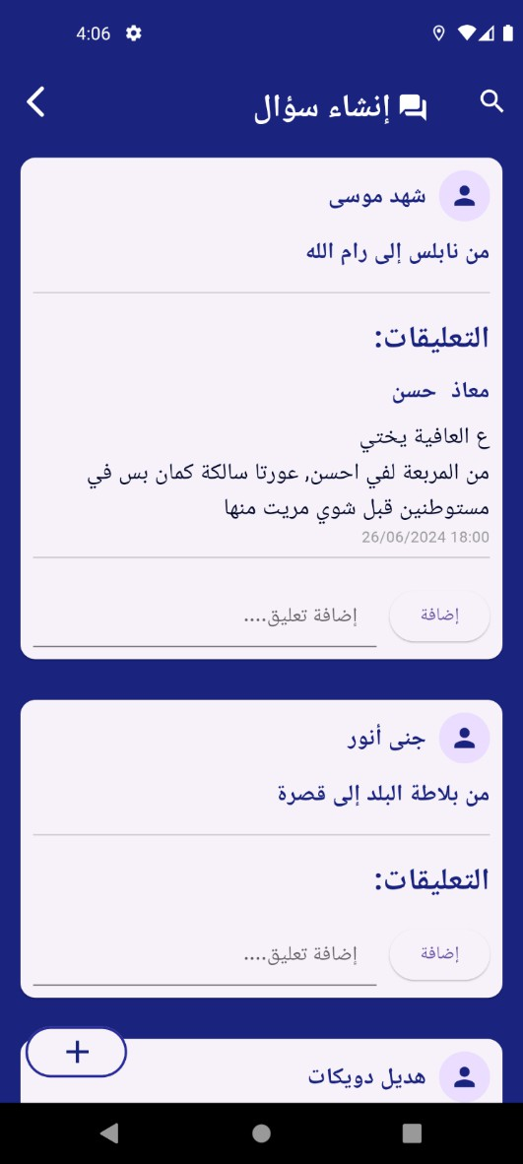
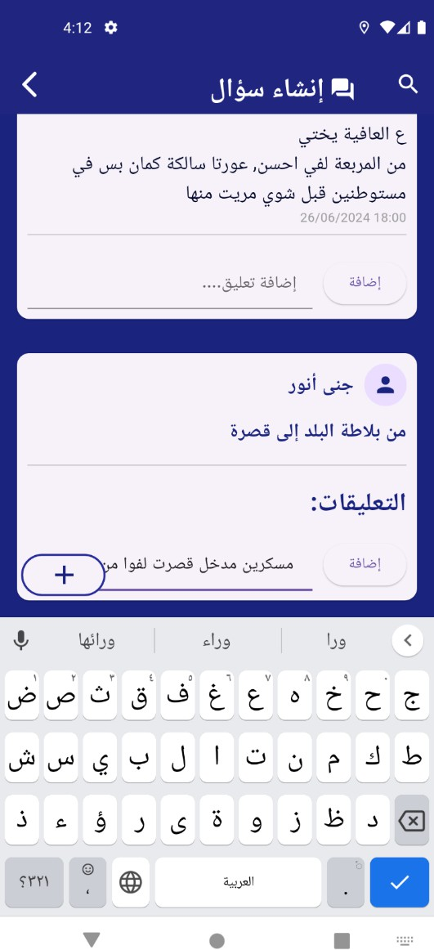
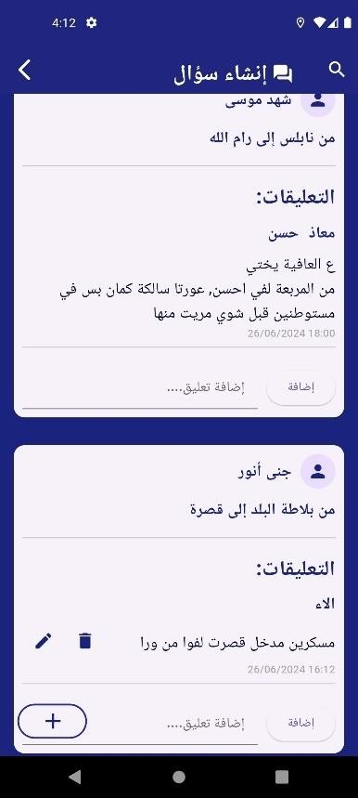
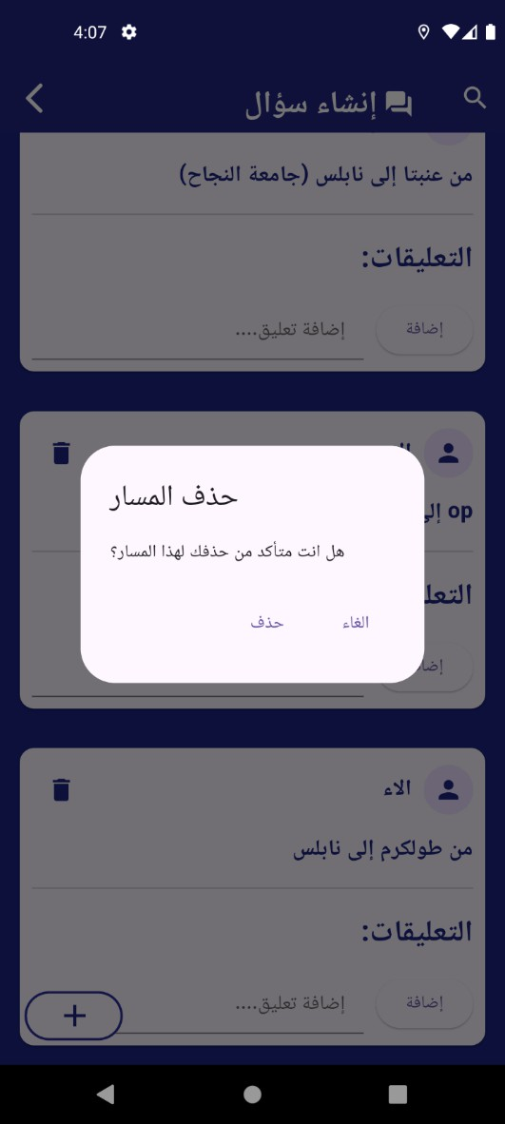
راسم نع لاؤسلا

Slide 22

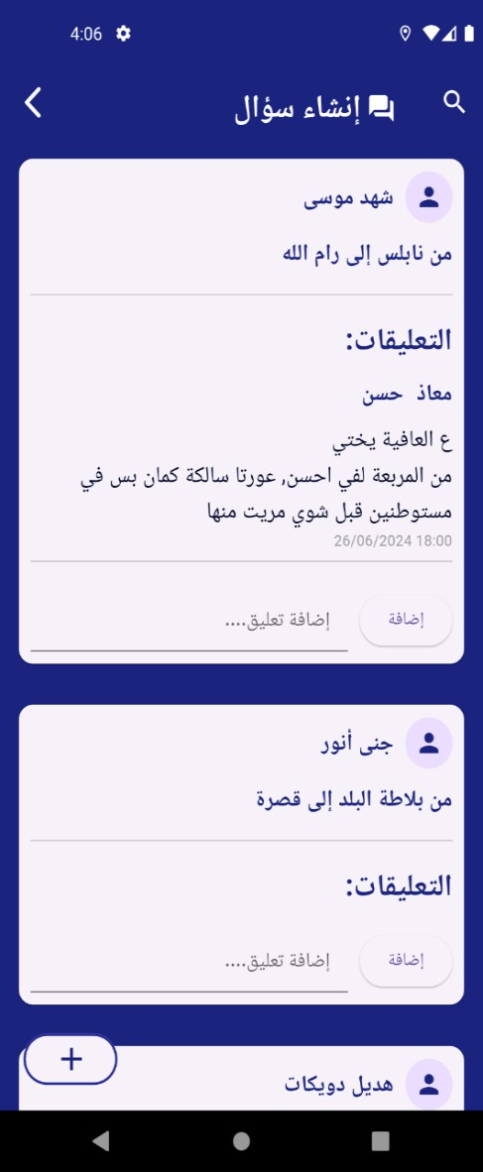


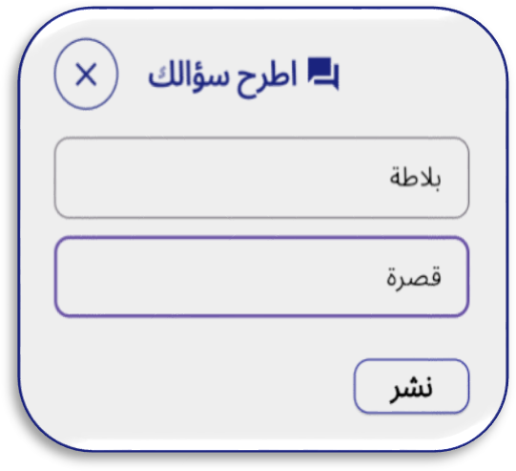

راسم نع لاؤسلا
SEARCH
ADD:

Slide 23





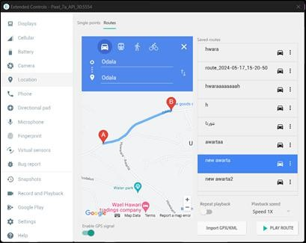
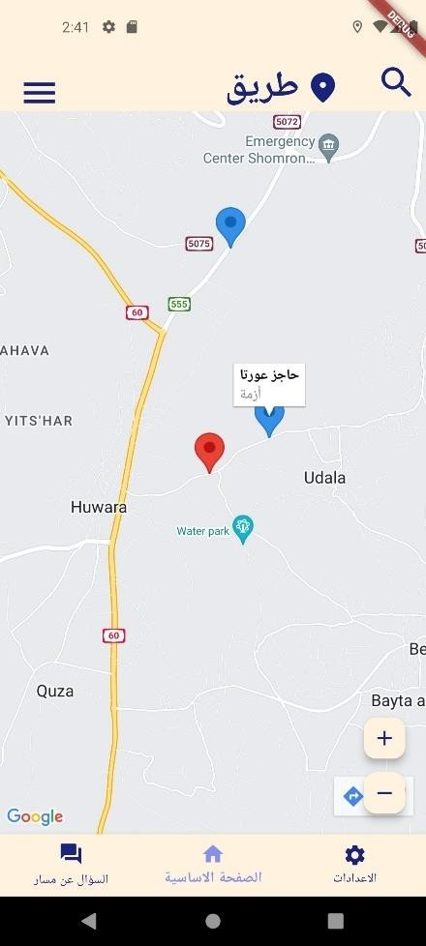
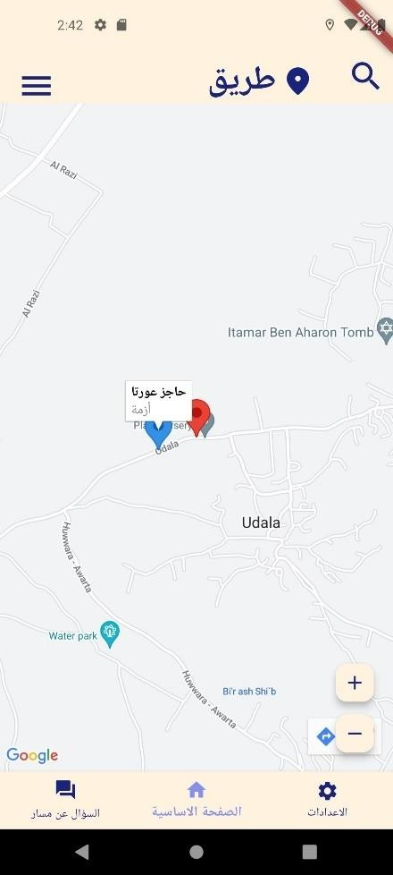
A
B

Slide 24
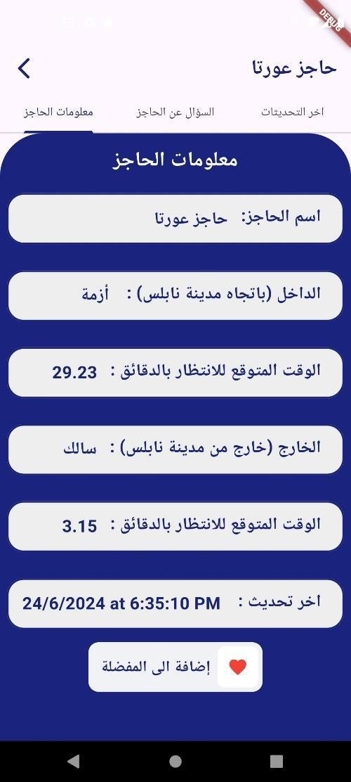
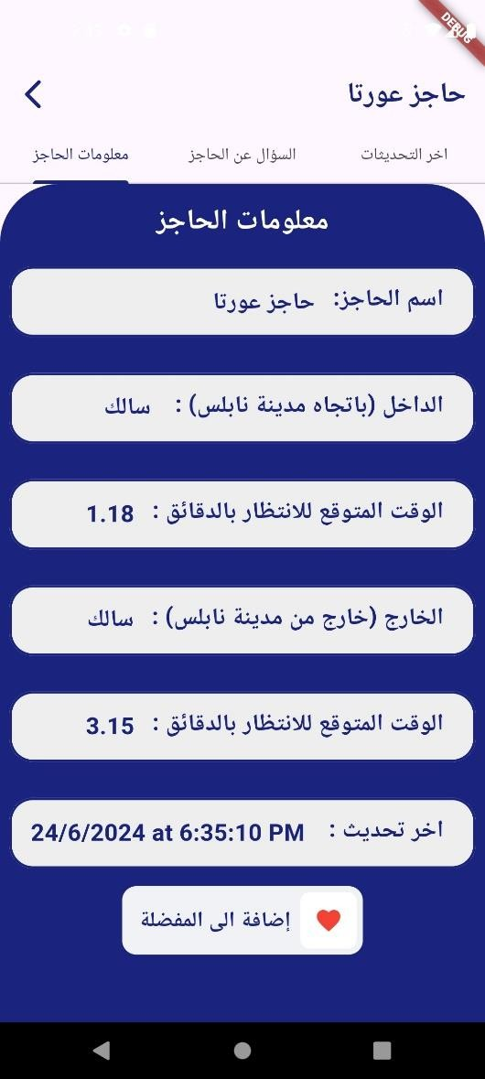
After
Befor

Slide 25

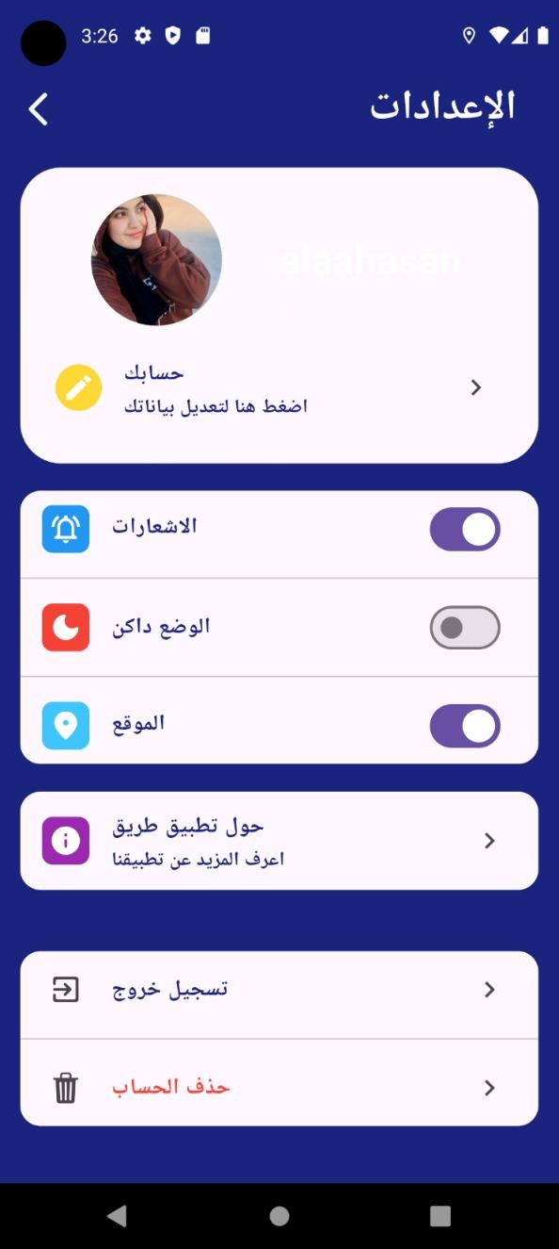
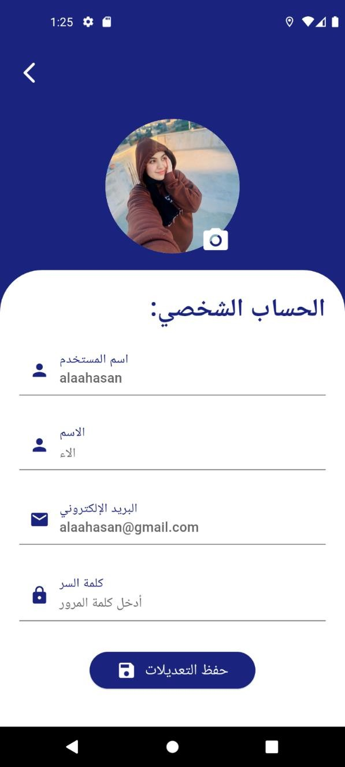
تادادعالا

Slide 26

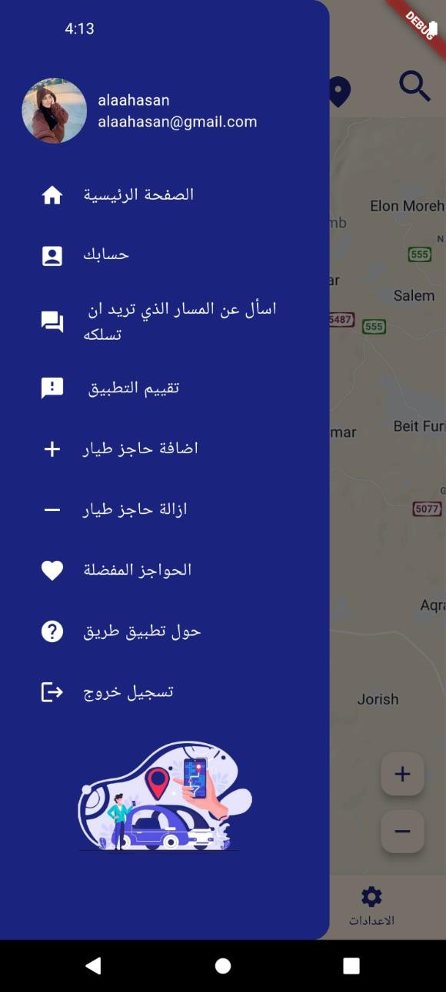
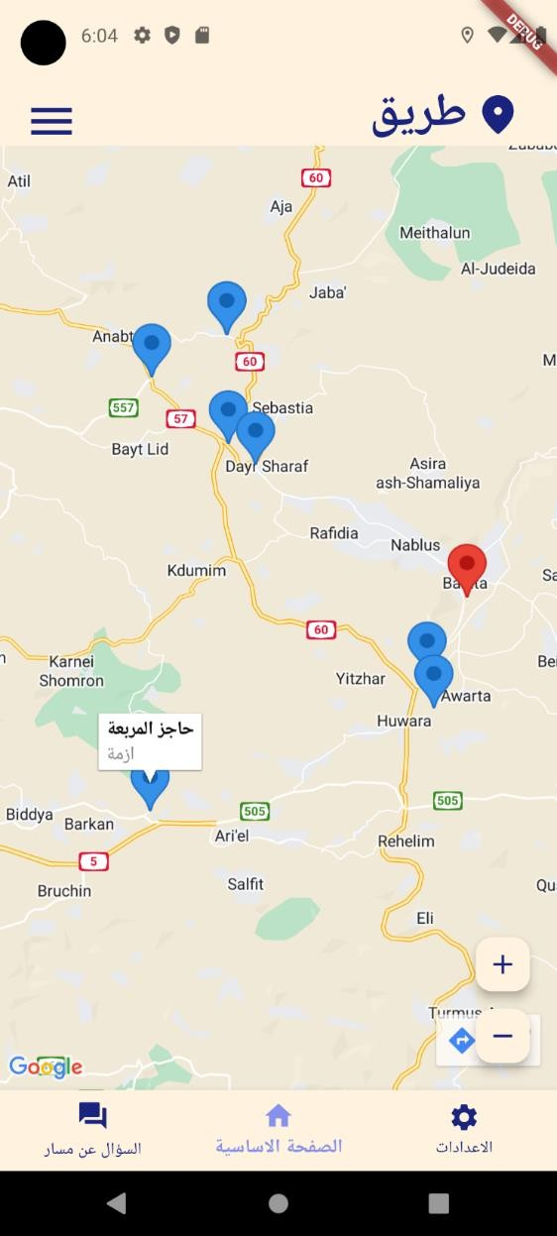

Slide 27


Slide 28


Slide 29
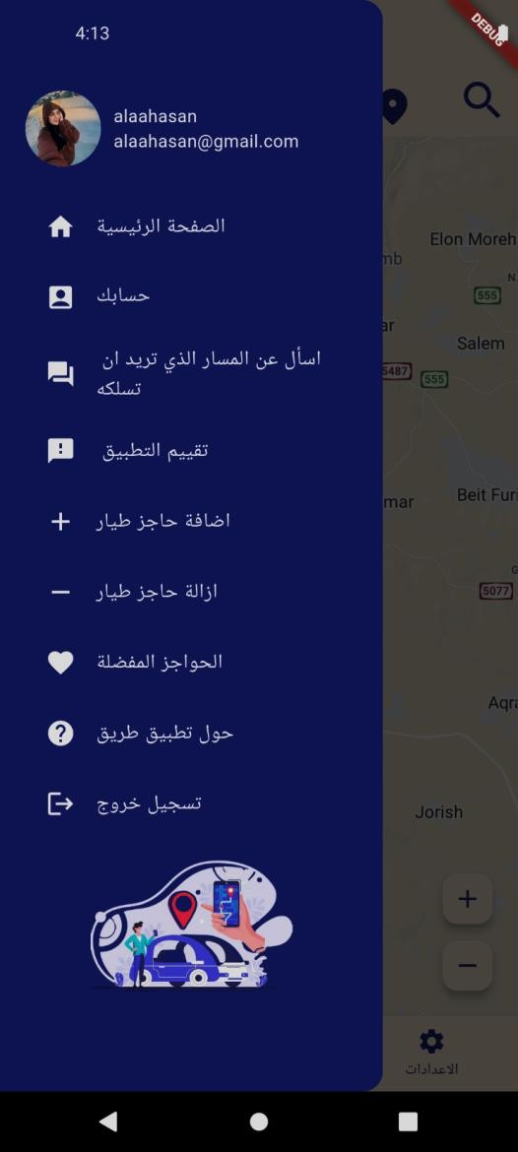
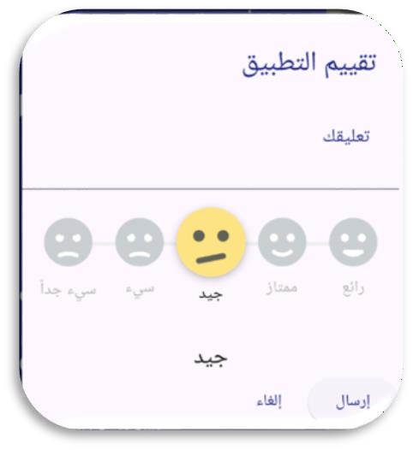
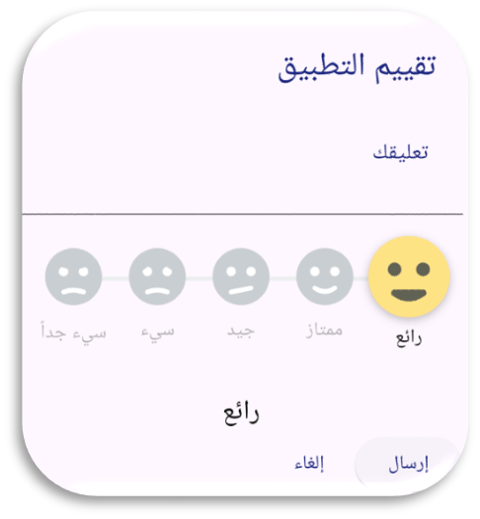

Slide 30

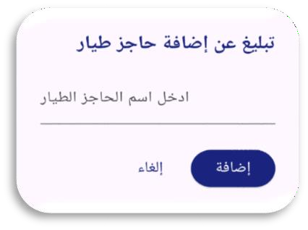


Slide 31
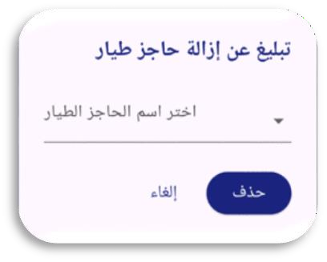
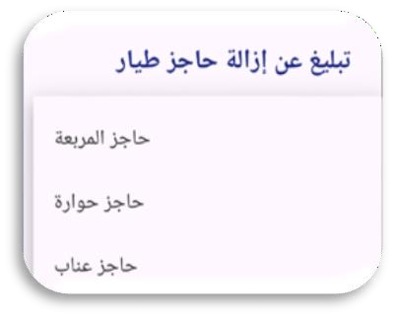
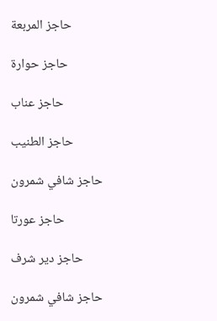

Slide 32
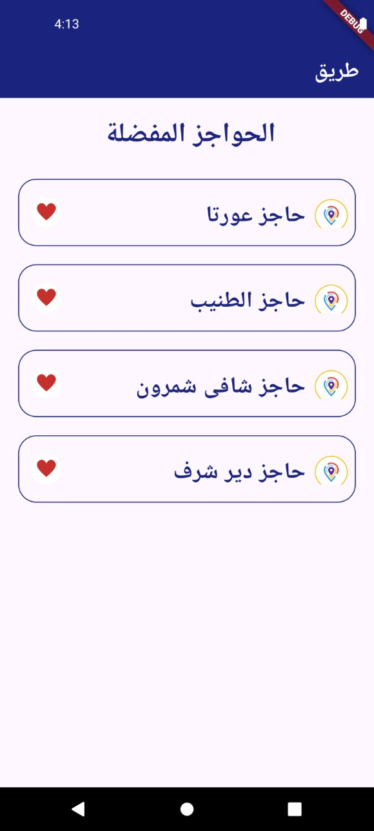
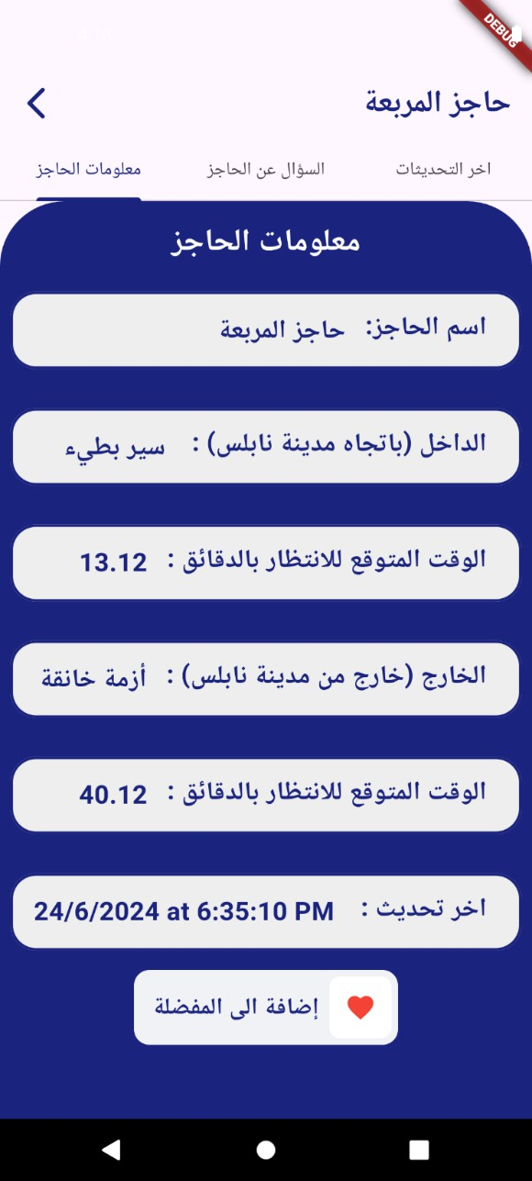
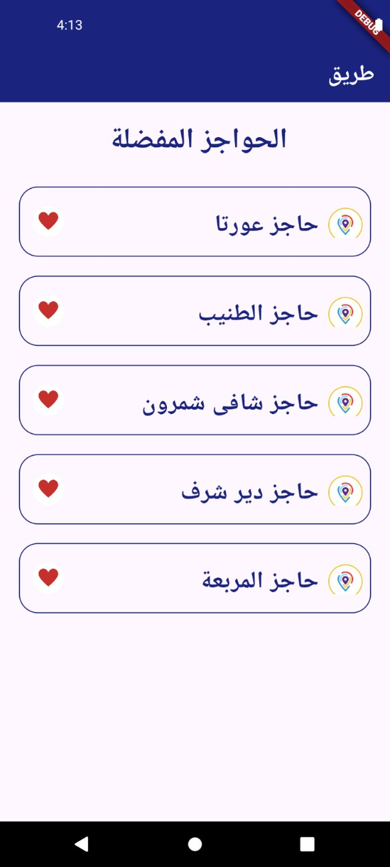

Slide 33
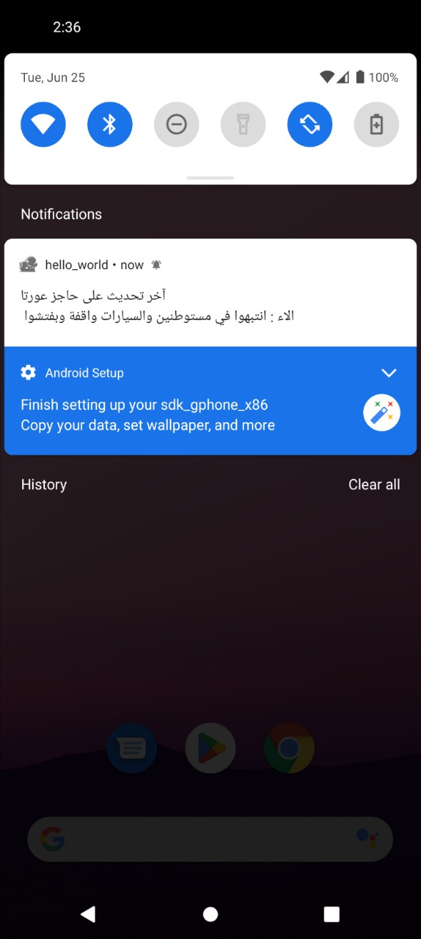
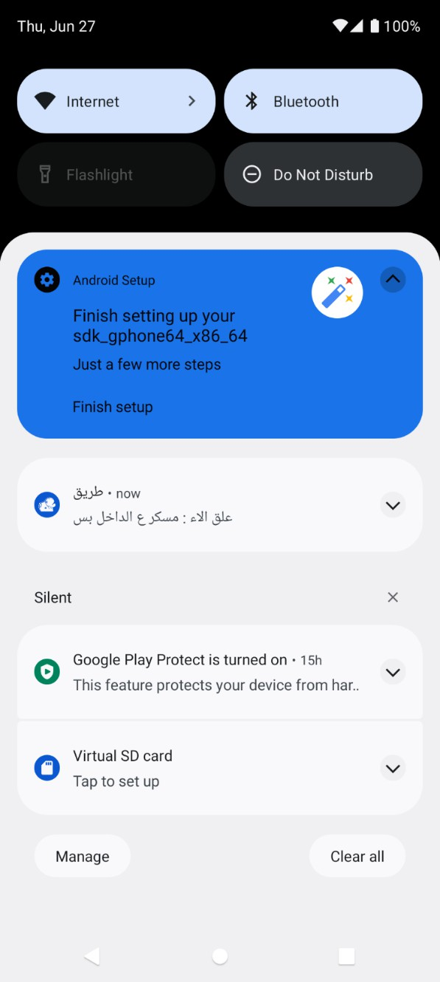

Slide 34


Slide 35


Slide 36
MOBILE APPLICATION ADMIN

Slide 37




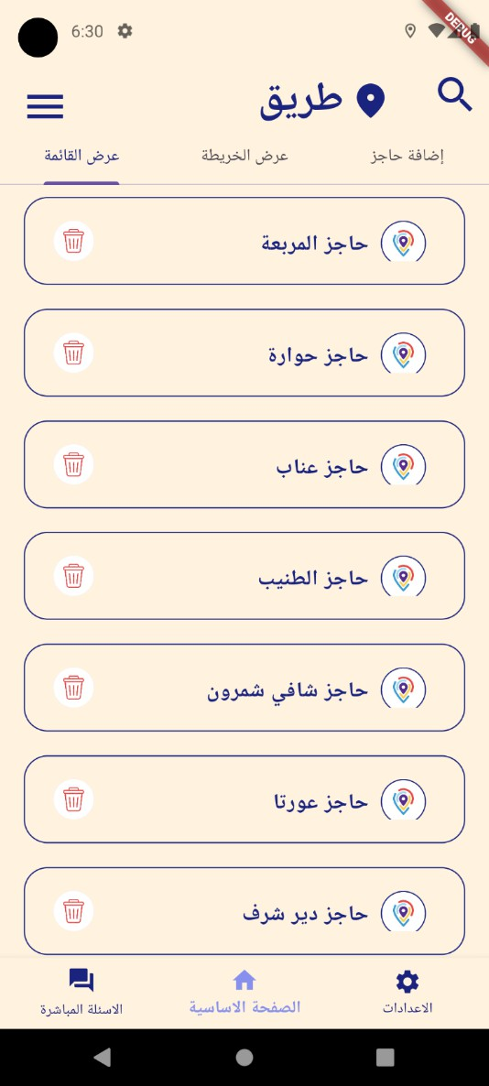
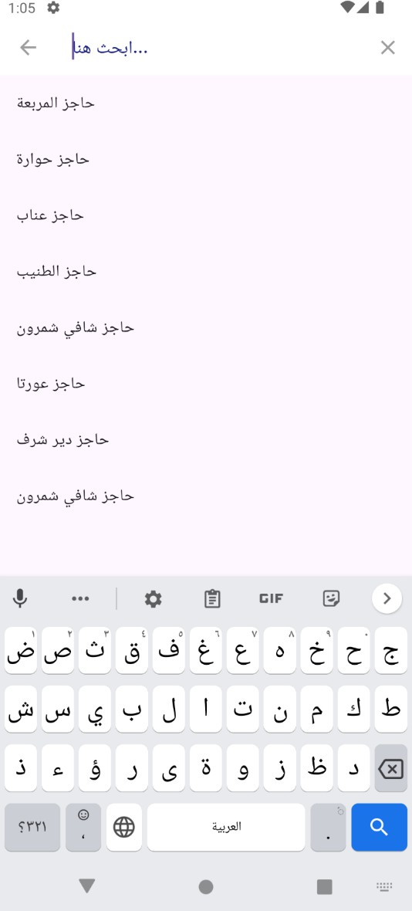
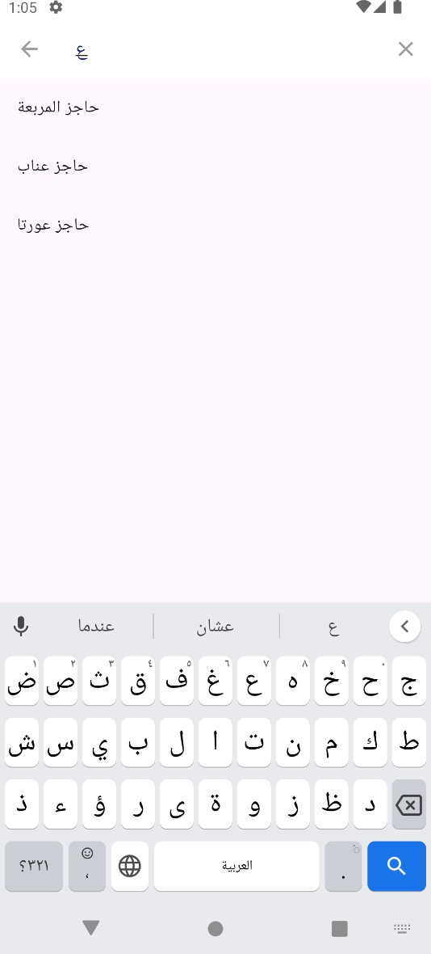
ةيسيئرلا ةحفصلا

Slide 38

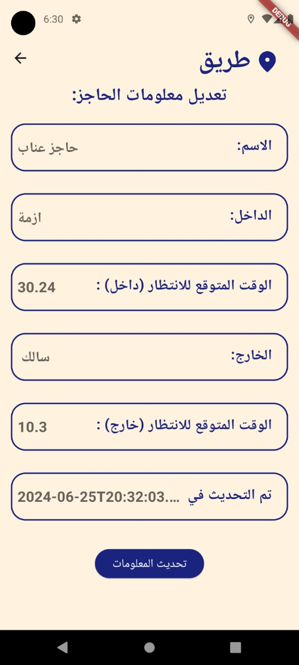
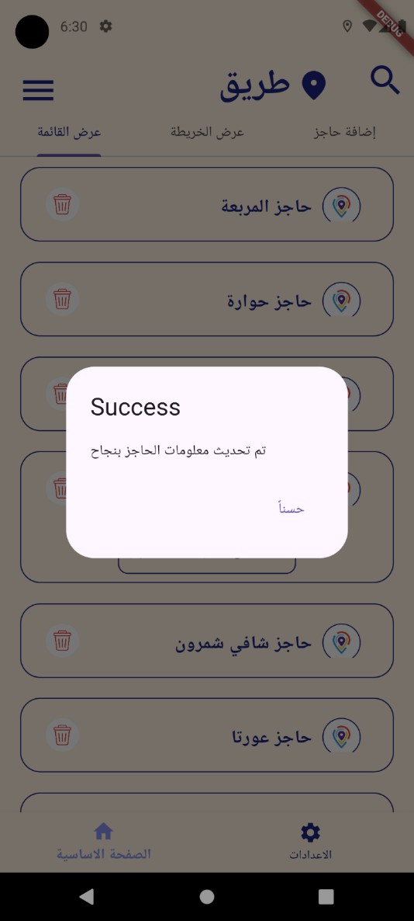
ةيسيئرلا ةحفصلا

Slide 39


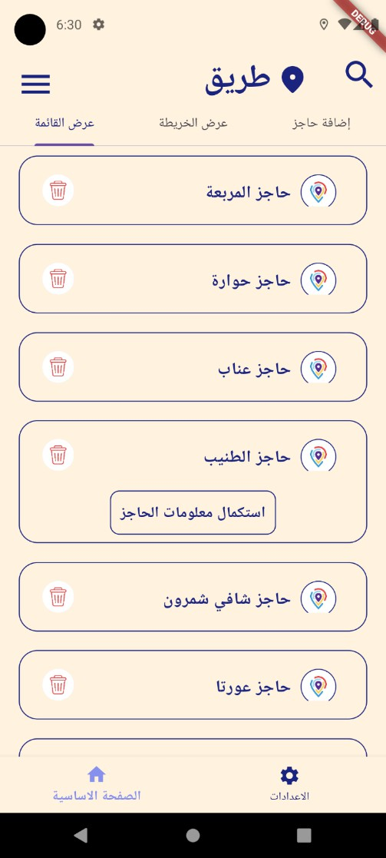
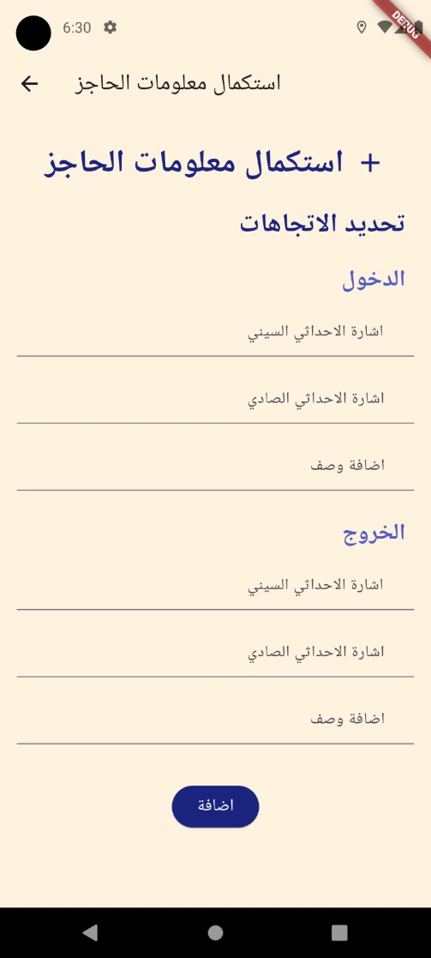
ةيسيئرلا ةحفصلا

Slide 40


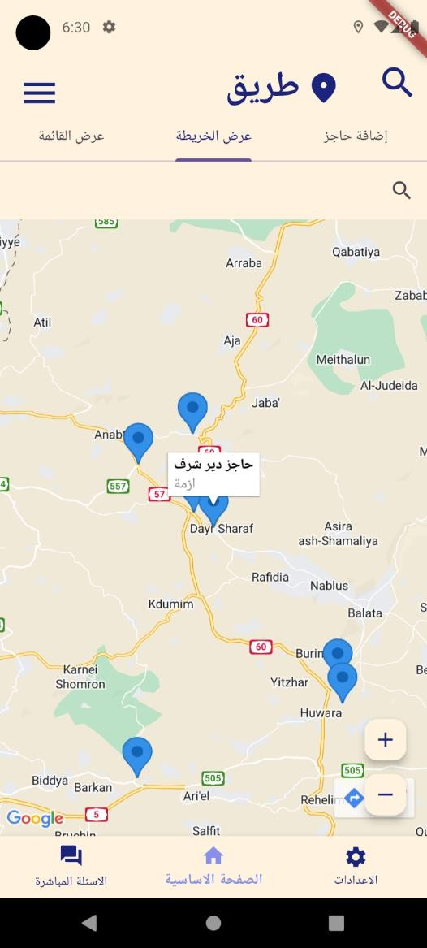
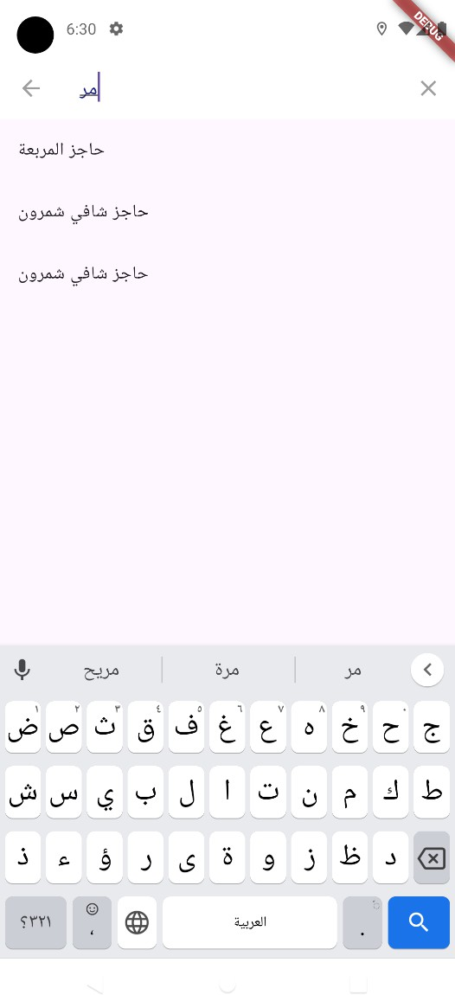

ةيسيئرلا ةحفصلا

Slide 41




ةيسيئرلا ةحفصلا

Slide 42





Slide 43


Slide 44
WEBSITE USER

Slide 45



Slide 46
WEBSITE ADMIN

Slide 47



Slide 48

TAREEQ | قيرط
1
INTRODUCTION
2
PROJECT EXECUTION
5
TABLE OF CONSTANTS
FUTURE WORK
4
CONSTRAINTS
3
TAREEQ | قيرط
FEATURE

Slide 49
CONSTRAINTS

Slide 50

CONSTRAINTS
Map Features and GPS Accuracy:
Faced challenges with emulator inaccuracies and GPS limitations.
Implemented movable checkpoints for testing.
Applied a threshold for GPS accuracy in simulations.
Direction at Checkpoints:
Difficulty determining user direction at bidirectional checkpoints.
Customized solutions for each checkpoint using a lookup table approach
Google Cloud Integration:
Challenges in storing images and integrating with the main database.
Required careful processing and troubleshooting.

Slide 51

TAREEQ | قيرط
1
INTRODUCTION
2
5
PROJECT EXECUTION
FUTURE WORK
TABLE OF CONSTANTS
4
3
TAREEQ | قيرط
FEATURE
CONSTRAINTS

Slide 52
FUTURE WORK

Slide 53






FUTURE WORK
❖
❖

Slide 54

THANK YOU

