Slide 1
مخالفاتي
Isra,Omar,Osaid

Slide 2
What we want to talk about !
Introduction
Description of the system
Data Base and System models
PhoneGap Framework .
OpenALPR-Cloud API
Police application interface .
Users application interface .
Difficulties we encountered .
omar

Slide 3
About the project!
Where the idea com from !
More details about the project.
omar

Slide 4
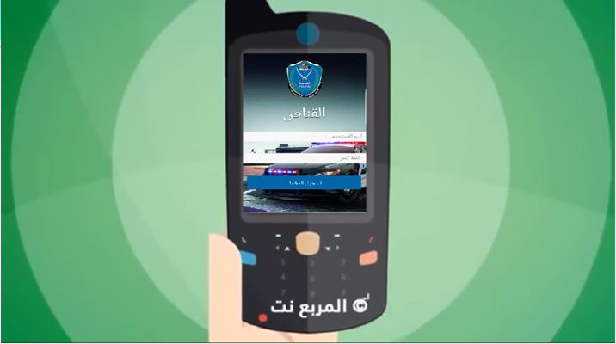

Slide 5
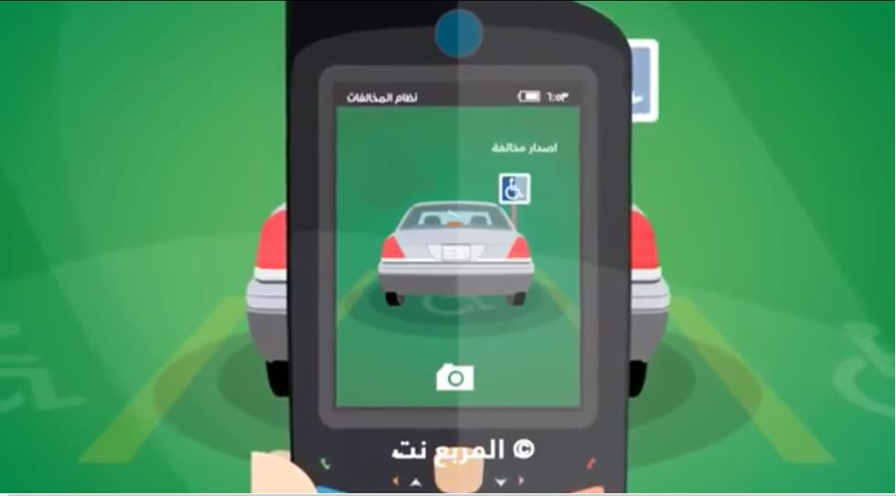

Slide 6


Slide 7
The system that infraction works on at this time !
The system that will infraction works on !
ISRA

Slide 8
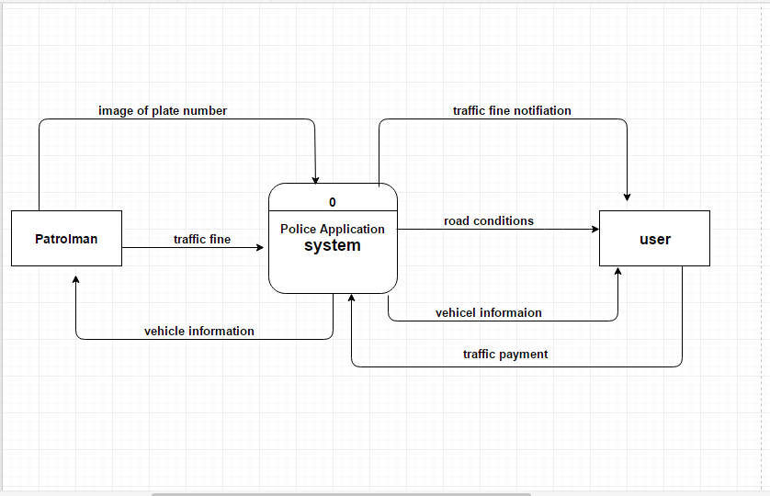
ISRA

Slide 9
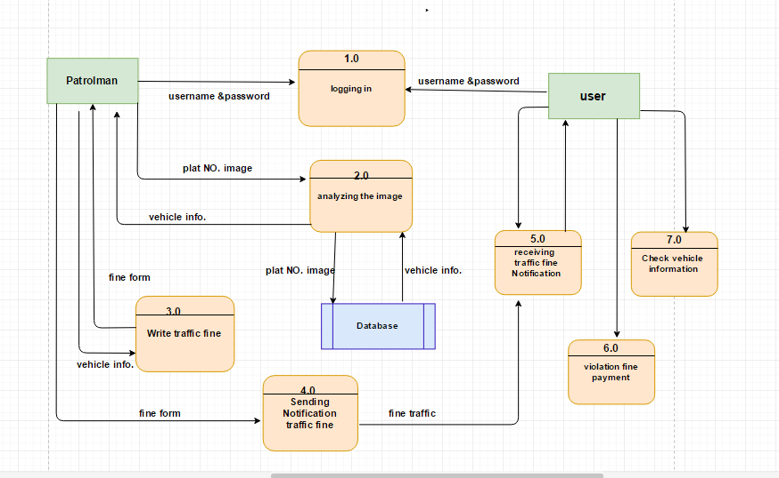
ISRA

Slide 10
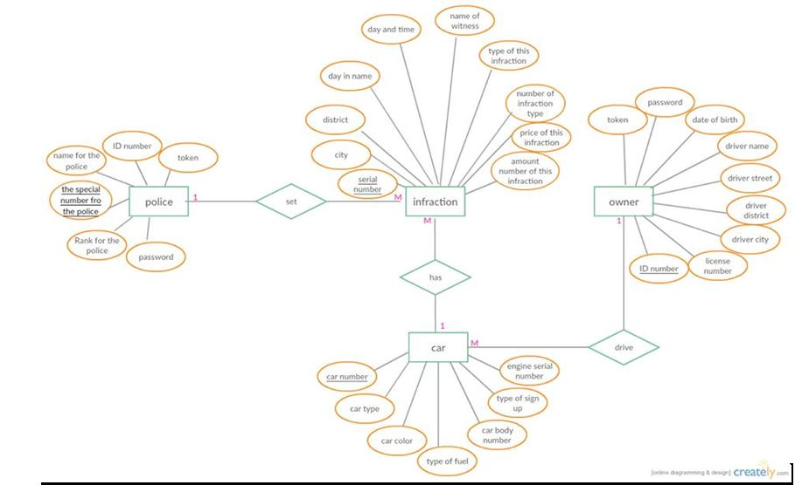
ISRA

Slide 11
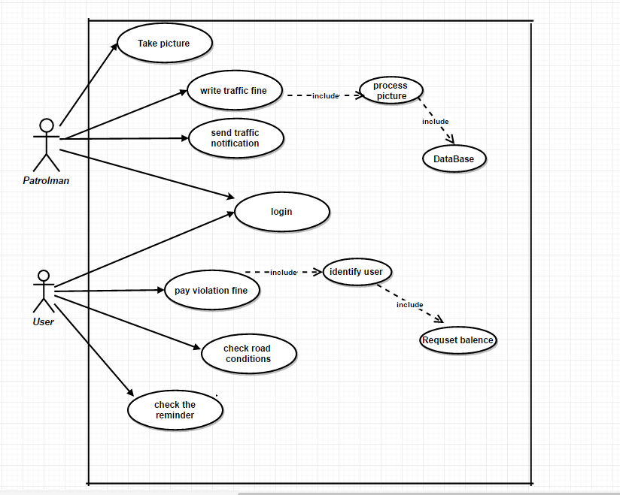
omar

Slide 12
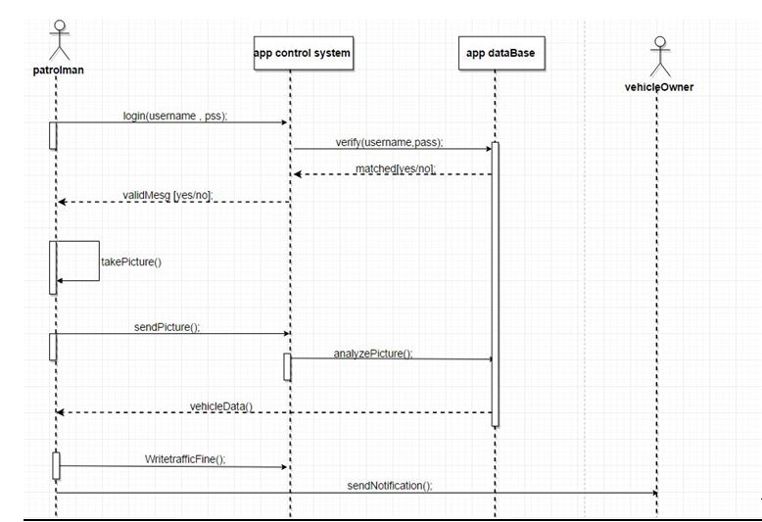
omar

Slide 13
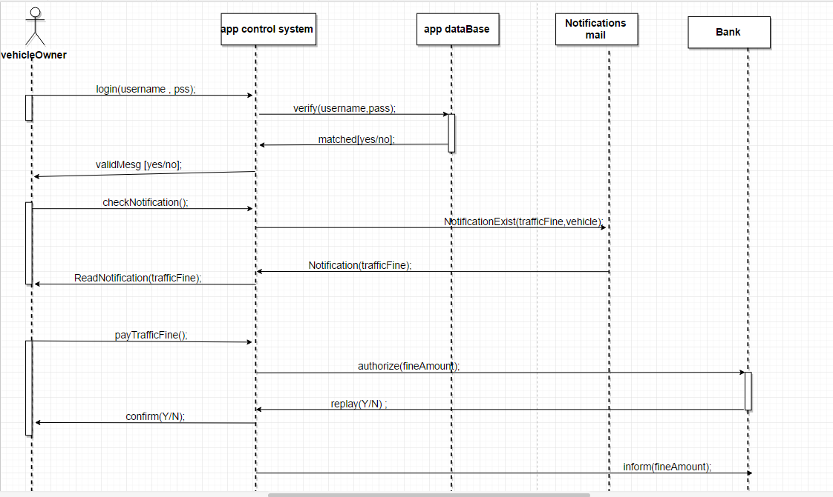
omar

Slide 14
Cross Platform Mobile Application “PhoneGap”
OSAID

Slide 15
Why Cross Platforms ?
Help a software developer to code an application in a single code base and deploy that single code base to multiple operating
If a developer codes in Java for Android, the developer can deploy the same Java code to iOS ,windows phone and Blackberry.
OSAID

Slide 16
PhoneGap Framework
PhoneGap is an open source mobile development framework originally produced by Nitobi, but later purchased by Adobe Systems.
Developers to build apps for mobile devices using HTML5, CSS3 and JavaScript.
Do not have to be skilled in every lower-level language corresponding to the desired platforms, such as Objective-C for iOS or Java for Android.
OSAID

Slide 17
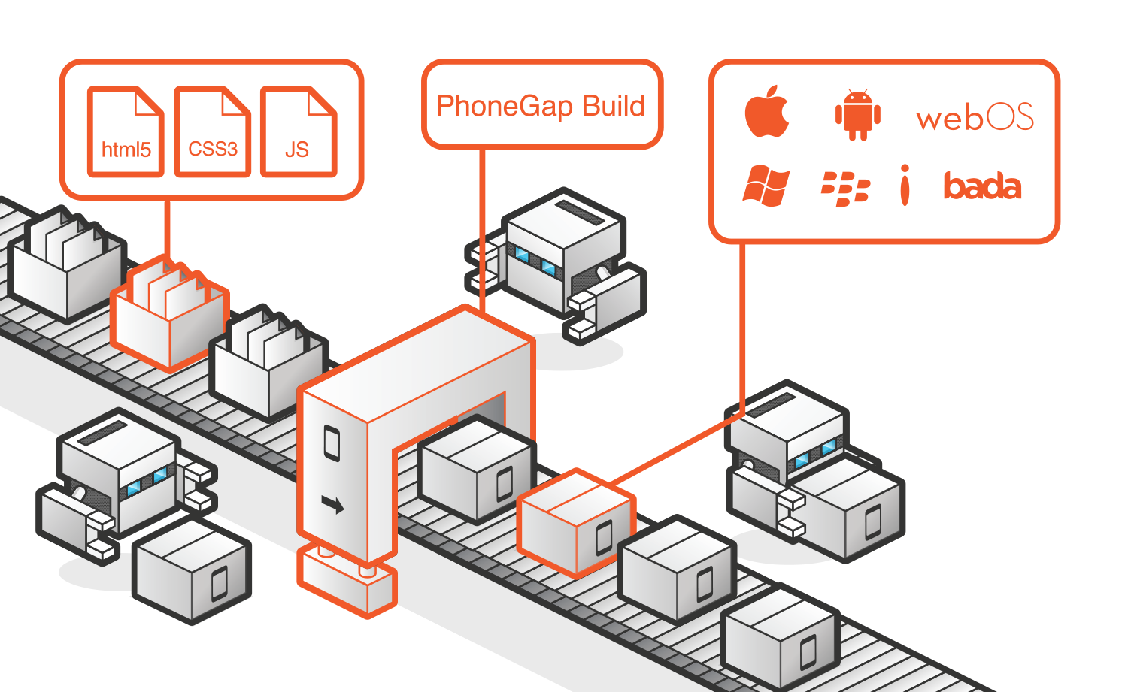
How it work ?
OSAID

Slide 18
The PhoneGap architecture layers:
Web Application
PhoneGap
OS and native API’s
OSAID

Slide 19
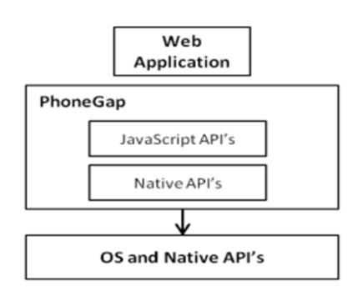
The PhoneGap architecture layers:
The top layer represents the application source code.
The central layer is composed by JavaScript and native API’s, this layer is responsible for the interfacing between web application and PhoneGap layers
The last layer about the OS for device
OSAID

Slide 20
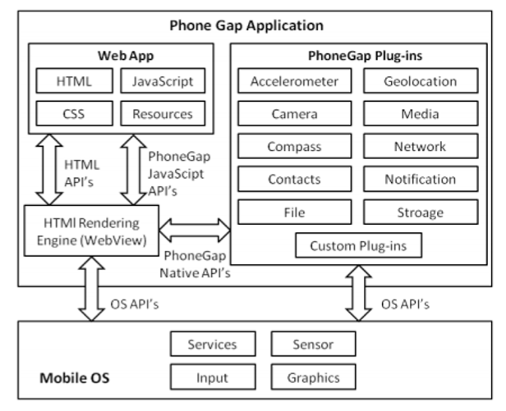
The PhoneGap architecture layers:
OSAID

Slide 21
Plugins Used :
Camera
File
Storage
Network
Notification
OSAID

Slide 22
OpenALPR-Cloud API
The OpenALPR Cloud API is a service running in the cloud that is ready to analyse images. The service receives image data and responds with license plate information.
Cloud API (Commercial)
The OpenALPR Cloud API is a web-based service that analyses images for license plates as well as vehicle information. The Cloud API service is easy to integrate into your application via a web-based REST service. send image data to the OpenALPR API, then process the data, and return JSON data describing the license plate and vehicle.
OSAID

Slide 23
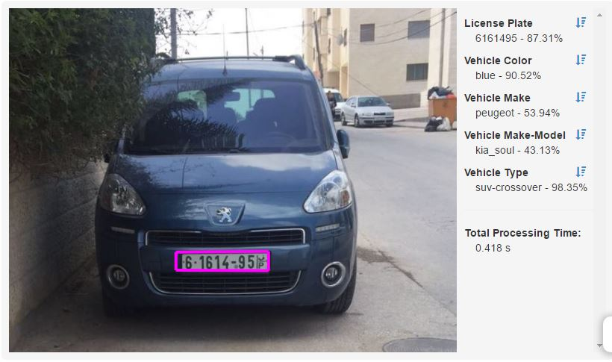

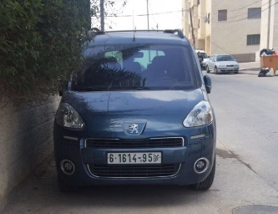
OpenALPR-Cloud API
Cloud-Openalpr
OSAID

Slide 24


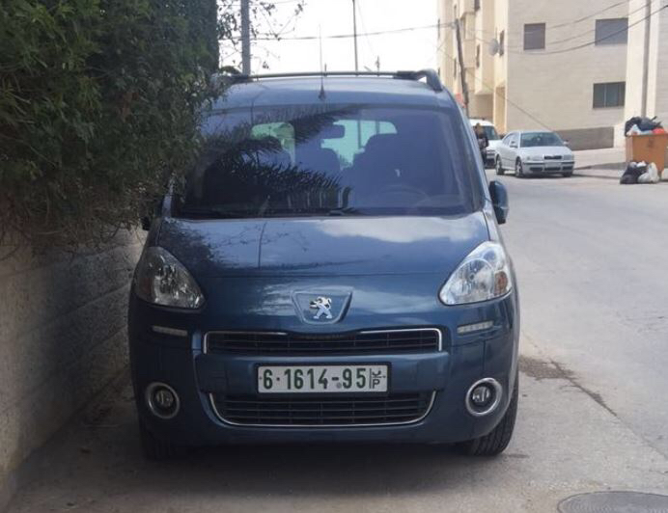

Cloud-openalpr
server
Send image url to cloud-API
InterNet
recognize image and return information to Police man
Upload image to server
Police Man
car
Take Pic Or upload form galary
OSAID

Slide 25
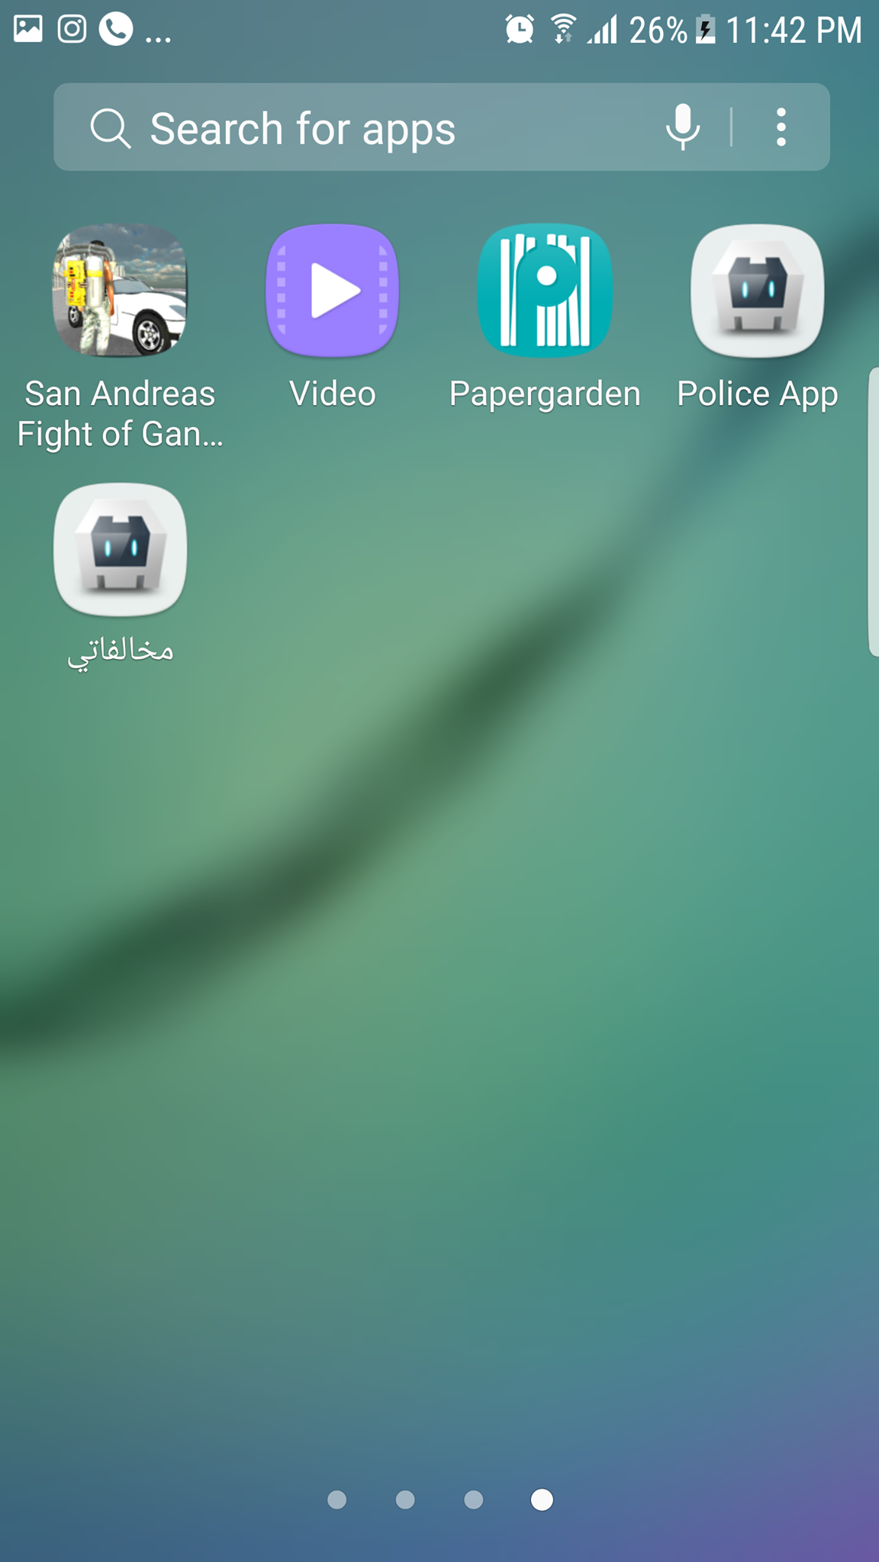
ISRA

Slide 26

ISRA

Slide 27

ISRA

Slide 28
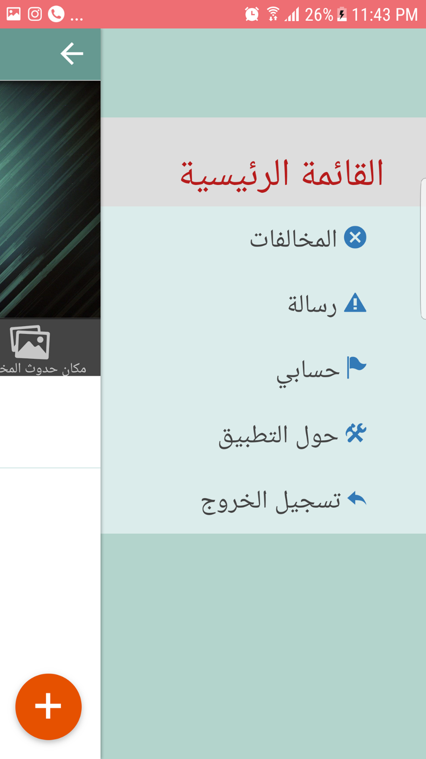
ISRA

Slide 29

ISRA

Slide 30
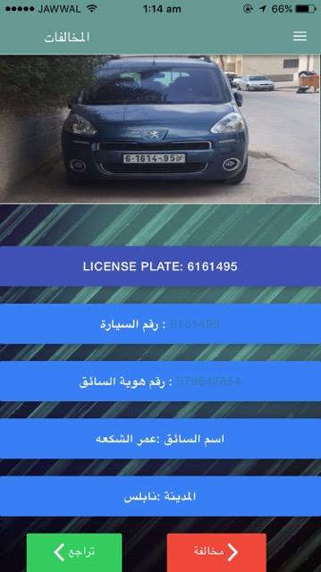
ISRA

Slide 31
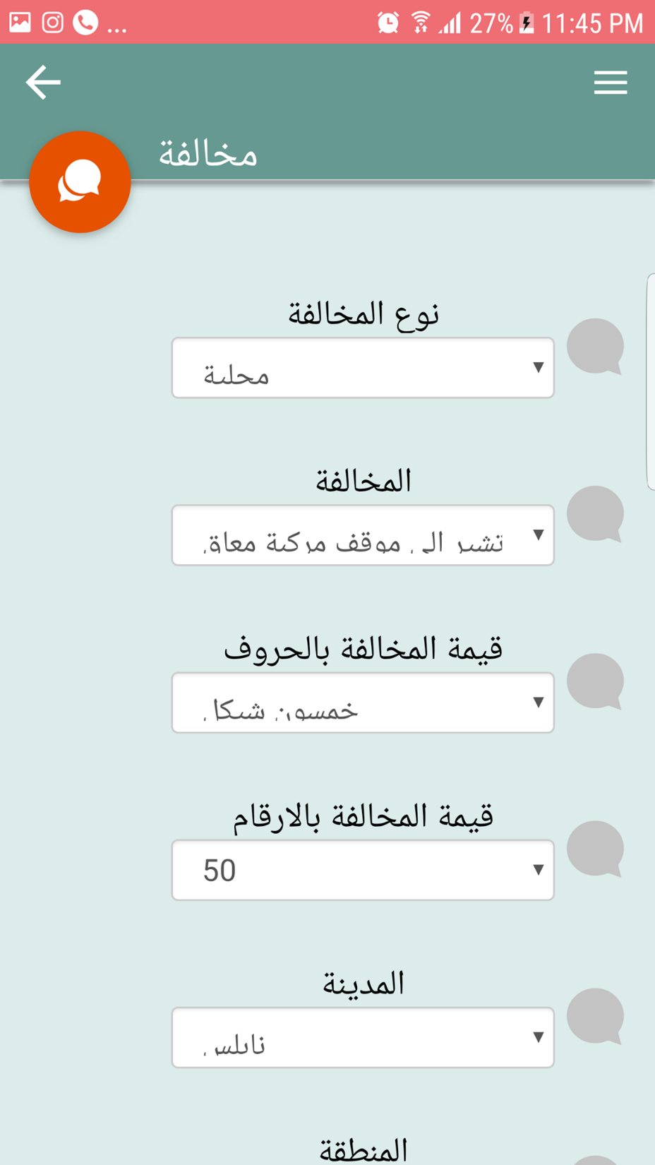
ISRA

Slide 32
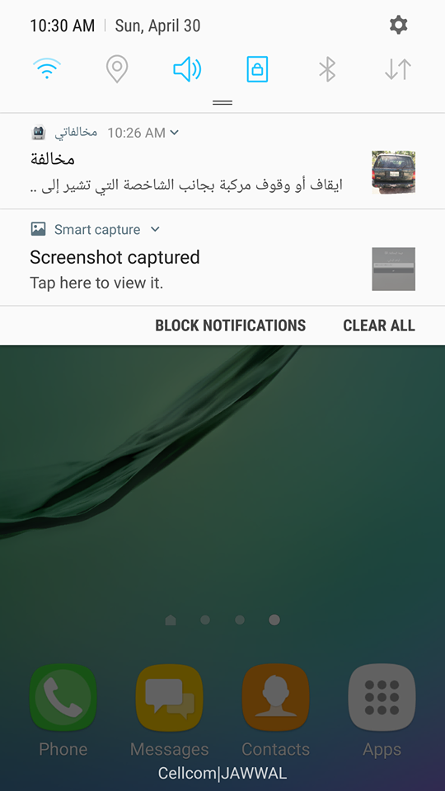

Slide 33
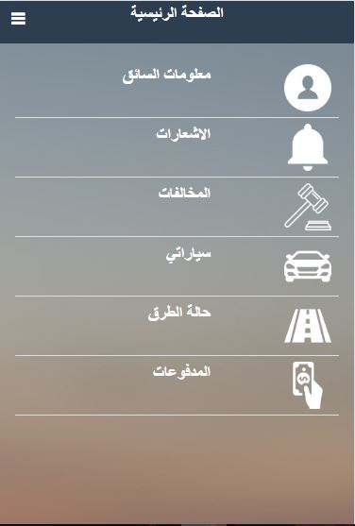

Slide 34
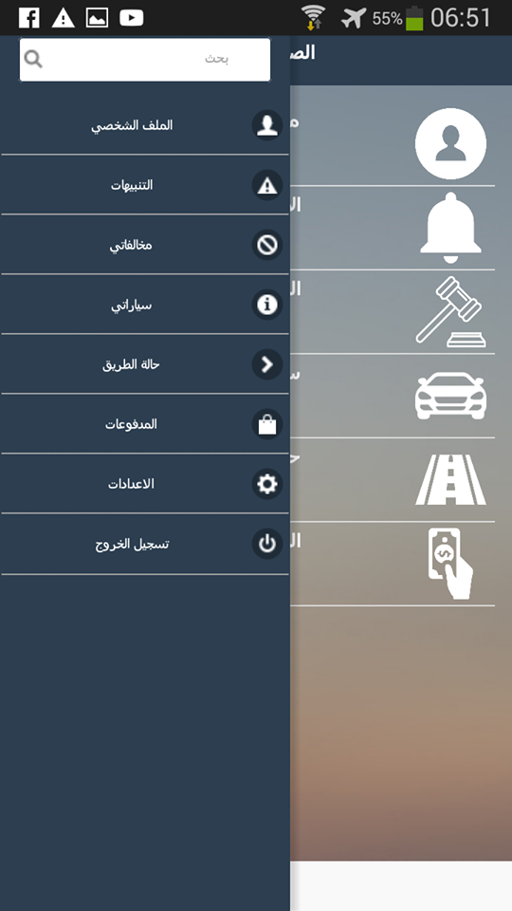

Slide 35
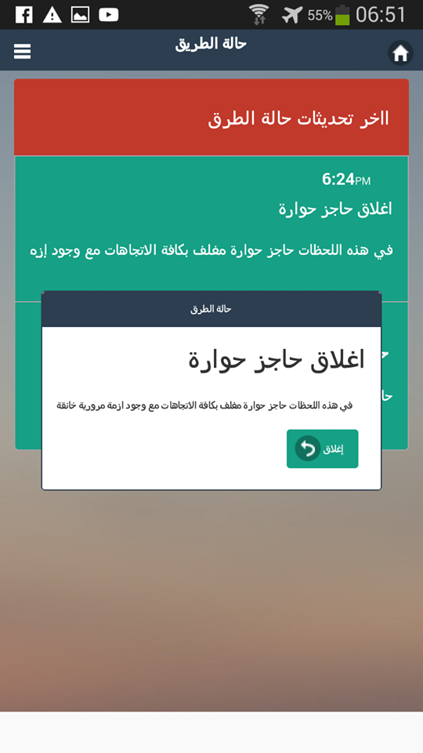

Slide 36


Slide 37


Slide 38
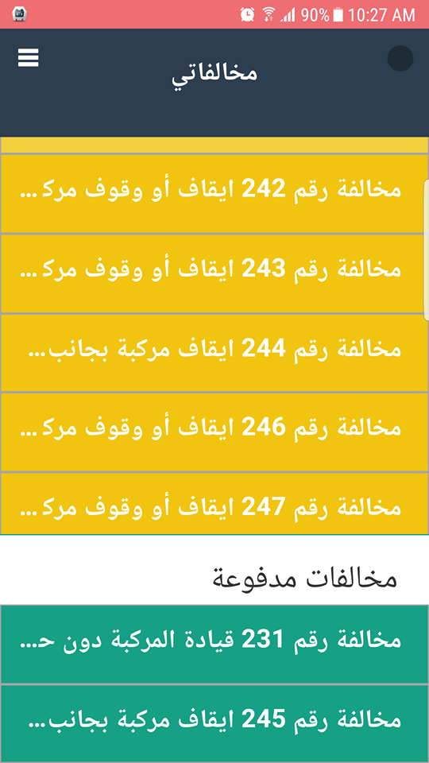

Slide 39
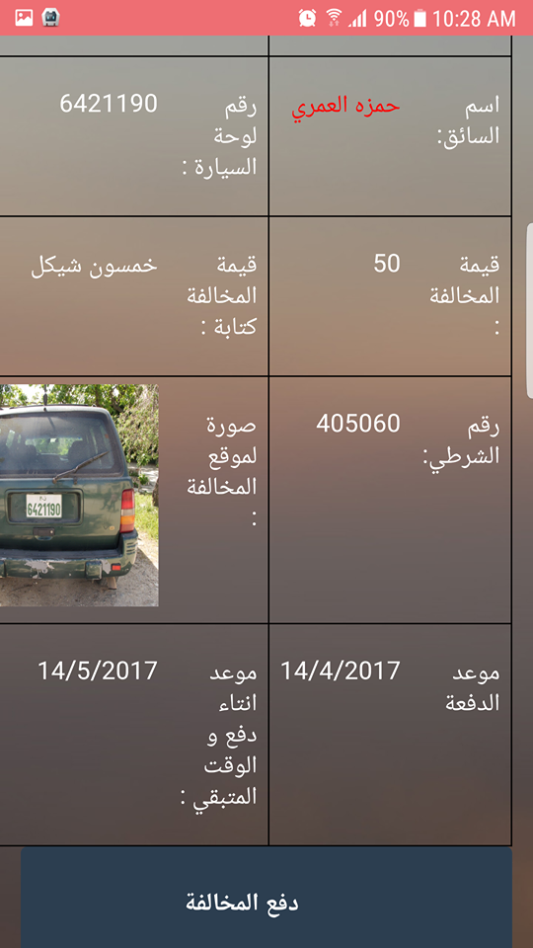

Slide 40
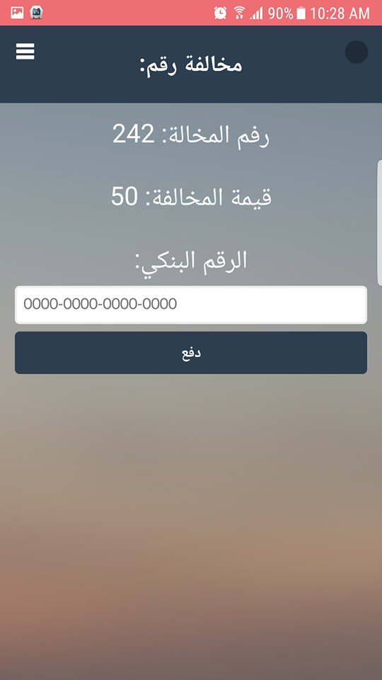

Slide 41
Difficulties :
Police cooperation with
Server
Internet availability
image analyzing libraries

Slide 42
Thanks for listening .
Any question

