Slide 1
DISCRPTION
PRINCIPILES
4
3
CHAPTER
FOUR:
CHAPTER THREE:
2
Analyis And Design Of Planet Biodiversity Research Center
CHAPTER ONE:
1
CHAPTER TWO:
SESIMEC
MODELING
GRADUATION PROJECT II
PRELIMINARY
Hybat Omaria
Morad Shehade
Mahmoud Mahmoud
MATERILS
CODES AND LOADS
Qusai Bani Fadel

Slide 2
INTRODUCTION:

Slide 3
DESCRPTION:
Project Name:
The project is called Planet Biodiversity Research Center
Location:
This project is located in Hebron City
Specifications:
This project includes the design of Stage, Library, Management rooms, Galleries, Oratory, Cafeteria, Video Conference Hall, Lecture halls, Stores and Computer halls that fulfilled all the requirements of comfort and safety according to usage requirements and include the design of all structural element in building .

Slide 4
DESCRPTION:
Geotechnical investigation:
According to soil investigation report which made from the engineering office which design this tower.
𝐵𝑒𝑎𝑟𝑖𝑛𝑔 𝐶𝑎𝑝𝑎𝑐𝑖𝑡𝑦 𝑜𝑓 𝑠𝑜𝑖𝑙=𝑞𝑎𝑙𝑙=300𝐾𝑁/𝑚2.
Ɣ=18 𝐾𝑁/𝑚3.

Slide 5
MATERIALS:
Materials:
1. Concrete:
Concrete used has compressive strength 𝑓𝑐/ = 28 𝑀𝑃𝑎 for all elements in the structure.𝐿𝑖𝑛𝑒𝑎𝑟 𝑀𝑜𝑑𝑢𝑙𝑢𝑠 𝑜𝑓 𝐸𝑙𝑎𝑠𝑡𝑖𝑠𝑖𝑡𝑦 = 𝐸 = 4700√𝑓𝑐/ = 27806 𝑀𝑃𝑎.
2. Steel:
Steel used is grade 60 steels with yielding stress, 𝑓𝑦 = 420 𝑀𝑃𝑎. 𝑓𝑢 = 620 𝑀𝑃𝑎.

Slide 6
MATERIALS:
4. Other Materials:
Theses contains the materials used for finishing workings.

Slide 7
CODES USED:
ACI 318-14: American Concrete Institute code. For design the elements of structure.
IBC 2012: International Building Code. For earthquake design.
ASCE 7-10: American Society of Civil Engineering. For determination of loads applied on the structure and considerations of earthquake design.

Slide 8
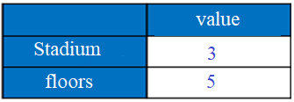
LOADS:
Gravity Loads:
1. Dead Loads:
The own weight of the structural elements which is mainly consists of reinforced concrete members with unit weight Ɣ=25 KN/m3.
2. Live Loads:
This load different between the existing and the proposed structures. And for the garages and the floors.

Slide 9
LOADS:
3. Superimposed Loads:

Slide 10
LOADS:
Lateral Loads:
**Seismic Loads:
Computed using by IBC code

Slide 11
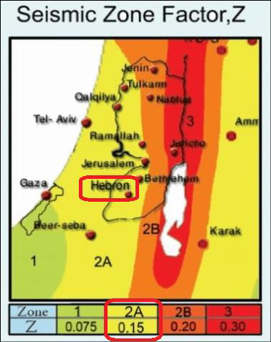
LOADS:
Z factor = 0.15g

Slide 12
LOADS:
Then, Mapped Acceleration Parameters:
Ss = 2.5*0.15 = 0.375 sec
S1 = 1.25*0.15 = 0.1875 sec

Slide 13
Design philosophy
The slab used in project is two way solid slab because in reality solid slabs work on two way system.
In mass source to determine effective weight of the structure, "dead load, superimposed dead load and 0.25 live load" considered because live load move free in building.
In structural element, capacity of the cross section reduced by reduce modifiers of the element because cracks have been considered
For seismic design, the height of the floors must be uniform.
The structure divides to two blocks because of and thermal effect on building due to long dimension.
Design method that used in project is ultimate design method, this method use factor and combination to increase the value of load.
In any structure program, beam & column represent as 1dimential element but slab and shear wall represent as 2D element.
Codes that used in project are ACI-318-14 and IBC-2012 for seismic load.

Slide 14
Preliminary design

Slide 15
Preliminary design
The main objective of the process design is to ensure the existence of necessary operating advantages with structural elements on the most suitable dimensions in terms of security and economic terms.
The knowledge of structural elements of any project is essential in the design of reinforced concrete structures to make comparisons between different types of these elements for the construction of safer system. So, the structural elements that go into the design of this project will described.

Slide 16
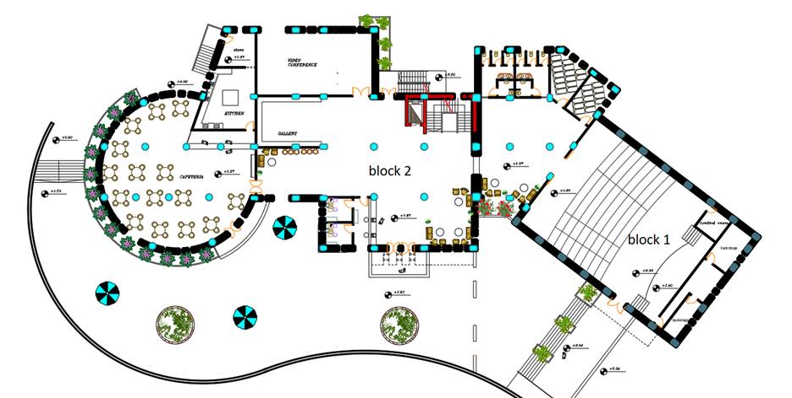
Preliminary design
Blocks in this project was divided to two blocks by architect engineer as shown

Slide 17
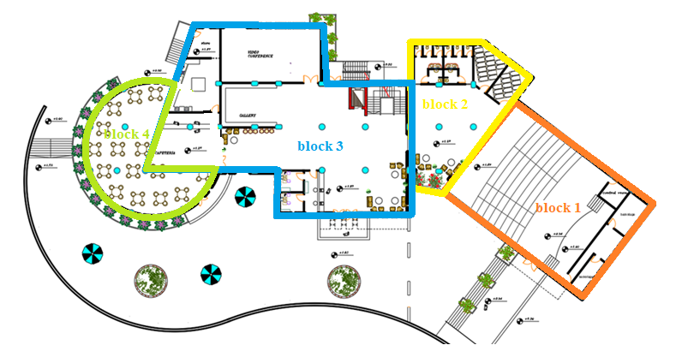
Preliminary design
After that, building divided to four blocks depends on earthquake design requirement like irregularity , … etc. as shown below.

Slide 18
DATA OF STRUCUTRE:
Structural System:
The system is building frame system using ordinary concrete shear wall
Slab Structural System:
The slab is two-way solid slab
Beams:
Beams are located between all column except block 4 (flat slab used).

Slide 19
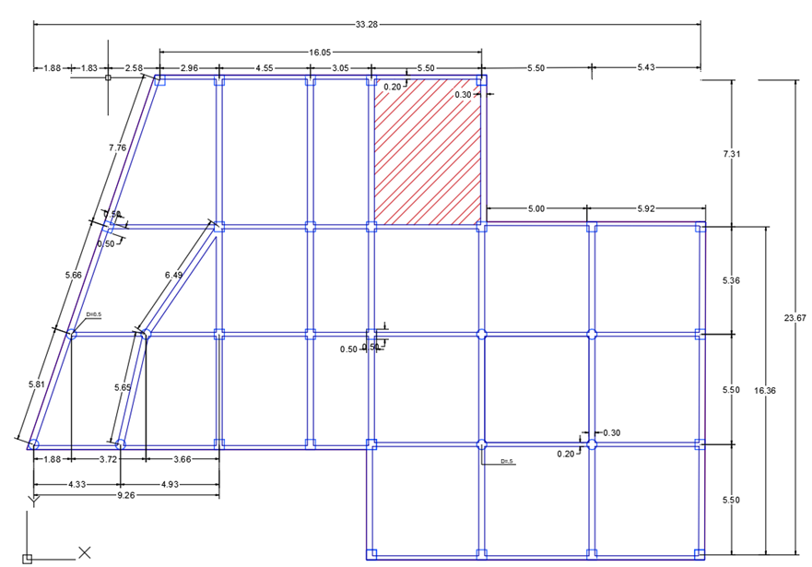
Slab sample calculation for block 3

Slide 20

Slab
$h=\frac{Ln(0.8+\frac{fy}{1400})}{36+9β}$ = $\frac{7.3(0.8+\frac{420}{1400})}{36+9\frac{7.3}{5.5}}$
h= 0.167
use h =200mm
Vu = Wu (L/2 – d)
= 15.86 (5.5 /2 – 0.16)
= 41.1 KN
$$∅Vc=\frac{φλ}{6} \sqrt{fc } bw d$$
$∅ Vc=\frac{0.75∗1}{6} \sqrt{28 } 1000∗\left(200−40\right)$ = 105.83 KN o.k

Slide 21
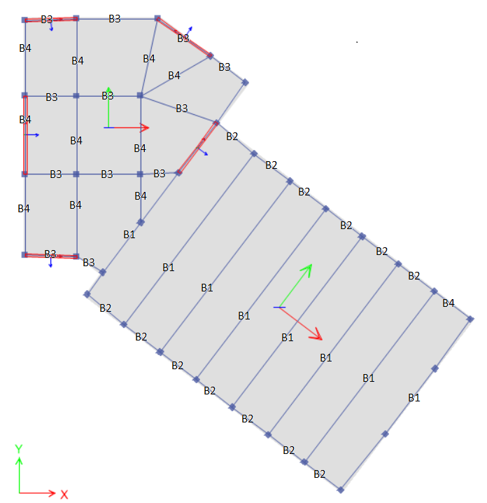
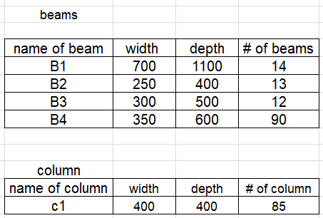
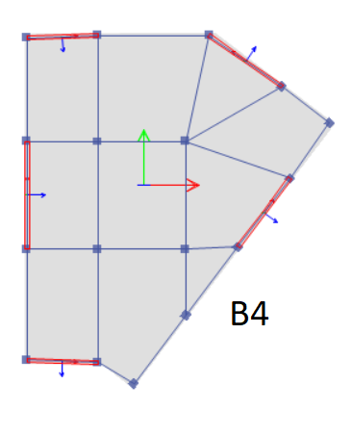
Beam
Block 1

Slide 22
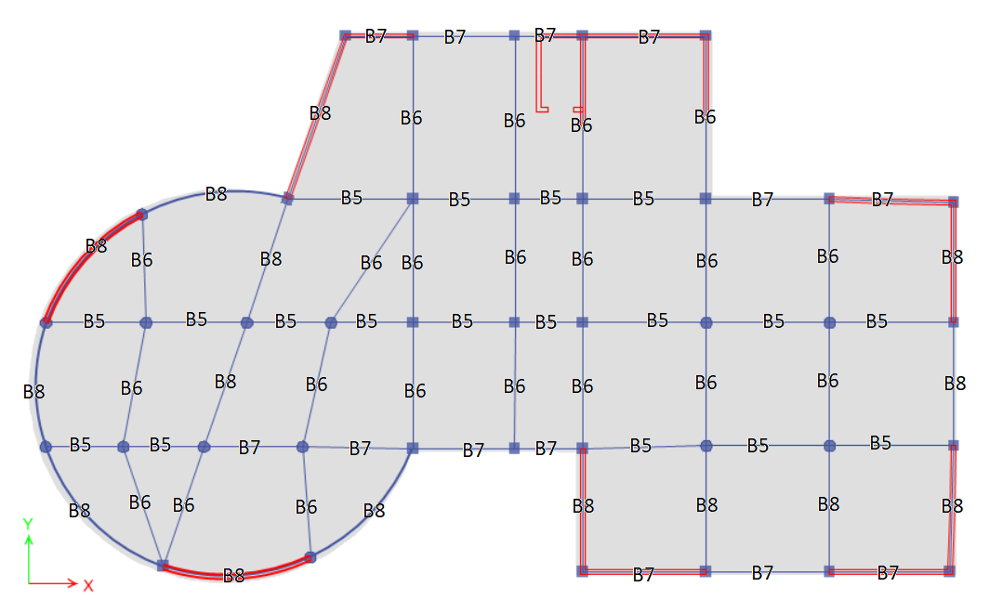
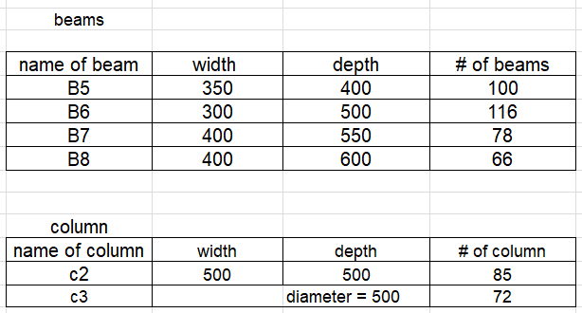
beam
Block 2

Slide 23
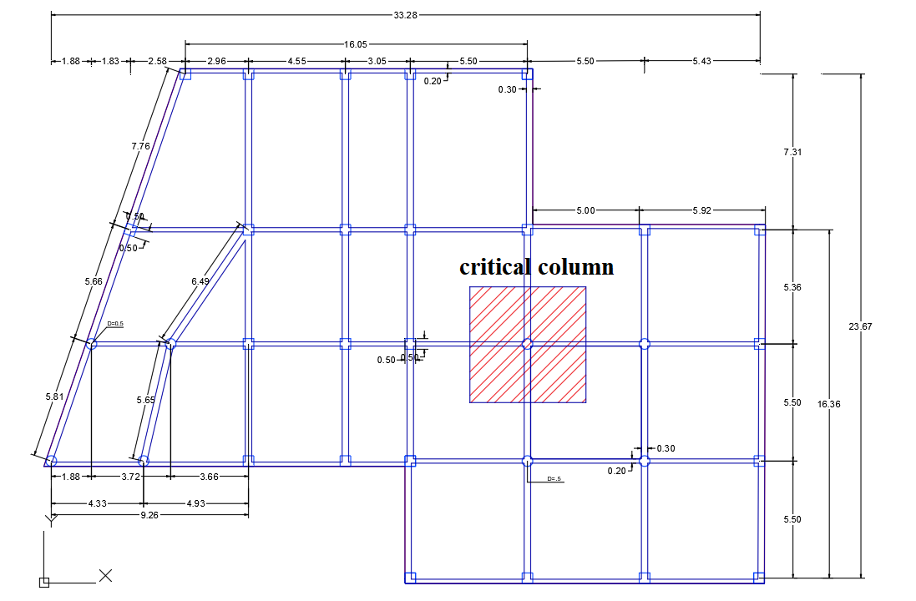
Column sample calculation for block 3
the tributary area equal 5.5*5.5 = 30.25 m2
wu = 15.86 KN/m2
ϕpn=30.25*15.86*6 + 1.2*6*(0.15*0.2*5.5*25 + 0.25*0.3*5.5*25) =2982.54 KN
ϕpn=0.65*0.8 (0.85*28(0.99 Ag)+ 0.01*420 Ag)
So, Ag = 206600.88 mm2
h = √Ag = 454.53 mm
Use h=500 mm for rectangular section
And D = 500mm for circular section

Slide 24
MODELING
After Preliminary design the structure should be model on structure design program like ETAPs to make model check (compatibility, equilibrium…)
Modifiers for structure element
Column 0.7
Beam 0.35
Wall 0.7
Slab 0.25

Slide 25
Model check
Check for compatibility
This check doing to insure that the structure moves as one unit.

Slide 26
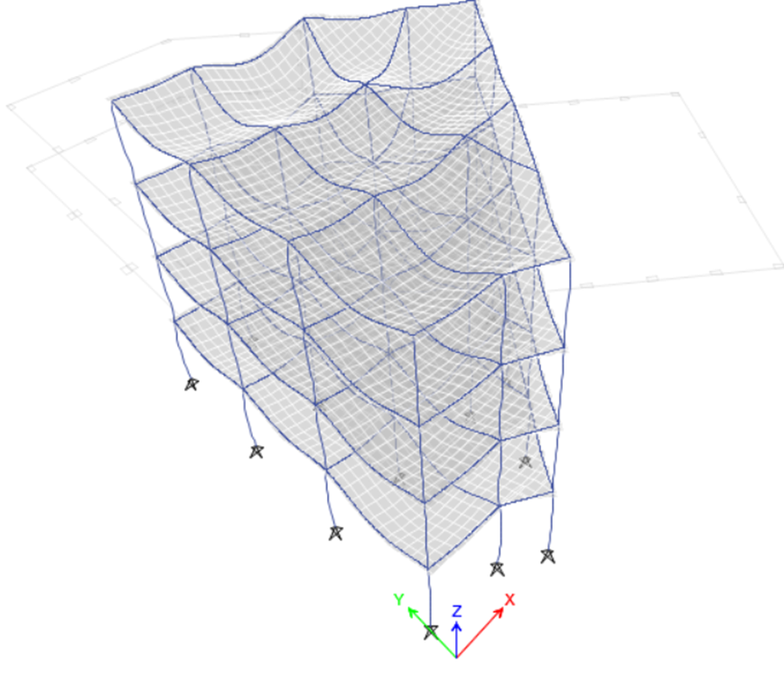
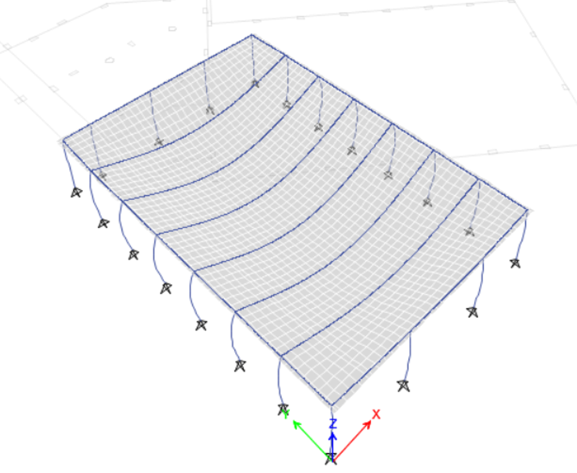
Block 1
Block 2

Slide 27
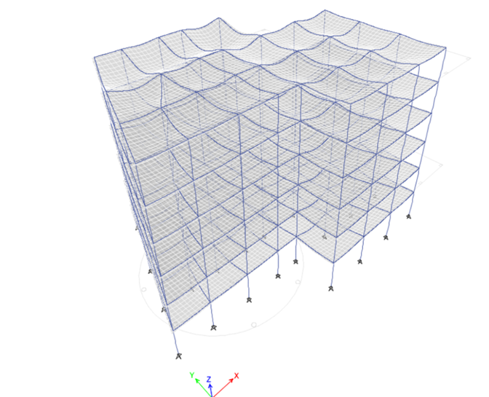
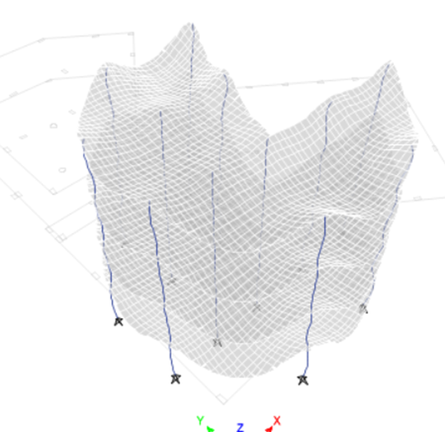
Block 3
Block 4

Slide 28

Model check
Check for deflection
by using Ц = 2D + 2S.D + 1.25L
Block 3
Deflection = 29.25 ≤ $\frac{L}{240}$ = $\frac{7.3}{240}$ = 30.4mm O.K

Slide 29
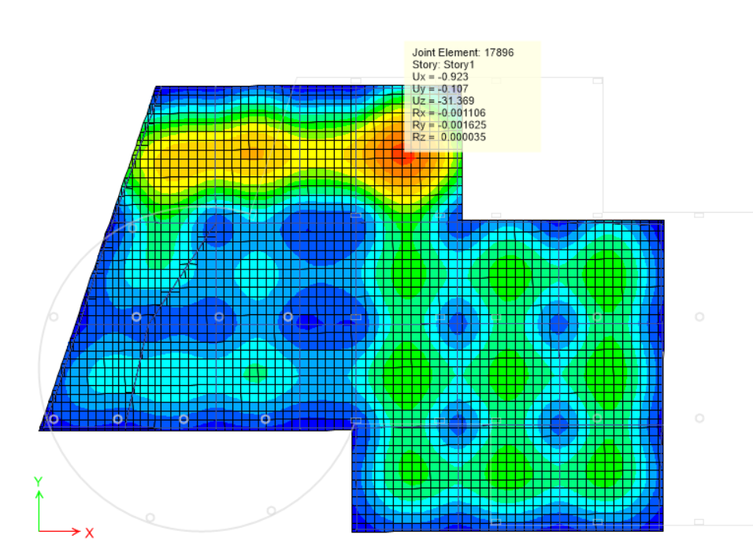

Slide 30
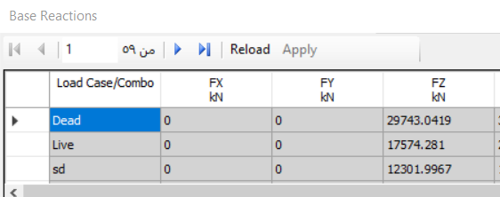
Check for equilibrium
Block 3
Live load = 17574.281 KN % error = 0%
Dead load = 32018.52 KN %error = 0.6%
Superimposed dead load = 25917.4 KN % error = 1.3%

Slide 31
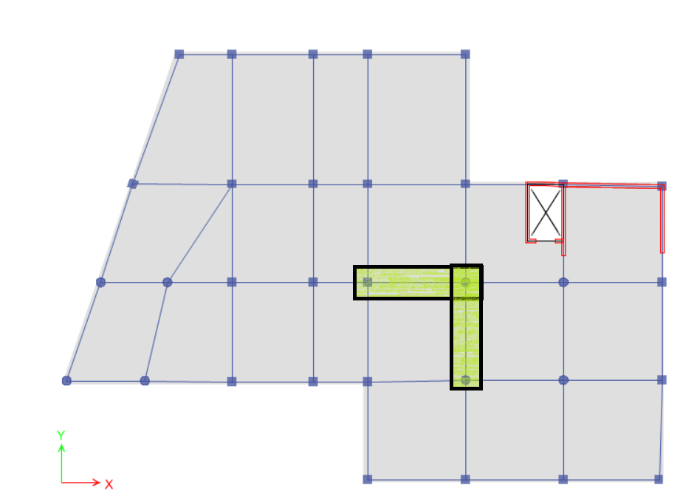
Check for internal forces
Block 3
Beam at x
Moment by hand = 86.72 KN.m
Moment from ETAB = 84.5 KN.m
%error = 2.6 %
Beam at y
Moment by hand = 85.9 KN.m
Moment from ETAB = 84.15 KN.m
%error = 2.1%

Slide 32
Seismic load calculation
To determine Ss & S1
Ss = 0.375 sec
S₁ = 0.1875 sec

Slide 33
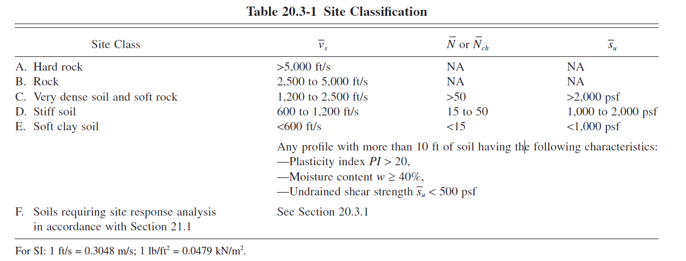
Seismic load calculation
Determine site class
Depends on soil report and the value of q for that rock equal to 300KN/m2 > 200KN/m2, and according to the table above the site class for area of project is B

Slide 34
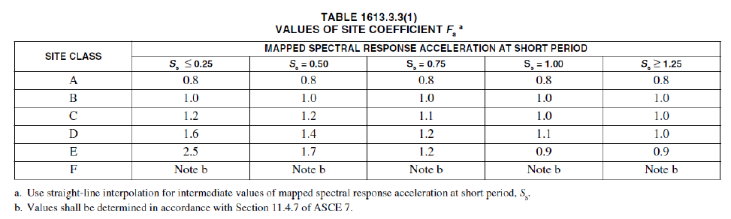
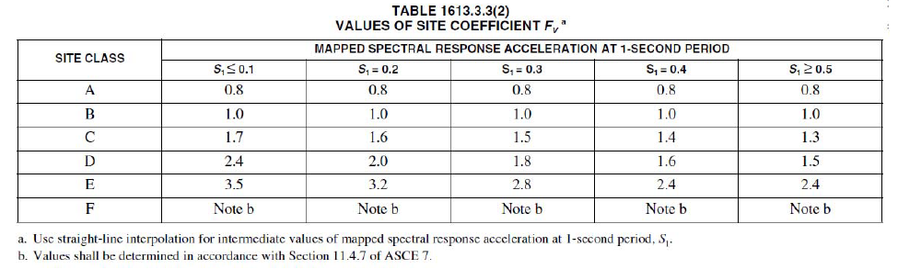
Seismic load calculation
Determine maximum considered earthquake spectral response accelerations
S_{MS =} Fa S_{s}
S_{M1} = Fv S₁

Slide 35
Seismic load calculation
Determine design spectral response accelerations
S_{D S} = (2/3) S_{MS}
S_{D1} = (2/3) S_{M1}

Slide 36
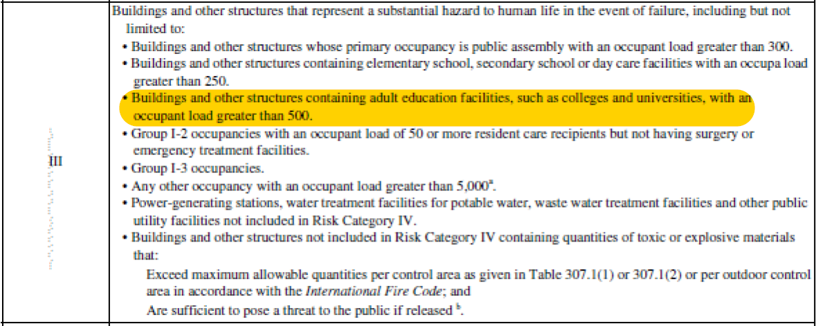
Seismic load calculation
Determine risk category
Risk category is III

Slide 37
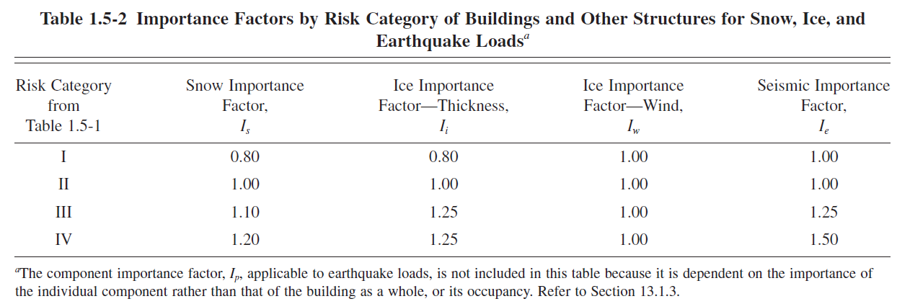
Seismic load calculation
Determine importance factor
Ie = 1.25

Slide 38
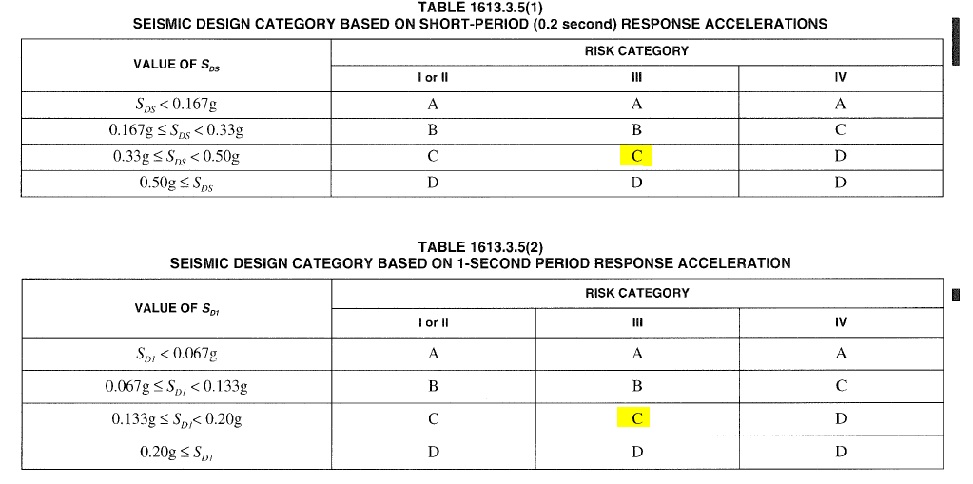
Seismic load calculation
Determine seismic design category
Design category is C

Slide 39
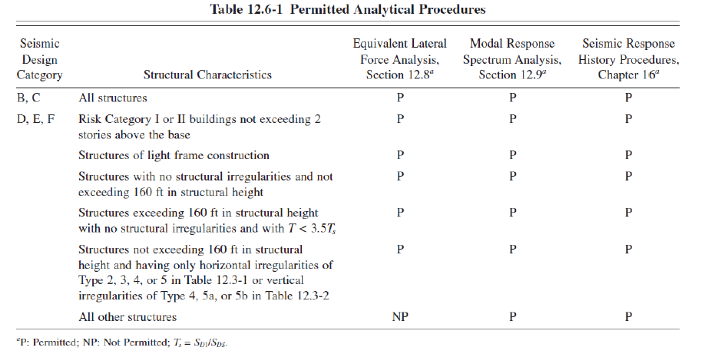
Seismic load calculation
Determine base shear
So equivalent lateral
force & response
spectrum methods
are permitted .

Slide 40
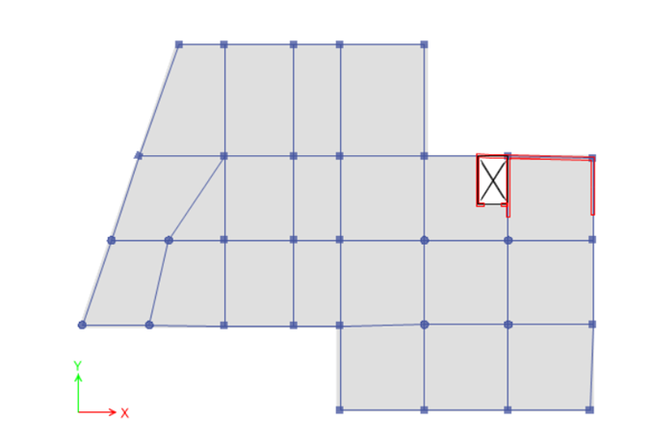
Seismic load sample calculation for block 3
As shown in start animation screenshot and mass participation ratio table, mode 1 and mode 2 do not represent any direction and include a high percentage of torsion , so added shear wall become important .

Slide 41
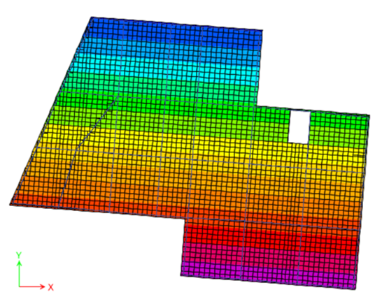
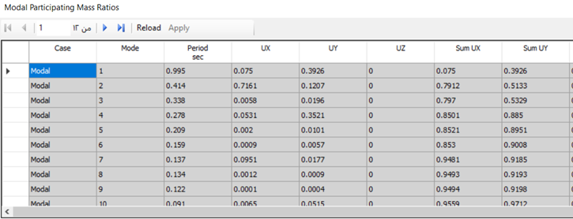

Slide 42
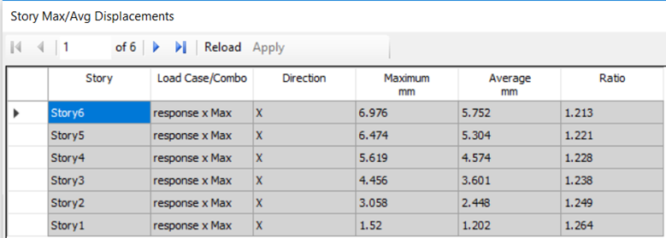
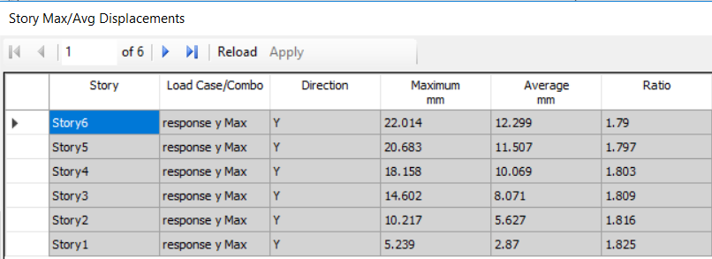

Slide 43
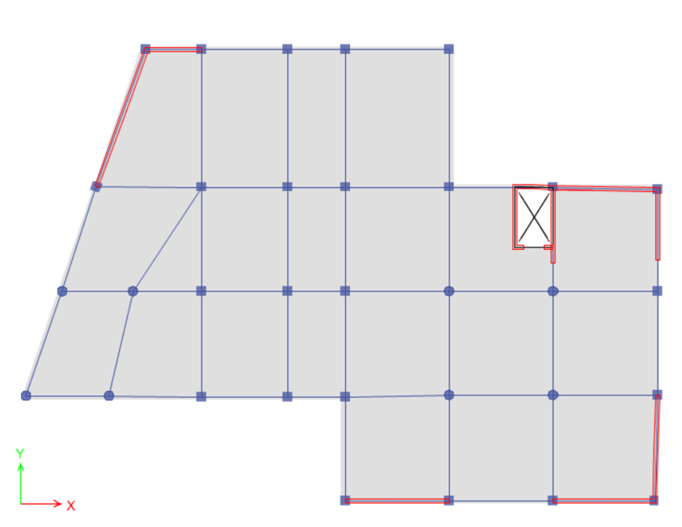
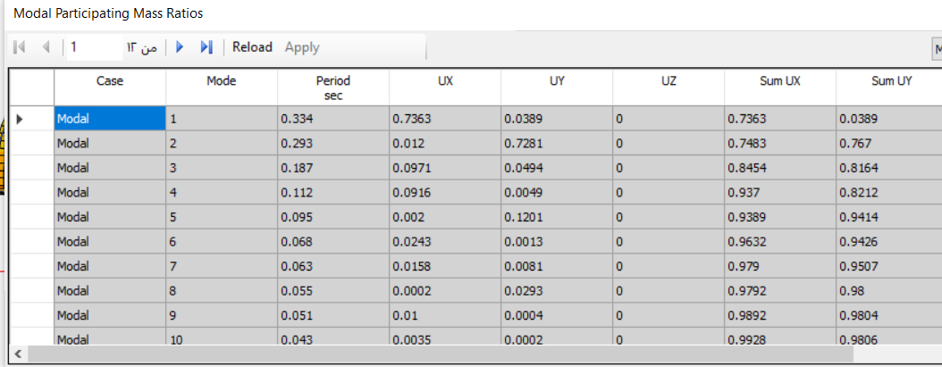
Seismic load sample calculation for block 3
After adding a distribution of shear wall the mass participation ratio in x and y for mode 1 and 2 and problem of
extreme torsion is solved
( less than 1.2) as shown .

Slide 44
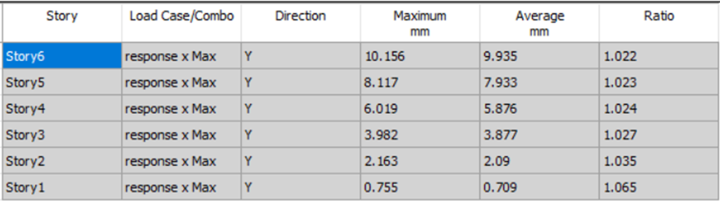
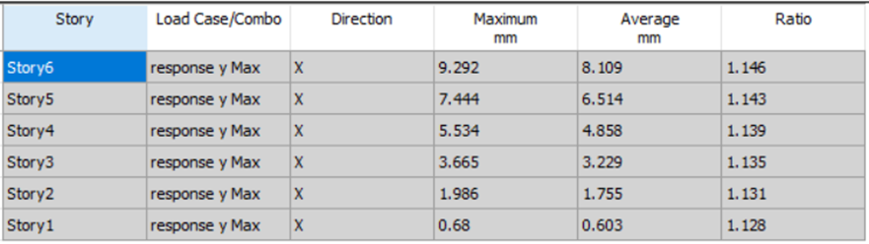
Seismic load sample calculation for block 3

Slide 45
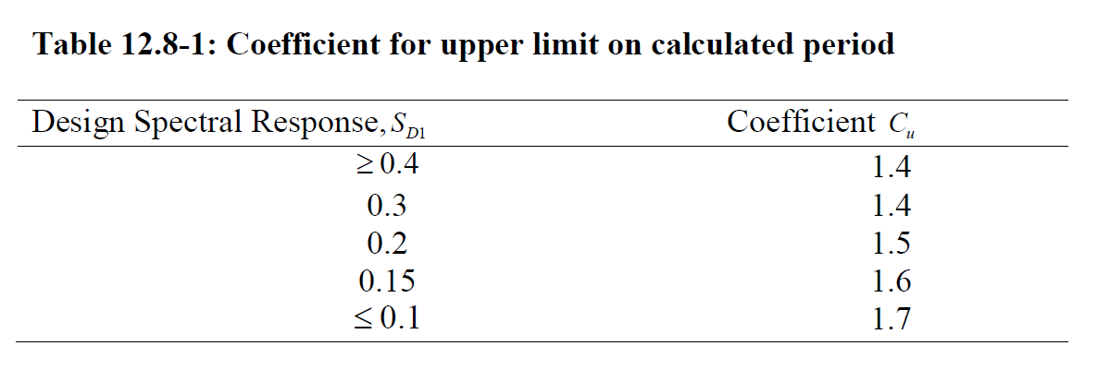

Seismic load sample calculation for block 3
Mode 1 in X direction
and Mode 2 in Y direction
T_{a} = C_{t} * ${h_{n}}^{x}$
h_{n} = 24 m
T_{a} = 0.0466 * ${24}^{0.9}$ = 0.814 sec
T = Ca * Ta
T = 1.525 * 0.814 = 1.241 sec
In X direction
T _{ETABs} = 0.503 sec (mode 2)
Take minimum period
T = 0.503 sec

Slide 46


Seismic load sample calculation for block 3
C_{S} = $\frac{0.375 }{5/1.25}$ = 0.09375
C_{S,max} = $\frac{S_{D1} }{T(\frac{R}{Ie})}$ = $\frac{0.1875 }{0.503(\frac{5}{1.25})}$ = 0.0932
C_{S,min} = 0.044 * S_{DS} * I_{e} = 0.044 * 0.375 * 1.25 = 0.0206 > 0.01
By using C_{s} = 0.0932 and W = 70569.01 KN
V = 0.0932 * 70569.01 = 6577.03 KN
V_{from ETABs} = 6498.1 KN
%error = 1.2 %

Slide 47
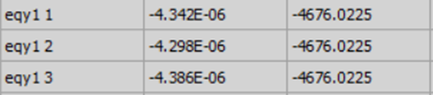
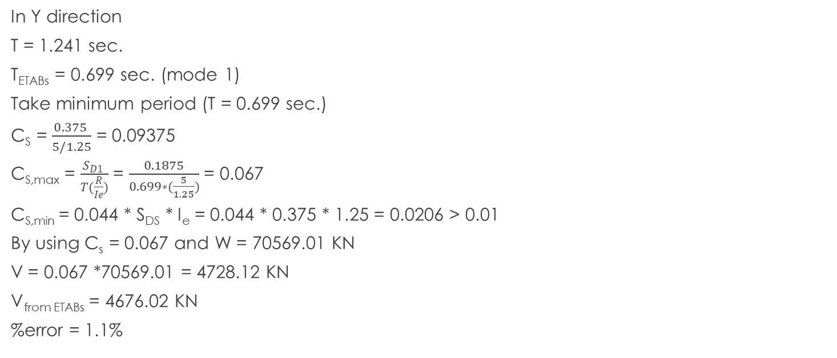
Seismic load sample calculation for block 3
In Y direction
T = 1.241 sec.
T_{ETABs} = 0.699 sec. (mode 1)
Take minimum period (T = 0.699 sec.)
C_{S} = $\frac{0.375 }{5/1.25}$ = 0.09375
C_{S,max} = $\frac{S_{D1} }{T(\frac{R}{Ie})}$ = $\frac{0.1875}{0.699∗(\frac{5}{1.25})}$ = 0.067
C_{S,min} = 0.044 * S_{DS} * I_{e} = 0.044 * 0.375 * 1.25 = 0.0206 > 0.01
By using C_{s} = 0.067 and W = 70569.01 KN
V = 0.067 *70569.01 = 4728.12 KN
V_{from ETABs} = 4676.02 KN
%error = 1.1%

Slide 48
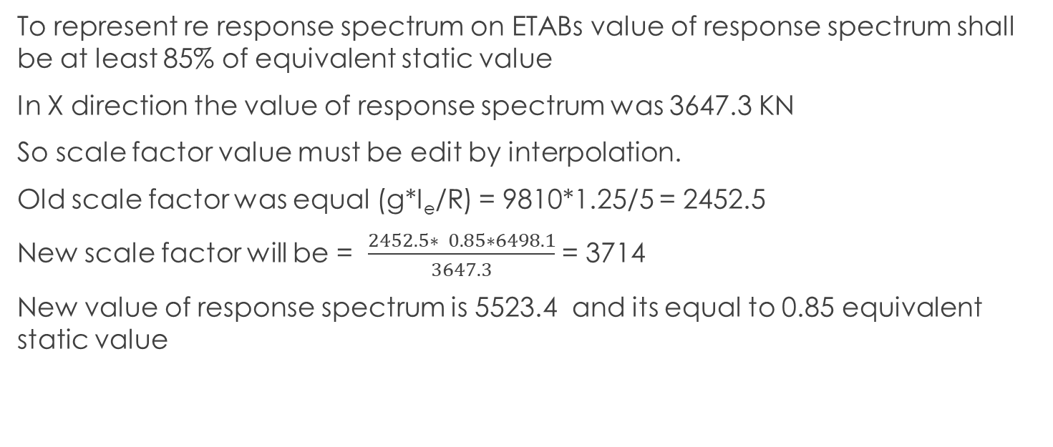
Seismic load sample calculation for block 3
To represent re response spectrum on ETABs value of response spectrum shall be at least 85% of equivalent static value
In X direction the value of response spectrum was 3647.3 KN
So scale factor value must be edit by interpolation.
Old scale factor was equal (g*I_{e}/R) = 9810*1.25/5 = 2452.5
New scale factor will be = $\frac{2452.5∗ 0.85∗6498.1}{3647.3}$ = 3714
New value of response spectrum is 5523.4 and its equal to 0.85 equivalent static value

Slide 49
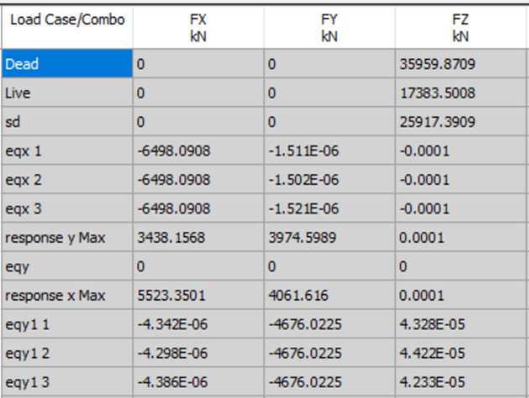
Seismic load sample calculation for block 3
In Y direction the value of response spectrum was 3100.5 KN
So scale factor value must be edit by interpolation.
Old scale factor was equal (g*Ie/R) = 9810*1.25/5 = 2452.5
New scale factor will be = (2452.5* 0.85*4676.02)/3100.5 = 3143.9
New value of response spectrum is 3947.6 and its equal to 0.85 equivalent static value
.

Slide 50
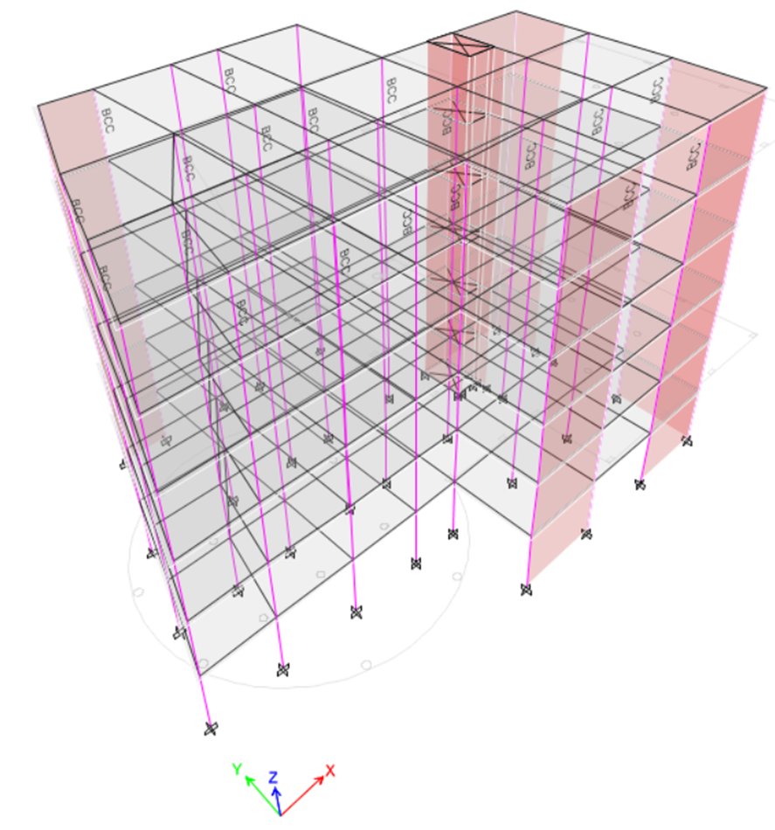
Design check for block 3 after adding seismic load

Slide 51
Torsional irregularity

Slide 52
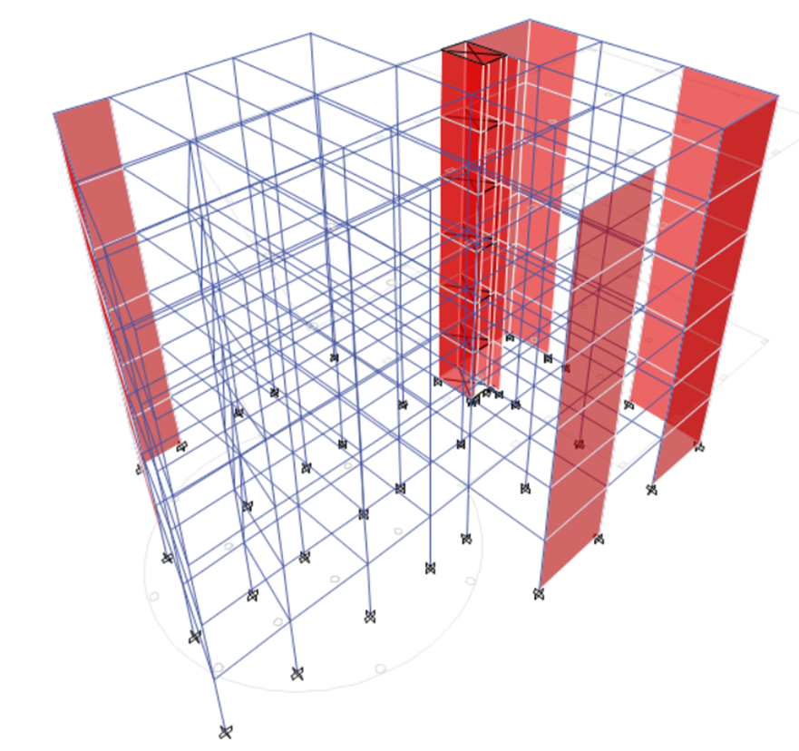
out-of-plan offset irregularity

Slide 53
stiffness for soft and extreme soft story

Slide 54
weight (mass) irregularity

Slide 55
check centre of mass and centre of rigidity

Slide 56
Check drift
Floor 6
X direction
Δ elastic = 0.00209
Δ inelastic = (Cd* Δ elastic )/Ie = (4.5*0.00209/1.25 = 0.007524
Δ all = 0.015 * 24 = 0.36
 |  |  |  |  |  |  | In Y
check drift |  | ∆ all=0.015*h (m) | ∆ inelastic(∆ elastic*cd/i) (m) | ∆ elastic (m) | max displacement (mm) | height (m) | # floor
ok |  | 0.06 | 0.000882 | 0.000245 | 0.245 | 4 | 1
ok |  | 0.12 | 0.0020196 | 0.000561 | 0.806 | 8 | 2
ok |  | 0.18 | 0.0026388 | 0.000733 | 1.539 | 12 | 3
ok |  | 0.24 | 0.0028872 | 0.000802 | 2.341 | 16 | 4
ok |  | 0.3 | 0.0028944 | 0.000804 | 3.145 | 20 | 5
ok |  | 0.36 | 0.0027648 | 0.000768 | 3.913 | 24 | 6

Slide 57
Check p-delta effect
Floor 6
Y direction
ϴ = (Px* Δ inelastic*Ie)/(Vx*hx*Cd) = (11761* 0.00276*1.25)/(1309*24*4.5)
= 0.000518
ϴmax = 0.5/(β*Cd) = 0.5/(1*4.5 ) = 0.1111
ϴ < ϴmax
 |  |  |  |  |  |  | In Y
check p-delta | Ɵall | Ɵ | V(KN) | ∆ inelastic(m) | P axial(KN) | height (m) | floor #
ok | 0.1 | 0.001958 | 3974 | 0.000882 | 70569 | 4 | 1
ok | 0.1 | 0.001986 | 3738 | 0.0020196 | 58807 | 8 | 2
ok | 0.1 | 0.001516 | 3413 | 0.0026388 | 47046 | 12 | 3
ok | 0.1 | 0.001094 | 2911 | 0.0028872 | 35284 | 16 | 4
ok | 0.1 | 0.000756 | 2251 | 0.0028944 | 23523 | 20 | 5
ok | 0.1 | 0.000518 | 1309 | 0.0027648 | 11761 | 24 | 6
check p-delta | Ɵall | Ɵ | V(KN) | ∆ inelastic(m) | P axial(KN) | height (m) | floor #
ok | 0.1 | 0.006248 | 4061 | 0.0028764 | 70569 | 4 | 1
ok | 0.1 | 0.005174 | 3882 | 0.0054648 | 58807 | 8 | 2
ok | 0.1 | 0.003876 | 3519 | 0.0069588 | 47046 | 12 | 3
ok | 0.1 | 0.002812 | 3007 | 0.007668 | 35284 | 16 | 4
ok | 0.1 | 0.001974 | 2317 | 0.007776 | 23523 | 20 | 5
ok | 0.1 | 0.001382 | 1334 | 0.007524 | 11761 | 24 | 6

Slide 58
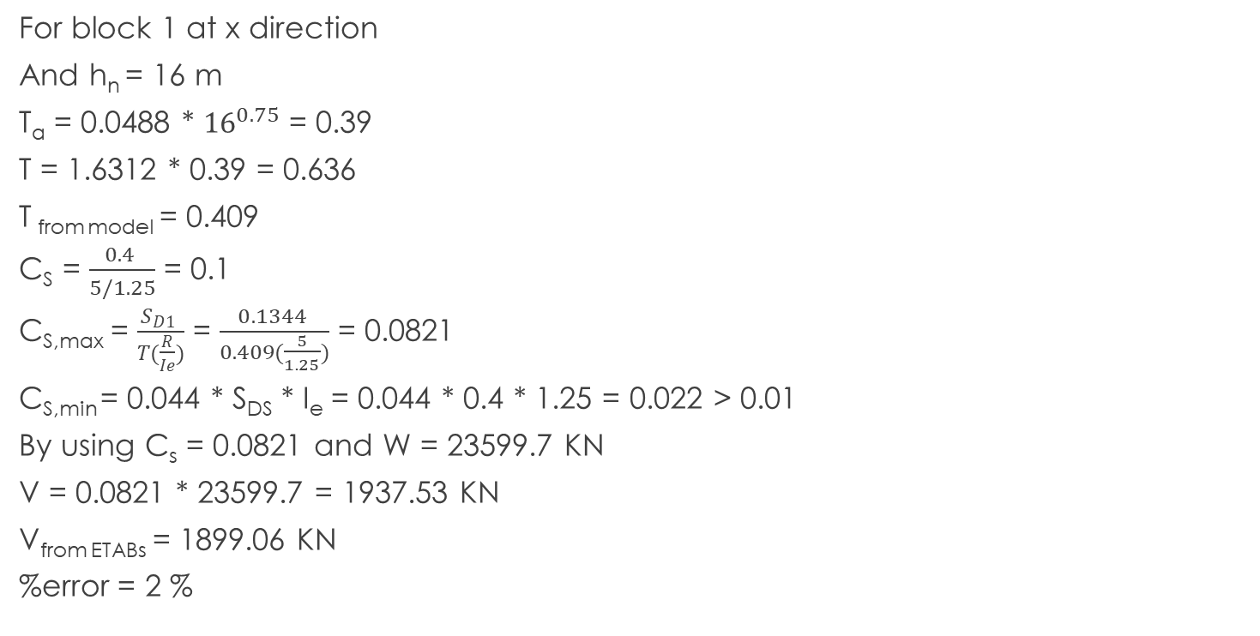
Seismic load sample calculation for block 3
For block 1 at x direction
And h_{n} = 16 m
T_{a} = 0.0488 * ${16}^{0.75}$ = 0.39
T = 1.6312 * 0.39 = 0.636
T _{from model} = 0.409
C_{S} = $\frac{0.4 }{5/1.25}$ = 0.1
C_{S,max} = $\frac{S_{D1} }{T(\frac{R}{Ie})}$ = $\frac{0.1344 }{0.409(\frac{5}{1.25})}$ = 0.0821
C_{S,min} = 0.044 * S_{DS} * I_{e} = 0.044 * 0.4 * 1.25 = 0.022 > 0.01
By using C_{s} = 0.0821 and W = 23599.7 KN
V = 0.0821 * 23599.7 = 1937.53 KN
V_{from ETABs} = 1899.06 KN
%error = 2 %

Slide 59

Seismic load sample calculation for block 3
For block 1 at y direction
h_{n} = 16 m
T_{a} = 0.0488 * ${16}^{0.75}$ = 0.39
C_{u} = 1.6312
T = 1.6312 * 0.39 = 0.636
T _{from model} = 0.39
C_{S} = $\frac{0.4 }{5/1.25}$ = 0.1
C_{S,max} = $\frac{S_{D1} }{T(\frac{R}{Ie})}$ = $\frac{0.1344}{0.39∗(\frac{5}{1.25})}$ = 0.086
C_{S,min} = 0.044 * S_{DS} * I_{e} = 0.044 * 0.4 * 1.25 = 0.022 > 0.01
By using C_{s} = 0.086 and W = 23599.7 KN
V = 0.086 *23599.7 = 2029.75 KN
V_{from ETABs} = 1991.5 KN
%error = 1.9%

Slide 60

Seismic load sample calculation for block 3
For block 2 at x direction
h_{n} = 24 m
T_{a} = 0.0488 * ${24}^{0.75}$ = 0.52
C_{u} = 1.6312
T = 1.6312 * 0.39 = 0.848
T _{from model} = 0.443
C_{S} = $\frac{0.4 }{5/1.25}$ = 0.1
C_{S,max} = $\frac{S_{D1} }{T(\frac{R}{Ie})}$ = $\frac{0.1344}{0.443(\frac{5}{1.25})}$ = 0.0758
C_{S,min} = 0.044 * S_{DS} * I_{e} = 0.044 * 0.4 * 1.25 = 0.022 > 0.01
By using C_{s} = 0.0758 and W = 78772.9 KN
V = 0.0758 *78772.9 = 5971 KN
V_{from ETABs} = 5859.5 KN
%error = 1.9%

Slide 61

Seismic load sample calculation for block 3
For block 2 at y direction
h_{n} = 24 m
T_{a} = 0.0488 * ${24}^{0.75}$ = 0.52
C_{u} = 1.6312
T = 1.6312 * 0.39 = 0.848
T _{from model} = 0.502
C_{S} = $\frac{0.4 }{5/1.25}$ = 0.1
C_{S,max} = $\frac{S_{D1} }{T(\frac{R}{Ie})}$ = $\frac{0.1344}{0.502(\frac{5}{1.25})}$ = 0.067
C_{S,min} = 0.044 * S_{DS} * I_{e} = 0.044 * 0.4 * 1.25 = 0.022 > 0.01
By using C_{s} = 0.067 and W = 78772.9 KN
V = 0.067 *78772.9 = 5277.78 KN
V_{from ETABs} = 5170.78 KN
%error = 2%

Slide 62
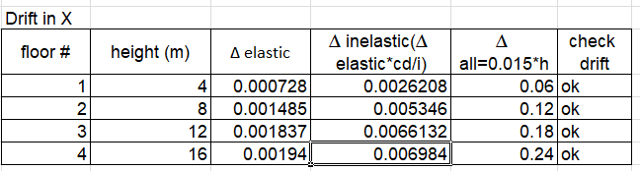


check drift
For block 1 at x direction
Δ _{elastic} = 0.00194
Δ _{inelastic} = $\frac{Cd∗ Δ elastic }{Ie}$ = $\frac{4.5∗0.00194}{1.25}$
= 0.006984
Δ _{all} = 0.015 * 16 = 0.24
Δ _{inelastic} < Δ _{all}
For block 2 at y direction

Slide 63


check drift
For block 2 at x direction
For block 2 at y direction

Slide 64



check P delta effect
For block 1 at x direction
ϴ = $\frac{Px∗ Δinelastic∗Ie}{Vx∗hx∗Cd}$ = $\frac{4223.9∗ 0.006984∗1.25}{620∗16∗4.5}$
= 0.000826045
ϴ_{max} = $\frac{0.5}{β∗Cd}$ = $\frac{0.5}{1∗4.5 }$ = 0.1111
ϴ < ϴ_{max}
For block 1 at y direction

Slide 65


check P delta effect
For block 2 at x direction
For block 2 at y direction

Slide 66
Design of structural element
In this chapter, structure element will be designed according to the ACI Code requirement. Slab that used in building is two way slab system with drop beam. And the design include earthquake requirement. Block 2 and block 3 will design in this chapter.

Slide 67
Design of slab
The structure didn’t achieve the direct design method , so a new method will be used as procedure bellow depends on finite element used ETAB’s programme:
1/ calculate minimum area of steel depends on 𝜌_{min}= 0.0018
2/ calculate the capacity of section of slab according minimum steel on section.
3/ compute the positive and negative moment during minimum capacity.
4/ display “moment11 & moment22” on ETAB’s included maximum positive and negative range.
5/ define the location that capacity increase.
6/ define the moment that exceed minimum.
7/ calculate new 𝜌 of new moment.
8/ add addition steel on slab.

Slide 68

block 2 slab
𝜌_{min}= 0.0018
thickness of slab = 200mm
As=0.0018*200*1000 = 360 mm²
use steel ∅12 = 113 mm²
use 4 bars with area = 452 mm²
a = $\frac{As∗fy}{0.85∗fc∗b}$ = $\frac{452∗420}{0.85∗28∗1000}$ = 7.97mm
$∅Mn= ∅(As∗fy(d−\frac{a}{2})$ = 0.9(452*420(160 - $\frac{7.97}{2}$) = 26.65 KN.m/m

Slide 69


Block 2 slab
M11
M22

Slide 70
Block 2 slab
As noted, all range in slab is less than minimum moment, so reinforcement in slab is minimum steel.
1∅12/250mm bottom steel
For top steel use shrinkage steel with 𝜌_{min}= 0.0018
As = 360mm²

Slide 71

Slab reinforcement block 2

Slide 72
Block 3 slab
𝜌_{min}= 0.0018
thickness of slab = 200mm
As=0.0018*200*1000 = 360 mm²
use steel ∅12 = 113 mm²
use 4 bars with area = 452 mm²
a = $\frac{As∗fy}{0.85∗fc∗b}$ = $\frac{452∗420}{0.85∗28∗1000}$ = 7.97mm
$∅Mn= ∅(As∗fy(d−\frac{a}{2})$ = 0.9(452*420(160 - $\frac{7.97}{2}$) = 26.65 KN.m/m

Slide 73


Block 3 slab
M11
M22

Slide 74
Block 3 slab
As noted, there is a moment value more than capacity of section using minimum steel.
Maximum moment after display moment 11 & 22 is 60 KN.m so, 1m in each side of centre of column in both direction is adequate for this value of moment as shown in figure below.

Slide 75

Block 3 slab
After that, steel that used in whole slab is minimum steel except the region around column in both direction.
As_{min}= 0.018 * 1000 * 200 = 3600 mm²
Use 1∅12/250 mm
And for region around column Mu = 60 KN.m
𝜌=$\frac{0.85 fc}{fy}\left(1−\sqrt{1−\frac{2.61∗Mu}{b∗ d^{2}∗fc}}\right)$ = $\frac{0.85∗28}{420}\left(1−\sqrt{1−\frac{2.61∗60∗{10}^{6}}{1000∗ {160}^{2}∗28}}\right)$ = 0.0066
As = 0.0066 * 1000 * 160 = 1056 mm²
Use 1∅18/200 mm

Slide 76

Slab reinforcement for block 3

Slide 77
Design of beam
For flexure
At beginning, there is a check must be doing to ensure that ETAB programme calculate rebar percentage like hand calculation by doing this procedure:
1/ Display and design for moment come from live load on selected beam below .
2/Calculate rebar percentage from moment and compare it with rebar percentage from ETAB.

Slide 78

Design of beam
For shear and torsion
Compare the values of Vu with ∅Vc
And compare the values of Tu with Tth
Then compute the values of $\frac{A_{v+t}}{s}$ , S and Al

Slide 79

Design of beam
1/ requirement for longitudinal bars
(1) Beams shall have at least two continuous bars at both top and bottom faces. Continuous bottom bars shall have area not less than one-fourth the maximum area of bottom bars along the span. These bars shall be anchored to develop fy in tension at the face of support.
(this requirement will show in detailing drawing)
(2) The positive moment strength at the face of the joint shall be at least one-third the negative moment strength provided at that face of the joint. Neither the negative not the positive moment strength at any section along the length of the beam shall be less than one-fifth the maximum moment strength provided at the face of either joint.
.

Slide 80

Design of beam
2/ for transverse reinforcement
∅Vn of beams resisting earthquake effect, E, shall not be less than the smaller of (a) and (b):
(a)The sum of the shear associated with development of nominal moment strengths of the member at each restrained end of the clear span and the shear calculated for factored gravity loads as shown in the figure

Slide 81
Design of beam
(b) The maximum shear obtained from design load combinations that include E, with taking E twice the earthquake load in the load combinations.
(2) At both ends of the beams, stirrups shall be provided over a length of at least 2h measured from the face of the supporting member toward midspan. The first stirrups shall be located not more than 50mm from the face of the supporting member. Spacing of stirrups shall not exceed the smallest of
(a) d/4.
(b) Eight times the diameter of the smallest longitudinal bar enclosed.
(c) 24 times the diameter of the stirrupsbar.
(d) 300 mm.
(3) Transverse reinforcement spacing shall not exceed d/2 throughout the length of the beam.

Slide 82


Block 2 beam
For flexure
Check for ETAB value
1/ display moment from live for selected beam below.
M =19.53 KN.m

Slide 83

Block 2 beam
Calculate rebar percentage from moment and compare it with rebar percentage from ETAB.
𝜌=$\frac{0.85 fc}{fy}\left(1−\sqrt{1−\frac{2.61∗Mu}{b∗ d^{2}∗fc}}\right)$ = $\frac{0.85∗28}{420}\left(1−\sqrt{1−\frac{2.61∗19.53∗{10}^{6}}{500∗ {590}^{2}∗28}}\right)$ = 0.000278
𝜌_{ETAB}=0.0003
%Difference = 7.3%
Check O.K.

Slide 84
Block 2 beam
Now display rebar percentage from ETAB including all combination that include seismic load.
As noted, most beams in structure have minimum rebar percentage
(𝜌_{min}= 0.0033) exclude beams shown in figure

Slide 85


Block 2 beam

Slide 86
Block 2 beam
All beams that signed in figure have a cross section 650*500
As650*500 = 0.0033*650*500 = 1072.5 mm2
use 5∅18 with As = 1272.3 mm2 for positive and negative reinforcement(top and bottom)
As800*600 = 0.0033*800*600 = 1584 mm2
use 7∅18 with As = 1781.3 mm2 for positive and negative reinforcement(top and bottom)
For beams that signed in figure, all values of rebar percentage that exceed 𝜌min is negative reinforcement.
use 𝜌 =0.0041
As = 0.0041*590*500 = 1209.5 mm2
use 6∅18 with As = 1526.8 mm2 for top steel.

Slide 87


Block 2 beam ( stirrups )
beam 650*500
Vc=$0.166∗\sqrt{fc}∗bw∗d$ = $0.166∗\sqrt{28}∗500∗590$ = 260.16 KN
Vu from envelop strength combination = 188.5 KN
Tu = 20.05 KN.m
Vu ≤ Vc
so use minimum shear reinforcement
($\frac{Av}{s}$)_{min} = max [$0.062∗\sqrt{fc}∗ \frac{bw}{fyt}$ , $\frac{0.35bw}{fyt}$] = $\frac{0.35∗500}{420}$ = 0.416
T_{th} = $∅λ\frac{\sqrt{fc}}{12}∗ \left(\frac{{Acp}^{2}}{Pcp}\right)$ = $0.75∗1∗\frac{\sqrt{28}}{12}∗ \left(\frac{{325000}^{2}}{2300}\right)$ = 15.188 KN.m
$\left(\frac{At}{s}\right)=\frac{\frac{Tu}{∅}}{2∗Ao∗fyt}$ = $\frac{\frac{20.05}{0.75}}{2∗0.85(530∗380)∗420}$ = 0.186 mm²/mm
$\left(\frac{At}{s}\right)min= \frac{0.175∗bw}{fyt}$ = 0.208
$\frac{A_{v+t}}{s}=\frac{Av}{s}+n\frac{At}{s}$ = 0.416 + 2*0.208 = 0.832 mm²/mm
Use $\frac{A_{v+t}}{s}$ = 1.01 mm²/mm and stirrups with ∅10
$A_{v+t}$ = 2*78.5 =157 mm²
S =$\frac{157}{1.01}$ = 155.52 mm use S =150 mm
800*600mm section
($\frac{Av}{s}$)_{min} = max [$0.062∗\sqrt{fc}∗ \frac{bw}{fyt}$ , $\frac{0.35bw}{fyt}$] = $\frac{0.35∗600}{420}$ = 0.5 mm²/mm
$\left(\frac{At}{s}\right)min= \frac{0.175∗bw}{fyt}$ = 0.25
$\frac{A_{v+t}}{s}=\frac{Av}{s}+n\frac{At}{s}$ = 0.5 + 2*0.25 = 1 mm²/mm
S = $\frac{2∗78.5}{1}$ = 157 mm
Use stirrups with 1∅10 with S = 150mm

Slide 88

Block 2 beam (longitudinal torsional reinforcement)
650*500mm
A_{l} = $\left(\frac{At}{s}\right)∗Ph∗\left(\frac{fyt}{fy}\right)$ = 0.208 $∗1820∗\left(\frac{420}{420}\right)$ = 378.56 mm²
A_{l.min} = $\frac{5\sqrt{fc}}{12fy}Acp−\left(\frac{At}{s}\right)Ph\left(\frac{fyt}{fy}\right)$ = $\frac{5\sqrt{28}}{12∗420}325000−378.56$ = 1327.53mm²
Use A_{l} = 1327.53 mm²
1327.53/6 =221.25 mm²
Use 2∅18 in middle of beam
800*600 mm
A_{l} = $\left(\frac{At}{s}\right)∗Ph∗\left(\frac{fyt}{fy}\right)$ = 0.25 $∗2320∗\left(\frac{420}{420}\right)$ = 580 mm²
A_{l.min} = $\frac{5\sqrt{fc}}{12fy}Acp−\left(\frac{At}{s}\right)Ph\left(\frac{fyt}{fy}\right)$ = $\frac{5\sqrt{28}}{12∗420}480000−580$= 1939.763mm²
1939.763/6 =323.3 mm²
Use 2∅18 in middle of beam

Slide 89


Block 3 beam
For flexure
Check for ETAB value
1/ display moment from live for selected beam below.
M = 24.312 KN.m

Slide 90

Block 3 beam
Calculate rebar percentage from moment and compare it with rebar percentage from ETAB.
𝜌=$\frac{0.85 fc}{fy}\left(1−\sqrt{1−\frac{2.61∗Mu}{b∗ d^{2}∗fc}}\right)$ = $\frac{0.85∗28}{420}\left(1−\sqrt{1−\frac{2.61∗24.3125∗{10}^{6}}{400∗ {440}^{2}∗28}}\right)$ = 0.000835
𝜌_{ETAB}=0.0009
%Difference = 7.2%
Check O.K.

Slide 91


Block 3 beam
Now display rebar percentage from ETAB including all combination that include seismic load.

Slide 92
Block 3 beam
As_{500*400} = 0.0033*500*400 =660 mm²
use 5∅14 with As =769.7mm² for positive and negative reinforcement(top and bottom)
As_{400*300} = 0.0033*400*300 =396 mm²
use 3∅14 with As = 461.8 mm² for positive and negative reinforcement(top and bottom)
As_{600*500} = 0.0033*600*500 = 990 mm²
use 7∅14 with As = 1077.6 mm² for positive and negative reinforcement(top and bottom)
For beams that signed in figure, all values of rebar percentage that exceed 𝜌_{min} is negative reinforcement.
𝜌= 0.0057
As_{500*400} = 0.0057*440*400 = 1003.2 mm²
use 7∅14 with As = 1077.6mm² for positive and negative reinforcement(top and bottom)
𝜌= 0.0048
As_{400*300} = 0.0048*340*300 = 489.6 mm²
use 4∅14 with As = 615.7 mm² for positive and negative reinforcement(top and bottom)
𝜌=0.0043
As_{600*500} = 0.0043*540*500 = 1161 mm²
use 8∅14 with As = 1231.5 mm² for positive and negative reinforcement(top and bottom)

Slide 93

Block 3 beam ( stirrups )
beam 500*400
Vc=$0.166∗\sqrt{fc}∗bw∗d$ = $0.166∗\sqrt{28}∗400∗440$ = 155.2 KN
Vu from envelop strength combination = 110.2 KN
Tu = 19.9 KN.m
Vu ≤ Vc
so use minimum shear reinforcement
($\frac{Av}{s}$)_{min} = max [$0.062∗\sqrt{fc}∗ \frac{bw}{fyt}$ , $\frac{0.35bw}{fyt}$] = $\frac{0.35∗400}{420}$ = 0.333 mm²/mm
T_{th} = $∅λ\frac{\sqrt{fc}}{12}∗ \left(\frac{{Acp}^{2}}{Pcp}\right)$ = $0.75∗1∗\frac{\sqrt{28}}{12}∗ \left(\frac{{200000}^{2}}{1800}\right)$ = 7.35 KN.m
$\left(\frac{At}{s}\right)=\frac{\frac{Tu}{∅}}{2∗Ao∗fyt}$ = $\frac{\frac{19.9}{0.75}}{2∗0.85(380∗280)∗420}$ = 0.35 mm²/mm
$\left(\frac{At}{s}\right)min= \frac{0.175∗bw}{fyt}$ = 0.166
$\frac{A_{v+t}}{s}=\frac{Av}{s}+n\frac{At}{s}$ = 0.333 + 2*0.35 = 1.033 mm²/mm
Use $\frac{A_{v+t}}{s}$ = 1.085 mm²/mm and stirrups with ∅10
$A_{v+t}$ = 2*78.5 =157 mm²
S =$\frac{157}{1.085}$ = 144.7 mm use S =140 mm

Slide 94

Block 3 beam ( stirrups )
400*300mm section
($\frac{Av}{s}$)_{min} = max [$0.062∗\sqrt{fc}∗ \frac{bw}{fyt}$ , $\frac{0.35bw}{fyt}$] = $\frac{0.35∗300}{420}$ = 0.25 mm²/mm
$\left(\frac{At}{s}\right)min= \frac{0.175∗bw}{fyt}$ = 0.125
$\frac{A_{v+t}}{s}=\frac{Av}{s}+n\frac{At}{s}$ = 0.25 + 2*0.125 = 0.5 mm²/mm
S = $\frac{2∗78.5}{0.5}$ = 314 mm
S_{min} = 380$\left(\frac{280}{fs}\right)$ = 253.33
Use stirrups with 1∅10 with S = 250mm
600*500mm section
($\frac{Av}{s}$)_{min} = max [$0.062∗\sqrt{fc}∗ \frac{bw}{fyt}$ , $\frac{0.35bw}{fyt}$] = $\frac{0.35∗500}{420}$ = 0.416 mm²/mm
$\left(\frac{At}{s}\right)min= \frac{0.175∗bw}{fyt}$ = 0.208
$\frac{A_{v+t}}{s}=\frac{Av}{s}+n\frac{At}{s}$ = 0.416 + 2*0.208 = 0.832 mm²/mm
S = $\frac{2∗78.5}{0.832}$ = 188 mm
Use stirrups with 1∅10 with S = 150mm

Slide 95


Block 3 beam (longitudinal torsional reinforcement)
500*400mm
A_{l} = $\left(\frac{At}{s}\right)∗Ph∗\left(\frac{fyt}{fy}\right)$ = 0.35 $∗1240∗\left(\frac{420}{420}\right)$ = 434 mm²
A_{l.min} = $\frac{5\sqrt{fc}}{12fy}Acp−\left(\frac{At}{s}\right)Ph\left(\frac{fyt}{fy}\right)$ = $\frac{5\sqrt{28}}{12∗420}20000−434$ = 615.9mm²
Use A_{l} = 615.9 mm²
1327.53/6 =102.65 mm²
Use 2∅14 in middle of beam
400*300 mm
A_{l} = $\left(\frac{At}{s}\right)∗Ph∗\left(\frac{fyt}{fy}\right)$ = 0.125 $∗840∗\left(\frac{420}{420}\right)$ = 105 mm²
A_{l.min} = $\frac{5\sqrt{fc}}{12fy}Acp−\left(\frac{At}{s}\right)Ph\left(\frac{fyt}{fy}\right)$ = $\frac{5\sqrt{28}}{12∗420}120000−105$= 524.94mm²
524.94/6 =87.49 mm²
Use 2∅14 in middle of beam
600*500 mm
A_{l} = $\left(\frac{At}{s}\right)∗Ph∗\left(\frac{fyt}{fy}\right)$ = 0.208 $∗1640∗\left(\frac{420}{420}\right)$ = 341.12 mm²
A_{l.min} = $\frac{5\sqrt{fc}}{12fy}Acp−\left(\frac{At}{s}\right)Ph\left(\frac{fyt}{fy}\right)$ = $\frac{5\sqrt{28}}{12∗420}300000−105$= 1469.8mm²
1469.8/6 =245 mm²
Use 2∅14 in middle of beam

Slide 96

Beam reinforcement

Slide 97

Beam reinforcement

Slide 98

Beam reinforcement

Slide 99
Design for column
Firstly , check for ETAB results from gravity load and then start design check including all design combinations.
And for shear load compare Vu with ∅Vc to compute shear reinforcing.

Slide 100
Design for column
requirement for intermediate column
(1) Vu shall be at least the leaser of (a) and (b):
(a) The shear associated with development of nominal moment strengths of the column at each restrained end of the unsupported length due to reverse curvature bending. Column flexural strength shall be calculated for the factored axial force, consistent with the direction of the lateral forces considered, resulting in the highest flexural strength.
(b) The maximum shear obtained from factored load combinations that include E, with 𝛺𝑜 𝐸 substituted for E.
(2) At both ends of the columns, stirrups shall be provided at spacing S₀ over a length 𝑙𝑜 measured from the joint face. Spacing S₀ shall not exceed the smallest of :
(a) 8 times the diameter of the smallest longitudinal bar enclosed.
(b) 24 times the diameter of the stirrups bar.
(c) One-half of the smallest cross-sectional dimension of the column.
(d) 300 mm.
Length 𝑙𝑜 shall not be less than the greatest of :
(a) One-sixth of the clear span of the column.
(b) Maximum cross-sectional dimension of the column.
(c) 450 mm.
(3) The first stirrups shall be located not more than S₀ from the joint face.
(4) Outside of length 𝑙𝑜 spacing of transverse reinforcement shall be in accordance with 10.7.6.5.2. from ACI 318-11.

Slide 101


Block 2 column
Check ETAB results, by choosing this column below according gravity load.
This column has a dimension 400*400mm with effective depth 340mm
At the beginning, make a slenderness check for column to define short or long column.
Slenderness ratio = $\frac{K∗ L_{u}}{r}$ ≤ 22
K = 1 (fixed support)
Lu = 4000 - $\frac{650}{2}$ = 3675 mm
r = 0.3 * 400 = 120mm
$\frac{K∗ L_{u}}{r}$ = $\frac{1∗ 3675}{120}$ = 30.625 > 22
So check moment
M1=14.155 KN.m
M2=22.634 KN.m
M1/M2 = 0.64
34-12 * $\frac{M1}{M2}$= 41.5 > 30.625
Neglect slenderness so, column is short

Slide 102

Block 2 column
To find rebar percentage, interaction diagram will be used as follow:
1/ Mu = 22.634 KN.m
2/ axial load = 480.16 KN
3/ 𝛾 = $\frac{h−2∗cover}{h}$ = $\frac{400−2∗60}{400}$ = 0.7
$\frac{∅Mn}{bh^{2}}$ = $\frac{Mu}{bh^{2}}$ = $\frac{22.634∗{10}^{6}}{400∗ {400}^{2}}$ = 0.354 → $\frac{0.354}{7}$ = 0.05 ksi
$\frac{∅Pn}{bh}$ = $\frac{Pu}{bh}$ = $\frac{480.16∗{10}^{3}}{400∗400}$ = 3.01 → $\frac{3.01}{7}$ = 0.43 ksi
By hand calculation for rebar percentage using interaction diagram for column
ρ = 0.01

Slide 103

Block 2 column

Slide 104


Block 2 column
At the beginning, determine capacity of the column section by using equation below:
$$∅Vc= \frac{∅}{6} \sqrt{fc}∗b∗d$$
$∅Vc= \frac{0.75}{6} \sqrt{28}∗400∗360$= 95.25 KN
Firstly, computing Vu from gravity load using ETAB.
Vu = 11.5 KN < ∅Vc so use $\left(\frac{Av}{s}\right)$min
($\frac{Av}{s}$)_{min} = max [$0.062∗\sqrt{fc}∗ \frac{bw}{fyt}$ , $\frac{0.35bw}{fyt}$] = $\frac{0.35∗400}{420}$ = 0.333

Slide 105


Block 2 column
Now start design including all combinations
Vu = 32.7 KN
Vu < ∅Vc
So use $\left(\frac{Av}{s}\right)$min = 0.333 mm²/mm

Slide 106

Block 2 column

Slide 107

Block 2 column
$\frac{Av}{s}=0.333$mm²/mm
Av = 2 * $\frac{π}{4}∗{10}^{2}$ = 157 mm²
S = $\frac{157}{0.333}$ = 471 mm
Compare this value of spacing with intermediate column requirement as shown in figure.
S₀ = $min\left\{\begin{aligned}{\frac{least column dimention}{2}=200 mm \atop 8∗db=128 mm} \\ {24∗ds=240 mm \atop 300 mm}\end{aligned}\right.$ →→ use 120 mm
S₁= $min\left\{\begin{aligned}least column dimention=400 mm \\ 16∗db=256 mm \\ 48∗ds=480 mm\end{aligned}\right.$ →→ use 250 mm
L₀ = $max\left\{\begin{aligned}\frac{clear hight of column }{6}=566.67 mm \\ max. column dimention=400 mm \\ 450 mm\end{aligned}\right.$ →→ use 600 mm
L_{s} = 4000 – 2*600 = 2800 mm

Slide 108


Block 2 column

Slide 109

Block 3 column
Check ETAB results, by choosing this column below according gravity load.
This column has a dimension 500*500mm with effective depth 440mm
At the beginning, make a slenderness check for column to define short or long column.
Slenderness ratio = $\frac{K∗ L_{u}}{r}$ ≤ 22
K = 1 (fixed support)
Lu = 4000 - $\frac{400}{2}$ = 3800 mm
r = 0.3 * 500 = 150mm
$\frac{K∗ L_{u}}{r}$ = $\frac{1∗ 3800}{150}$ = 25.33 > 22
So check moment
M1=-23.7 KN.m
M2=39.66 KN.m
M1/M2 = -0.6
34-12 * $\frac{M1}{M2}$= 41.2 > 25.33
Neglect slenderness so, column is short

Slide 110


Block 3 column
To find rebar percentage, interaction diagram will be used as follow:
1/ Mu = 39.66 KN.m
2/ axial load = 3142.18 KN
3/ 𝛾 = $\frac{h−2∗cover}{h}$ = $\frac{500−2∗60}{500}$ = 0.75
$\frac{∅Mn}{bh^{2}}$ = $\frac{Mu}{bh^{2}}$ = $\frac{39.66∗{10}^{6}}{500∗ {500}^{2}}$ = 0.317 → $\frac{0.317}{7}$ = 0.045 ksi
$\frac{∅Pn}{bh}$ = $\frac{Pu}{bh}$ = $\frac{3142.8∗{10}^{3}}{500∗500}$ = 12.57 → $\frac{12.57}{7}$ = 1.79 ksi
By hand calculation for rebar percentage using interaction diagram for column ρ = 0.01

Slide 111

Block 3 column
At the beginning, determine capacity of the column section by using equation below:
$$∅Vc= \frac{∅}{6} \sqrt{fc}∗b∗d$$
$∅Vc= \frac{0.75}{6} \sqrt{28}∗500∗440$= 152.13 KN
Firstly, computing Vu from gravity load using ETAB.
Vu = 18.1 KN < ∅Vc so use $\left(\frac{Av}{s}\right)$min
($\frac{Av}{s}$)_{min} = max [$0.062∗\sqrt{fc}∗ \frac{bw}{fyt}$ , $\frac{0.35bw}{fyt}$] = $\frac{0.35∗500}{420}$ = 0.416

Slide 112


Block 3 column
Now start design including all combinations
Vu = 34.4 KN
Vu < ∅Vc
So use $\left(\frac{Av}{s}\right)$min = 0.416 mm²/mm

Slide 113

Block 3 column
$\frac{Av}{s}=0.416$mm²/mm
Av = 2 * $\frac{π}{4}∗{10}^{2}$ = 157 mm²
S = $\frac{157}{0.416}$ = 377.4 mm
S₀ = $min\left\{\begin{aligned}{\frac{least column dimention}{2}=250 mm \atop 8∗db=128 mm} \\ {24∗ds=240 mm \atop 300 mm}\end{aligned}\right.$ →→ use 120 mm
S₁= $min\left\{\begin{aligned}least column dimention=500 mm \\ 16∗db=256 mm \\ 48∗ds=480 mm\end{aligned}\right.$ →→ use 250 mm
L₀ = $max\left\{\begin{aligned}\frac{clear hight of column }{6}=566.67 mm \\ max. column dimention=500 mm \\ 450 mm\end{aligned}\right.$ →→ use 600 mm
L_{s} = 4000 – 2*600 = 2800 mm

Slide 114



Block 3 column

Slide 115
Design for shear wall
1/using design in ETAB the value of rebar percentage is determined and compare it with minimum value.
2/using maximum of these values to determine area of steel and determine capacity of section using section designer in ETAB.
3/Compare capacity values with load on shear load.

Slide 116

Shear wall in block 2
To check ETAB’s results select a sample of shear wall to check result as shown in figure.
At ground floor => Length = 1000mm thickness =200mm height = 4m
After start design check, ETAB give rebar percentage 0.0072, use Ø12 mm.
As = 1000*200*0.0072 =1440 mm²
As = 1440/2 = 720 mm² for each layer.
Use 1Ø12/100 mm

Slide 117


Shear wall in block 2
To determine capacity of section and drawing interaction diagram for cross section of shear wall including minimum longitudinal reinforcing, section designer in ETAB will use.

Slide 118

Shear wall in block 2
By displaying interaction diagram for M 3&2, capacity of section .
Axial capacity = 2933.78 KN
Moment 3 capacity = 105.5 KN.m
Moment 2 capacity = 608.2 KN.m
Nu = 1010.85 KN
Mu major = 584.16 KN.m
Mu minor = 4.19 KN.m
Vu = 226.1 KN
h= 200 mm Lw = 1000mm d=0.85*1000 = 850mm
ØVc = $min\left({243.74 \atop negative value so neglect it}\right)$ = 243.74 KN
cross section IS adequate.

Slide 119

Shear wall in block 2
Check spacing
S = min$\left\{\begin{aligned}3h \\ 450 \\ Lw/3\end{aligned}\right.$ = 333mm
Use 1Ø12/100mm for Longitudinal reinforcement
For transverse reinforcement
Because the section is adequate for shear use minimum reinforcement
$\frac{Av}{s}=ρ∗h$ = 0.0072*200 = 1.44 mm²/mm
Use Ø10 for two layers
$\frac{2∗78.5}{s}$ = 1.44 S =109..03 use 100mm
S = min$\left\{\begin{aligned}3h \\ 450 \\ Lw/5\end{aligned}\right.$ = 200 so use 1Ø10/100 mm

Slide 120

Shear wall in block 2
Check for nominal capacity
Vn = 𝐴_{𝑐𝑣} ( 𝛼_{𝑐} 𝜆 $\sqrt{fc}$+ 𝜌* 𝑓𝑦 )
𝐴_{𝑐𝑣} = 1000*200 = 200000 mm²
𝛼_{𝑐} = 0.17 because 4000/1000 >2
Vn = 200000(0.17*$\sqrt{28}$ + 0.0072*420) = 784.71 KN
Vn = Vc+Vs = 243.74 + 1.44*420*$\frac{850}{1000}$ = 757.82 KN < 784.71 O.K

Slide 121

Shear wall in block 2

Slide 122

Shear wall in block 3
By using ETAB’s programme and to check ETAB’s results select a sample of shear wall to check result as shown in figure.
After start design check, ETAB give rebar percentage 0.0025 at this value is minimum so, use Ø12 mm.
As = 5500*200*0.0025 =2750 mm²
As = 2750/2 = 1375 mm² for each layer.
Use 1Ø12/450 mm (to make check only)

Slide 123


Shear wall in block 3
To determine capacity of section and drawing interaction diagram for cross section of shear wall including minimum longitudinal reinforcing, section designer in ETAB will use.

Slide 124
Shear wall in block 3
By displaying interaction diagram for M 3&2, capacity of section as shown in figure.
Axial capacity = 31226.78 KN
Moment 3 capacity = 31901 KN.m
Moment 2 capacity = 2545.3 KN.m

Slide 125

Shear wall in block 3
For shear loads on shear wall:
Ø Vc =$min\left({0.27\sqrt{fc}∗hd+ \frac{Nu∗d}{Lw} \atop \left[0.05∗λ\sqrt{fc}+\frac{Lw\left(0.1λ\sqrt{fc}+0.2\frac{Nu}{Lw∗h}\right)}{\frac{Mu}{Vu} − \frac{Lw}{2}}\right]hd}\right)$
Nu = 4435 KN
Mu major = 9072 KN.m
Mu minor = 54.3 KN.m
Vu = 1435.2 KN
h= 200 mm Lw = 5500mm d=0.85*5500 = 4675mm
ØVc = $min\left({1335.84 \atop negative value so neglect it}\right)$ = 1335.84 KN
So shear wall thickness must be increase to 300 mm
ØVc = 2007.53 KN
so now cross section adequate.
Check spacing
S = min$\left\{\begin{aligned}3h \\ 450 \\ Lw/3\end{aligned}\right.$ = 450mm
Use 1Ø12/450mm for Longitudinal reinforcement

Slide 126

Shear wall in block 3
For transverse reinforcement
Because the section is adequate for shear use minimum reinforcement
$\frac{Av}{s}=ρ∗h$ = 0.0025*300 = 0.75mm²/mm
Use Ø10 for two layers
$\frac{2∗78.5}{s}$ = 0.75 S =209.333 use 200mm
S = min$\left\{\begin{aligned}3h \\ 450 \\ Lw/5\end{aligned}\right.$ = 450 so use 1Ø10/200 mm

Slide 127

Shear wall in block 3
Check for nominal capacity
Vn = 𝐴_{𝑐𝑣} ( 𝛼_{𝑐} 𝜆 $\sqrt{fc}$+ 𝜌* 𝑓𝑦 )
𝐴_{𝑐𝑣} = 5500*300 = 1650000 mm²
𝛼_{𝑐} = 0.25 because 4000/5500 <1.5
Vn = 1650000(0.25*$\sqrt{28}$ + 0.0025*420) = 3915.24 KN
Vn = Vc+Vs = 2007.53 + 0.75*420*$\frac{4675}{1000}$ = 3480.15 KN < 3915.24 O.K

Slide 128

Shear wall in block 3

Slide 129
Design for footing
The select of the type of foundation depend on the bearing capacity of soil or rock, the distance column and checking the overlapping condition if happened or not if choosing single footing, or this structure if state over rock layer with bearing capacity of 300KN/m2,so for economic consideration the single footing is the best choice .
in other hand, the requirement for designing the structure for earth quick ,is to have plastic hinges in joint and this need fixed support , so to solve these problem , an distribution of ties beam is used between column & shear wall , and this choice will help to resist differential settlement and make a structure as one unit to resist the earth quick force .

Slide 130

Design for footing
There is two type of footing in this project :
1/ mat foundation
Mat foundation used when single footing overlap and distance between footing is too small and the area of footing cover the most of ground floor area and it used in block 3 as shown.

Slide 131
Design for footing
Mat foundation design steps :
1/ calculate minimum area of steel depends on 𝜌_{min}= 0.0018
2/ calculate the capacity of section of foundation according minimum steel on section.
3/ compute the positive and negative moment during minimum capacity.
4/ display “moment11 & moment22” on ETAB’s included maximum positive and negative range.
5/ define the location that capacity increase.
6/ define the moment that exceed minimum.
7/ calculate new 𝜌 of new moment.
8/ add addition steel on foundation.

Slide 132

Design for footing

Slide 133
Design for footing
2/ single footing
Single footing was designed with tie beam
In the model fixed restrain is used but the single footing area designed for axial load only by using pin restrain in stead of fixed restrain by established new model with pin restrain and tie beam.
Tie beam is used to resist differential settlement and moment on column

Slide 134

Block 2 footing (single footing)
Axial load is taken from ETAB to compute area of single footing as shown in table

Slide 135


Block 2 footing (single footing)
Design for the first group with dimensions (2 * 2 m) and axial force of 1563.8 KN
qu = pu/AF= 1563.8/ 4 = 390.9 KN/m²
to determine thickness of footing
Vu =$qu\left(\frac{(L−c)}{2}−d\right)$ = $390.9\left(\frac{(2−0.4)}{2}−d\right)$
ǾVc= $\frac{0.75}{6}\sqrt{fc}$ *bw *d =$\frac{0.75}{6}\sqrt{28}$ *1000 *d
By solving these two equation d =.29m
Using h = 400mm & d = 330mm
Check for punching
Vu punching = Pu – a₁qu = 1563.8 – ( 0.4+0.33)² *390.9 = 1355.4 KN
ǾVc punching = .33*$\sqrt{fc}$ *bo *d
Where bo is the perimeter of the critical section for interior column
bo = 2(c₁ +d) + 2(c₂ + d)
ǾVc punching= 0.75*0.33*$\sqrt{28}$* ( 400+330) *4 *330/1000 = 1261.9 KN
ǾVc punching < Vu punching so increase the thickness of footing to 500mm with effective depth 430 mm .
Vu punching = Pu – a₁qu = 1563.8 – ( 0.4+0.43)² *390.9 = 1294.5 KN
ǾVc punching= 0.75*0.33*$\sqrt{28}$* ( 400+430) *4 *430/1000 = 1576.8 KN
ǾVc punching > Vu punching O.K

Slide 136


Block 2 footing (single footing)
The procedure of design for flexure is as cantilever in each direction with width of 1000mm an effective depth of 430mm & l₁= l-c₁/2 = (2 - 0.4) /2 = 0.8
Mu =$\frac{qu {L1}^{2} }{2}$ = $\frac{390.9∗ {0.8}^{2} }{2}$ = 125.08 KN.m
𝜌=$\frac{0.85 fc}{fy}\left(1−\sqrt{1−\frac{2.61∗Mu}{b∗ d^{2}∗fc}}\right)$ = $\frac{0.85∗28}{420}\left(1−\sqrt{1−\frac{2.61∗125.08∗{10}^{6}}{1000∗ {430}^{2}∗28}}\right)$ = 0.001816
As= 0.001816*1000*430= 780.8mm2
As_{min} = 0.0018*1000*500 = 900mm2
Use 5Ǿ16/1000mm bottom steel in each direction.
As _{shrinkage} = As_{min} /2 = 450 mm²
Use 4Ǿ12/1000mm top steel for each direction.
Design for the second group with dimensions (2.5m*2.5m)and axial force of 2196.9KN
qu = Pu/AF= 2196.9/ 6.25 = 351.5 KN/m²
to determine thickness of footing
Vu =$qu\left(\frac{(L−c)}{2}−d\right)$ =$351.5\left(\frac{(2.5−0.4)}{2}−d\right)$
ǾVc= $\frac{0.75}{6}\sqrt{fc}$ *bw *d = $\frac{0.75}{6}\sqrt{28}$ *1000 *d
By solving these two equation d 0.36m
Using h = 500mm & d = 430mm

Slide 137

Block 2 footing (single footing)
The procedure of design for flexure is as cantilever in each direction with width of 1000mm an defective depth of 430mm & l₁= (l - c₁)/2 = (2.5 - 0.4) /2 = 1.05
MU =$\frac{qu{ l1}^{2} }{2}$ =$\frac{351.5{ 1.05}^{2} }{2}$ = 193.7 KN.m
𝜌=$\frac{0.85 fc}{fy}\left(1−\sqrt{1−\frac{2.61∗Mu}{b∗ d^{2}∗fc}}\right)$ = $\frac{0.85∗28}{420}\left(1−\sqrt{1−\frac{2.61∗193.7∗{10}^{6}}{1000∗ {430}^{2}∗28}}\right)$ = 0.00283
As = 0.00283*1000*430 = 1220.2mm²
As _{min} = 0.0018*1000*500 = 900mm² so use As = 1220.mm²
Use 4Ǿ20/1000 mm bottom steel in each direction.
As _{shrinkage} = As _{min} /2 = 450mm².
Use 4Ǿ12/1000 mm top steel for each direction.

Slide 138
Block 2 footing (wall footing)
By using pier in ETAB, values of moment and shear will be get
Area of footing needed = (axial force)/(b.c ) = 1254.6/(300 ) = 4.1 m² this area needed for axial force only so to take the two moment in consideration , try a footing with dimension 2.5*2.5 m

Slide 139

Block 2 footing (wall footing)
qu = $\frac{Pu}{Af}+\frac{M2∗C}{I}$ =$\frac{1593}{2.5∗2.5}+\frac{71.8∗1.25}{\frac{{2.5}^{4}}{12}}$ = 281.2 KN/m² <300 KN/m² O.K
Check wide beam shear
Because the footing is square footing so this check will done for the maximum moment M2
qu₁ = $\frac{Pu}{Af}+\frac{M2∗C}{I}$ =$\frac{1593}{2.5∗2.5}+\frac{71.8∗1.25}{\frac{{2.5}^{4}}{12}}$ = 282.4 KN/m²
qu₂ = $\frac{Pu}{Af}+\frac{M2∗C}{I}$ =$\frac{1593}{2.5∗2.5}−\frac{71.8∗1.25}{\frac{{2.5}^{4}}{12}}$ = 245.3 KN/m²
try a thickness of 500 mm with effective depth of 430 mm.
qu _{at d = 430mm} = 245.3 + ((282.4 – 245.3)*1.08)/2.5 = 269.62 KN/m²
Vu = area under the load = 0.82(282.4+269.62)*0.5= 225.8 KN
ǾVc= $\frac{0.75}{6}$ *$\sqrt{fc}$ *bw *d = = $\frac{0.75}{6}∗\sqrt{28}$*1000 *430/1000 = 284.41 KN
ǾVc > Vu O.K

Slide 140

Block 2 footing (wall footing)
Check punching
qu at d/2 = 245.3+14.9 = 260.2 KN/m²
A* for bunching = 1.43*0.63+0.8*0.63 = 1.4 m²
B0 = (0.63+1.43+0.8)*2 = 5.72 m
Vu _{punching} = pu – a₁qu = 1593.06 – ( 1.41)*260.2 =1227.5 KN
ǾVc _{punching}= 0.75*0.33*$\sqrt{28}$* 5.72 *1000 *430/1000 = 3221.2 KN
ǾVc _{punching} > Vu _{punching} O.K

Slide 141

Block 2 footing (wall footing)
The procedure of design for flexure is as cantilever in each direction with width of 1000mm an defective depth of 430mm
Mu =$\frac{qu∗L^{2}}{2}$ = $\frac{281.2∗{1.25}^{2}}{2}$= 219.6 KN.m
𝜌=$\frac{0.85 fc}{fy}\left(1−\sqrt{1−\frac{2.61∗Mu}{b∗ d^{2}∗fc}}\right)$ = $\frac{0.85∗28}{420}\left(1−\sqrt{1−\frac{2.61∗219.6∗{10}^{6}}{1000∗ {430}^{2}∗28}}\right)$ = 0.0032
As= .0032*1000*430= 1388.7mm²
As_{min} = 0.0018*1000*500 = 900mm² so use As = 1388.7.mm²
Use 6Ǿ18/1m bottom steel in direction of M2.
For another direction with M3 = 37.8 KN.m
qu = $\frac{Pu}{Af}+\frac{M3∗C}{I}$ = $\frac{1593}{2.5∗2.5}+\frac{37.8∗1.25}{\frac{{2.5}^{4}}{12}}$=269.3 KN/m2
by comparing the value of qu in each direction of M2&M3 is too close so using the same reinforcement for bottom steel 6Ǿ18/1000 mm
For top steel
As _{shrinkage} = As _{min} /2 = 450mm².
Use 4Ǿ12/1000 mm top steel in each direction.

Slide 142


Block 2 footing (tie beam)

Slide 143
Block 2 footing (tie beam)
For flexure
Use 4Ø20 with As=1256.64 mm²
For shear
Use 1Ø10/250 mm

Slide 144
Block 3 foundation
Axial load is taken from ETAB to compute area of single footing as shown in table

Slide 145

Block 3 foundation
Mat foundation will be use
By assuming thickness of mat foundation is 700 mm with effective depth = 630mm
At the beginning, check for punching
Vu _{punching} = pu – a₁qu = 3850.052 – ( 0.5+0.63)² * 427.7 =3303.92 KN
b₀= 4(500+630) = 4520 mm
ǾVc _{punching}= 0.75*0.33*$\sqrt{28}$* 4.52*1000 *630/1000 = 3729.35 KN
ǾVc _{punching} > Vu _{punching} O.K

Slide 146

Block 3 foundation
As shown most of value are in range so its reinforcement minimum
1Ø18/200 mm
And for value exceed minimum rebar reinforcement
Max value of moment is 404.18 KN.m
𝜌=$\frac{0.85 fc}{fy}\left(1−\sqrt{1−\frac{2.61∗Mu}{b∗ d^{2}∗fc}}\right)$ = $\frac{0.85∗28}{420}\left(1−\sqrt{1−\frac{2.61∗404.18∗{10}^{6}}{1000∗ {630}^{2}∗28}}\right)$ = 0.002756
As = 0.002756 * 1000 * 630 = 1736.6 mm²
Use 1Ø20/150 mm

Slide 147

Block 3 foundation

