Slide 1






Software project 2025
Safe Aging
Presented By : Mohammad Alkhateeb Ahmad Hawwari
Supervisor: Dr. Haya Samaana

Slide 2


content
The Purpose Of This Project?
Features
what we Used?
Design and development
Limitations
Future Work
Acknowledgements

Slide 3
The Purpose Of This Project?
Enable elderly individuals to monitor their health and communicate with doctors.
Provide emergency support through an alert system with GPS tracking.
Manage medications, appointments, and medical reports in one platform.

Slide 4








Features
All alerts about new
notifications and changes
Searching
Communication
via chat
Emergency Button (GPS Tracking) – Sends location-based emergency alerts to doctors.
Appointment Scheduling – Allows patients to book, modify, and manage doctor appointments.
Medical Reports Management – Upload, view, and track medical records.
Medication Reminders – Alerts for scheduled medication intake.
Doctor’s Availability Management – Doctors can set available appointment slots.

Slide 5
Roles
Admin
Care Giver
Care Recipient
Hospital

Slide 6


what we Used?
Flutter
Node Js
phpMyadmin(mysql)

Slide 7
Why Mysql?
We chose MySQL because our database is :
the number of columns is fixed in each table , so we don’t need Nosql databases.

Slide 8
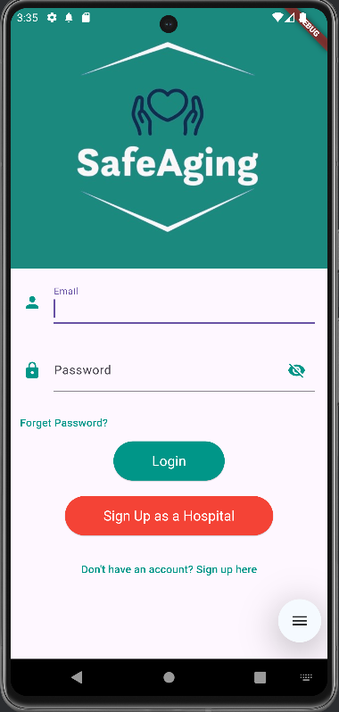

login

Slide 9
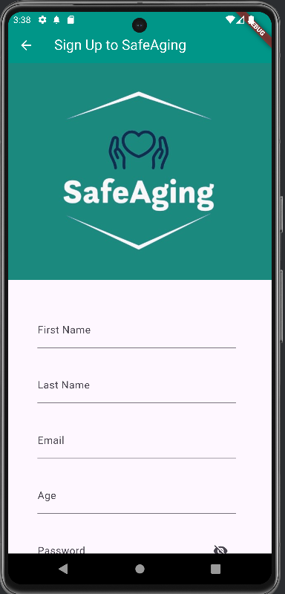
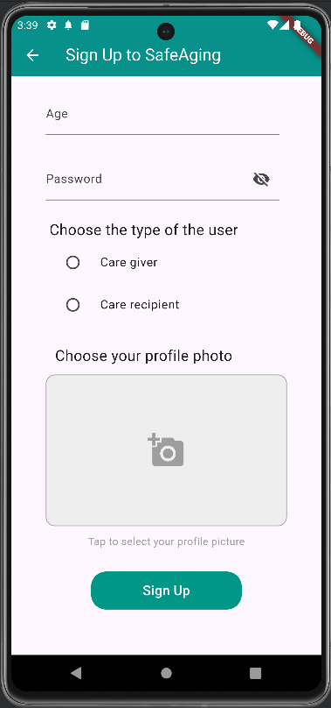
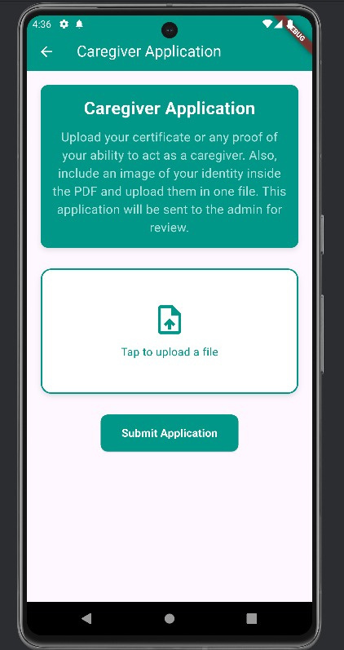
sign up

Slide 10
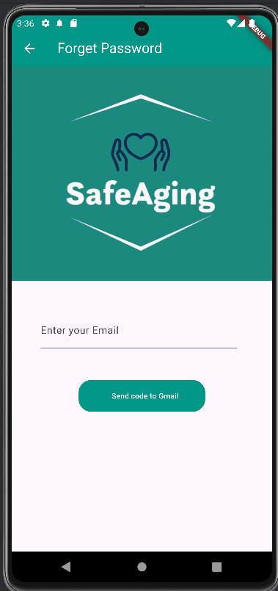
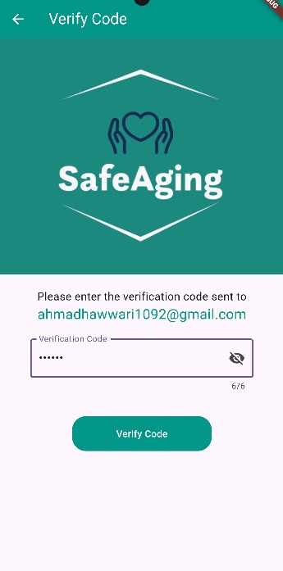
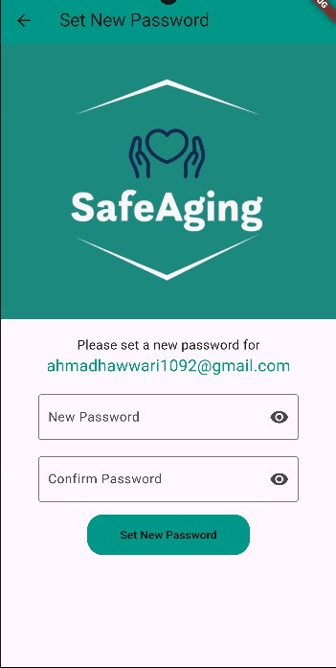
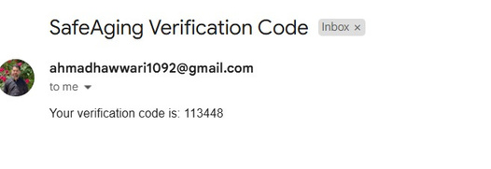
forget pass

Slide 11
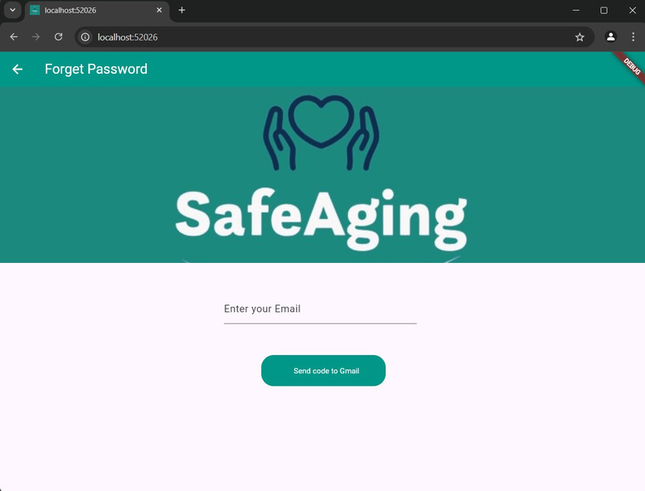
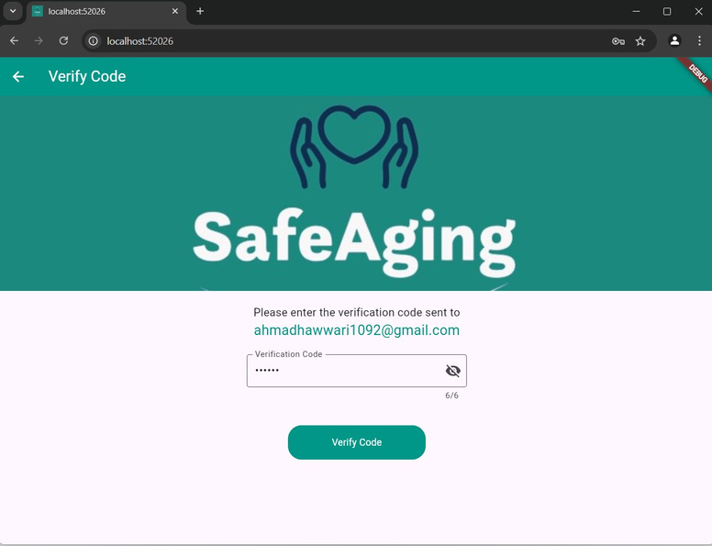
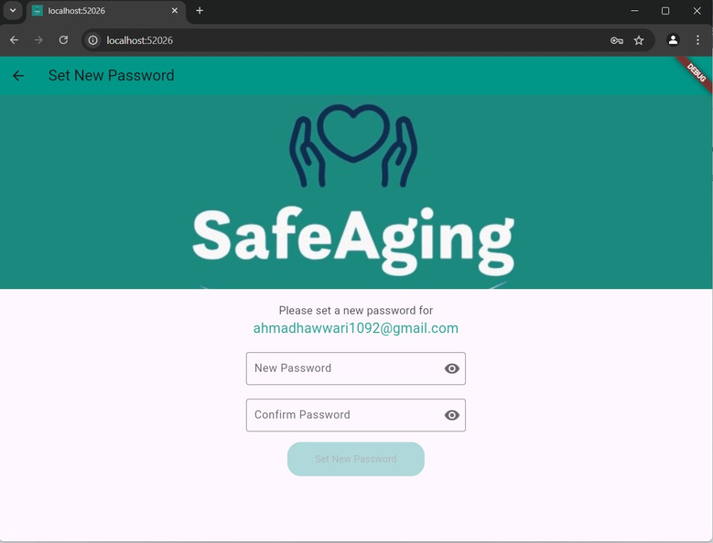
forget pass

Slide 12
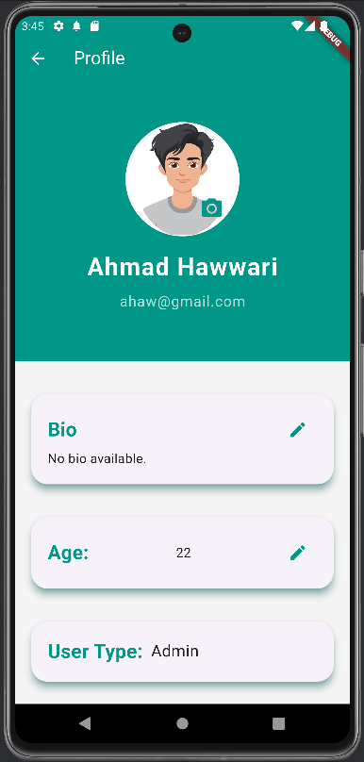


Slide 13
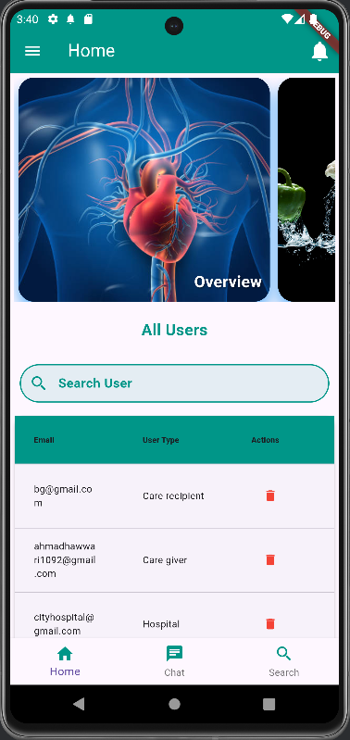
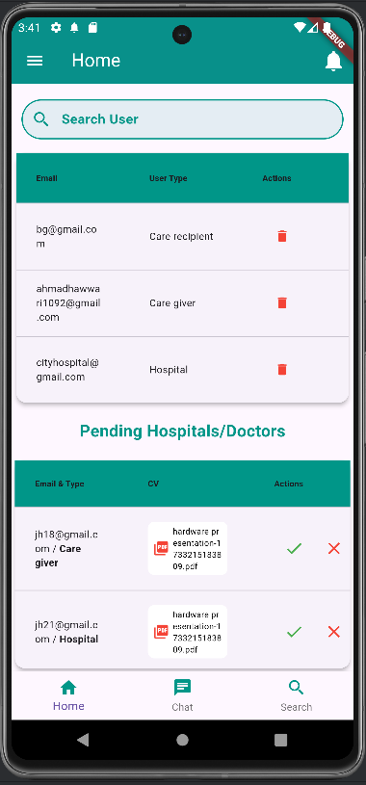
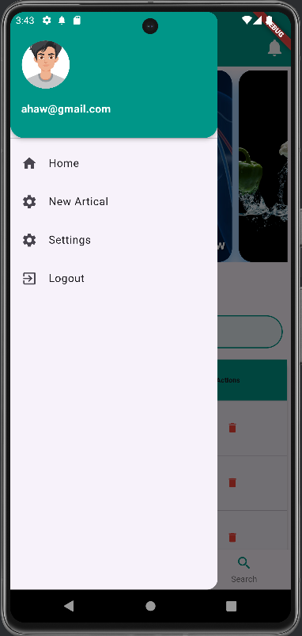
Admin page

Slide 14
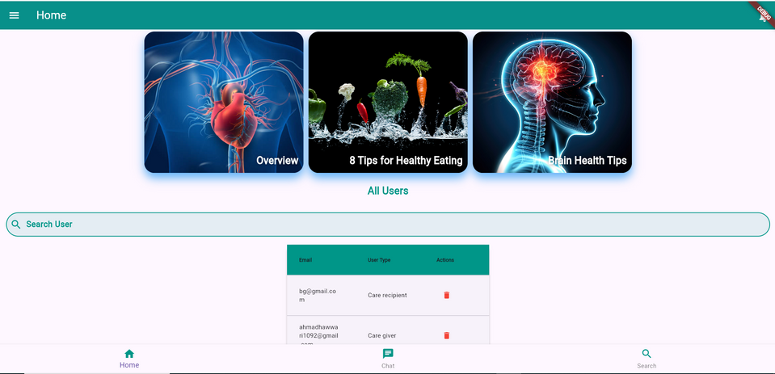
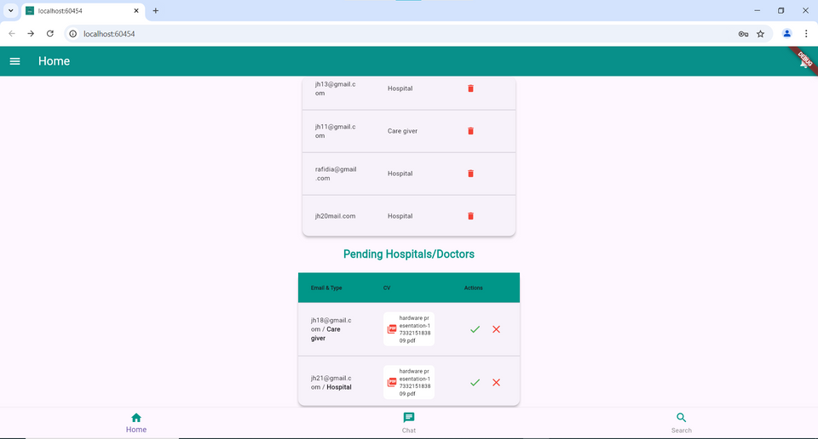
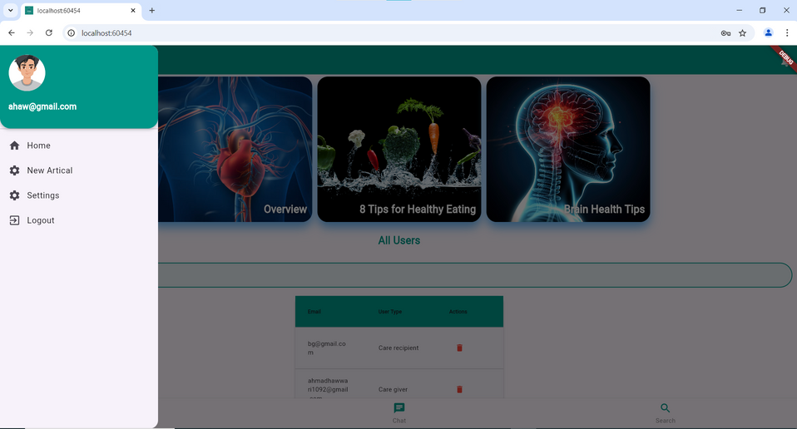
forget pass

Slide 15
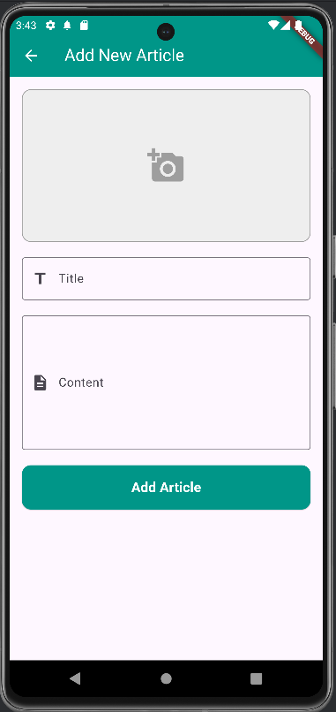
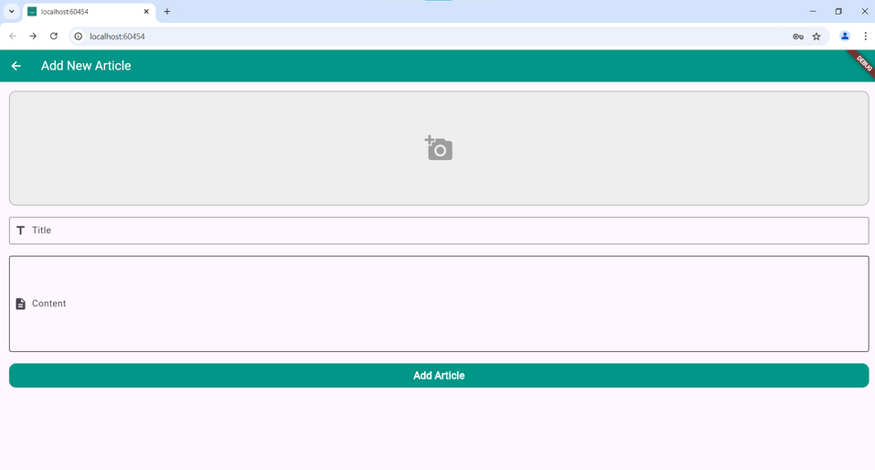

Slide 16
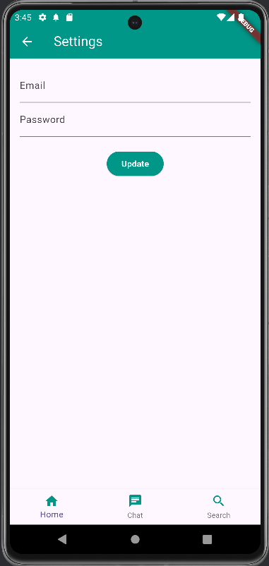
Settings

Slide 17
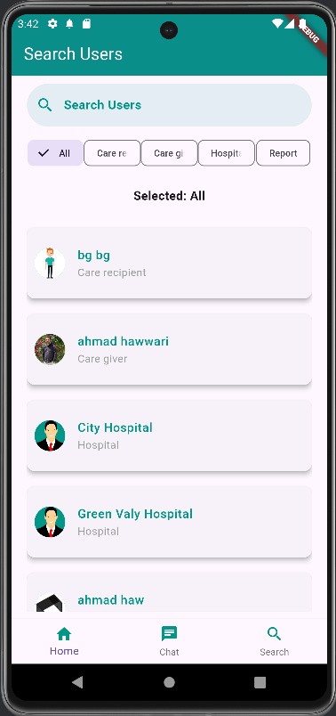
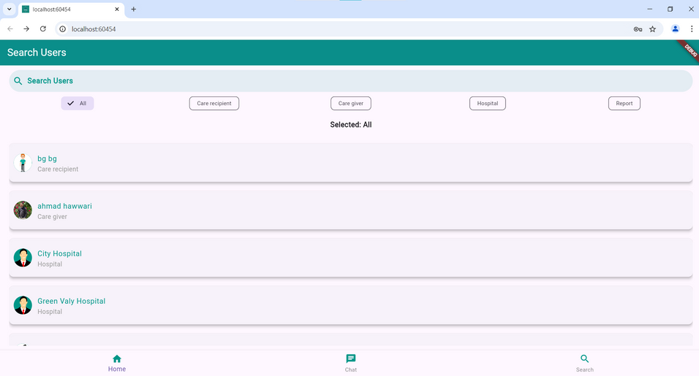
Search

Slide 18
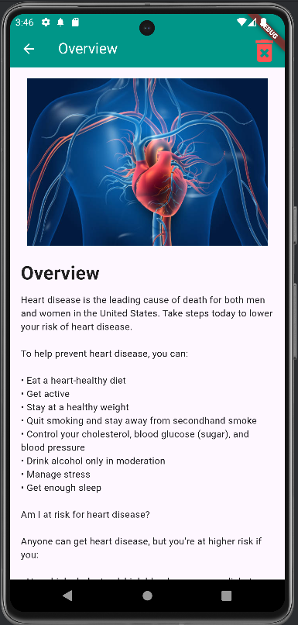
The Articles

Slide 19

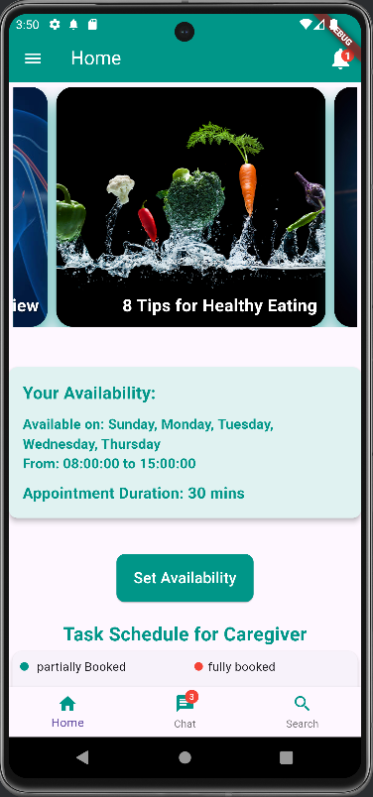
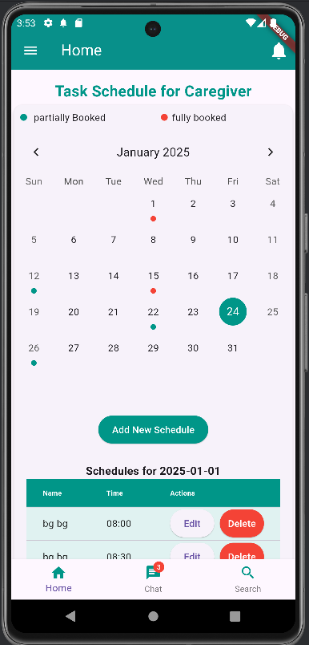
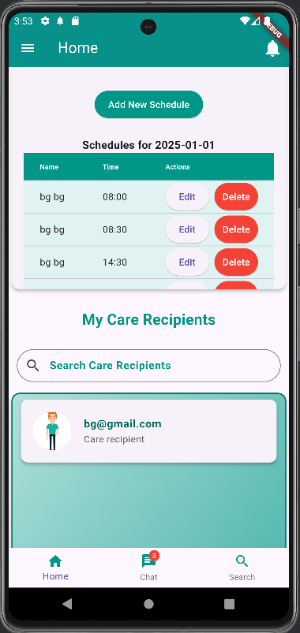
Doctor home page

Slide 20
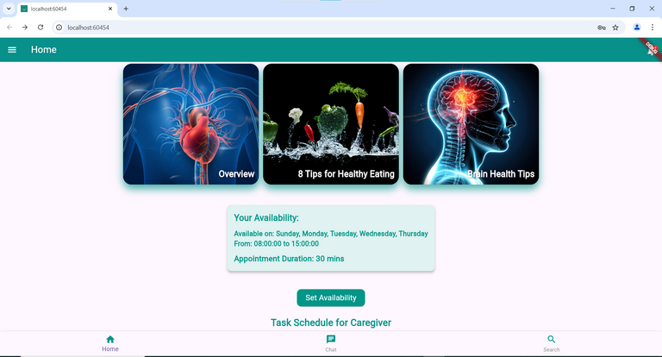
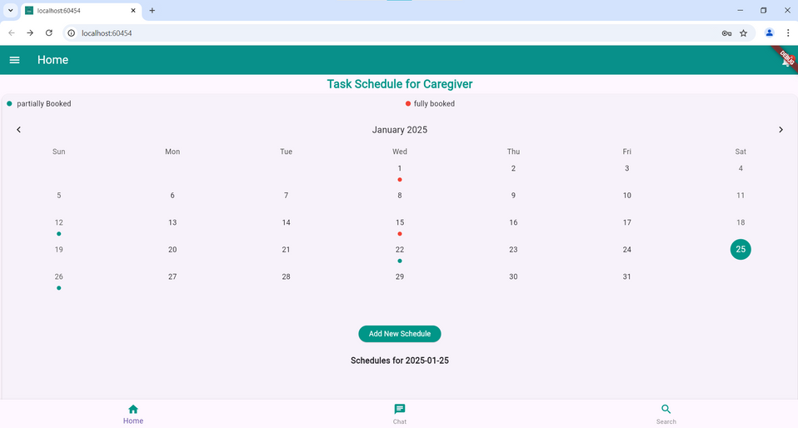
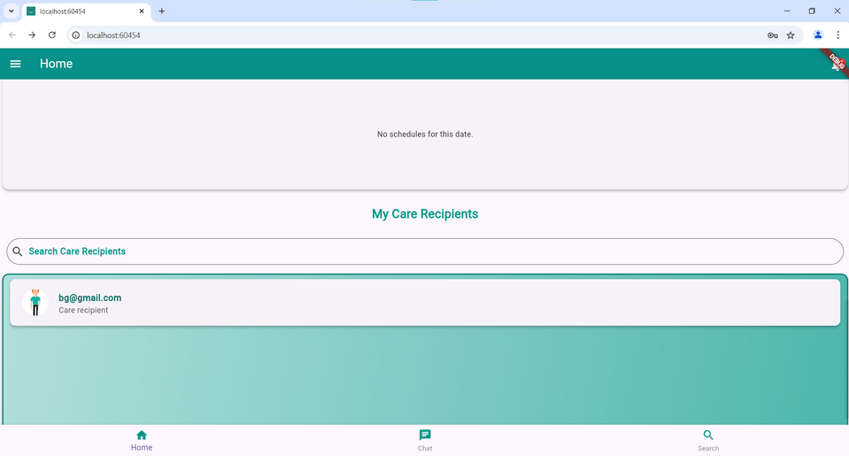
Doctor home page

Slide 21
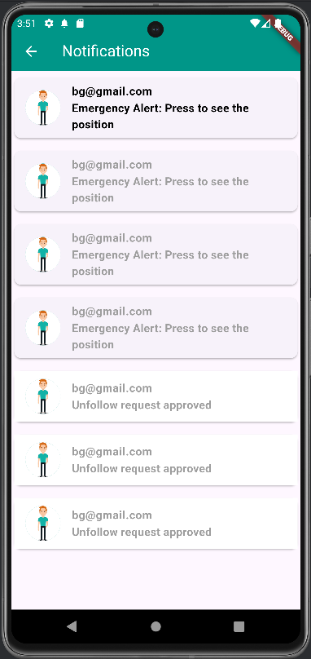
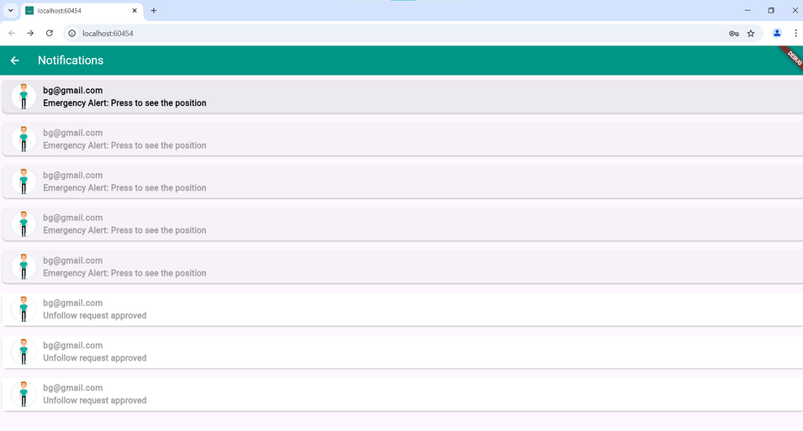
Notifications

Slide 22
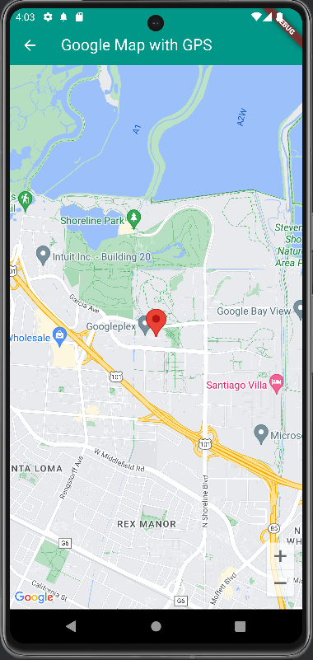
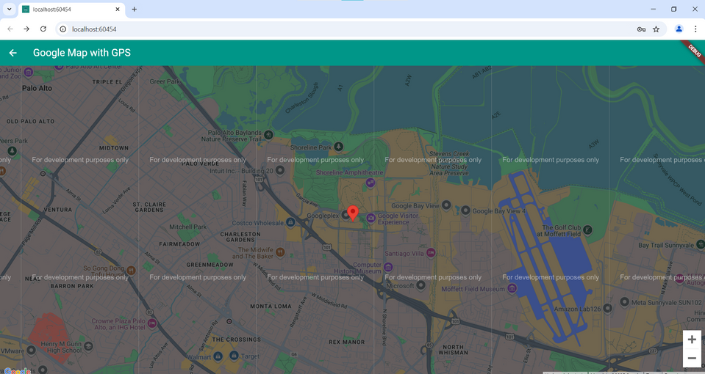
Emergancy button (GPS)

Slide 23
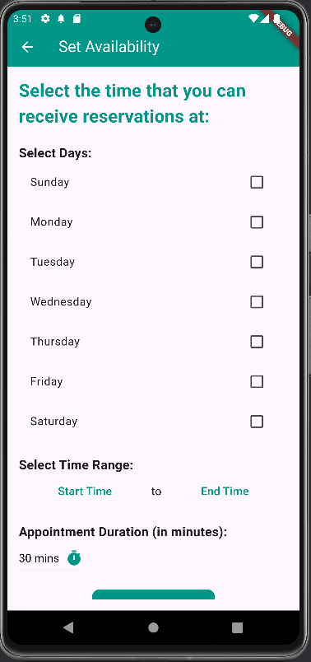
Set Availability

Slide 24
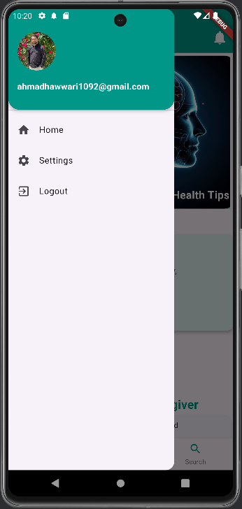
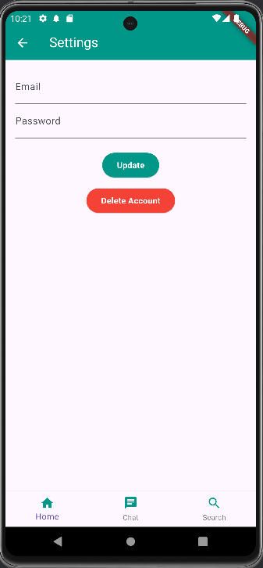
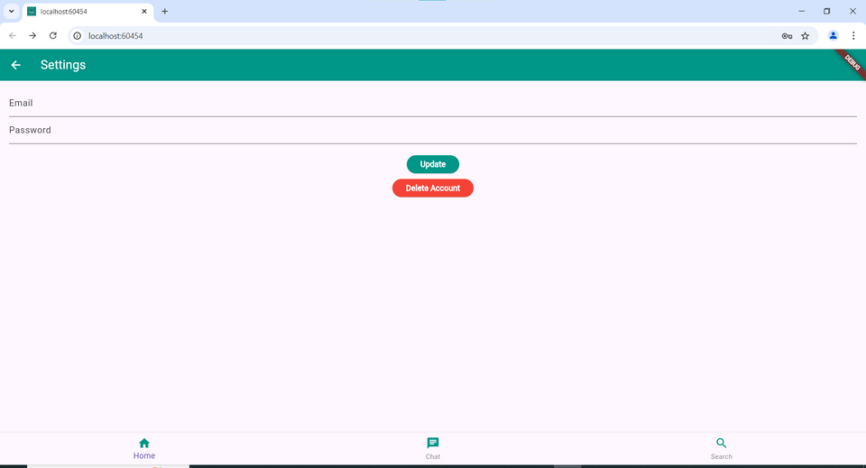
Settings

Slide 25
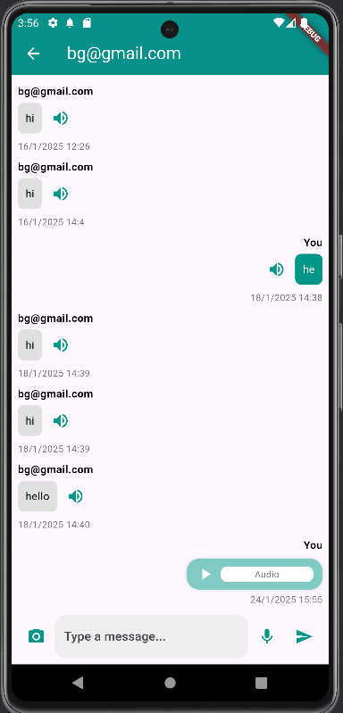
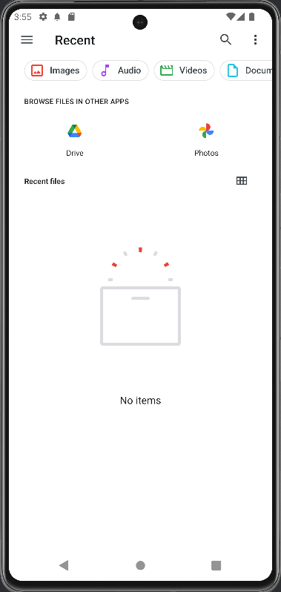
Chating

Slide 26
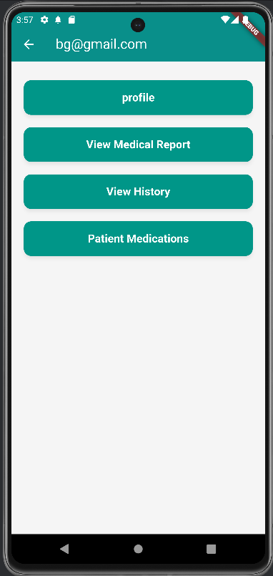
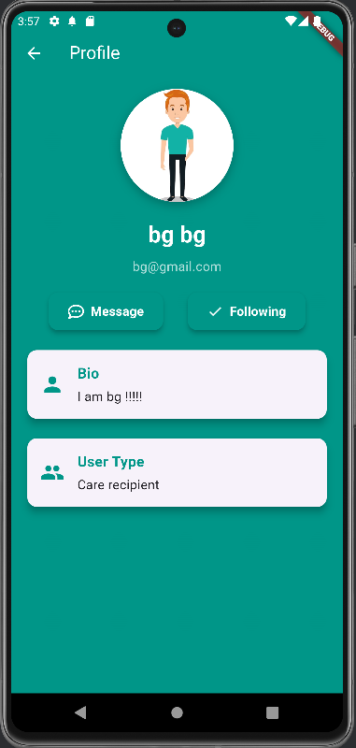
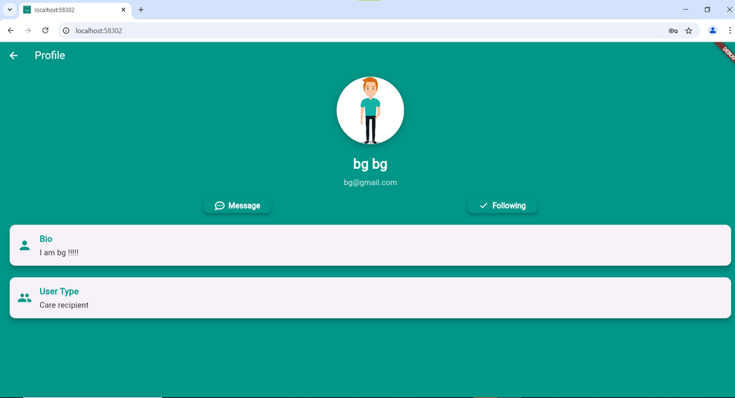
Care recipients
Doctor profile

Slide 27
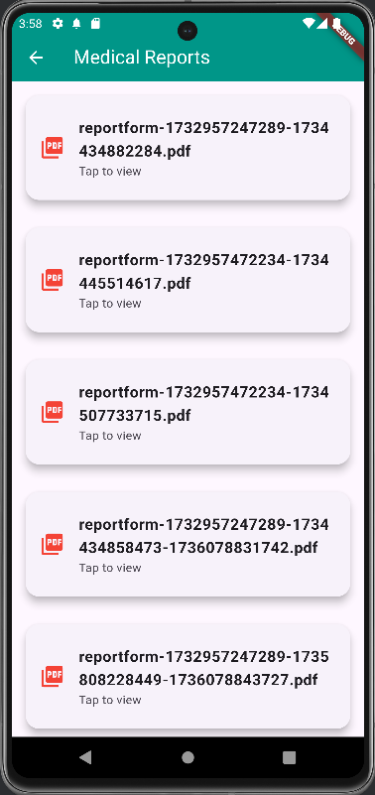
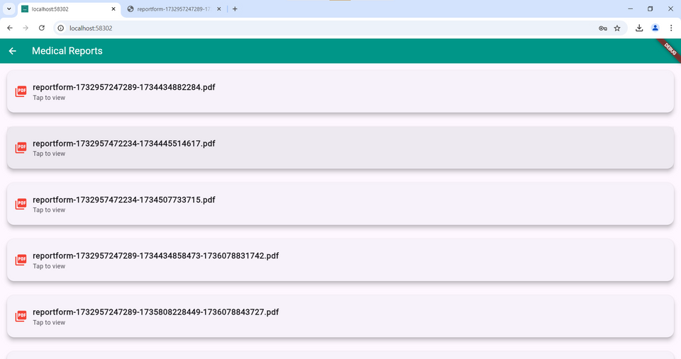
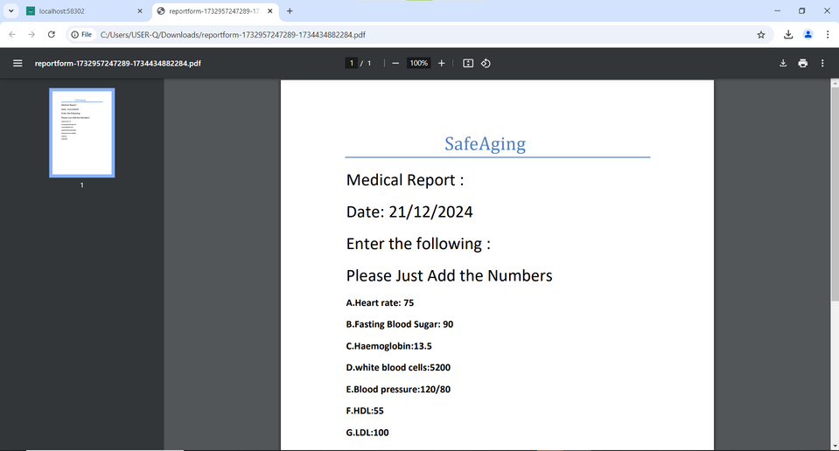
Medical Reports

Slide 28
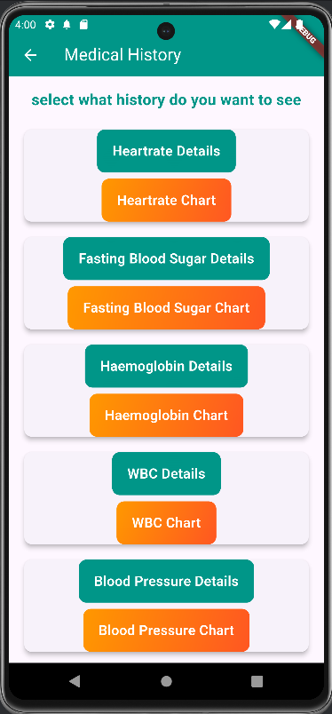
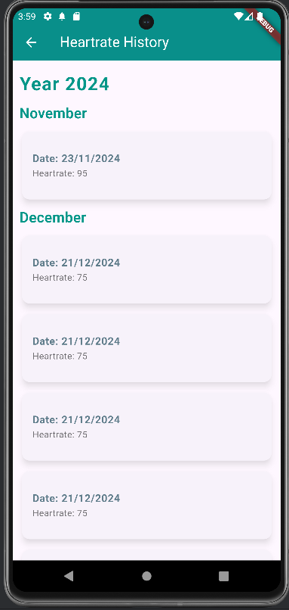
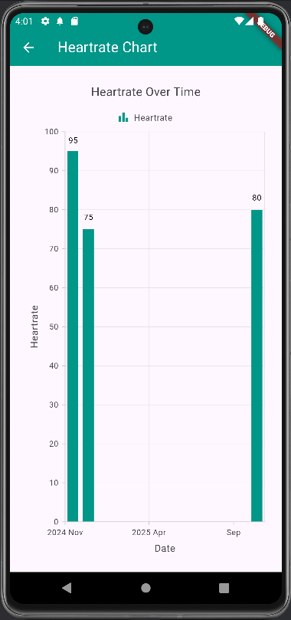
History

Slide 29
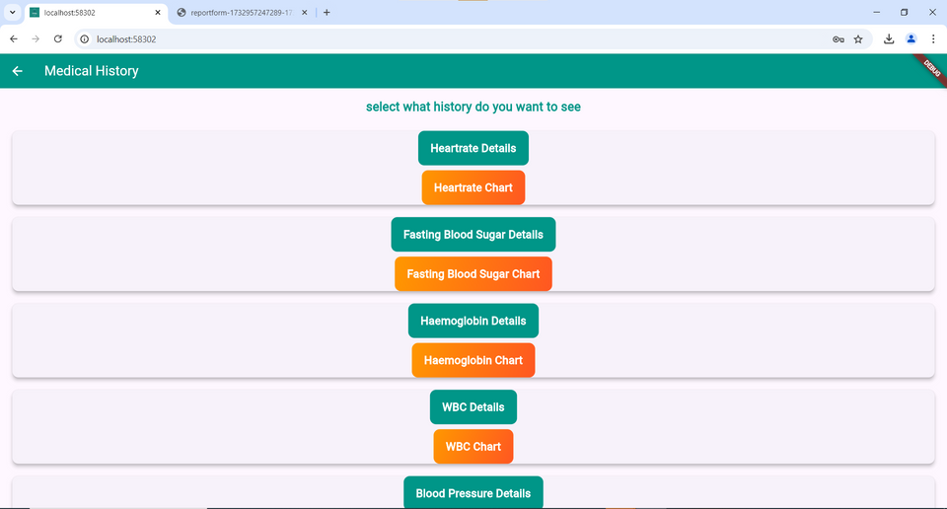

History

Slide 30



Patient medications

Slide 31



Care recipients home page

Slide 32

Reminder to take medication

Slide 33



Hospital

Slide 34



Medicine

Slide 35


Report PDF reader

Slide 36


Report PDF reader

Slide 37

Medical Report

Slide 38


Emergancy button ssettings

Slide 39


Doctor

Slide 40



Doctor

Slide 41



Doctor

Slide 42



Hospital Page

Slide 43
Limitations
Insert your payment card into Google Map
Learn skills during project work
Library publications

Slide 44
Future Work
Work on improving the website design
Add a feature to order and deliver medications
Activate the emergency button on the phone's power button

Slide 45
Acknowledgements
We would like to express our deepest appreciation to our supervisor, Dr. Haya samaana, for his outstanding assistance during the proįect, Our families, doctors, friends and colleagues for their support.

Slide 46
Thank you

