Slide 1

An-Najah National University
Faculty Of Engineering
Civil Engineering Department
KAFA VILLAGE WATER SUPPLY NETWORK
Prepared By : Adham Jihad Dibbas
Supervision of Dr. Anan Jayyousi

Slide 2
Outline:
Objectives of the project.
Study area.
Methodology.
Analysis of Existing Network.
Design of Future Network.

Slide 3
Objective:
Analysis of Existing Water Supply Network for Kafa Village.
Design of Future Water Supply Network for Kafa village.

Slide 4
Study area
Location :
Kafa village is located in Tulkarm at a distance about 5 km to the south of Tulkarm city.
It is surrounded by Faroun from the west, Shofa from the east, Ezbet Algrad from the north and Ezbet Shofa from the south.

Slide 5
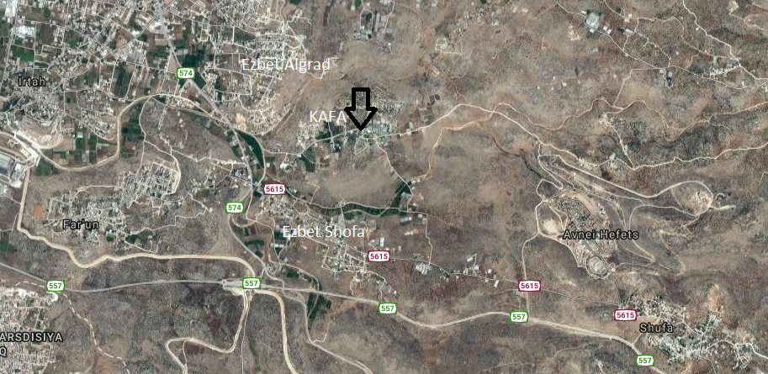

Slide 6

Area :
The area of the lands belonging to the Kafa is 634 donum Which include agriculture lands about 330 donum and building lands about 304 donum.
Population :
The present population is 1,000 persons.
Elevation :
Kafa is rising between (65-200) meters above mean sea level (A.M.S.L).

Slide 7
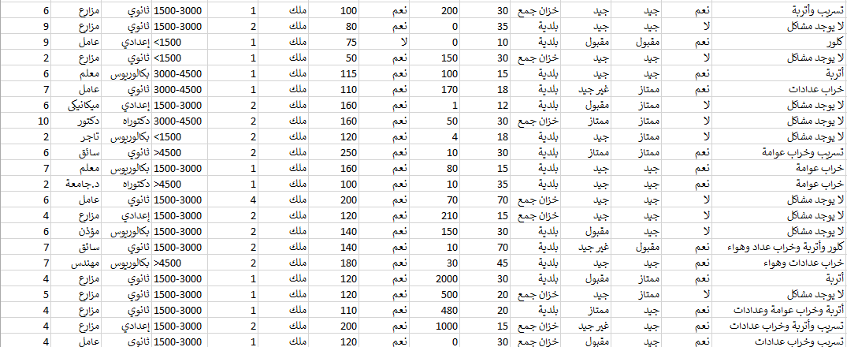
The Questionnaire
I took sample of 30 families and tried to be representative

Slide 8
Family Size:
The average number of the persons in Kafa Families is 6 persons.
The Income of Families:

Slide 9
Education:
The education in Kafa town is moderate good, as shown in figure below.

Slide 10
Houses Gardens or Agricultural Land:
You can see in figure below that 93% of the families own gardens or agricultural land.

Slide 11
Source of Water:
The main source of water in Kafa town is from the municipality, in addition about 33% of the families have cisterns as shown if figure below.

Slide 12
Water Bills in Summer and Winter :
The average of water consumption in the summer season is about 31.5 CM/month, and it’s larger than the consumption in the winter season which about 21.5 CM/month.

Slide 13
Problems with Water:
As shown in figure below, 60% of families complained from the water quality.

Slide 14
The problems:

Slide 15
The Relation between per capita consumption and the number of family members:
The figure shows that the L/C/day decrease with the in increase # of person.
The average L/C/day = 180 (consumption)
L/C/day (demand) = consumption/(1-UFW) = 285
UFW form municipality = 37%

Slide 16
Rainfall
The only available rainfall data are being recorded at Tulkarm meteorological stations located in the city are shown in the following Table.
Year | 2010 | 2011 | 2012 | 2013 | 2014 | 2015 | 2016
Rainfall (mm) | 660.5 | 467 | 565 | 680 | 412.5 | 695.5 | 410

Slide 17
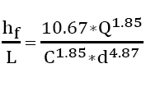
Methodology
Hydraulic Equations:
Head loss due to friction in the pipes calculated by Hazen-William’s equation.
Analysis and Design Constraints:
Pressure at junction between (20-100) m.H₂O.
Velocity in pipe (0.1-3.0) m/s.

Slide 18
Analysis of Existing Network
Node :
In Kafa’s network, there are 36 nodes that connect the pipes together.
Now, I find the demand of the nodes by assume density of each area.

Slide 19
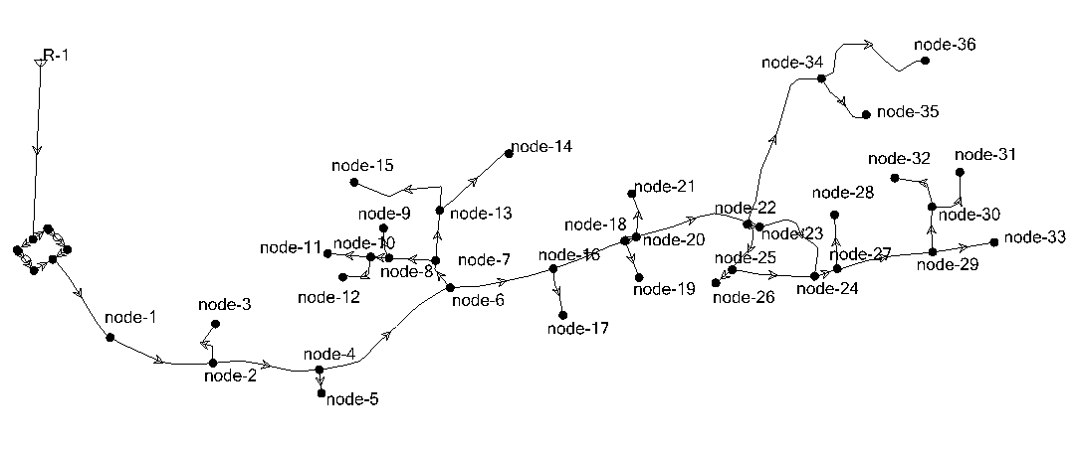

Slide 20
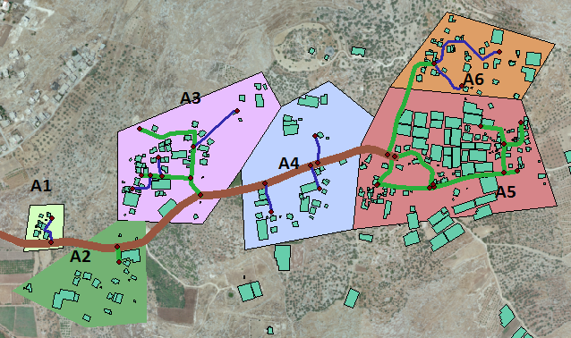
Analysis of Existing Network
The Equation:
D(A6+A5)+0.5(A1+A3)+0.25D(A2+A4) = # of Pop =1000
D=3.93*10^-3
For Example the population of A3 = 0.5D*Area=172 capita
As you can see in the table below

Slide 21
Analysis of Existing Network
Table of Areas:
Demand(CM/day) | Population | Type | Area(m^2) | # Area
5.13 | 18 | 0.5D | 9285.415 | 1
14.25 | 50 | 0.25D | 51377.245 | 2
49.02 | 172 | 0.5D | 87121.415 | 3
24.225 | 85 | 0.25D | 86211.595 | 4
136.8 | 480 | D | 122316.495 | 5
55.575 | 195 | D | 49510.226 | 6
285 | 1000 |  | 405822.4 | Sum
The demand of each area(CM/day) = # of Pop * L/C/day(demand) * 10^-3
L/C/day (demand) = 285

Slide 22
Analysis of Existing Network
Now find the density of each node using GIS program:
A1
A2
Demand(CM/day) | Population | Density | Nodes
3.42 | 12 | 0.6666 | 2
1.71 | 6 | 0.3334 | 3
5.13 | 18 | 1 | Sum
Demand(CM/day) | Population | Density | Nodes
9.69 | 34 | 0.68 | 4
4.56 | 16 | 0.32 | 5
14.25 | 50 | 1 | Sum

Slide 23
Analysis of Existing Network
A3
A4
Demand(CM/day) | Population | Density | Nodes
2.85 | 10 | 0.0581 | 6
3.705 | 13 | 0.0755 | 7
4.56 | 16 | 0.0930 | 8
7.695 | 27 | 0.1569 | 9
2.28 | 8 | 0.0465 | 10
5.13 | 18 | 0.1046 | 11
7.695 | 27 | 0.1569 | 12
8.835 | 31 | 0.1802 | 13
1.71 | 6 | 0.0348 | 14
4.56 | 16 | 0.0930 | 15
49.02 | 172 | 1 | Sum
Demand(CM/day) | Population | Density | Nodes
3.135 | 11 | 0.1294 | 16
4.845 | 17 | 0.2 | 17
1.995 | 7 | 0.0825 | 18
6.27 | 22 | 0.2588 | 19
3.42 | 12 | 0.1411 | 20
4.56 | 16 | 0.1882 | 21
24.225 | 85 | 1 | Sum

Slide 24
Analysis of Existing Network
A5
A6
Demand(CM/day) | Population | Density | Nodes
3.135 | 11 | 0.0229 | 22
13.395 | 47 | 0.0979 | 23
4.275 | 15 | 0.0312 | 24
4.845 | 17 | 0.0354 | 25
15.675 | 55 | 0.1145 | 26
7.41 | 26 | 0.0541 | 27
15.96 | 56 | 0.1166 | 28
9.405 | 33 | 0.0687 | 29
18.525 | 65 | 0.1354 | 30
12.255 | 43 | 0.0895 | 31
23.94 | 84 | 0.1750 | 32
7.98 | 28 | 0.0583 | 33
136.8 | 480 | 1 | Sum
Demand(CM/day) | Population | Density | Nodes
26.505 | 93 | 0.4769 | 34
10.83 | 38 | 0.1948 | 35
18.24 | 64 | 0.3282 | 36
55.575 | 195 | 1 | Sum

Slide 25
Analysis of Existing Network
Pipelines :
The Network has 37 pipes of different diameter(1,2,3)inches, the roughness coefficient is 100 for steel, as reported by Hazen Williams roughness coefficient.

Slide 26
Analysis of Existing Network
Table of Pipes:
C | D (inch) | L | TO | From | Pipes ID
100 | 3 | 161 | N-1 | Pumps | Main-Pipe
100 | 3 | 161 | N-2 | N-1 | P-1
100 | 1 | 76 | N-3 | N-2 | P-2
100 | 3 | 160 | N-4 | N-2 | P-3
100 | 2 | 35 | N-5 | N-4 | P-4
100 | 3 | 237 | N-6 | N-4 | P-5
100 | 2 | 49 | N-7 | N-6 | P-6
100 | 2 | 69 | N-8 | N-7 | P-7

Slide 27
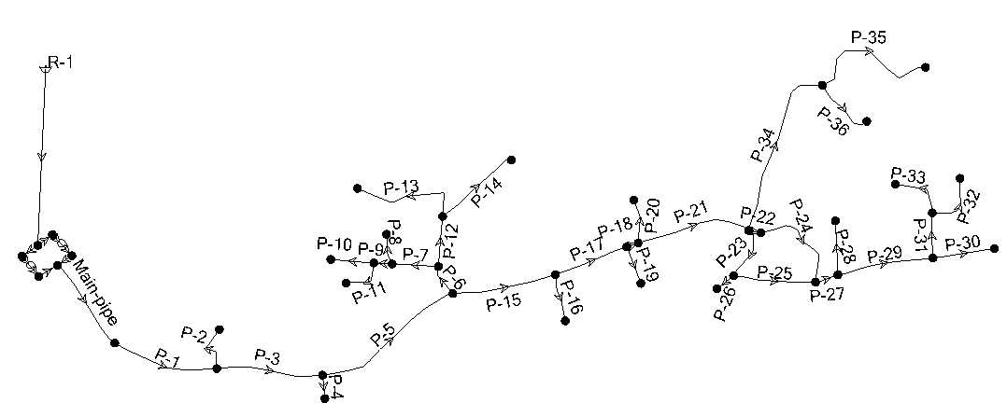

Slide 28
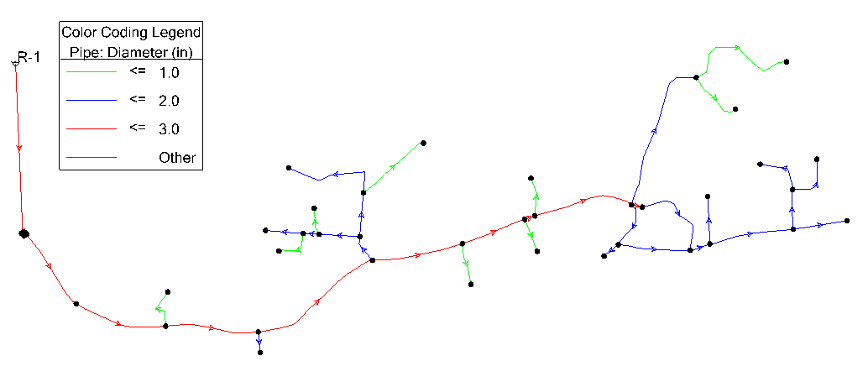
Analysis of Existing Network
Diameters of pipes

Slide 29
Analysis of Existing Network
Pump:
There is two pumps connected in parallel in Kafa’s town, which has a head of each pump between (98.6 to 179) meters, flow between (8 to 24 ) Cm/day.

Slide 30
EPS Analysis and Demand Pattern
After running the model using Water-Cad program, I have this results.

Slide 31
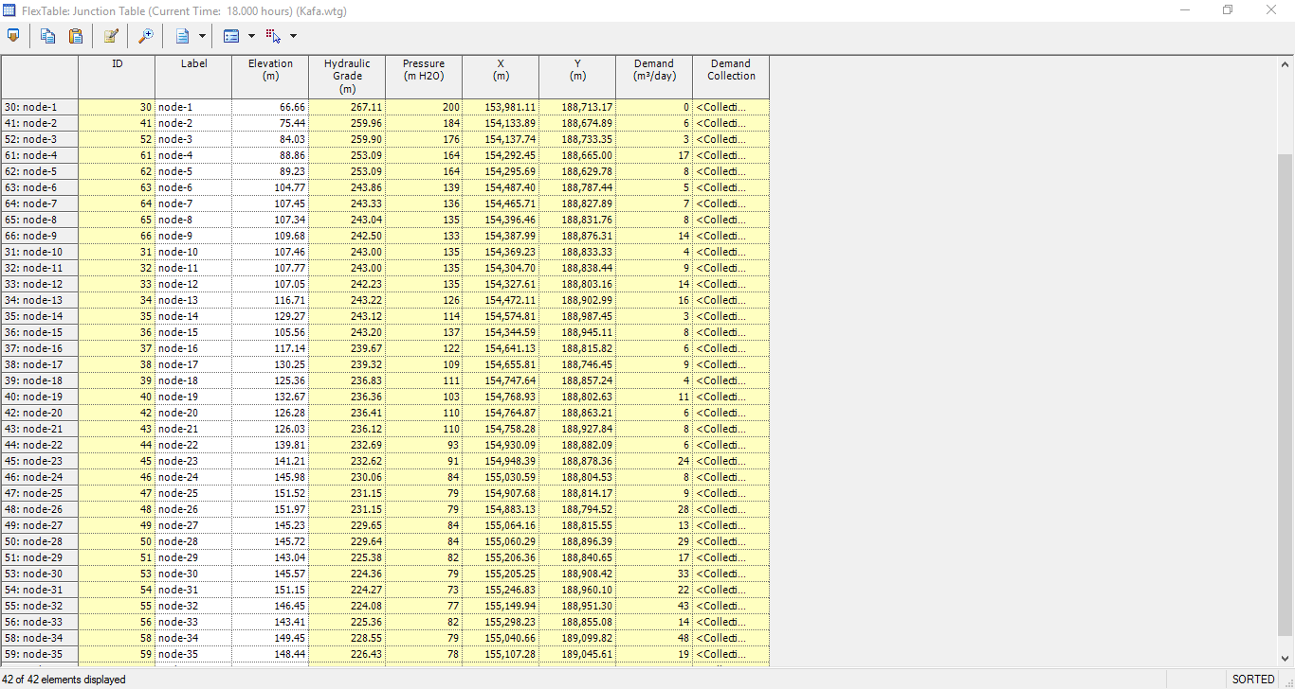
Junctions Table (Peak Hour)

Slide 32
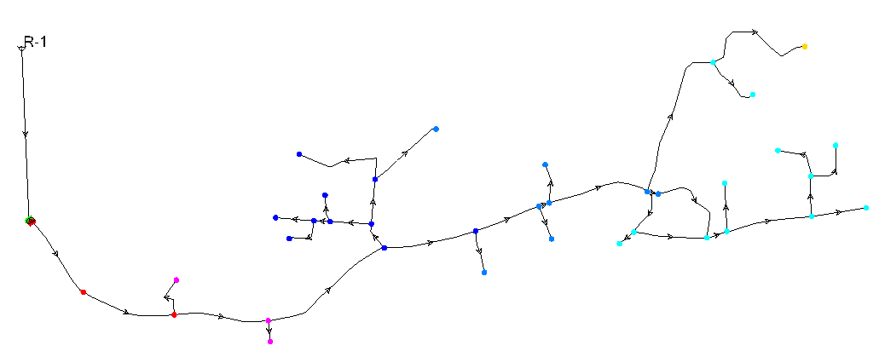
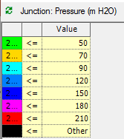
Pressure of Nodes

Slide 33
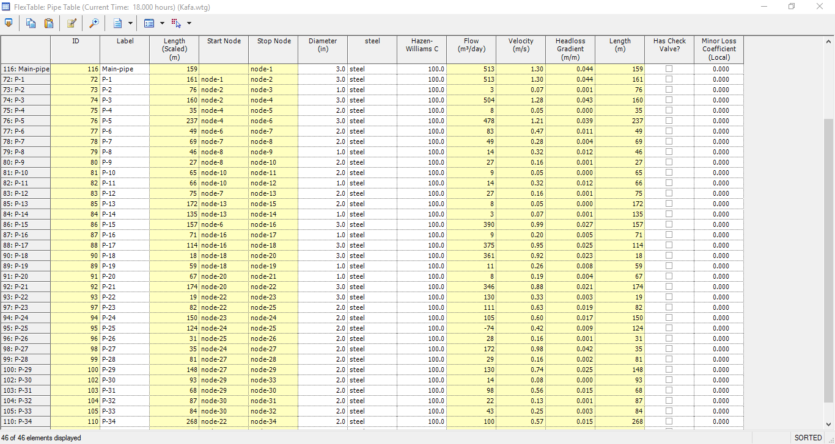
Pipes Table (Peak Hour)

Slide 34
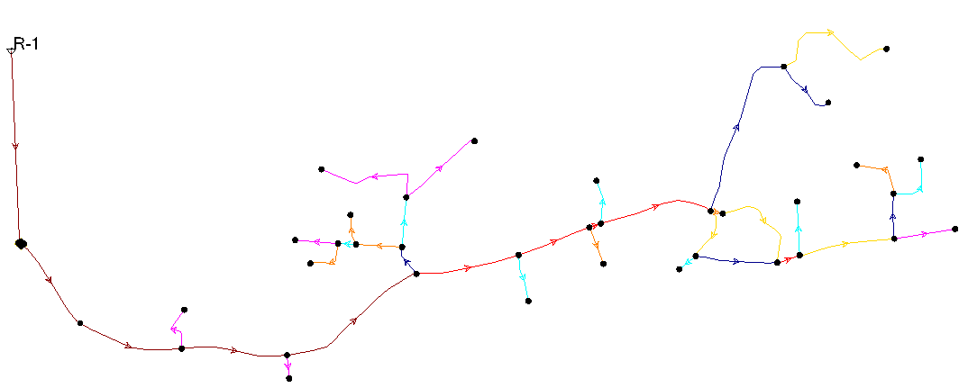
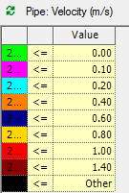
Velocity in Pipes

Slide 35

Pump Table

Slide 36
Conclusions of Analysis
From the results obtained from previously model, noticed that most of junction has pressure head between (60-200) m H2O,which is grater than the Constraints and all velocity is between (0.05-1.3) m/s.

Slide 37
Design of Future Network
Population Projection:
The current population of Kafa town is 1000 inhabitant. In order to develop the current water network to serve for the 25 years. One needed to calculate the future population.
According to Palestinian Central Bureau of statistics (PCBS), Kafa’s population growth rate is about 3.5%.
Based on this, the future population of Kafa town till 2042 is estimated according on the following equation:
P2042=P2017*(1+i)^n
If i (growth rate) = 3.5%
n= 25 years
P2017= 1000 person
P2042= 2364 person

Slide 38
Design of Future Network
Future Water Demand:
In order to supply people with enough of water in the future, the minimum domestic consumption rate is taken as 120 L/C/d according to WHO standards for small communities, so the municipal consumption will be:
Municipal consumption = Domestic consumption/0.9 = 120/0.9 = 133.34 L/C/day
Demand = consumption / (1-UFW) = 133.34/(1-0.37) = 212 L/C/day
The present Demand per capita equals 285 L/C/day
This less than the present per capita demand rate, so take the present per capita demand.

Slide 39
Design of Future Network
Estimation of Future Water Demand:
To estimation the future water demand for each node, the existing water demand will be multiplied by the future demand factor that equals to:
Factor = (P2042/P2017) * (new demand / old demand)
Factor = 2.364
Future Demand = Existing Demand * Factor = 285 CM/day * 2.364
= 674 CM/day

Slide 40
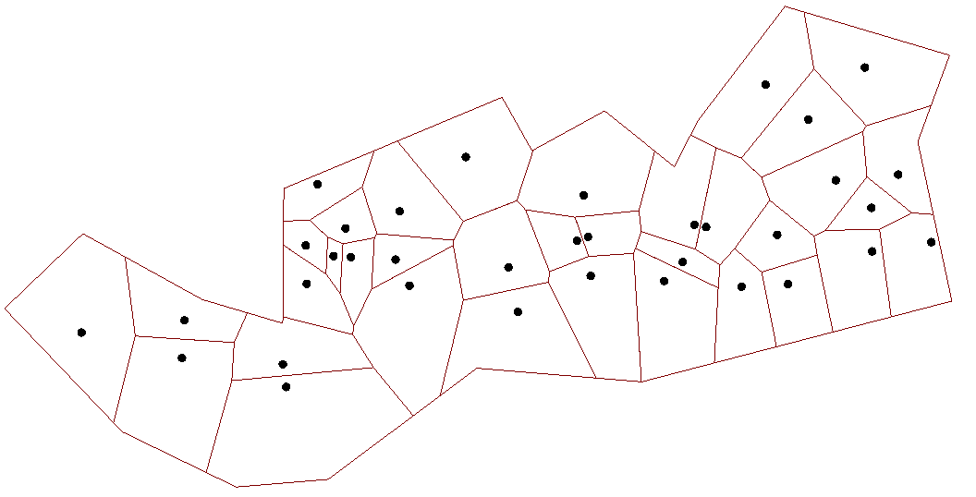
By using “ load builder ” on WaterCAD software

Slide 41
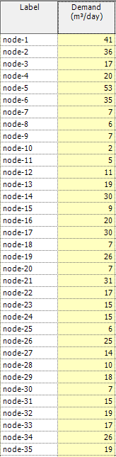

Slide 42
EPS Analysis and Demand Pattern

Slide 43
Future Analysis Based on Existing Network
Node ID | Pressure(mH2O ) | Node ID | Pressure(mH2O )
N-1 | 106 | N-19 | -20
N-2 | 80 | N-20 | -10
N-3 | 43 | N-21 | -12
N-4 | 53 | N-22 | -27
N-5 | 50 | N-23 | -28
N-6 | 21 | N-24 | -35
N-7 | 16 | N-25 | -39
N-8 | 16 | N-26 | -40
N-9 | 14 | N-27 | -35
N-10 | 16 | N-28 | -36
N-11 | 16 | N-29 | -36
N-12 | 16 | N-30 | -39
N-13 | 6 | N-31 | -45
N-14 | -13 | N-32 | -46
N-15 | 17 | N-33 | -36
N-16 | 3 | N-34 | -39
N-17 | -17 | N-35 | -42
N-18 | -9 | N-36 | -53

Slide 44
Design of Future Network
To solve the problem of the negative pressure in the future network, I have two options. The first one to add another booster pump in parallel, the second one to conversion the system from pump system to gravity system.
The design criteria that I used according to PWA:
Pressure: (20-100) mH20
Velocity: (0.1-3) m/sec

Slide 45
Design of Future Network
Option One:
The new pump has a head of (170m) and flow of (730 CM/day), the three pumps connected in parallel to increase the flow of water in system, because the existing two pumps their capacity of flow is 1152 CM/day and head 100 mH2O at maximum operation, but the demand at the peak hour of day is 1213 CM/day, so I use another pump (in parallel) to increase the flow of water.
To maintain high pressure in the low elevation areas with the standards and the increase of pressure at the minimum consumption of water of the day, a pressure reducing valve (PRV) was used.

Slide 46
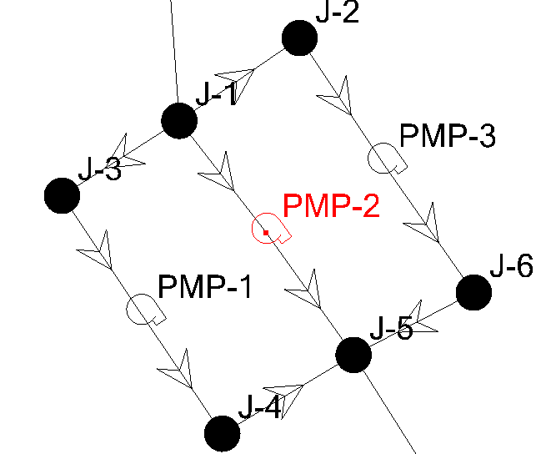
Design of Future Network
Option One:

Slide 47
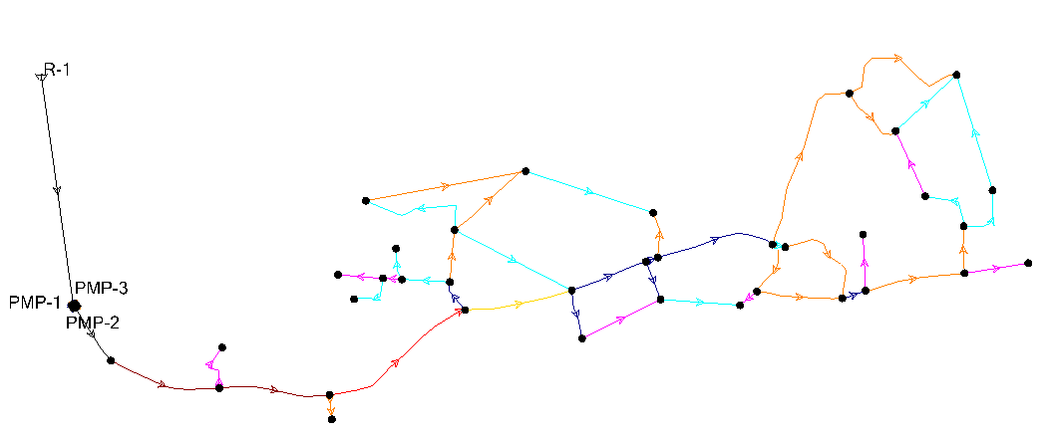
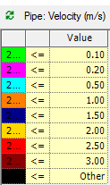
Result of this Option (Peak Hour)
1- Velocity

Slide 48
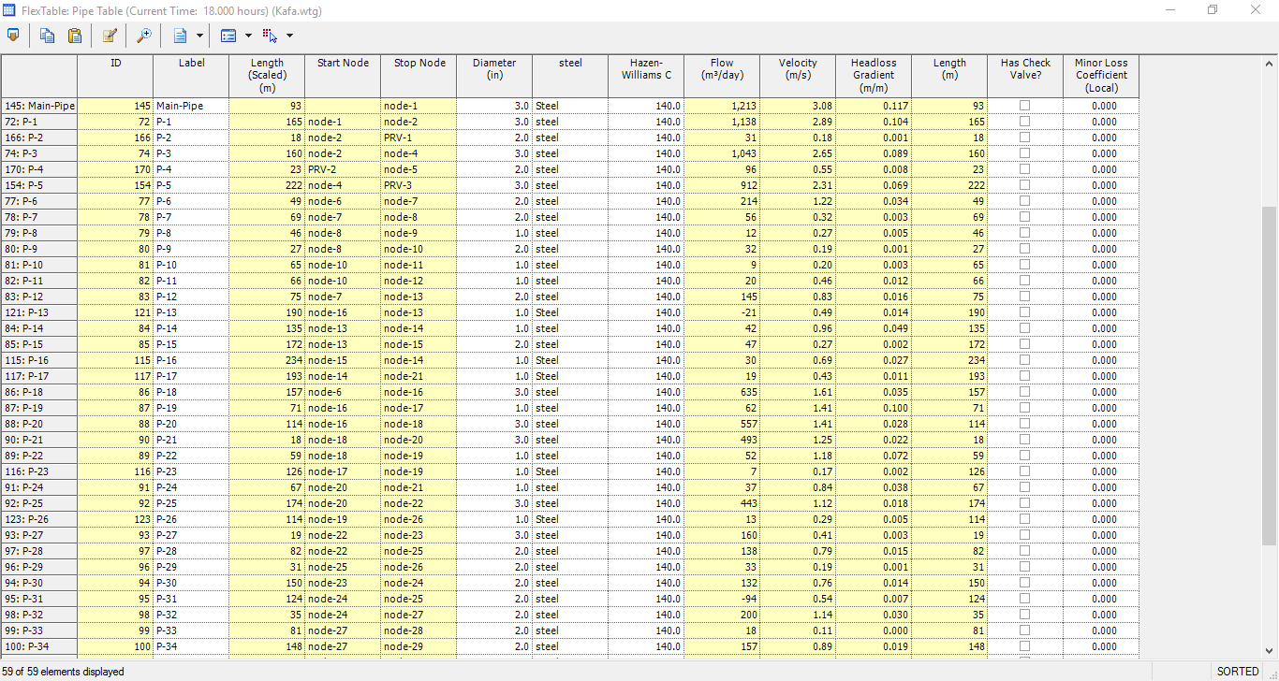

Slide 49
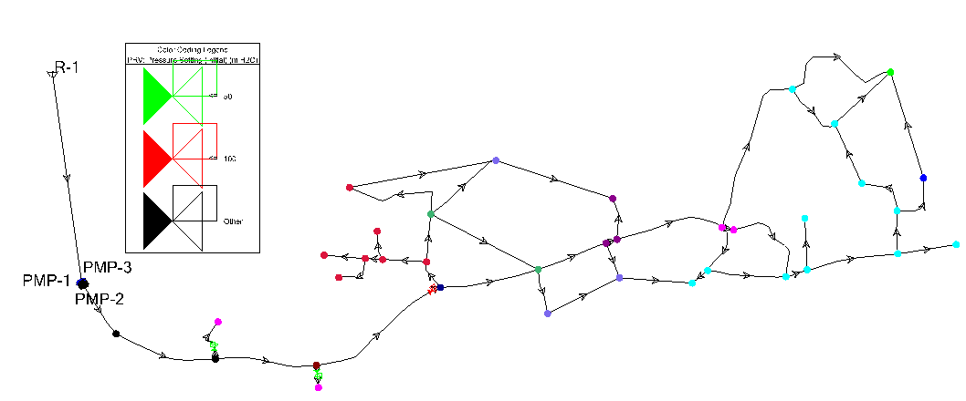
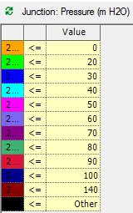
Result of this Option
2- Pressure

Slide 50
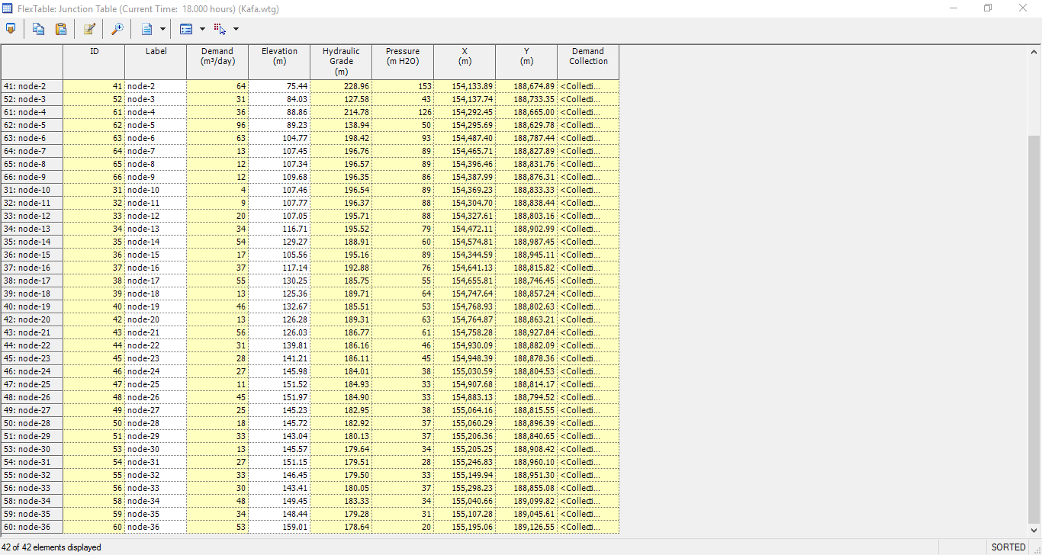

Slide 51
Design of Future Network
Option Two:
This option considered to conversion the system from pump system to gravity system by elevate the water to new reservoir (200 MSL) using the existing pumps, the height of the new reservoir is equal 20 meters.
The total length added to transfer the water from the old reservoir to new one is equal 1759 meters.

Slide 52
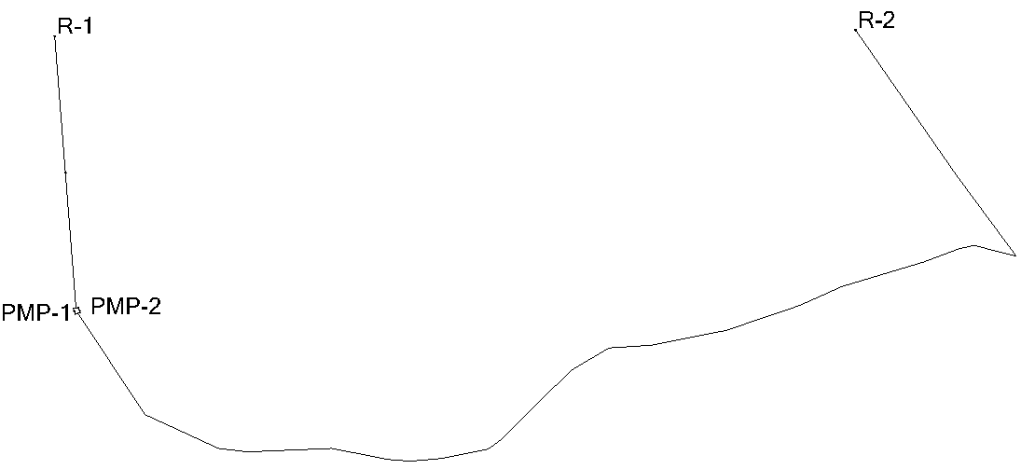
Design of Future Network
Option Two:

Slide 53
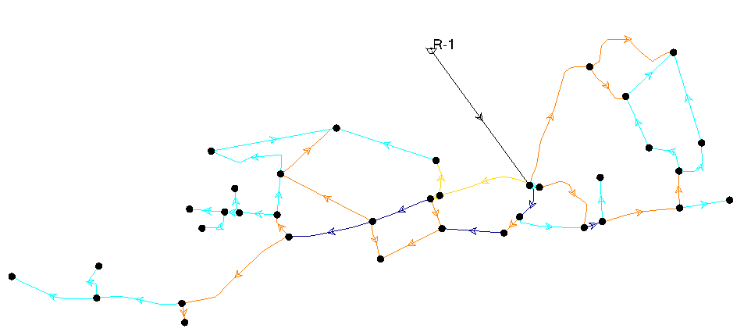
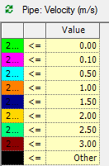
Result of this Option (Peak Hour)
1- Velocity

Slide 54
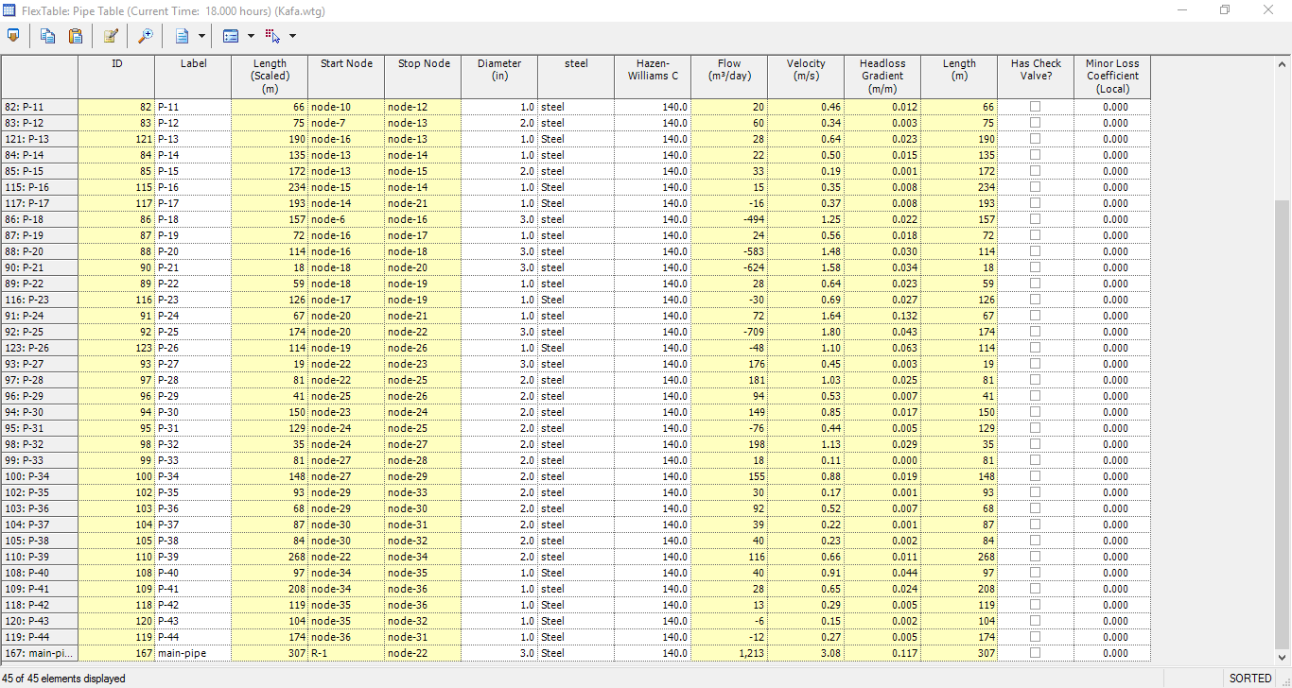

Slide 55
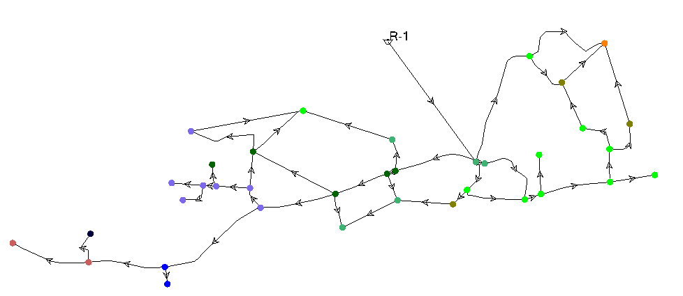
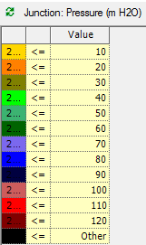
Result of this Option
2- Pressure

Slide 56
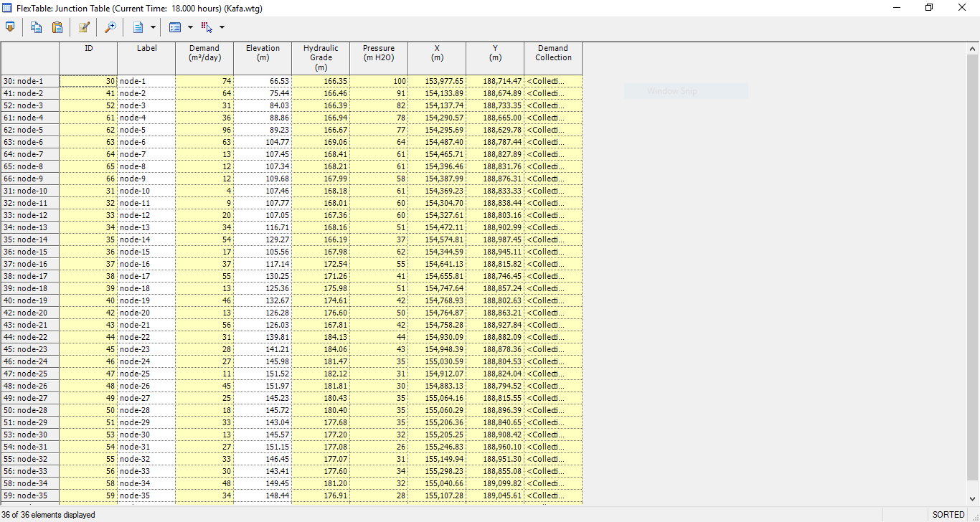

Slide 57
Conclusions of Design
After calculation the cost of each option, option two was found to be better than option one with its high efficiency according to the design criteria such as velocity and pressure, but option one was found to be better than option two with its low cost.

Slide 58
Thank You
For Your Attention…

