Slide 1
EcoBin
Hardware project

Slide 2
TABLE OF CONTENTS
Introduction
Features
01
02
Eectronic pieces
Future work
03
04

Slide 3
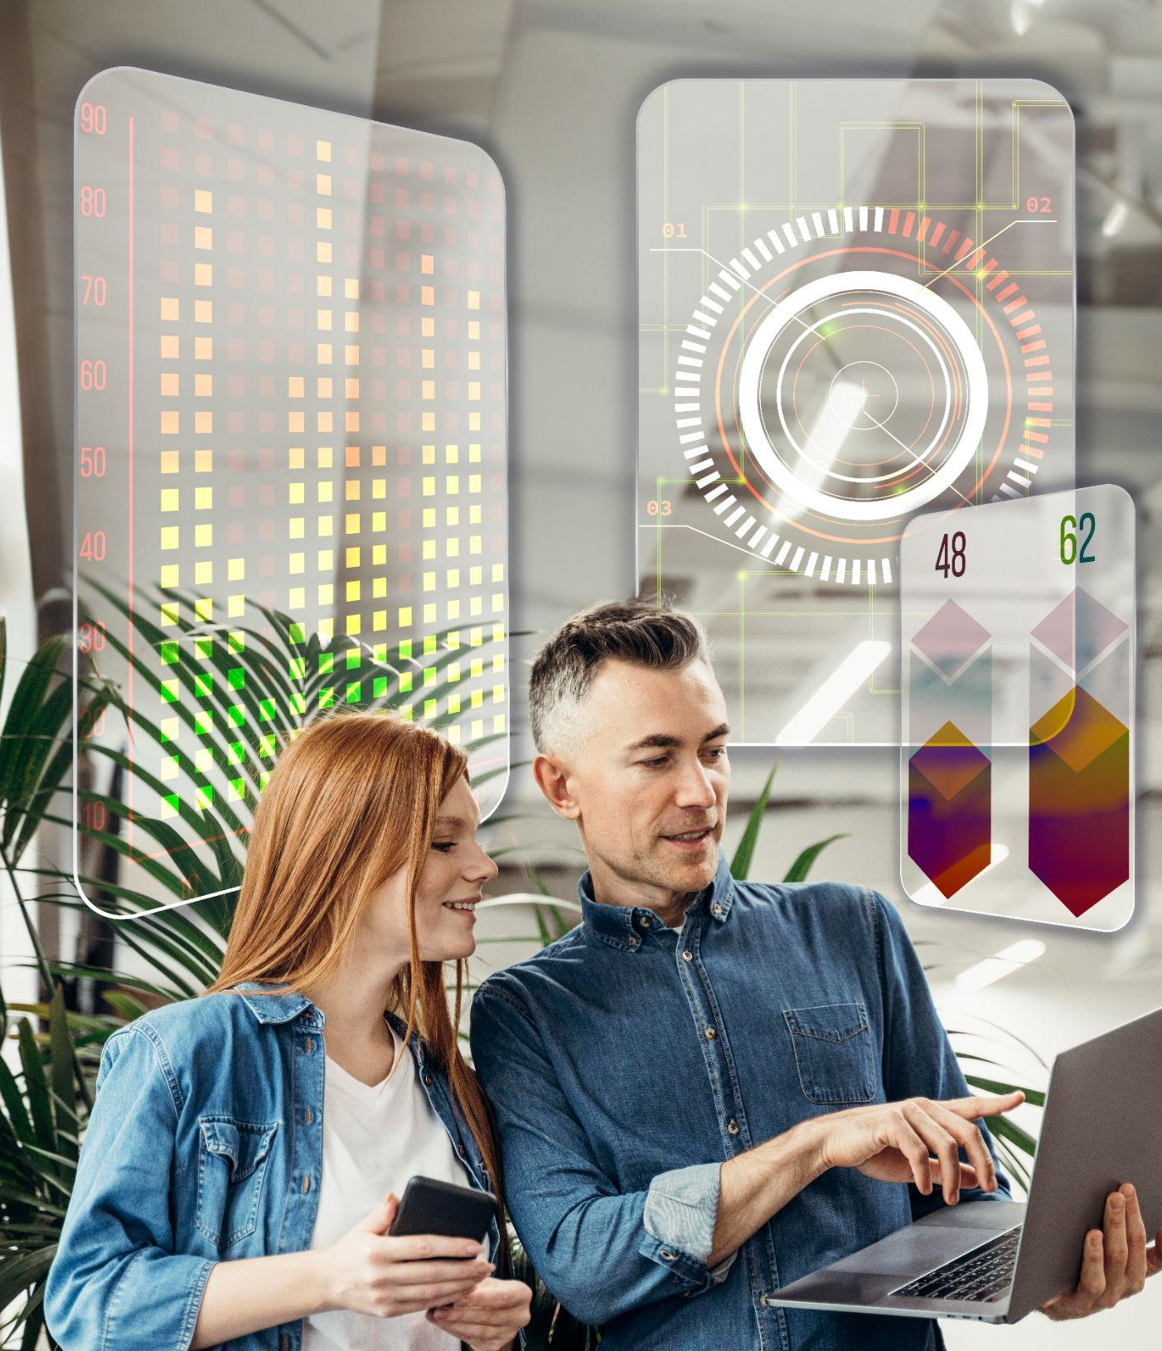
01
PROJECT
AND STRATEGY

Slide 4
Introduction
During recycling operations, separating metals from mixed garbage is prone to errors, is time-consuming, and relies on manual labor, leading to significant contamination and the loss of recoverable materials. The EcoBin project utilizes Arduino technology to develop an intelligent recycling bin for enhanced waste management. This bin is specifically tailored for public areas and is designed to streamline the recycling processes.

Slide 5
02
Features

Slide 6
How does the project work?

Slide 7
Detect and separate metal waste from other types.
Measure the weight of each metal object and sort it accordingly.
Implement RFID security to restrict access to a few authorized personnel.
Control the door to release the objects based on specific conditions.
Detect if the interior basket is full and decide whether to open the door or not.
Display user instructions and information on an OLED screen.

Slide 8
03
Electronic pieces

Slide 9
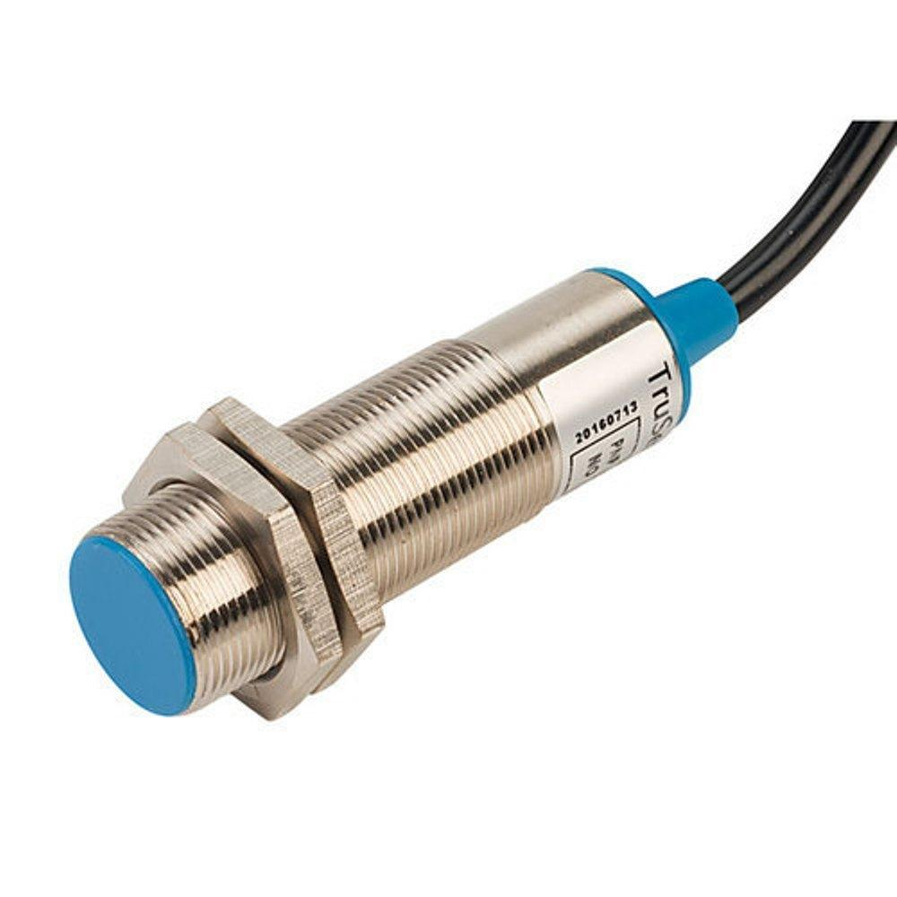
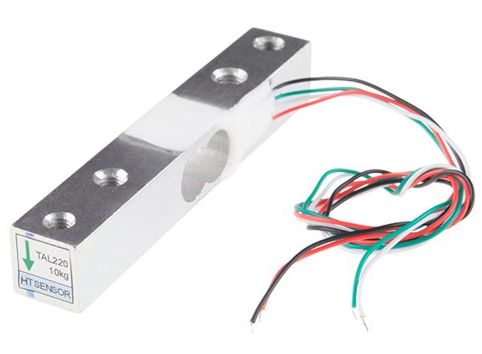
Electronic pieces
Inductive proximity sensor
Load cell
An inductive proximity sensor is a sensing device that detects metal targets using electromagnetic energy and without contact.
is an electro-mechanical sensor used to measure force or weight

Slide 10
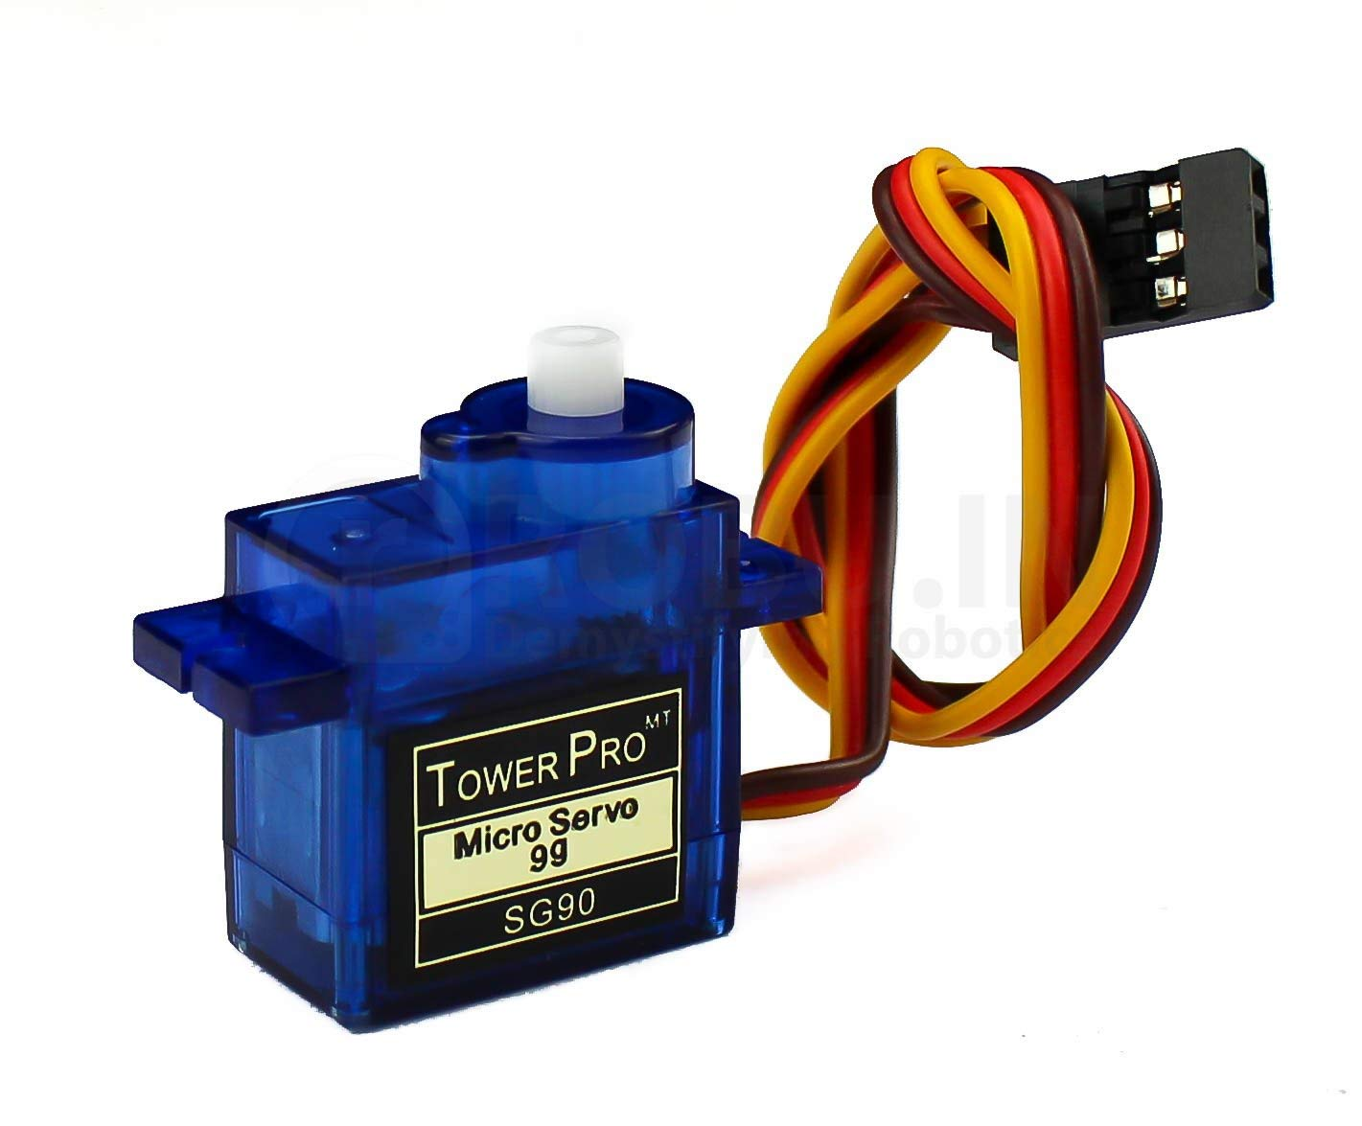
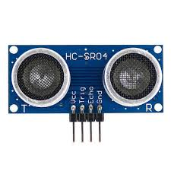
Electronic pieces
Servo Motor
Ultrasonic
are electronic devices and rotary or linear actuators that rotate and push parts of a machine with precision.
measures the distance to an object using ultrasonic sound waves.

Slide 11
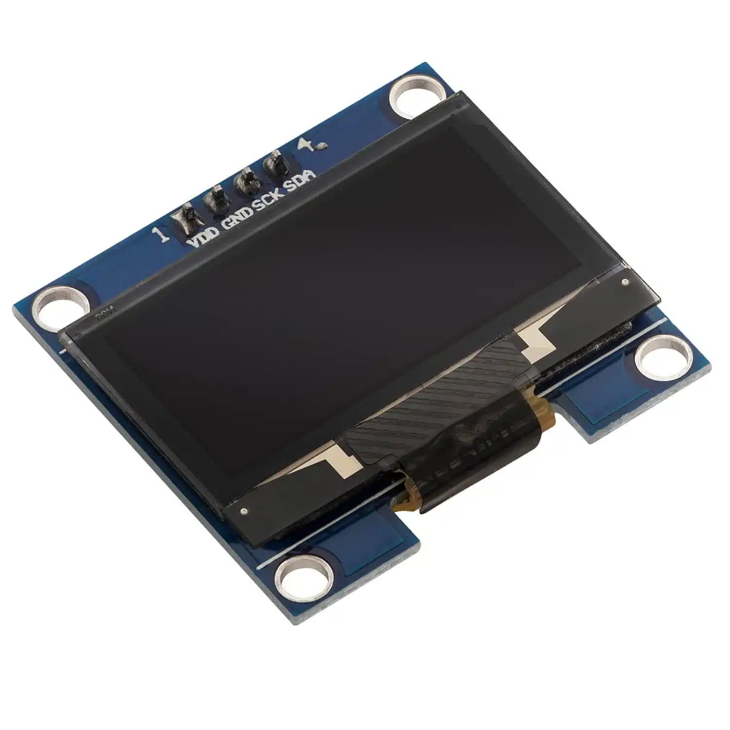
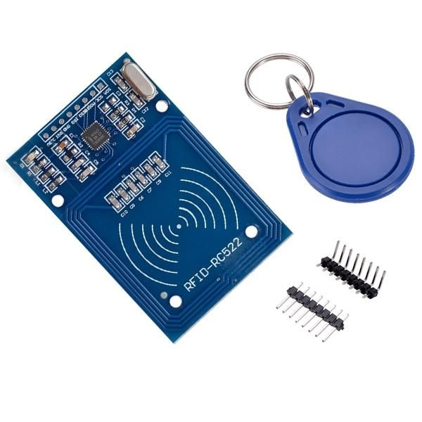
Electronic pieces
OLED
RFID
The Organic Light-Emitting Diode, or simply OLED, is the technology used for the screen in the Arduino Sensor Kit.
consists of two main components, a transponder/tag attached to an object to be identified, and a Transceiver also known as interrogator/Reader

Slide 12
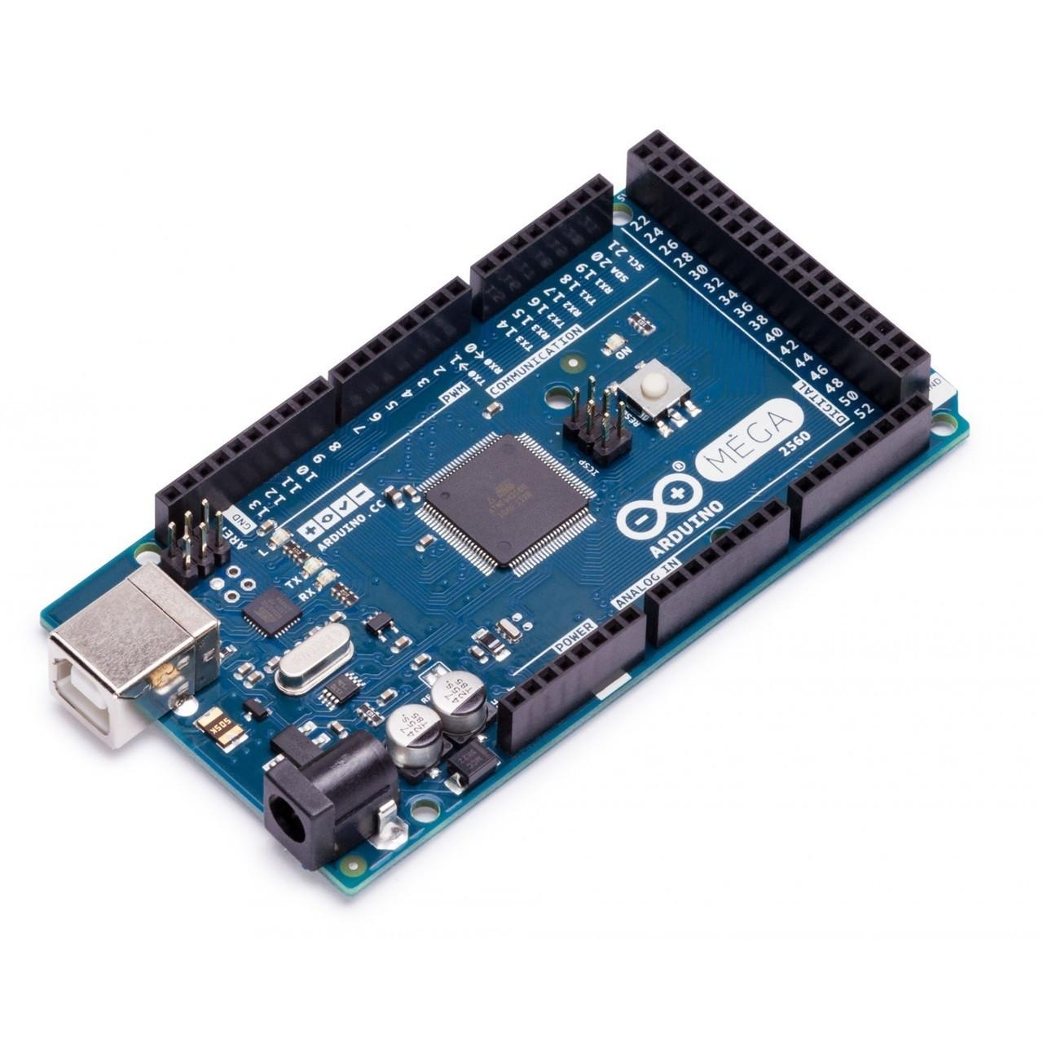
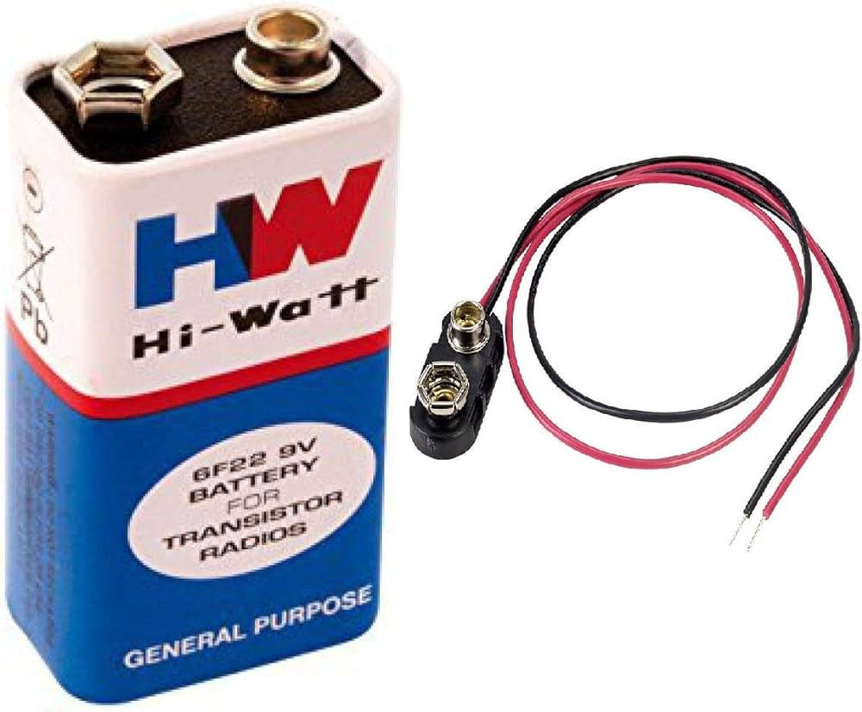
Electronic pieces
Arduino mega
Battery
It is generally used to create complex projects due to its structure

Slide 13
04
Future Work

Slide 14
Future Work
Build a full server to connect all EcoBins into a centralized system,to enable coordinated monitoring and management to make waste collection more organized and systematic, and link the bins with GPS to know the location of the full garbage bin.
Ability to separate more types of garbage.
Enhance the durability of components to withstand harsh outdoor conditions and heavy usage. Improve the reliability of sensors and motors for consistent performance.

Slide 15
THANKS!
By Alaa Adham & Batool kharraz
Supervisor: Dr.Hanal Abu zant

