Slide 1

An-Najah National University
Faculty of Engineering
Computer Science Department
جامعة النجاح الوطنية
كلية الهندسة وتكنولوجيا المعلومات
CV Finder: Intelligent Recruitment tool
By:
Kinana Abueideh
Ayat Dardouk
Supervisor:
Dr. May Abusair

Slide 2
Outlines
1
Introduction
2
Problem Statement
3
Objectives
4
Preposed Methodology
5
Workflow Overview
6
Technology &Tools
7
Model training & Evaluation
8
Demo
9
10
Results
Future Work

Slide 3
Introduction
At job portal platform, we're passionate about
helping companies and work places find the best job candidates efficiently through
automated CV analysis and job matching. Also, helping people who are looking for jobs.

Slide 4
PROBLEM STATEMENT
1
Job seekers struggle with finding personalized job recommendations.
2
Employers receive a large number of applications but lack an efficient
way to filter and match candidates.
3
Manually filtering resumes is time-consuming.

Slide 5
Objectives
1
Develop an AI-powered resume classification system.
2
Reduce manual effort in reviewing resumes.
3
Improve recruitment efficiency with automation.
4
Leverage NLP and Machine Learning for classification.
5
Providing a community for job seekers

Slide 6
Proposed Methodology
1
Data Collection
2
Data Preprocessing (CV & Job Description Processing)
3
Job Matching Algorithm
4
Post-Processing & Deadline Handling

Slide 7
Model Training & Evaluation
INFORMATION-TECHNOLOGY: 1200
BUSINESS-DEVELOPMENT: 1150
FINANCE: 118 ADVOCATE: 1100
ACCOUNTANT: 850
ENGINEERING: 1000
CHEF: 750
AVIATION: 700
FITNESS: 650
SALES: 600
BANKING: 550
HEALTHCARE: 500

Slide 8
Model Training & Evaluation
CONSULTANT: 115
CONSTRUCTION: 112
PUBLIC-RELATIONS: 111
HR: 110
DESIGNER: 107
ARTS: 103
TEACHER: 102
APPAREL: 97
DIGITAL-MEDIA: 96
AGRICULTURE: 63
AUTOMOBILE: 36
BPO: 22

Slide 9
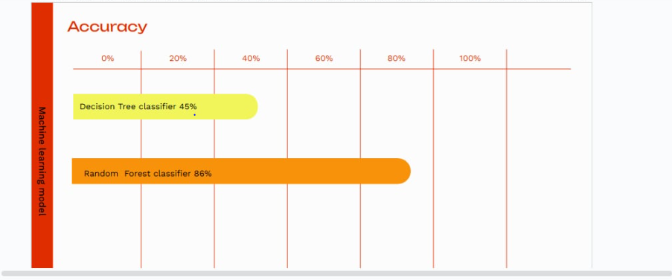

Slide 10
Model Training & Evaluation
Random forest Classifier used for resume categorization.
Trained on a labeled resume dataset.
Model evaluated using accuracy.
Confusion matrix used for performance analysis.

Slide 11
Technologies & Tools
Django
bootsrape
Pyreparser for text extraction
Pandas for data handling
TfidfVectorizer for text processing
Time zone
Send email

Slide 12
Workflow Overview
1
Extract text from resumes .
2
Preprocess and vectorize text data.
3
Train a Machine Learning model for classification.
4
Predict the job category of a resume.
5
Evaluate model accuracy and performance.

Slide 13

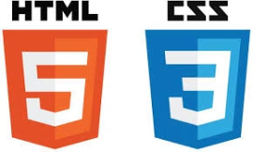






Technologies & Tools

Slide 14
Demo Time

Slide 15
VIDEO

Slide 16
Results
Successfully categorized resumes into predefined job roles.
Demonstrated real-world applicability of the model.

Slide 17
Future Improvements
Improve accuracy with deep learning models.
Allow communication between the appliers and website viewer.
Work on automated emails

Slide 18
Conclusion
AI-powered resume classification streamlines recruitment.
Machine Learning enhances efficiency and accuracy.
Future improvements can further optimize the system.

Slide 19
Thank You !

