Slide 1



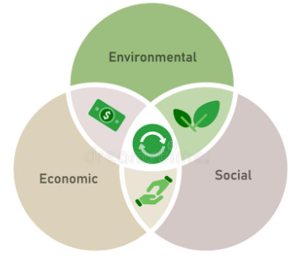
Industrial and System Engineering
Graduation Project
The Impact of Sustainability Practices on Organizational Performance in Palestinian Dairy Sector
Group Members:
Aseel Khanfar
Rania Ameerah
Raghad Akleek
Zahraa Khalifeh
Supervisor Name:
Dr. Ahmad Ramahi

Slide 2

List of Contents
01
04
Methodology
Introduction
02
05
The Research Problem
Results and Analysis
03
06
Goal and Objectives of the Research
Conclusions and Recommendations

Slide 3


Introduction
Sustainability
Largest Industrial Sector in Palestine
Broad term that attempts to link social, environmental and economic sciences and aims to meet the needs of the current population without affecting the fulfillment of the needs of future generations.
As it accounts for about 75% of the local market share.
General Goal
Assess the three sustainability aspects and study the impact of them on organizational performance of the dairy industry in Palestine.
Project Implementation Sequence
We developed a methodology and followed it. And we developed several hypotheses and tested them using the Minitab program. Some of these hypotheses were accepted and others were rejected.

Slide 4
The Research Problem
Environmental
The dairy industry consumes many resources and produces many wastes and damages to:
Social
Economic

Slide 5



Goal and Objectives of the Research
Developing a framework for the sustainability and organizational performance of the dairy industry in Palestine.
Developing a proper data collection tool to assess the sustainability in the dairy sector.
1.
2.
Investigating level of sustainability practices in the Palestinian dairy industry.
3.
Investigating the impact of sustainability practices on organizational performance in the Palestinian dairy industry.
4.
The goal of this project is to assess the environmental, economic and social sustainability practices and study the impact of sustainability practices on organizational performance of the dairy industry in Palestine.

Slide 6
Methodology
Identifying the Research Study
Conducting a Literature Review
Developing a Sustainability - Organizational Performance Framework
Identifying the Research Scope and Formulating the Hypotheses
The following flow chart summarize the methodology to implement this study:
Designing the Data Collecting Tool
Collecting Data
Analyzing the Collecting Data and Testing the Hypotheses
Discussing the Results
Drawing Conclusions and Recommendations
Documenting all Results in a Report

Slide 7

Limitations
Only large factories that have well established administrator and production systems are considered as targeted factories to be included in the study sample.
As for the governorates included in our study, we were keen to cover all possible governorates.
      The chain was followed from the commencement of the factory until the exit of the product, which means that farmers are not included.

Slide 8
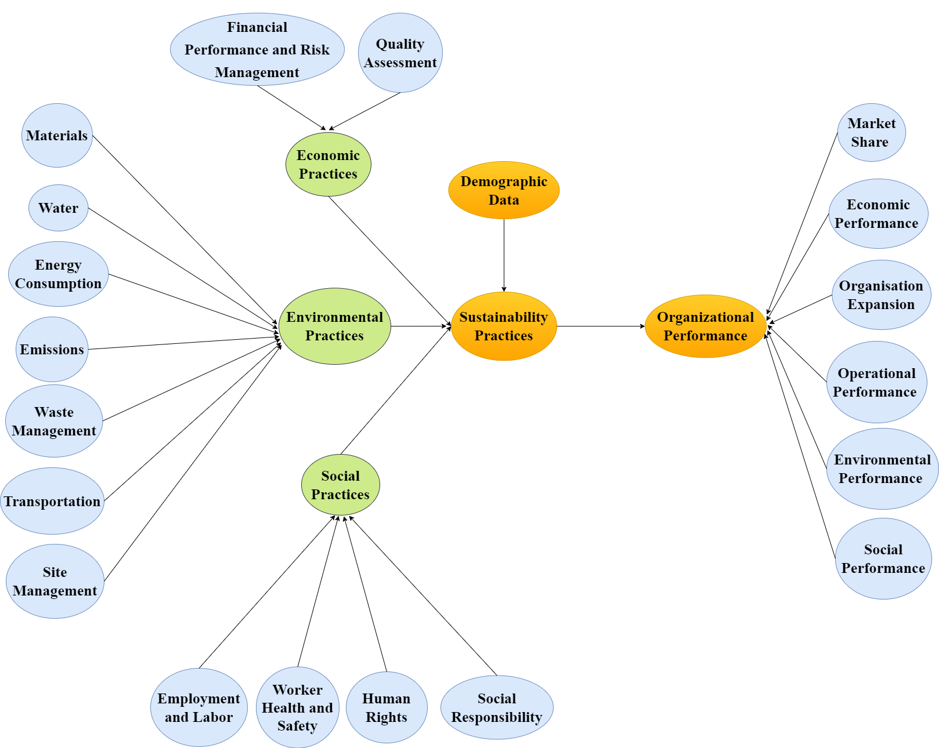
Sustainability – Organizational Performance Framework

Slide 9
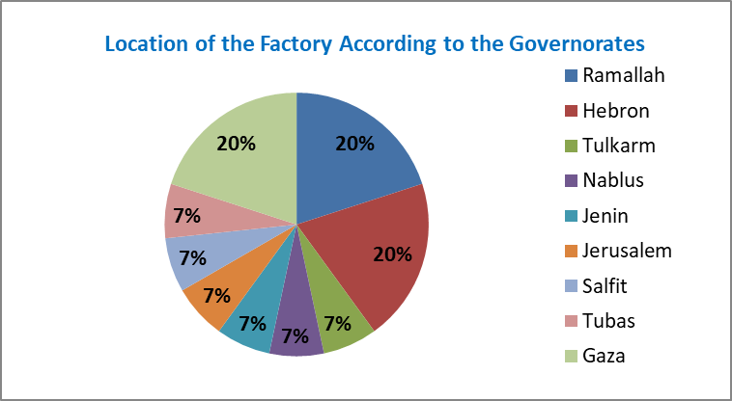
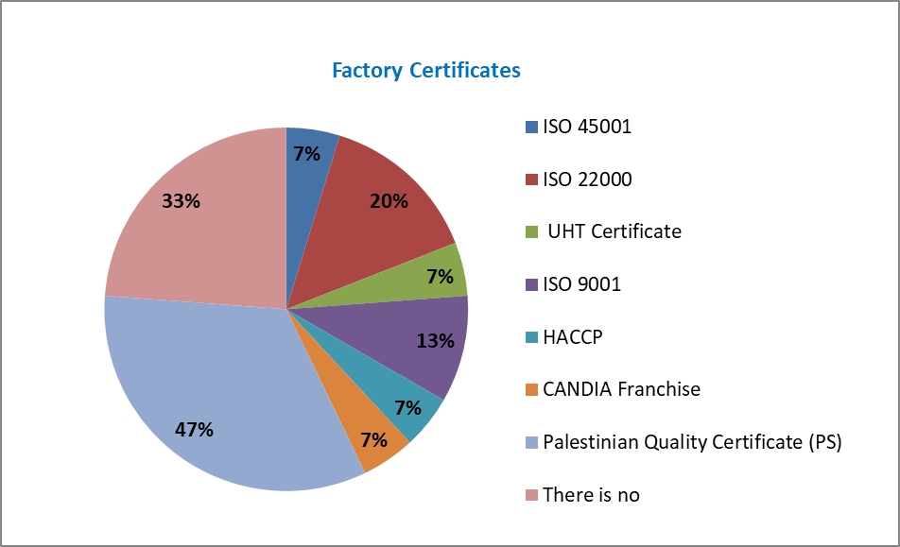
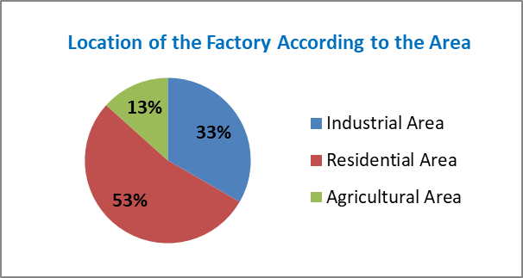
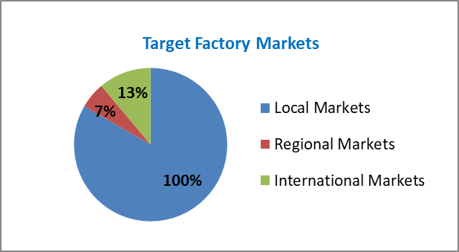
Results and Analysis
1. Demographic Data Analysis

Slide 10
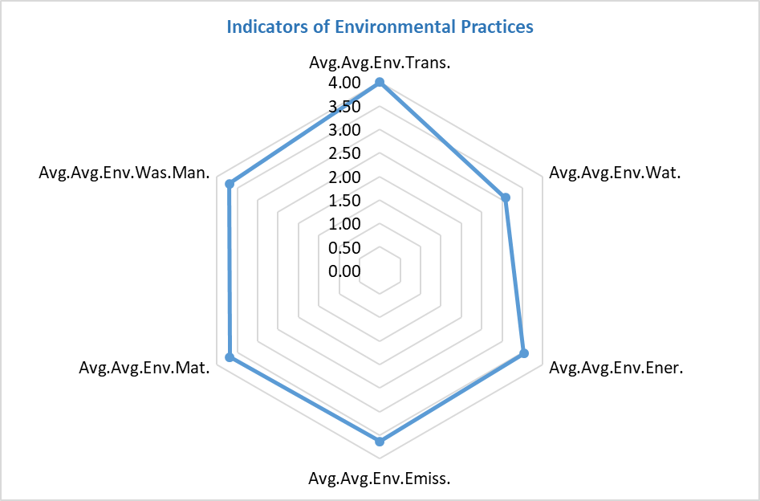
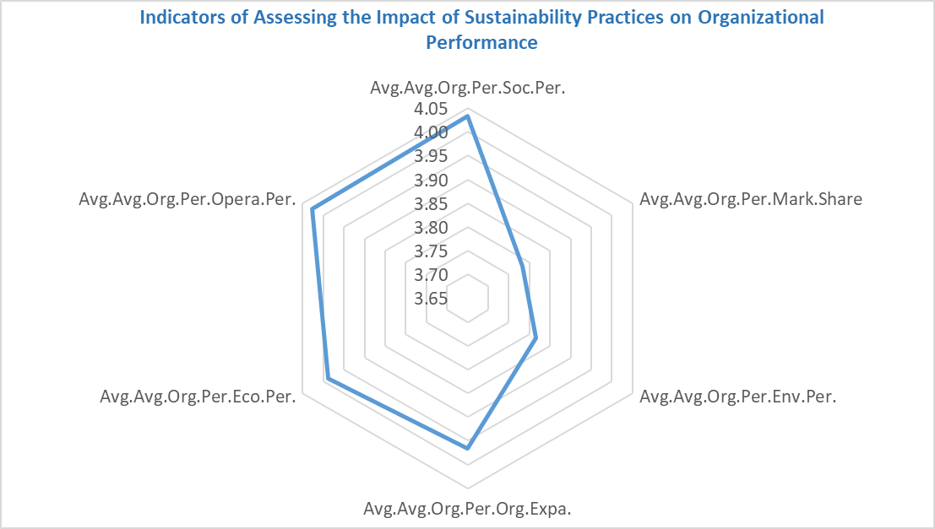
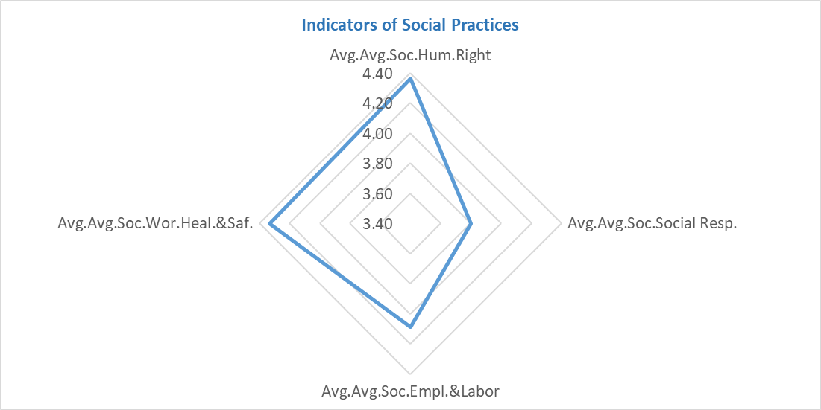
    2. Tool Reliability Test
3. Analysis of Likert Scale
Intervals of Five-Point Likert Scale | Level of Implementation
1 - 1.79 | Very Low
1.8 - 2.59 | Low
2.6 - 3.39 | Medium
3.4 - 4.19 | High
4.2 - 5 | Very High
Indicators of Economic Practices | Average
Quality Assessment | 4.83
Financial Performance and Risk Management | 3.97

Slide 11
4. Hypothesis Testing
H1
There is an impact of sustainability practices on organizational performance in Palestinian dairy sector.
Term | Coef. | SE Coef. | 95% CI | P-Value | R-sq. | Correlation
Constant | -1.150 | 1.220 | (-3.780; 1.480) | 0.362 | 57.55% | 0.759
Avg.Sust.Prac. | 1.255 | 0.299 | (0.609; 1.901) | 0.001
The analysis was completed in order to find out which of the three dimensions of sustainability practices had the greatest impact on organizational performance.
Term | Coef. | SE Coef. | 95% CI | P-Value | R-sq. | Correlation
Constant | 1.640 | 0.890 | (-0.281; 3.561) | 0.088 | 34.49% | 0.588
Avg.Env.Prac. | 0.637 | 0.244 | (0.111; 1.163) | 0.021
Term | Coef. | SE Coef. | 95% CI | P-Value | R-sq. | Correlation
Constant | -2.720 | 1.830 | (-6.670; 1.220) | 0.610 | 50.65% | 0.712
Avg.Eco.Prac. | 1.513 | 0.414 | (0.618; 2.408) | 0.003
Term | Coef. | SE Coef. | 95% CI | P-Value | R-sq. | Correlation
Constant | 0.020 | 1.160 | (-2.480; 2.520) | 0.986 | 47.15% | 0.687
Avg.Soc.Prac. | 0.944 | 0.277 | (0.345; 1.543) | 0.005

Slide 12
H2-H19
We measure if there is a relationship between the sustainability practices and the indicators of organizational performance.
Variable 1 | Variable 2 | P-Value | Comment | Correlation | 95% CI for ρ
Avg.Org.Per.Org.Expa. | Avg.Eco.Prac. | 0.000 | Accept | 0.794 | (0.474; 0.928)
Avg.Org.Per.Env.Per. | Avg.Env.Prac. | 0.002 | Accept | 0.719 | (0.328; 0.900)
Avg.Org.Per.Env.Per. | Avg.Soc.Prac. | 0.003 | Accept | 0.703 | (0.298; 0.894)
Avg.Org.Per.Mark.Share | Avg.Eco.Prac. | 0.004 | Accept | 0.692 | (0.278; 0.889)
Avg.Org.Per.Eco.Per. | Avg.Soc.Prac. | 0.005 | Accept | 0.684 | (0.265; 0.886)
Avg.Org.Per.Env.Per. | Avg.Eco.Prac. | 0.005 | Accept | 0.682 | (0.261; 0.885)
Avg.Org.Per.Mark.Share | Avg.Env.Prac. | 0.011 | Accept | 0.637 | (0.186; 0.867)
Avg.Org.Per.Org.Expa. | Avg.Env.Prac. | 0.013 | Accept | 0.621 | (0.160; 0.860)
Avg.Org.Per.Soc.Per. | Avg.Soc.Prac. | 0.015 | Accept | 0.614 | (0.148; 0.857)
Avg.Org.Per.Org.Expa. | Avg.Soc.Prac. | 0.016 | Accept | 0.609 | (0.140; 0.854)
Avg.Org.Per.Opera.Per. | Avg.Soc.Prac. | 0.021 | Accept | 0.589 | (0.110; 0.846)
Avg.Org.Per.Eco.Per. | Avg.Eco.Prac. | 0.022 | Accept | 0.586 | (0.105; 0.845)
Avg.Org.Per.Opera.Per. | Avg.Eco.Prac. | 0.022 | Accept | 0.584 | (0.103; 0.844)
Avg.Org.Per.Soc.Per. | Avg.Eco.Prac. | 0.041 | Accept | 0.532 | (0.027; 0.821)
Avg.Org.Per.Mark.Share | Avg.Soc.Prac. | 0.051 | Reject | 0.512 | (-0.000;0.812)
Avg.Org.Per.Eco.Per. | Avg.Env.Prac. | 0.114 | Reject | 0.426 | (-0.111;0.770)
Avg.Org.Per.Opera.Per. | Avg.Env.Prac. | 0.123 | Reject | 0.416 | (-0.123;0.765)
Avg.Org.Per.Soc.Per. | Avg.Env.Prac. | 0.169 | Reject | 0.375 | (-0.123;0.765)

Slide 13
H20
There is an impact of market share in organizational Palestinian dairy sector on the factory targeted markets.
Variable 1 | Variable 2 | Correlation | 95% CI for ρ | Comment | P-Value
Avg.Org.Per.Mark.Share | Factory Targeted Markets | 0.247 | (-0.311; 0.679) | Weak | 0.374

Slide 14
H21
There are a statistically significant differences between social sustainability practices in Palestinian dairy sector with respect to the old of the factory.
Coding | The Old of the Factory
1 | 1-5 years
2 | 6-10 years
3 | 11-15 years
4 | 16-20 years
5 | More than 20 years
The Old of the Factory | N | Mean | 95% CI | Grouping |  | P-Value
1 | 3 | 4.404 | (3.918; 4.889) | A |  | 0.029
5 | 10 | 4.222 | (2.783; 3.973) | A
3 | 2 | 3.378 | (3.956; 4.488) |  | B

Slide 15
H22
There are a statistically significant differences between environmental sustainability practices in Palestinian dairy sector with respect to the factory market share in Palestinian local market.
Coding | Factory Market Share in Palestinian Local Market
1 | (1-10)%
2 | (11-15)%
3 | (16-20)%
4 | (21-25)%
5 | (26-35)%
Factory Market Share in Palestinian Local Market | N | Mean | 95% CI | Grouping |  | P-Value
4 | 2 | 4.567 | (4.061; 5.072) | A |  | 0.002
1 | 6 | 3.824 | (3.532; 4.116) | A
5 | 2 | 3.567 | (3.061; 4.072) | A | B
3 | 3 | 3.011 | (2.598; 3.424) |  | B
2 | 2 | 2.913 | (2.407; 3.418) |  | B

Slide 16

Conclusions and Recommendations
Conclusions
The results indicated that there is a relationship between each of the three aspects (environmental, economic and social) with organizational performance.
The aspect that has a strong and clear relationship is the economic aspect, as there was a strong relationship between it and all indicators of organizational performance (market share, economic performance, organizational expansion, operational performance, environmental performance and social performance).
Social practices formed a strong relationship between it and all indicators of organizational performance with the exception of (market share) and environmental practices formed a strong relationship between it and these indicators of organizational performance (market share, organizational expansion and environmental performance).

Slide 17
Recommendations
1. We recommend that dairy factories improve their environmental and social sustainability, while not neglecting the economic aspect, which is critical. Such as:
Investing in renewable energies and the need to focus on maximizing their potential.
Adopting a long-term strategy to minimize pollution and learning from the experiences of successful dairy factories in this area in order to accomplish long-term development goals.
Necessitating effective techniques such as electrocoagulation or specific filter flasks to efficiently collect and reuse the water following biological wastewater treatment.
Dairy factories should be made aware of the importance and impact of sustainability.
Workers should be taught how to use sustainable approaches and informed about the concept.
Emphasize social practices such as participating in festivals and distributing free samples from each factory to allow customers to try the factory's products.

Slide 18

Recommendations Con.
2. We recommend that dairy factories be built in industrial areas, away from residential and agricultural areas.
3. We advise dairy companies to aim toward gaining many certificates that help them establish themselves in this industry.

Slide 19
Thank you for your Attention!
Any Question?

