Slide 1

An-Najah National University Faculty of Engineering and Information Technology Civil Engineering Department Graduation Project II Structural Design and Analysis of AL-Quds Open University AL-Zawya
Prepared by:
Ahmad Abdul-Rahman Majdouba
Laith Bassam Abo Abed
Qasem Saleh Khuffash
Under supervision of:
Dr . Mohammad Sama’nah

Slide 2
Outline :
Introduction.
Architectural Drawing.
Lateral loads
Preliminary Structural Design.
Three Dimensional Structural Analysis and verification .
Design and Reinforcement for slab and beams .
Design and Reinforcement for columns and shear walls
Design and Reinforcement for footings.
Design and Reinforcement for Stairs .

Slide 3
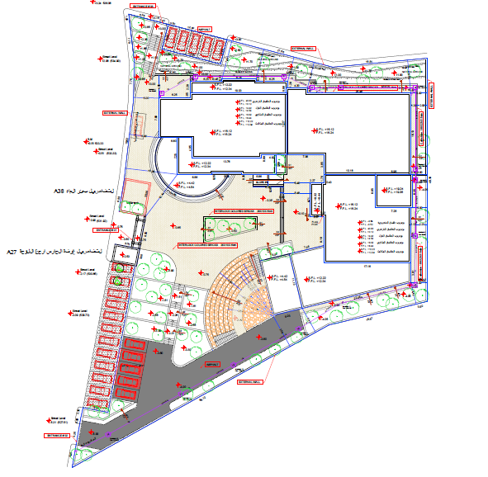
Site plan

Slide 4
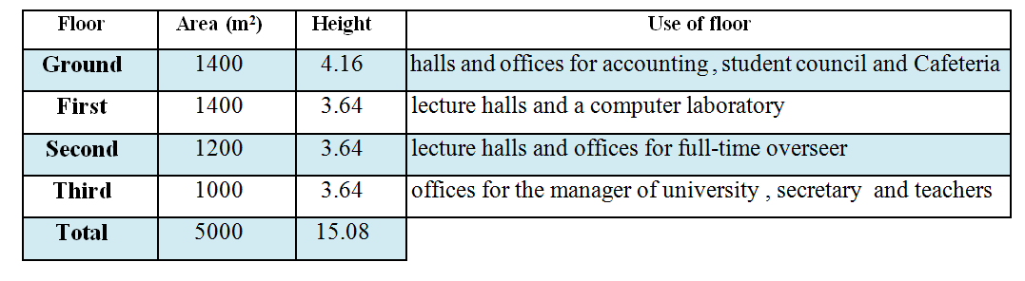
Project Description
The project is structural analysis and design of AL-Quds Open University – ALZawya
The building is four floors of reinforced concrete.
Contains three Block
Two expansion joint of width 5cm is used.
The building is about 400 m above Mean See Level.

Slide 5
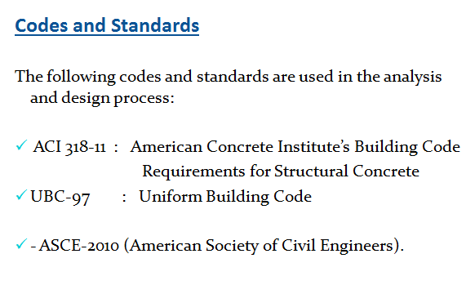
Analysis and Design Principles
Three dimensional model is used to model the building using ETABS V15.1.0 program.
The footings are considered as fixed supports .

Slide 6
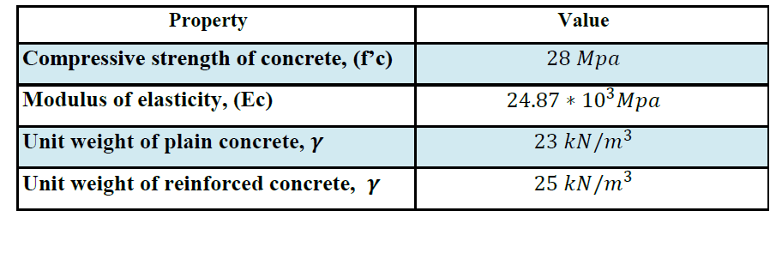
Structural Materials
Concrete:
The concrete type for all structural Element is B350
Steel:
The steel used in all reinforcements is ASTM A955 Grade 60, and this type has a tensile strength of 620 MPa, yield strength of 420 MPa, and modulus of elasticity of 200 GPa.

Slide 7
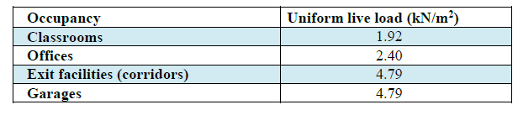
Loads
Gravity loads:
Live load: according to UBC97 , the following uniform live loads are used
Live load of 5 kN/m² is used for all slabs.
Dead load:
The super imposed dead load on slabs = 4 kN/m².

Slide 8
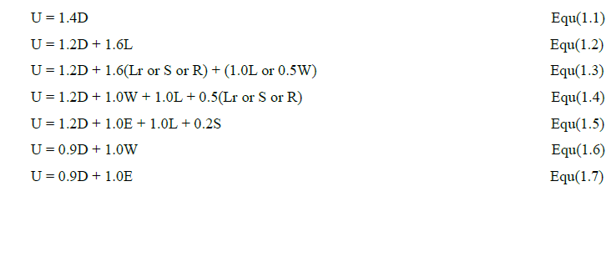
Load combinations

Slide 9
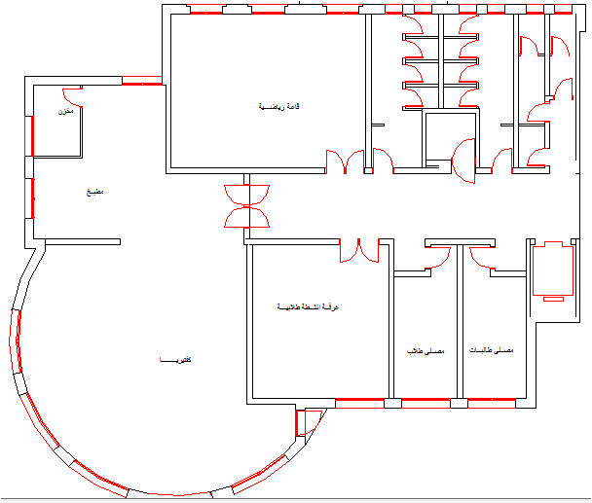
Architectural Drawings Block 1

Slide 10
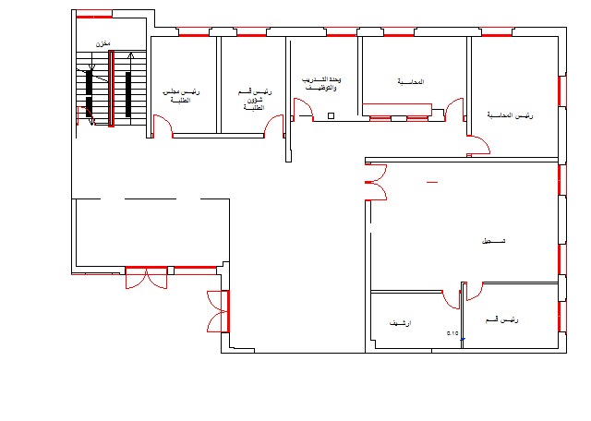
Architectural Drawings Block 2

Slide 11
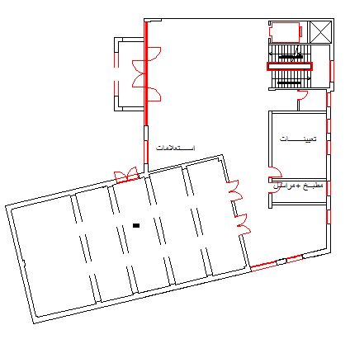
Architectural Drawings Block 3

Slide 12
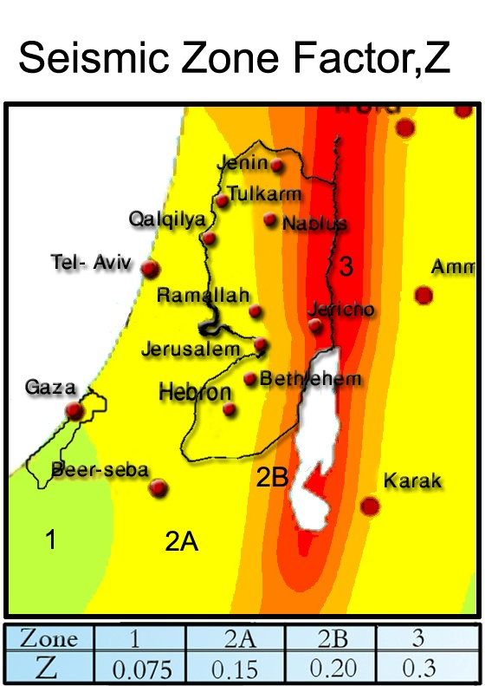
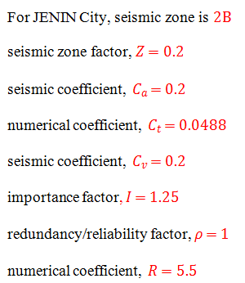
2) Lateral loads:

Slide 13
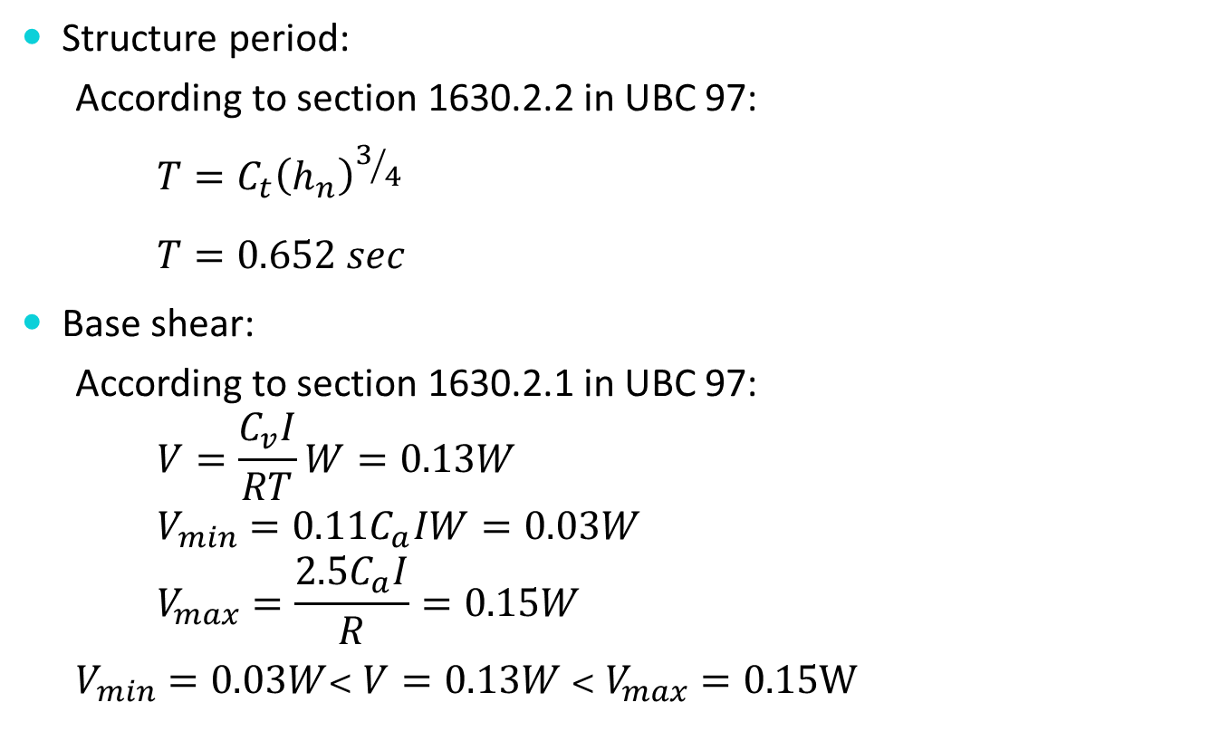

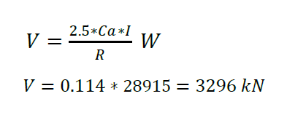

Seismic loads UBC

Slide 14
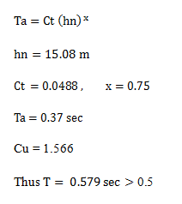
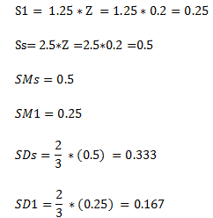
Seismic loads IBC

Slide 15
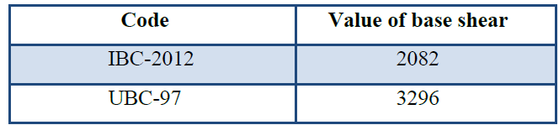
Base shear values

Slide 16
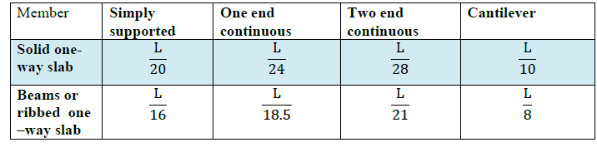
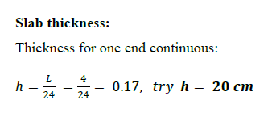

Preliminary Slabs Thickness and Loads
According to ACI 318-11, Table 9.5(a), the thickness of one way slabs and beams can be obtained based on the deflection limit:

Slide 17
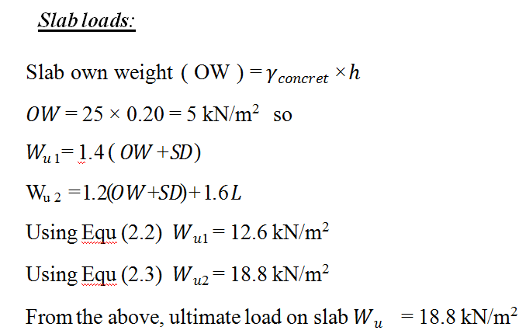
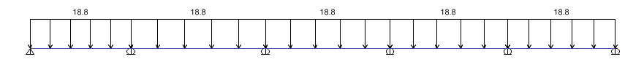
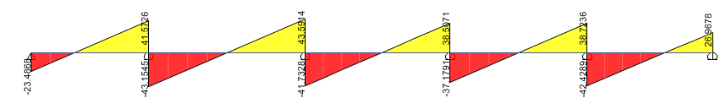
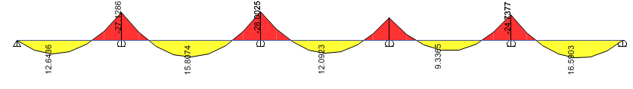

Slide 18
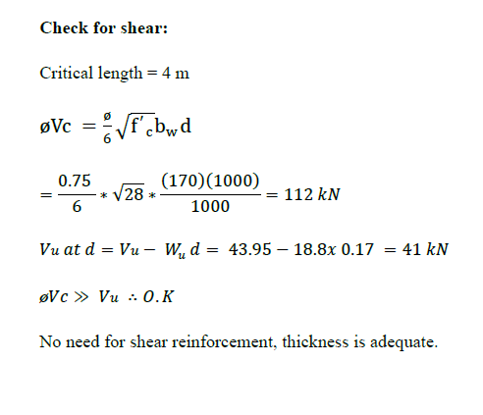
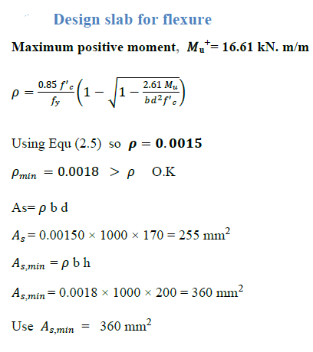

Slide 19
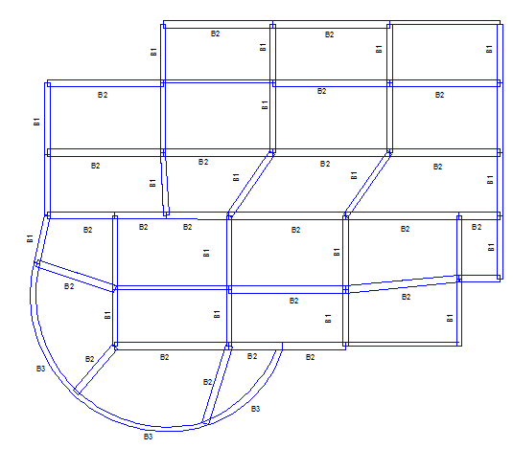
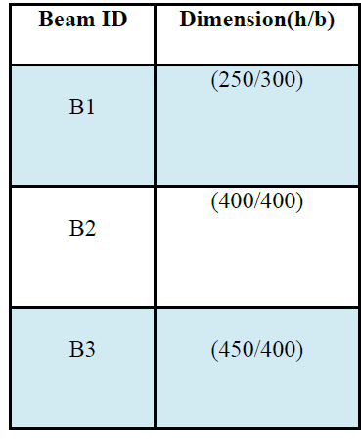
Preliminary Dimensions of Beams

Slide 20
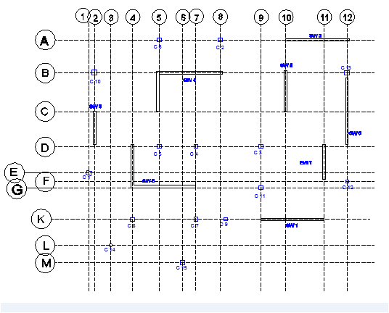
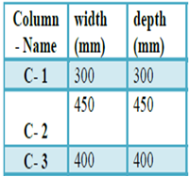
Preliminary Dimension of Columns

Slide 21
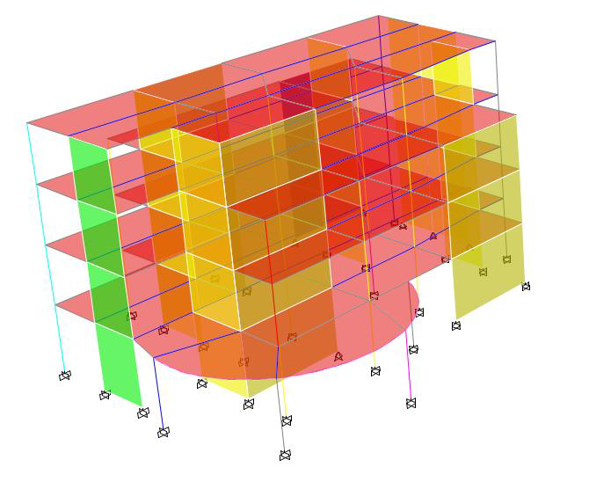
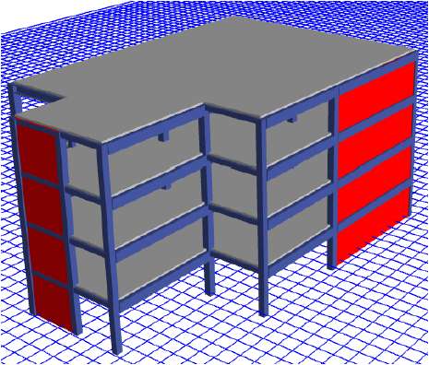
Three Dimensional Structural Analysis.
Structural Model for Part 1 Structural Model for Part 2

Slide 22
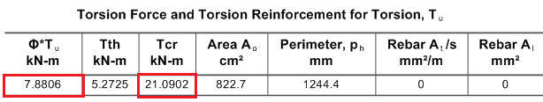
Structural Modeling of the Building
Units:
The main units are kilo Newton (kN) for loads and meter (m) for lengths.
Materials:
Concrete 28 MPa was used for all structural elements
Modifiers epically torsion modifiers for Beams was calculated for some critical Beams as
Modifier = 7.88 / 21 = 0.375

Slide 23
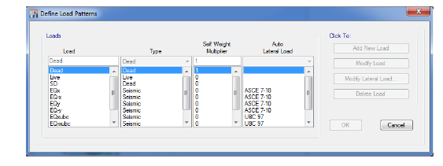
Loads Patterns

Slide 24
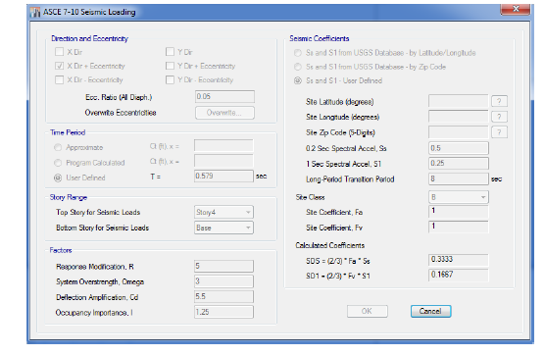
Loads assignments:
Earthquake Assignment in X-Direction with Positive Eccentricity

Slide 25
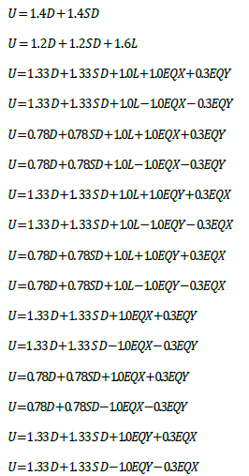
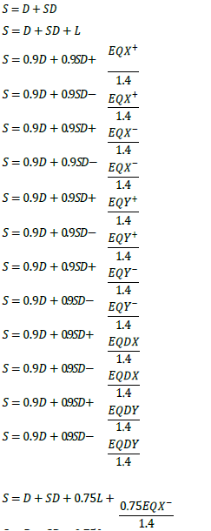
Load combinations:

Slide 26
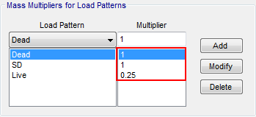
Masses:
The mass source used to calculate the seismic weight of the building.

Slide 27
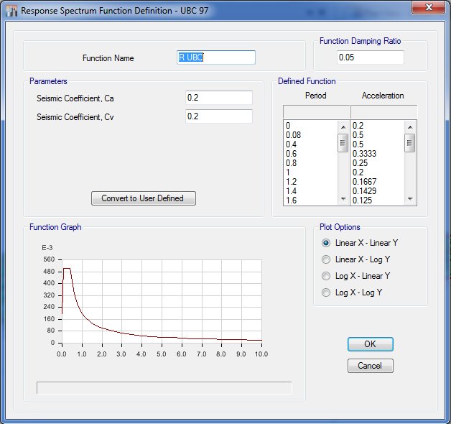
Functions:
Response Spectrum Function Definition

Slide 28

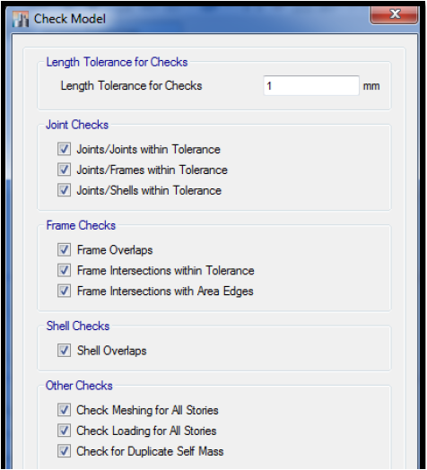
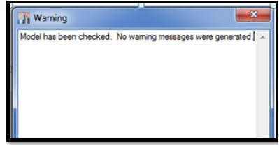
Verification of Structural Analysis

Slide 29

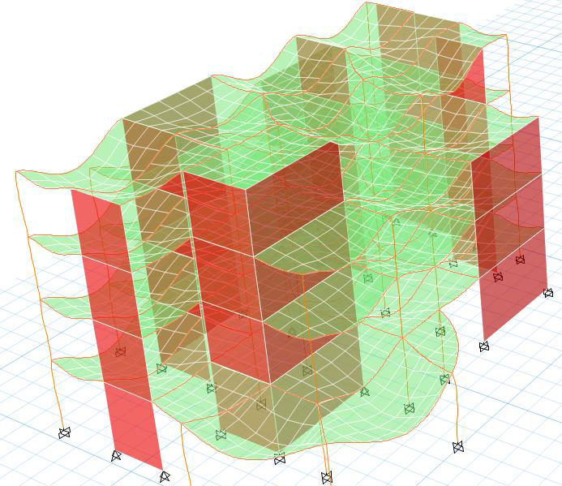

Slide 30

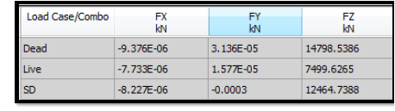
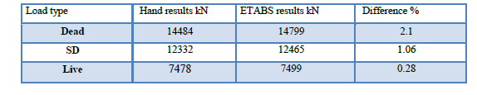

Slide 31

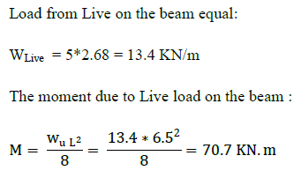
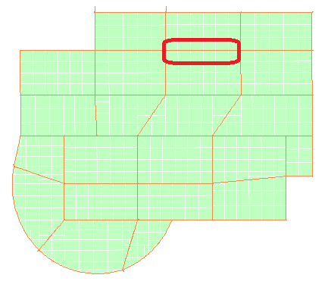
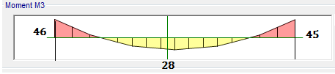
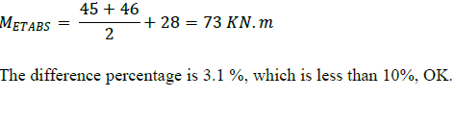

Slide 32
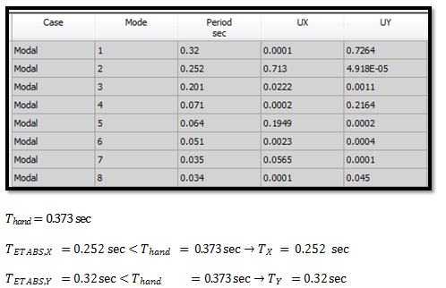
Lateral loads checks

Slide 33
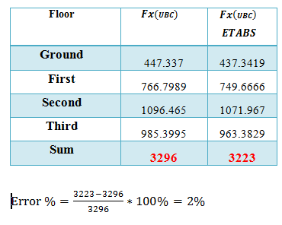
Base shear Check

Slide 34
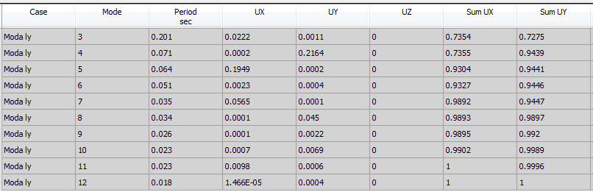
Mass precipitation check

Slide 35
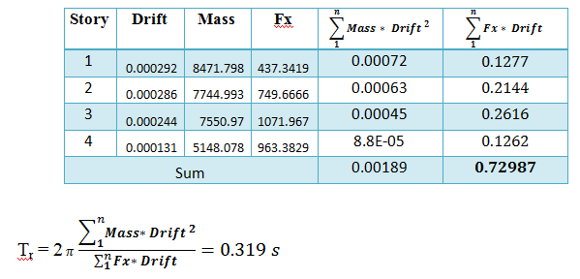
Reloph period check

Slide 36



Type of lateral force structural system:

Slide 37

Stiffness irregularity – soft story:

Slide 38


Weight (mass) irregularity

Slide 39
Other checks
Vertical geometric irregularity
In-plan discontinuity in vertical lateral-force-resisting element
Discontinuity in capacity – weak story
Re-entrant corners
Diaphragm discontinuity
Out-of-plane offsets:

Slide 40



Story drift

Slide 41



Width of separation joint between building parts:

Slide 42



Slide 43





Slide 44




Slide 45



Slide 46

Output of Design

Slide 47



Slide 48



ETABS Result
Manual Result

Slide 49


Summary of Beams

Slide 50


Slide 51


Slide 52


Slide 53





Slide 54


Determination for K

Slide 55

All column in the same Group less than above Result

Slide 56


Slide 57



Summary of Columns

Slide 58



Slide 59


Slide 60


Slide 61

Design of Shear walls

Slide 62


Slide 63


Slide 64


Slide 65

Design of Footings

Slide 66


Slide 67



Slide 68


Slide 69



Slide 70


Design the mat for flexure

Slide 71


Slide 72

Design the Stairs

Slide 73


Slide 74


Slide 75


Slide 76


Slide 77




