Slide 1
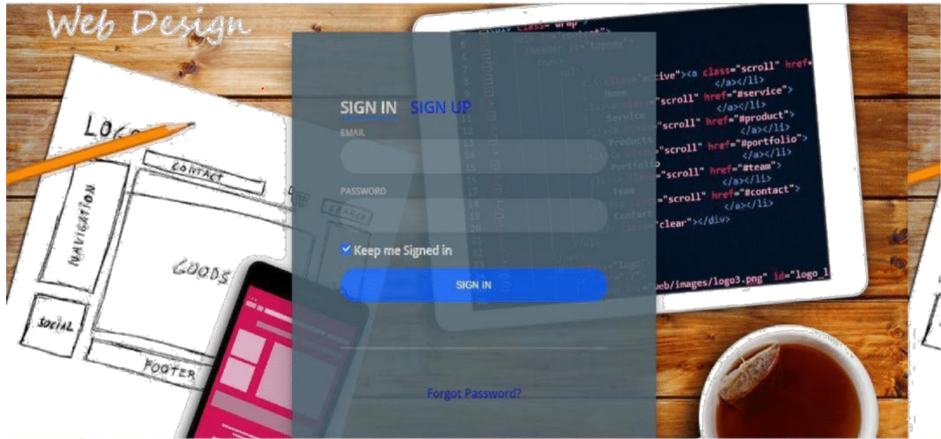
Software Graduation Project
Website Builder

Slide 2
While the technology and internet was evolved the need for website was increased and manypeople need to have their own website to achieve their goals. Students to learn, sellers topresent their products to customer and other people with different goals.
Web Design is a website that allow users to design their web pages online, and this help usersuch as designers, students, and beginners that theydon’t know anything or know a bit littleabout web programming, in building their website as they like, then they can see or take thecode of this design.

Slide 3
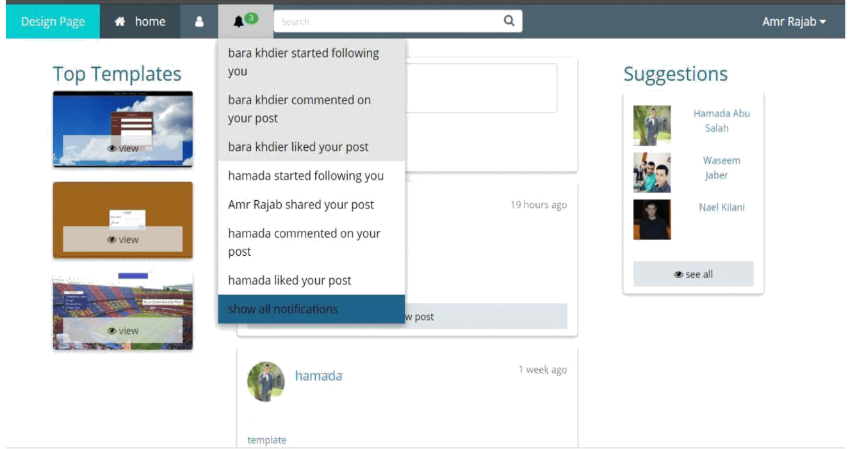

Slide 4
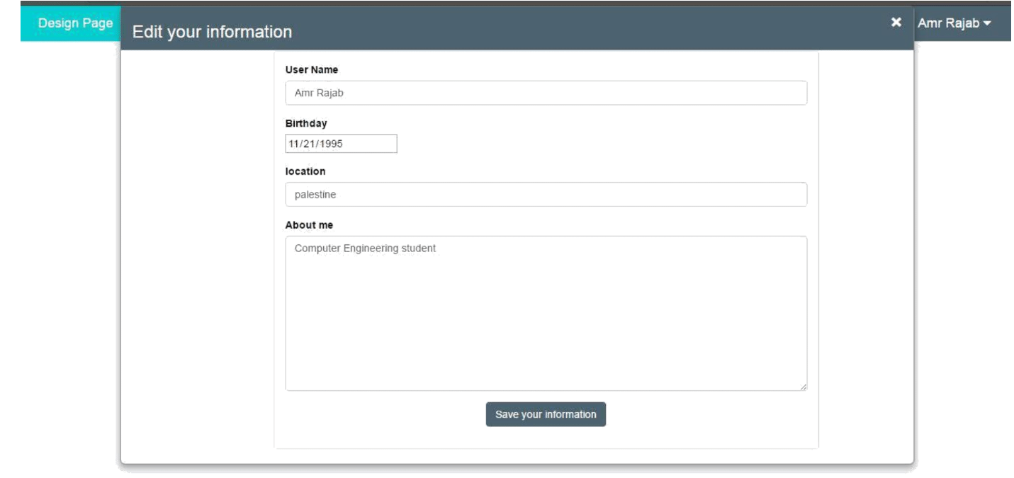

Slide 5
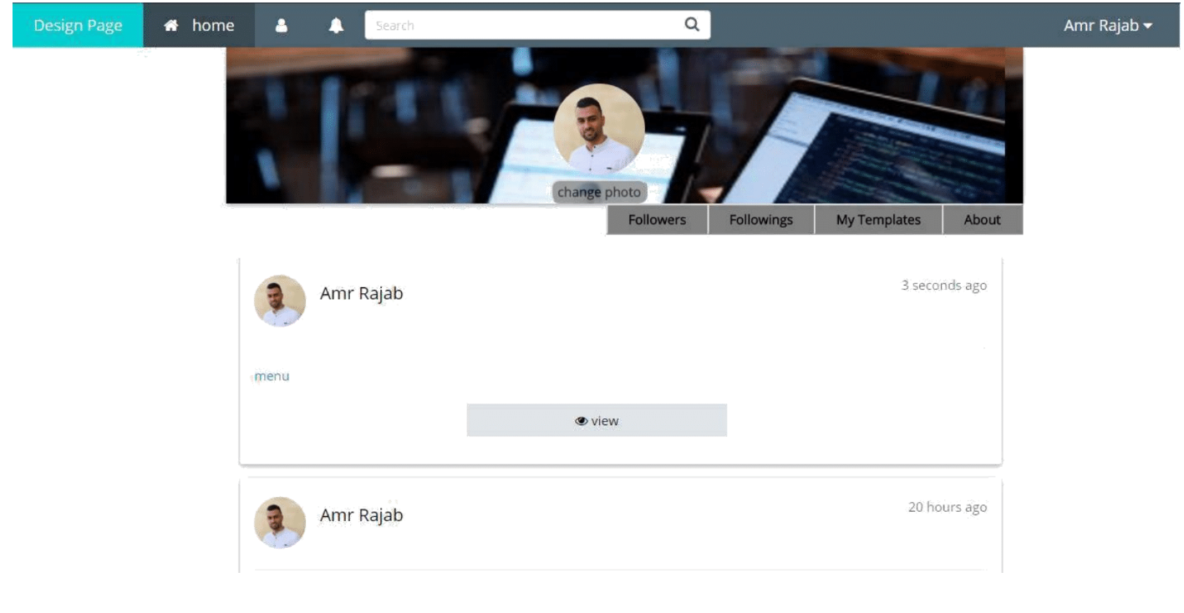

Slide 6
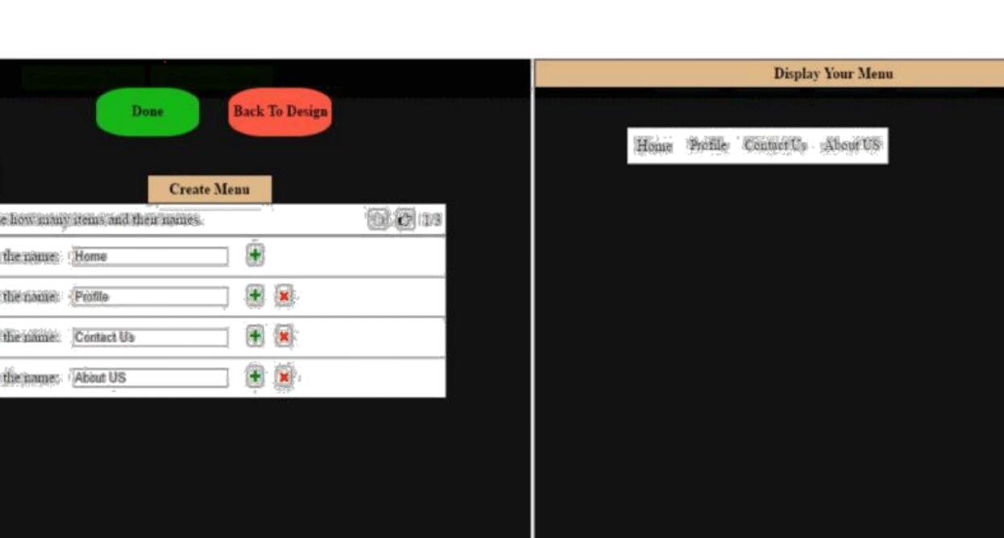

Slide 7
In this project, we built a website that aims to make building a website easier. This will benefitmany different kind of peoples as we specify in the introduction.
From this project, we gained an experience in the framework thatwe use such as Laravel, which isconsider as new framework for us, and being well-known with most features that Laravel provided We learned how to deal with MVC architecture deeply.
One of the most achieved works is being familiar of bootstrap and JQuery. We also improve our search skills, since we faced several problems that needs to solve.

