Slide 1
An-Najah National University
Faculty of Engineering
Graduation project I
Copper wire furnace in pyrolysis
Presented by:
Hussam Suliman
Islam Myadmeh
Majd Swafta
Sohaib Abdelhadi
Supervisor:
Dr. Mahmoud Assad
Discussant:
Dr. Osaid Abdelfattah
Eng. Ramez Khaldi
Notes:
This template can be used as a starter file for presenting training materials in a group setting.
Sections
Right-click on a slide to add sections. Sections can help to organize your slides or facilitate collaboration between multiple authors.
Notes
Use the Notes section for delivery notes or to provide additional details for the audience. View these notes in Presentation View during your presentation.
Keep in mind the font size (important for accessibility, visibility, videotaping, and online production)
Coordinated colors
Pay particular attention to the graphs, charts, and text boxes.
Consider that attendees will print in black and white or grayscale. Run a test print to make sure your colors work when printed in pure black and white and grayscale.
Graphics, tables, and graphs
Keep it simple: If possible, use consistent, non-distracting styles and colors.
Label all graphs and tables.

Slide 2

Outline
Introduction
Literature review
Methodology
Primary design
Future work
Conclusion
Notes:
This is another option for an Overview slides using transitions.

Slide 3
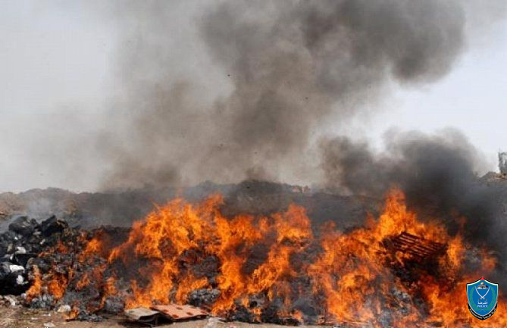
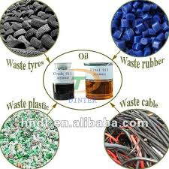
Introduction
Literature review
Methodology
Primary design
Future work
Conclusion
Introduction
In this section we will present a description of the project and the idea of ​​its establishment and the objectives we hope to achieve.
The idea of ​​project creation:
Reduce pollution in environment.
Keep on copper properties.
Produce fuel and charcoal.

Slide 4
Introduction
Literature review
Methodology
Primary design
Future work
Conclusion
Site and sitting
This study is conducted in Palestine to solve problem of copper extraction pollution due to toxic substance especially that burning of copper is everywhere in Palestine this was the motivation of pyrolysis creating as it is believed the pyrolysis is the solution of this polluting process.

Slide 5
Introduction
Literature review
Methodology
Primary design
Future work
Conclusion
pyrolysis: is thermal de-composition process in the absence of oxygen which is able to convert plastic into gasoline-range hydrocarbons.
Masses used in pyrolysis are wood, plastic and tires.
Objective of the project:
Design of the a reactor model and its parts.

Slide 6
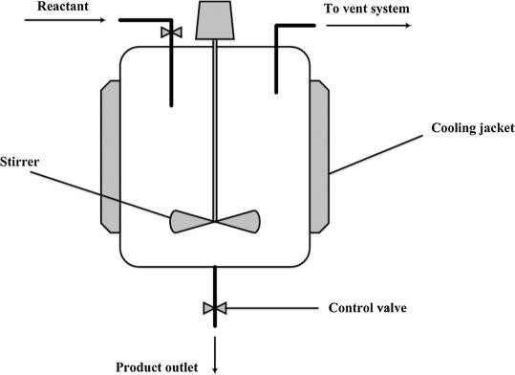
Introduction
Literature review
Methodology
Primary design
Future work
Conclusion
Literature review
Types of reactors in pyrolysis process
Batch and semi-batch reactor.
Fixed and fluidized bed reactor.
Screw reactor.

Slide 7
Types of plastic used in pyrolysis
Introduction
Literature review
Methodology
Primary design
Future work
Conclusion
The main types of plastic used in pyrolysis process are:
Polypropylene (PP)
High density Polyethylene (HDPE)
Low density polyethylene (LDPE)

Slide 8
Catalyst in pyrolysis
Introduction
Literature review
Methodology
Primary design
Future work
Conclusion
What’s the catalyst?
A chemical compound that is added in small amounts to the reaction in order to increase reaction speed without changing its reactants properties.
Type of catalyst.
There is main two types of catalyst:
MgO.
CaCO₃.
The advantages of a catalyst provided lower operating temperature, and lower pressure.

Slide 9
Introduction
Literature review
Methodology
Primary design
Future work
Conclusion
Methodology
In this section we will show methods that will be followed to design the pyrolysis reactor, this study is theoretical design on one hand with practical design of the reactor, on the other hand to eliminate the problem mentioned previously and get as much as possible benefits of reaction products to operate the system using its gaseous products.

Slide 10
Introduction
Literature review
Methodology
Primary design
Future work
Conclusion
Main components
Reactor
The reactor material used for the project is steel 1030 with a thickness of 1 cm, diameter.
of 46 cm, and Height of 70 cm, a burner system is attached to the reactor to provide high.
temperatures to achieve the decomposition process.

Slide 11
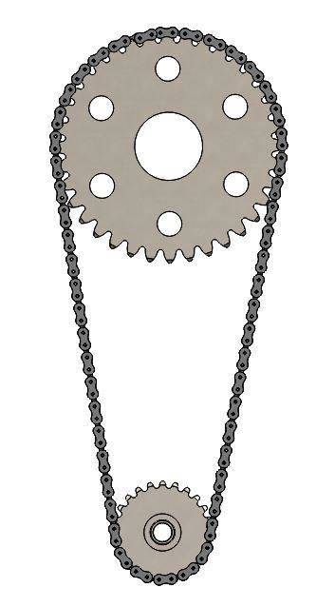
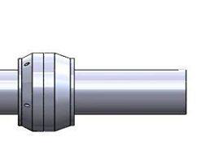
Introduction
Literature review
Methodology
Primary design
Future work
Conclusion
Sprocket chain Supporting box Swivel joint

Slide 12
Introduction
Literature review
Methodology
Primary design
Future work
Conclusion
steel cover front wheels back design

Slide 13
Introduction
Literature review
Methodology
Primary design
Future work
Conclusion
Burner:
Burner is used in order to provide heat to the rotating reactor using gas resulted from
reaction.

Slide 14
Introduction
Literature review
Methodology
Primary design
Future work
Conclusion
Isolation units:
The concept of isolation is to ensure that heat loss from reactor to the ambient and to maintain the reaction at desired temperature the isolation used is rock wool.
Sensors:
The process of anaerobic combustion depends greatly on the temperature and pressure
inside the reactor a sensor will be placed to measure heat and pressure.

Slide 15
Introduction
Literature review
Methodology
Primary design
Future work
Conclusion
While executing the plan cylinder of 1 cm thickness was needed but it was not offered an alternative choice was that cylinder of 0.5 cm thickness, also a low speed motor was needed to rotate the cylindrical rector at speed of 0.5 revolution per minutes but it was replaced by 3 revolutions per minute and make speed reduction by sprocket chain moreover the rector is supposed to be closed well but there’s air leakage (i.e. it is cannot guaranteed the air won’t leak into reactor) but the reactor will be heated for a while in order to expel air inside before reaction hence eliminate air as possible as should be, also time needed to achieve this research wasn’t enough because of academic load.

Slide 16
Gantt chart

Slide 17
Introduction
Literature review
Methodology
Primary design
Future work
Conclusion
Primary design
  Design of reactor
The reactor is designed to rotate at 0.5 RPM, the sprocket chain is linked to the motor and the reactor to rotate the cylinder of 0.5 cm thickness the material of reactor is steel to maintain high temperature which is about 400 ºC sensors will be attached in order to measure temperature and pressure

Slide 18
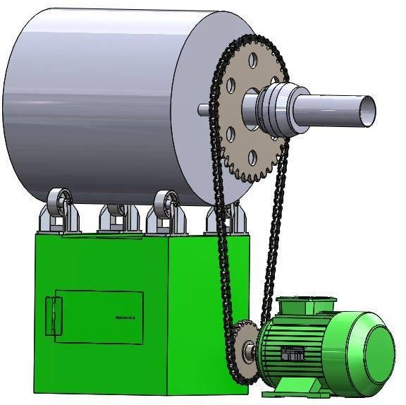
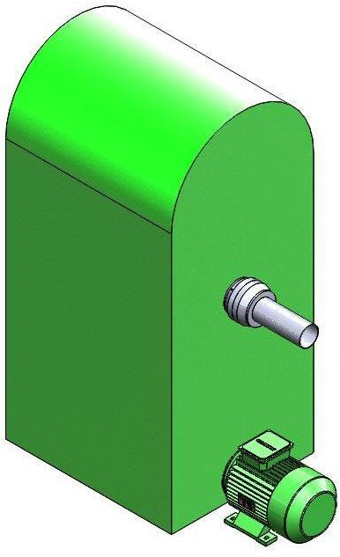
Introduction
Literature review
Methodology
Primary design
Future work
Conclusion

Slide 19
Introduction
Literature review
Methodology
Primary design
Future work
Conclusion
Complete system of pyrolysis
The cylinder is the suitable reaction atmosphere it is linked to cooling system to condensate gaseous products so after the plastic cover is burned it evaporates the cooling system cools the gas and precipitates it, the resulted substance from condensation is heavy fuel but uncompensated gas is returned to the burner as a source of energy for the system but at the beginning of experiment methane gas will be used, the reactor is well closed and insulted to prevent air leakage and heat loss a bearing is attached because of reactor rotation the pipe will be extended from the bearing to the cooling system

Slide 20
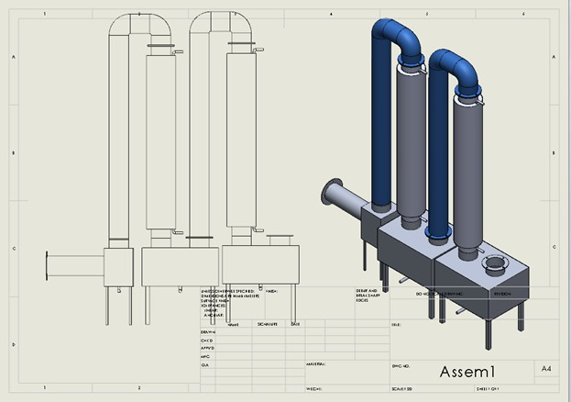
Introduction
Literature review
Methodology
Primary design
Future work
Conclusion

Slide 21
Introduction
Literature review
Methodology
Primary design
Future work
Conclusion
Future work
Building the reactor
Combining the system and analyzing results

Slide 22
Introduction
Literature review
Methodology
Primary design
Future work
Conclusion
Conclusion
Theoretically pyrolysis system can be used to eliminate problem of copper extraction pollution by anaerobic combustion inside the furnace. This research can solve problem of copper wire extraction pollution in Palestinian society and it can be certified by government or environmental organizations as a method of copper recycling and ending problem of copper extraction pollution.

