Slide 1

An-Najah National University
Faculty of Engineering and Information Technology
Industrial Engineering Department
Graduation Project
Implementation of Statistical Process Control (SPC) Tools
at Al-Maslamani Company

Slide 2

Meet The Team
Students Names:
Aya Dababat
Dana Kukhun
Sali Younis
Fadi Shaban
Marah Odeh
Supervisor:
Dr. Yahya Salahat :

Slide 3

Outline
Introduction
Problem Statement
Objectives
Literature Review
Methodology
Results
Conclusion and Recommendation

Slide 4
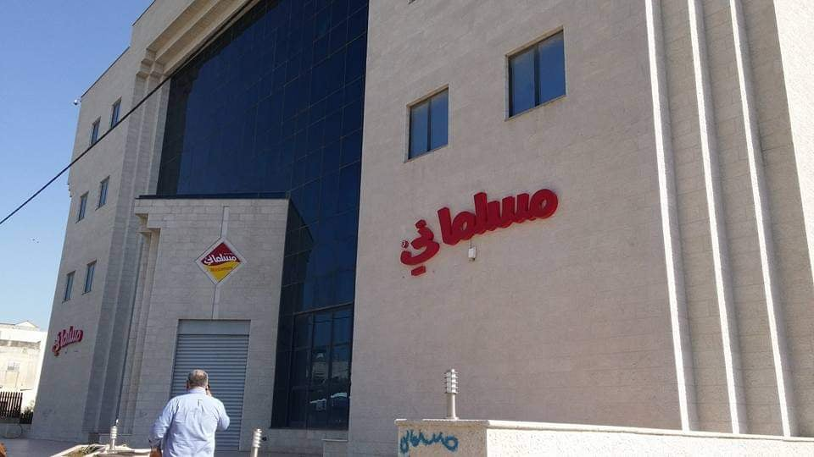
Introduction
Al- Maslamani Company
Maslamani Co. was established in Nablus 1952, its main premises are located in BeitIba, west of Nablus.
It is considered as one of the biggest trading companies in Palestine.
It is producing & marketing roasted Arabic nuts and import confectionery products like wafers and chocolates.

Slide 5
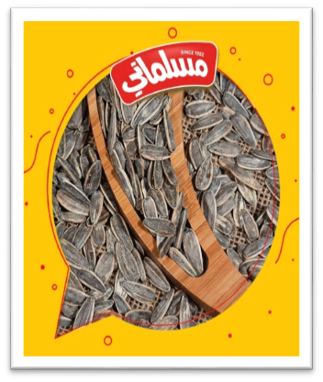
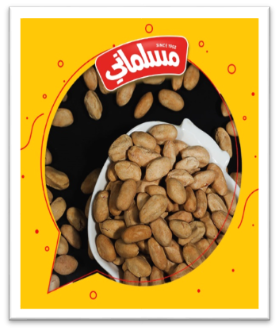
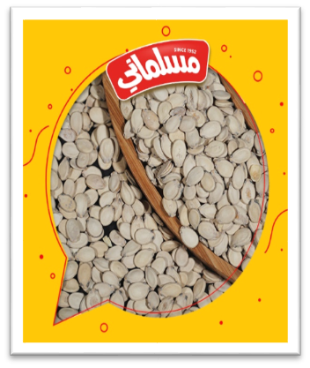
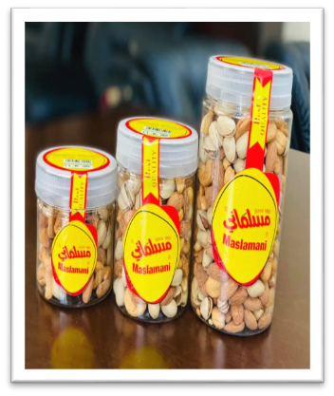
Products produced by Al Maslamani
Sunflower Seeds
Armsh
Watermelon Seeds
Mixed nuts

Slide 6

Problem statement
In Al Maslamani company, monitoring current quality levels and spot potential problem areas is difficult with the current quality system.
They don't implement its data by any type of statistical programs so they do not have any effective indicators of production progress or the causes of non-conforming products, which may affect the company’s reputation and financial losses for the company.

Slide 7

Objectives
1
Assessing the current quality system.
2
Implementation SPC tools.
3
Measuring the processes capabilities.

Slide 8

Literature Review
Quality Definition
quality includes all of the actions that a business engages in to guarantee that the product meets the needs of the customer and compliance with specification .
Statistical Process Control Definition
SPC is the practice of using statistical methods to monitor and regulate how a product is created in order to ensure its quality and that the process produces uniform items with low waste.
It inspects the production process for problems that may occur in undesirable products and it is an effective instrument for continuous improvement.

Slide 9

Methodology
DMAIC Methodology:
In our project, we used the DMAIC model for assessing and improving processes.
It is divided into five Phases:
Define, measure, analysis, improvement, and control.

Slide 10
Define Phase
After identifying the problem and describing it, and defining the objective.
We have decided to implement the SPC method on two of their products: Sunflower and Armsh. For the following reasons:
These products have a large demand compared to other products.
Sunflower and Armsh are one of the largest production lines in the factory.
They pass through many different tests and inspection points such as: Weight, packaging and date.

Slide 11
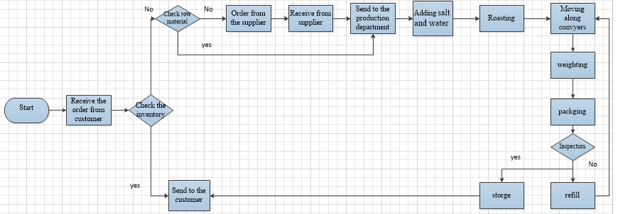
Sunflower Seed Production Line
Process Flow Chart

Slide 12
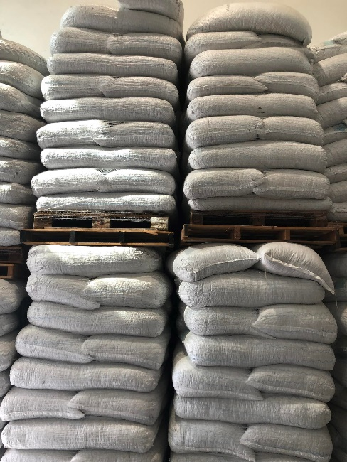
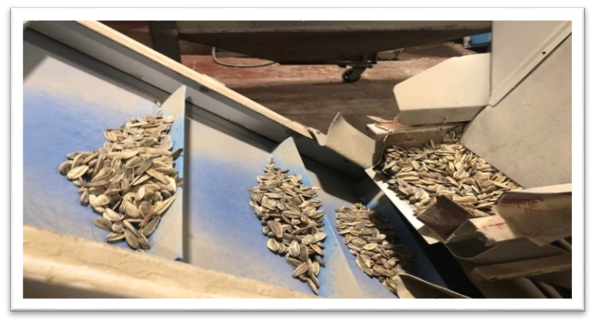
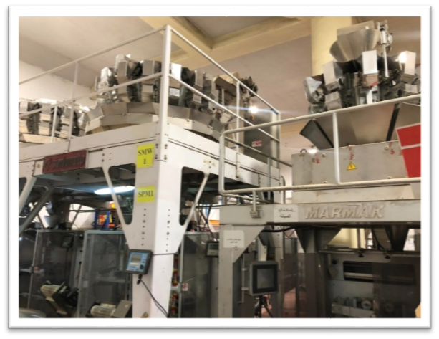
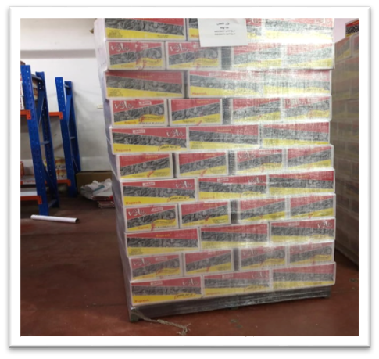
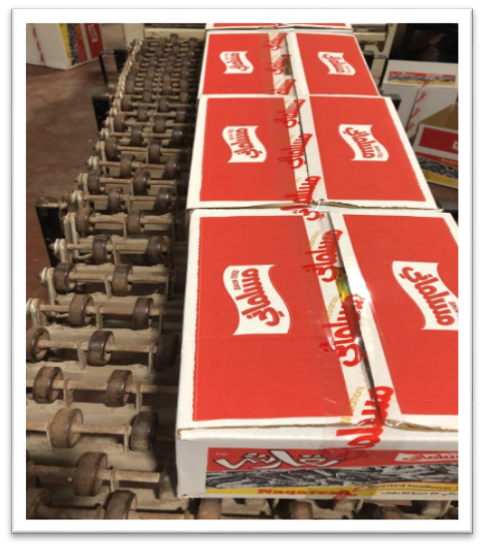
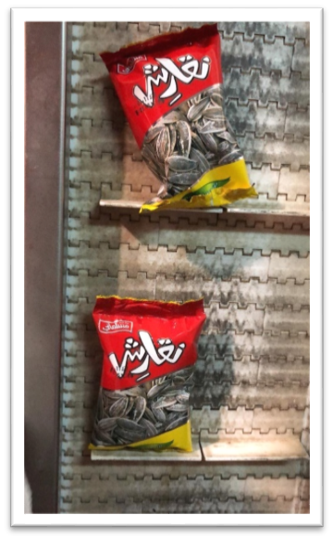
Sequence of Operations

Slide 13
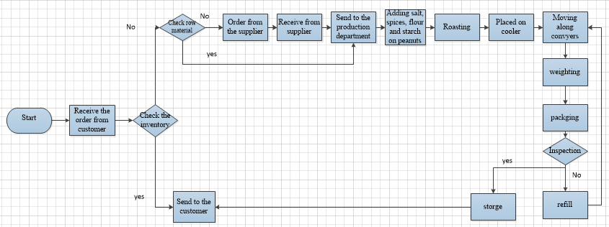
Armsh Production Line
Process Flow Chart :

Slide 14
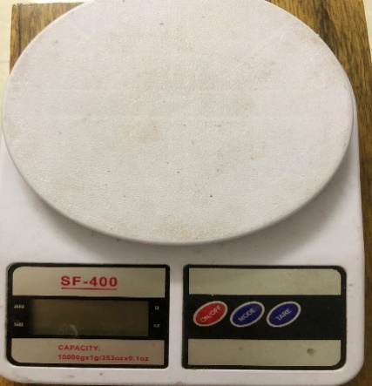
Measure Phase
Data collection for sunflower
We take a five samples from three different sunflower machines, at different times with an interval of 5 minutes between each sample , after that we start to check the following:
Weight
The specification limit for weight should be (40 ± 2g) .
We have used SF-400 as shown in the figure .

Slide 15
2. Packaging
This test was done by eye observation , we checked :
If the envelope was tightly closed from all sides.
The results were recorded in sheet by yes or no.
3. Date
The selected samples were examined by eye observation ,we checked :
If the date was printed and clear so that it could be read.
The results were recorded as yes if it was printed as required and no if it was not.

Slide 16
Data collection for Armsh
We take a five samples from three different machines, at different times with an interval of 5 minutes between each sample , after that we start to check the following:
1. Weight
The specification limit for weight should be (20 ± 2g) ,we have used SF-400.
2. Packaging and Date
Testing the packaging and the date will be checked by eye observation as it is in sunflower.

Slide 17
Analyze Phase
Analyze the Collected Data for Armsh by applying SPC tools .
Type of Charts used:
Normality test
Xbar-R Chart for weight.
P-chart for packaging and date.
Process Capability Analysis.

Slide 18
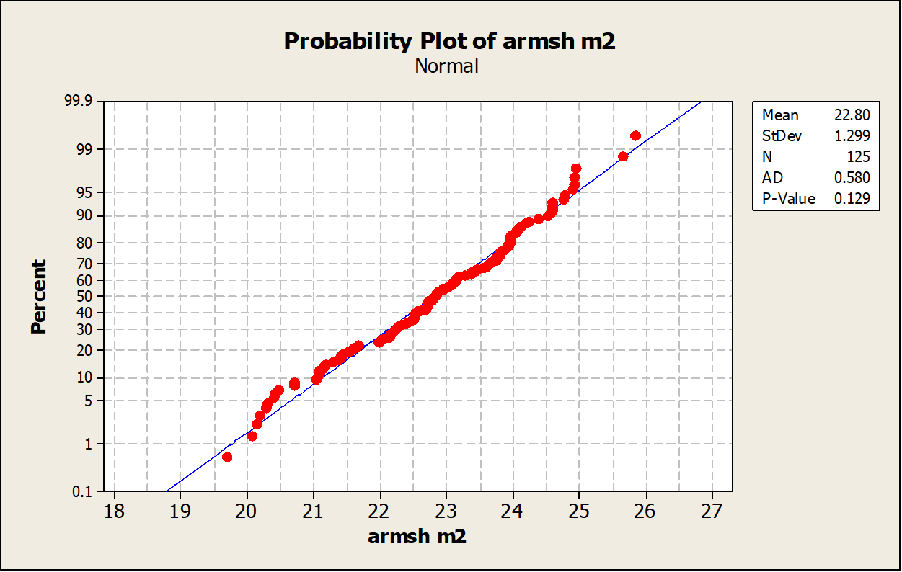
Normality test:
For machine number 1
For machine number 2
For machine number 3

Slide 19
Xbar-R Chart for weight:

Slide 20
For machine number 1
P-chart for packaging:
P-chart for date:

Slide 21
For machine number 2
P-chart for packaging:
P-chart for date:

Slide 22
For machine number 3
P-chart for packaging:
P-chart for date:

Slide 23
Process Capability Analysis:

Slide 24
Process Capability Analysis:

Slide 25
Process Capability Analysis:

Slide 26
Analyze the Collected Data for Sunflower:
For machine number 1:
Xbar-R Chart for weight

Slide 27
P-chart for packaging:
P-chart for date:

Slide 28
Process Capability Analysis:

Slide 29
For machine number 2
Xbar-R Chart for weight:

Slide 30
P-chart for packaging:
P-chart for date:

Slide 31
Process Capability Analysis:

Slide 32
For machine number 3
Xbar-R Chart for weight:

Slide 33
P-chart for packaging:
P-chart for date:

Slide 34
Process Capability Analysis:

Slide 35
Losses calculation:
sales of Sunflower product
Total Quantity for February =10,942 Box
Total Quantity for March =6,291 Box
Average Quantity for (Feb, Mar) = (10,942+6,291)/2=8,617 Box
Shift in machine 1 = 2.728 g /Shift in machine 2 = 2.953 g /Shift in machine 3 = 3.41 g
Average for shifts in three machines= (2.728+2.953+3.41)/3=3.03g
Losses in kg = (Average Quantity * Average for shifts * #of bag in each box)/1000
= (8,617 *3.03*30)/1,000=783.2 kg /month
Losses in operational cost = Losses in kg * operational cost
= 783.2 *2 = 1,566.4 NIS
Losses in raw material = Losses in kg * raw material cost
= 783.2 *9 = 7049 NIS
Total cost = Losses in operational cost + Losses in raw material
= 1,566.4+7049= 8615.4 NIS /month
Total cost / year = # of month * Total cost = 12*8615.4 = 103,382.4 NIS/year
Data | Quantity (box)
6/2/2022 | 5857
10/2/2022 | 1001
13/2/2022 | 505
13/2/2022 | 737
14/2/2022 | 813
24/2/2022 | 1391
27/2/2022 | 638
5/3/2022 | 715
6/3/2022 | 1144
8/3/2022 | 185
13/3/2022 | 650
14/3/2022 | 550
15/3/2022 | 572
21/3/2022 | 585
23/3/2022 | 1522
24/3/2022 | 268

Slide 36
Losses calculation:
sales of Armsh product
Total Quantity for February =2,094 Box
Total Quantity for March =836 Box
Average Quantity for (Feb, Mar) = (2,094+836)/2=1,465 Box
Shift in machine 1 = 2.598 g. /Shift in machine 2=2.804 g.
/Shift in machine 3 = 3.364 g.
Average for shifts in three machines= (2.598+2.804+3.364)/3=2.922g
Losses in kg = (Average Quantity * Average for shifts* #of bag in each box)/1000 = (1,465 *2.922*60)/1,000=256.8 kg /month
Losses in operational cost = Losses in kg * operational cost
= 256.8*3=770NIS
Losses in raw material = Losses in kg * raw material cost
= 256.8*8=2054.4 NIS
Total cost = Losses in operational cost + Losses in raw material
= 770 + 2054.4 = 2824.4 NIS /month
Total cost / year = # of month * Total cost = 12*2824.4 = 33,892.8 NIS/year
Total cost (Armsh and Sunflower) =33,892.8 +103,384.8= 137,277.6 NIS/year
Data | Quantity (box)
6/2/2022 | 1023
7/2/2022 | 64
10/2/2022 | 111
14/2/2022 | 356
17/2/2022 | 69
20/2/2022 | 69
21/2/2022 | 294
21/2/2022 | 108
2/3/2022 | 10
5/3/2022 | 335
17/3/2022 | 319
28/3/2022 | 172

Slide 37
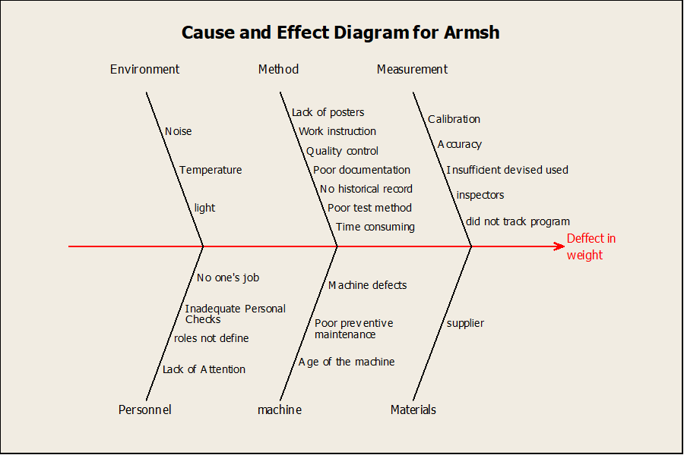
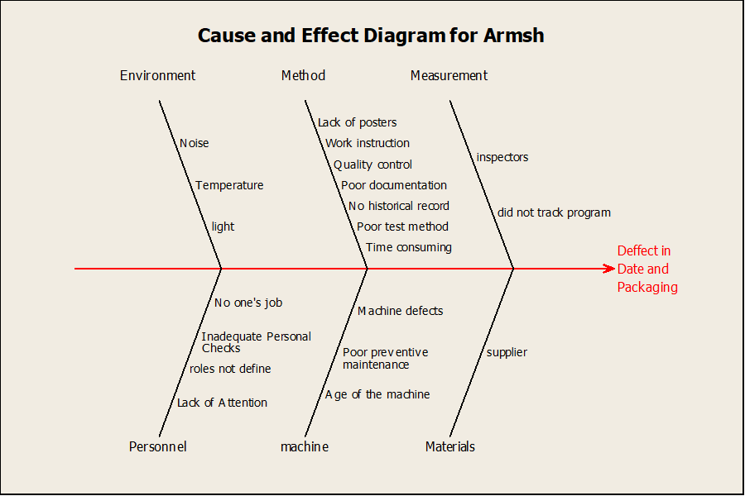
Cause and effect diagram for Armsh

Slide 38
Causes defects in Armsh
Weight:
Since the Armsh machine depends on the size of the grain and not its weight, therefore, the machine will work with less accuracy, which causes an imbalance in the weight of the final product.
Packaging:
1. Cutting the piston wire will result in a lack of heat that reaches the piston and therefore the bag will not be closed tightly.
2. Improper work of the piston.
3. Failure to properly calibrate the temperature.
Date:
Not noting the end of the ink for the machine and its continued operation, as well as the manufacturing of products without a date.

Slide 39
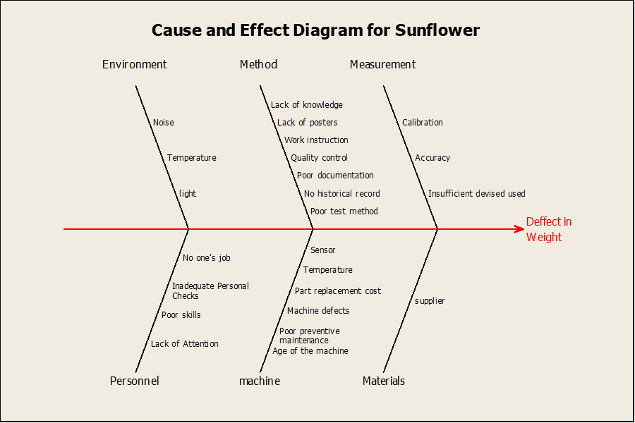
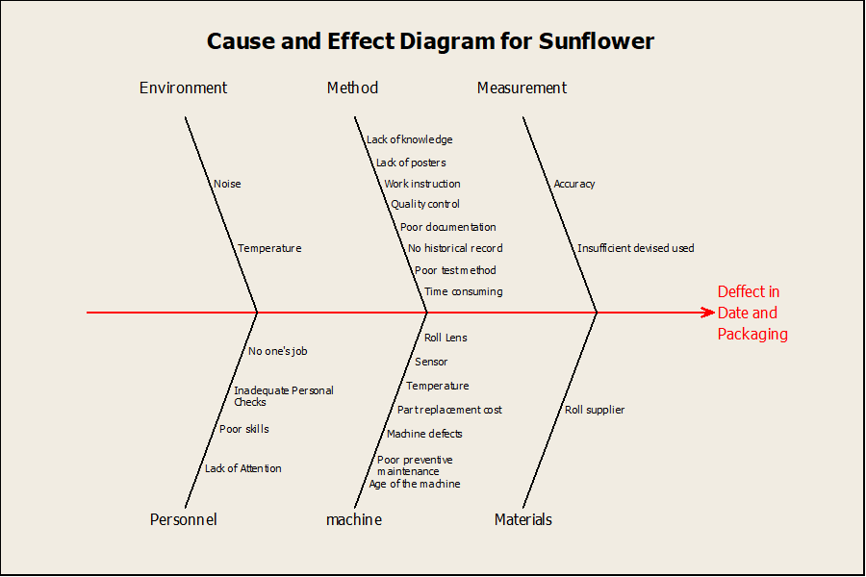
Cause and effect diagram for Sunflower

Slide 40
Causes defects in sunflower
weight:
The presence of some defective scales in the machines leads to inaccurate packing of weights, which leads to the production of products that contain a defect in the weight of the final product..
Packaging :
1. Cutting the piston wire will result in a lack of heat that reaches the piston and therefore the bag will not be closed tightly.
2. A defect in the work of the piston.
3. Failure to properly calibrate the temperature.
Date :
Not noticing the end of the ink for the machine and its continuity of work and the production of products without a date.

Slide 41
Improvement Phase
Sunflower weight Improvement
1- Corrective maintenance for malfunctioning scales if they are repairable.
2 - Spare parts for scales.
3 - Preventive maintenance.

Slide 42
Sunflower charts after improvement
Machine number 1
Xbar-R Chart for weight:

Slide 43
Process Capability analysis:

Slide 44
Machine number 2
Xbar-R Chart for weight

Slide 45
Process Capability analysis:

Slide 46
Machine number 3
Xbar-R Chart for weight:

Slide 47
Process Capability Analysis:

Slide 48
Losses in Sunflower after improvement:
Average Quantity for (Feb, Mar) = (10,942+6,291)/2=8,617 Box
Shift in machine 1= 1.533 g.
Shift in machine 2= 1.041g.
Shift in machine 3 = 1.063g.
Average for shifts in three machines= (1.533+1.041+1.063)/3=1.212g
Losses in kg = (Average Quantity * Average for shifts * #of bag in each box)/1000
= (8,617 *1.212*30)/1,000= 313.3 kg /month
Losses in operational cost = Losses in kg * operational cost
= 313.3 *2=626.6 NIS
Losses in raw material = Losses in kg * raw material cost
= 313.3 * 9 = 2819.7NIS
Total cost = Losses in operational cost + Losses in raw material
= 626.6+2819.7 = 3446.3 NIS /month
Total cost / year = # of month * Total cost
= 12* 3446.3 = 41355.6 NIS/year
Saving in year = 103384.8 – 41355.6 = 62029.2 NIS /year

Slide 49
Sunflower and Armash improvement
packaging:
Corrective maintenance of the piston heat wire to solve the problem of not closing the bag tightly.
Develop a working procedure showing the appropriate temperatures for the piston according to the type of roll used for each type of product.
Date:
Calculating the time required for the expiry of the ink, then setting an alarm that gives a warning that the ink expiry time is near to end to supply the machine with new ink.

Slide 50
Armsh improvement
weight
Replacing volumetric machines with modern weighing.
2. Adding scales to the machines that weigh the quantities entering the bag.

Slide 51

Control Phase
This phase aims to control the developments made in the improvement phase, so it will monitor the critical process characteristics and document the new performance to ensure the validity of improvement actions that will provide sustainability over time.

Slide 52
Results
 | Sunflower
 | machine | in control | mean | Cpk | losses
Before | machine 1 | in control | 42.953 | -0.49 | 103,384.8 NIS/year
 | machine 2 | in control | 42.728 | -0.25
 | machine 3 | in control | 43.41 | -0.28
After | machine 1 | in control | 41.533 | 0.18 | 41,355.6 NIS/year
 | machine 2 | in control | 41.038 | 0.54
 | machine 3 | in control | 41.06 | 0.52

Slide 53
Conclusions
The DMAIC methodology has been applied in all its phases and applied SPC tools.
The results are as follows:
Reduce in mean shift of the process.
Reduce defects.
Increase productivity.
Saving money about 62,029.2 NIS/year.

Slide 54
Recommendations
Continuous random sampling after improvement to guarantee process stability.
Performing regular preventive maintenance.
Follow the instructions by conducting work procedures.

Slide 55


