Slide 1

LABELING MACHINE
Prepared by:
Shaima’ Dwekat
Saja Salahat
Supervisor:
Dr. Kamel Saleh

Slide 2
Outline
Introduction
Objectives
Hardware component
Machine process sequence
System Setup
Control Panel

Slide 3
Introduction
This project is to design and build a labeling machine for SUN PHARM DRUG STORE. the design and building of a an automatic prototype. The labeling machine is designed to apply labels to bottles which are 50 ml volume; also it is required to be cost effective and easy to use.

Slide 4
Introduction
The labeling machine is considered as a very essential component of the industrial production lines, therefore, we have been manufactured this machine with a very simple parts that assure high quality products.

Slide 5
Objectives
Mitigating the cost
Assuring high quality of product
Improving the efficiency of the production line for our local industrial market

Slide 6
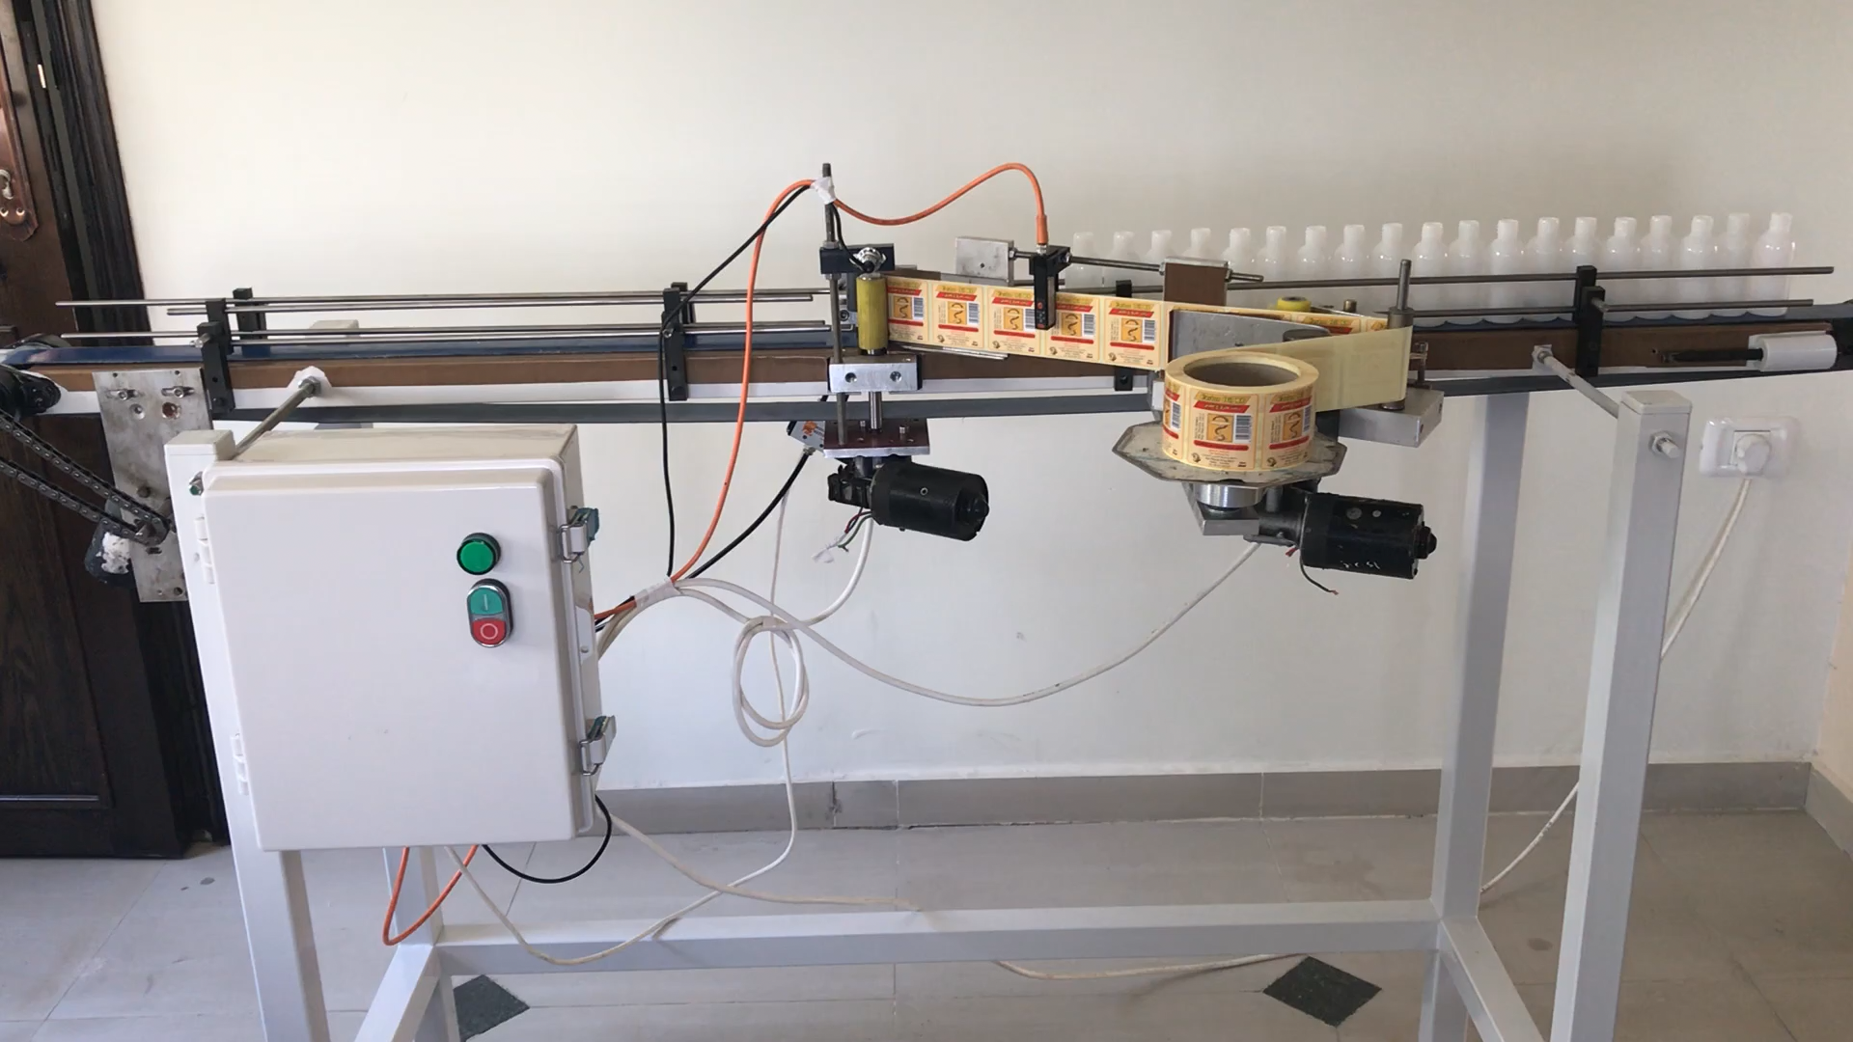
Video

Slide 7
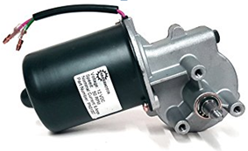
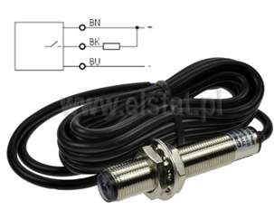
Hardware component
Motors
Photoelectric sensor

Slide 8
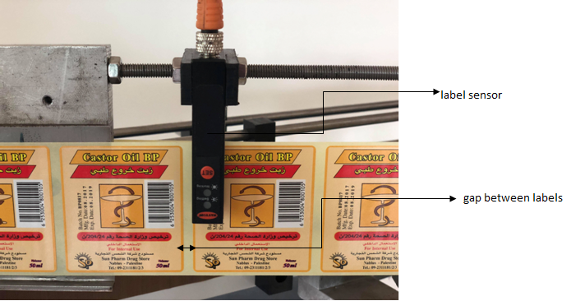
Label sensor

Slide 9
SYSTEM SETUP
This machine consists of three parts specified as the following:-
1-Gearbox.
2-Bottle Incubator.
3-Sticker Feeder

Slide 10
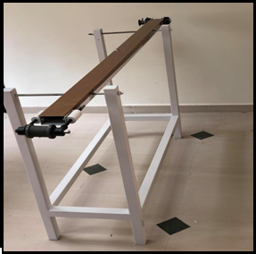
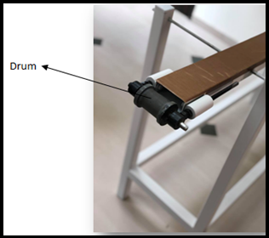
Gearbox

Slide 11
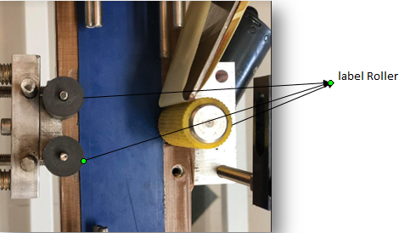
Bottle Incubator

Slide 12
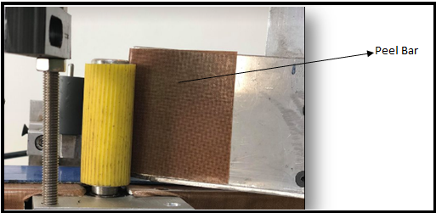
The Sticker Feeder
Peel plate

Slide 13
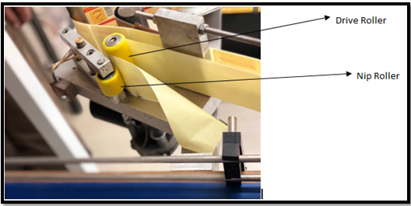
Drive roller

Slide 14
Control Panel
we must control the motors and sensors to allow the system work properly and that will be done through the PLC.

Slide 15
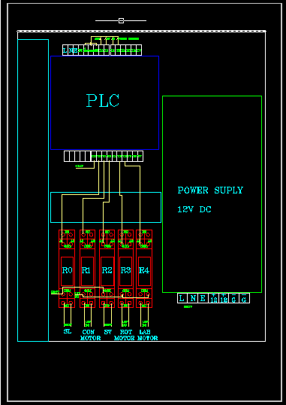
Cont

Slide 16
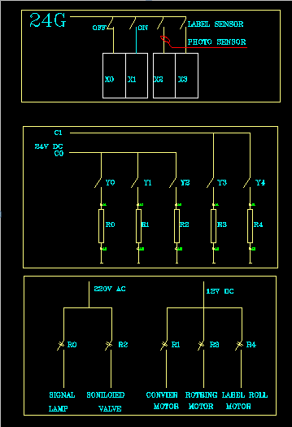
Schematic Diagram

Slide 17
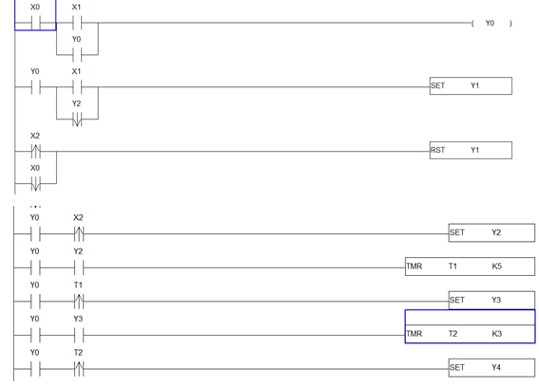
Ladder diagram

Slide 18
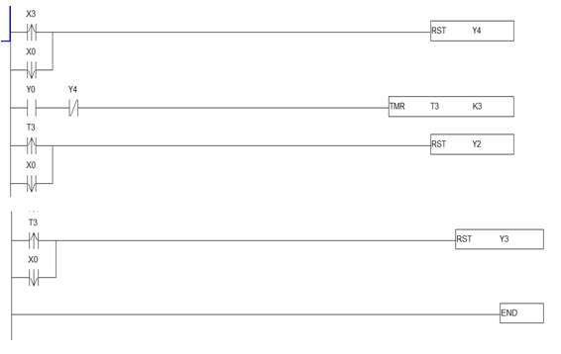
Cont

Slide 19


