Slide 1
Building a bridge in Nablus city
Prepared by : Monawwar Abdulrahman.
Noor Hussein.
Under supervision of : Dr.Mohammad Ghazal.

Slide 2
contents
Introduction.
Site Description.
→ Problem definition.
→Site investigation.
→Design of bridge foundations.
→ Column footing design.
→ Retaining wall footing design.

Slide 3
Introduction

Slide 4
The main task of our project is to design foundations for abridge instead of the roundabout at the intersection of of Haifa Road and Mohammad Bin Rashid Al-Maktoom Road at the western entrance of Nablus city.

Slide 5


Slide 6
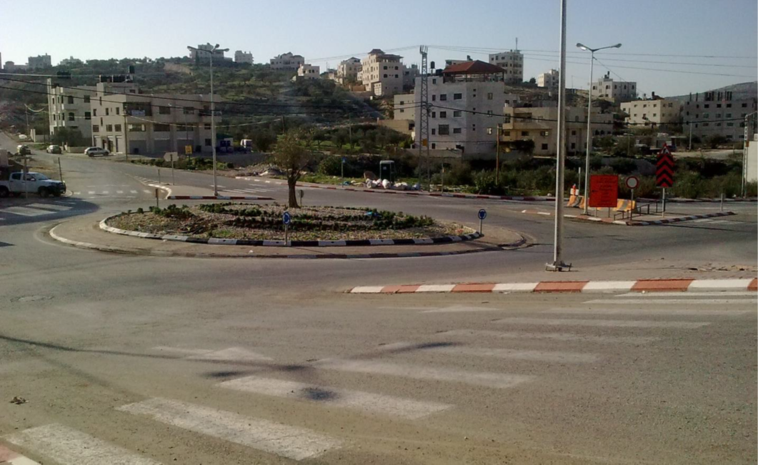
The intersection

Slide 7
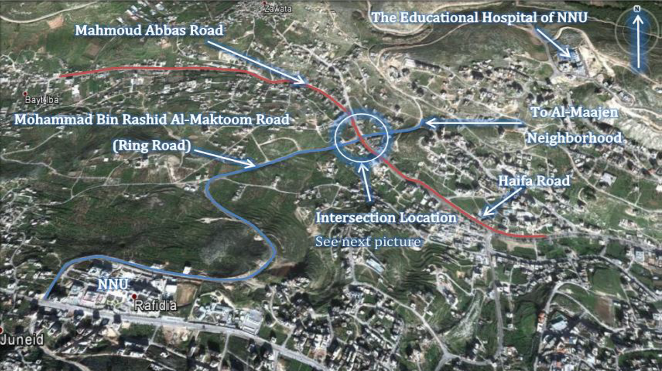
Areal View

Slide 8
Problem definition

Slide 9
The New Campus of NNU
Increase in the Average Delay Per Vehicle
Urbanization Expansion
High Traffic Load
Congestion Problems
Accidents increase
Educational Hospital of NNU
High Traffic Loads from Tulkarm and Jenin Governorates
Limited Capacity

Slide 10
SITE INVESTIGATION

Slide 11
Site investigation purposes
Site description
Laboratory tests results
Water table

Slide 12
Site description
The site consists of layers of sedimentary brownish silty clay of high plasticity with pebbles and boulders of varying sizes. Wastewater open channel passes through the site its southern part.

Slide 13
Laboratory tests results
BH No. | Sample No. | Depth M | Nature moisture % | Liquid limit % | Plastic limit % | Plasticity index | Angle of internal friction | Cohesion (from unconfined compression test ) Kg/cm²
1 | 1 | 0.0-5.0 | 14 |  |  |  |  | .85
 | 2 | 5.0-7.5 | 15 |  |  |  |  | .7
 | 3 | 7.5-13 | 23
2 | 1 | 0.0-5.0 | 21 | 61 | 33 | 28 |  | .93
 | 2 | 5.0-9.0 | 7
3 | 1 | 0.0-4.0 | 17 | 54 | 28 | 26
 | 2 | 4.0-6.0 | 7
 | 3 | 6.0-9.0 | 6 | 35 | 19 | 16

Slide 14
The recommended bearing capacity is 3.5 Kg/cm².
Cohesion in average equal to 0.8.
Lateral earth pressure at rest (K₀) =0.5.

Slide 15
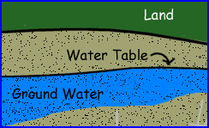
Water table
Ground water table was found at 5 m depth.

Slide 16
Design of bridge foundations

Slide 17
A bridge is a structure that spans horizontally between supports and provides passage over obstacles such as valleys, rough terrain or water…. Etc.
A foundation is the element which connects the structure (here: bridge) to the ground, and transfers its loads to the ground. Foundations are generally considered either shallow or deep.
The foundations of a bridge is particularly critical because they must carry the traffic loads and the weight of the bridge itself.

Slide 18
Loads on the bridge
Loads
Dead
Live
Soil
Wearing
Breaking force

Slide 19
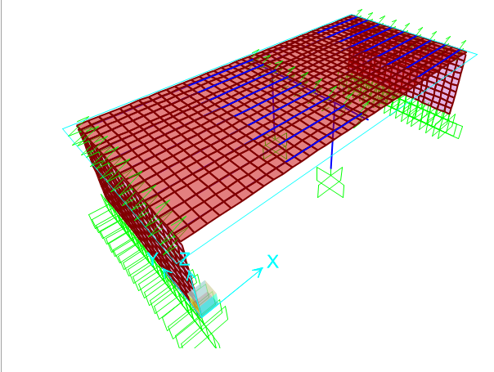
3-D model for the bridge on sap2000 program

Slide 20
Definitions Of Material.
CONCRETE
  fˋc=32 MPa
STEEL
  fy=420 MPa.

Slide 21
Design and dimensions
COLUMNS
80 cm Diameter
70 cm Thickness.
7.8 m Height.
RETAINING WALL

Slide 22
Footing of the bridge
9 Ø 20/m.
Columns Footing
Dimensions
Area of steel
13.3*5.8*1.5
Bridge Footing
Retaining Wall Footing
7 Ø 20/m for toe.
6 Ø 20/m for heal.
6 Ø 12/m for stem.
6 Ø 16/m for shrinkage .
15*8*0.6

Slide 23
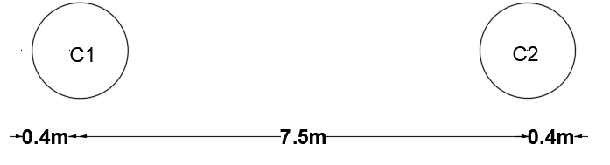
Columns footing design
The Dimensions and distances of the columns as shown.
The footing of the columns is combined one.

Slide 24
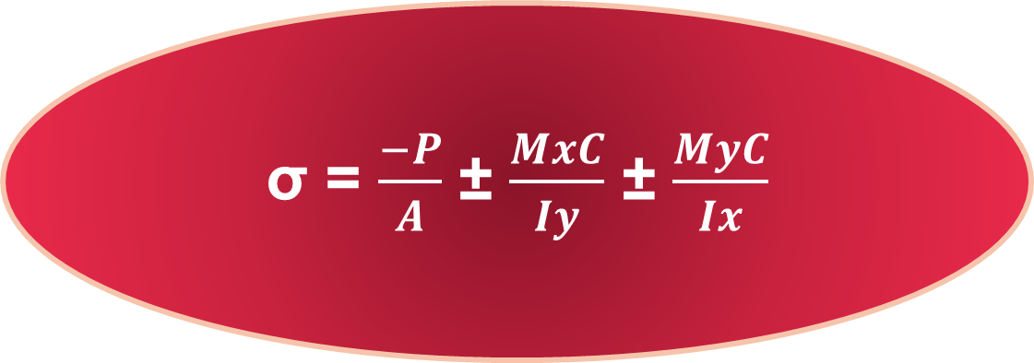
An excel sheet was made to check the ability of the suggested footing to carry the loads from the bridge by applying an equation to compare the stress comes from columns with the allowable bearing capacity .
The stress equation:
σ = $\frac{−P}{A}$ ± $\frac{MxC}{Iy}$ ± $\frac{MyC}{Ix}$

Slide 25
Stress2 | Stress1 | M2 | M1 | Axial Force
-210.2 | -167.819 | -608.434 | 731.7037 | 13071.89
-207.259 | -170.76 | -608.434 | 1182.476 | 13071.89
-170.437 | -137.95 | -468.026 | 571.5184 | 10664.01
-168.288 | -140.098 | -468.026 | 900.9273 | 10664.01
-143.928 | -118.037 | -374.421 | 464.7282 | 9058.748
-142.307 | -119.658 | -374.421 | 713.2283 | 9058.748
-55.1672 | -13.8092 | -375.579 | -713.228 | 2385.205
-53.5462 | -15.4302 | -375.579 | -464.728 | 2385.205
-59.4854 | -7.66544 | -469.473 | -900.927 | 2322.077
-57.3367 | -9.81416 | -469.473 | -571.518 | 2322.077
-65.9628 | 1.55021 | -610.315 | -1182.48 | 2227.387
-63.0224 | -1.39016 | -610.315 | -731.704 | 2227.387
All values of stress on the suggested footing are lower than the allowable bearing capacity which is equal to 350 KN/m². So it's ok.

Slide 26
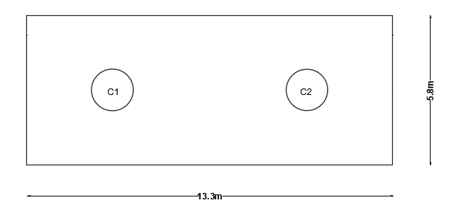
Columns Footing :
An area of (13.3m length×5.8m width) was suggested as shown below.

Slide 27
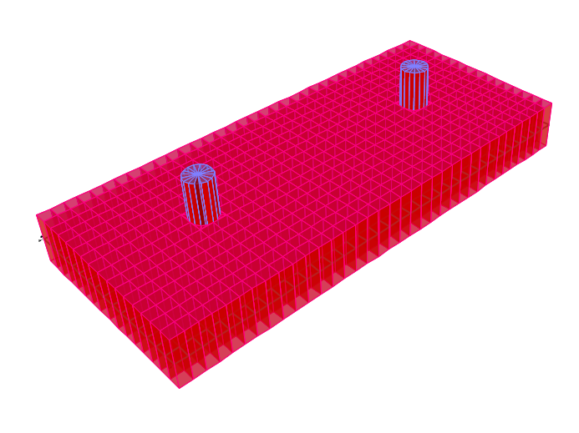
3-d model for columns footing

Slide 28
Check Wide beam Shear
q_{u} =207 KN/m².
q_{all} = 350 KN/m².
Footing area = 77.14 m² .
Let d =1.4m.
L1=2.5m.
.
Vu= q_{u}(L1-d)= 227.7 KN.
.
ØVc =0.75 * $\frac{1}{6}$∗ 1∗ $√fꞌc$* b*d / 1000= 989.95 KN.
ØVc =0.75 * 𝟏/𝟔∗ 1∗ √𝐟ꞌ𝐜* b*d / 1000= 989.95 KN.
Vu < ΦVc …. OK

Slide 29

Check Punishing Shear
Pu= 13071.89 KN.
A₁= (r+$\frac{d}{2}$ )²*π =3.8 m^{2 .}
^{Thickness of the footing :}
^{h=1.5m.}
.
Vup= Pu- qu A1=12285.29 KN.
.
ØVc_{p} = 0.75 * $\frac{1}{3}$∗ 1∗ $√fꞌc$* 2π *($\frac{d}{2}$ +r )*d= 13670.4 KN.
ØVc_{p} = 0.75 * 𝟏/𝟑∗ 1∗ √𝐟ꞌ𝐜* 2π *( 𝒅/𝟐 +r )*d= 13670.4 KN.
Vup < ΦVc p ….OK.

Slide 30
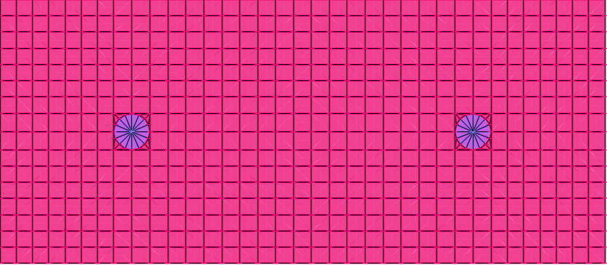

Check of deflection
Max deflection in Footing = 9.82 mm < 10 mm …… OK

Slide 31
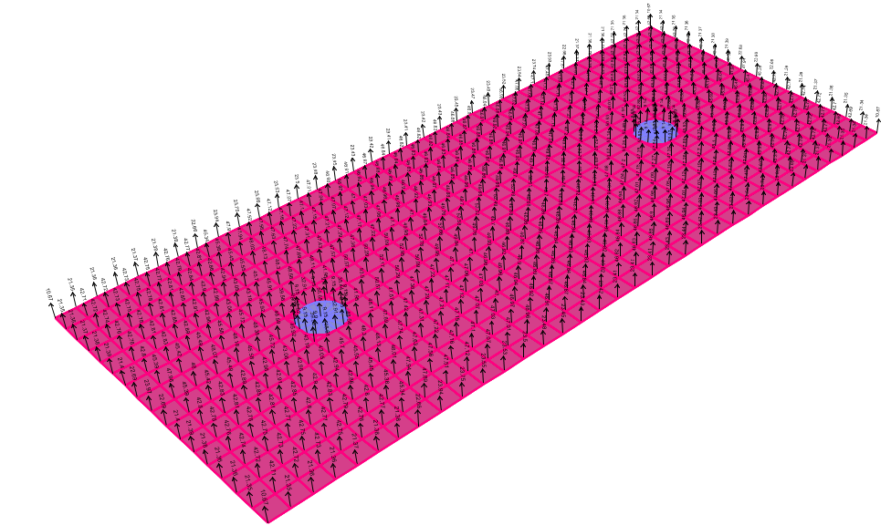
Check Stress under Footing
$stress= \frac{53.5}{0.4∗0.4}=334.4KN/m^{2}<350 KN/m^{2}$ ..OK

Slide 32
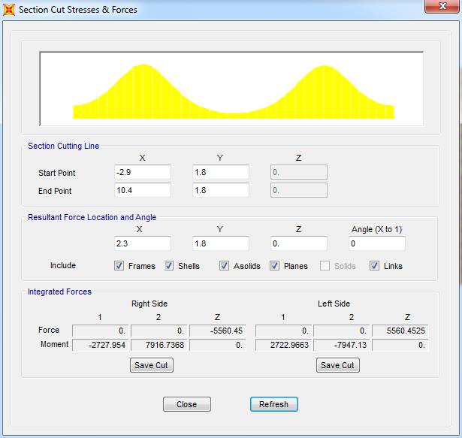
CHECK SHEAR FROM ULTIMATE LOAD
Section Cut at d
ϕ V_{c} =989.95 KN
Vu=5560.45/13.3=418 KN
Capacity of section ok

Slide 33

REINFORCMENT STEEL OF COLUMNS FOOTING
M_{u}= q_{u}$\frac{L^{2}}{2}$= $646.9 KN.m.$
ρ=8.8*10⁻⁴ .
ρ_{min} =0.0018.
A_{s}= ρ b d =0.0018 *1000*1500 = 2700 mm²/m.
Use 9 Ø 20/m.

Slide 34
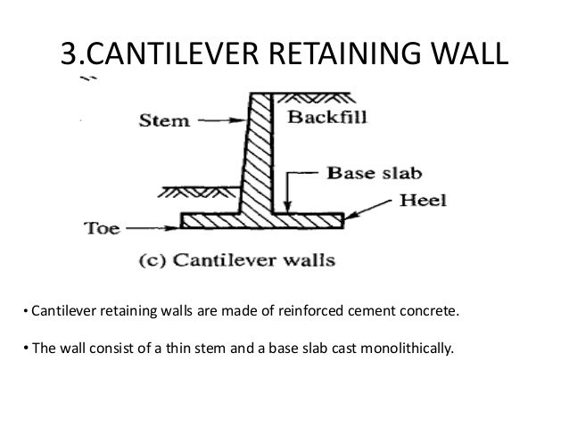
DESIGN OF RETAINING WALL FOOTING
The retaining wall is chosen to be cantilever one, which consists of a relatively thin stem and a base slab. The base is also divided into two parts, the heel and toe. The heel is the part of the base under the backfill. The toe is the other part of the base. This type of retaining walls has many advantages such as:
Use much less concrete than gravity walls, but require more design and careful construction.
Generally, it's economical.
Can be precast in a factory or formed on site.

Slide 35
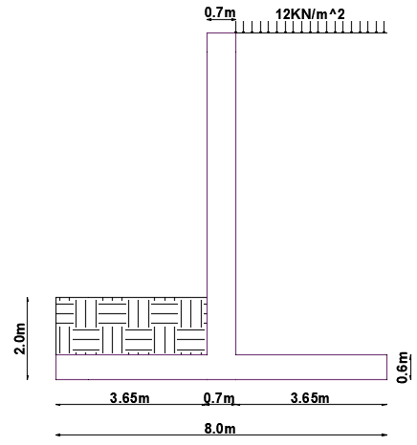
The Preliminary Dimensions of the Retaining Wall is Shown in the Figure:
- Back filling material unit weight of 20 KN/m².
- Friction angle = 0º.
- Live load = 12 KN/m².
- fc’ = 32 and fy = 420 Mpa.
- Concrete unit weight = 25 Mpa.
- h=8.4m.

Slide 36
Check of the overturning for the wall:
k_{a} = 1−sin (Ø)/1+sin (Ø) = 1
q₁ = Ɣ * h * k_{a} = 168 KN/m².
q₂ = W * k_{a} =12 * 1 = 12 KN/m^{2 .}
P₁ = 0.5 * q₁ * h = 705.6 KN .
P₂ = 0.5 * q₂ * h= 50.4 KN.
P_{t} = P₁ + P₂ = 756 KN.
M(ov.) = P₁(8.4/3) + P₂(8.4/2) = 2187.63 KN.m

Slide 37
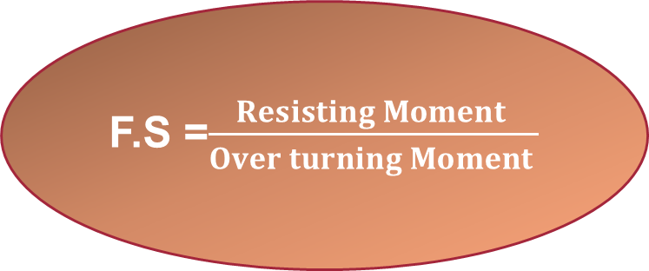
The following table shows the moment resistance calculation:
Weight Name | Unit weight | Weight | Force arm | Moment Ris.
W1 | 25 | 136.5 | 4 | 546
W2 | 25 | 120 | 4 | 480
W3 | 20 | 146 | 1.825 | 266.45
W4 | 20 | 569.4 | 6.175 | 3516.04
Total |  | 971.9 |  | 4808.495
F.S =$\frac{Resisting Moment }{Over turning Moment }$
F.S = 2.198 > 2 …so it is Ok.

Slide 38

Check of bearing capacity
a = $\frac{Δ M}{W}$=$\frac{2409.995}{971.9 }$ = 2.5 m .
M = (4 –2.5)*(971.9) = 1457.85 KN.
q₁ = $\frac{− P}{A}$ ± $\frac{MC}{I}$ = -260.064 KN/m² .
q₂= -121.472 KN/m^{2 .}
Stress less than 350 ….So its Ok.

Slide 39
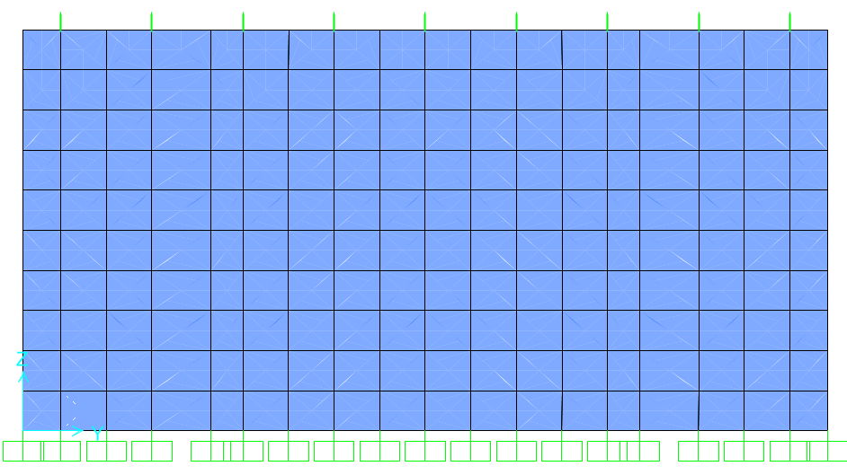

Check deflection of stem
Max deflection < 10 ...OK.

Slide 40
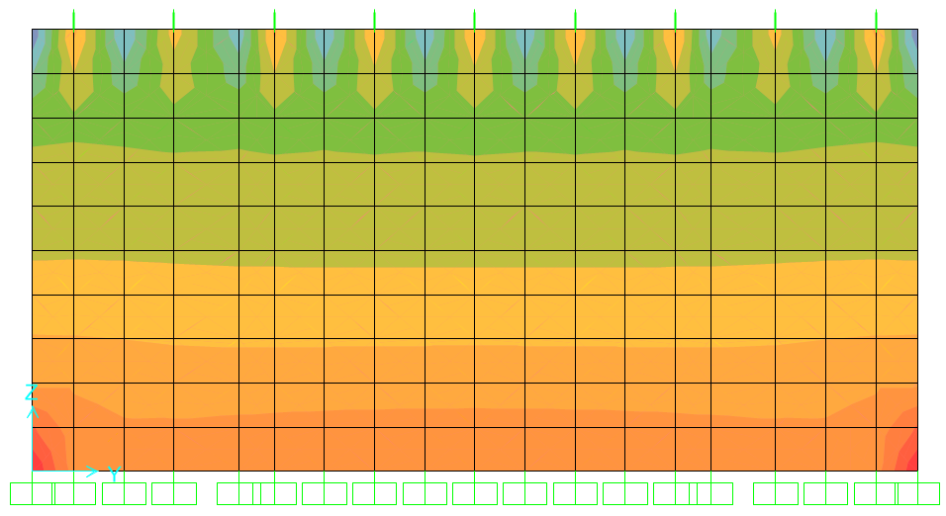

Check shear for the stem
ØVc = 0.75 * 1/6 * λ * √𝑓𝑐′ * b_{w} * d
= 0.75 * 1/6 * 1 * √32 * 1000 *630
= 445.5 KN.
All Vu values < ØVc
so it is ok

Slide 41
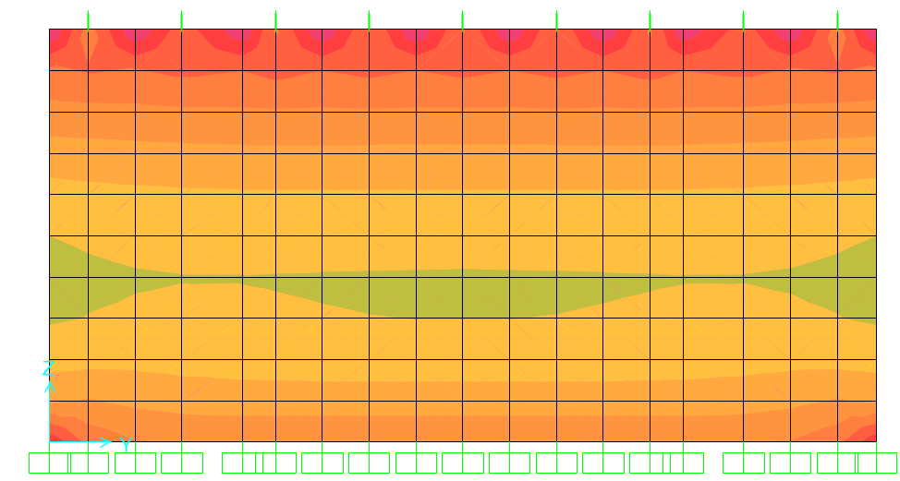


Flexural design for the stem
Moment on the stem from ultimate loads:
M_{u} from SAP = 470 KN.m
ρ = 0.0032
As = 0.0032*1000*630 = 2020.4 mm²
Use 7 ø 20 /m.
Use shrinkage steel in other direction at each face
As = $\frac{0.0018∗1000∗700}{2}=630 mm$^{2.}
Use 6 ø 12 / m

Slide 42
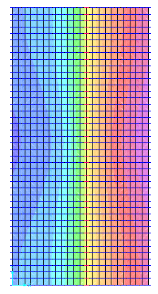

Check deflection for retaining wall footing.
Max deflection in Footing:
4 mm < 10 mm
SO its Ok.

Slide 43
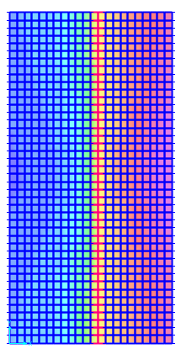


Check stress under footing
A tension stress appear on the heel ,so a tension equation was applied to check the stress values due to tension , The stress under footing was less than bearing capacity of soil so the footing is safe.
The tension equation :
σ = $\frac{−4}{3}$ * $\frac{P}{b∗(L−2e)}$ Where e =$\frac{My}{P}$

Slide 44
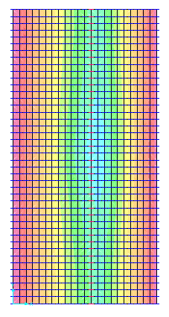


Check shear for the heal and toe from the ultimate load.
ϕ V_{c} = 0.75*($\frac{1}{6}$)*$(√$32) *1000*530 = 374 KN
(from manual calculation).
ALL value of shear less than 375 KN.
So its ok.

Slide 45
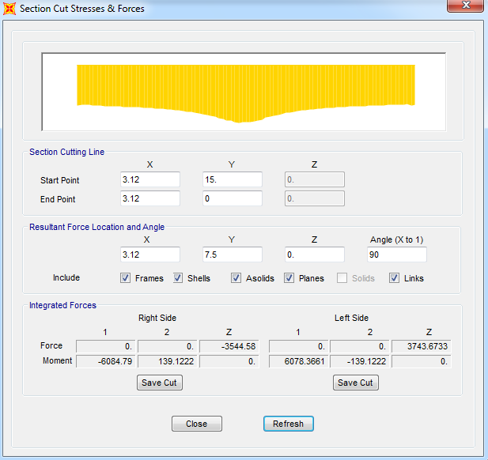

Reinforcement steel in the toe
M_{u}= $\frac{6085}{15}$ = 406 KN.m
ρ=0.004
A_{s}= ρ b d
=0.004*1000*5300
= 2087 mm²/m .
Use 7 Ø 20/m

Slide 46
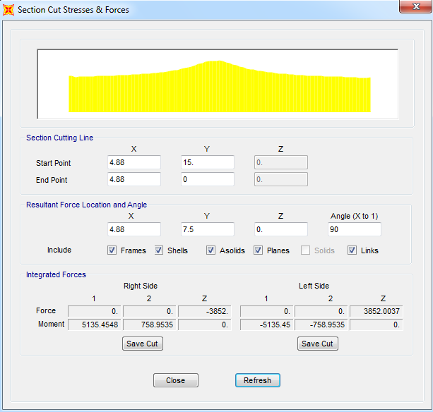

Reinforcement steel in heel
M_{u}=$\frac{5135.5}{15}$ = 342.4
ρ=0.0033
A_{s}= ρ b d = 0.003*1000*530
= 1751 mm²/m
Use 6 Ø 20/m.
use in other direction of footing:
Shrinkage steel :
0.0018*1000*600= 1800 mm²
Use 6 ø16/m

Slide 47
Thank you!

