Slide 2
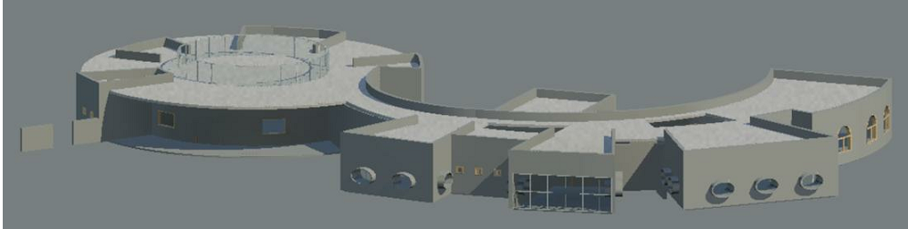
Kindergarten
Amani Nasasrah , Enas Awad
Shadia Yamin , Sondos Ghanim
Dr. Mohannad Haj Hussin

Slide 3
Contents:
1.Architectral design
2. Environmental design
3. Structural design
4. Mechanical design
5. BOQ calculation

Slide 4
Architectural design

Slide 5
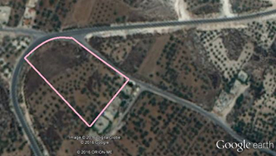
site
Land area = 5000 m2

Slide 6
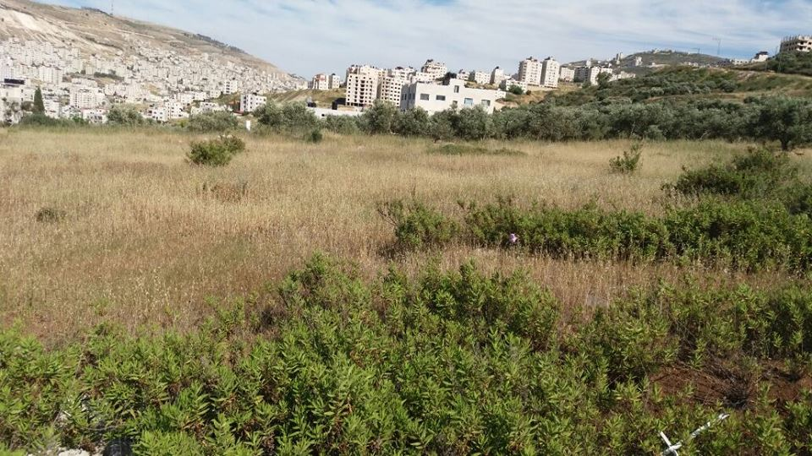
Site

Slide 7
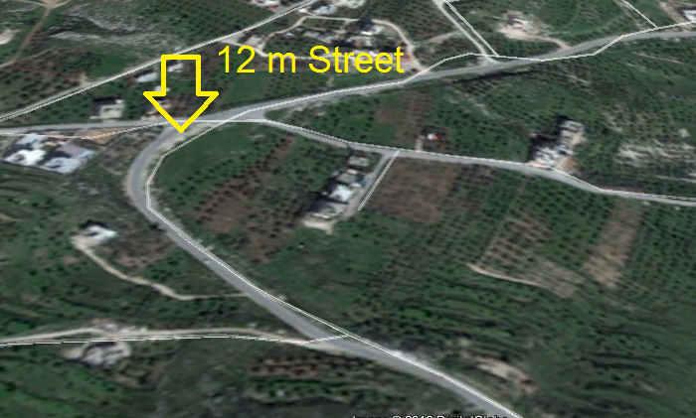
Surrounding streets

Slide 8
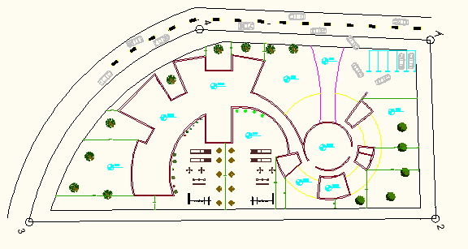
Site plan

Slide 9
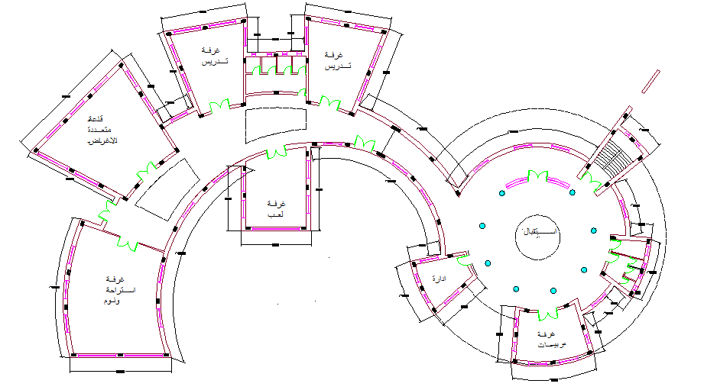
Main plan

Slide 10
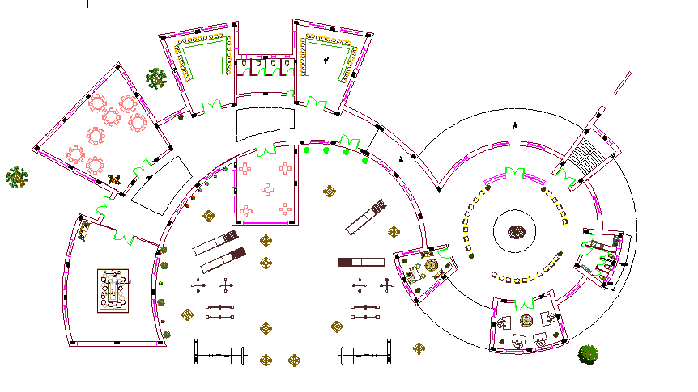
Furniture plan

Slide 11
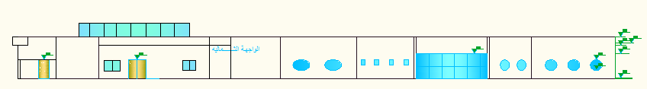
Elevations
North elevation

Slide 12
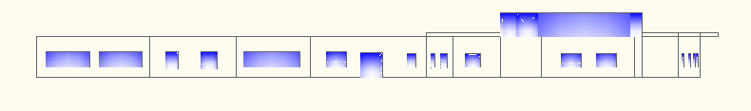
South elevation

Slide 13
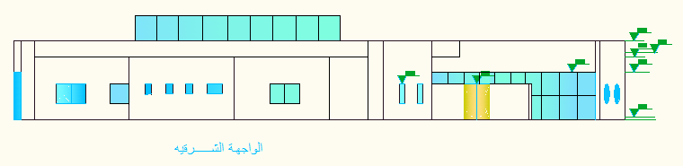
East elevation

Slide 14
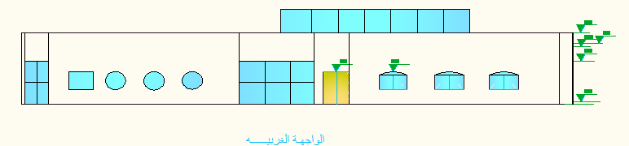
West elevation

Slide 15
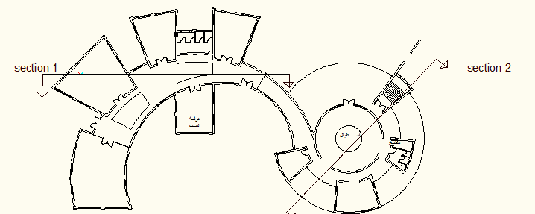

Slide 16
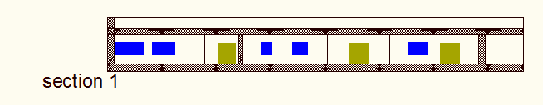
Sections
Section 1-1

Slide 17
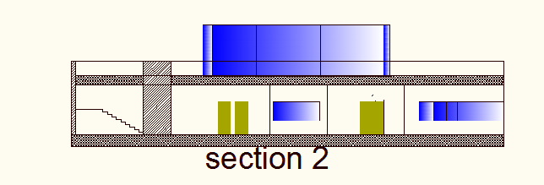
Section 2-2

Slide 18
Environmental Design

Slide 19
Environmental Design:
1- The layers for the elements.
2-Total Heating and Cooling Load.
3- Daylight factor.
4- Acoustical Analysis.

Slide 20
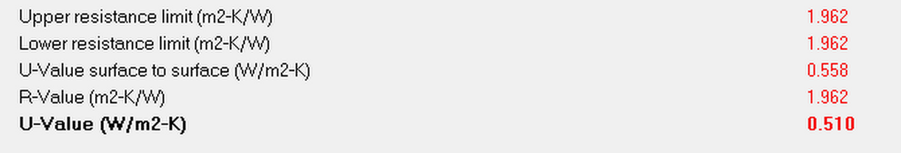
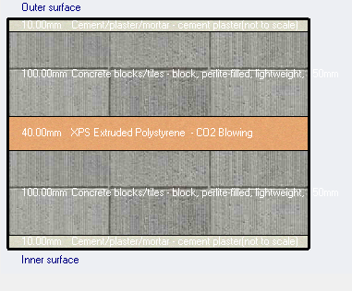
U_value for external wall and their thermal properties

Slide 21
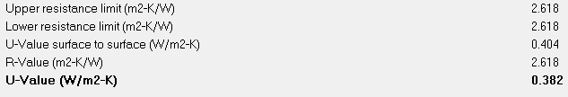
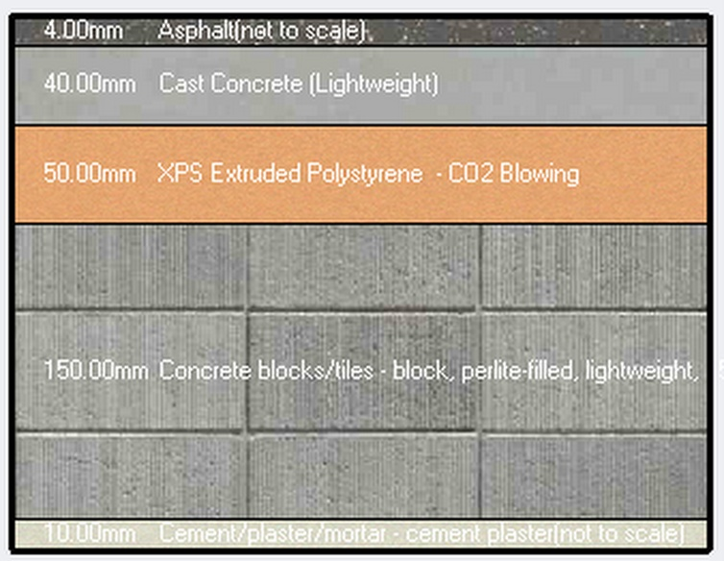
U_value for flat roof and their thermal properties

Slide 22
The Total Heating Load capacity =44.76 kW
The Total Cooling Load capacity =151.35 kW

Slide 23
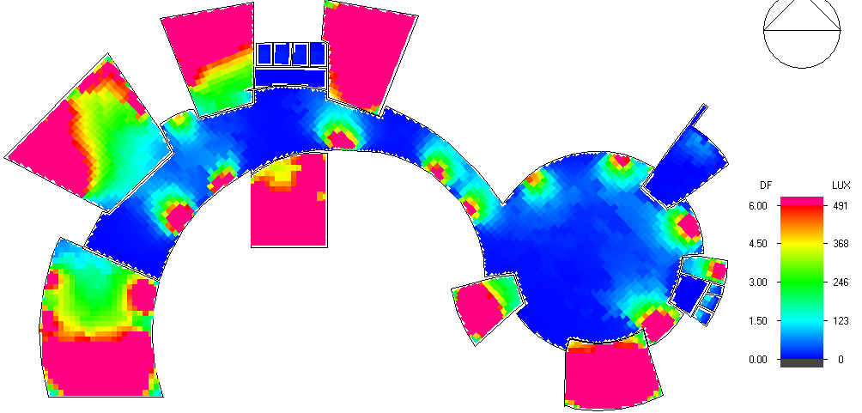
Day lighting

Slide 24
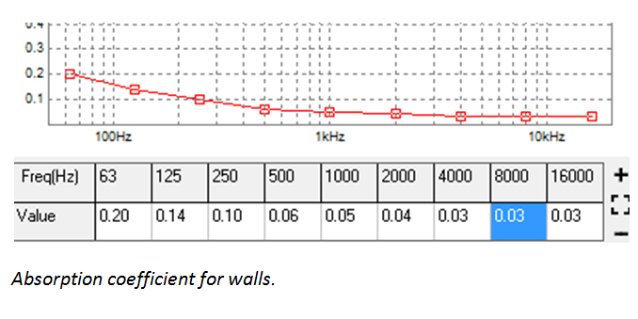
Acoustical Analysis

Slide 25
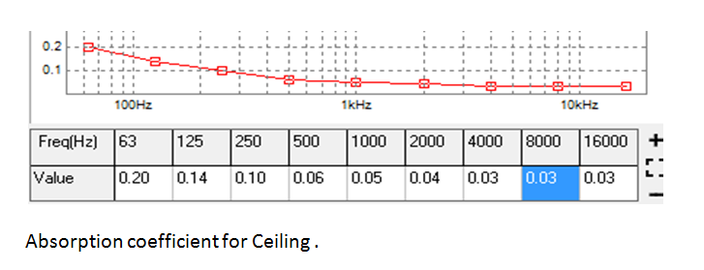

Slide 26
Sound Transmission Class (STC)
STC for partition = 50db

Slide 27
Sound Transmission Class (STC)
STC for Masonry Wall = 50db

Slide 28
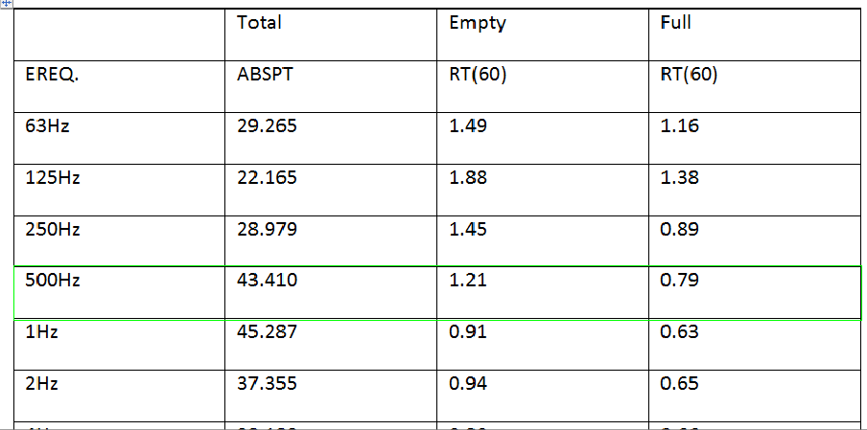
Reverberation Time
Case 1 (Playing room):
The RT60 is in standard range (1.20-1.60).

Slide 29
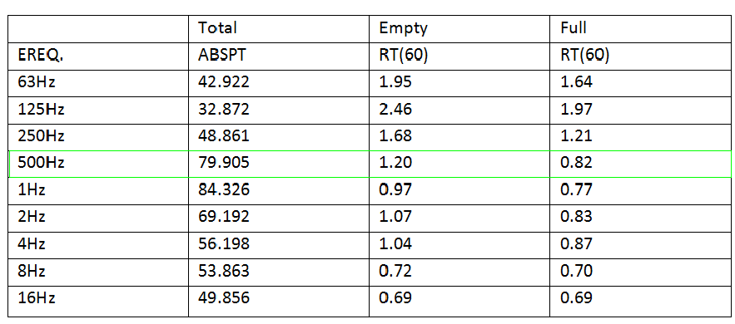
Reverberation Time
Case 2 (Multipurpose Hall):

Slide 31
Structural design

Slide 32
Structural design
1- Design codes
2- Loads
3-ETABS model and checks
4- Structural elements and detailing

Slide 33
Structural Design:
Design Codes:
ACI -318-08 (American Concrete Institution) for reinforced concrete structural design.
UBC-97 (Uniform Building Code) for earthquake load computations.
ASCE (American Society Of Civil Engineers) for design loads.

Slide 34
Loads:
Type of load | Load
Live load | 4KN/m2
SID load | 6.1KN/m2

Slide 35
Seismic Design Data:
Location: Nablus
Symbol | value
zone | 2B
Z | 0.20
Soil type | Sd
Cv | 0.40
Ca | 0.28
I | 1.00
R | 5.50

Slide 36
Material Strength Data
Strength type | value
f′c (for columns and footings) | 28 MPa.
f′c (for beams and slabs) | 24 MPa
fy | 420 MPa

Slide 37
Structural Element Dimensions
STRUCTARAL ELEMENT | DIMENIONS
Slab thickness | 0.3 m
Beam dimensions | 0.4 x 0.6 m
Column dimensions | 0.3 x 0.6 m
Footing(1) dimension | 1x1x0.35 m
Footing(2) dimension | 1.5x1.5x0.35 m

Slide 38
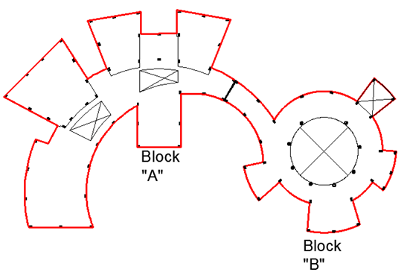
PLAN

Slide 39
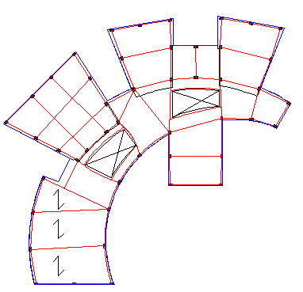
The system of the slab is one way ribbed slab.

Slide 40
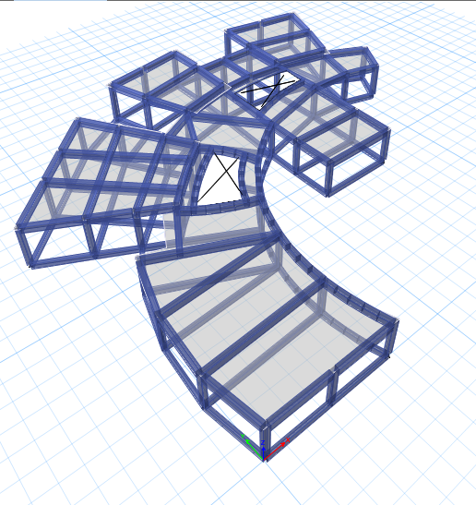
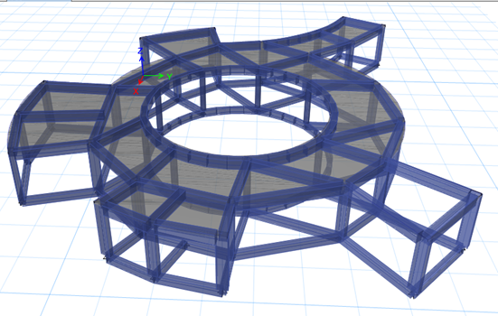
3D model

Slide 41
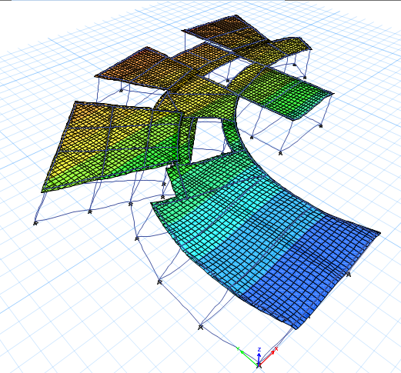
Checks for models :
Compatibility check :
Period = 0.299 < 2 second

Slide 42
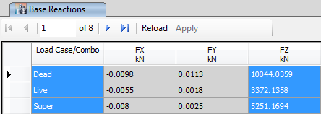
2. Equilibrium check:

Slide 43
3. Internal Forces Check:
Load | manual | ETABS | % of error
Axial load for column | 418.17 | 439.11 KN | 4.77%
Moment for beam | 1462 KN.m | 1486.84 KN.m | 1.67%
Moment for slab | 16.00 KN .m | 16.50 KN.m | 3.00%

Slide 44
4.Deflection check:
type | Max deflection | Deflection
slab | 21.75 mm | 8.15 mm
Beam | 44.58 mm | 27.58 mm

Slide 45
5.Shear force check
Block Name | Direction of shear force | Manual shear force (KN) | ETABs shear force (KN) | % of error
Block “A” | EQX | 2053.95 | 2170.50 | 5.3%
 | EQY | 2053.95 | 2230.78 | 7.92%

Slide 46
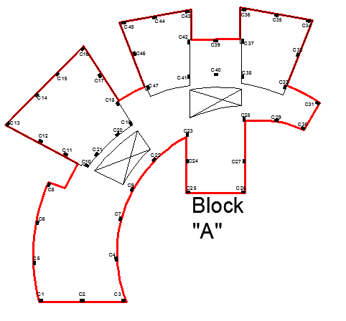
Plan of column

Slide 47
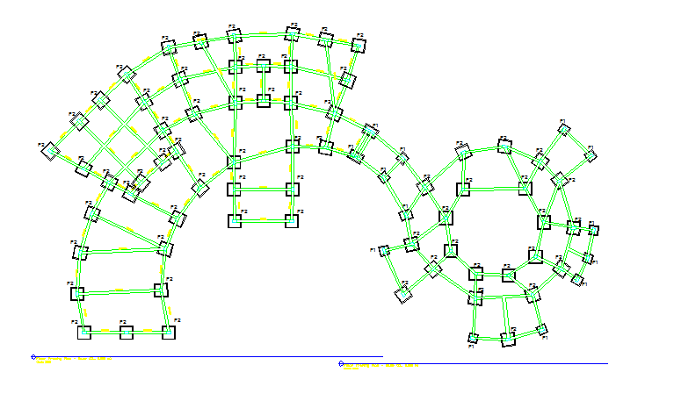
Plan of footing

Slide 48
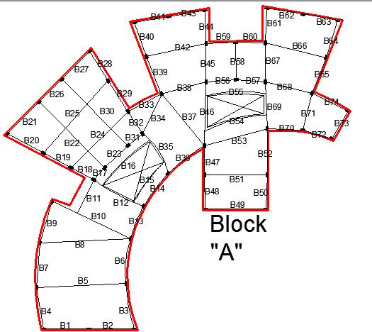
Plan of beam

Slide 49
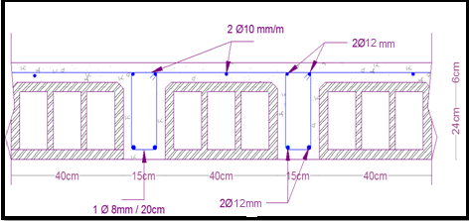
Design of slab

Slide 50
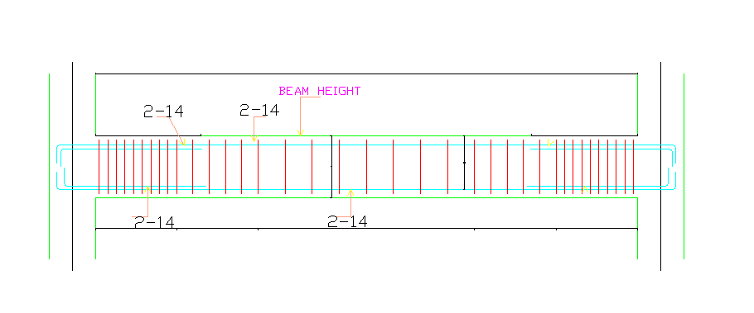
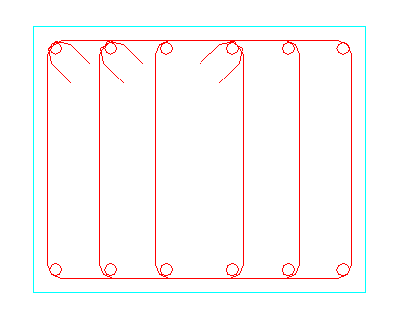
Beam design

Slide 51
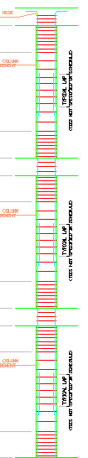
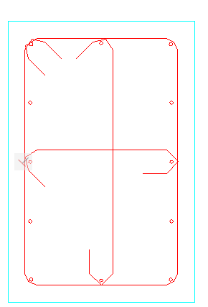
design of column

Slide 52
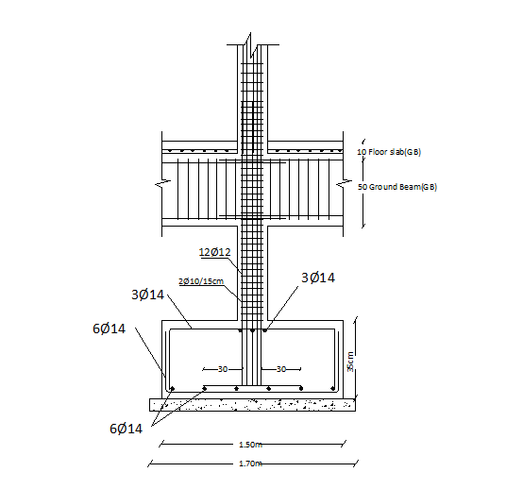
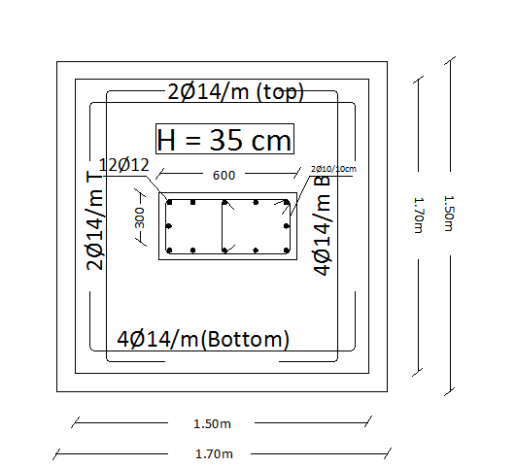
Footing design

Slide 53
Mechanical design:
1. Water supply
2. Water drainage
3. HVAC system

Slide 54
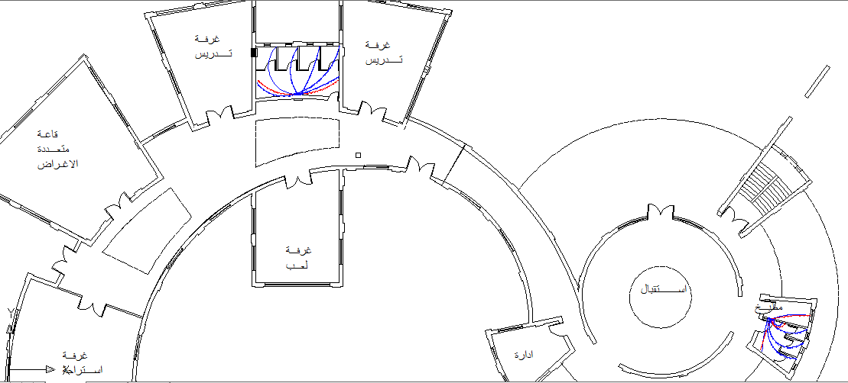
Water supply system:

Slide 55
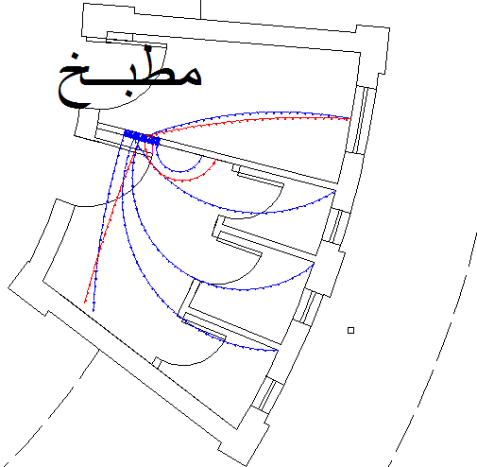
ZONE2

Slide 56
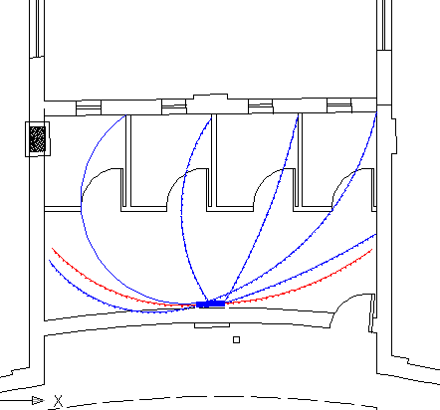
ZONE1

Slide 57
Total | Weight in F.U | Number of function | Type of supply control | occupancy | fixture
20 | 5 | 4 | Flush tank | public | W.C
4 | 2 | 2 | Faucet | public | Lavatory
24 |  |  |  |  | Total F.U
Table: Fixture units for the zone 1
Total | Weight in F.U | Number of function | Type of supply control | occupancy | fixture
15 | 5 | 3 | Flush tank | public | W.C
2 | 2 | 1 | Faucet | public | Lavatory
3 | 3 | 1 | faucet | clinic | Kitchen sink
20 |  |  |  |  | Total F.U
Table : Fixture units for the zone 2
Water demand (gpm) | Number of F.U | Type of supply control | zone
18 | 24 | Flush tank | Zone 1
15 | 20 | Flush tank | Zone2
Table :Water demand for each zones:

Slide 58
Water supply system:
Suitable diameter for vertical feeder (2'') , horizontal feeder(1.5'') and branches(3/4'')
Number of dfu’s :
The total number of fixture units = 33 dfu

Slide 59
Mechanical design:
Drainage design system:
The purpose of drainage lines design:
1-easy flow of sewage water.
2- no return of gases.

Slide 60
*Clean out : the point reaches any place in the pipe for solving any problem occurs to the black water network .
*Trap : The most important element in drainage system design .
Water closet doesn't need trap because it has one on itself.

Slide 61
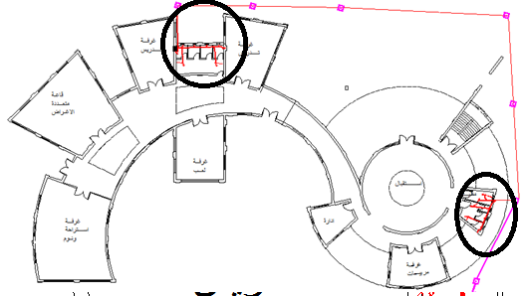
Mechanical design:

Slide 62
Mechanical design:
      *Black water: W.CS & Kitchen sink
      *Grey water: Lavatory.
Stack diameter = 4"
Diameters of the pipes = 2 " , 3 " and 4" (horizontal).
Stacks , manholes and vent with diameter = 4" .

Slide 63
Diameter size (inch) | Drainage fixture unit | Fixture unit
4 | 4 | Water closet
2 | 1 | lavatory
2 | 2 | Kitchen sink
2 | 2 | Service sink
2 | 0.5 | Drinking fountain
Table : diameter size for the drainage fixture unit in the building

Slide 64
Mechanical design:
Drainage system
roof shows manhole lines

Slide 65
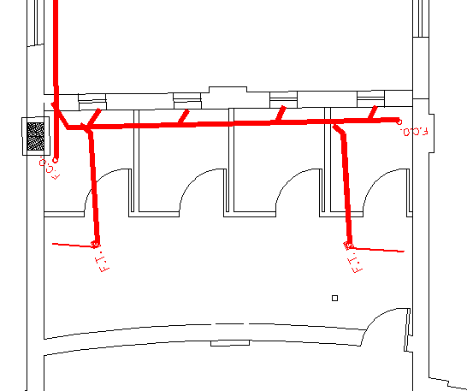

Slide 66
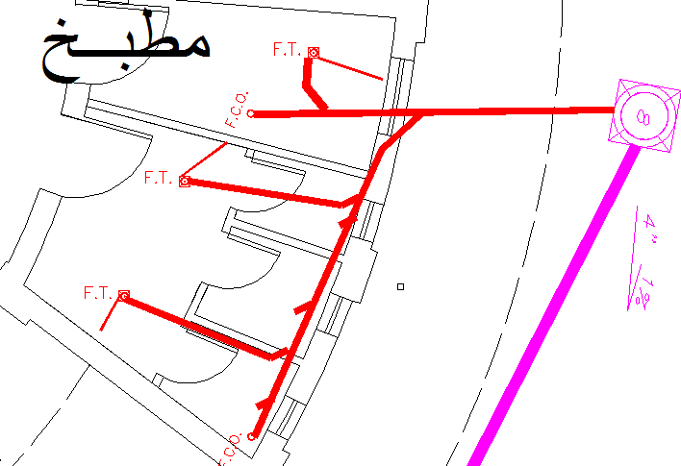

Slide 67
HVAC Design Data :
For external walls =0.51 W/m² . °C
For roof = 0.382 W/m² . °C
For doors=6.2 W/m² . °C
For windows=2.47 W/m² . °C
For internal wall = 0.61 W/m² . °C

Slide 68
Design of main duct , branches duct and diffuser:
light , equipment, occupant,envelope))Heat gain
∆T(supply-return)=10°C
Ƿ=1.2 kg/m³
V (velocity)=5 m/sec
Vo :volumetric flow rate(m³/sec)
Vo=20.85/(10*1.2)=1.74 m³/sec
Area =1.74/5 =0.3475=0.35 m²
Pa/EI =0.6 Pa /m for all ducts.

Slide 69
# of diffuser for administration =3
# of diffuser for bedroom =8
# of diffuser for multi. room =8
# of diffuser for classroom=4
# of diffuser for teacher room =4

Slide 70
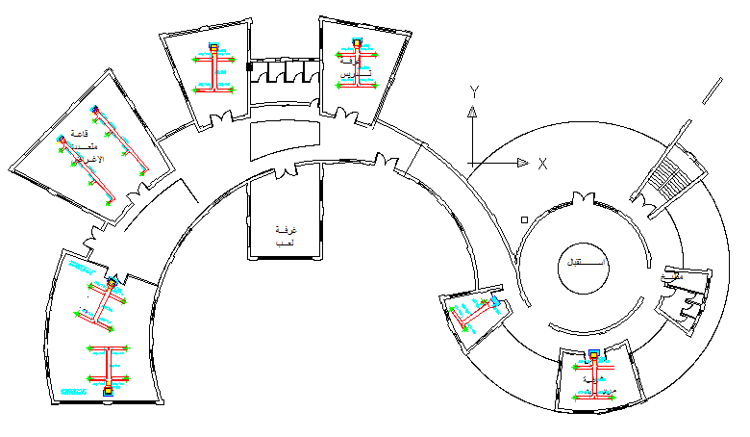
Diffusers distribution:

Slide 71
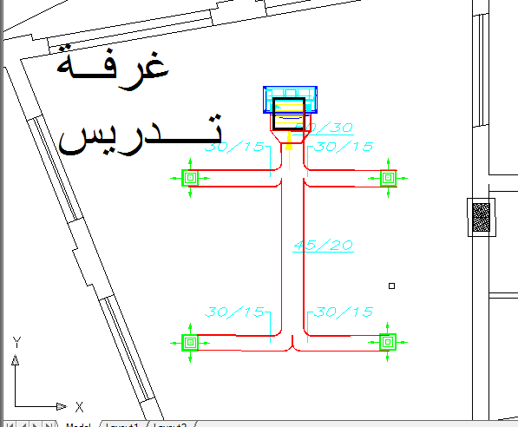

Slide 72
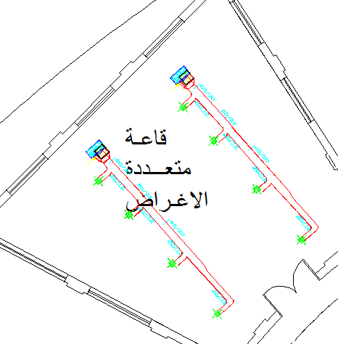

Slide 73
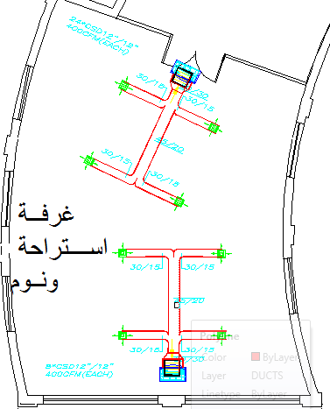

Slide 74
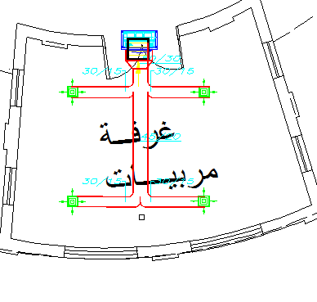

Slide 75


Slide 76
Heating load calculation
Boiler design:
Assume daily hot water = 100 l/s
Cp for water =4.18
T.HW-T.cw=50 C
From table 7-1 un text book boiler tank volume = 100litre
(iron boiler with choosen from table7-8 in text book)

Slide 77
Pump design
Sell height =100 cm and radiator up 12 cm over ground .
H =100-12=88 cm
From fig. 7-20 MA3 radiator type chosen with H=681mm, L=65 mm, section watt=113
For admin. Room:
Q total = 1566.3 w
# of section=1566.31/113= 14 section
#of radiator =2

Slide 78
For bed room:
Q total=2275.19
# of section=21section
#of radiator =4
For multi room :
Q total = 2306.2 w
# of section=2306.2/113= 21 section
#of radiator =4
For classroom :
Q total = 2010.67 w
# of section=2010/113= 18 section
#of radiator =3

Slide 79
Two water pipe was using then:
EL=24*2*1.5=72 m.
M.pump=11.88/4.186*10=0.283 kg/s
SMC choosen (125SE)from fig 7-18 in textbook
P.drop=34*1000/72=472.2m³.h
From table7-6 in textbook the pipe sizing was be:
Two water pip :H=680 mm, depth =70 mm ,output=94w.

Slide 80
Boiler chimney design:
Given the data as following:
Ƞ=80%
CV=39000
Velocity of water= 5m/s
M.f=Qboiler/ Ƞ* CV =11.88/.8*3900=3.7*10⁻³
Mg=M.f*25.20=0.095 kg/sec
Ac=Mg/1.1*v=0.017 m²
D=14.85 cm.

Slide 81
Quantity surveying and cost estimation
Total cost of the project = 601646.85Nis
=158328.11$
=111416 JD

Slide 82


