Slide 1

Online Media streaming and transferring
Prepared By :
Sondos Ishtawi
Asma Salman
Supervised By :
Raed Al-Qadi

Slide 2
Outline
Overview
Video Format Conversion
Connection with An authentication
Streaming media
Transferring media

Slide 3
Overview
Online media streaming and transferring is a project that supports both transferring and streaming media from pc to the mobile.
streaming part allows the user to watch any media whatever its size is without needing to store it in the mobile’s memory.
Transferring part allows the user to download any media from the PC directly to its mobile memory.

Slide 4
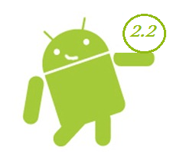
Overview
Android system ( Version 2.2) is our choice to do the implementation of the project ( Client Side).

Slide 5

Why Android !!
Low Barrier to Entry.
An Ideal Platform for Companies New To Mobile
A Variety of Distribution Mechanisms
Open and Free Platform
Best Mobile Platform for Inter-Application Integration.

Slide 6
Outline
Overview
Video Format Conversion
Authentication
Streaming media
Transferring media

Slide 7
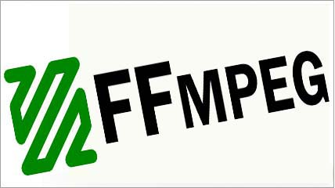
Video Format Conversion
Android System doesn't cover wide range of video formats available , here is our first problem.
We managed this problem by writing a program that converts the format of the video from a format that isn’t supported by android to supported formats.
We use FFMPEG to achieve that using ASP.net to access commands for conversion.
Notes:
Before we start playing a specific video we should keep track of the type of that’s vide, and since

Slide 8

HOW…
Step – 1
Just download FFMPEG module , and put in your application path.
Step -2
Assign the I/O vides path, directories and FFMPEG command.
Step - 3
Now create a function which can execute those command line

Slide 9
Video Format Conversion
Choose the Video File
Check the Video Format
Supported
By android
Stored in a Specific Directory
Not Supported
By android
Use command of FFMPEG Library
Run Command on the chosen Video
Done

Slide 10
Outline
Overview
Video Format Conversion
Connection with Authentication
Streaming media
Transferring media

Slide 11
Connection with Authentication
Our project provides a security access from the mobile to the PC, only users having a username and a password can access a specific directory where the media are stored.
We do the connection over wirless network.
We do this by using Android System on the mobile, PHP server on the PC and the connection is done over HTTP Server (WampServer).
Notes:
After we check that’s the video can be played by android , now we come to next steps . Connecting to android

Slide 12
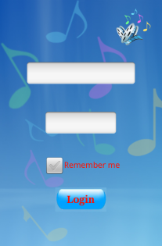

Connection with Authentication
User should insert his name and password .
User should insert his name and password .
Enter if has a permission .

Slide 13
Outline
Overview
Video Format Conversion
Authentication
Streaming media
Transferring media

Slide 14

Media Streaming
Streaming media is multimedia that is constantly received by and presented to an end-user while being delivered by a streaming provider.
Bandwidth of network and length of the media are the main factor that’s affect the speed and the quality of streaming.
Many network protocols are supporting media streaming , one of these protocol is RTSP Protocol.
Notes:
*************

Slide 15

Media Streaming- RTSP.
RTSP Protocol(Real Time Streaming Protocol):
is a network control protocol designed for use in communications systems to control media streaming.
This protocol is establishing and controlling media sessions between end points ( client and server ).

Slide 16
Media Streaming- RTSP.
Streaming media using RTSP protocol solve the problem of limited mobile memory, user can stream any media stored in the server side whatever was its size without caring about the size of the memory mobile.

Slide 17
Media Streaming- RTSP.
MediaPlayer with MediaController :
we use the MediaPlayer class for playing the video.
MediaPlayer objects operate as a state machine. This means that operations need to be performed in a specific order and various methods should be called only when the object is in the correct state to handle them.

Slide 18
Media Streaming- RTSP.
MediaController of MediaPlayer has : rewind, pause, play, and fast-forward buttons along with a scrubber and progress bar combination that can be used to seek to any point in the video.

Slide 19
Media Streaming- TCP.
TCP Socket Protocol :
in this part we implement our streaming Protocol using TCP Sockets.
We write the server side using c# language, and the client side using java android.
Here we divide video file into frames (each of size 1024 bytes ) and send these frames through the TCP socket, we control and manage the ordering of these frames through the streaming operation.

Slide 20
Media Streaming- TCP.
Client Process :
the application provide to the user listview of available videos that’s he can stream.
When user choose the video, client send the name of the video to the server side through TCP Socket ( OutputStream).

Slide 21
Media Streaming- TCP.
Server Process :
Server Receive name of video through TCP socket( read Input Stream) then read the desired video from the specific Directory and stored it in array of bytes.
Server Divide video into frame, each frame with size 1024 bytes.
Notes:
Choose 1024 bytes ??

Slide 22
Media Streaming- TCP.
Problem with TCP Protocol:
1) Limited Bandwidth.
2) In ordering of data Receive to the client side.

Slide 23
media Streaming
Client
Connect to the IP address
and Port number
Server
Send Chosen Video name
Read video into array of bytes
For loop of
Number of Packet
Number of Packet = video size / 1024
Send frames of video
Read Frames and view it in MediaPlayer

Slide 24

media Streaming
TCP Vs RTSP protocol:
1) Performance:
RTSP is Better Than TCP.
2) Memory Saving:
RTSP is Better Than TCP.
3) Quality:
RTSP is Better Than TCP.

Slide 25
media Streaming
Future Work to do:
Since Android system it’s a new system, we found a problem in how to decode the receiving packets(array of bytes) into video format in order to be able to view it in a media player.

Slide 26
media Transferring
This part of project allow the user to transfer any video or any audio store in the server side and save it in his mobile memory.
We use the same protocol we implemented in streaming media through TCP socket.
When all packets receive we write it in its transfer format into a specific location in the SDcard.

Slide 27
media Transferring
Client
Connect to the IP address
and Port number
Server
Send Chosen Video name
Read video into array of bytes
For loop of
Number of Packet
Number of Packets
Read Frames and view it in MediaPlayer
Send frames of video
Write on the
SDcard

Slide 28
Features
User friendly interface.
good performance, since most of media processing are doing in the server side.
Users can watch any video whatever its size is through there mobile.
Users can transfer media from pc to there mobile easily.

