Slide 1


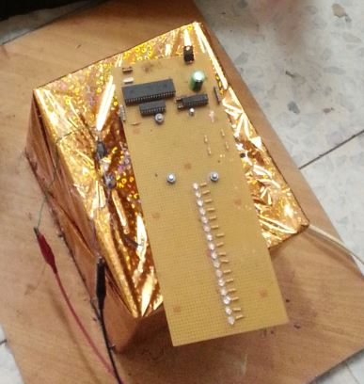
POV System
Done by:
Iman Abu-Mazen
Beesan Imad Zraiqi
Supervised by :
Dr. AlaDin Al-Masri

Slide 2

Outline:
Introduction
Design & implementation
Software
Problems & Challenges
Future Work
Demo

Slide 3
Outline:
Introduction
Design & implementation
Software
Problems & Challenges
Future Work
Demo

Slide 4
Introduction
Main idea
OPTICAL ILLUSIONS

Slide 5
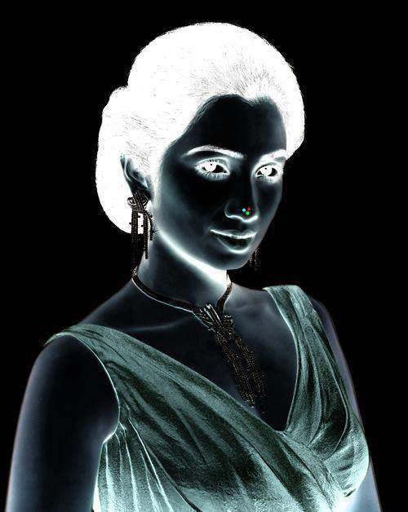

Slide 7
Introduction
Circle & Half Circle

Slide 8
Outline:
Introduction
Design & implementation
Software
Problems & Challenges
Future Work
Demo

Slide 9
Design & Implementation
Propeller circuit
IR Circuit
DC Motor

Slide 10
Propeller Circuit
Power Source
Microcontroller
Mathematical calculations
Output LEDs

Slide 11
Power Source
9v Battery
Voltage Regulation
5v Feeds propeller circuit

Slide 12
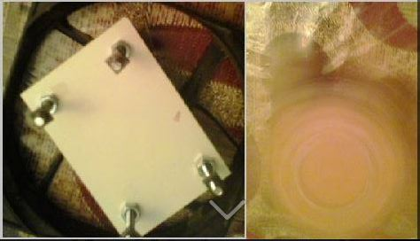
Power Source
Battery Holder

Slide 13
Microcontroller
PIC18F4620
MPLAB_X_IDE_v2.10 software
mplabc18 v3.47 compiler

Slide 14
Mathematical Calculations
Speed of rotation
(2000 rpm)
Osc frequency
(4 MHz)
Mathematical equations
LEDs ON-OFF
timing

Slide 15
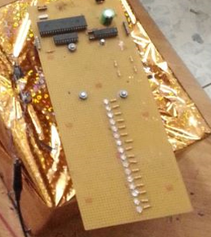
Output LEDs
16 Green LEDs connected to two Latches

Slide 16
IR-Circuit
Define 'Home' point
Cause Interrupt
Change LEDs

Slide 17
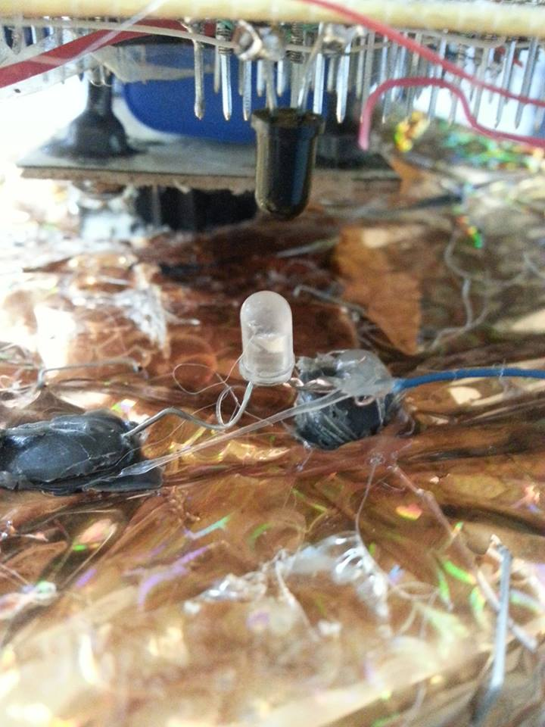
IR-Circuit

Slide 18
DC Motor
12 V
2 A
2000 rpm

Slide 19
Outline:
Introduction
Design & implementation
Software
Problems & Challenges
Future Work
Demo

Slide 20
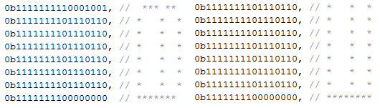
Software
Setting LEDs:
Letters (Example)

Slide 21
IR Cause Interrupt
High priority interrupt invoked
Low priority interrupt invoked
Set_LEDs from array of binaries

Slide 22
Outline:
Introduction
Design & implementation
Software
Problems & Challenges
Future Work
Demo

Slide 23
Problems & Challenges
Safety
Power Supply

Slide 24
Outline:
Introduction
Design & implementation
Software
Problems & Challenges
Future Work
Demo

Slide 25
Future Work
RGB LEDs
Using transformer for power supply

Slide 26
Outline:
Introduction
Design & implementation
Software
Problems & Challenges
Future Work
Demo

Slide 27
Questions ??

