Slide 1

Assessment and Redesigning of HVAC system for Al-Rawda Complex
Graduation Project 2
Done by :
Abdullah Alshelleh
Mohammed Fauor
Dunia Lahham
Supervisor: Dr. Abdelrahim Abusafa

Slide 2



TEAM MEMBERS
Mohamed Faour
Energy Engineer
Dunia Lahham
Energy Engineer
Abdullah Alshelleh
Energy Engineer

Slide 3
TABLE OF CONTENTS
1
2
3
4
Main idea
Proplem statement
Methodology
Case study
5
6
Thermal load
Detailed design
7
8
Results & conclusion
Feasibility study

Slide 4

Main idea of the project
The project involved suggesting the replacement of the existing heating and air conditioning system found in the medical complex and Al-Rawda Mosque. The proposal was to upgrade from the current split unit system to a more advanced and energy-efficient option like the VRF system. In the current project, a suitable VRF system was specifically designed for the location, and its effectiveness and economic feasibility were verified.

Slide 5

Problem statement
The most common and used HVAC system in Palestine is the split unit systems, and this system is currently used in the mosque and the medical complex .
Some of the disadvantages of this system used in the complex:
Wrong installation .
Costly .

Slide 6






METHODOLOGY
General Analysis by visits .
View existing system , bills and data.
Take dimensional measurements.
Calculate the heating and cooling load.
Suggestion for a new system.
Economic feasibility calculation.

Slide 7
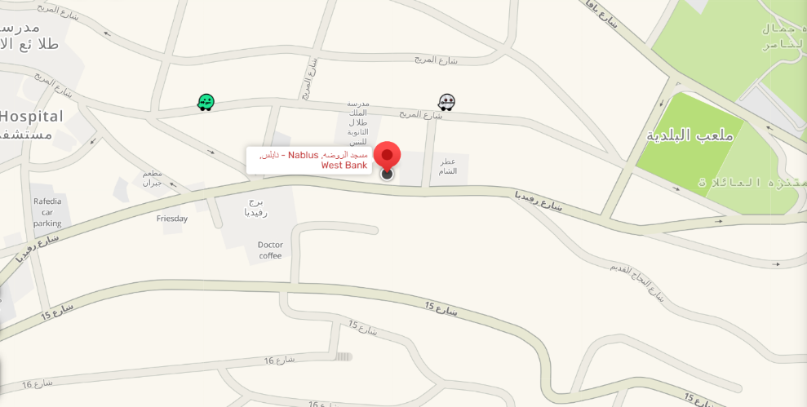
Case study
COMPLEX
Al-Rawda Mosque
Taddamun dispensary

Slide 8
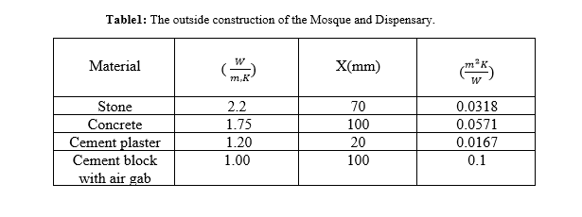
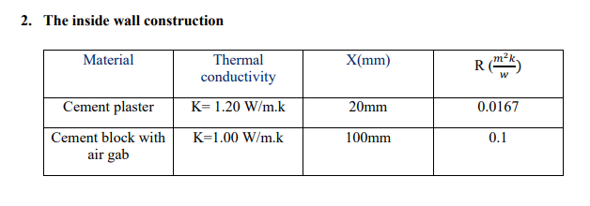
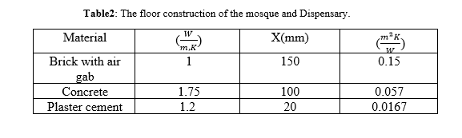
Construction of the complex

Slide 9
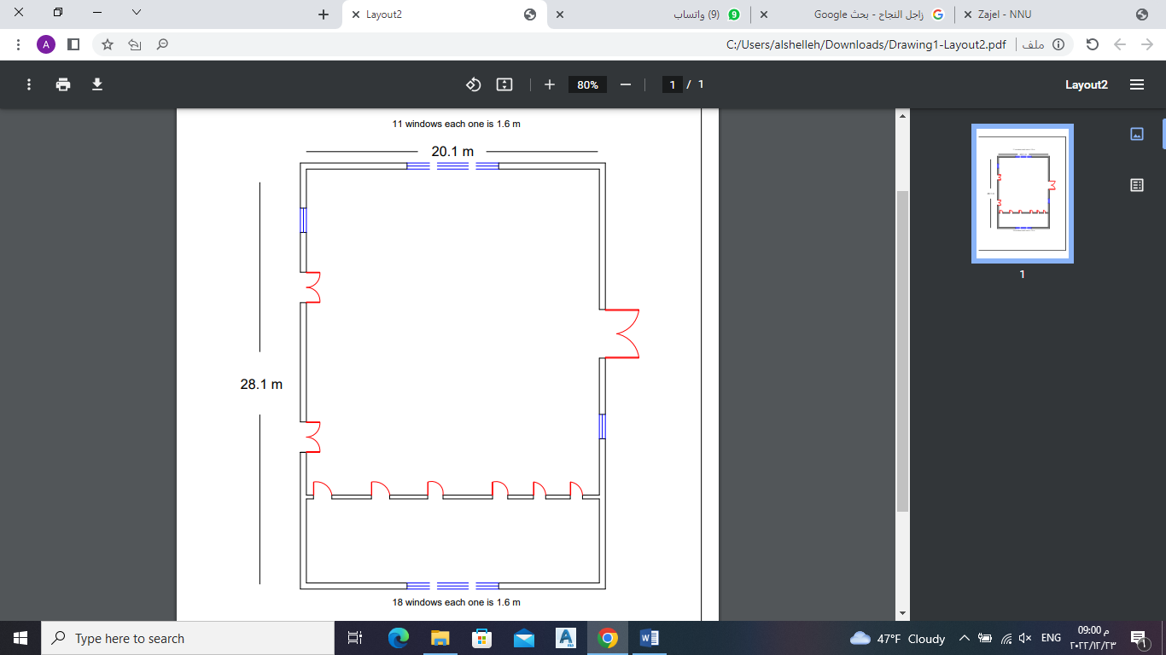
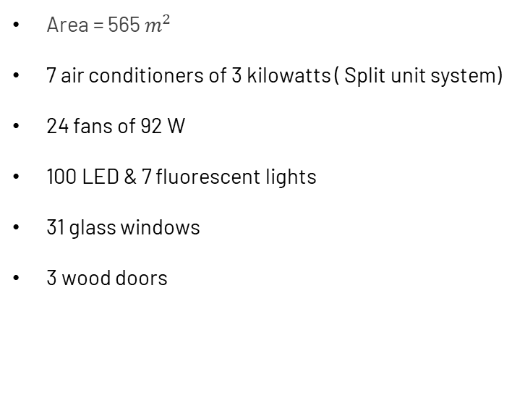
Al-rawda mosque
Area = 565 $m^{2}$
7 air conditioners of 3 kilowatts ( Split unit system)
24 fans of 92 W
100 LED & 7 fluorescent lights
31 glass windows
3 wood doors

Slide 10
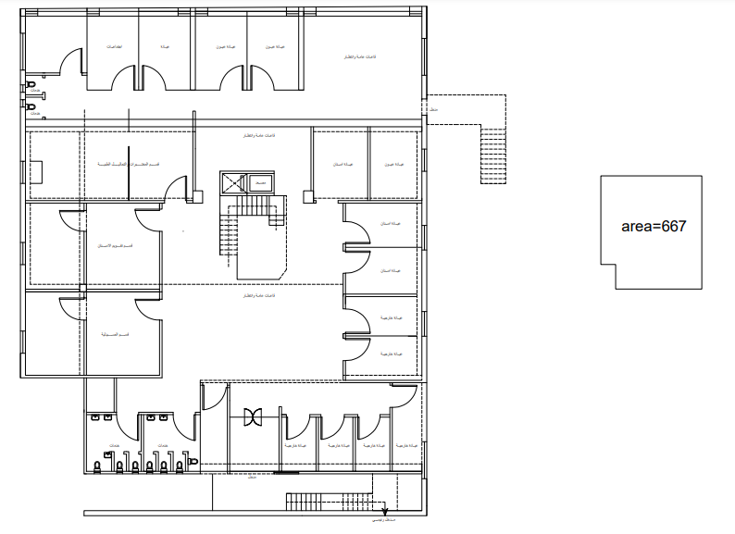
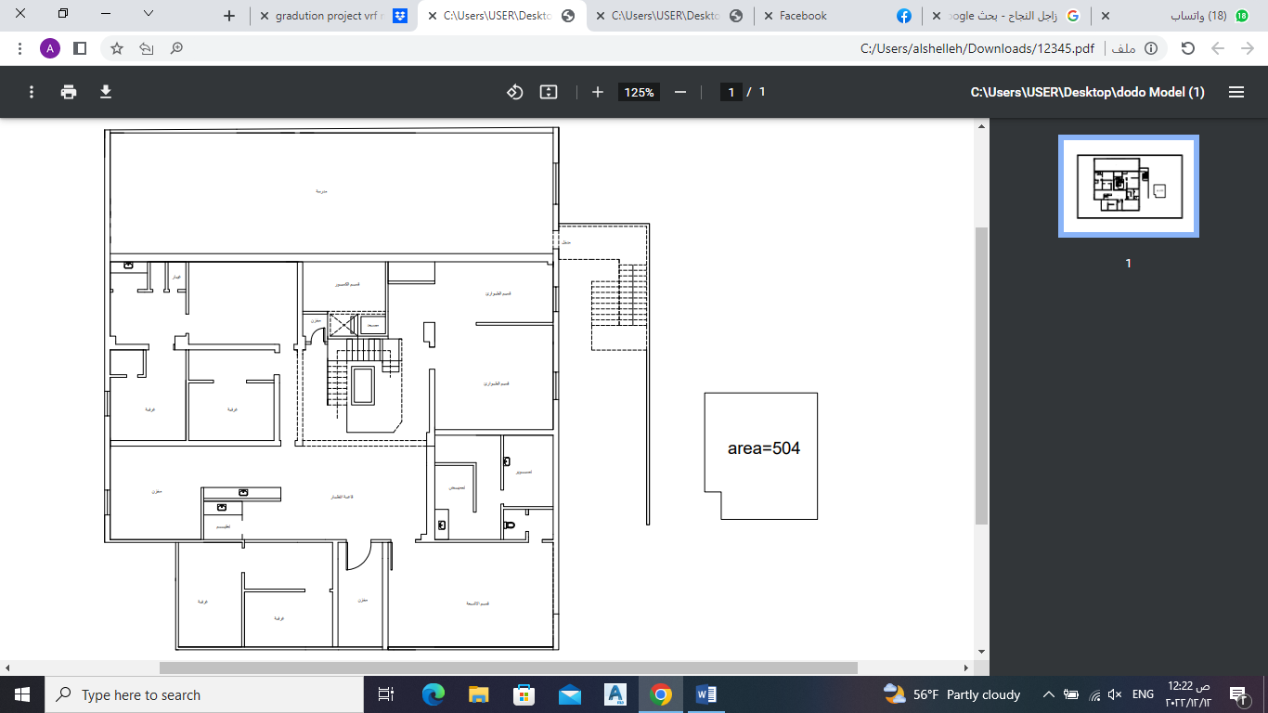
Taddamun dispensary
The dispensary consists of two floors:
Ground floor
Basement floor

Slide 11

COST
Al-Rawda Mosque
The estimated monthly electricity consumption from HVAC sys ranges from 700 to 1200 shekels.
Taddamun dispensary
The average account per month of the dispensary with the Electricity Company is about 7,298 shekels, including lighting, heating and air conditioning, in addition to the devices that are used in clinics.

Slide 12
THERMAL LOAD CALCULATION
Heat load refers to the amount of heating or cooling necessary to maintain the required temperature in a building or space within that building. This can be determined in relation either to the required heating or the required cooling.
Thermal load
Heating load (Heat loss)
Cooling load (Heat gain)

Slide 13
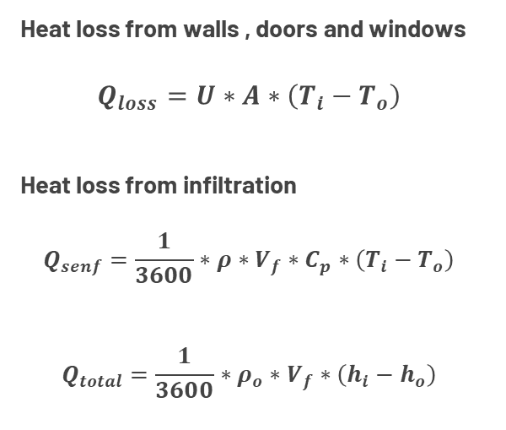
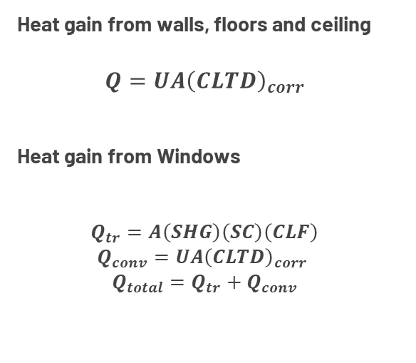
Heating load theory
Cooling load theory
Heat loss from walls , doors and windows
$$Q_{loss}=U∗A∗\left(T_{i}−T_{o}\right)$$
Heat loss from infiltration
$$Q_{senf}=\frac{1}{3600}∗ρ∗V_{f}∗C_{p}∗\left(T_{i}−T_{o}\right)$$
$$Q_{total}=\frac{1}{3600}∗ρ_{o}∗V_{f}∗\left(h_{i}−h_{o}\right)$$
Heat gain from walls, floors and ceiling
$$Q=UA{\left(CLTD\right)}_{corr}$$
Heat gain from Windows
$$Q_{tr}=A\left(SHG\right)\left(SC\right)\left(CLF\right)$$
$$Q_{conv}=UA{\left(CLTD\right)}_{corr}$$
$$Q_{total}=Q_{tr}+Q_{conv}$$

Slide 14
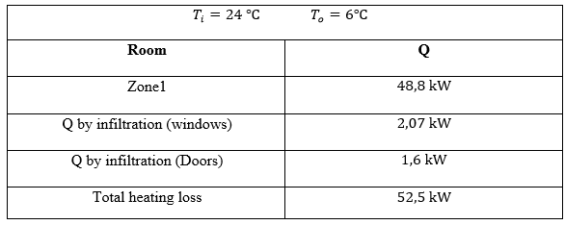
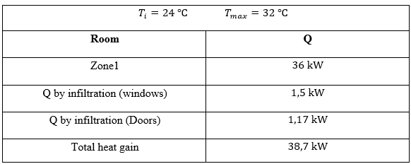
load summary
For the Mosque
Heating load
Cooling load

Slide 15
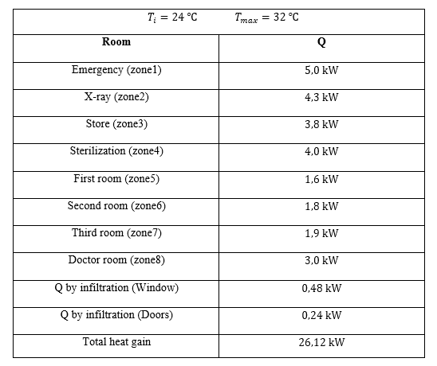
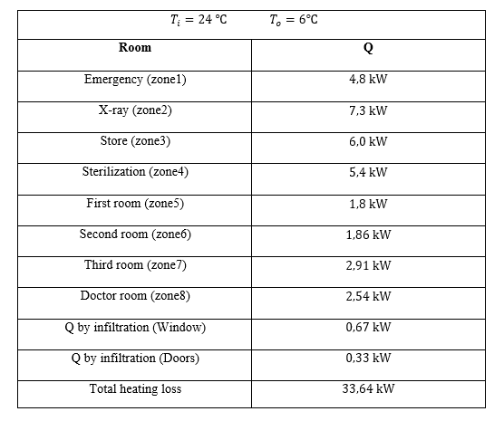
For the ground floor of Dispensary
Cooling load
Heating load

Slide 16
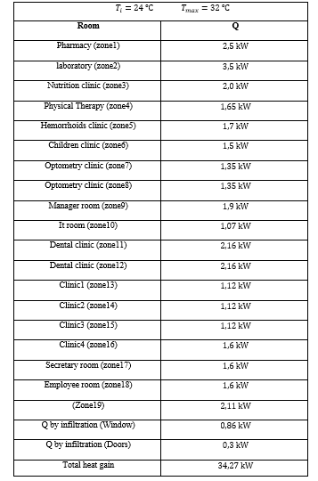

Heating load
Cooling load

Slide 17
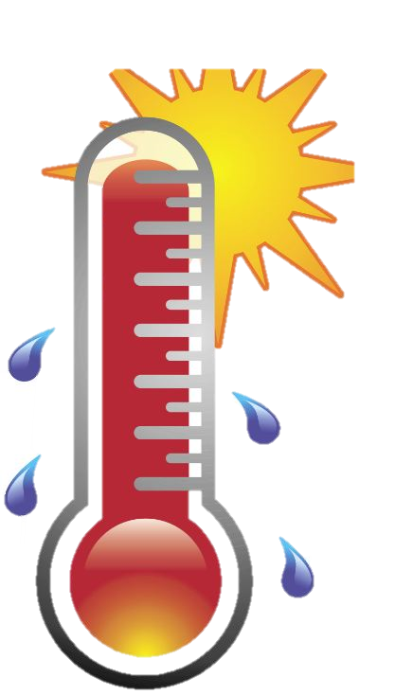
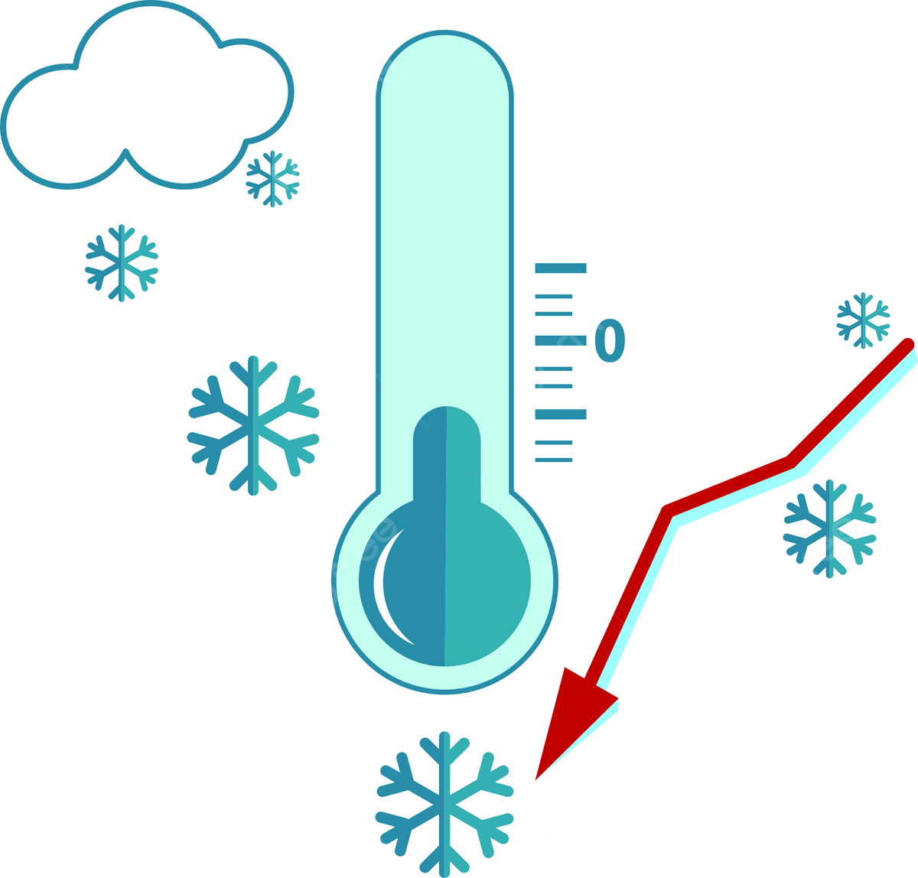
Total | Dispensary (First floor) | Dispensary (Ground floor) | Mosque | Load
127 kW | 40.8 kW | 33.64 kW | 52.5 kW | Heating load
99.1 kW | 34.27 kW | 26.12 kW | 38.7 kW | Cooling load

Slide 18
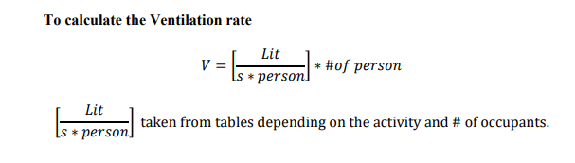
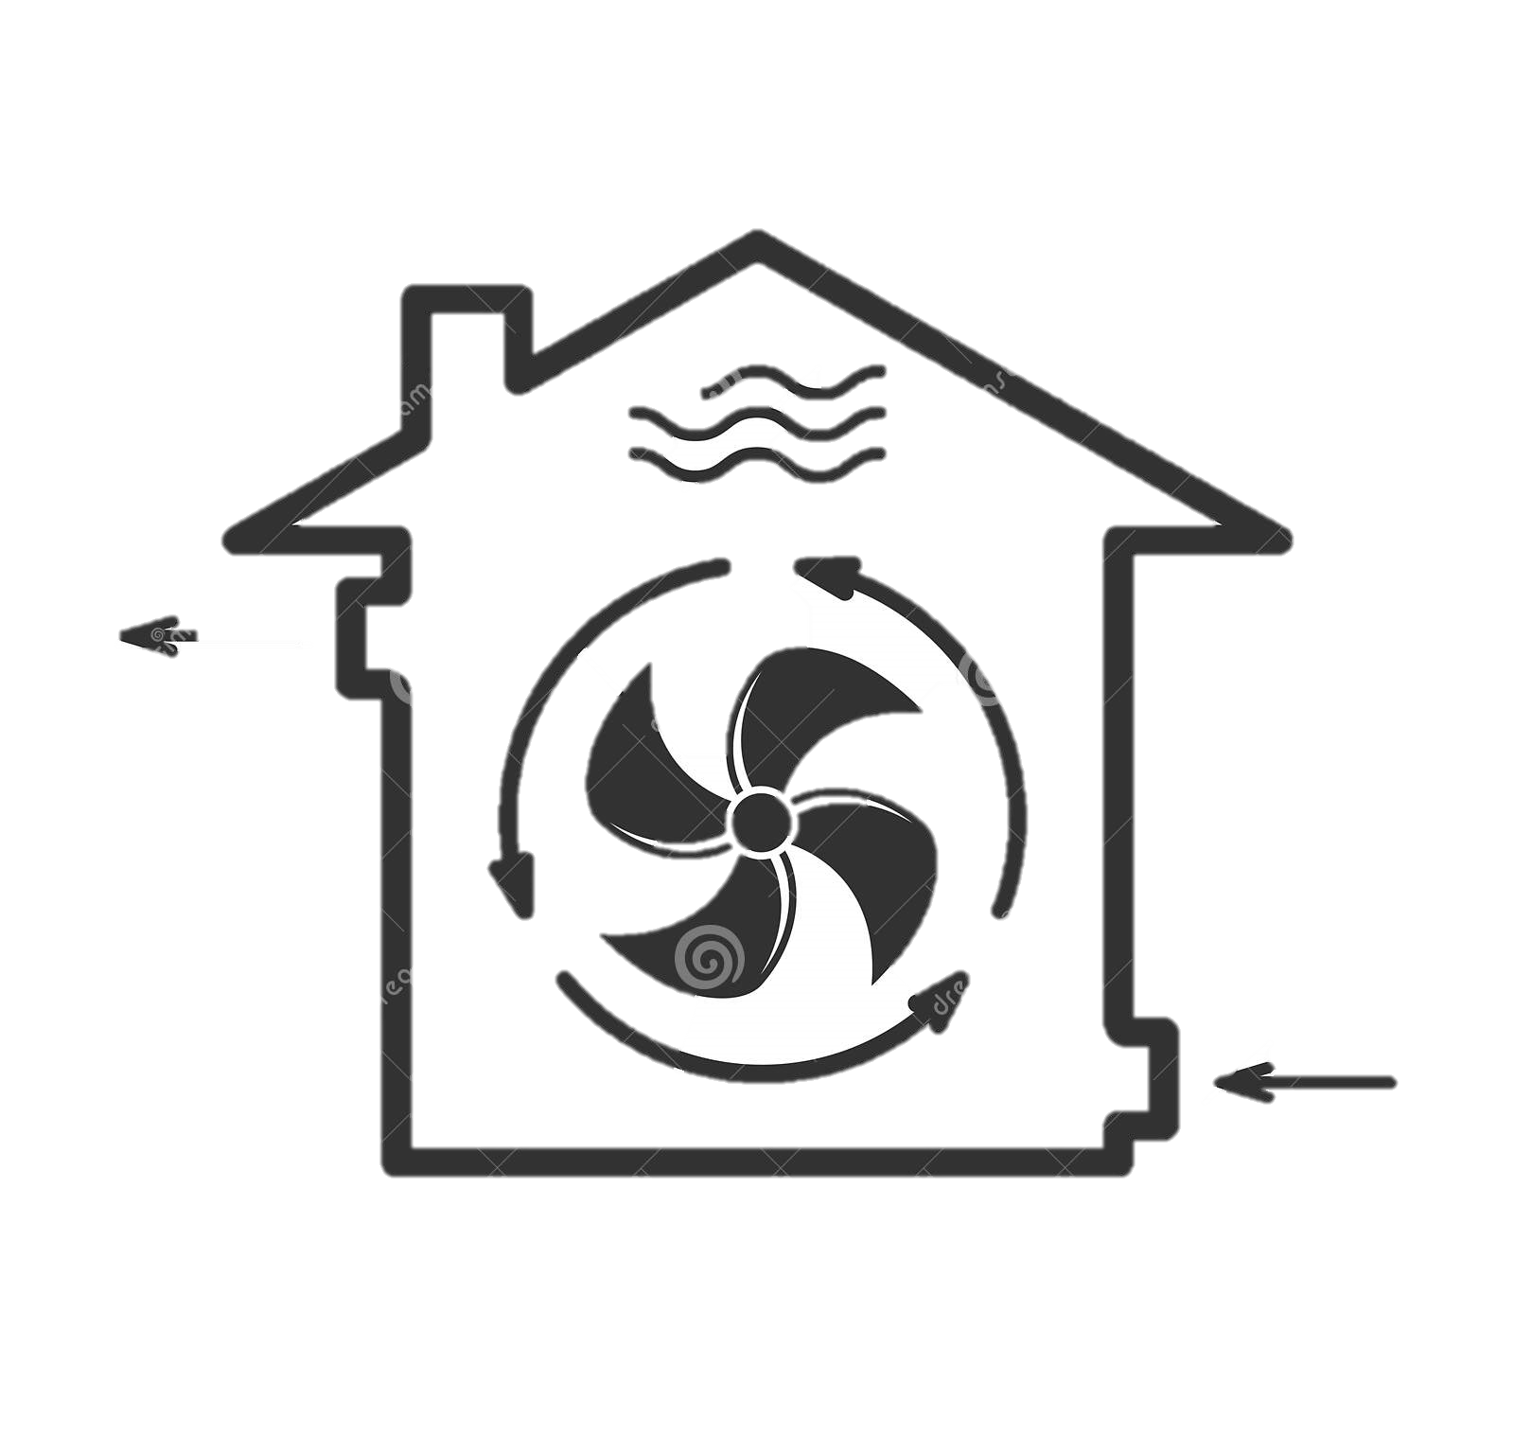
Ventilation rate
The aim of ventilation is to remove the product of respiration and space contaminants such as smells, water vapor, gases, fumes and vapors of industrial processes.

Slide 19
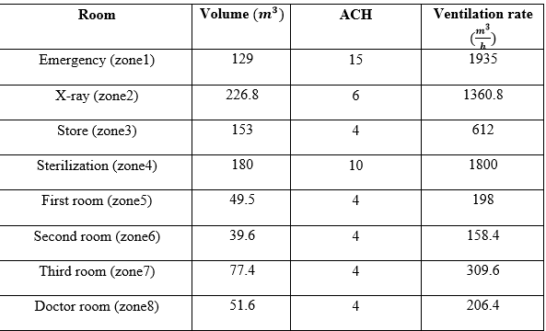
The following table is for Ventilation rate for the basement floor (dispensary) :

Slide 20
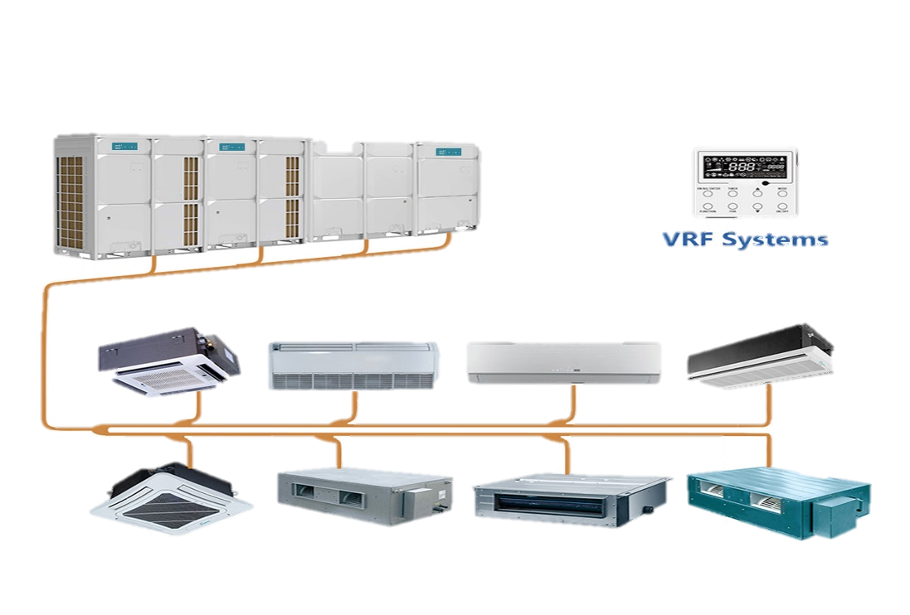
Detailed design
Variable refrigerant flow (VRF) system
The variable refrigerant flow is used for cooling and heating in multi-floor buildings and multi-use rooms that have different heat loads, as some rooms need heating and others are cooled
In addition to providing superior comfort, VRF systems offer design flexibility, energy savings, and cost effective installation.

Slide 21
Control means comfort
Design Flexibility
VRF Advantages
Cost effective installation
Energy saving

Slide 22
Heat recovery Air handling units
A heat recovery air handling unit is a mechanical ventilation system that uses a heat exchanger to recover heat from the outgoing air stream and transfer it to the incoming air stream. These units are typically used in larger commercial or industrial buildings to provide a constant supply of fresh air while also maintaining a comfortable indoor temperature.
Benefits of Heat Recovery AHU
Improved energy efficiency
Reduced carbon footprint
Improved indoor air quality

Slide 23

Scenarios for the design
More than one scenario was proposed in the design process. There were scenarios that depended on outdoor units that were brought from the official Samsung website. For the last scenario, the necessary units were brought from the Palestinian market.

Slide 24
First Scenario
Two outdoor units (Samsung AM220FXVAGH/EU)
Total cooling capacity = 61.6 kW X 2 = 123.2 kW
Total heating capacity = 69.3 kW X 2 = 138.6 kW
Dispensary
Mosque
Winter
1284 NIS/month
Summer
1340 NIS/month
Winter
608 NIS/month
Summer
573 NIS/month

Slide 25
Second Scenario
Four outdoor units (Samsung MV6-R335WV2GNI)
Total cooling capacity = 33.5 kW X 4 = 134 kW
Total heating capacity = 33.5 KW X 4 = 134 kW
Dispensary
Mosque
Winter
1045 NIS/month
Summer
1227 NIS/month
Winter
492 NIS/month
Summer
524 NIS/month

Slide 26
Third Scenario (from the Palestinian market)
Three outdoor units (Samsung AM140HXVFGH/ID)
Total Cooling capacity = 40 KW X 3 = 120 kW
Total Heating capacity = 45 kW X 3 = 135 kW
Dispensary
Mosque
Winter
1522 NIS/month
Summer
1252 NIS/month
Winter
716 NIS/month
Summer
535 NIS/month

Slide 27
Feasibility study
The main objective of a feasibility study is to determine if the proposed project or business idea is viable and if it aligns with the organization's goals and objectives. The study helps decision-makers understand the potential risks and benefits of the proposed project and make an informed decision on whether to proceed with it or not.

Slide 28
ECONOMIC Parametrs
Simple payback period
1
2
Present value
Saving to investment ratio
4
3
Rate of return

Slide 29
Investment cost
The investment is divided into several sections , including:
Outdoor units
Piping and labor
Indoor units
Remote control

Slide 30
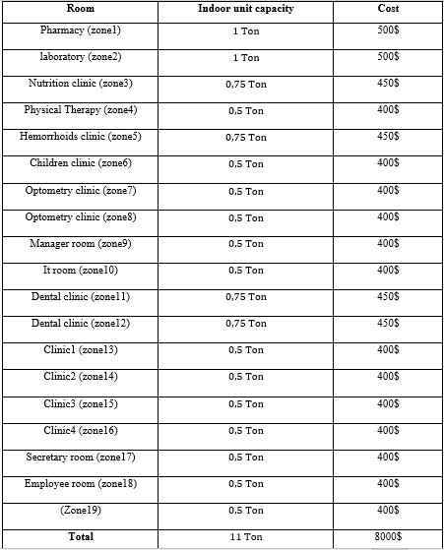
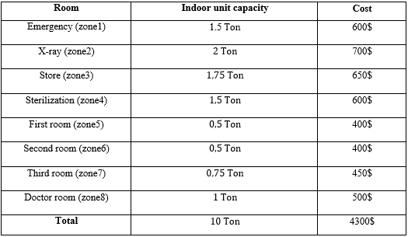
The following tables represent the indoor capacity and cost of each zone
Ground floor
First floor

Slide 31
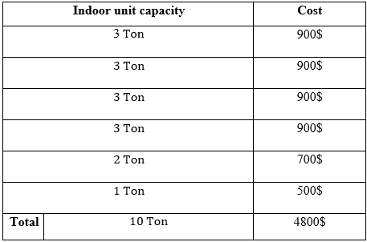
The following tables represent the indoor capacity and cost for the mosque
Mosque
Total investment for the indoor units = 8000$+4300$+4800$ = 17100 $

Slide 32
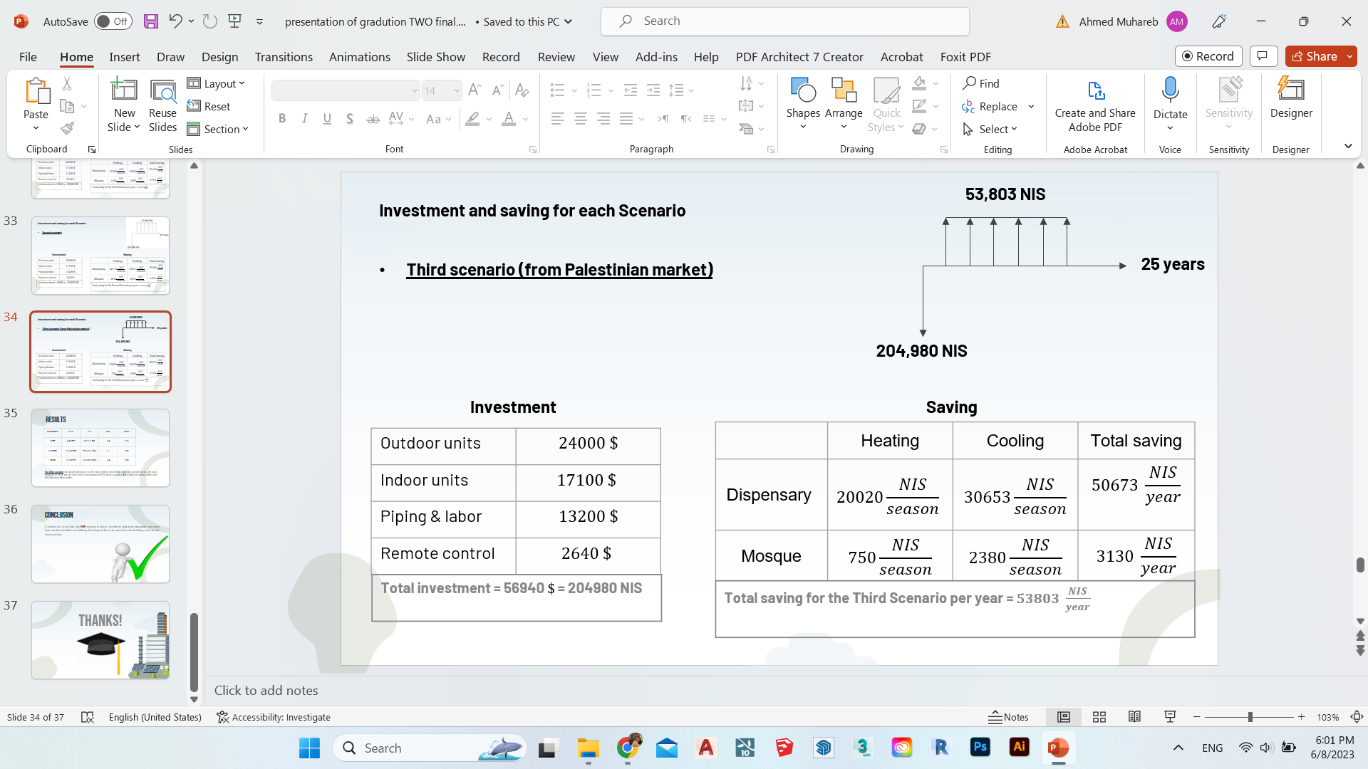

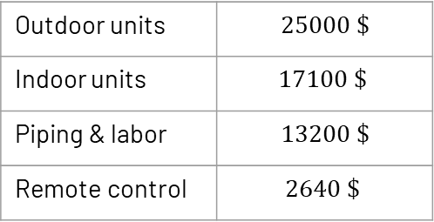

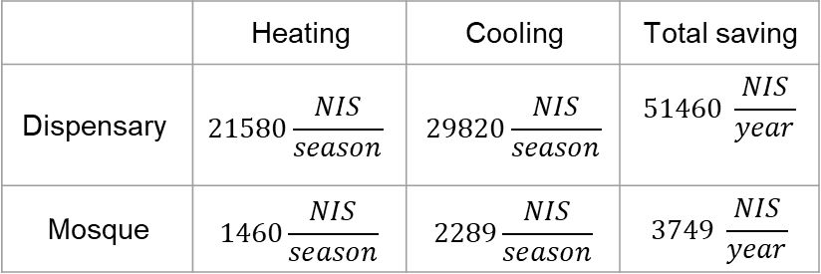
Investment and saving for each Scenario
55,209 NIS
First scenario
208,580 NIS
Investment
Saving
$$25000 \$$$ | Outdoor units
$$17100 \$$$ | Indoor units
$$13200 \$$$ | Piping & labor
$$2640 \$$$ | Remote control
Total saving | Cooling | Heating
$$51460 \frac{NIS}{year}$$ | $$29820\frac{NIS}{season}$$ | $$21580\frac{NIS}{season}$$ | Dispensary
$$3749 \frac{NIS}{year}$$ | $$2289\frac{NIS}{season}$$ | $$1460\frac{NIS}{season}$$ | Mosque
Total investment = 57940 $\$$ = 208580 NIS
Total saving for the First Scenario per year = $55209 \frac{NIS}{year}$

Slide 33

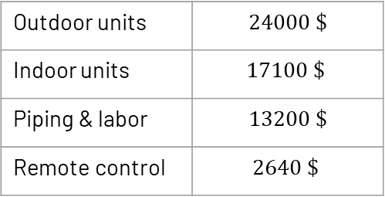

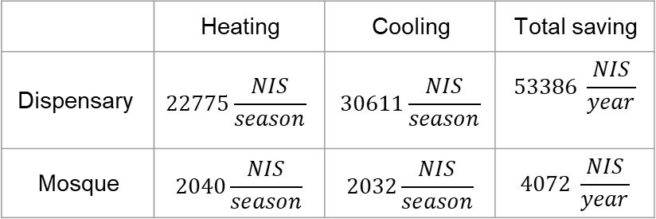
Investment and saving for each Scenario
57,458 NIS
Second scenario
Investment
Saving
$$24000 \$$$ | Outdoor units
$$17100 \$$$ | Indoor units
$$13200 \$$$ | Piping & labor
$$2640 \$$$ | Remote control
Total saving | Cooling | Heating
$$53386 \frac{NIS}{year}$$ | $$30611\frac{NIS}{season}$$ | $$22775\frac{NIS}{season}$$ | Dispensary
$$4072 \frac{NIS}{year}$$ | $$2032\frac{NIS}{season}$$ | $$2040\frac{NIS}{season}$$ | Mosque
Total investment = 56940 $\$$ = 204980 NIS
Total saving for the Second Scenario per year = $57458 \frac{NIS}{year}$

Slide 34

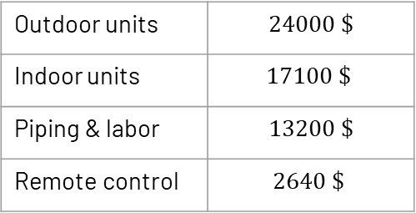

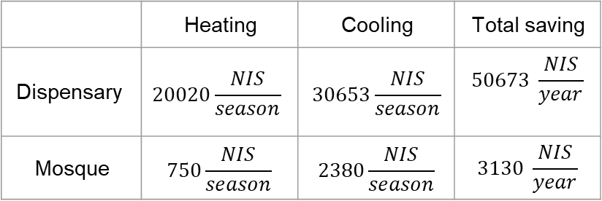
Investment and saving for each Scenario
Third scenario (from Palestinian market)
Investment
Saving
$$24000 \$$$ | Outdoor units
$$17100 \$$$ | Indoor units
$$13200 \$$$ | Piping & labor
$$2640 \$$$ | Remote control
Total saving | Cooling | Heating
$$50673 \frac{NIS}{year}$$ | $$30653\frac{NIS}{season}$$ | $$20020\frac{NIS}{season}$$ | Dispensary
$$3130 \frac{NIS}{year}$$ | $$2380\frac{NIS}{season}$$ | $$750\frac{NIS}{season}$$ | Mosque
Total investment = 56940 $\$$ = 204980 NIS
Total saving for the Third Scenario per year = $53803 \frac{NIS}{year}$

Slide 35
results
Scenarios | SPP | PV | SIR | ROR
First | 4 years | 292552 NIS | 2,4 | 25%
Second | 3.56 years | 316566,2 NIS | 2.5 | 28%
Third | 3,8 years | 283389.8 NIS | 2.4 | 29%
The third scenario was chosen because it is the most realistic and reliable based on several factors, the most important of which was the coefficient of performance (COP), which is equal to 3.5, in addition to being taken from the Palestinian labor market.

Slide 36

Conclusion
It turned out to us that the VRF system is one of the latest and most abundant systems that can be installed in buildings Existing without the need for the building to be in the construction.

Slide 37

Thanks!

