Slide 1

College of Engineering & Information Technology
Department of Management Information Systems

Slide 2








Slide 3
G EEN _{S}FO_{TO}O_{R}D_{E}
New Palestinian Idea

Slide 4




E-COMMERCE AND E-MARKETING FOR GREEN FOODs STORE
Students Momen Saleh Waleed Ismail
Supervised by Dr. Kamal Irshid

Slide 5


Introduction
Problems
Solution
E - Marketing
Website (Our Store)

Slide 6


introduction
Green Foods Store was established in October 2024 to sell healthy and organic food, in addition to a special section called the Palestinian Fingers Section which is a corner in the store for every struggling woman , who wants to market her products and display them inside our distinguished store in addition to a distinguished section specializing in special food orders that the customer requests and we prepare them for him according to his request

Slide 7





To be the first and most successful choice in the field of healthy food , displaying and marketing Palestinian women’s product’s and providing job opportunities in the field of preparing healthy food
OUR VISION

Slide 8
Giving a new shopping experience in the field of unique healthy food
through the best marketing methods
OUR MISSION

Slide 9



PROBLEMS
1
Sales management and order arrangement
2
Coordination and response to customers
3
There is no electronic payment feature only Cash on delivery
4
Logistics and delivery cost
5
There are problems in tracking inventory
6
Recording orders on paper
7
The promotion was simple and traditional and we had no experience
in marketing and promotion methods

Slide 10


SOLUTIONS
* We created an online store on WordPress
to display all food products in the store in an organized tidy and easy way to order and buy online .

Slide 11

SOLUTION
* Setting up an online store and linking it to WordPress
with the development of integrated conversion
and commercial systems.

Slide 12
SOLUTION
* We learned powerful ways to market and increase traffic.

Slide 13
SOLUTION
*Create sales invoices , issue reports electronically and eliminate manual food and sales orders.

Slide 14






Tools we used to market and analyze different platforms to sell our products
Facebook
Postcron
TikTok Analystic
Wordpress Analystic

Slide 15










Social Media Marketing
Marketing strategies and methods we used
to market our healthy food
products through social media

Slide 16


The first social platform we will talk about is Facebook.

Slide 17



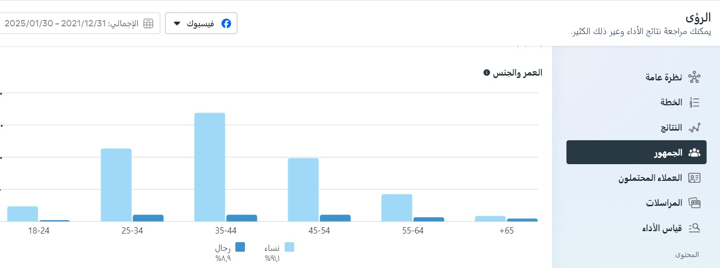
Analysing Meta Buisness Suite Age & Gander
Chiaki Restaurant

Slide 18
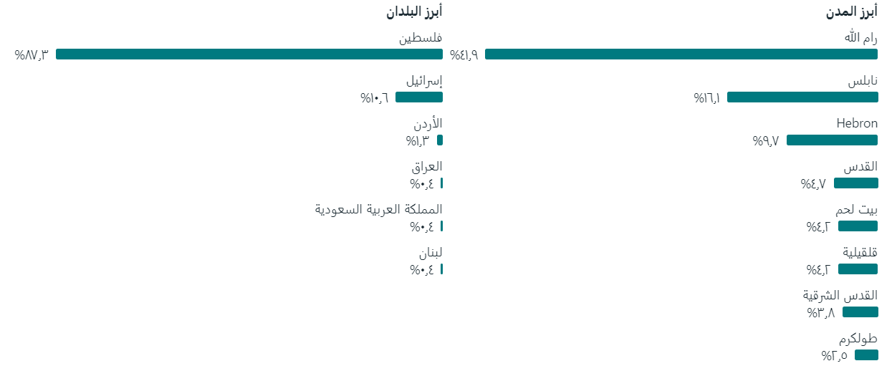
Analysing Meta Buisness Suite Visitor Cities Analysis

Slide 19

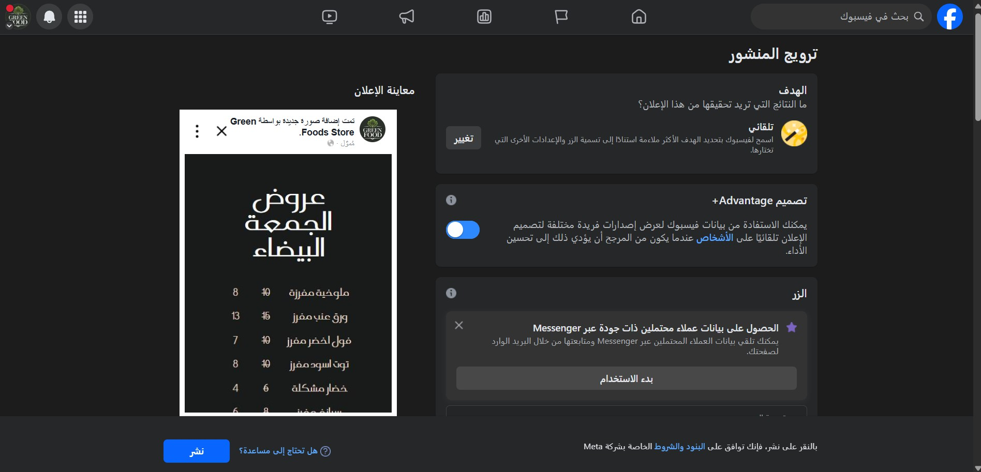


Paid Advertisements.

Slide 20
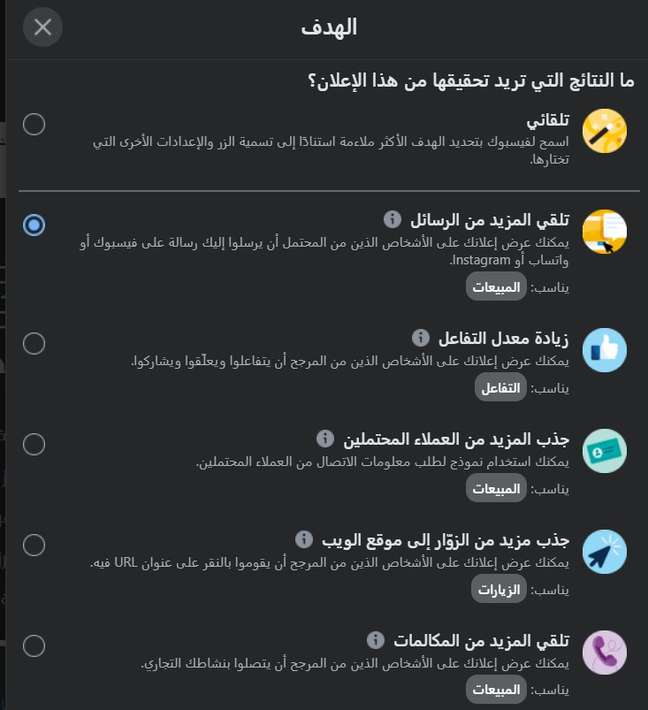
Paid Advertisements.

Slide 21
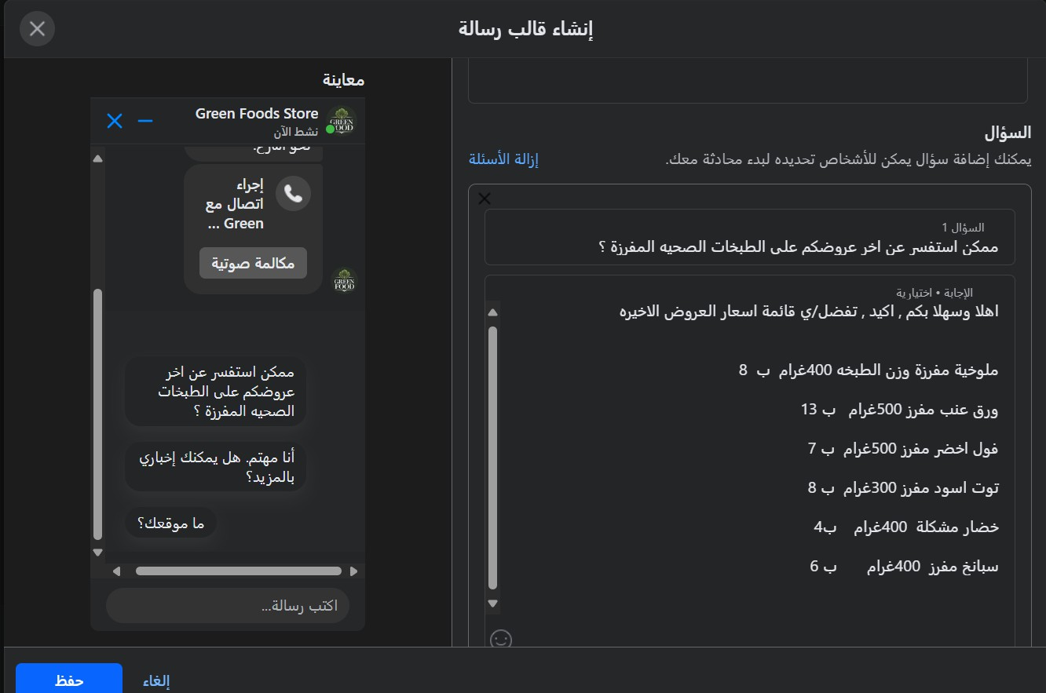
Paid Advertisements.

Slide 22
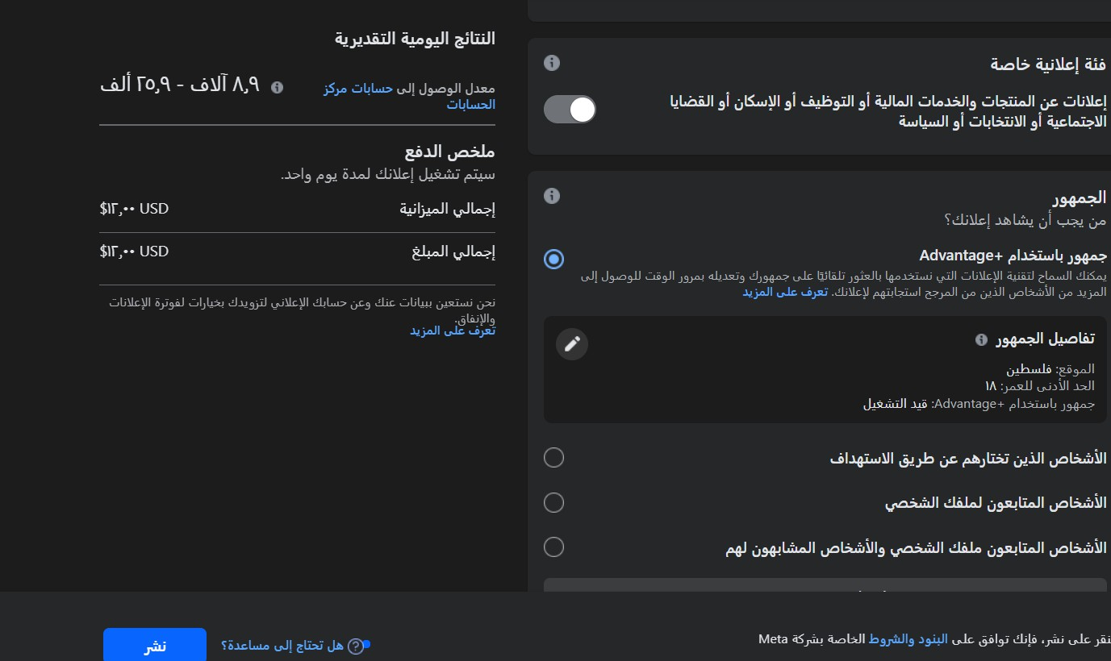
Paid Advertisements.

Slide 23
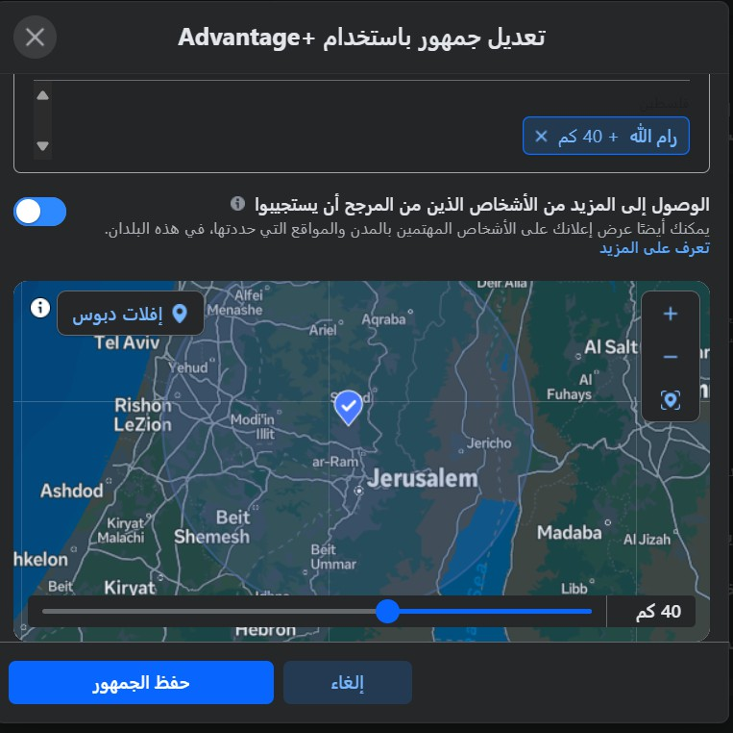
Paid Advertisements.

Slide 24
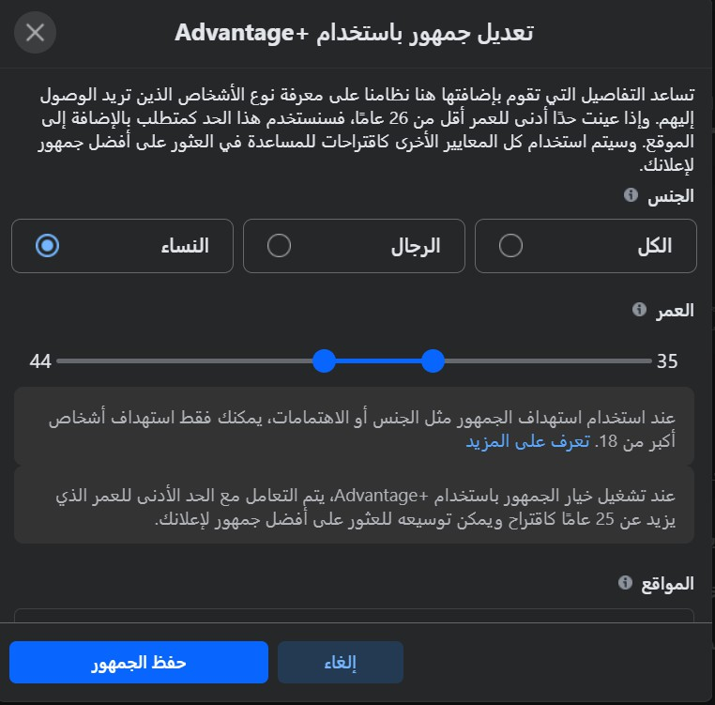
Paid Advertisements.

Slide 25
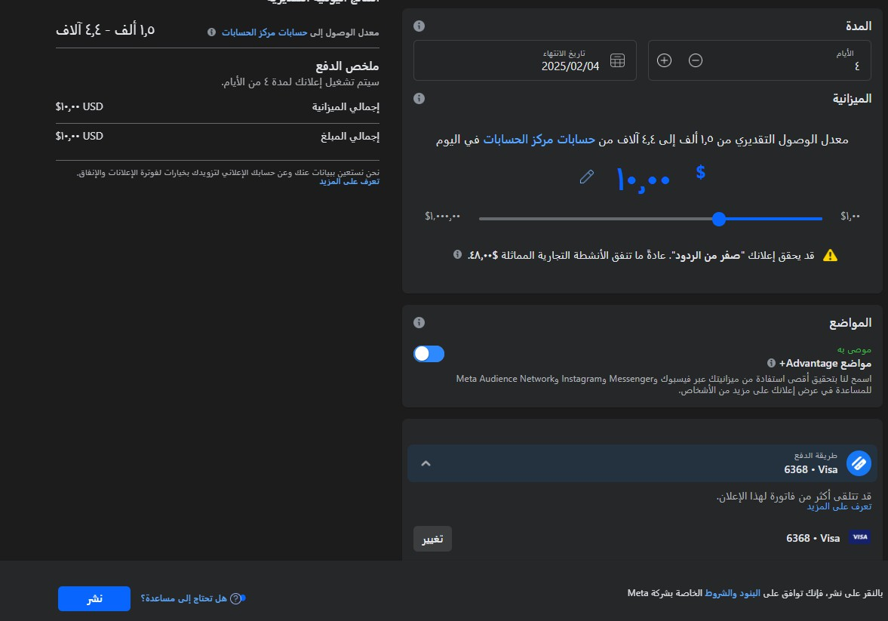
Paid Advertisements.

Slide 26

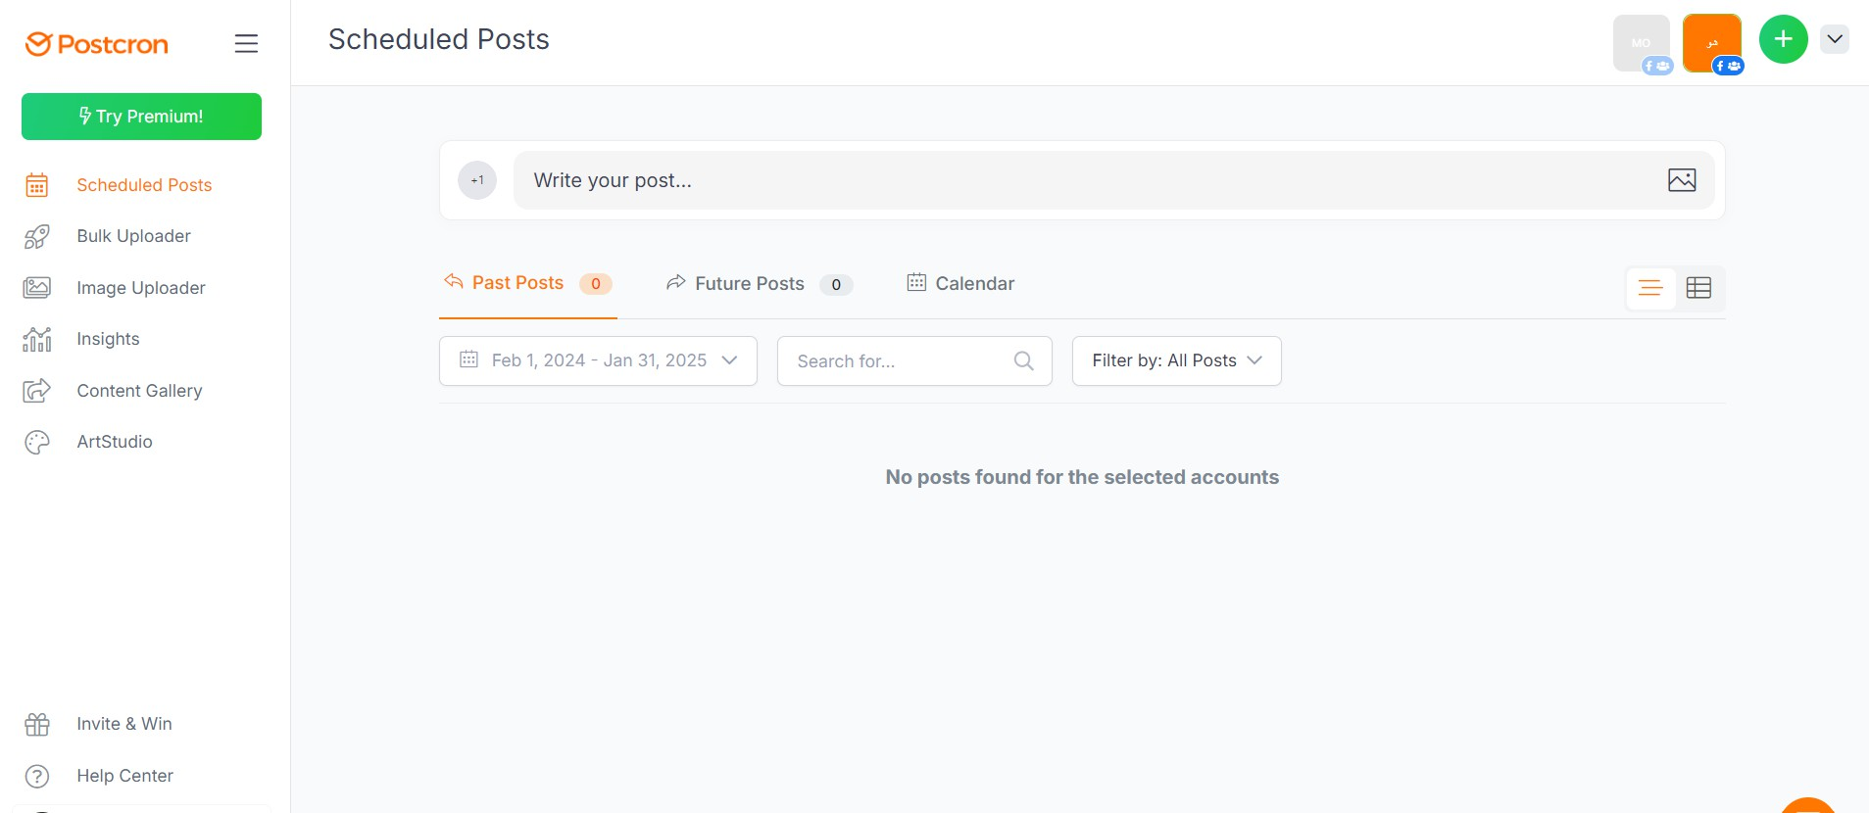
Employing a Post Corn Website For Automatic Marketing

Slide 27



Employing a Post Corn Website For Automatic Marketing

Slide 28
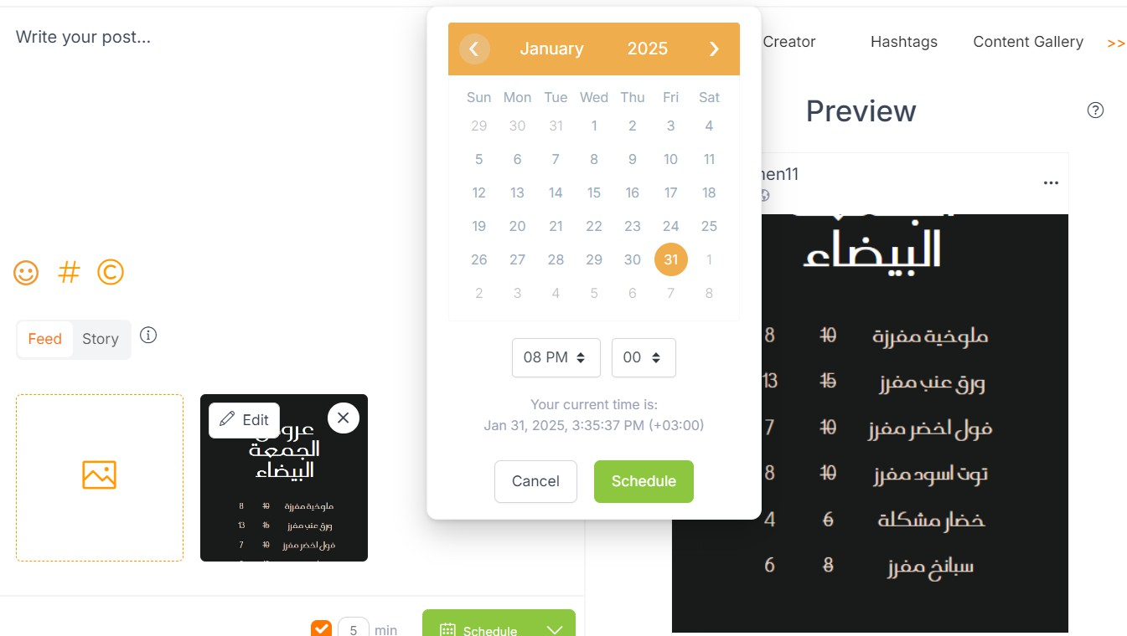
Employing a Post Corn Website For Automatic Marketing

Slide 29
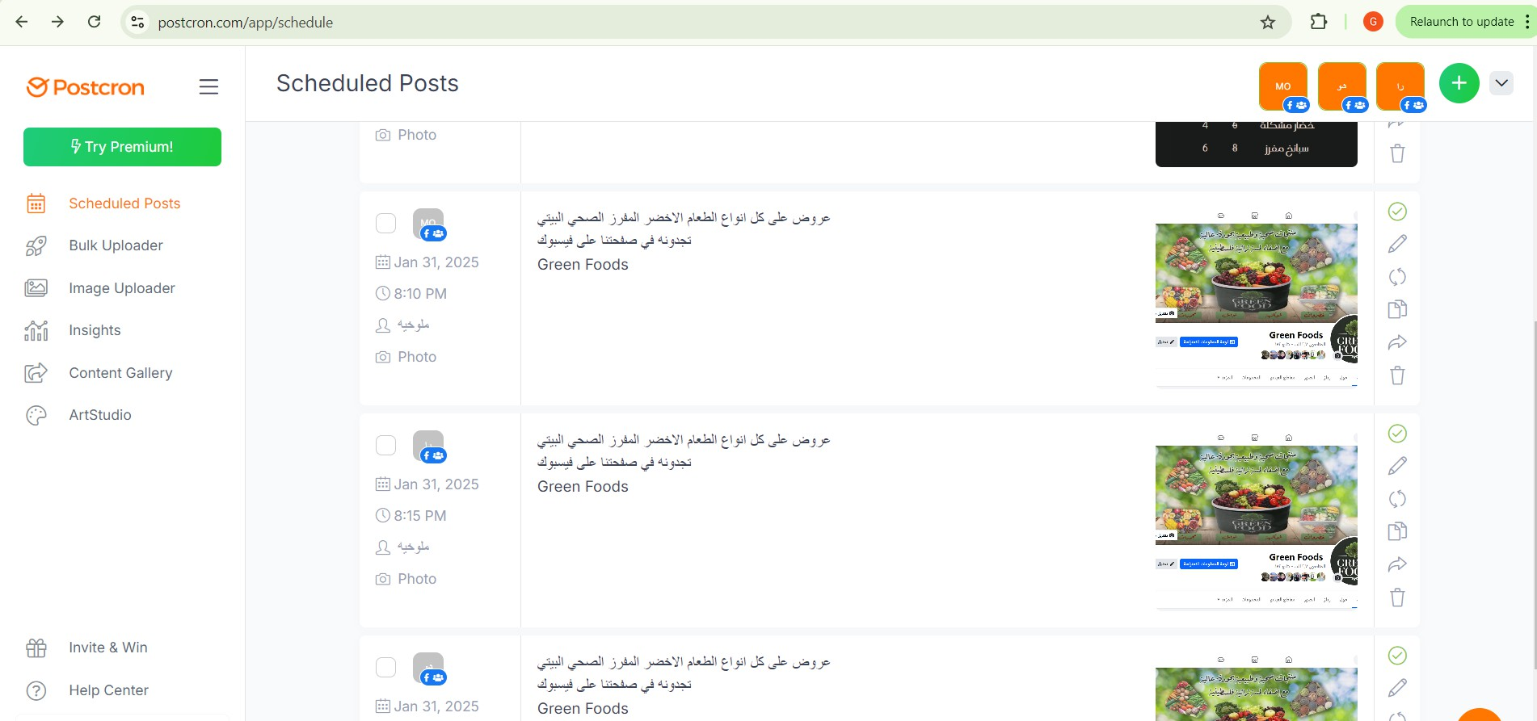
Employing a Post Corn Website For Automatic Marketing

Slide 30
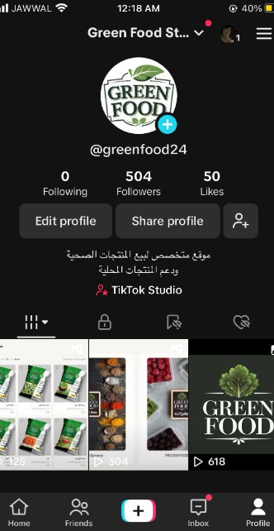
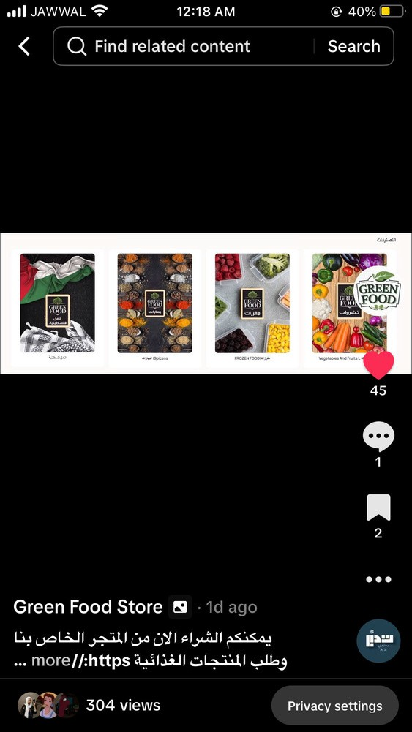
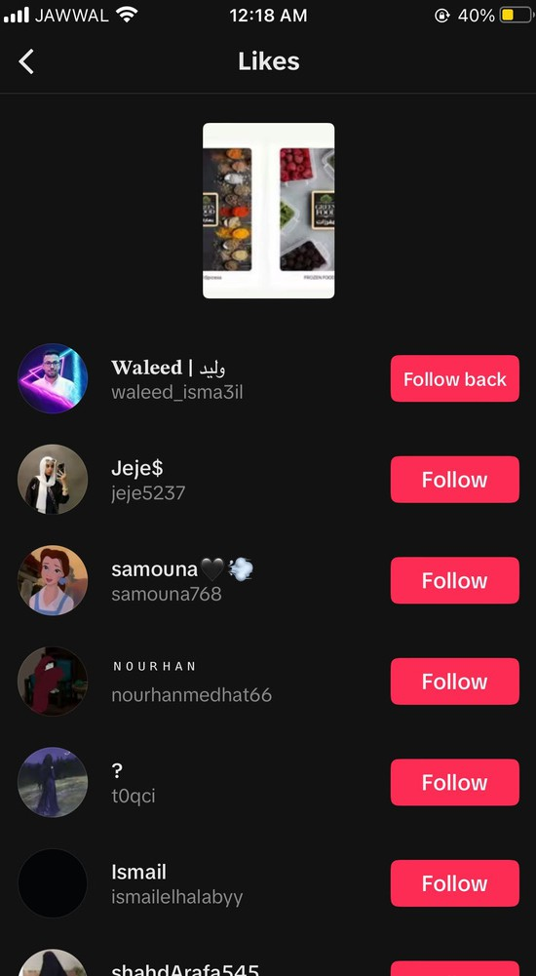
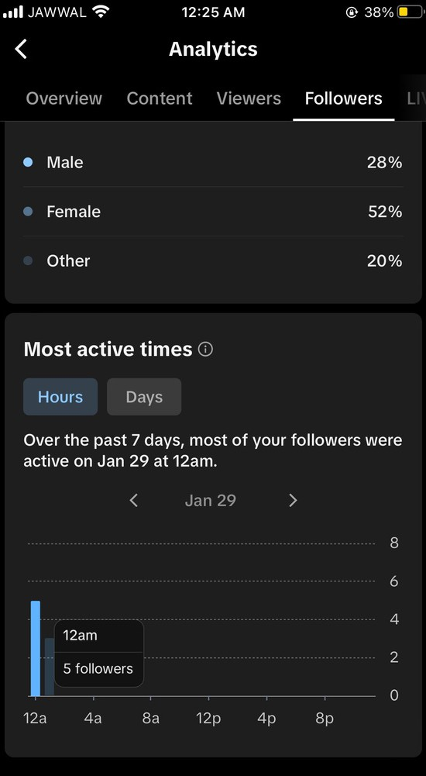
TikTok Analystic

Slide 31
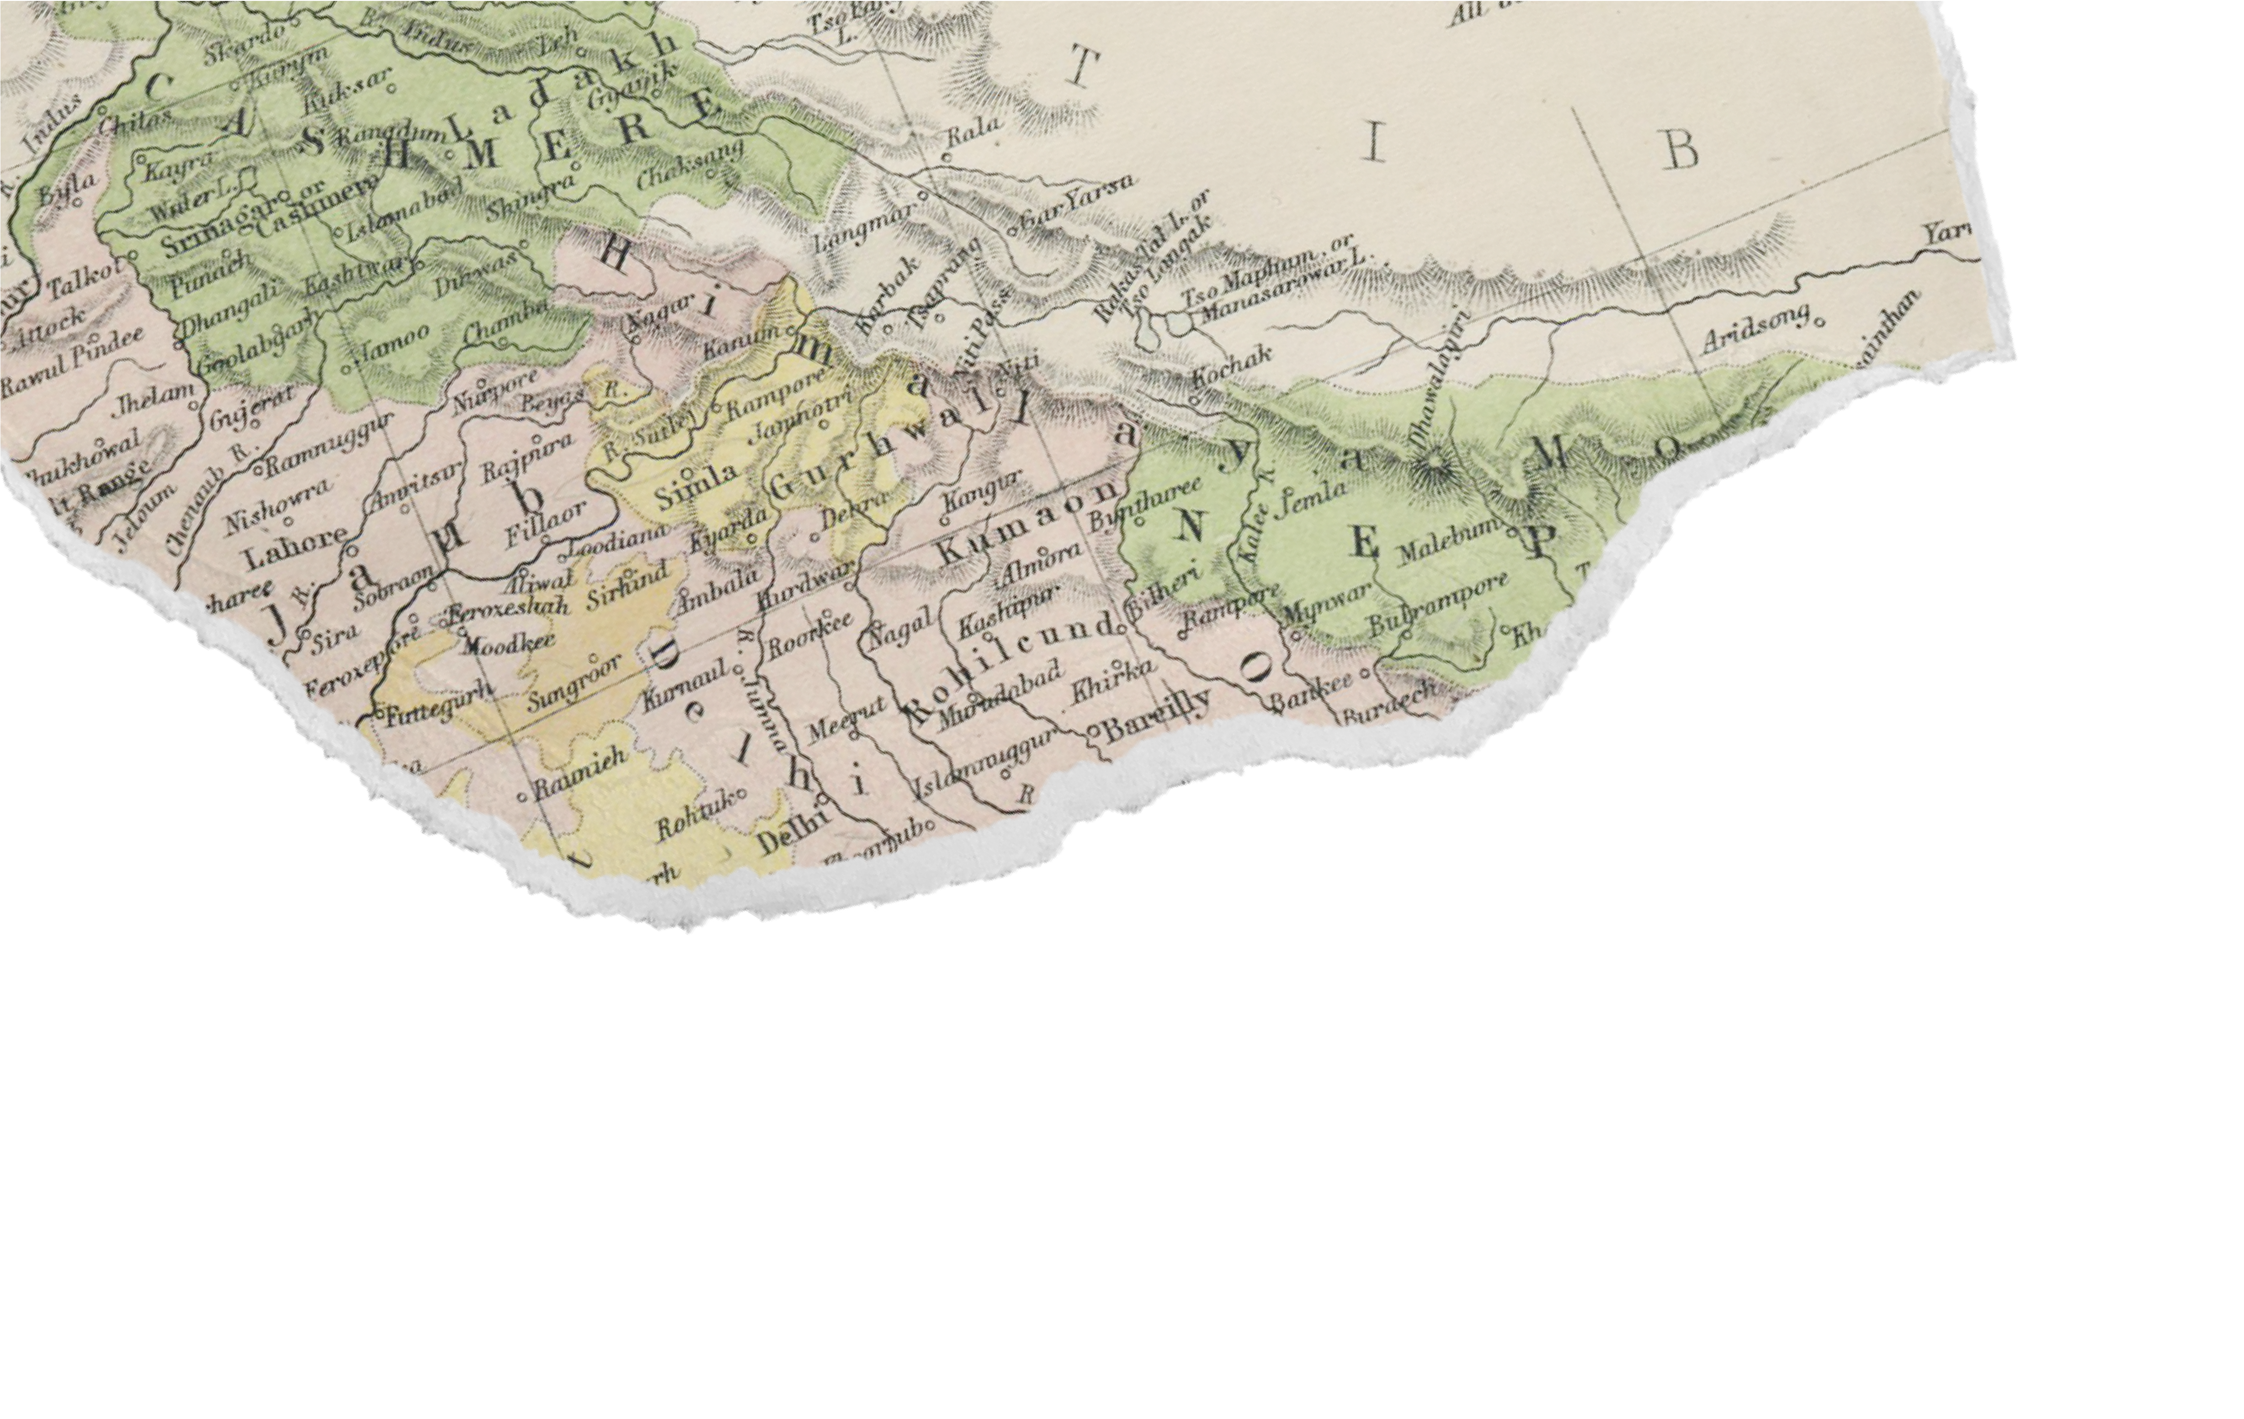









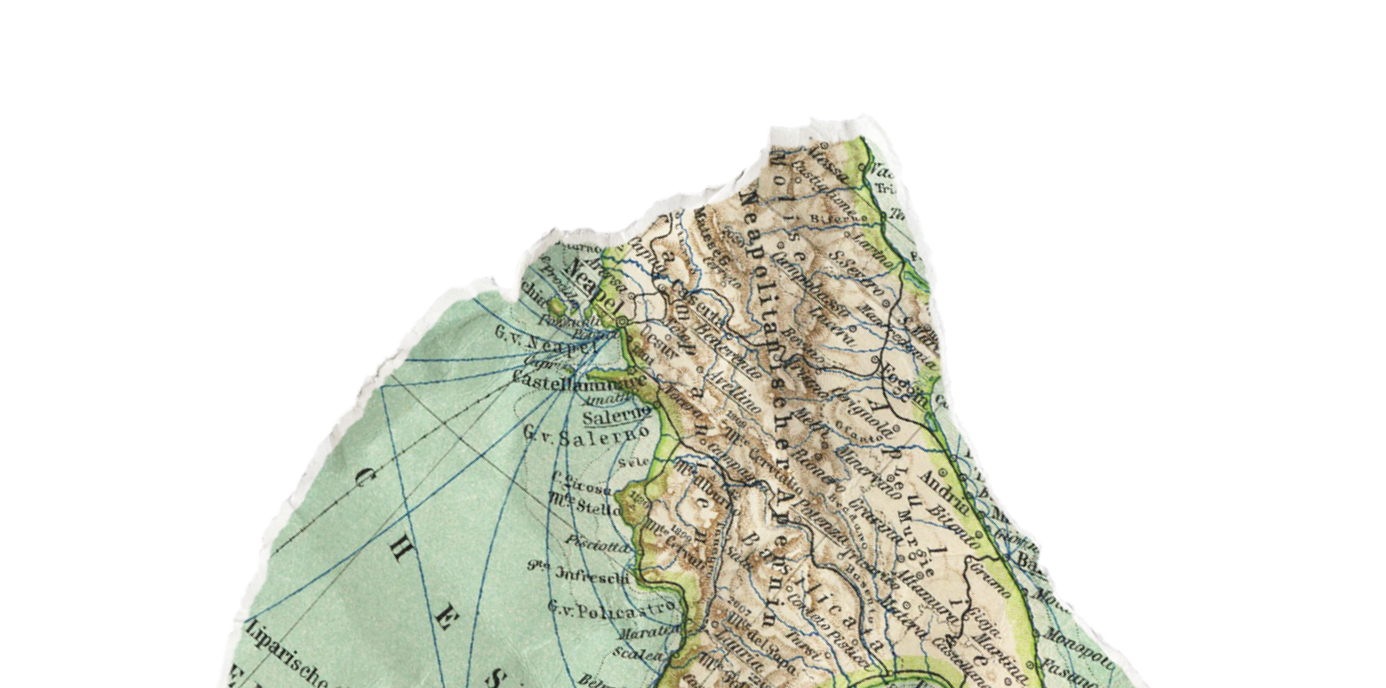



We come to the most important part of the
presentation, which is our distinctive electronic store, which was created to be integrated with all
marketing , analysis and display means in one platform.

Slide 32


Green Foods Website QR Code

Slide 33
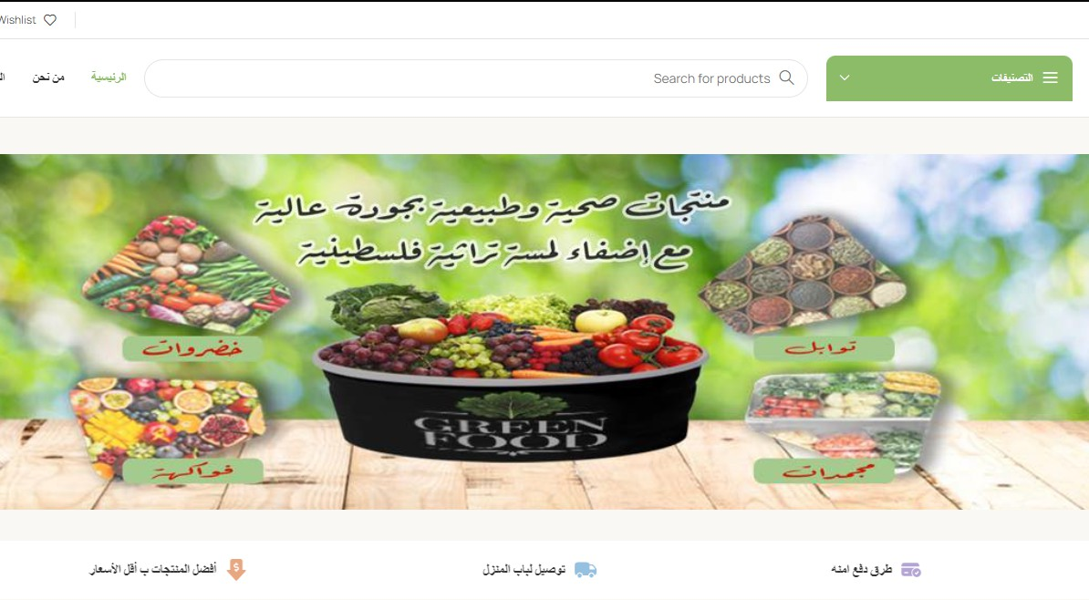

Slide 34


Slide 35
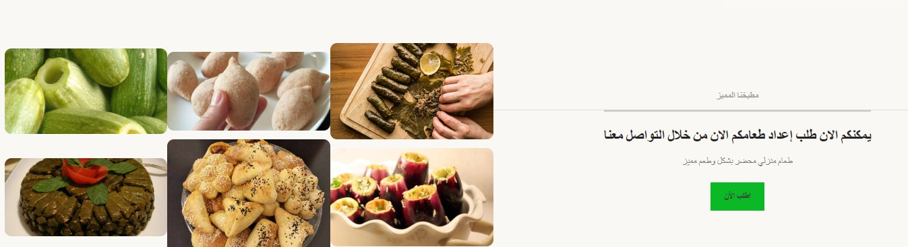

Slide 36
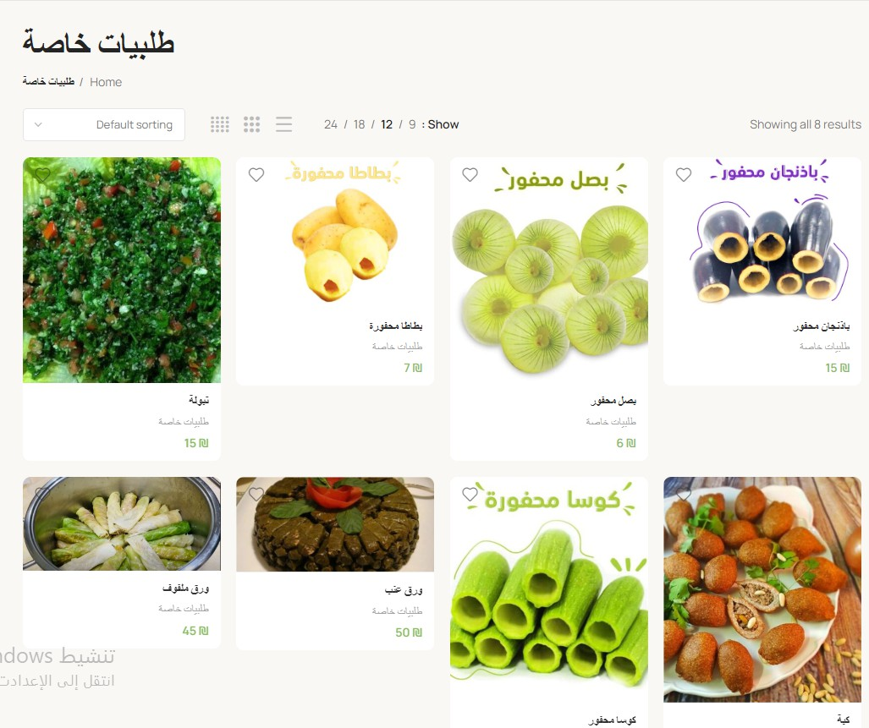

Slide 37
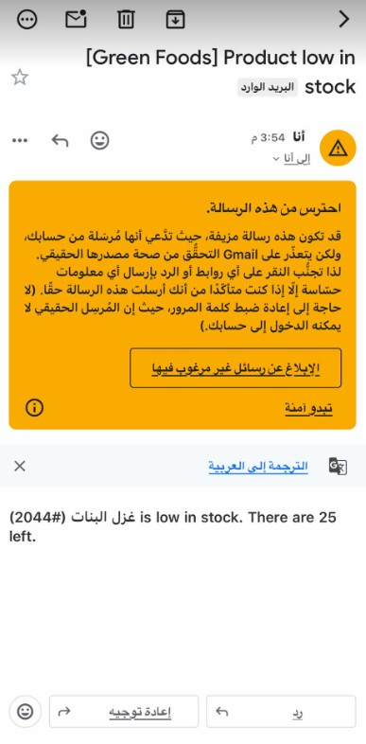


Slide 38



Slide 39
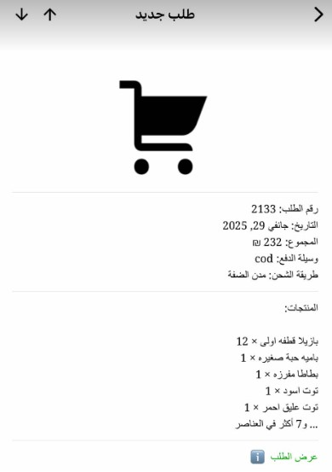
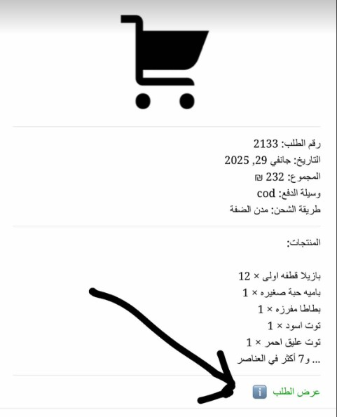

Slide 40
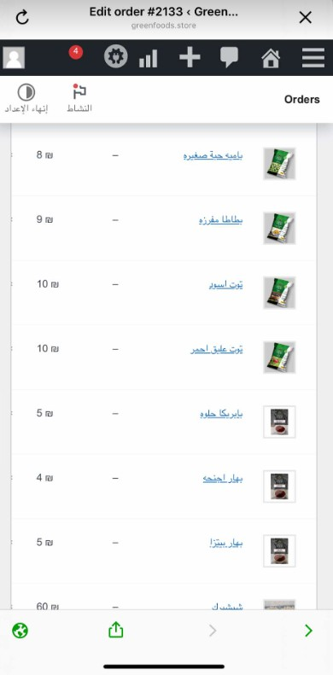
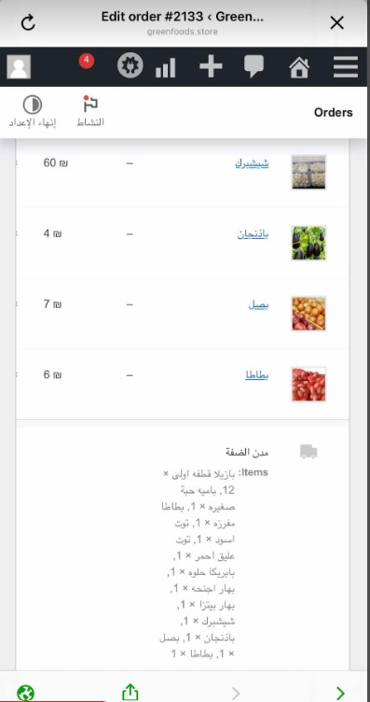
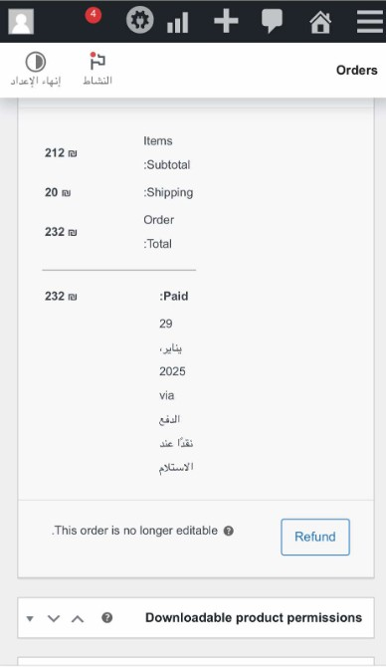

Slide 41

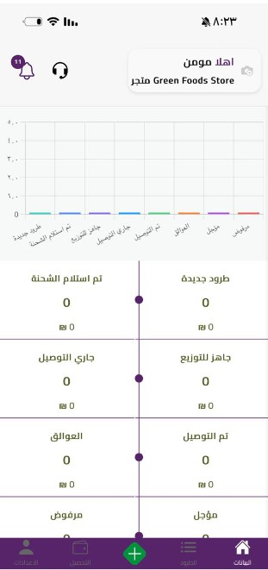
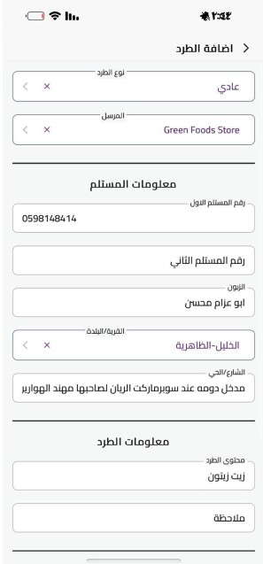
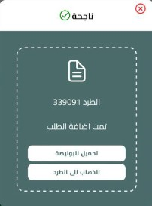
O R D E R T R A C K I N G A P P S H A R E D W I T H D E L I V E R Y C O M P A N Y

Slide 42
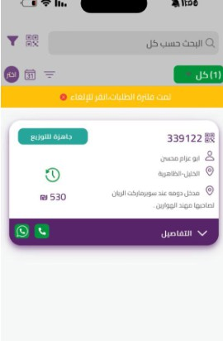
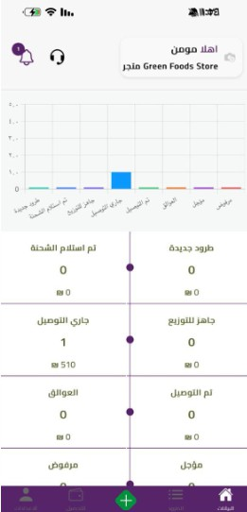

O R D E R T R A C K I N G A P P S H A R E D W I T H D E L I V E R Y C O M P A N Y

Slide 43
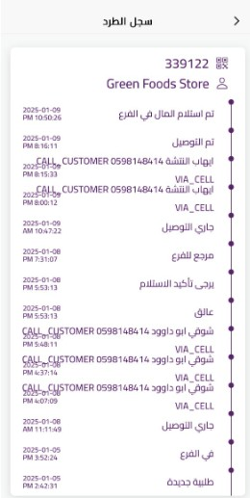
O R D E R T R A C K I N G A P P S H A R E D W I T H D E L I V E R Y C O M P A N Y

Slide 44



T H A N K Y O U
A N Y Q U E S T I O N S ?
W A L E E D
I S M A I L
M O M E N
S A L E E H

