Slide 1

Redesigning of a Primary school
Prepared by : Saleem Sirra
Alaa Ibreigheth
Fadi Nazzal
Rabee’ Soudeh
Supervisor: Dr. Nirmeen Al-Barq

Slide 2
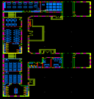
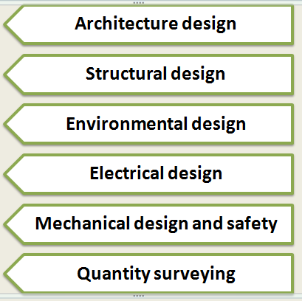
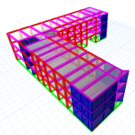
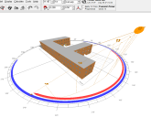
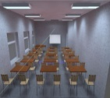
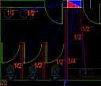

Outline

Slide 3
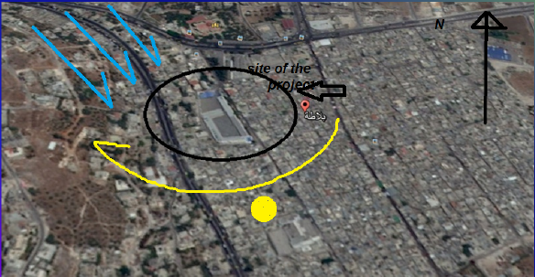
Architectural design
Site of the project: our project site is located in Balata camp witch is to the east of Nablus city.

Slide 4
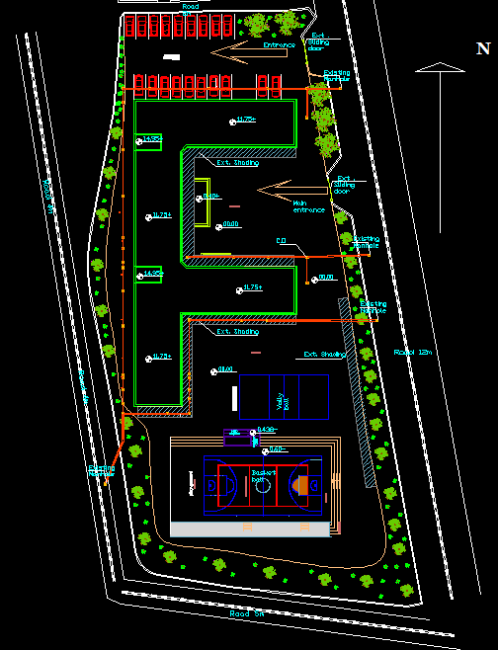
Site plan
we have a road with 12m width from east, a road with5m form south and road with 5m from the west.
Our building consists of 3 floors each floor has an area about 990m2 with 23 classrooms.

Slide 5
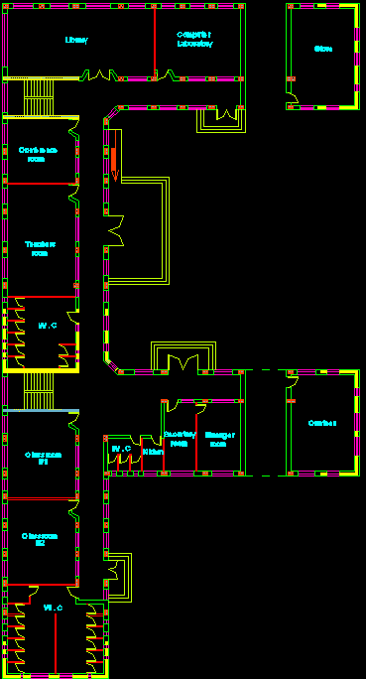
Ground floor plan

Slide 6
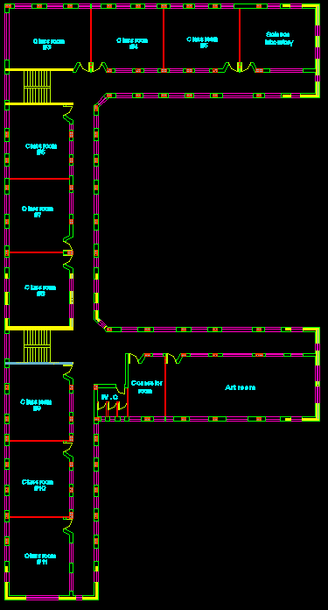
First floor plan

Slide 7
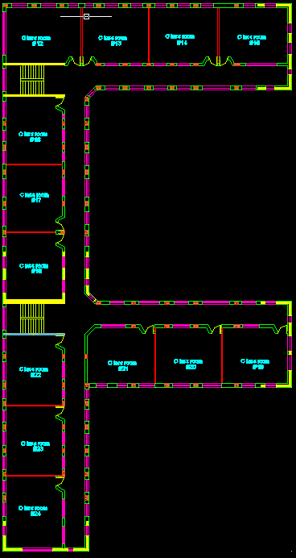
Second floor plan

Slide 8
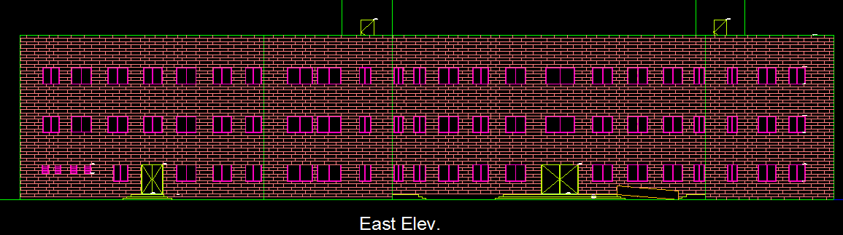
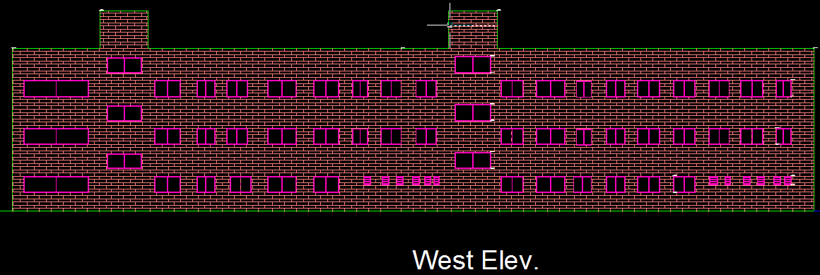
Elevations

Slide 9
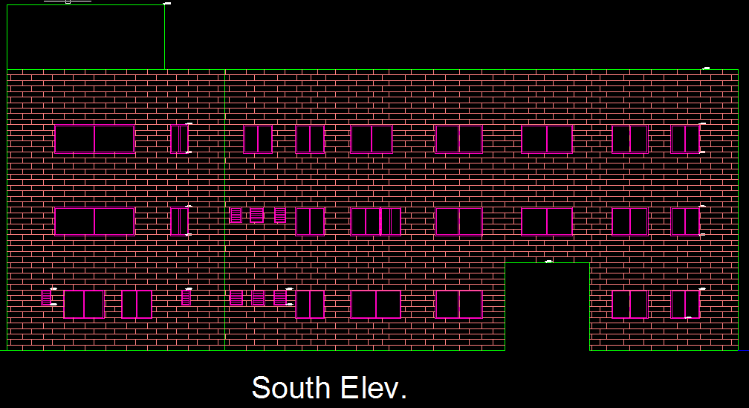
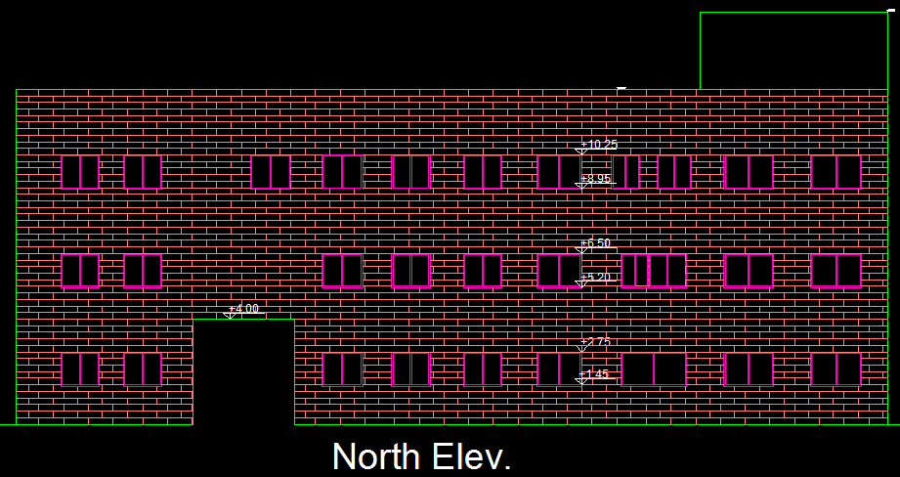

Slide 10
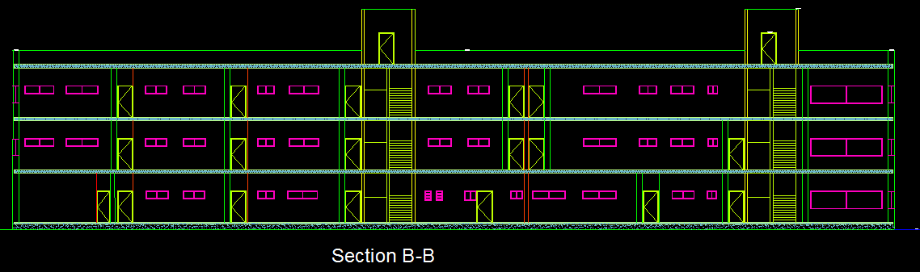
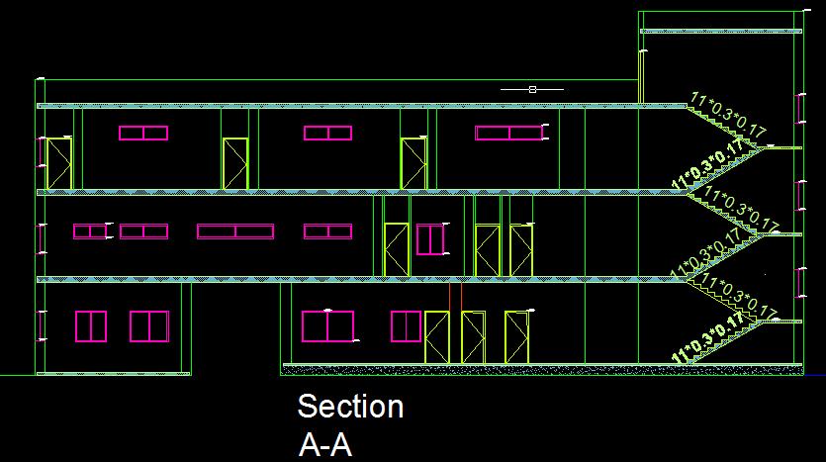
Sections

Slide 11
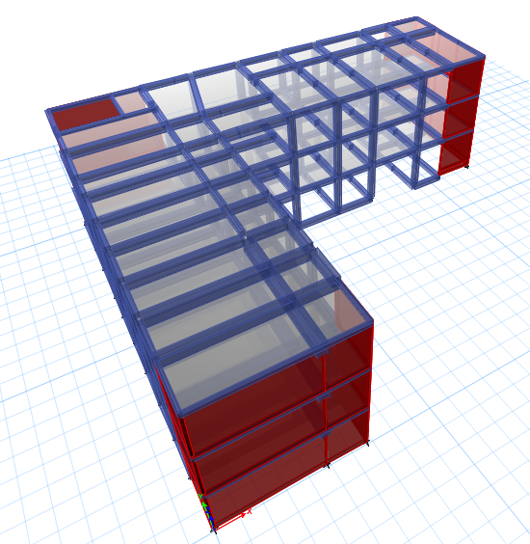
Structural design

Slide 12
Design Data
Slab System : One Way Ribbed Slab .
Concrete Fc = 24 Mpa for slab .
Concrete Fc = 28 Mpa for beams, column and footing .
Bearing capacity of soil = 300 KN/m2.
Loads : Live Load = 5 KN/m2
Super Imposed Dead Load = 4.5 KN/m2
Our structure system consists of two models and there is a seismic joint between them with 3cm thickness.

Slide 13
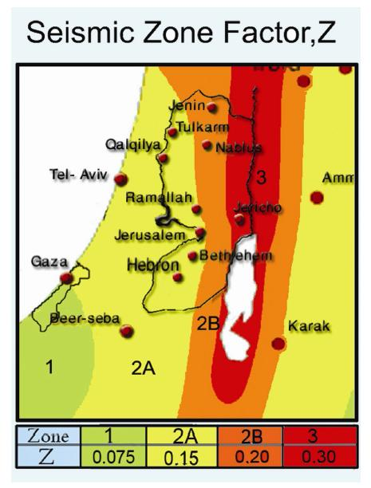
Seismic Design Data
Seismic zone factor : Z= 0.2
Soil profile type is SC
Seismic coefficients : Cv = 0.32,Ca = 0.24
Importance factor : I=1.5
Structural system coefficient : R=5.5

Slide 14
Design Codes
ACI – 318 –14 for reinforced concrete structural design.
UBC – 97 for earthquake load combinations.
ASCE for load combinations.

Slide 15
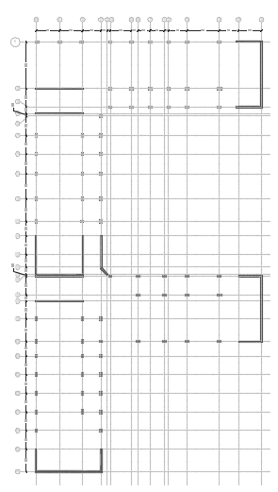
Column center lines

Slide 16
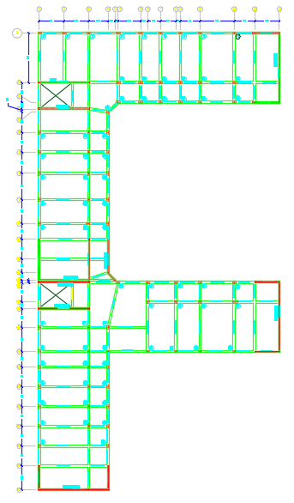
Beams Layout

Slide 17

Etabs Models

Slide 18
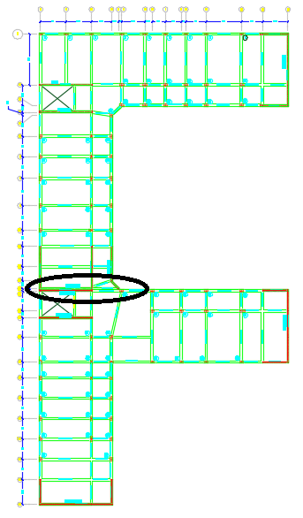
Seismic joint design
Seismic joint thickness = 3 cm

Slide 19
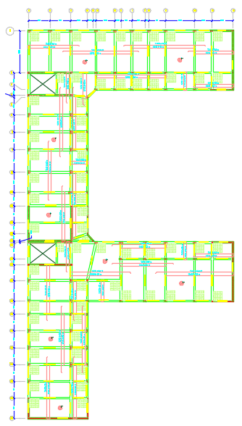
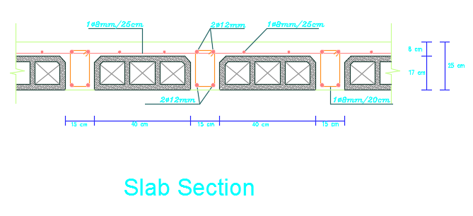
Slab Design

Slide 20
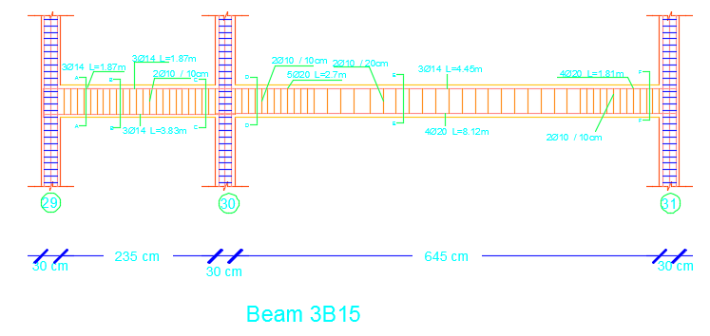
Beam Design

Slide 21
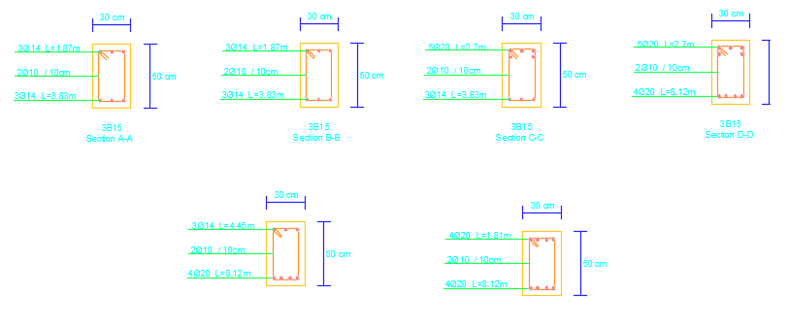
Sections in beams

Slide 22
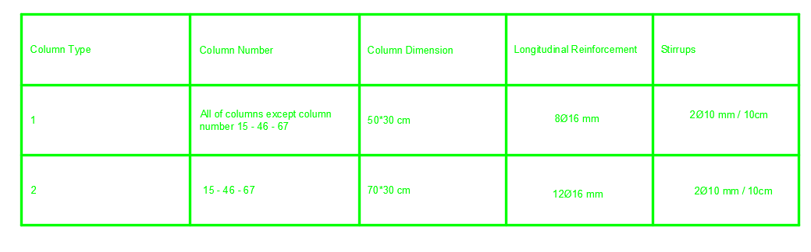
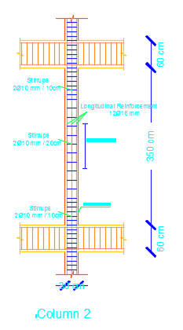
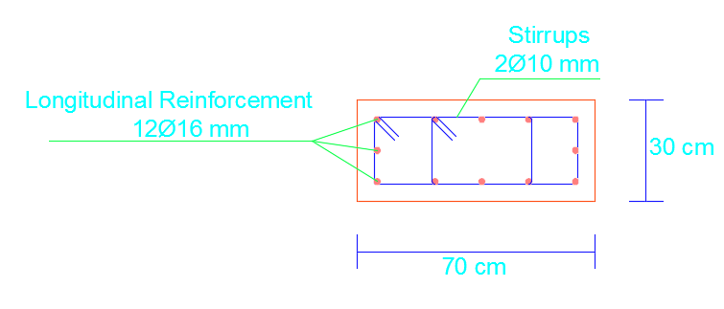
Columns Design

Slide 23
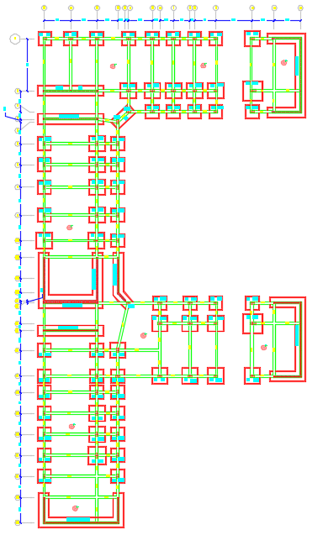
Footing Plan

Slide 24
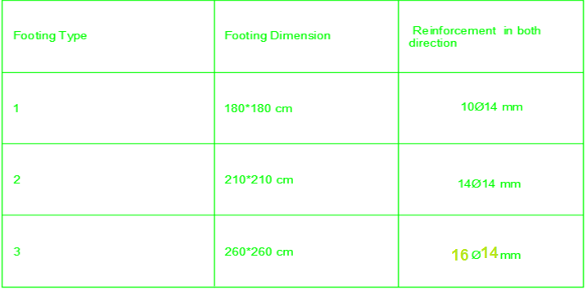
Isolated Footing Design

Slide 25
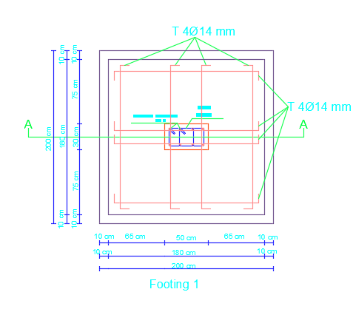
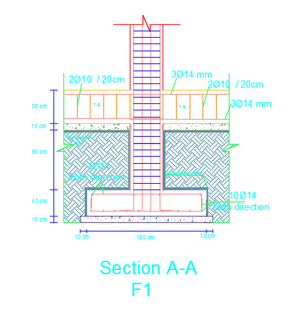
Isolated Footing Details

Slide 26
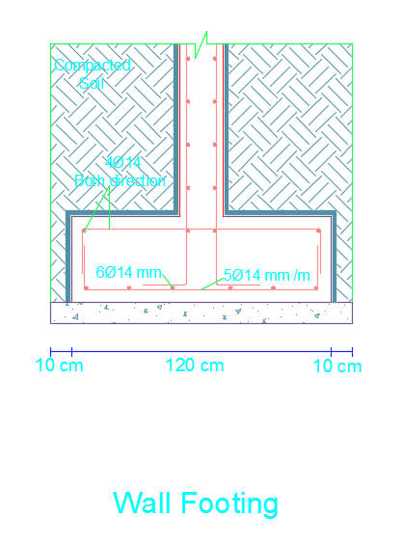
Wall Footing Details

Slide 27
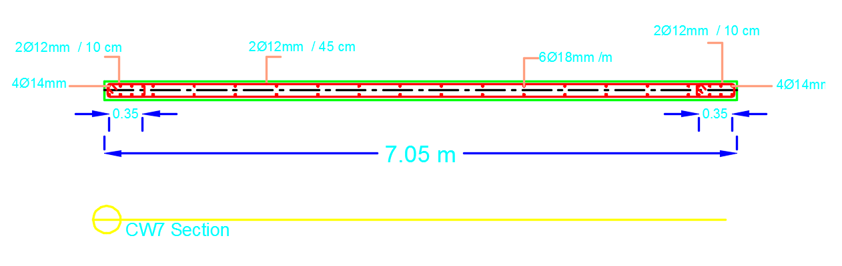
Shear Wall Design

Slide 28
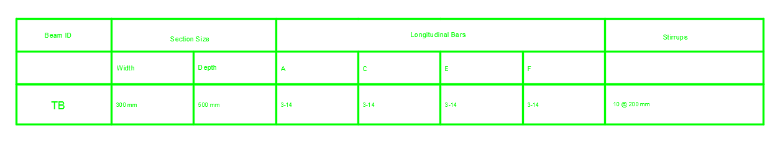
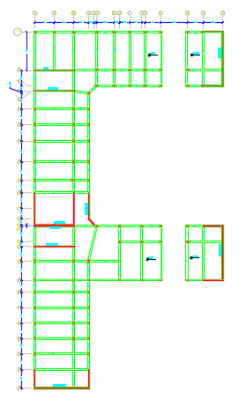
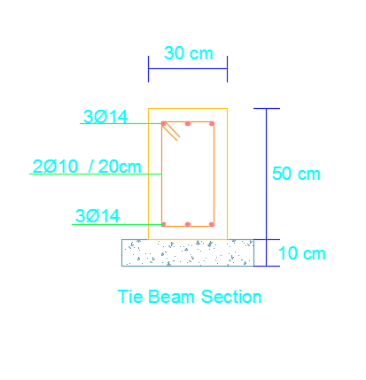
Tie Beam Design

Slide 29
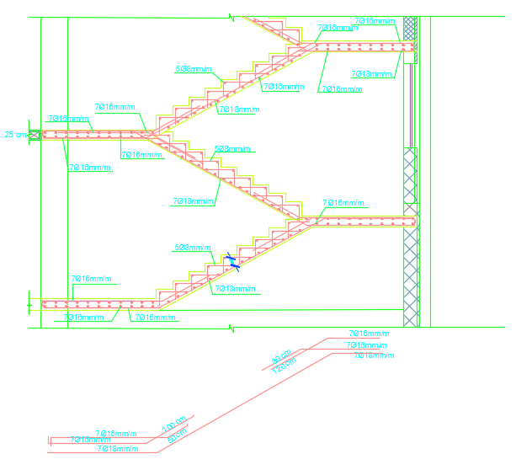
Stair Reinforcement

Slide 30

Environmental design

Slide 31
environmental friendly school
Our project is an
(environmental friendly school )
that means the environmental side is the most important part in our project, and we should get all requirements for this purpose.
Environmental study of the project will be:
Solar analysis
Solar shading
Daylight
Thermal insulate
Heating and cooling
Photovoltaic panels

Slide 32
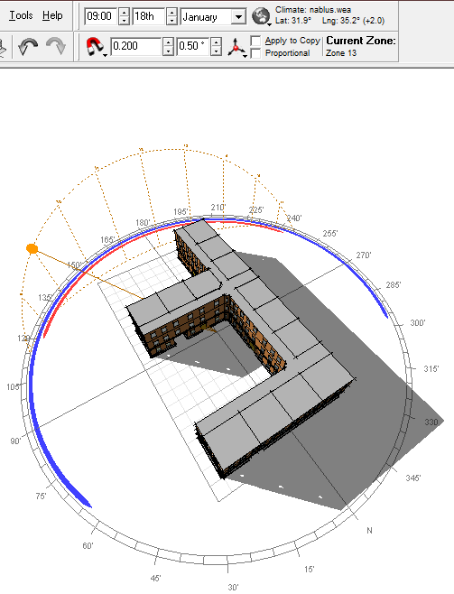
1. Solar analysis
the sun position at 9:00 AM in winter(January) and its shadow in our the building

Slide 33

Solar analysis
the sun position at 11:45 AM in winter(January) and its shadow in our the building

Slide 34
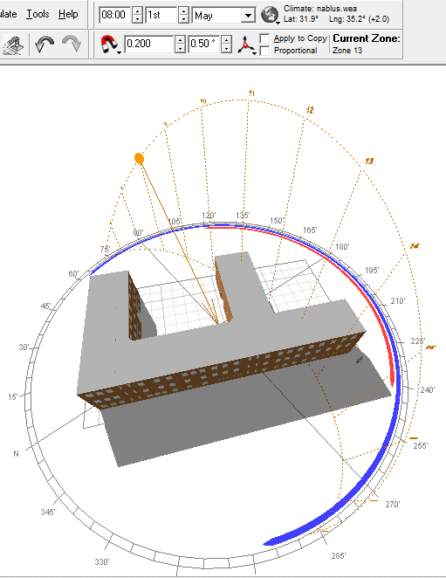
Solar analysis
the sun position at 8:00 AM in summer(May) and its shadow in our the building

Slide 35
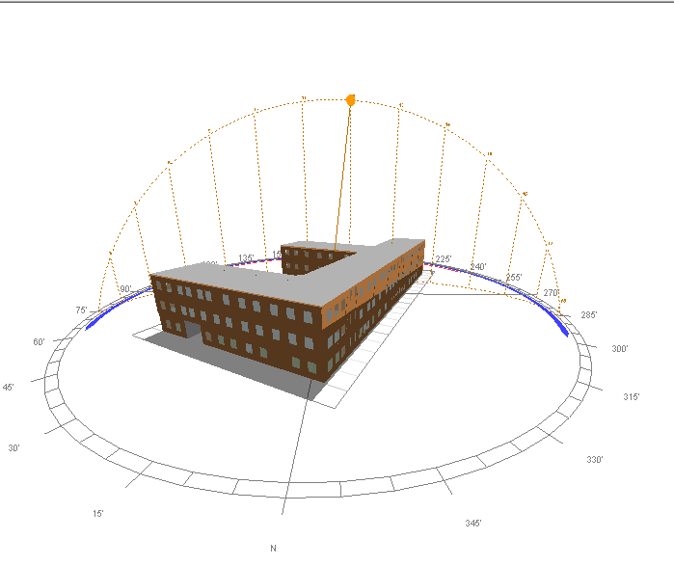
Solar analysis
the sun position at 12:00 AM in summer (May) and its shadow in our the building

Slide 36
2. Solar shading
We only need shading for eastern and southern side of the building, for eastern side the best shading tool we will use it is vertical manual orientation louvers and change the angel of louvers only, to get minimum shading in winter and maximum shading in summer, as shown in figures.

Slide 37
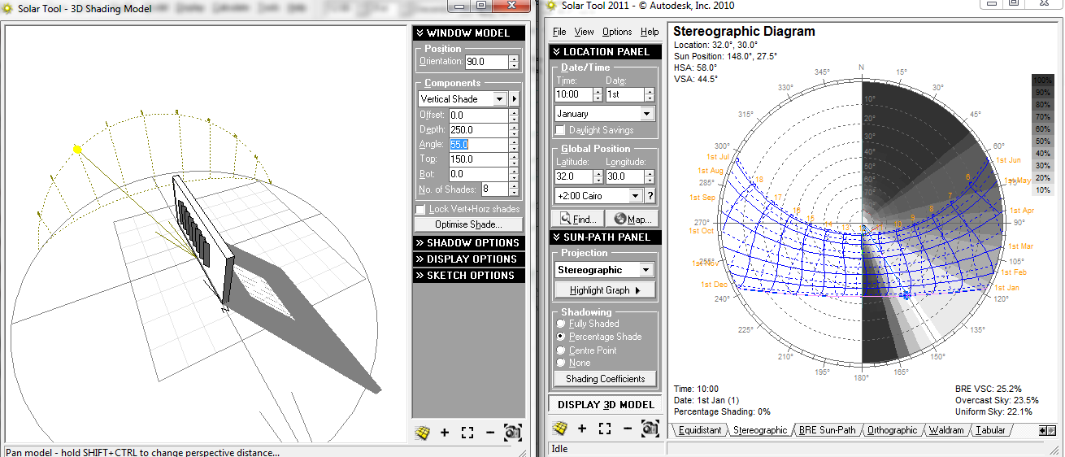
Solar shading
shading percentage in winter from eastern window

Slide 38
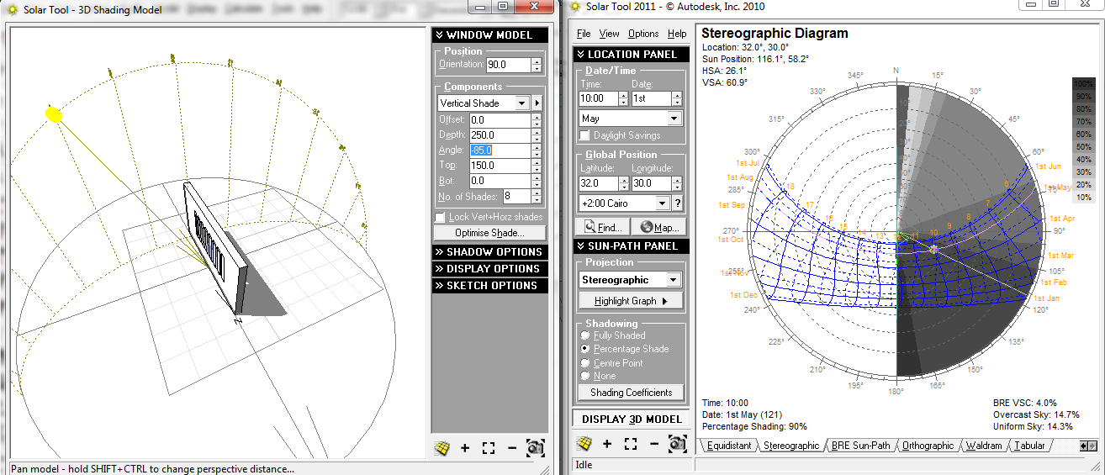
Solar shading
shading percentage in (May) from eastern window

Slide 39
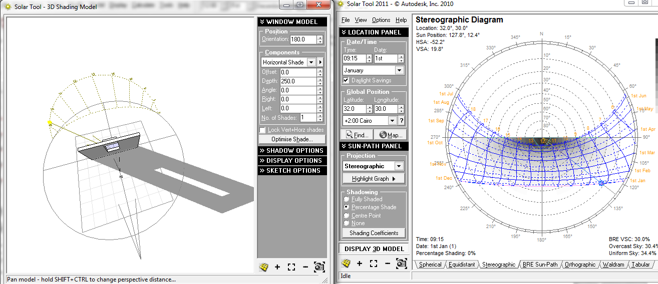
Solar shading
shading percentage for southern window in winter (Horizontal)

Slide 40
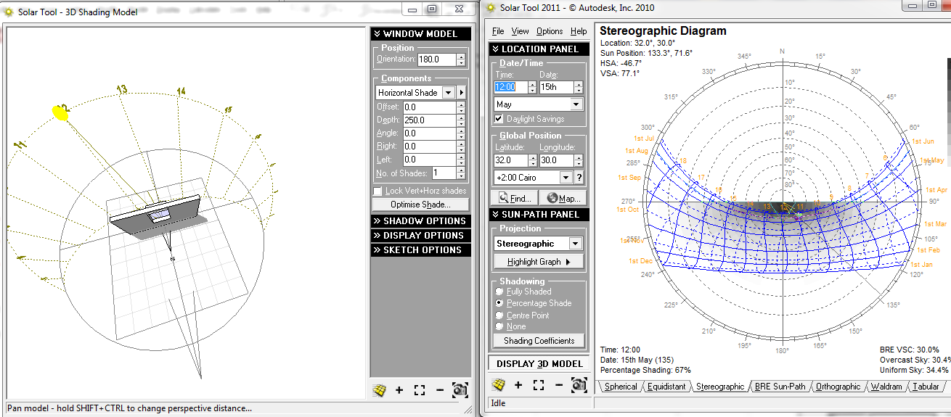
Solar shading
shading percentage for southern window in (May) summer (Horizontal)

Slide 41
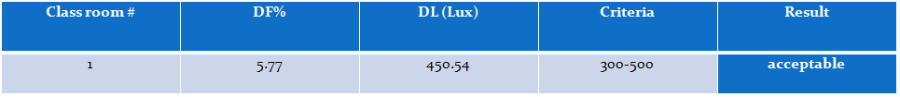
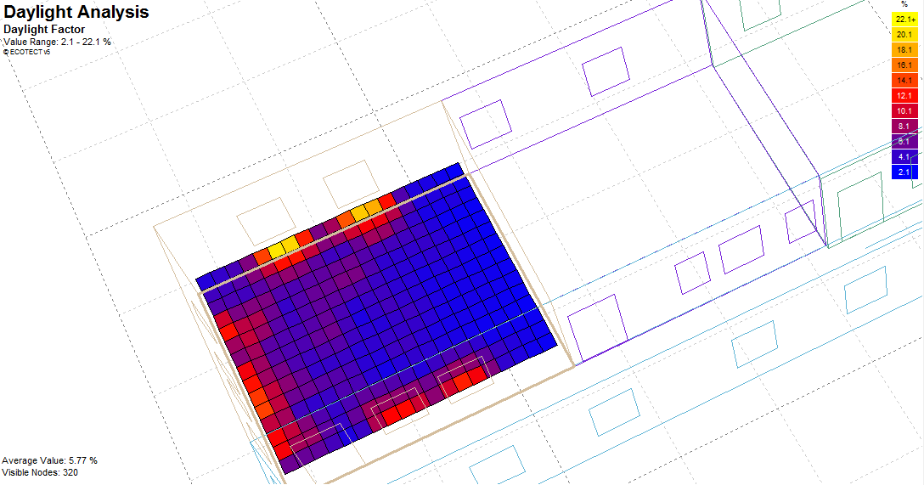
3. Daylight
we estimate DF% for each zone in the school

Slide 42
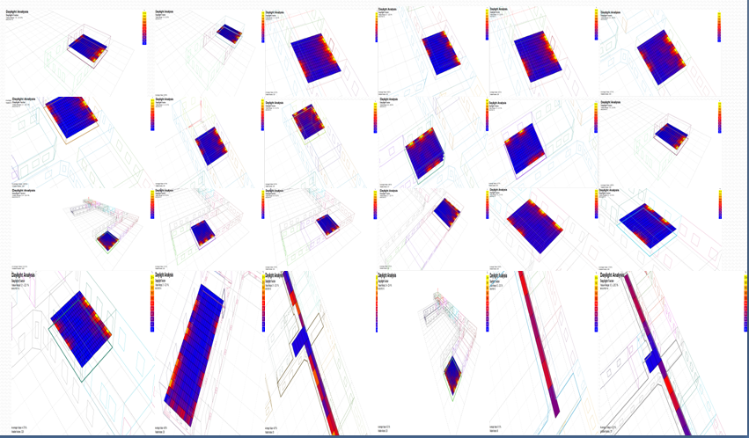
Daylight
Lux of the classrooms 300-500 lux
most of our classrooms have acceptable DF

Slide 43
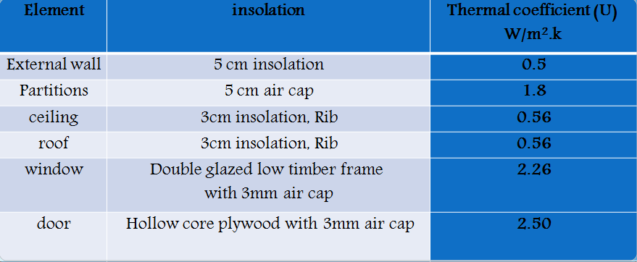
4. Thermal insulate
increasing the total resistance for the external walls, roof, and choosing a good insolating windows and doors is the best solution to prevent heat losses through conduction in winter, and this will reduce the heating and cooling.

Slide 44

5. Heating and cooling
Many factors affect in the space heat losses and gain

Slide 45

Heating and cooling
Zone: Zone 31 classroom1
Operation: Weekdays 08-13, Weekends 00-00.
Thermostat Settings: 19.5 - 26.0 C
Max losses: 1477 W on 19th January
Max gain: 5156 W on 15th May
(( total losses and gain in all zones =2003648Wt))

Slide 46

6. Photovoltaic solar panels

Slide 47

Photovoltaic solar panels

Slide 48


Slide 49


Slide 50


Electrical design
For artificial lighting design we will use Dialux program
There are three types of luminaries have been used in the electrical design, as shown in the following figures:
For classroom

Slide 51


artificial lighting
For corridor and wc’s:

Slide 52


artificial lighting

Slide 53



artificial lighting
Classrooms:

Slide 54



artificial lighting
Computer laboratory:

Slide 55



Luminaries distribution plans

Slide 56



Sockets distribution

Slide 57


Circuit breakers

Slide 58

Mechanical design
water supply system : in our project we have 5 main vertical lines with roof tank system.
Sample calculation:
For vertical line : #of fixture units = 35
For horizontal line : #of fixture units = 35
For branch line : #of fixture units = 2
The pressure at this floor = 0.433*h = 16 psi
For vertical line : water demand = 22 gpm
For horizontal line : water demand = 22 gpm
For branch line : water demand = 2 gpm
Suitable diameter for vertical line (1.5"), horizontal line (1.25") and branches (1/2")
Δp = 16-8 = 8psi
Ʃlosses = 5.33 psi < 8 so it is OK.

Slide 59
Drainage system
#of w.c DFU's = 4Dfu.
#of Lavatory DFU's= 1 Dfu.
#of kitchen DFU's= 2 Dfu
The horizontal Line for lavatory which reaches to the main drainage = 2" slope= 1%
The horizontal Line for kitchen sink which reaches to the main drainage = 2" slope= 1%
The horizontal Line for W.C which reaches to the main drainage = 4" slope= 1%
The horizontal Line which reaches to the main drainage = 4" slope= 1%
The vertical Line for any line which reaches to the manhole = 4"
The horizontal Line between manhole = 6" slope= 1% as minimum.
The horizontal Lines in a science lab. = 3" (Palestinian schools standards)
The slope for the roof slabs for the rain water = 1.5% (Palestinian schools standards) .
The length of the vents = 1.2 as minimum
The maximum distance between manholes is 12-15m

Slide 60


Drainage system

Slide 61


Fire fighting system
We will use this system for fighting

Slide 62

Quantity surveying and cost estimation
Total price= 2,090,081 NIS
=2112 NIS/m2

Slide 63
THANK
YOU

